Slide 1
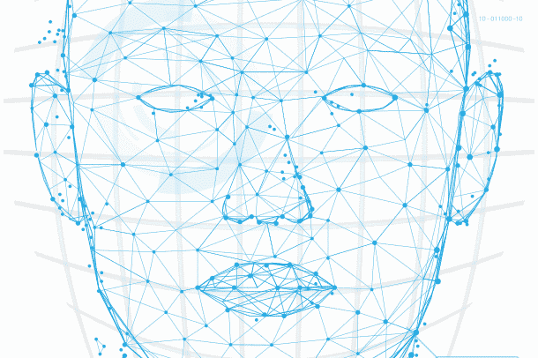
Face Recognition using CRI AI Thermal Camera
Mid-term Presentation

Slide 2
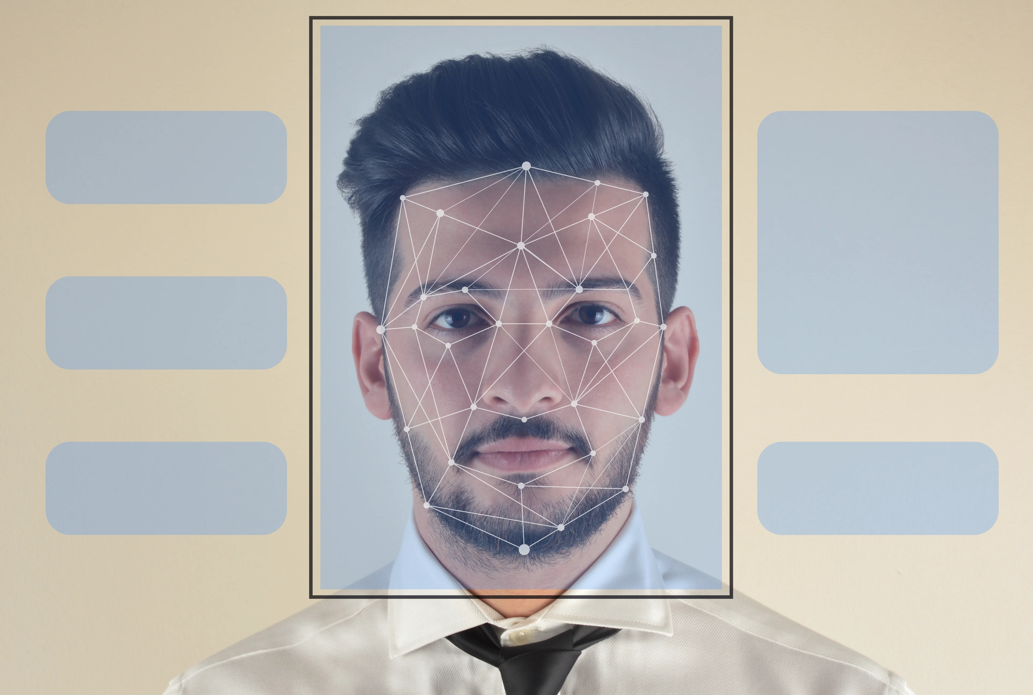
Agenda
Introduction
PROJECT SUMMARY
MEET OUR TEAM
SCOPE OF WORK
TIMELINE
Phases of work
REFERENCES
IMAGE SOURCE: LEARN G2

Slide 3
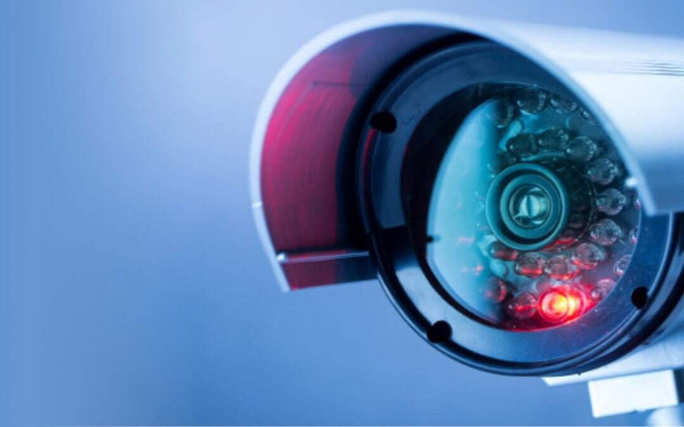
Introduction
What is CRI AI Camera?
CRI stands for Color Rendering Index and is nothing but a specification of cameras which states how accurately artificial light shows colors of the people under them.
CRI AI Thermal camera is used to develop this project.

Slide 4

Primary goals
Face Recognition
Security and surveillance
Contactless access control

Slide 5
Summary
Facial Recognition is the process of identifying a person through his or her facial features. We will be using thermal cameras to detect human faces. When we think about thermal images in the context of people, what usually comes to mind is night vision. The ability to see a person, or group of people, by the inevitable heat their bodies emit.
An important aspect of our project requires us to understand that thermal images capture heat in the form of frequency of pixels, varying from 0 to 1. Studies have found that each face emits a unique heat signature due to the blood vessels below the skin, as mentioned by Barclay (2013). Therefore, thermal facial images capture unique individual facial heat signatures which mark as unique biomarkers, providing us with rich information to classify a person correctly using a model.

Slide 6



Meet our team
Tilak Pandya
(B.C.A., M.C.A.)
Namra Patel
(B.E Computer Science.)
Kishan Patel
(B.Sc. Physics, PGDCA, Big Data Solution Architecture)
A Big Data Analyst having non-cs bachelor degree, yet significantly interested, and competent in AI industry.
A developer who explores concepts and potential in the tech industry.
A developer with real-world problem solving experience and a desire for innovation.

Slide 7
SCOPE OF WORK
Research on CRI AI thermal camera
Development of facial recognition algorithms
Integration with existing systems
Testing and validation
Deployment and training
Maintenance and support

Slide 8

Timeline
Week 1
Week 2
WEEK 3
WEEK 4
WEEK 5
WEEK 6
Team assigned
Project
Understanding
Face Detection
using OpenCV
Saving Facial
Images in the
Dataset
Adding Thermal Images in dataset
Configuring CRI AI Camera

Slide 9
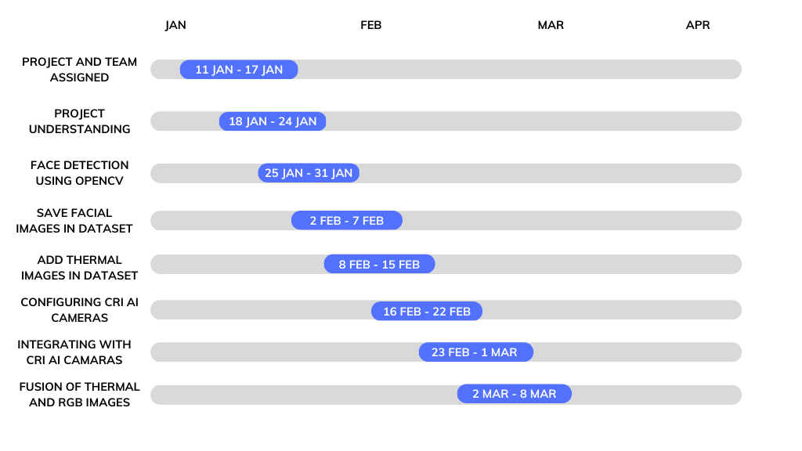

High-level timeline chart (GANTT)

Slide 10

PHASE 1
Defining the project objective
Started by understanding what the project is about and what it seeks to achieve
Allocate roles and responsibilities
Determined the roles and responsibilities of each team member
Establish communication protocols
Chose the best way of communication between the team and the client.
Identify and manage risks
Identified any potential risks that could impact the project's success and develop a plan to manage them.
Stay on top of progress
Monitored progress closely to ensure the project stays on track

Slide 11
PHASE 2
Exploring different libraries
Finalized OpenCV due to its ease of use and functionality for Computer Vision.
Accessing the image source
Initially used webcam as the source of image.
Creating a 4D blob
Converted image into multidimensional array to feed the Deep learning algorithm.
Detecting the Face
Drew rectangle around the face to detect it.
Displaying the confidence rate
Displayed the confidence rate of the detected face.

Slide 12
PHASE 3
CONVERTING IMAGE TO GRAYSCALE
The reason of converting RGB images to grayscale is to reduce the computational processing to process the algorithm faster.
Saving Multiple images in the dataset
Since we did not have image dataset, we started capturing our faces and stored those images in the dataset using unique naming convention to make sure an image does not overlap.

Slide 13
PHASE 4
CONVERTING to Thermal images
Initially, we did not have access to CRI AI Camera, so we converted RGB images to thermal images to identify the unique heat signature of different faces.
Saving Thermal images in the dataset
Stored grayscale and thermal images both with unique naming convention in the dataset to analyze the images accurately.

Slide 14
PHASE 5
SAVING user data in the CSV file
Saved the user data such as name and student id, associated with the user’s face.
Recognizing the faces
Recognize the face of user using OpenCv’s LBPHFaceRecognizer_create model. User’s name will be shown on the rectangle while detecting face
Configuring CRI AI Camera
Successfully configured CRI AI camera using its own IP address, and iVMS – 4200 software.

Slide 15
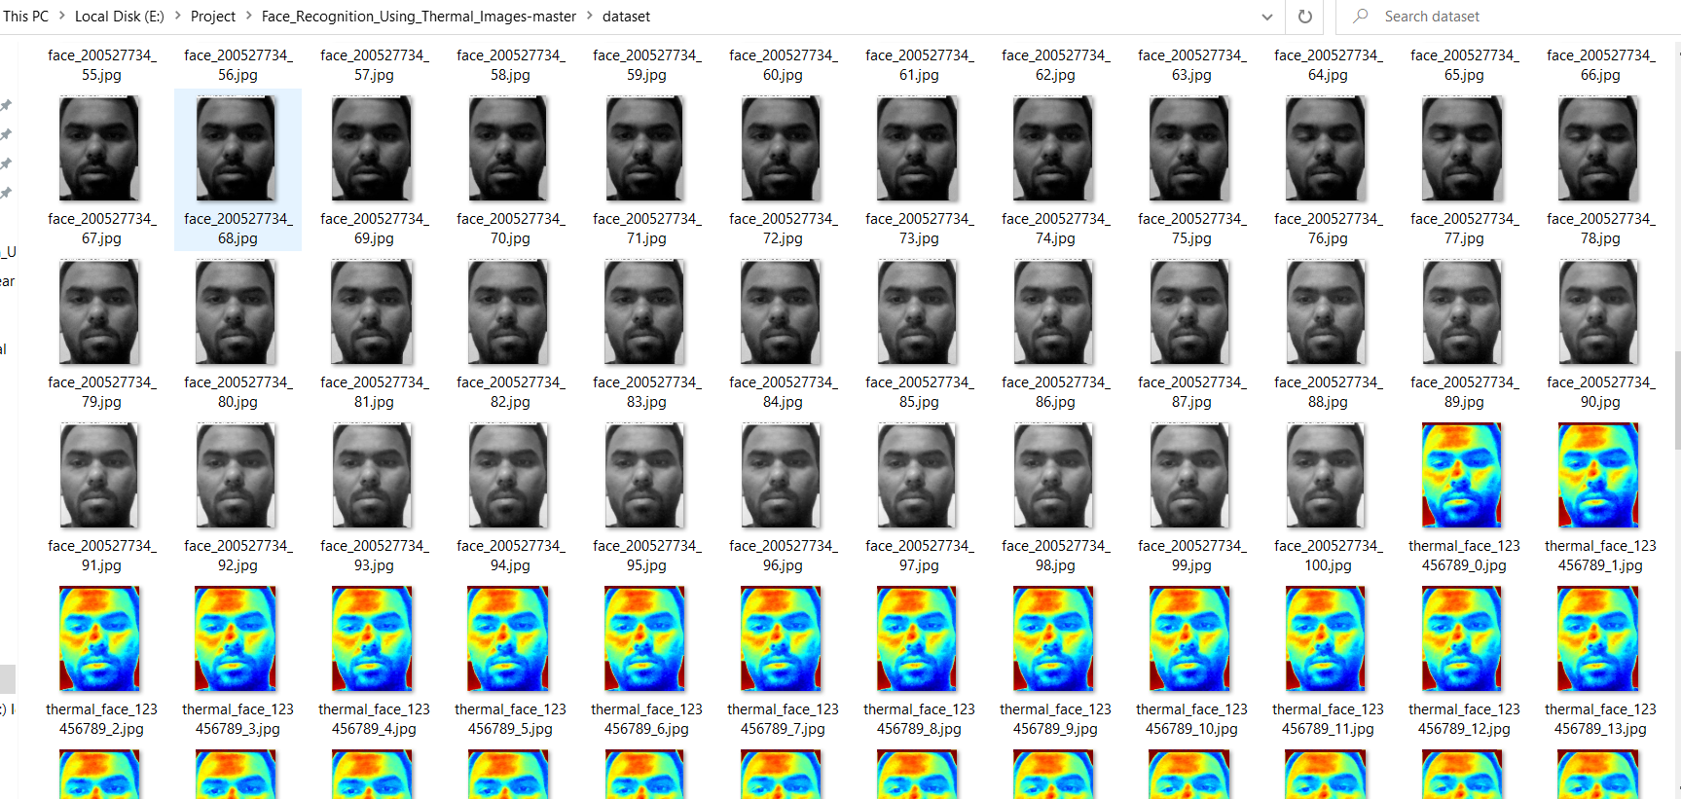
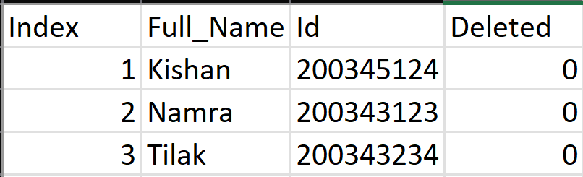
Glimpse of the work done
Sample Dataset
Sample CSV

Slide 16
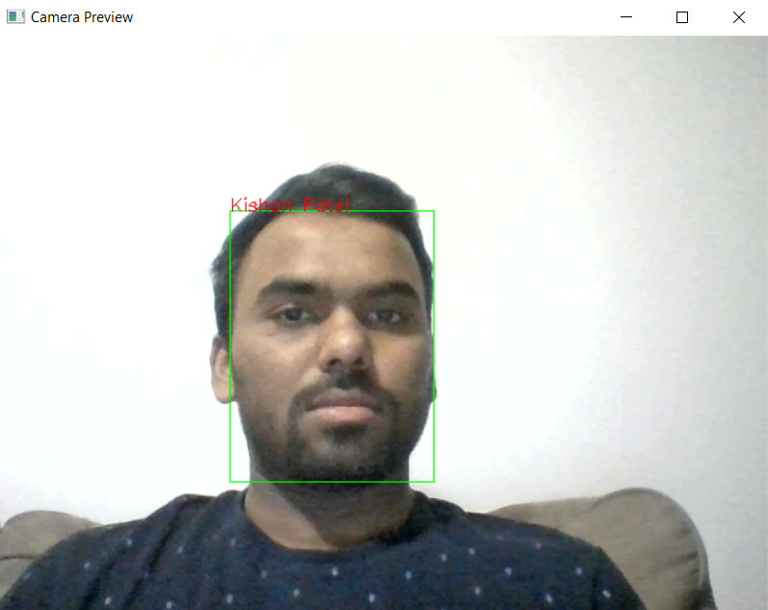
Glimpse of the work done
Face Recognition

Slide 17
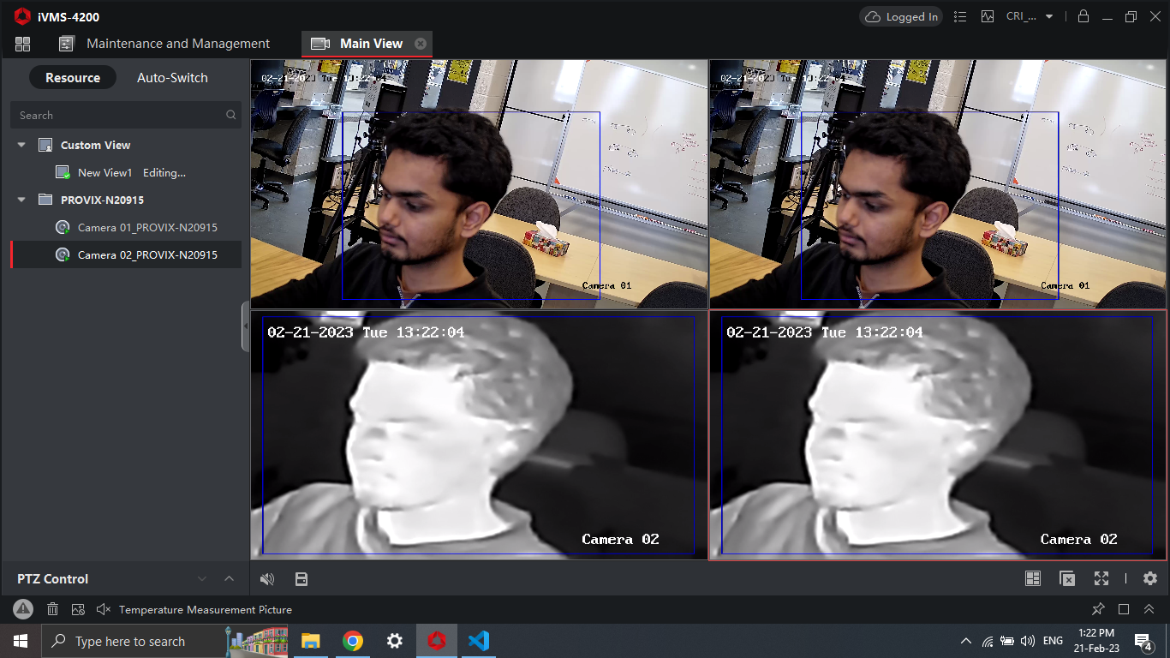
Glimpse of the work done
Accessibility to CRI AI Camera

Slide 18
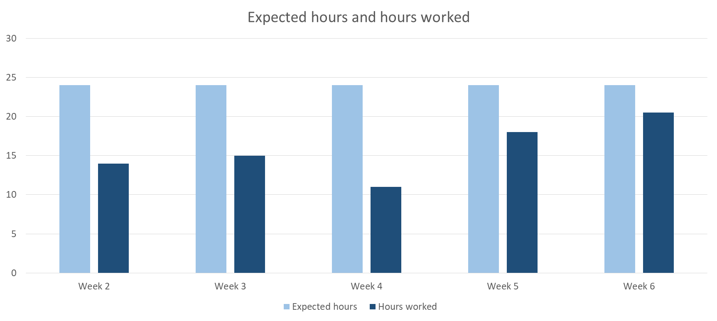
Hours worked (weekly)

Slide 19

General Budget
•Number of developers: 3
•Hourly cost: $50 per developer
•Estimated weekly time: 8 hours per developer
•Estimated weeks: 13
•Estimated fictious budget: $15,600

Slide 20
REFERENCES
iVMS 4200 References •User Manual Of iVMS 4200: https://us.hikvision.com/en/system/files_force/ivms-4200_v2.8.2.2_windows_user_manual_v2_0.pdf?download=1
Software Used: https://www.hikvision.com/ca-en/support/download/software/ivms4200-series/
For More Information FAQs: https://us.hikvision.com/en/support-resources/documentation/faq/software
For more information on the cv2.cvtColor function: https://docs.opencv.org/master/d9/d61/tutorial_py_morphological_ops.html
For more information on the cv2.applyColorMap function: https://docs.opencv.org/master/d3/d50/group__imgproc__colormap.html
For more information on the cv2.imwrite function: https://docs.opencv.org/master/d4/dc0/group__imgcodecs.html

Slide 21

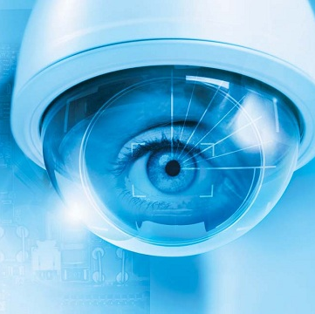
Thank you
GitHUB:
https://github.com/tilakpandya/face_recognition_using_thermal_images

