Slide 1
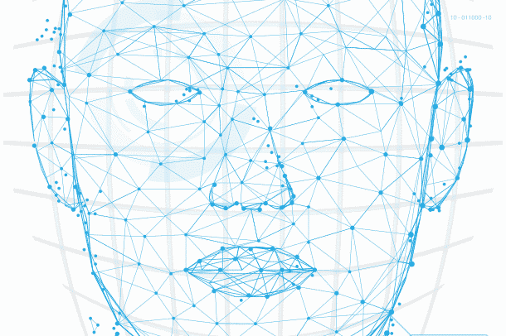
Face Recognition using CRI AI Thermal Camera
Assignment 10

Slide 2
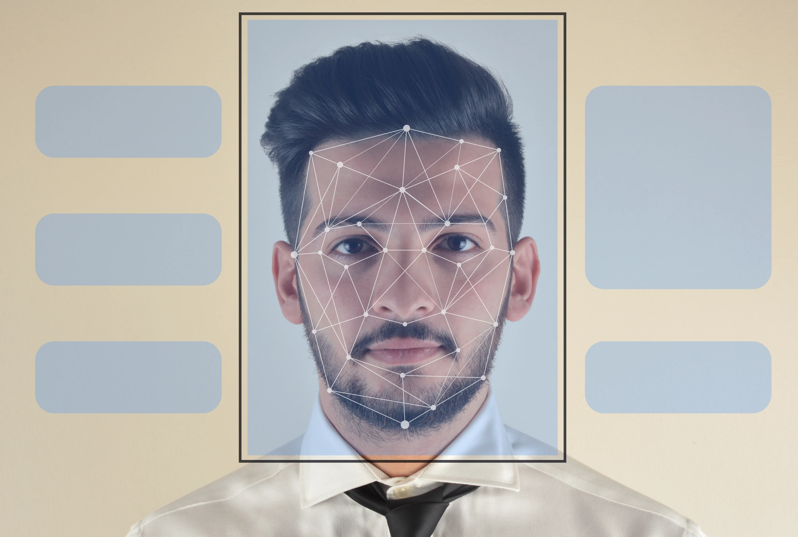
Agenda
Introduction
PROJECT SUMMARY
MEET OUR TEAM
SCOPE OF WORK
Project Progress
Individual status
Gantt chart
Glimpse of work
Weekly report
References
IMAGE SOURCE: LEARN G2

Slide 3
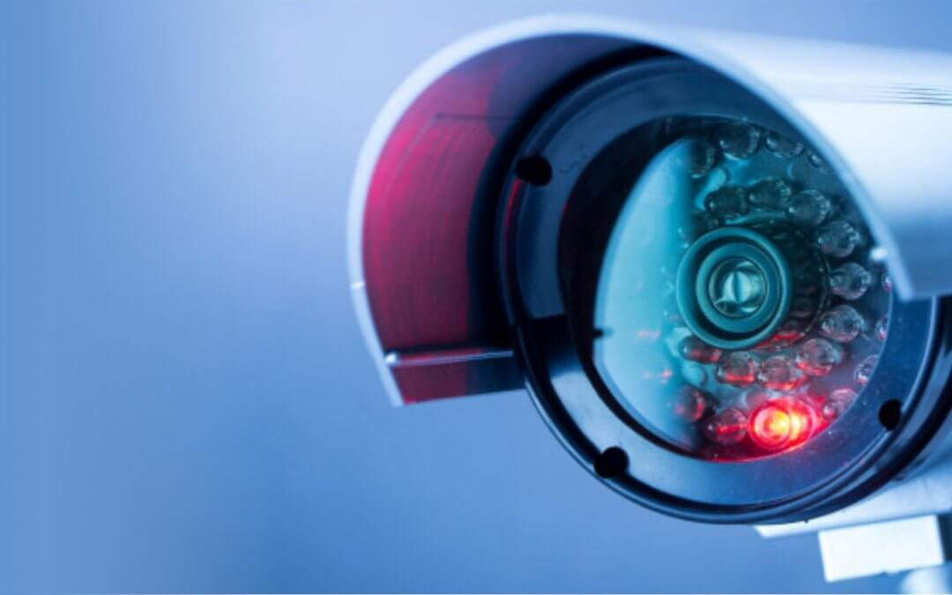
Introduction
What is CRI AI Camera?
CRI stands for Color Rendering Index and is nothing but a specification of cameras which states how accurately artificial light shows colors of the people under them.
CRI AI Thermal camera is used to develop this project.

Slide 4

Primary goals
Face Recognition
Security and surveillance
Contactless access control

Slide 5
Summary
Facial Recognition is the process of identifying a person through his or her facial features. We will be using thermal cameras to detect human faces. When we think about thermal images in the context of people, what usually comes to mind is night vision. The ability to see a person, or group of people, by the inevitable heat their bodies emit.
An important aspect of our project requires us to understand that thermal images capture heat in the form of frequency of pixels, varying from 0 to 1. Studies have found that each face emits a unique heat signature due to the blood vessels below the skin, as mentioned by Barclay (2013). Therefore, thermal facial images capture unique individual facial heat signatures which mark as unique biomarkers, providing us with rich information to classify a person correctly using a model.

Slide 6



Meet our team
Tilak Pandya
(B.C.A., M.C.A.)
Namra Patel
(B.E Computer Science.)
Kishan Patel
(B.Sc. Physics, PGDCA, Big Data Solution Architecture)
A Big Data Analyst having non-cs bachelor degree, yet significantly interested, and competent in AI industry.
A developer who explores concepts and potential in the tech industry.
A developer with real-world problem solving experience and a desire for innovation.

Slide 7
SCOPE OF WORK
Research on CRI AI thermal camera
Development of facial recognition algorithms
Integration with existing systems
Testing and validation
Deployment and training
Maintenance and support

Slide 8
Project progress
Prepare Splash Screen with UI for better user experience
Troubleshooting Blackbody radiation box
Create History Log file for activity Monitor
Update Git repository
Presentation.
Preparing Documentation

Slide 9
Python Tkinter Library
a built-in Python library for creating graphical user interfaces (GUIs).
easy to learn and use, even for beginners.
provides a range of layout managers that allow you to position widgets within a window or frame.
provides a range of styling options that allow you to customize the appearance.

Slide 10
Individual status
Namra:
Worked on UI development
Documentation
Tilak:
Create History Log file
Documentation
Kishan:
Worked on UI development
Documentation.

Slide 11
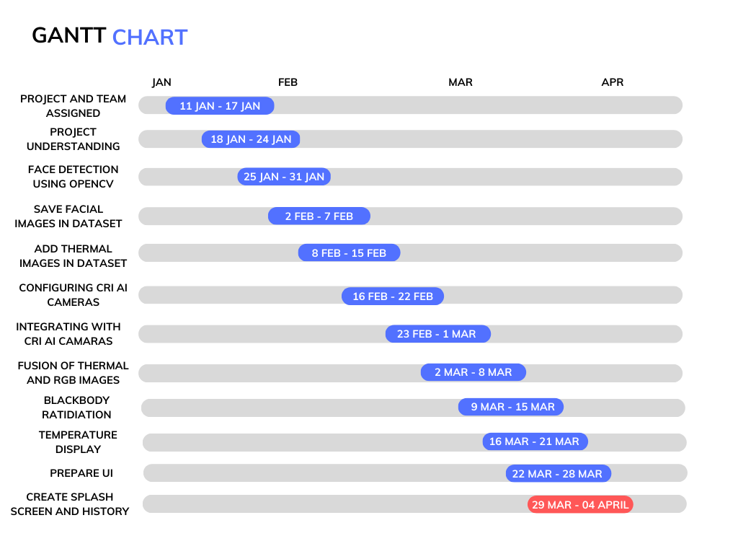
High-level timeline chart (GANTT)

Slide 12
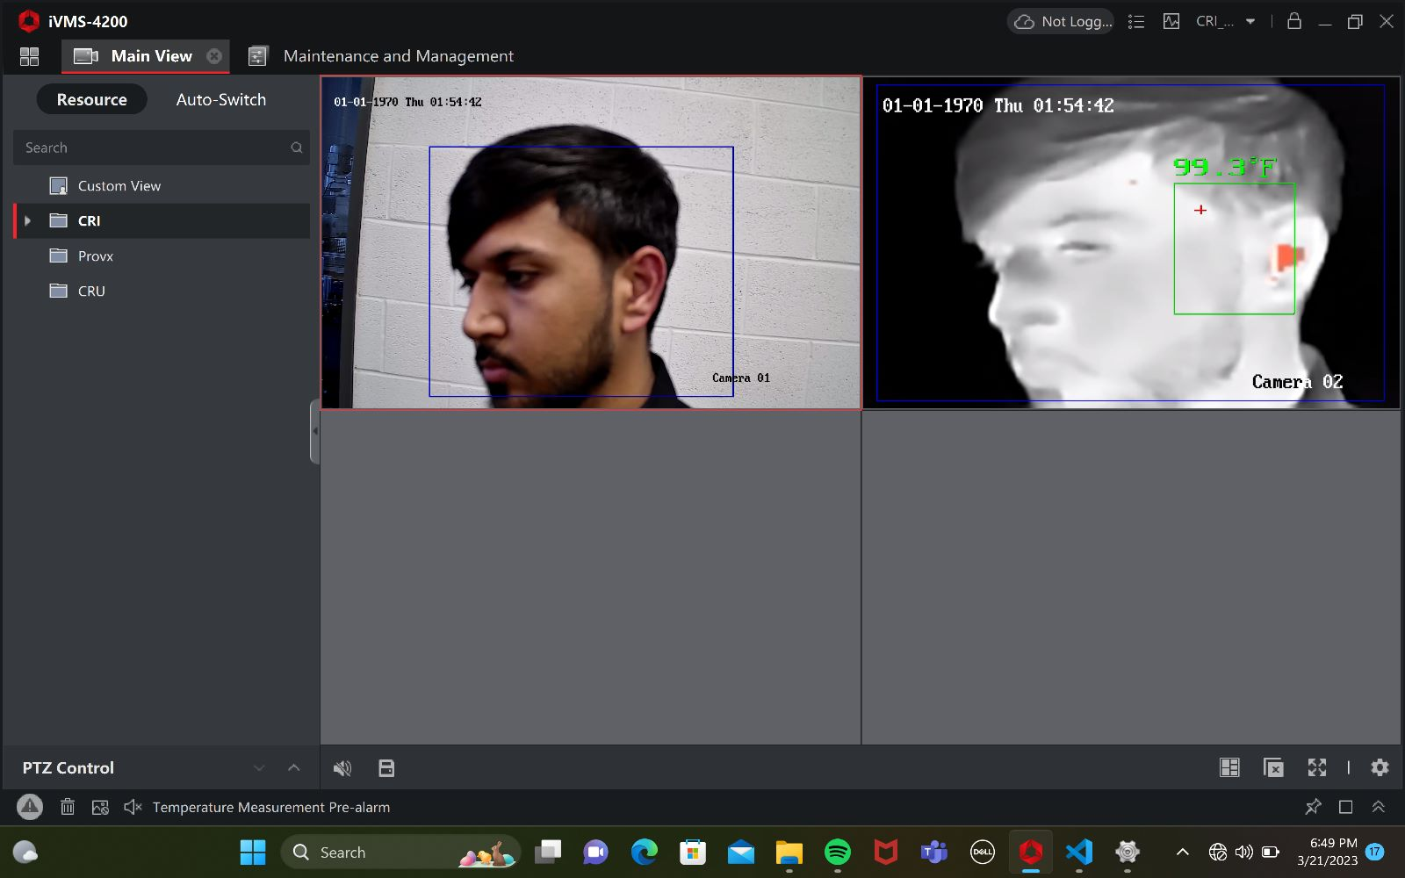
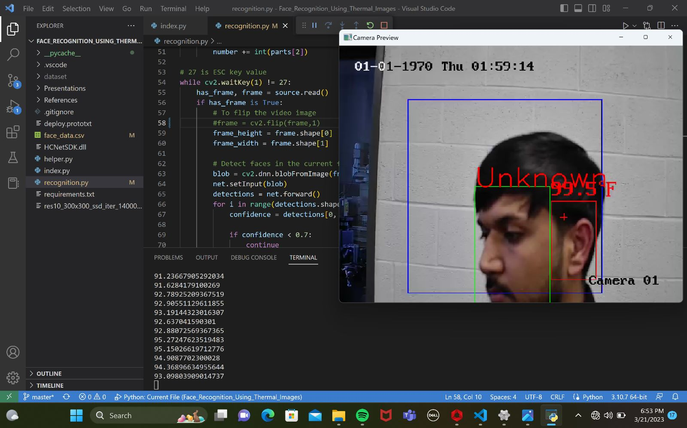
Glimpse of the work done
Blackbody radiation box integrated with camera showing temperature

Slide 13

Glimpse of the work done

Slide 14
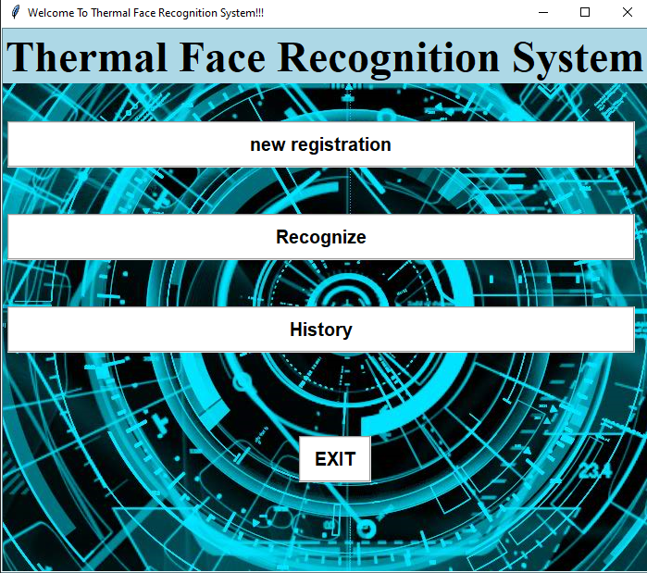
Glimpse of the work done

Slide 15
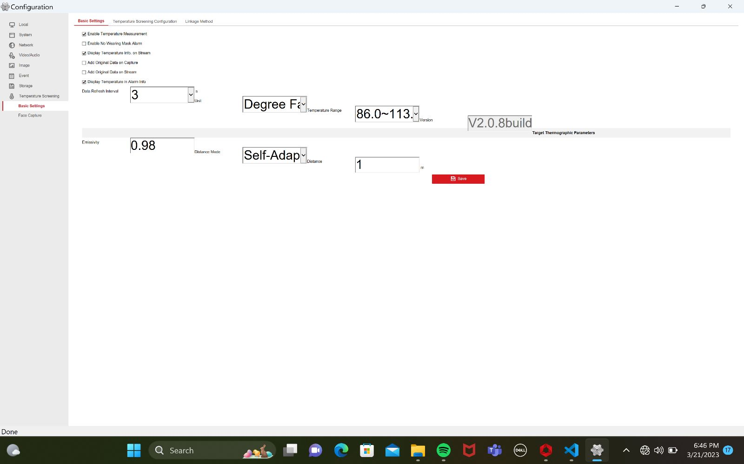
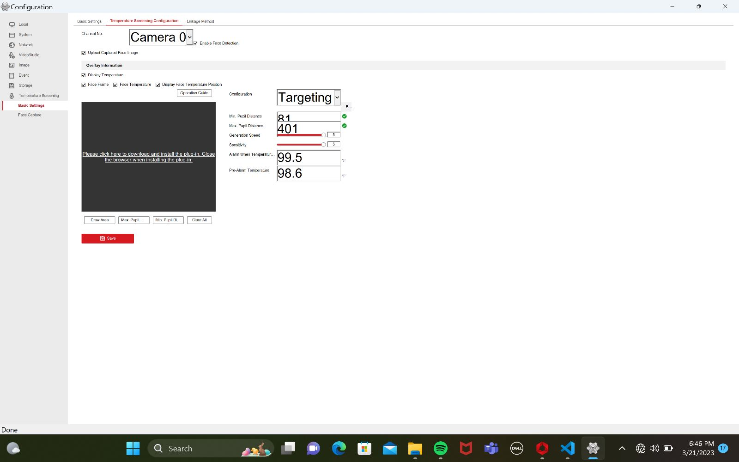

Glimpse of the work done
Camera configuration Change

Slide 16

General Budget
•Number of developers: 3
•Hourly cost: $50 per developer
•Estimated weekly time: 8 hours per developer
•Estimated weeks: 13
•Estimated fictious budget: $15,600

Slide 17
REFERENCES
iVMS 4200 References •User Manual Of iVMS 4200: https://us.hikvision.com/en/system/files_force/ivms-4200_v2.8.2.2_windows_user_manual_v2_0.pdf?download=1
Software Used: https://www.hikvision.com/ca-en/support/download/software/ivms4200-series/
For More Information FAQs: https://us.hikvision.com/en/support-resources/documentation/faq/software
Integrating CRI Camera: https://www.aranacorp.com/en/managing-an-ip-camera-with-python/
Hikvision Thermal Image Screening Camera: https://www.jojomarketing.ae/products/hikvision-ds-2te127-g4a-thermal-image-screening-camera-dubai-uae/
Python Tkinter Library Documentation: https://docs.python.org/3/library/tk.html

Slide 18

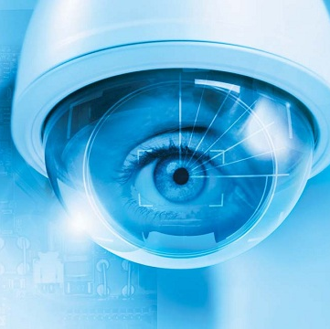
Thank you
GitHUB:
https://github.com/tilakpandya/face_recognition_using_thermal_images

