Slide 1


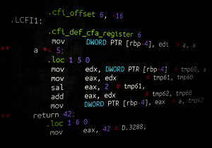


3,888 × 2,592
Lets break down the layers of abstraction
Build an 8-~Bit computer of your own, and program it with complete compilation transparency
Program a computer which is considered a Turing Complete Machine, and take after the father of computing himself
- With the language based on familiar syntax, you will hit the ground running with instant results
GNG
>_
GaunGau
Revealing the mystery of modern computing
A modern take on yesterday technology
Take control of how your software is written

