Slide 1
Bankruptcy Prediction MGMT 57100: Data Mining
The Analytics Avengers
Kshitij Chauhan, Swanand Gaikwad, Namra Shah
12/2/2024

Slide 2
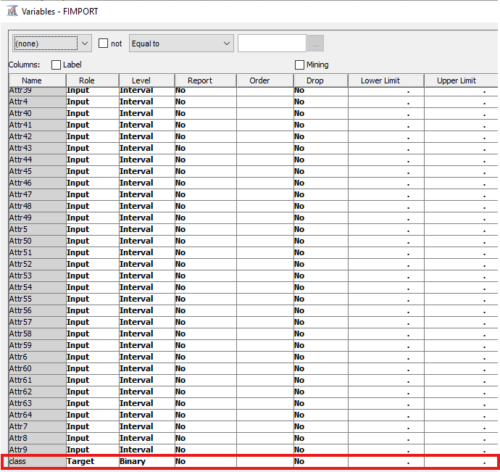
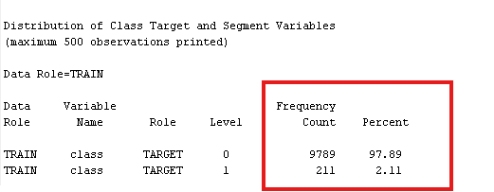
Introduction
Objective: Predicting company bankruptcy using financial data.
Source: Dataset with 64 financial attributes and a binary target (class)
Class Imbalance: 2.11% bankrupt, 97.89% non-bankrupt.
Final Scores: 0.9138 (Public) | 0.93980 (Private)
Fig: Input variable role assignment
Fig: Class Imbalance

Slide 3
Pre-Processing Methodology Overview
Utilized Data Partition, Graph Explore, Stat Explore, Replacement Nodes
Data Ingestion
Data Partitioning
EDA
Outlier Handling
Data Ingestion performed using File Import Node. The role and level of Class variable is changed to Target and Binary respectively
Data Partition Node was used for 70:30 split into train and validation data set with Stratification. This was to ensure representation of rare bankrupt cases in both training and validation sets.
Identified no missing values, high presence of outlier using Graph and Stat Explore Nodes. Analyzed variable distribution and correlations.
Used Replacement node for robust outlier management based on standard deviations.

Slide 4
Data Ingestion and Target Variable Setup
Data Ingestion performed using File Import Node. The role and level of Class variable is changed to Target and Binary respectively

Slide 5
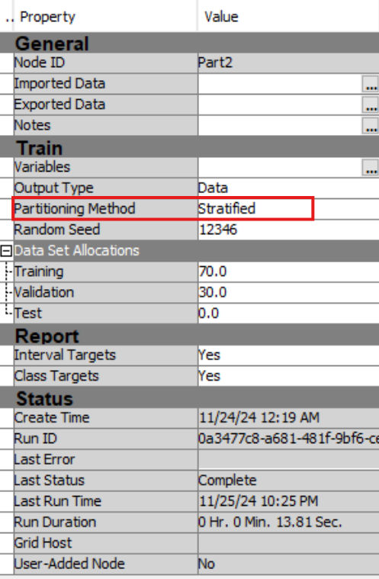
Data Partitioning
70% training, 30% validation with Stratification
Rationale: To ensure representation of rare bankrupt cases in both training and validation sets and account for data Imbalance
Fig: Target Variable Imbalance
Fig: Partition Node Configs

Slide 6
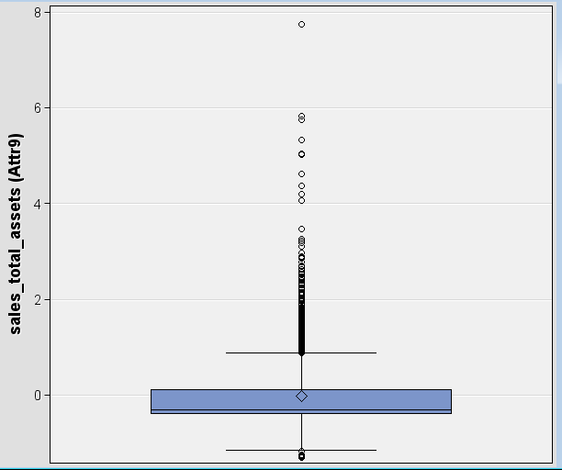
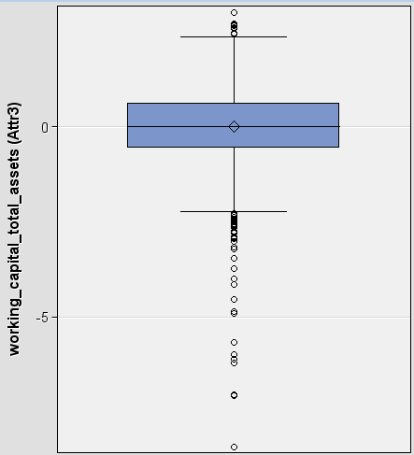
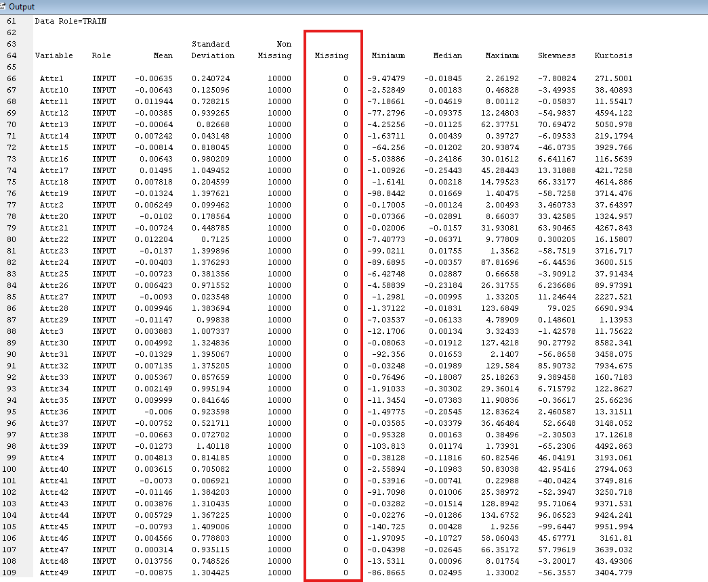
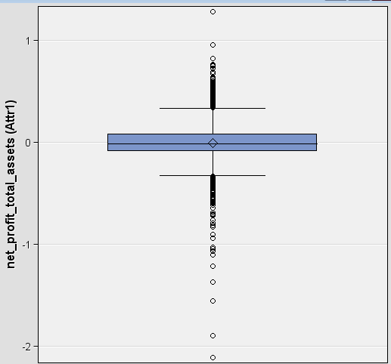
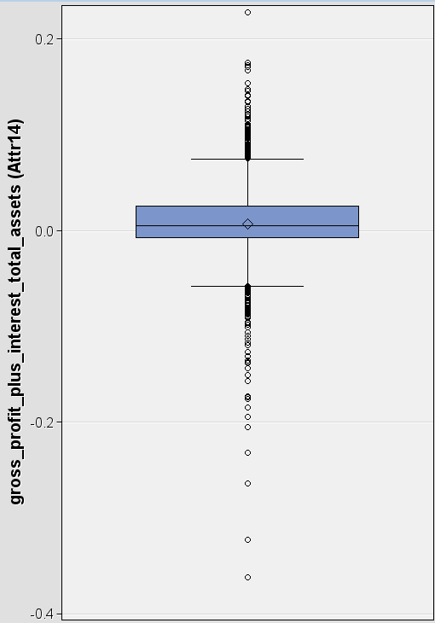
Exploratory Data Analysis
Identified no missing values. Hence, no need for Filter and Imputation.
Detected high presence of outliers
Analyzed variable distribution and correlations
Fig: No missing values
Fig: Box plots displaying outliers

Slide 7
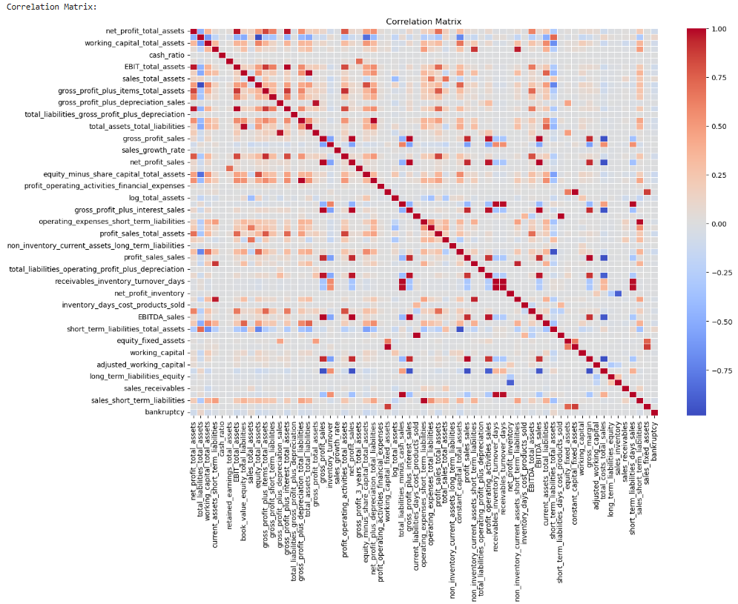
Exploratory Data Analysis : Multi-collinearity
Top Positive Correlations:
total_liabilities_total_assets (0.966): This attribute shows a strong positive correlation with the target variable, indicating it could be a significant predictor.
short_term_liabilities_total_assets (0.970): Slight positive correlation with the target variable, worth analyzing further.
Top Negative Correlations:
equity_minus_share_capital_total_assets (-0.919): Shows the strongest negative correlation with the target, indicating it could play an inverse role in prediction.
constant_capital_total_assets (-0.954): Another attribute with a notable negative relationship with the target variable.
profit_sales_total_assets (-0.960): Slight negative correlation, may have predictive value when combined with others.
Fig: Correlation Plot of variables

Slide 8

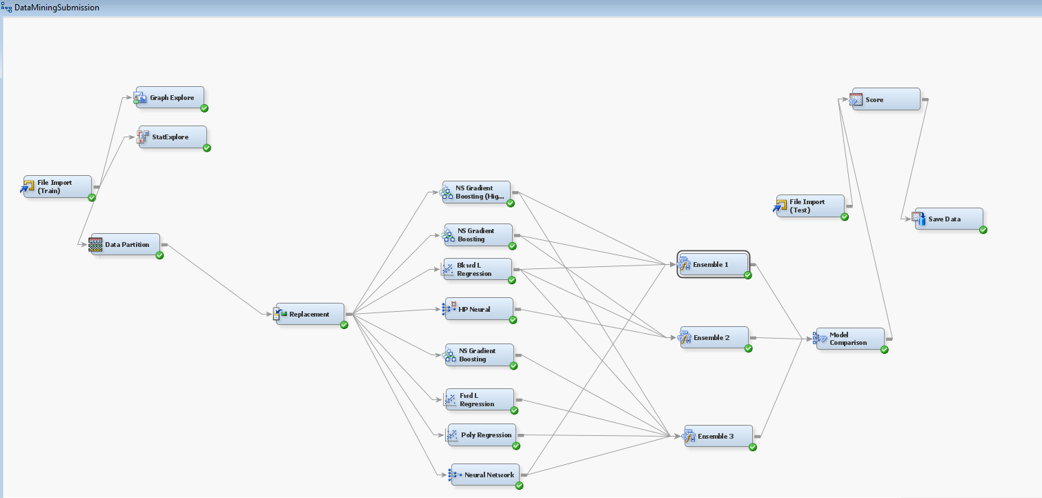
Model Architecture
Tested three Ensemble Models:
Ensemble 1: Two GB models, One Backward Regression model and One NN model
Ensemble 2: One GB model, One Backward Regression model, One HP Neural model
Ensemble 3: Two GB models, One Backward Regression model, One Forward Regression model, Polynomial Regression model, NN Model.
Fig: Predictive Model Diagram

Slide 9
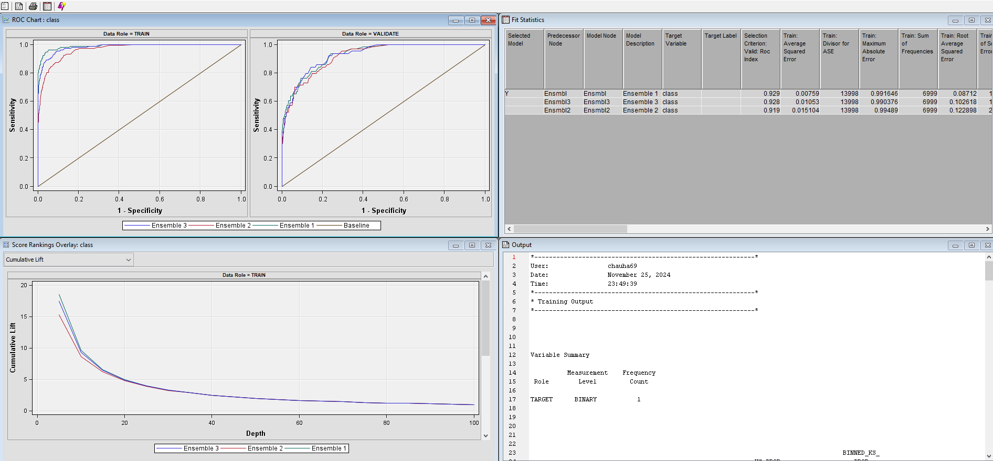
Combined Model Results
Performance Comparison: Ensemble 1 achieved the highest ROC index of 0.929, followed by Ensemble 3 with 0.928 and Ensemble 2 with 0.919, making Ensemble 1 the best-performing model.
Cumulative Lift: Ensemble 1 demonstrated superior cumulative lift on both train and validation datasets, indicating better segmentation of the target class.
Misclassification Rates: Ensemble 1 had the lowest misclassification rate across both train and validation datasets, showcasing its effectiveness in minimizing classification errors.
Low Importance Variables: REP_Attr1, REP_Attr12, REP_Attr4, REP_Attr36 have zero importance in both train and validation set. Removed these features improved the accuracy of Gradient Boosting model and overall ensemble.
Fig: Model comparison node results

Slide 10
Model Comparison
Aspect | Ensemble 1 | Ensemble 2 | Ensemble 3
Models Used | 2 Gradient Boosting 1 Backward Regression 1 Neural Network (NN) | 1 Gradient Boosting 1 Backward Regression 1 High-Performance Neural Network | 2 Gradient Boosting 1 Backward 1 Forward Regression 1 Polynomial Regression 1 Neural Network (NN)
Validation ROC Index | 0.929 (Highest among all ensembles, showing superior predictive performance for the validation set) | 0.919 (Lower predictive power on unseen data due to the simpler model diversity) | 0.928 (Similar to Ensemble 1, but with added complexity and minor performance drawbacks)
Training ROC Index | 0.982 | 0.965 | 0.989
Misclassification Rate (Validation) | 0.0167 (Lowest among all ensembles, indicating better classification accuracy on the validation set) | 0.02 (Higher misclassification due to reduced complexity in the HP NN model) | 0.0187 (Higher misclassification caused by redundancy in Forward and Polynomial Regression models)
Gini Coefficient (Validation) | 0.858 | 0.838 | 0.856
Kolmogorov-Smirnov Statistic (Validation) | 0.70 (Strong separation between event and non-event classes) | 0.66 (Slightly lower separation due to reduced diversity in model predictions) | 0.70 (On par with Ensemble 1 but fails to outperform in other metrics)
Cumulative Lift (Validation) | 7.28 (Best lift, demonstrating better identification of top-ranked events) | 7.12 (Lower ability to rank true positives due to less diverse model components) | 7.12 (On par with Ensemble 2 but with higher complexity and similar performance)
Number of Wrong Classifications (Validation) | 50 | 60 | 56
Strengths | Combines robustness (GB), non-linearity (NN), and simplicity (Backward Regression). | HP NN handles feature transformations efficiently and is computationally faster than traditional NN. | Highly diverse, covering linearity (Regression), non-linearity (Neural Network), and robust learners (GB).
Weaknesses | Computationally intensive due to two GB models. | Lower accuracy due to limited diversity (only one GB model); HP NN failed to generalize as well as traditional NN. | Overly complex; redundant models like Poly Reg and Forward Reg added no significant value, leading to marginal gains.
Why Not Chosen? | N/A (Best Performing Ensemble) | Lower ROC Index (0.919) and higher misclassification (2%) failed to meet the accuracy required for bankruptcy prediction. | Marginal difference in validation ROC Index (0.928) with added complexity; the ensemble didn’t justify the overhead.
Fig: Model comparison grid

Slide 11
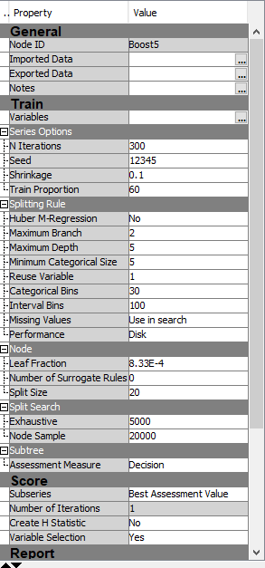
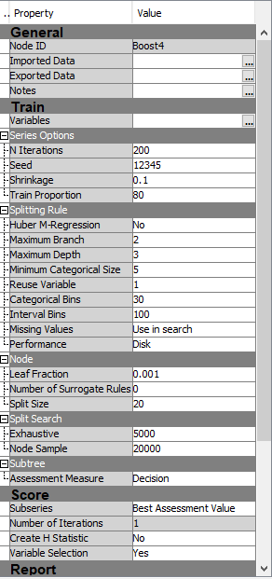
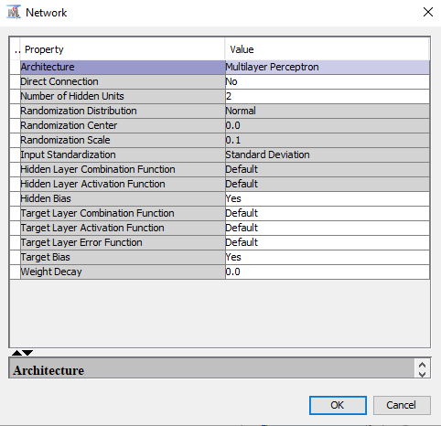
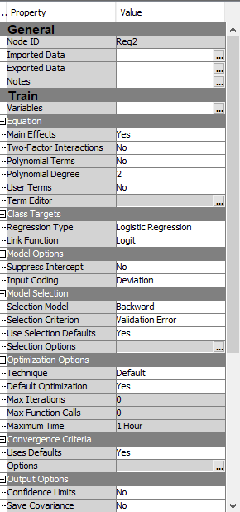
Ensemble1: Winning Ensemble
Rationale for Ensemble 1:
GB: Handles non-linear relationships effectively. Significant improvement achieved by removing zero importance variables
Backward Regression: Selects significant features for interpretability
Neural Network: To capture more complex patterns and interactions.
Parameter Tuning: Performed Randomized search for hyperparameter tuning using 2-fold cross validation with help of SAS EM help documentation(www.communities.sas.com/hyperparametertuning).
Fig: GB Model1, GB Model2, Neural Network, Backward Regression (clockwise from top-left)

Slide 12
Key Learnings Courtesy: Learning Machine, Titans
Gradient Boosting
Increase train proportion (ideally 100), shrinkage size (not to go below 0.05), and tree depth for better pattern learning.
Posterior Probabilities in Ensemble
Use average posterior probabilities for smoother, probabilistic predictions. Top Teams had used "average" as a method to calculate posterior probabilities.
Neural Networks
Higher iterations risk overfitting; use early stopping, Model selection criteria could have been changed to "Misclassification". Number of Hidden units under neural network to be tweaked.
Keep iterations low to prevent overfitting.
Monitor validation loss for optimal iteration stopping
Weighted averaging might have improved ensemble accuracy which should have been investigated.
Monitor validation vs. training error to detect overfitting early.
Auto Neural Exploration
Automates architecture tuning for better performance in non-linear data.
Model Diagnostics
Hyperparameter Optimization
Use Variable Importance and Partial Dependence Plots for insights
Model Ensembles
Leverage SAS EM’s Decision Trees and Hyperparameter Search for fine-tuning, even if standalone Decision trees do not provide value in terms of ROC, adding them in an Ensemble might boost ROC scores.
Higher time should have been spent on models offered in SAS-EM than pre-processing data.
Compare with manual models using Model Comparison.
Exploration of this model was not done due to assumption of sticking to models discussed in lectures.
Diversity reduces the risk of overfitting and improves the ensemble's ability to generalize to unseen data.
Combine Gradient Boosting, Auto Neural, and other models for robust performance

Slide 13
Thank You

