Slide 1


T | W | E | E | T | - | D | R | I | V | E | N
M | O | Z | F | E | S | T | - | S | T | O | R | Y | T | E | L | L | I | N | G
Shadab Hussain, MozFest 2018

Slide 2

Intro
Data Science Tools
Tweet Structure
Hands on Demo
Q & A
About Me
Shadab Hussain
Education, Training & Assessment
Infosys Ltd.
https://www.linkedin.com/in/shadabhussain96/
Background:
Computer Science Engineer, AKTU
Pursuing PG Diploma in Data Science, IIIT-B
… using a diverse set of tools:
SQL, Excel, R, Python, Tableau
Tweet-Driven Mozfest-Storytelling, Shadab Hussain, MozFest 2018

Slide 3
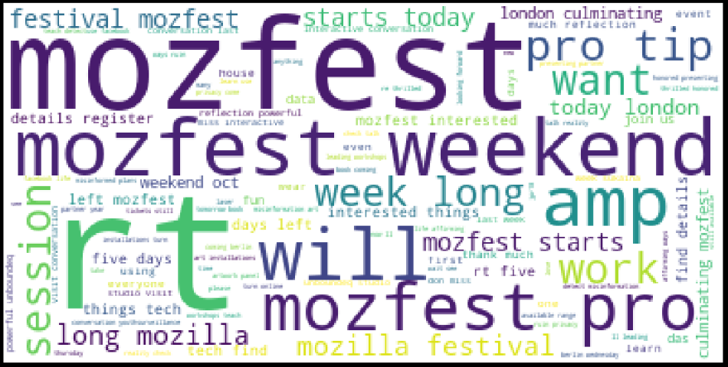
Intro
Data Science Tools
Tweet Structure
Hands on Demo
Q & A
About this talk
Objective:
Introduction to Data-Analytics and Visualization through the tweets containing hashtag ‘#mozfest’ with practical example.
Structure:
Data Science Tools
Tweet Structure
Hands on Demo
Tweet-Driven
Mozfest-Storytelling
Tweet-Driven Mozfest-Storytelling, Shadab Hussain, MozFest 2018

Slide 4
Intro
Data Science Tools
Tweet Structure
Hands on Demo
Q & A
What’s a Data Scientist?
Tweet-Driven Mozfest-Storytelling, Shadab Hussain, MozFest 2018

Slide 5
Intro
Data Science Tools
Tweet Structure
Hands on Demo
Q & A
What’s a Data Scientist?
Solid hands-on experience in developing analytical solutions using statistical tools
Experience in implementing Machine Learning systems which may include classification, clustering, natural language processing and time series analysis.
Hands-on experience in database management
Solid hands-on coding experience in Python, R, Julia or similar
Experience in dealing with large data sets and a solid understanding of Big Data technologies and applications
Sound presentation skills, visualizing complicated data science results in Tableau, or similar
Comfortable working with front-end development technologies, including: HTML, JavaScript, D3.js, Django, etc.
Tweet-Driven Mozfest-Storytelling, Shadab Hussain, MozFest 2018

Slide 6
Intro
Data Science Tools
Tweet Structure
Hands on Demo
Q & A
“ At my company X, we have peta/terabytes of data, just lying
around, waiting for someone to explore it”
- someone at some conference
Tweet-Driven Mozfest-Storytelling, Shadab Hussain, MozFest 2018

Slide 7
Intro
Data Science Tools
Tweet Structure
Hands on Demo
Q & A
“ At my company X, we have peta/terabytes of data, just lying
around, waiting for someone to explore it”
- someone at some conference
Let’s make it easier for users to explore and extract useful insights out of data.
Tweet-Driven Mozfest-Storytelling, Shadab Hussain, MozFest 2018

Slide 8
Intro
Data Science Tools
Tweet Structure
Hands on Demo
Q & A
“ At my company X, we have peta/terabytes of data, just lying
around, waiting for someone to explore it”
- someone at some conference
Let’s make it easier for users to explore and extract useful insights out of data.
Anaconda | Search and download popular Python/R packages
Conda | Package manager
Tweepy | Python library for connecting with Twitter API
Matplotlib/Seaborn | Data Visualization
Folium | Plotting WorldMap
Tweet-Driven Mozfest-Storytelling, Shadab Hussain, MozFest 2018

Slide 9
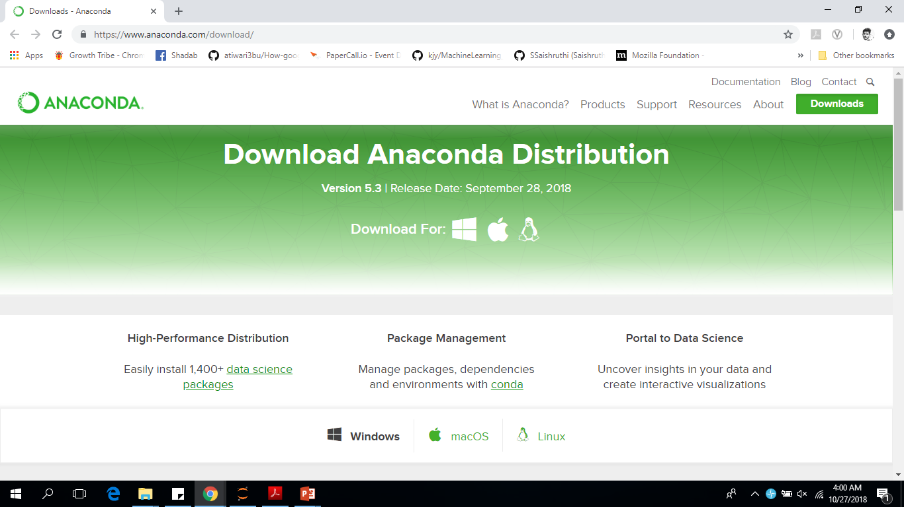
Intro
Data Science Tools
Tweet Structure
Hands on Demo
Q & A
Downloading and Installing Anaconda
Tweet-Driven Mozfest-Storytelling, Shadab Hussain, MozFest 2018

Slide 10
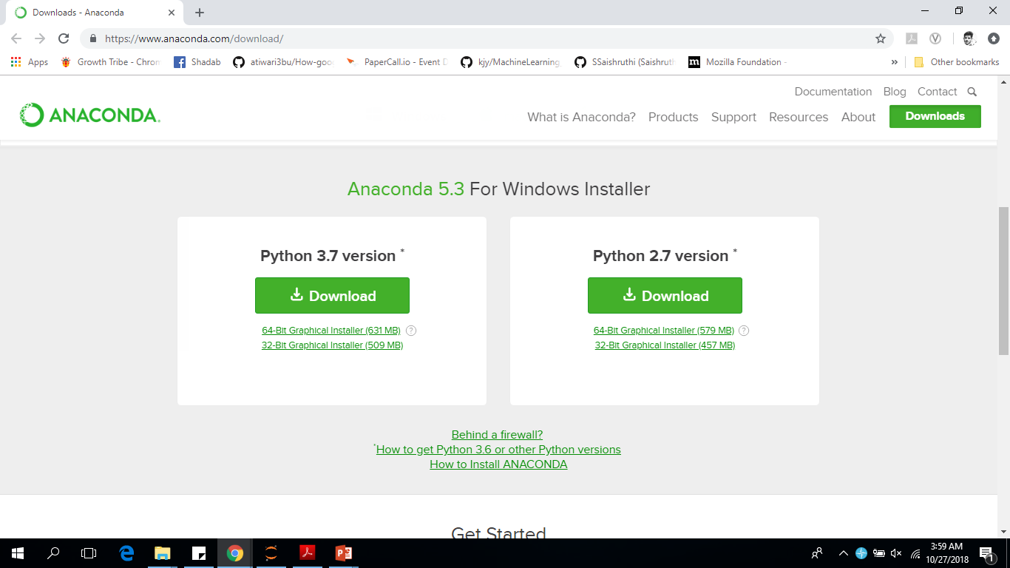
Intro
Data Science Tools
Tweet Structure
Hands on Demo
Q & A
Downloading and Installing Anaconda
Tweet-Driven Mozfest-Storytelling, Shadab Hussain, MozFest 2018

Slide 11
Intro
Data Science Tools
Tweet Structure
Hands on Demo
Q & A
Tweet Structure
Tweepy- a python library to extract tweets using Twitter API
! pip install tweepy
Tweet-Driven Mozfest-Storytelling, Shadab Hussain, MozFest 2018

Slide 12
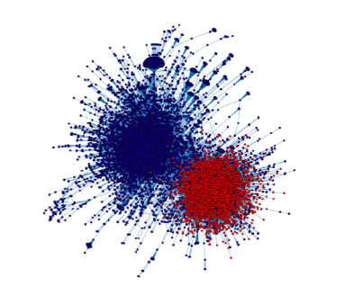
Intro
Data Science Tools
Tweet Structure
Hands on Demo
Q & A
Why analyze Twitter Data?
Tweet-Driven Mozfest-Storytelling, Shadab Hussain, MozFest 2018

Slide 13
Intro
Data Science Tools
Tweet Structure
Hands on Demo
Q & A
What we can't analyze
Can't collect data on observers
Free-level of access is restrictive
Can't collect historical data
Only a 1% (unverified) sample
Tweet-Driven Mozfest-Storytelling, Shadab Hussain, MozFest 2018

Slide 14
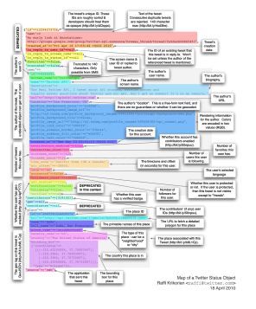
Intro
Data Science Tools
Tweet Structure
Hands on Demo
Q & A
What we can analyze
1% sample is still a few million tweets
Within a tweet
Text
User profile information
Geolocation
Retweets and quoted
Tweet-Driven Mozfest-Storytelling, Shadab Hussain, MozFest 2018

Slide 15
Intro
Data Science Tools
Tweet Structure
Hands on Demo
Q & A
Twitter API
API: Application Programming Interface
Twitter APIs
Search API
Ads API
Streaming API
Tweet-Driven Mozfest-Storytelling, Shadab Hussain, MozFest 2018

Slide 16
Intro
Data Science Tools
Tweet Structure
Hands on Demo
Q & A
Streaming API
Real-time tweets
Filter endpoint- Keywords, User IDs, Locations
Sample endpoint- Random sample
Tweet-Driven Mozfest-Storytelling, Shadab Hussain, MozFest 2018

Slide 17
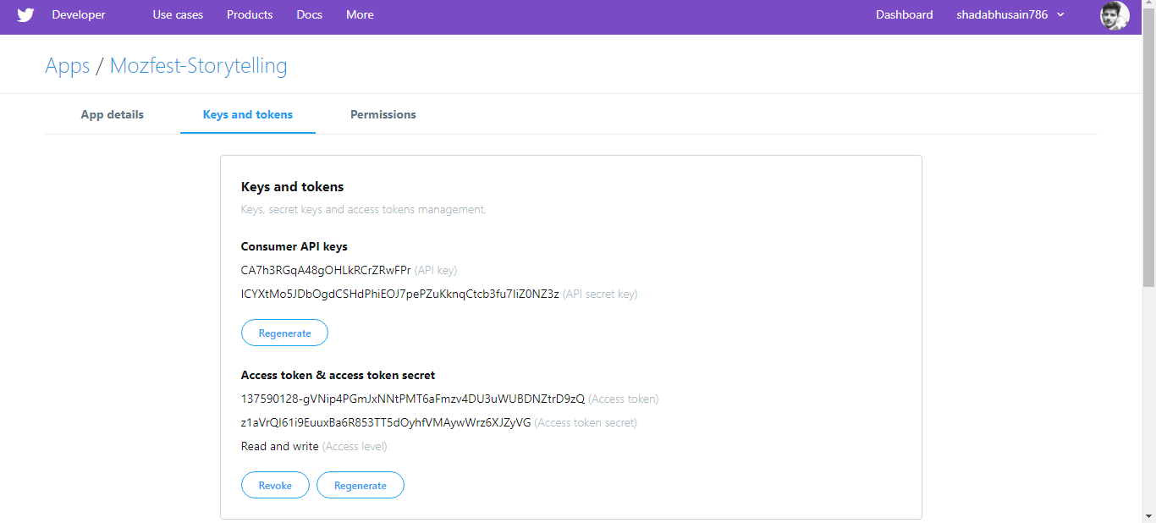
Intro
Data Science Tools
Tweet Structure
Hands on Demo
Q & A
Twitter API Key
Tweet-Driven Mozfest-Storytelling, Shadab Hussain, MozFest 2018

Slide 18
Intro
Data Science Tools
Tweet Structure
Hands on Demo
Q & A
Tweepy Authentication
auth = tweepy.OAuthHandler(consumer_key, consumer_secret)
auth.set_access_token(access_token, access_token_secret)
api = tweepy.API(auth)
Tweet-Driven Mozfest-Storytelling, Shadab Hussain, MozFest 2018

Slide 19
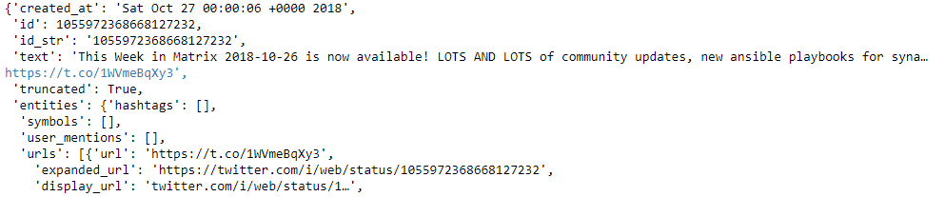
Intro
Data Science Tools
Tweet Structure
Hands on Demo
Q & A
Twitter JSON
How many retweets, favorites
Language
Reply to which tweet
Reply to which user
Tweet-Driven Mozfest-Storytelling, Shadab Hussain, MozFest 2018

Slide 20
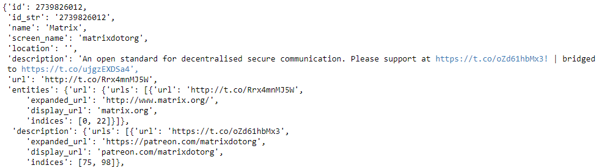
Intro
Data Science Tools
Tweet Structure
Hands on Demo
Q & A
Child Json Object
Tweet-Driven Mozfest-Storytelling, Shadab Hussain, MozFest 2018

Slide 21
Intro
Data Science Tools
Tweet Structure
Hands on Demo
Q & A
Places, retweets/quoted tweets, and 140+ tweets
place and coordinate- contain geolocation
extended_tweet- tweets over 140 characters
retweeted_status and quoted_status- contain all tweet information of retweets
and quoted tweets
Tweet-Driven Mozfest-Storytelling, Shadab Hussain, MozFest 2018

Slide 22
Intro
Data Science Tools
Tweet Structure
Hands on Demo
Q & A
Accessing JSON
searched_tweets[0][‘text’]
Accessing Child JSON
searched_tweets[0]['user'][‘screen_name’]
Tweet-Driven Mozfest-Storytelling, Shadab Hussain, MozFest 2018

Slide 23
Intro
Data Science Tools
Tweet Structure
Hands on Demo
Q & A
Tweepy Authentication
auth = tweepy.OAuthHandler(consumer_key, consumer_secret)
auth.set_access_token(access_token, access_token_secret)
api = tweepy.API(auth)
Tweet-Driven Mozfest-Storytelling, Shadab Hussain, MozFest 2018

Slide 24
Intro
Data Science Tools
Tweet Structure
Hands on Demo
Q & A
Demo
Tweet-Driven Mozfest-Storytelling, Shadab Hussain, MozFest 2018

Slide 25
Intro
Data Science Tools
Tweet Structure
Hands on Demo
Q & A
Thank You ☺
Tweet-Driven Mozfest-Storytelling, Shadab Hussain, MozFest 2018

