Slide 1
Deep Learning for IoT
Intrusion Detection
Comparative evaluation on the CICIoT2023 dataset
PROJECT
AUTHOR
INSTITUTE
Deep learning model comparison across 7 architectures
Namrata Kothari
Manipal University Jaipur
• Goal: identify a strong accuracy–training-cost trade-off for IoT intrusion detection.
Deep Learning Project • IoT Intrusion Detection • Manipal University Jaipur
1

Slide 2
1. Problem, Aim & Objectives
Why deep learning is being evaluated for IoT intrusion detection
PROBLEM
IoT network traffic
IoT traffic is heterogeneous and attack patterns can be difficult to distinguish. High benchmark accuracy can also hide minority-class errors and false alarms.
↓
Feature-based representation
AIM
↓
Compare multiple deep learning architectures under the same experimental setting and identify the best-performing model.
Deep learning models
↓
OBJECTIVES
Attack classification
• Evaluate DNN, regularized DNNs, 1D CNN, LSTM and Transformer
• Compare accuracy, precision, recall, F1 and specificity
• Measure training cost and interpret the trade-off
Deep Learning Project • IoT Intrusion Detection • Manipal University Jaipur
2

Slide 3
2. Dataset & Experimental Setting
CICIoT2023 context and the supplied experiment configuration
TRAINING SAMPLES
TEST SAMPLES
CLASSES
MODELS
1,073,851
268,463
8
7
DATASET CONTEXT
EXPERIMENT
EVALUATION
CICIoT2023 is a modern IoT intrusion-detection benchmark. The supplied literature reports 105 IoT devices, 47 features and 34 classes including benign traffic.
The project evaluates seven models using the same reported test setting and compares predictive metrics plus training time.
Accuracy • Precision • Recall • F1 Score • Specificity
Additional metric: training time (seconds).
KEY FAIRNESS POINT
Published CICIoT2023 results are not directly comparable when label sets, sampling and rebalancing differ. This project therefore focuses on the controlled comparison within its own experiment.
Deep Learning Project • IoT Intrusion Detection • Manipal University Jaipur
3

Slide 4
3. Literature Review & Research Gap
What the supplied 20-study literature corpus shows
20 STUDIES
CICIoT2023
MAIN WARNING
8 reviews/surveys + 11 experimental studies + 1 benchmark.
10 of 11 experimental studies use CICIoT2023, making it the main benchmark in the corpus.
Accuracy alone can hide rare-class failure under severe imbalance.
• Enhanced LSTM: 98.58% on a 34-class CICIoT2023 setup (Meena & Indian).
• LSTM: 96.02% on six harmonised classes across CICIoT2023 + IoT-23 (Imran et al.).
• CatBoost: 99.96% on 20 classes with feature selection and class weighting (Hajjouz & Avksentieva).
• Natural-imbalance 34-class experiment: 76.88% accuracy and 0.54 macro-F1 (Kwari & Rajkumar).
RESEARCH GAPS
• Cross-dataset generalisation
• Adversarial robustness
• Quantified XAI
• Privacy-preserving validation
• Production / streaming evaluation
Deep Learning Project • IoT Intrusion Detection • Manipal University Jaipur
4

Slide 5
4. Deep Learning Models Evaluated
Seven architectures, from feed-forward networks to attention-based models
DNN
DNN + Dropout
DNN + L2
Fully connected baseline
Regularisation by randomly dropping units
Weight-penalty regularisation
Proposed DNN
1D CNN
LSTM
Project-specific DNN variant
Learns local patterns across feature sequences
Sequence model with memory gates
DESIGN LOGIC
Transformer
COMPARISON PRINCIPLE
Start with DNN baseline → test regularisation → test CNN / sequence architectures.
Self-attention based sequence model
Same reported metrics across models; training time added to assess efficiency.
Deep Learning Project • IoT Intrusion Detection • Manipal University Jaipur
5

Slide 6
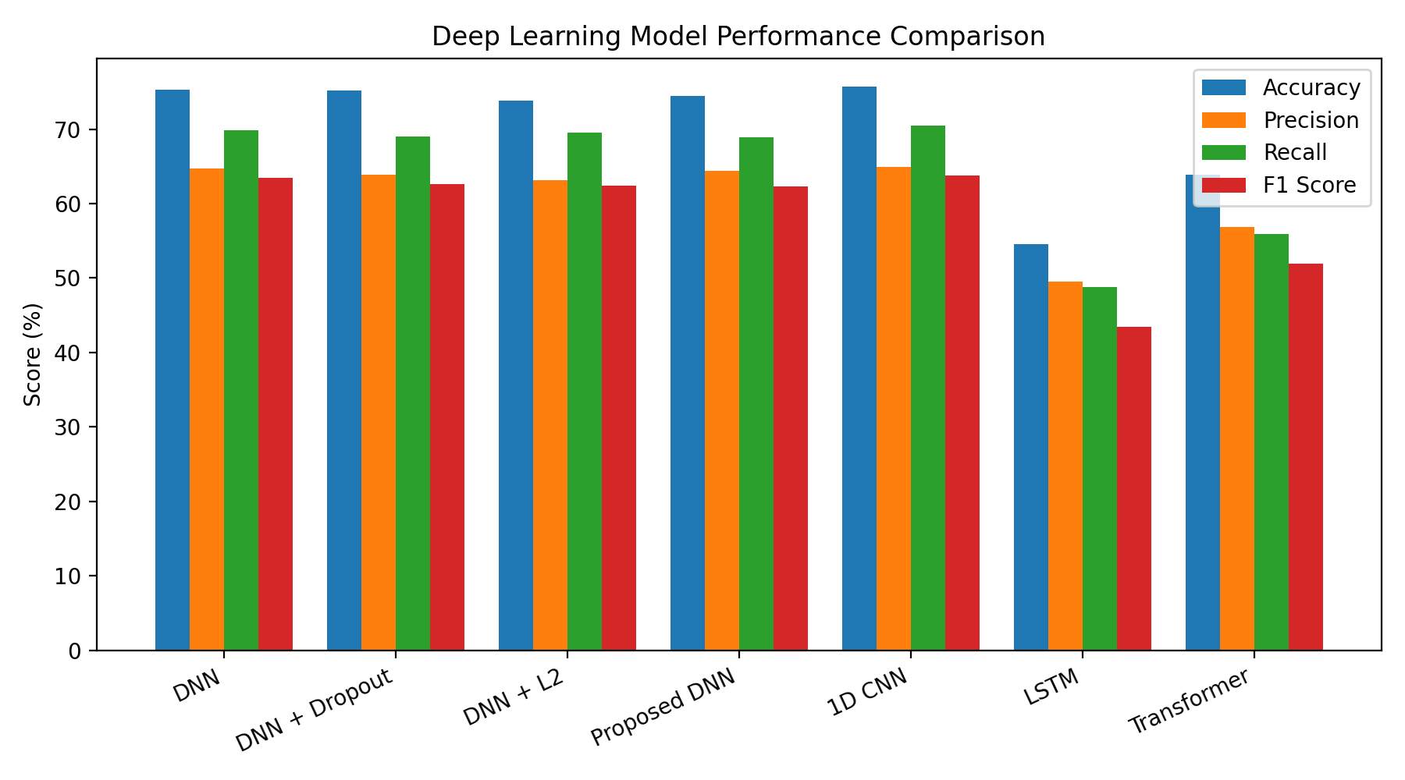
5. Experimental Results: Model Performance
1D CNN is the performance leader in the supplied experiment
BEST ACCURACY
75.74%
BEST PRECISION
64.94%
BEST RECALL
70.49%
BEST F1
63.77%
Deep Learning Project • IoT Intrusion Detection • Manipal University Jaipur
6

Slide 7
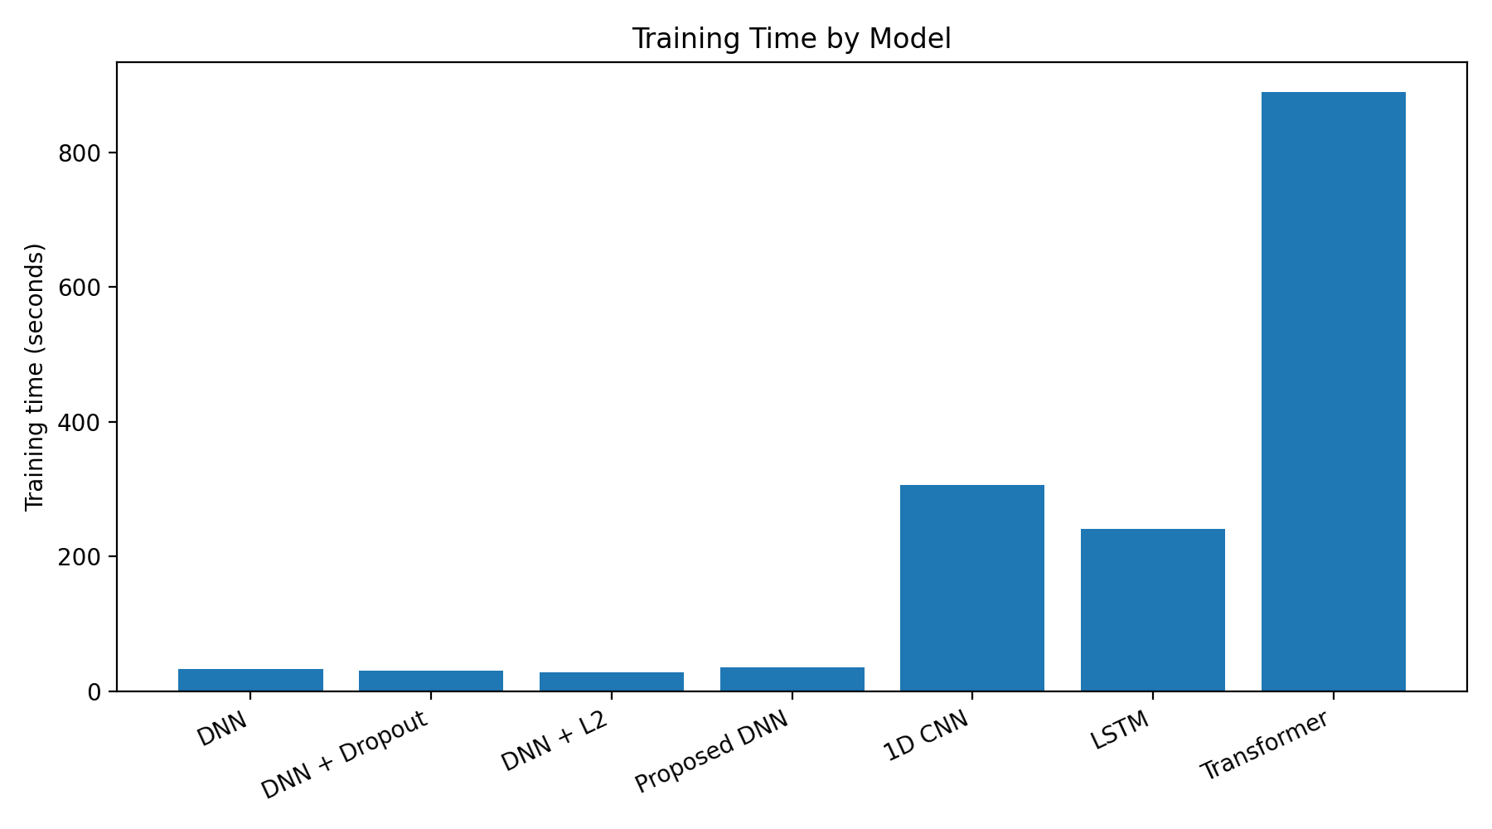
6. Training Cost & Performance–Efficiency Trade-off
Predictive strength and computational cost do not move together
FASTEST
DNN + L2 — 27.66 s
STRONG SPEED/PERFORMANCE
Base DNN — 75.30% accuracy in 32.37 s
COSTLY MODELS
1D CNN — 305.55 s
LSTM — 240.64 s
Transformer — 889.91 s
Deep Learning Project • IoT Intrusion Detection • Manipal University Jaipur
7

Slide 8
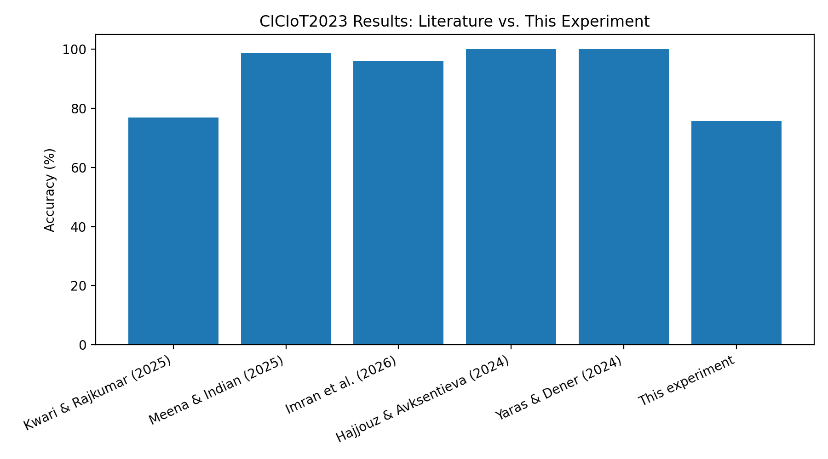
7. Comparison with State of the Art
Published CICIoT2023 results provide context, but task definitions differ
WHY THE GAP?
Literature reports up to 99.995% on binary or simplified tasks, while this experiment uses 8 classes.
NOT APPLES-TO-APPLES
Label granularity, sample size, rebalancing and train/test design strongly affect reported accuracy.
PROJECT VALUE
The contribution is a controlled comparison of seven deep models under one experiment, rather than a claim of SOTA accuracy.
Deep Learning Project • IoT Intrusion Detection • Manipal University Jaipur
8

Slide 9
8. Key Findings, Limitations & Future Scope
What the experiment tells us — and what it does not
KEY FINDINGS
LIMITATIONS
FUTURE SCOPE
• 1D CNN ranks first on all reported predictive metrics.
• Base DNN offers a strong efficiency alternative.
• Regularisation variants did not improve test accuracy.
• LSTM and Transformer underperformed here despite higher computational cost.
• Results are tied to the supplied 8-class experiment.
• No claim of production readiness.
• Literature comparisons use different setups.
• No adversarial or cross-dataset validation in this experiment.
• Class-imbalance-aware training
• Cross-dataset testing
• Explainability with SHAP/LIME
• Adversarial robustness
• Edge deployment and latency benchmarking
CENTRAL TAKEAWAY
For this experiment, 1D CNN provides the best predictive performance, while DNN-based models provide much lower training cost. The practical choice depends on the required accuracy–efficiency balance.
ACCURACY RANKING
1D CNN 75.74% › DNN 75.30% › Dropout 75.21% › Proposed DNN 74.46% › DNN+L2 73.88% › Transformer 63.90% › LSTM 54.58%
Deep Learning Project • IoT Intrusion Detection • Manipal University Jaipur
9

Slide 10
Conclusion
• The project demonstrates how deep learning architectures can be systematically compared for IoT intrusion detection.
• Across the supplied experiment, 1D CNN achieved the highest accuracy (75.74%), precision (64.94%), recall (70.49%), F1 (63.77%) and specificity (96.55%).
• DNN + L2 was the fastest model to train at 27.66 seconds, while the Transformer required 889.91 seconds.
• Literature evidence shows that very high CICIoT2023 accuracy is strongly dependent on task definition, class granularity and balancing strategy.
• The most meaningful next step is robust, imbalance-aware and cross-dataset evaluation rather than chasing small gains in headline accuracy.
THANK YOU
Questions & Discussion
Deep Learning Project • IoT Intrusion Detection • Manipal University Jaipur
10

