Slide 1
Semantic Parsing via Staged Query Graph Generation: Question Answering with Knowledge Base
Scott Wen-tau Yih Ming-Wei Chang, Xiaodong He, Jianfeng Gao

Slide 2
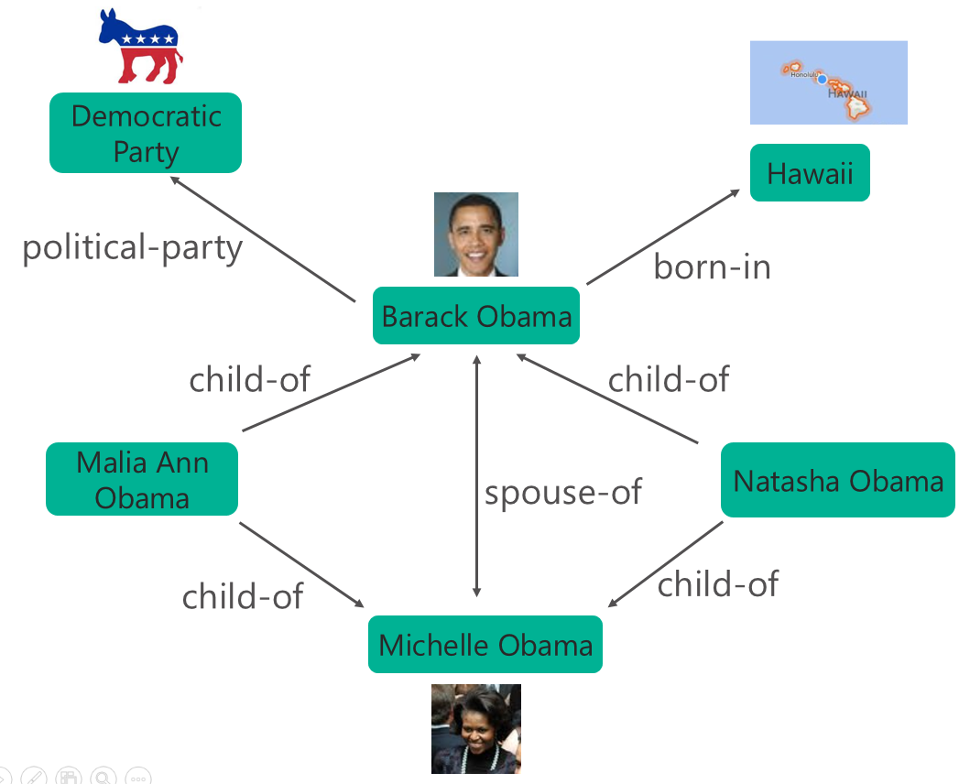

Question Answering with Knowledge Base
Large-scale Knowledge Base
Properties of billions of entities
Plus relations among them
Question Answering
“What are the names of Obama’s daughters?”
$λx.parent\left(Obama,x\right)∧gender(x,Female)$
Freebase
DBpedia
YAGO
NELL
OpenIE/ReVerb
Microsoft Satori

Slide 3
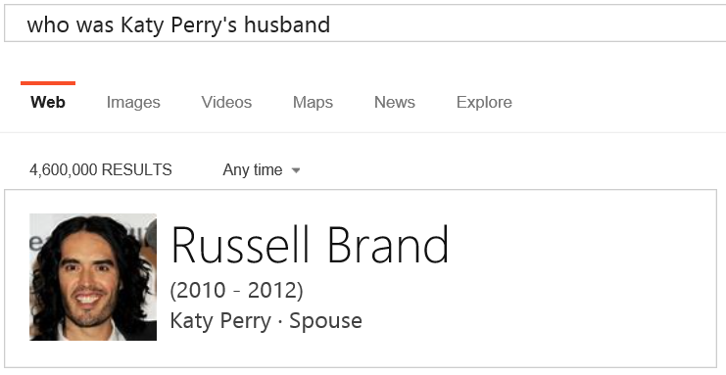
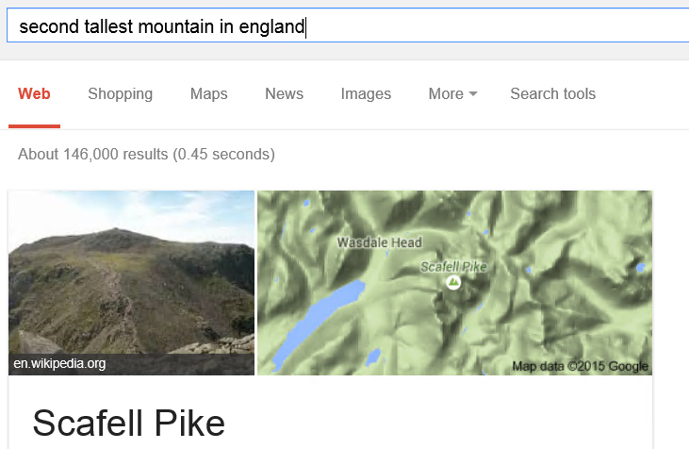
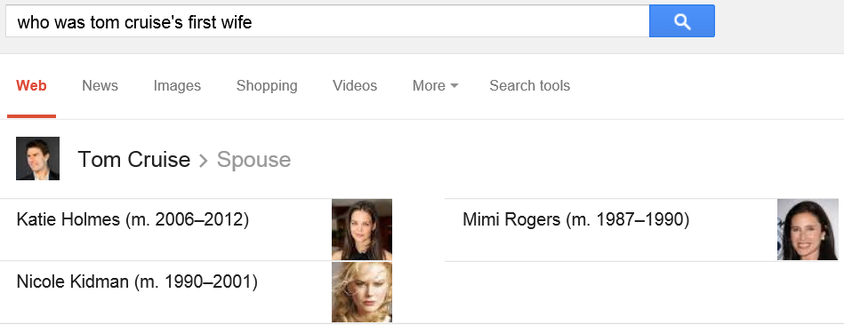
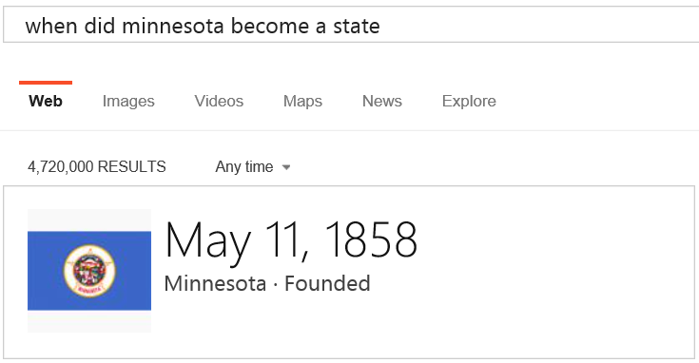
Search Engine $→$ QA Engine

Slide 4

Generic Semantic Parsing (e.g., [Kwiatkowski+ 13])
Who is Justin Bieber’s sister?
Jazmyn Bieber
semantic parsing
Knowledge Base
$$λx. \text{sister}\text{_}\text{o}\text{f}\text{(}\text{justin}\text{_}\text{bieber}\text{,} x\text{)}$$
query
matching
$$λx.\text{sibling}\text{_}\text{of}\text{(}\text{justin}\text{_}\text{bieber}\text{, }\text{x}\text{)}∧\text{gender}\text{(}\text{x}\text{, }\text{female}\text{)}$$

Slide 5
KB-Specific Semantic Parsing (e.g., [Berant+ 13])
Who is Justin Bieber’s sister?
Jazmyn Bieber
Knowledge Base
semantic parsing
query
$$λx. \text{sibling}\text{_}\text{of}\text{(}\text{justin}\text{_}\text{bieber}\text{, }\text{x}\text{)}∧\text{gender}\text{(}\text{x}\text{, }\text{female}\text{)}$$

Slide 6
Key Challenges
Language mismatch
Lots of ways to ask the same question
“What was the date that Minnesota became a state?”
“When was the state Minnesota created?”
“Minnesota's date it entered the union?”
Need to map them to the predicate defined in KB
location.dated_location.date_founded
Large search space
Some Freebase entities have >160,000 immediate neighbors
Compositionality

Slide 7
Staged Query Graph Generation Basic idea
Query graph
Resembles subgraphs of the knowledge base
Can be directly mapped to a logical form in 𝜆-calculus
Semantic parsing
A search problem that grows the graph through staged state-actions

Slide 8
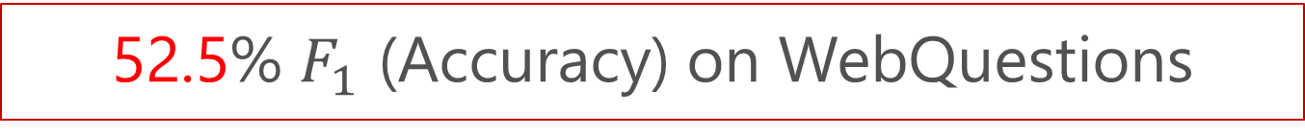
Staged Query Graph Generation Addresses Key Challenges
Language mismatch
Advanced entity linking
Relation matching via deep convolutional NN
Large search space
Representation power of a parse controlled by staged search actions
Grounding partially the utterance during search
Compositionality
Possible combinations limited by local subgraphs
52.5% $F_{1}$ (Accuracy) on WebQuestions

Slide 9
Outline
Introduction
Background
Graph knowledge base
Query graph
Staged Query Graph Generation (Our Approach)
Experiments
Conclusion

Slide 10
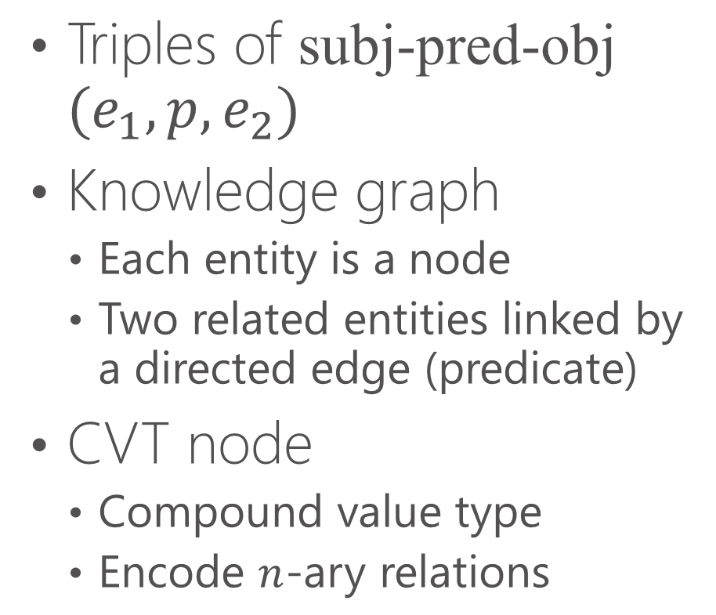
Knowledge Base
Triples of subj-pred-obj $(e_{1},p, e_{2})$
Knowledge graph
Each entity is a node
Two related entities linked by a directed edge (predicate)
CVT node
Compound value type
Encode $n$-ary relations

Slide 11
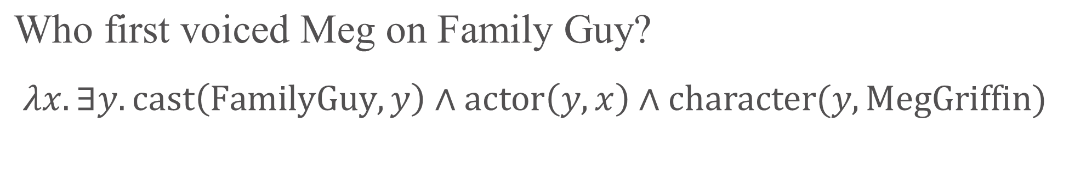
Query Graph
Who first voiced Meg on Family Guy?
$$λx. ∃y. cast\left(\text{FamilyGuy}, y\right)∧actor\left(y,x\right)∧character(y, MegGriffin)$$
constraints
topic entity
core inferential chain
Inspired by [Reddy+ 14], but closer to $λ$-DCS [Liang 13]

Slide 12
Outline
Introduction
Background
Staged Query Graph Generation (Our Approach)
Link topic entity
Identify core inferential chain
Augment constraints
Experiments
Conclusion

Slide 13
Staged Query Graph Generation
A search problem with staged states and actions
Who first voiced Meg on Family Guy?
(1) Link Topic Entity

Slide 14
Staged Query Graph Generation
Who first voiced Meg on Family Guy?
(2) Identify Core Inferential Chain

Slide 15
Staged Query Graph Generation
Who first voiced Meg on Family Guy?
(3) Augment Constraints

Slide 16
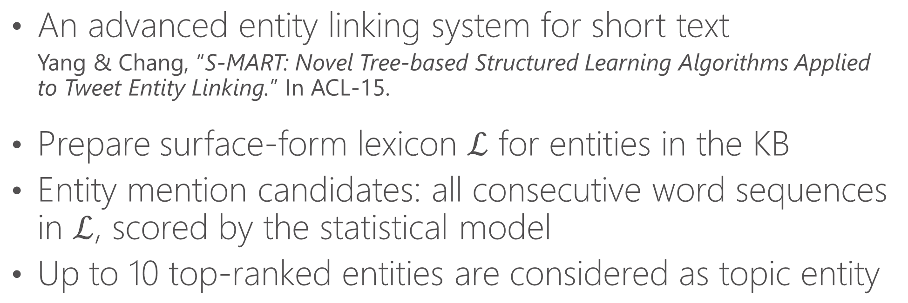
Link Topic Entity
An advanced entity linking system for short text
Yang & Chang, “S-MART: Novel Tree-based Structured Learning Algorithms Applied to Tweet Entity Linking.” In ACL-15.
Prepare surface-form lexicon $ℒ$ for entities in the KB
Entity mention candidates: all consecutive word sequences in $ℒ$, scored by the statistical model
Up to 10 top-ranked entities are considered as topic entity

Slide 17

Identify Core Inferential Chain
Relationship between topic and answer ($x$) entities
Explore two types of paths
Length 1 to non-CVT node
Length 2 where $y$ can be grounded to CVT
Who first voiced Meg on Family Guy?
$$\{\text{cast}\text{−}\text{actor}\text{, }\text{writer}\text{−}\text{start}\text{, }\text{genre}\}$$

Slide 18
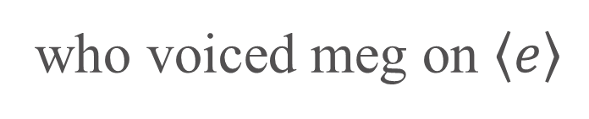


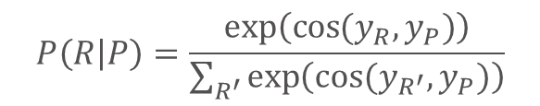

Relation Matching using Deep Convolutional Neural Networks (DSSM [Shen+ 14])
Input is mapped to two $k$-dimensional vectors
Probability is determined by softmax of their cosine similarity
$$P\left(R | P\right)=\frac{exp⁡\left(\cos{(y_{R},y_{P})}\right)}{\sum_{R^{′}}{\exp\left(cos⁡(y_{R^{′}},y_{P})\right)}}$$
$$y_{P}∈R^{k}$$
$$y_{R}∈R^{k}$$
who voiced meg on $\left\langle e\right\rangle$
$$\text{cast}\text{−}\text{actor}$$

Slide 19
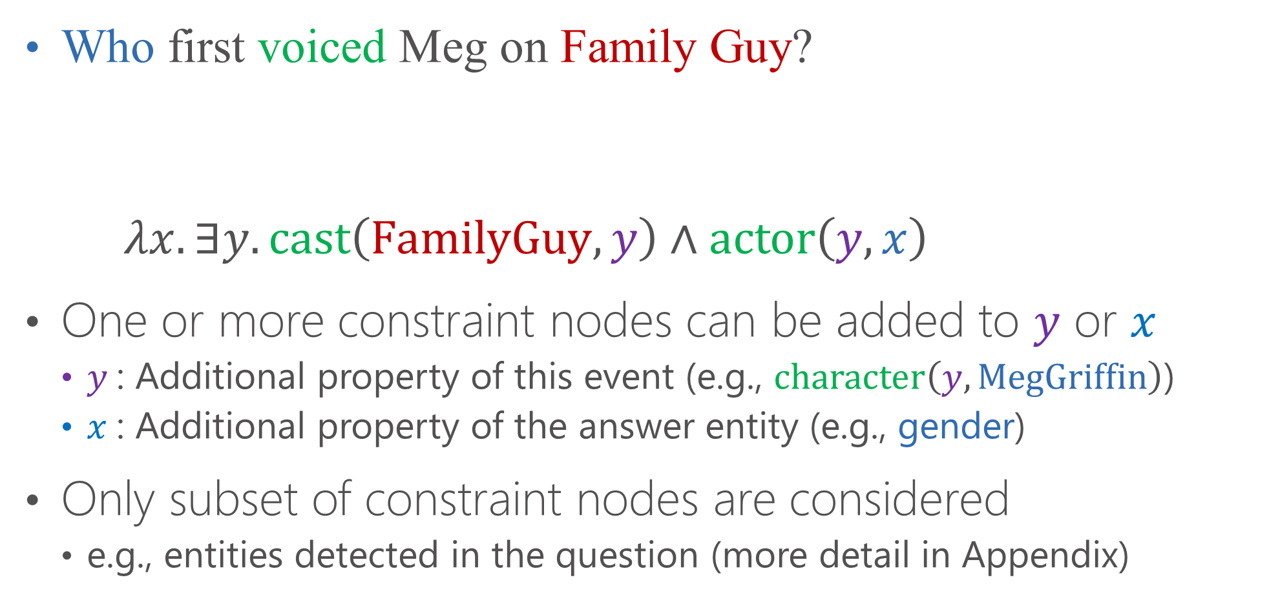
Augment Constraints
Who first voiced Meg on Family Guy?
$λx. ∃y. cast\left(\text{FamilyGuy}, y\right)∧actor\left(y,x\right)$
One or more constraint nodes can be added to $y$ or $x$
$y$: Additional property of this event (e.g., $character\left(y,\text{MegGriffin}\right)$)
$x$: Additional property of the answer entity (e.g., gender)
Only subset of constraint nodes are considered
e.g., entities detected in the question (more detail in Appendix)

Slide 20



Learning Reward Function $γ$
Judge whether a query graph is a correct semantic parse
Log-linear model with pairwise ranking objective [Burges 10]
Who first voiced Meg on Family Guy?
$$γ\left( \right)$$
$$>$$
$$γ\left( \right)$$

Slide 21

Learning Reward Function $γ$
Judge whether a query graph is a correct semantic parse
Log-linear model with pairwise ranking objective [Burges 10]
Who first voiced Meg on Family Guy?
$$γ\left( \right)$$
$$>$$
$$γ\left( \right)$$

Slide 22
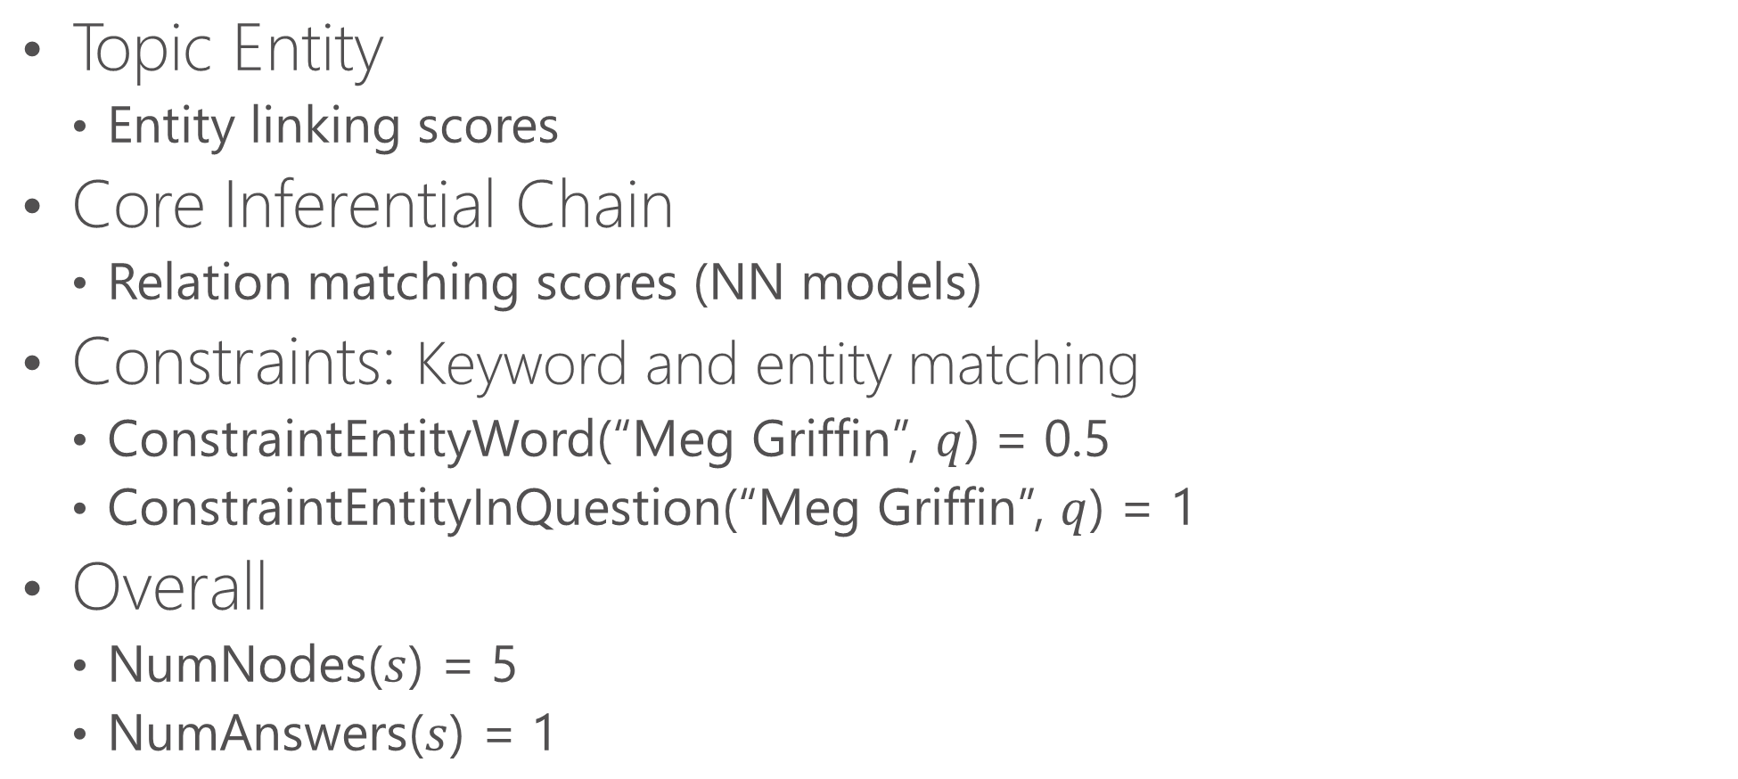

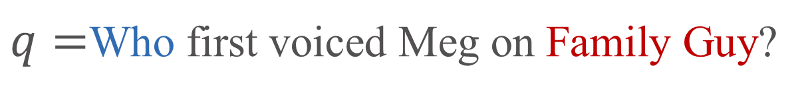
Learning Reward Function – Features
$q=$Who first voiced Meg on Family Guy?
Topic Entity
Entity linking scores
Core Inferential Chain
Relation matching scores (NN models)
Constraints: Keyword and entity matching
ConstraintEntityWord(“Meg Griffin”, $q$) = 0.5
ConstraintEntityInQuestion(“Meg Griffin”, $q$) = 1
Overall
NumNodes($s$) = 5
NumAnswers($s$) = 1
$$s=$$

Slide 23
Outline
Introduction
Background
Staged Query Graph Generation (Our Approach)
Experiments
Data & evaluation metric
Creating training data from Q/A pairs
Results
Conclusion

Slide 24
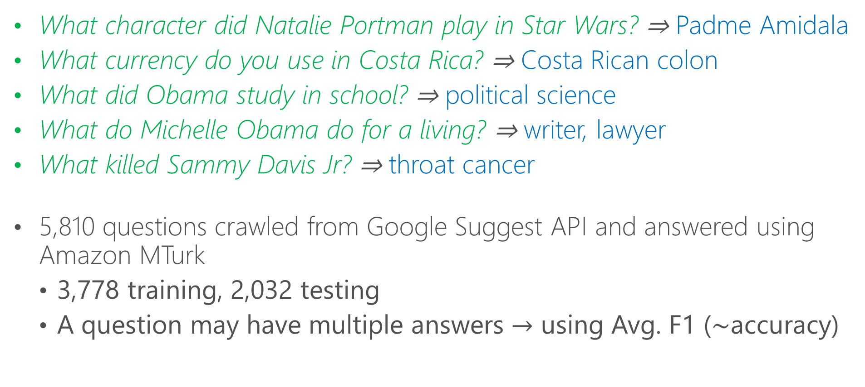
WebQuestions Dataset [Berant+ 13]
What character did Natalie Portman play in Star Wars? ⇒ Padme Amidala
What currency do you use in Costa Rica? ⇒ Costa Rican colon
What did Obama study in school? ⇒ political science
What do Michelle Obama do for a living? ⇒ writer, lawyer
What killed Sammy Davis Jr? ⇒ throat cancer
5,810 questions crawled from Google Suggest API and answered using Amazon MTurk
3,778 training, 2,032 testing
A question may have multiple answers $→$ using Avg. F1 ($\sim$accuracy)
[Examples from Berant]

Slide 25
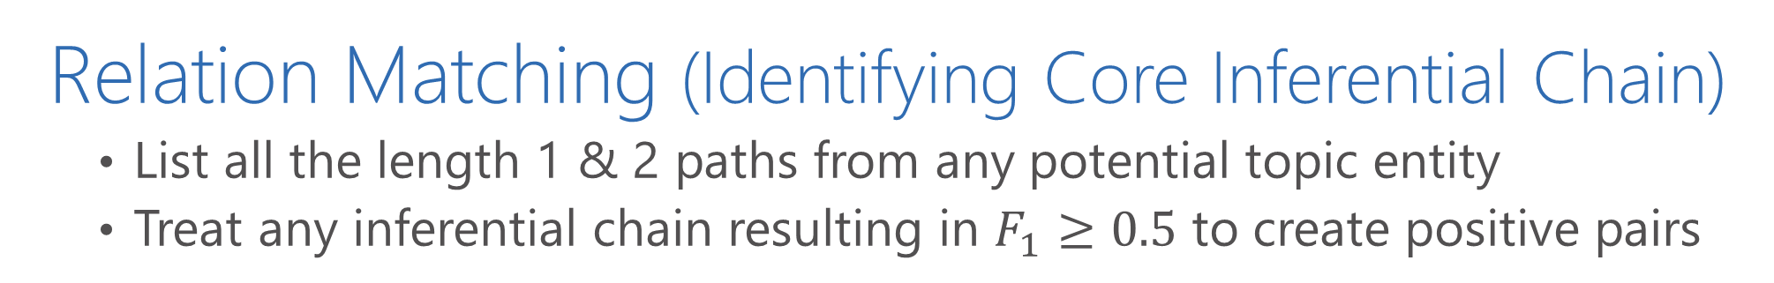
Creating Training Data from Q/A Pairs
Relation Matching (Identifying Core Inferential Chain)
List all the length 1 & 2 paths from any potential topic entity
Treat any inferential chain resulting in $F_{1}≥0.5$ to create positive pairs
Pattern | Inferential Chain
what was <e> known for | people.person.profession
what kind of government does <e> have | location.country.form_of_government
what year were the <e> established | sports.sports_team.founded
what city was <e> born in | people.person.place_of_birth
what did <e> die from | people.deceased_person.cause_of_death
who married <e> | people.person.spouse_s people.marriage.spouse

Slide 26

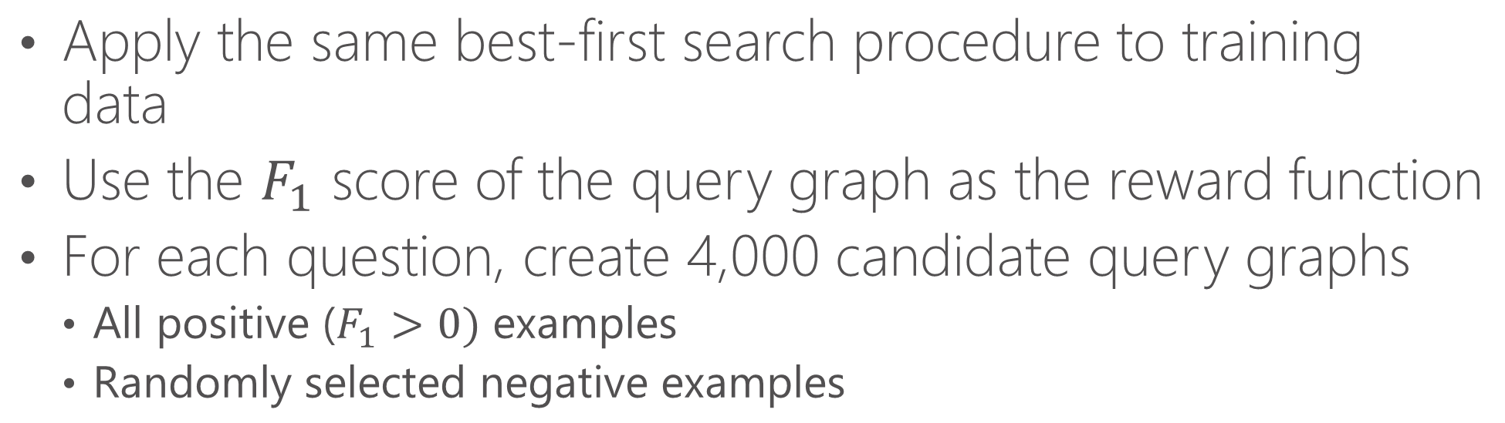
Creating Training Data from Q/A Pairs Reward Function $γ$
Apply the same best-first search procedure to training data
Use the $F_{1}$ score of the query graph as the reward function
For each question, create 4,000 candidate query graphs
All positive ($F_{1}>0)$ examples
Randomly selected negative examples

Slide 28
Contribution from Entity Linking
Statistics of entity linking results on training set questions
Method | #Entities | Covered Ques. | Labeled Ent.
Freebase API | 19,485 | 98.8% | 81.2%
Yang & Chang, ACL-15 | 9,147 | 99.8% | 87.8%
$F_{1}$ drops from 52.5% to 48.4% when using Freebase API

Slide 29
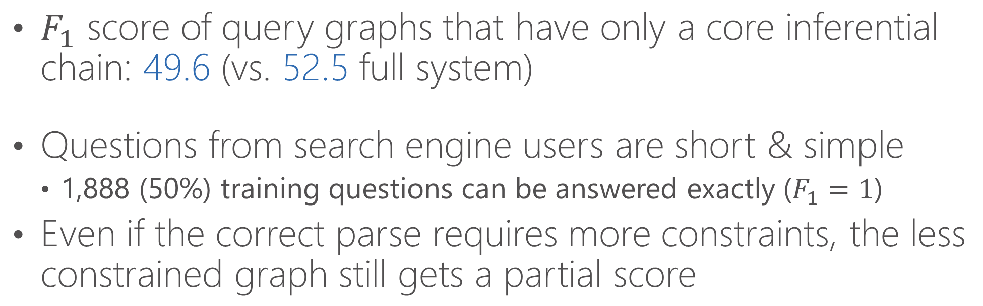
Contribution from Relation Matching
$F_{1}$ score of query graphs that have only a core inferential chain: 49.6 (vs. 52.5 full system)
Questions from search engine users are short & simple
1,888 (50%) training questions can be answered exactly ($F_{1}=1$)
Even if the correct parse requires more constraints, the less constrained graph still gets a partial score

Slide 30
Error Analysis
A random sample of 100 incorrectly answered questions
Label issues (34%)
Label error (2%)
Incomplete labels (17%, e.g., “What songs did Bob Dylan write?”)
Acceptable answers (15%, e.g., “Time in China” vs. “UTC+8”)
Incorrect entity linking (8%)
Incorrect inferential chain (35%)
Incorrect/Missing constraints (23%)

Slide 31
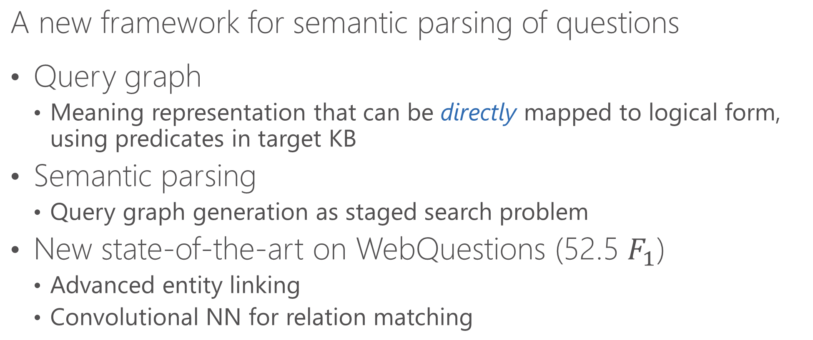
Conclusions (1/2)
A new framework for semantic parsing of questions
Query graph
Meaning representation that can be directly mapped to logical form, using predicates in target KB
Semantic parsing
Query graph generation as staged search problem
New state-of-the-art on WebQuestions (52.5 $F_{1}$)
Advanced entity linking
Convolutional NN for relation matching

Slide 32
Conclusions (2/2)
Future Work
Improve the current system
Matching relations more accurately
Handling constraints in a more principled way
Joint structured-output prediction model (e.g., SEARN [Daumé III 06])
Extend the query graph to represent more complicated questions
Data & Resource
Sent2Vec (DSSM) http://aka.ms/sent2vec
System output http://aka.ms/codalab-webq
Intermediate files (e.g., entity linking, model files, training data, etc.) will be released soon http://aka.ms/stagg

