Slide 1
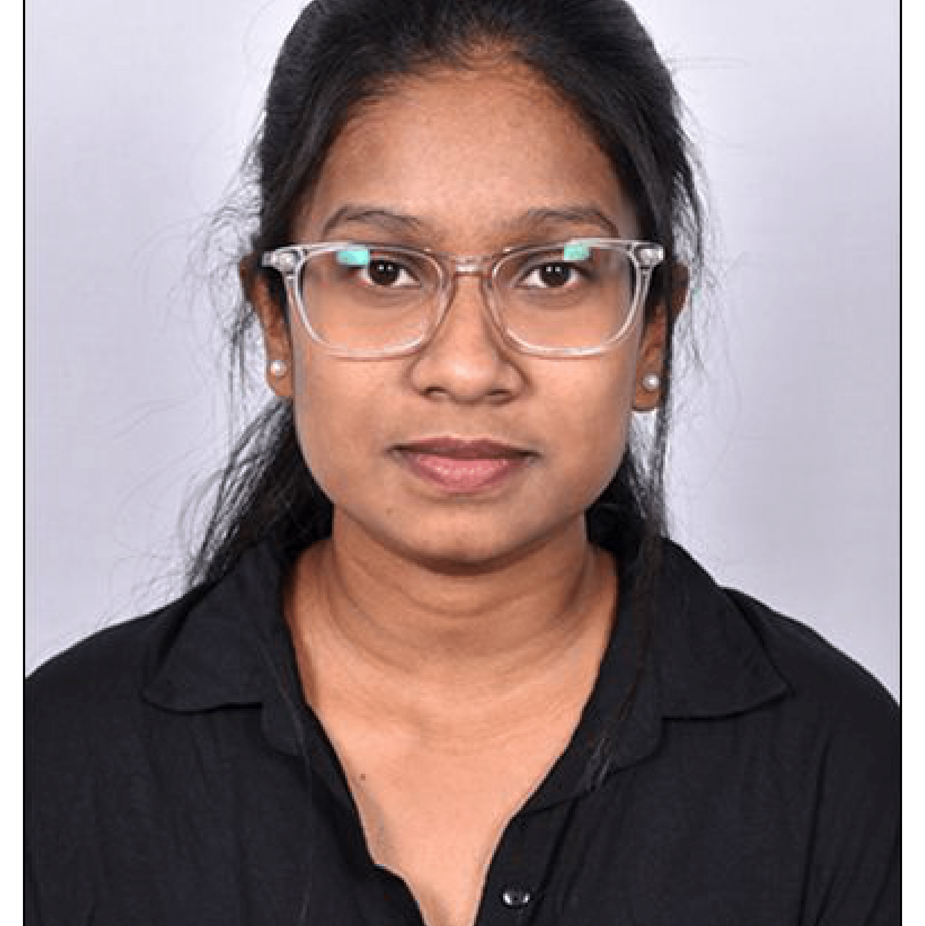


NAMRATA NAIK
Analyst/Software Engineer
Bachelor of Technology
Computer Science & Engineering: 2016-2020
Skills Java 8
Spring Boot
Spring Core
Backend
Spring Boot
Spring Core
Rest API
Database
SQL database
PostgreSQL
mongoDB
Web Technologies
HTML5
CSS3
Javascript,ES6
Bootstrap
AddOns
Github
Gradle
Swagger,Eclipse
Additional Details
Leadership
Proficient Communication
Team player
Mumbai
namrata.a.naik@capgemini.com
91 7008406906
A4
Ready to learn new technologies and implement them to further improve of my skill and knowledge.
Has working knowledge on Sql, React and Java Development using Spring framework on an intermediate level.
Software Engineer who is Strong in design and integration with intuitive problem-solving skills. Passionate about implementing and launching new projects.
e-Vehicle-Service and Enquiry system
Created a Enquiry management system with spring boot as backend along with swagger for testing .
React as frontend, used HTML5 ,CSS ,ES6 and bootstrap for designing responsive web pages .
https://github.com/namrata44/UpdatedResume.git

