Slide 1


AngularJS
December 2014
This document is confidential and contains proprietary information, including trade secrets of CitiusTech. Neither the document nor any of the information contained in it may be reproduced or disclosed to any unauthorized person under any circumstances without the express written permission of CitiusTech.

Slide 2
Agenda
Introduction To AngularJS
Controllers
Modules
Services
Filters
Routing
Custom Directive
Sending Ajax Request
Unit Testing

Slide 3
Agenda - Introduction To AngularJS
History
Single Page Application
Key Challenges Before AngularJS
What is AngularJS
AngularJS Complete Client Side Solution
AngularJS Core Design Principles
AngularJS Core Building Blocks
Simple HelloWorld Example

Slide 4
History
This slide depicts overall journey of web applications - from server-side frameworks to client-side frameworks:
Traditional web application architecture using ASP.net , JSP
Wide use of server side frameworks
Focus shifted from server to client - JavaScript
Need for rich Application UI
Use of AJAX
Jquery - Scripts which can run on all browsers unifomly
Introduction to SPA
Client side frameworks - AngularJs
Notes:
Traditional web application architecture:
In traditional web applications html was sent in response object from server to client and then rendered by browser.
For each request sent from client to server, targeted resource was executed at server generating resultant html. This resultant html was added to response object and sent back by server to client browser which then rendered it.
Thus, All template html was generated and sent from server side to client.
Server side frameworks:
As amount of code on server-side increased it became necessary to manage code efficiently thus different frameworks like Spring, Struts came
into picture which brought good design principles like MVC etc. along with them resulting in loosely coupled code.
JavaScript:
Html was static (can’t be executed and generate result at runtime) but javascript supported along with html by browsers made dynamic generation
Of web page (on client side) possible
People started using JavaScript along with html on client side initially for basic validation thus avoiding round trip to server atleast for basic validation.
Later they started using javascript for doing DOM manipulation, coding etc. and thus amount of web application code started shifting slowly
from server slide towards client side
Still, for every change in state of web page resulted in request- response cycle and thee entire web page needed to be reloaded
This took time and user UI experience was poor
Ajax:
With introduction of Ajax (asynchronous request), entire web page reload was no longer needed and it became possible to refresh part of the webpage with response
Jquery:
Coding with javascript was still tiresome.Script had to be checked/tested/debugged in all browsers for overall output uniformity.Workaround had to be designed wherever specific javascript feature was not supported by browser.
Jquery library came with wrapper around javascript with easy to use functions and functions that gave uniform output in all browsers.
It also introduced powerful selector with which DOM Manipulation became easy.Making Ajax calls became very easy with few lines of code
SPA (Single Page Application):
Tradition web application html pages/snippets were generated on server side and sent to client.
Overall navigation logic of web application was coded on server side.All hyperlinks on webpages were routed to server side to some resource or
Html templates. All html templates were generated from server side.
Every web application link routed to server resulted in new html page being loaded in the browser starting from home page to sigin,login page etc…
In Single page application there is only one page for entire apllication. All hyperlinks like sigin,login on main page route to html templates
kept on client side. Entire navigation flow is coded on client side with pure client side routes and client side resultant html templates.
Instead of loading entire html template into the browser just the resultant html snippet on that template is loaded onto the main page.
Thus all hyperlinks on Single Page app result in html snippets being loaded into view part of the same main page.
Because all html templates are on client side and routing is entirely done on client side. The overall speed of web application is much much faster
Client side frameworks:
As people started coding lot of code on client side it became necessary to manage client side code efficiently.
There came a need of loosely coupled code which was easy to change and maintain in future.Good
Design principle like Separation Of Concern became necessity. This resulted in intorduction of many client
side frameworks.One of these client side frameworks is ANgularJS

Slide 5
Agenda - Introduction To AngularJS
History
Single Page Application
Key Challenges Before AngularJS
What is AngularJS
AngularJS Complete Client Side Solution
AngularJS Core Design Principles
AngularJS Core Building Blocks
Simple HelloWorld Example

Slide 6
Single Page Applications (SPA) – Before SPA
Traditional client - server application
Full page refresh cycle with GET/POST request to server
Uses server side routing with navigation between pages via server (servlet controller)
All resultant html snippets/templates generated from server side
Traditional web applications had many web pages, every hyperlink on home page loaded new web page in the browser
Redundant loading of libraries on every new page load
High amount of network traffic(data flow between UI & server)

Slide 7
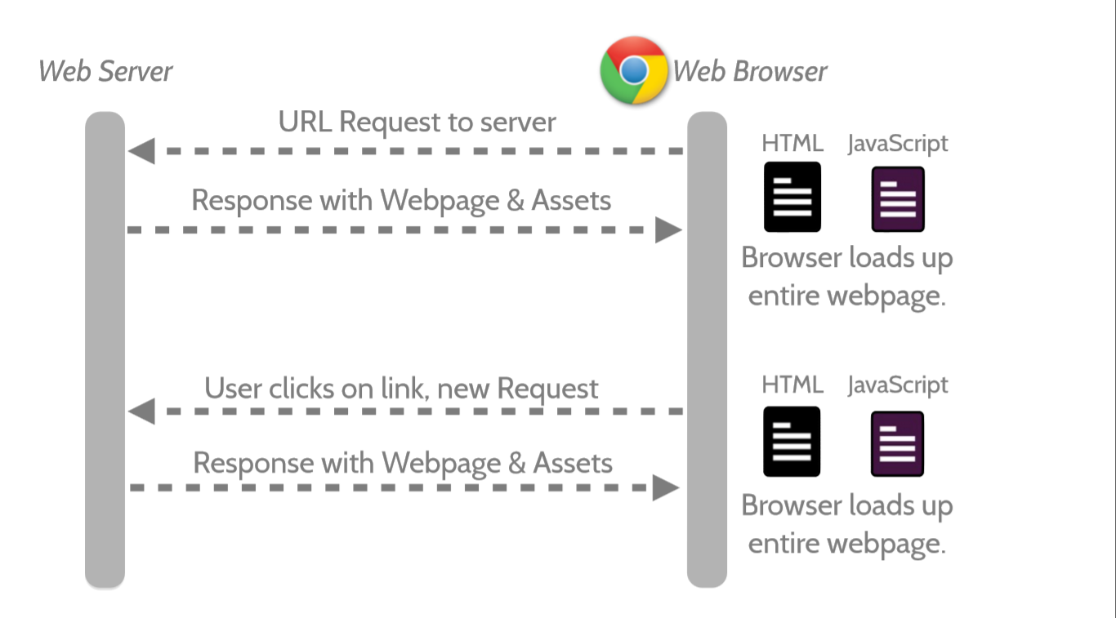
Traditional Page Refresh – Before SPA

Slide 8
Single Page Application (SPA) – What is SPA?
A single-page application (SPA), is a web application that fits on a single web page.
It provides a more fluid user experience akin to a desktop application
Uses client side routing with navigation logic coded on client side
Round trip to the server for every request is avoided, as all view related logic and html templates are present at client side only.
Every hyperlink on home/main page of SPA just loads new html template onto the main page
All libraries on main page are loaded only once at the start.
Less amount of network traffic (data flow to & from Clientside UI-components)

Slide 9
Agenda - Introduction To AngularJS
History
Single Page Application
Key Challenges Before AngularJS
What is AngularJS
AngularJS Complete Client Side Solution
AngularJS Core Design Principles
AngularJS Core Building Blocks
Simple HelloWorld Example

Slide 10
Key Challenges Before AngularJS
Manipulating Html DOM programmatically - Writing lot of code to fetch data from DOM elements and updating the DOM
Boilerplate code just to get started (e.g. Ajax)
Messy Code resulting from nested call-backs and registering call-backs
No clear cut division of responsibility resulting in tight coupling between:
View and Presentation logic & Model data
Hard coding of component dependencies resulting in tight coupling between:
Presentation logic and Service layer components
Notes:
http://www.agilethought.com/blog/articles/how-to-think-angularjs-in-a-jquery-world
Jquery callback explain -

Slide 11
Agenda - Introduction To AngularJS
History
Single Page Application
Key Challenges Before AngularJS
What is AngularJS
AngularJS Complete Client Side Solution
AngularJS Core Design Principles
AngularJS Core Building Blocks
Simple HelloWorld Example

Slide 12
What is AngularJS
Open source JS framework by Google & community
AngularJS is one core library
Supports creation of SPA
Gives MV* capability to browser-based single page web application
Good design principles that makes development and testing easier
Can do mind-boggling things in just few lines of code

Slide 13
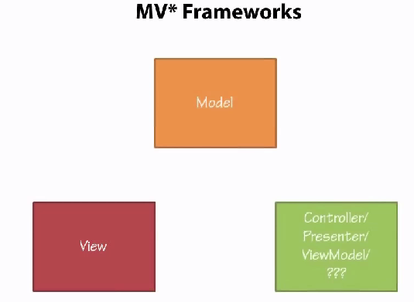
What is AngularJS - MV* Framework

Slide 14
Agenda - Introduction To AngularJS
History
Single Page Application
Key Challenges Before AngularJS
What is AngularJS
AngularJS Complete Client Side Solution
AngularJS Core Design Principles
AngularJS Core Building Blocks
Simple HelloWorld Example

Slide 15
AngularJS Complete Client Side Solution
Before AngularJS, you would have used
With AngularJS, none of these libraries are needed as Angular provides support for all the above features.
Angular comes with a lightweight version of jQuery called jQLite
Clean and easy to use syntax
Feature | Library
Client-based routing | BackboneJS, Sammy JS
DOM Manipulation | jQuery
Two way binding | KnockoutJS

Slide 16
Agenda - Introduction To AngularJS
History
Single Page Application
Key Challenges Before AngularJS
What is AngularJS
AngularJS Complete Client side Solution
AngularJS Core Design Principles
AngularJS Core Building Blocks
Simple HelloWorld Example

Slide 17
AngularJS Core Design Principles (1/6)
AngularJs works on following core design principles:
Two way data-binding
Separation Of Concern
Declarative approach – extends Html vocabulary by using directives
Dependency Injection (DI)

Slide 18
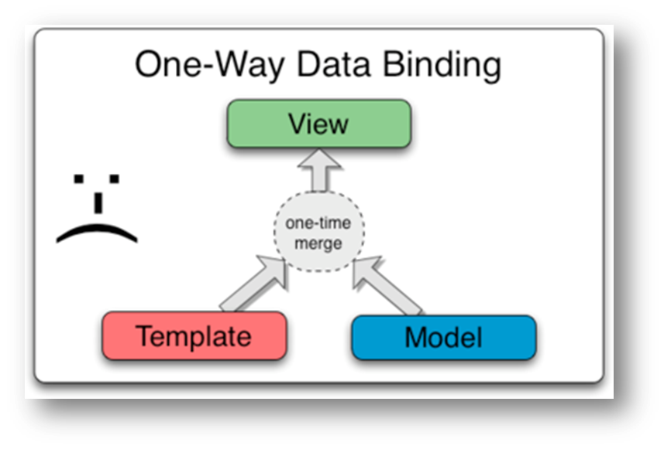
AngularJS Core Design Principles (2/6)
One-way or Classical data binding before AngularJS:
One way data binding merges the template and model components together into a view.
View or Model are not updated automatically when the View or Model is changed
Developer have to write extra code to sync the View and Model

Slide 19
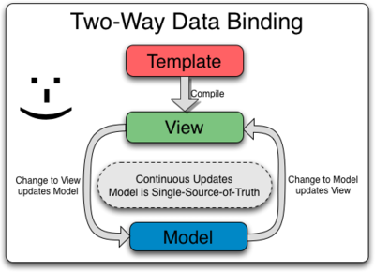
AngularJS Core Design Principles (3/6)
Two-way data binding:
Two way data binding is the core of Angular’s magical spell
View is updated automatically when the Model is changed
Model is updated automatically when the value in the view has changed

Slide 20
AngularJs Core Design Principle (4/6)
Separation Of Concerns:
Software systems must be decomposed into parts such as modules as much as possible.
In AngularJS, the code can be broken down into components like controllers, views, models, and services.
One doesn’t need to write much code for DOM manipulation
AngularJS makes the code more clearer
Client side
Client Side
controller
Server side
Controller Function
View
Model and presentation logic
Web service
Angular ajax call
Service
Notes:
http://victorblog.com/2013/03/18/angularjs-separation-of-concerns/
There is decoupling between view and controller as well as controller and service. Thus we are achieving goal of separation of concern.

Slide 21
AngularJs Core Design Principle (5/6)
Declarative Approach – extends Html vocabulary by using directives:
Declarative approach directs Angular what should be done on our behalf instead of we explicitly coding for it.
We use Angular directives to tell Angular what has to be done
Directives are used as attributes of html element inside html page
<div id=“myid” ng-controller=“DemoController”></div>
ng-controller – is angular directive that tells angualr to instantiate the Controller function and inject dependencies to it.
<body ng-app>
ng-app – This directive auto-bootstraps angularjs application at body element
Directives handle everything automatically in the background, we need not code anything explicitly to get it done
Notes:
https://docs.angularjs.org/api/ng/directive/ngApp

Slide 22
AngularJs Core Design Principle (6/6)
Dependency Injection:
DI - object is given its dependencies, rather than the object creating them itself.
Avoids tight coupling with dependency creation logic by creating dependencies outside the application
Dependency is instantiated and injected by Angular when dependency name is mentioned as function argument inside controller or service function.
// ’calcService’ is dependency
module.controllerFunction(calcService) {
// once injected we can use it normal way invoking functions on it
calcService.add(3,5);
… }
It is possible to change dependency without breaking code that uses that dependency.
Allows injecting mock objects as dependencies in absence of actual dependency making unit testing easy
Angular has two important services which makes DI possible - $injector and $provide which we will see later.
Notes:
https://docs.angularjs.org/api/auto/service/$provide
https://docs.angularjs.org/api/auto/service/$injector

Slide 23
Agenda - Introduction To AngularJS
History
Single Page Application
Key Challenges Before AngularJS
What is AngularJS
AngularJS Complete Client Side Solution
AngularJS Core Design Principles
AngularJS Core Building Blocks
Simple HelloWorld Example

Slide 24
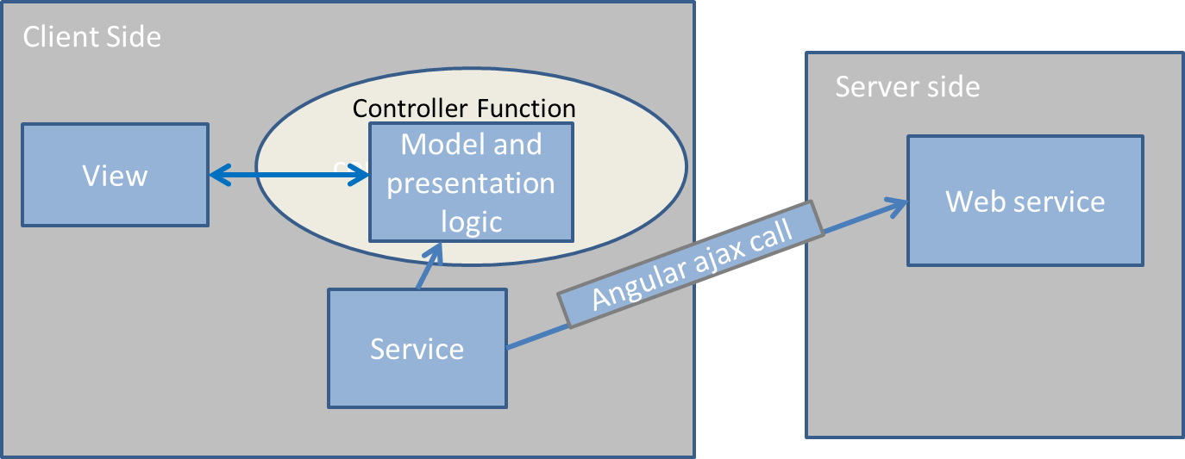
AngularJS Core Building Blocks
Model
View
Controller
Services
Modules
Filters

Slide 25
Agenda - Introduction To AngularJS
History
Single Page Application
Key Challenges Before AngularJS
What is AngularJS
AngularJS Complete Client Side Solution
AngularJS Core Design Principles
AngularJS Core Building Blocks
Simple HelloWorld Example

Slide 26
Simple HelloWorld Example
ng-app
Declarative way – function calls not needed like JQuery
Directives
ng-model
AngularJS API… Eg - ng-app: https://docs.angularjs.org/api/ng/directive/ngApp

Slide 27
Agenda
Introduction To AngularJS
Controllers
Modules
Services
Filters
Routing
Custom Directive
Sending Ajax Request
Unit Testing

Slide 28
Controllers - Agenda
Controller Introduction
Controller & $scope
Correct usage of controller
Controller Inheritance

Slide 29
Controller Introduction
Controller is a JavaScript constructor function used to wire up services, dependencies, etc. & assign them to the view via scope.
Use controllers to place the model data & business logic related to view
$scope is nothing but an object that glues the View with the Controller
$scope is a container for business data (i.e. all model data)
$scope can hold variables, functions, arrays, json, any form of business data
View
$scope
Controller
Notes:
Imagine you have included user information retrieval logic in both profile and Dashboard controller & you have to change something than you have to go and change in both controller but if we have user service than there is need to change at one place . Hence its easy to decouple logic.

Slide 30
Controller Introduction
$scope has the model data & its behaviour(functions)
Eg - function ContactController($scope) {
$scope.greet = function() { $scope.myname1 = "hi"+$scope.myname; }
}
ng-model – directive to indicate a model, available automatically in $scope
ng-controller – directive is used to define controller to be bound with the view
<div ng-controller="ContactController">
Greet: <input type="text" ng-model="myname"/>
<button ng-click="greet()">Greet</button>
<h2> {{ myname1 }} </h2>
</div>
When controller is attached to a DOM element using ng-controller directive, AngularJS will do the following:
Instantiate a new controller object using the controller’s constructor function
Instantiate and inject the $scope object inside the controller
Invoke the controller

Slide 31
Controllers - Agenda
Controller Introduction
Controller & $scope
Correct usage of controller
Controller Inheritance

Slide 32
Controller & $scope – adding initial state & behavior
The scope is used to expose the model to the view, but the scope is not the model. The model is the data that is put into the scope.
{{ .. }} expression is used to access the model value
Set up the initial state of a scope by attaching properties to the $scope object.
i.e. $scope.patientFirstName = "Test, Patient";
Add behavior to $scope by attaching method to it.
$scope.getFullName = function() { $scope.patient = $scope.patientFirstName +", "+ $scope.patientLastName; };
Execute controller method with angular directive like ng-click or by directly placing in angular bracket. i.e. {{ getFullName() }}

Slide 33
Controllers - Agenda
Controller Introduction
Controller & $scope
Correct Usage of Controllers
Controller Inheritance

Slide 34
Correct Usage of Controllers
Use controllers to:
Controller should not do too much, it should only contain the business logic used to represent single view.
Need to keep controller code as small as possible.
Refactor business logic into service instead of writing into controller & inject that service into the controller via dependency injection.
Do not use controllers to:
Manipulate DOM — Controllers should contain only business logic.
Putting any presentation logic into Controllers significantly affects its testability. Angular has data binding for most cases and directives to encapsulate manual DOM manipulation.
Format input — Use angular form controls instead.
Filter output — Use angular filters instead.
Share code or state across controllers — Use angular services instead.
Manage the life-cycle of other components
Notes:
http://kirkbushell.me/when-to-use-directives-controllers-or-services-in-angular/
Both controllers and view have reference to the scope, but not to each other. This arrangement isolates the controller from the view as well as from DOM.
During the template linking phase the directives set up watch expressions on the scope, that notify directives about any property changes, which allows the directive to render the updated value to the DOM.
Since, controllers are view agnostic, it greatly improves the testability of the applications.

Slide 35
Controllers - Agenda
Controller Introduction
Controller & $scope
Correct Usage of Controllers
Controller Inheritance

Slide 36
Controller Inheritance
Reusability in AngularJS
Reusability: Need to share common functionality across different parts of the application
There are different approaches to maximize code reuse and clarity:
Services: Move functionality into services, where it can be appropriately factored.
Custom Directives: Refactor repeated functionality into directives and aim for directive reuse.
Controller Inheritance: Create an inheritance hierarchy of page controllers and place common functionality in ancestor controllers.
All of these are valid approaches and can be mixed and matched to suit the scenario.
Two Approaches to AngularJS Controller Inheritance
Controller Inheritance by nesting of scopes
Controller Inheritance via $injector

Slide 37
Controller Inheritance by Nesting of Scopes
<body ng-app>
<div ng-controller=“GenralDoctorController">
My name is {{ name }} and I am a {{ type }}
<div ng-controller=“SpecialistDoctorController">
My name is {{ name }} and I am a {{ type }}
<div ng-controller=“TraineeDoctorController">
My name is {{ name }} and I am a {{ type }}
</div> </div> </div>
<script>
function GenralDoctorController($scope) {
$scope.name = ‘Rahul';
$scope.type = ‘General Doctor'; }
function SpecialistDoctorController($scope) {
$scope.type = ‘Specialist Doctor';
}
function TraineeDoctorController($scope) {
$scope.name = ‘Hemant';
$scope.type = ‘TraineeDoctor';
}
</script>
</body>

Slide 38
Controller Inheritance via $injector
<body ng-app>
<div ng-controller=“SpecialistDoctorController">
My name is {{ name }} and I am a {{ type }}
<button ng-click="clickme()">Click Me</button>
</div>
<script>
function GeneralDoctorController($scope) {
$scope.name = ‘Namrata';
$scope.type = ‘Genral Docotor';
$scope.clickme = function() { alert('This is parent controller “GeneralDoctorController" calling'); }
} function SpecialistDoctorController($scope, $injector) {
$injector.invoke(GeneralDoctorController, this, {$scope: $scope});
$scope.type = ‘Specialist Doctor’;
}
</script>
</body>

Slide 39
Agenda
Introduction To AngularJS
Controllers
Modules
Services
Filters
Routing
Custom Directive
Sending Ajax Request
Unit Testing

Slide 40
Modules - Agenda
Modules Introduction
What is a Module?
Why Modules?
Creating Modules
Creating component in a module
Inter-Module code access
Module Lifecycle
Module Loading & Dependencies
Notes:
https://github.com/jedrichards/angularjs-handbook

Slide 41
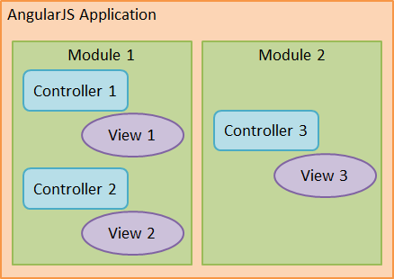
Modules Introduction
What is a Module in AngularJS?
A Module is a logical collection of application components like – controllers, services, filters, directives and configuration information.
Angular apps don't have a main method.
Instead of main method, Modules provide a mechanism for declaring how groups of app components should be configured and then bootstrapped
The reference to myApp module in <div ng-app="myApp"> bootstraps the app using your module.
They also provide a way for modules to declare dependencies on other modules.
Notes:
Modules do not attempt to solve the problem of script lazy loading or inter-script dependencies.

Slide 42
Modules Introduction
Why Modules?
Modules help to modularize large applications
Modules makes application more readable, maintainable
Modules keep the global namespace clean.
Modules helps to package code as reusable modules

Slide 43
Modules - Agenda
Modules Introduction
What is a Module?
Why Modules?
Creating Modules
Module Lifecycle
Module Loading & Dependencies
Creating component in a module
Inter-Module code access
Notes:
https://github.com/jedrichards/angularjs-handbook

Slide 44
Creating Modules
The angular.module is a global place for creating, registering and retrieving Angular modules.
Modules are created by defining the module name and an array of dependencies on other modules:
//create a ‘sampleApp’ module with dependant modules
var sampleApp = angular.module('sampleApp',[ 'appControllers', 'appServices‘ ]);
1st argument specify name of the module to be created and 2nd argument specify name of the dependant modules to be injected.
All modules (angular core or 3rd party) that should be available to an application must be registered using this mechanism.
// create a new module without dependant modules
var myModule = angular.module('myModule', []);
Once created, modules can be retrieved later on by just passing in a single parameter, the module name:
var mod = angular.module("products");

Slide 45
Modules - Agenda
Modules Introduction
What is a Module?
Why Modules?
Creating Modules
Creating component in a module
Inter-Module code access
Module Lifecycle
Module Loading & Dependencies
Notes:
https://github.com/jedrichards/angularjs-handbook

Slide 46
Creating a component in a module
//create a new module ‘demoApp’
var demoApp = angular.module('demoApp', []);
//create a controller in ‘demoApp’
demoApp.controller('SimpleController', function ($scope) {
$scope.customers = [
{ name: 'Dave Jones', city: 'Phoenix' },
{ name: 'Jamie Riley', city: 'Atlanta' },
{ name: 'Heedy Wahlin', city: 'Chandler' },
{ name: 'Thomas Winter', city: 'Seattle' }
];
});

Slide 47
Modules - Agenda
Modules Introduction
What is a Module?
Why Modules?
Creating Modules
Creating component in a module
Inter-Module code access
Module Lifecycle
Module Loading & Dependencies
Notes:
https://github.com/jedrichards/angularjs-handbook

Slide 48
Inter-Module code access
Module Dependencies
Modules can list other modules as their dependencies
var app = angular.module('myApp', ['ngRoute']);
In above declaration ‘myApp’ has dependent ‘ngRoute’ module
Config Blocks & Run blocks of dependent are loaded first hence ‘ngRoute’ will be loaded before ‘myApp’.
var app = angular.module('myApp1', [‘myApp2']);
In above declaration ‘myApp1’ module has dependency of myApp2 and myApp1 can access data and method of myApp2. This is called inter module data access.

Slide 49
Inter-Module code access
var app = angular.module('app1', []);
app.service('MathService', function() {
this.add = function(a, b) { return a + b };
this.multiply = function(a, b) { return a * b};
});
//’app1’ module injected as dependency
var a =angular.module('app2',['app1']);
a.controller('CalculatorController', function($scope, MathService) {
$scope.doSquare = function() {
$scope.answer = MathService.multiply($scope.number1,$scope.number1);
}
});
<div ng-app="app2">
<div ng-controller="CalculatorController">
Enter a number:
<input type="number" ng-model="number1" />
<button ng-click="doSquare()">X<sup>2</sup>
</button>
<div>Answer: {{answer}}</div>
</div>
</div>

Slide 50
Modules - Agenda
Modules Introduction
What is a Module?
Why Modules?
Creating Modules
Creating component in a module
Inter-Module code access
Module Lifecycle
Module Loading & Dependencies
Notes:
https://github.com/jedrichards/angularjs-handbook

Slide 51
Module Lifecycle
Modules have two distinct phases in their lifecycle:
The configuration phase - Constants are set and module components are registered and configured. Components can be registered in any order.
The run phase - Module components are instantiated and injected with dependencies as needed.
As you can see a reference to a constructor function for the component is attached to the module but it is not invoked.
angular.module("header“).service("navService",ConstructorFunction) .controller("HeaderCtrl",ConstructorFunction);
Modules are a way of managing $injector configuration, and have nothing to do with loading of scripts into a VM.
As modules do nothing at load time they can be loaded into the VM in any order and thus script loaders can take advantage of this property and parallelize the loading process.
Notes:
There are existing projects which deal with script loading, which may be used with Angular for e.g.: RequireJS
http://weblogs.asp.net/dwahlin/dynamically-loading-controllers-and-views-with-angularjs-and-requirejs

Slide 52
Modules - Agenda
Modules Introduction
What is a Module?
Why Modules?
Creating Modules
Creating component in a module
Inter-Module code access
Module Lifecycle
Module Loading & Dependencies
Notes:
https://github.com/jedrichards/angularjs-handbook

Slide 53
Module Loading & Dependencies (1/3)
Configuration blocks
Angular executes blocks of configuration during the provider registration and configuration phases in the bootstrapping of the module.
It contains code to be run only during the configuration phase.
We can only inject and configure providers and constants into config block.
We can define multiple configuration block for a module
Angular runs functions in the order in which they are written and registered
Config block:
angular.module('myModule', []).
config(function (injectables) { // provider-injector
// This is an example of config block.
// You can have as many of these as you want.
// You can only inject Providers (not instances)
// into config blocks.
})
Example:
angular.module('myApp', [])
.config(function ($provide, $compileProvider) {
$provide.factory('myFactory', function () {
var service = {};
return service;
});
$compileProvider.directive('myDirective',
function () {
return { template: '<button>Click me</button>'
}
})
});
Notes:
Configuration
In particular, it’s also important to note that Angular runs these functions in the order in which they are written and registered. That is to say that we cannot inject a provider that has not yet been defined.
The only exception to the rule of in-order definitions is the constant() method. We always place these at the beginning of all configuration blocks.
When writing configuration for a module, it’s important to note that there are only a few types of objects that we can inject into the .config() function: providers and constants. If we inject any old service into a .config() function, then we might accidentally instantiate one before we actually configure it.
The by-product of this strict requirement for configurable services is that we can only inject custom services that are built with the provider() syntax and cannot inject other services.
For more information on how to build with the provider syntax, head over to the services chapter.
These .config() blocks are how we’ll custom configure our own services, such as setting API keys and custom URLs.

Slide 54
Module Loading & Dependencies (2/3)
Run blocks
It contains code to be run after the configuration phase but before the module at large kicks into gear.
This is where you can bootstrap your app if required.
Run blocks are the closest thing in Angular to the main method.
The run block is code that is typically hard to unit test and is related to the general app.
Run blocks are places where we’ll set up event listeners that should happen at the global scale of the app.
For example, we’ll use the .run() block to set up listeners for routing events or unauthenticated requests.
Run block:
angular.module('myModule', [])
.run(function (injectables) { // instance-injector
// This is an example of a run block.
// You can have as many of these as you want.
// You can only inject instances (not Providers)
// into run blocks
});
Example:
angular.module('myApp', ['ngRoute'])
.run(function ($rootScope, AuthService) {
$rootScope.$on('$routeChangeStart',
function (evt, next, current) {
// If the user is NOT logged in
if (!AuthService.userLoggedIn()) {
if (next.templateUrl === "login.html") {
// Already heading to the login route so no need to redirect
} else {
$location.path('/login');
}
} }); });
Notes:
Let’s say that we want to run a function that validates that we have an authenticated user every time that we change our route.
The only logical place to set this functionality is in the run method

Slide 55
Module Loading & Dependencies (3/3)
There are some convenience methods on the module which are equivalent to the config block.
For example:
angular.module('myModule', []). value('a', 123)
.factory('a', function() { return 123; })
. directive('directiveName', ...)
. filter('filterName', ...);
// is same as
angular.module('myModule', [])
. config(function($provide, $compileProvider, $filterProvider)
{
$provide.value('a', 123);
$provide.factory('a', function() { return 123; }); $compileProvider.directive('directiveName', ...);
$filterProvider.register('filterName', ...);
});

Slide 56
Agenda
Introduction To AngularJS
Controllers
Modules
Directive
Services
Filters
Routing
Directive
Sending Ajax Request
Unit Testing

Slide 57
Directive - Agenda
What are Directives?
Matching Directives
Inbuilt Directives
Custom Directives
Use of restrict function in directives
Isolating scope of the directive
Dom manipulation & Adding event listeners

Slide 58
What are directives?
Directives are nothing but HTML DOM elements, attributes or CSS class names that inform Angular’s HTML compiler to attach a specified behavior to that DOM element
Directives have the ability to execute methods, define behavior, attach controllers and $scope objects, manipulate the DOM and more
AngularJS has predefined in-built directives for use.
i.e. ng-bind, ng-model, ng-class
AngularJS also have provision to create custom directives also.
When AngularJS bootstraps your application, the HTML compiler traverses the DOM matching directives against the DOM elements.

Slide 59
Directive - Agenda
What are Directives?
Matching Directives
Inbuilt Directives
Custom Directives
Use of restrict function in directives
Isolating scope of the directive
Dom manipulation & Adding event listeners

Slide 60
Matching Directives
AngularJS normalizes an element's tag and attribute name to determine which elements match which directives.
AngularJS refers the directive by their case sensitive camelCase name.
i.e. ngModel
As HTML is not case sensitive , Angular refers the directives in the DOM by lower-case forms, by using dash-delimited attributes on DOM
i.e. ng-model
Below forms are all equivalent and match the ngBind directive
<span ng-bind=“patientName"></span> (Prefer to use)
<span ng:bind="patientName”></span>
<span ng_bind="patientName"></span>
<span data-ng-bind="patientName"></span> (Prefer to use for HTML validating tool)
<span x-ng-bind="patientName"></span>
Normalization Process
Strip x- and data- from attribute or element
Convert : , - or _ delimited name to camelCase

Slide 61
Matching Directives
Compiler can match the directives based on element name, DOM attribute, class name as well as comments.
Below forms are all equivalent to match the directive
<patient-Tagline></patient-Tagline > (Prefer to use)
<span patient-Tagline ="exp"></span> (Prefer to use)
<!-- directive: patient-Tagline exp -->
<span class=" patient-Tagline : exp;"></span>

Slide 62
Directive - Agenda
What are Directives?
Matching Directives
Inbuilt Directives
Custom Directives
Use of restrict function in directives
Isolating scope of the directive
Dom manipulation & Adding event listeners

Slide 63
Inbuilt Directives
AngularJS came with lots of inbuilt directives which makes your life easy.
ng-model
This directive is used to bind the value of the input DOM element to the $scope model in the controller.
<input ng-model=“patientName" placeholder="Enter your name"/>
ng-init
This directive is a function that runs at bootstrap time.
It allows too set default variables prior to running any other functions during runtime
<b ng-init=‘patientName = “Test, Patient"'>
{{patientName}}
</b>
ng-click
This directive registers a listener with the DOM element.
When the DOM listener fires, Angular executes the expression and updates the view as normal
<button ng-click=“submit">Submit Form</button>

Slide 64
Inbuilt Directives
ng-show / ng-hide
These directives show or hide a portion of the DOM depending on whether the expression is true or false.
<div ng-show="shouldShow">
<h3>{{ patientName}}</h3>
</div>
<div ng-hide="shouldShow">
<h3>{{ patientName}}</h3>
</div>
ng-repeat
This directive loads a template for each item in a collection.
Each copy of the template gets its own scope.
<ul>
<li ng-repeat="patient in listOfPatients">
{{patient.name}}
</li>
</ul>

Slide 65
HTML checkbox
Example - Checkbox_Directive.html
Parameter | Details
ngModel | Assignable angular expression to data-bind to
name(optional) | Property name of the form under which the control is published.
ngTrueValue(optional) | The value to which the expression should be set when selected.
ngFalseValue(optional) | The value to which the expression should be set when not selected.
ngChange(optional) | Angular expression to be executed when input changes due to user interaction with the input element.

Slide 66
HTML Radiobutton
Example - RadioButton_Directive.html
Param | Details
ngModel | Assignable angular expression to data-bind to.
value | The value to which the expression should be set when selected.
name(optional) | Property name of the form under which the control is published.
ngChange(optional) | Angular expression to be executed when input changes due to user interaction with the input element.
ngValue | Angular expression which sets the value to which the expression should be set when selected.

Slide 67
HTML Textbox
Example - Text_Directive.html
Required (optional) | Adds required validation error key if the value is not entered.
ngRequired (optional) | Adds required attribute and required validation constraint to the element when the ngRequired expression evaluates to true. Use ngRequired instead of required when you want to data-bind to therequired attribute.
ngMinlength (optional) | Sets minlength validation error key if the value is shorter than minlength.
ngMaxlength (optional) | Sets maxlength validation error key if the value is longer than maxlength. Setting the attribute to a negative or non-numeric value, allows view values of any length.
ngChange (optional) | Angular expression to be executed when input changes due to user interaction with the input element.
ngTrim (optional) | If set to false Angular will not automatically trim the input. This parameter is ignored for input[type=password] controls, which will never trim the input. (default: true)

Slide 68
HTML Number
Example - number_Directive.html
min(optional) | Sets the min validation error key if the value entered is less than min.
max(optional) | Sets the max validation error key if the value entered is greater than max.
required(optional) | Sets required validation error key if the value is not entered.
ngRequired(optional) | Adds required attribute and required validation constraint to the element when the ngRequired expression evaluates to true. Use ngRequired instead of required when you want to data-bind to therequired attribute.
ngMinlength (optional) | Sets minlength validation error key if the value is shorter than minlength.
ngMaxlength (optional) | Sets maxlength validation error key if the value is longer than maxlength. Setting the attribute to a negative or non-numeric value, allows view values of any length.

Slide 69
HTML Email
Example - Email_Directive.html
Pattern (optional) | Similar to ngPattern except that the attribute value is the actual string that contains the regular expression body that will be converted to a regular expression as in the ngPattern directive.
ngPattern (optional) | Sets pattern validation error key if the ngModel value does not match a RegExp found by evaluating the Angular expression given in the attribute value. If the expression evaluates to a RegExp object then this is used directly. If the expression is a string then it will be converted to a RegExp after wrapping it in ^ and $characters. For instance, "abc" will be converted to new RegExp('^abc$').
ngChange (optional) | Angular expression to be executed when input changes due to user interaction with the input element.

Slide 70
Directive - Agenda
What are Directives?
Matching Directives
Inbuilt Directives
Custom Directives
Use of restrict function in directives
Isolating scope of the directive
Dom manipulation & Adding event listeners

Slide 71
Custom Directives
How to register custom directives?
Directives are registered on modules.
Module.directive API is used to register directive.
var module = angular.module(‘simpleDirective', []);
module.directive (‘patientTagline', function() {
return {
….
};
});
Module.directive takes the directive name followed by a factory function, which in turn returns an object with different options to tell compiler how directive should behave when DOM matches.
Factory function is invoked when the compiler matches the directive first time.
Basically used to perform any initialization work.
Best practice for directive name
Prefer to use your own prefix with directive name to avoid collision with some standard feature of HTML
Do not prefix directive with “ng” to avoid conflict with existing or future directives.

Slide 72
Template Expanding directives
Assume if you have a piece of code that display patient information & it is repeated many times in your code & when you change in one place you have to change it in several places
In above case, use a directive to simplify your template.
Example - CD_Basic.html
In the above example, we in-lined the value of template option, this will become useless when size of template grows.
In this case, it’s better to use template in external HTML file & load it with the “templateUrl” option.
Example - CD_Template.html, CD_Template2.html

Slide 73
Template Expanding directives
“templateUrl” can also be written as function
Angular will call “templateUrl” function with two parameters
1. The element that directive was called on
2. Attribute object associated with that element.
This function will finally return an URL of the HTML template to be loaded.
Example - CD_TemplateUrlAsFunction.html

Slide 74
Directive - Agenda
What are Directives?
Matching Directives
Inbuilt Directives
Custom Directives
Use of restrict function in directives
Isolating scope of the directive
Dom manipulation & Adding event listeners

Slide 75
Use of restrict function in directives
By default directives are restricted to attribute and elements only.
To trigger directives by class name, the “restrict” options are used.
Example - CD_UseOfRestrict.html
Restrict Options
'A' - only matches attribute name
'E' - only matches element name
'C' - only matches class name
Above restriction can all be combined as needed.
'AEC' - matches either attribute or element or class name

Slide 76
Directive - Agenda
What are Directives?
Matching Directives
Inbuilt Directives
Custom Directives
Use of restrict function in directives
Isolating scope of the directive
Dom manipulation & Adding event listeners

Slide 77
Isolating scope of the directive
Limitation in above examples are we can only use it once within the given scope.
To re-use we need to create a different controller each time to re-use the directive which is not a good practice
To overcome this limitation we need to use isolate scope
Example - CD_IsolateScope.html
Separate the scope inside the directive from outside scope
Do mapping of the outer scope to directive’s inner scope
Directive’s “scope” option is used to achieve this.
First <patient-Tagline> element binds the “info” attribute to “patient1”, which is exposed in scope of controller.

Slide 78
Isolating scope of the directive
Understanding Scope option of directive
// …
scope: {
patientInfo: '=info'
};
// …
Scope is an object, that contains property for each isolate scope, here it has just one property called “patientInfo”
Name corresponds to the directive’s isolate scope property
Value tells the compiler to bind to the given attribute.
If attribute name is same as value, below shorthand expression is used
scope: {
patientInfo: '='
};
Isolate scope of the directive isolates everything except models that you have explicitly added to the scope hash object. This behavior is helpful when building reusable components from changing model state except for the model that you explicitly pass in.
Isolate scope prototypically does not inherit from it’s parent.

Slide 79
Directive - Agenda
What are Directives?
Matching Directives
Inbuilt Directives
Custom Directives
Use of restrict function in directives
Isolating scope of the directive
Dom manipulation & Adding event listeners

Slide 80
Create Directives that manipulate the DOM
To modify the DOM via directive “link” function is used
It takes a function with the following signature
function link(scope, element, attrs){
…
}
scope is an Angular scope object.
element is the element that this directive matches.
attrs is a hash object with key-value pairs of normalized attribute names and their corresponding attribute values.
Example - CD_ManipulateDOM.html

Slide 81
Understanding the Example
Function arguments (‘$interval’ & ‘dateFilter’) in module.directive is dependency injected which in turn are used inside the directive link function.
When DOM node that was complied with Angular’s complier is destroyed, it executes $destroy event, similarly when Angular scope is destroyed it broadcasts $destroy event to it’s listening scope.
By listening to this event, we can remove event listener that might cause memory leaks.
Listeners registered to scopes and elements are automatically cleaned up when they are destroyed.
If we register a listener on a service, or on a DOM node that is not being deleted by default, we need to do clean up ourselves to avoid memory leak issues.
As per the example, it updates the displayed time once a second, or whenever a user changes the time formatting string that our directive binds to. $interval service is used to call a handler on a regular basis

Slide 82
Create Directives that wraps other elements
In Isolating scope example, we can pass the model to the directive.
Sometimes it requires to pass the entire template rather than string or object & that should wrap any arbitrary content.
To achieve the above functionality “transclude” option is used.
Example - CD_WrapElements.html
“transclude” is used to make the content of the directive with this option have access to the scope outside of the directive rather than inside.
The “transclude” option changes the way scopes are nested.
Contents of a transcluded directive refers to the outside scope of the directive, rather than whatever scope is on the inside. In doing so, it gives the contents access to the outside scope.

Slide 83
Create Directives to Add event listeners
Angular provides capabilities to create directives that react to events on its elements
i.e. mouseOver, mouseOut, mouseUp, mouseDown etc…
Example - CD_EventListener.html

Slide 84
Agenda
Introduction To AngularJS
Controllers
Modules
Directive
Services
Filters
Routing
Sending Ajax Request
Unit Testing

Slide 85
Services - Agenda
Services Introduction
What is Service?
Uses
Different Ways of registering Service
Using a Service
Implicit DI
Explicit DI
AngularJS Internal Services
$timeout,$interval
$watch, $digest, $apply

Slide 86
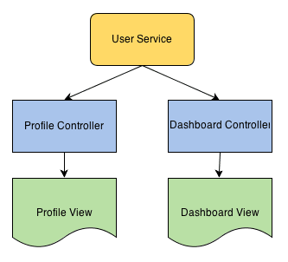
Service Introduction
What is Service in AngularJS?
AngularJS services are singleton components. Only one instance is created by the framework and then supplied for every DI request.
Services are Lazily instantiated - Angular only instantiates a service when an application component depends on it.
Example
Uses :
Service uses are typically:
Persist and share data between components
Provide an interface for loading and accessing that data
Containers for reusable chunks of business logic and functionality
Notes:
Imagine you have included user information retreival logic in both profile and Dashboard controller & you have to change something than you have to go and change in both controller but if we have user service than there is need to change at one place . Hence its easy to decouple logic.

Slide 87
Services - Agenda
Services Introduction
What is Service?
Uses
Different Ways of registering Service
Using a Service
Implicit DI
Explicit DI
AngularJS Internal Services
$timeout,$interval
$watch, $digest, $apply

Slide 88
Different Ways of registering Service (1/4)
Register a service as a value type.
var app = angular.module('myModule', []);
app.value(‘UserType', 2);
Injecting ‘UserType’ into a controller:
app.controller(‘TestCntrl’, function($scope,UserType){ //some code });
app.value(‘User’, { staffid:101, firstname:’namrata’,
lastname:’marathe’,
locale: ‘de:CH’ });
Injecting ‘User’ into a controller:
app.controller(‘LoginCntrl’, function($scope, User){ //some code });

Slide 89
Different Ways of registering Service (2/4)
Services can receive DI just like any other component and can be registered on a module in a number of ways.
module.service(name,fn) - This is simplest pattern
It allows registration of a service via a constructor function:
myApp.service('helloWorldFromService', function() {
this.sayHello = function() {
return "Hello, World!"
};
});
Notes:
Refer 8_value_service_factory_provider.html example in Day2 demos folder

Slide 90
Different Ways of registering Service (3/4)
module.factory(name,fn) - This is a slightly more flexible pattern.
Register an arbitrary object as a service. Object creation logic can be more complex and private fields can be simulated.
myApp.factory('helloWorldFromFactory', function() {
return {
sayHello: function() {
return "Hello, World!"
}
};
});
Notes:
Refer 8_value_service_factory_provider.html example in Day2 demos folder

Slide 91
Different Ways of registering Service (4/4)
module.provider(name,fn) - The most complex pattern.
It allows an arbitrary object to be registered just like the factory pattern.
It also allows that object to be configured during the configuration phase before it's used for DI.
Usually overkill for most services, but most useful when a service needs to be re-used across applications with configurable changes to behaviour.
Notes:
Note: Providers injected during the configuration phase have not been fully instantiated via their$get method yet, only the configuration API is exposed to the config code.
Refer 8_value_service_factory_provider.html example in Day2 demos folder

Slide 92
Different Ways of registering Service (5/4)
//Register a provider service
myApp.provider('helloWorld', function() { this.name = 'Default';
this.$get = function() {
var name = this.name;
return {
sayHello: function() {
return "Hello, " + name + "!” } } }; //end of $get
this.setName = function(name) {
this.name = name; }; });
//Configure a provider!
myApp.config(function(helloWorldProvider)
{ helloWorldProvider.setName('Angular');
});
//Use a provider in controller
myApp.controller('MyCtrl',function($scope, helloWorld) {
$scope.hellos = helloWorld.sayHello(); });
note: ‘Provider’ appended to ‘helloWorld’ in module.config function
Notes:
Refer 8_value_service_factory_provider.html example in Day2 demos folder

Slide 93
Services - Agenda
Services Introduction
What is Service?
Uses
Different Ways of registering Service
Using a Service
Implicit DI
Explicit DI
AngularJS Internal Services
$timeout,$interval
$watch, $digest, $apply

Slide 94
Using a Service
To manage the responsibility of dependency creation, each Angular application has an injector.
The injector is a service locator that is responsible for creating components, resolving their dependencies, and providing them to other components as requested.
$injector = angular.injector();
Angular creates a single $injector when it bootstraps an application and uses the single $injector to invoke controller functions, service functions
// inferred (only works if code not minified/obfuscated) $injector.invoke(function(serviceA){});
// inline array annotation (works with minified code)
$injector.invoke(['serviceA', function(serviceA){}]);
Notes:
https://github.com/angular/angular.js/wiki/Understanding-Dependency-Injection

Slide 95
Using a Service – Implicit DI
var app = angular.module("DemoApp", []);
// Controller is injected with $scope and $http as dependencies
app.controller('DemoController', ['$scope', ‘greeter’,
function (s, g) {
$scope.sayHello = function() { greeter.greet('Hello World'); };
} ]);
<div ng-controller=“DemoController">
<button ng-click="sayHello()"> Hello </button>
</div>
When Angular compiles the HTML, it processes the ng-controller directive.
It in turn asks the injector to create an instance of the controller and its dependencies.
injector.instantiate(DemoController);
This is all done behind the scenes, the controller doesn’t know about the injector.
Notes:
Javascript code minification
In this approach, instead of just providing a controller function, we pass an array whose elements consist of a list of names of the dependencies followed by the function itself.
This overcomes the issues caused with minified JavaScript.
Even if javascript code is minified and the parameter names are shortened angular still knows what’s to be injected from list of names of dependencies passed in an array.

Slide 96
Using a Service - Explicit DI using injector
Creates an injector object that can be used for retrieving services as well as for dependency injection
var myInjector = angular.injector([‘mymodule’ , ‘ng’]);
Call get() on returned injector instance to resolve a manually specified dependency.
var $http = myInjector.get("$http"); // After this, you can use $http just like before.
The injector is also responsible for injecting services into functions, services can be injected into any function using the injector's invoke method;
var myFunction = function(greeting) { greeting('Ford Prefect'); }; $injector.invoke(myFunction);
Injector will only create an instance of a service once and cache it by service's name; the next time service is injected using it’s name, it returns the cached service object.
Notes:
https://github.com/angular/angular.js/wiki/Understanding-Dependency-Injection
http://anandmanisankar.com/posts/angularjs-dependency-injection-demystified/
http://henriquat.re/basics-of-angular/services-dependency-injection/services-and-dependency-injection-in-angularjs.html

Slide 97
Services - Agenda
Services Introduction
What is Service?
Uses
Different Ways of registering Service
Using a Service
Implicit DI
Explicit DI
AngularJS Internal Services
$timeout,$interval
$watch, $digest, $apply

Slide 98
AngularJS Internal Services - $timeout, $interval
AngularJS provide internal services to user which can be used in application.
All internal service start with ‘$’ e.g. $http, $window, $location
Let us have look at some of internal services and its use:
What is $timeout?
$timeout is Angular's wrapper for window.setTimeout and $interval is for scheduling a repeated Function Call
var myapp = angular.module("myapp", []);
myapp.controller("MyController", function($scope, $timeout)
{ $timeout(callAtTimeout, 3000); $interval(callAtInterval, 5000); });
function callAtTimeout() { console.log("Timeout occurred"); } function callAtInterval() { console.log("Interval occurred"); }
Notes:
http://tutorials.jenkov.com/angularjs/timeout-interval.html
https://coderwall.com/p/udpmtq/angularjs-use-timeout-not-settimeout

Slide 99
AngularJS Internal Services - $watch, $digest
Data binding means that when you change something in the view, the scope model automagically updates and vice-a-versa.
When you write an expression ({{aModel}}), behind the scenes Angular sets up a watcher on the scope model using $watch, which in turn updates the view whenever the model changes.
$scope.$watch('aModel', function(newValue, oldValue) {
//update the DOM with newValue
});
$watch listener function does not get executed on its own. $digest triggers $watch.
Several built-in directives/services that change models (e.g. ng-model, ng-click, $timeout, etc.) automatically trigger a $digest cycle.
As $digest cycle starts, it fires each of the watchers that check if the current value of the scope model is different from last calculated value.
Notes:
http://www.sitepoint.com/understanding-angulars-apply-digest/

Slide 100
AngularJS Internal Services - $digest, $apply
Angular doesn’t directly call $digest(), it calls $scope.$apply() which in turn calls $rootScope.$digest().
As a result of this, a digest cycle starts at the $rootScope, and subsequently visits all the child scopes calling the watchers along the way.
When you change model outside of the Angular context (like DOM event listeners, setTimeout, XHR or third party libraries) then use $apply()
$scope.$apply();
Manually calling $apply() tells Angular that model is changed outside the context and it should fire the watchers so that changes propagate properly.
Notes:
http://www.sitepoint.com/understanding-angulars-apply-digest/

Slide 101
Agenda
Introduction To AngularJS
Controllers
Modules
Directives
Services
Filters
Routing
Sending Ajax Request
Unit Testing

Slide 102
Filters
AngularJS filter formats the value of an expression for display to the user
Filters can be used in view templates, controllers or services and it is easy to define your own filters.
Filters can be applied to expressions in view templates using the following syntax: {{ expression | filter }}
Filters can be applied to the result of another filter. This is called "chaining" and uses the following syntax:
{{ expression | filter1 | filter2 | ... }}
Filters may have arguments. The syntax for this is
{{ expression | filter:argument1:argument2:... }}
E.g. the markup {{ 1234 | number:2 }} formats the number 1234 with 2 decimal points using the number filter. The resulting value is 1,234.00
There are other inbuilt filters like orderBy, search, dateformat, currency
We can create custom filters also !!! ☺

Slide 103
Agenda
Introduction To AngularJS
Controllers
Modules
Directives
Services
Filters
Routing
Sending Ajax Request
Unit Testing

Slide 104
Routing - Agenda
Client Side Routing
Configuring Routes Using $routeProvider
$route, ng-view
$routeParams
Accessing current route

Slide 105
Client Side Routing (1/3)
Angular SPA uses client side routing as against traditional server side routing
With client-side routing, initial request loads the Main/Home page layout from server and css and JavaScript libraries
Main page has the client side URLs which route on client side
Every route is mapped to its associated html template and controller on client side
Client side routes don’t need entire page refresh, only the data changes to be loaded from its associated html template (client side) onto the main page

Slide 106
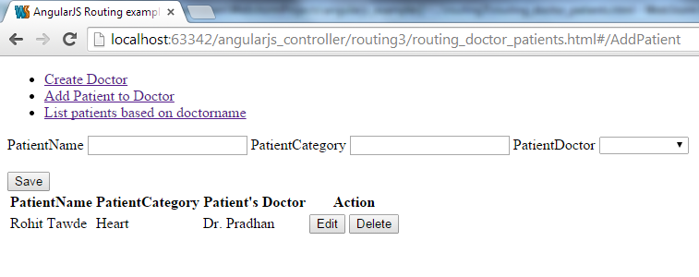
Client Side Routing (2/3)
Angular allows to create client side URLs in view using hashtag # as follows:
<ul class="nav">
<li><a href="#CreateDoctor"> Create Doctor</a></li>
<li><a href="#AddPatient"> Add Patient to Doctor </a></li>
<li><a href="#ListDoctorPatient">List patients based on doctorname </a></li>
</ul>

Slide 107
Client Side Routing (3/3)
We need to map each route to html template and controller on client side as follows:
$routeProvider.when('/AddPatient', {
templateUrl: 'template/add_patient.html',
controller: 'AddPatientController‘ }).
<div ng-view></div> - ng-view directive marks place on Main/index page where html template gets loaded

Slide 108
Routing - Agenda
Need for Routing
Configuring Routes Using $routeProvider
$route, ng-view
$routeParams
Accessing current route

Slide 109
Defining Routes Using $routeProvider
Used for configuring client side routes
Methods
when(path, route)
Adds new route definition to $route service
otherwise
Sets route definition that will be used on route change when no other route definition is matched.
var sampleApp = angular.module(‘sampleApp', ['ngRoute']);
sampleApp.config(function($routeProvider) {
$routeProvider.
when('/CreateDoctor', {
templateUrl: 'template/create_doctor.html',
controller: 'DoctorController'
}).
when('/AddPatient', {
templateUrl: 'template/add_patient.html',
controller: 'AddPatientController'
}).
otherwise({ redirectTo: '/CreateDoctor‘ });
});
Notes:
Properties
caseInsensitiveMatch
A boolean property indicating if routes defined using this provider should be matched using a case sensitive algorithm.
Defaults to false.

Slide 110
Routing - Agenda
Need for Routing
Configuring Routes Using $routeProvider
$route, ng-view
$routeParams
Accessing Current Route

Slide 111
$route
Used for deep-linking URLs to controllers and views
It watches $location.url() and tries to map the path to an existing route definition
Requires ngRoute module to be installed
This service is used in conjunction with ngView directive and $routeParams service

Slide 112
ng-view
A directive in module ngRoute
Complements the $route service by including the rendered template of the current route into the main layout (eg. Index.html) file
Every time the current route changes, the included view changes with it according to the configuration of $route service
Requires ngRoute module to be injected

Slide 113
Routing - Agenda
Need for Routing
Configuring Routes Using $routeProvider
$route, ng-view
$routeParams
Accessing Current Route

Slide 114
$routeParams (1/2)
Retrieves current set of route parameters
It is a combination of location’s search() and path()
If the parameter name collides, path params take precedence over the search params
sampleApp.config(['$routeProvider', function($routeProvider) {
$routeProvider.
when('/ShowOrder/:orderId', {
templateUrl: 'template/show_order.html',
controller: 'ShowOrderController‘ });
}]);
//how to access $routeParams in controller
sampleApp.controller('ShowOrderController', function($scope, $routeParams) {
$scope.order_id = $routeParams.orderId;
});

Slide 115
$routeParams (2/2)
var courseApp = angular.module(‘courseApp', ['ngRoute']);
courseApp.config(function ($routeProvider) {
$routeProvider
.when('/', {
controller:‘TOCController'
templateUrl:'View1.html'
})
.when('/Chapter/:chapterId', {
controller: 'ChapterController',
templateUrl:'View2.html'
})
.otherwise({ redirectTo: '/' });
});
// Given:
// URL: http://server.com/index.html#/Chapter/1
// Route: /Chapter/:chapterId
// Then
$routeParams ==> {chapterId:'1'}

Slide 116
Routing - Agenda
Need for Routing
Configuring Routes Using $routeProvider
$route, ng-view
$routeParams
Accessing Current Route

Slide 117
Accessing Current Route
$routeParams are only updated after a route change completes successfully
$route.current.params is used to access the new route’s parameter

Slide 118
Agenda
Introduction To AngularJS
Controllers
Modules
Directives
Services
Filters
Routing
Sending Ajax Request
Unit Testing

Slide 119
Sending Ajax Request - Agenda
Different Ways To Send Ajax Request
The $http Service
The $http Example & Promise object
Using $http As Function
$http – Setting Http Headers At Global Level
$http & JSONP – Cross Domain Access

Slide 120
Different Ways To Send Ajax Request
In AngularJS you can send AJAX requests in several different ways:
AJAX calls via the $http service.
JSONP calls via the $http service.
REST type calls.

Slide 121
Sending Ajax Request - Agenda
Different Ways To Send Ajax Request
The $http Service
The $http Example & Promise object
Using $http As Function
$http – Setting Http Headers At Global Level
$http & JSONP – Cross Domain Access

Slide 122
The $http Service (1/4)
The $http service is the easiest way to send AJAX calls to your web server.
It internally uses browser's XMLHttpRequest object or JSONP.
// Simple GET request example :
$http.get('/someUrl').
success(function(data, status, headers, config) {
// this callback will be called asynchronously // when the response is available }).
error(function(data, status, headers, config) { // called asynchronously if an error occurs // or server returns response with an error status.
});

Slide 123
The $http Service (2/4)
// Simple POST request example :
$http. post('/someUrl', {msg:'hello word!'}).
success(function(data, status, headers, config) {
// this callback will be called asynchronously // when the response is available }).
error(function(data, status, headers, config) { // called asynchronously if an error occurs // or server returns response with an error status. });
If the AJAX call succeeds (the server sends back an HTTP code between 200 and 209), the function passed to the success() function is executed.
If the AJAX call fails (all other codes except for redirects), the function passed to the error() method is executed.

Slide 124
The $http Service (3/4)
$http success and error callback functions take four parameters:
data
status
headers
config
data - It is the JSON object returned by the server. The $http service assumes that your server sends back JSON.
status - It is the HTTP status code returned by the server along with the response.
headers - It is a function that can be used to obtain any HTTP response headers returned along with the response.
You get a header by calling headers([headerName]);.
config - It is the configuration object that was passed as parameter to the $http ajax function call

Slide 125
The $http Service (4/4)
The $http service has following functions that can be used to send AJAX requests:
$http.get(url, config)
$http.post(url, data, config)
$http.put(url, data, config)
$http.delete(url, config)
$http.head(url, config)

Slide 126
Sending Ajax Request - Agenda
Different Ways To Send Ajax Request
The $http Service
The $http Example & Promise object
Using $http As Function
$http – Setting Http Headers At Global Level
$http & JSONP – Cross Domain Access

Slide 127
$http Example & Promise object
var promise = $http.get("/angularjs-examples/json-test-data.jsp");
promise.success(function(data, status, headers, config) { console.log(data.title); }); promise.error(function(data, status, headers, config) { alert("AJAX failed!"); }); } } );
The $http.get() function returns a "promise" object.
A promise represents the eventual result of an operation.
The promise object has a success() and an error() callback function - It is used to specify what to do when an operation eventually succeeds or fails.

Slide 128
Sending Ajax Request - Agenda
Different Ways To Send Ajax Request
The $http Service
The $http Example & Promise object
Using $http As Function
$http – Setting Http Headers At Global Level
$http & JSONP – Cross Domain Access

Slide 129
Using $http as a Function (1/2)
You can also use the $http service as a function directly:
var promise = $http(config);
The config parameter passed to the $http function controls the HTTP request sent to the server.
The config parameter is a JavaScript object which can contain the following properties:
Method, url, params, headers, timeout, cache, transformRequest, transformResponse
Promise can also use ‘then’ method to register call-backs that receive response object as an argument

Slide 130
Using $http as a Function (2/2)
// To remove the friend with the given ID from the remote collection.
function removeFriend(id) {
// var request is a ‘promise’ object returned by $http
var request = $http({ method: "delete", url: "api/index.cfm",
params: { action: "delete"},
data: {id: id} } );
//see the ‘then’ method used to register the call-backs.
return( request.then( handleSuccess, handleError ) );
}
function handleSuccess( response ) {
return( response.data );
}
function handleError ( response ) {
console.log( response.data.message);
}
Notes:
http://www.bennadel.com/blog/2612-using-the-http-service-in-angularjs-to-make-ajax-requests.htm
http://www.dwmkerr.com/promises-in-angularjs-the-definitive-guide/

Slide 131
Sending Ajax Request - Agenda
Different Ways To Send Ajax Request
The $http Service
The $http Example & Promise object
Using $http As Function
$http – Setting Http Headers At Global Level
$http & JSONP – Cross Domain Access

Slide 132
$http – Setting Http headers At Global Level (1/2)
The $http service will automatically add certain HTTP headers to all requests.
Following is the default configuration for $httpProvider.defaults.headers configuration object.
$httpProvider.defaults.headers.common - headers that are common for all requests
Accept: application/json, text/plain, * / *
$httpProvider.defaults.headers.post - header defaults for POST requests
Content-Type: application/json
$httpProvider.defaults.headers.put - header defaults for PUT requests
Content-Type: application/json

Slide 133
$http – Setting Http headers At Global Level (2/2)
To add or overwrite these defaults for all http messages, simply add or remove a property from these configuration objects as follows:
module.config(function ($httpProvider)
{ $httpProvider.defaults.headers.post['Accept'] = 'application/json, text/javascript';
$httpProvider.defaults.headers.post['Content-Type'] = 'application/json; charset=utf-8';
});
The defaults can also be set at runtime via the $http.defaults object in the same fashion. For example:
module.run(function($http)
{ $http.defaults.headers.common.Authorization = 'Basic YmVlcDpib29w' });

Slide 134
Sending Ajax Request - Agenda
Different Ways To Send Ajax Request
The $http Service
The $http Example & Promise object
Using $http As Function
$http – Setting Http Headers At Global Level
$http & JSONP – Cross Domain Access

Slide 135
$http & JSONP – Cross Domain Access (1/2)
Angular's $http service is also capable of sending JSONP requests.
We can make cross-domain Ajax calls using JSONP
JSONP calls can be made via the $http service like this:
$http.jsonp( url, config );
Notes:
http://tutorials.jenkov.com/angularjs/ajax.html

Slide 136
$http & JSONP – Cross Domain Access (2/2)
var url = http://jenkov.com/theService.json?callback=JSON_CALLBACK";
var resPromise = $http.jsonp( url, { params : { p1 : "v1" ,
p2 : "v2" }
} );
resPromise.success(function(data)
{ // do something with the returned JavaScript object
// ( in the "data" parameter ). });
The JSON_CALLBACK function must be present in your HTML page already. Inside this function you process the response sent back from the service.
Notes:
http://tutorials.jenkov.com/angularjs/ajax.html

Slide 137
Agenda
Introduction To AngularJS
Controllers
Modules
Directives
Services
Filters
Routing
Sending Ajax Request
Unit Testing

Slide 138
Unit Testing - Agenda
How AngularJS makes Unit Testing Easy?
Intro of Jasmine with Angular
Basic Example of Testing Controller using Jasmine

Slide 139
How AngularJS makes unit testing easy?
Unit testing, as the name implies, is about testing individual units of code
Goals of unit testing:
Take the smallest piece of testable code
Isolate it from remainder of the code
Determine whether it behaves exactly as you expect
What makes unit testing easy in Angular
Dependency injection
Loose coupling with the DOM
Services that would otherwise be hard to test e.g. $timeout, $location, $window

Slide 140
Unit Testing - Agenda
How AngularJS makes Unit Testing Easy?
Intro of Jasmine with Angular
Basic Example of Testing Controller using Jasmine

Slide 141
Intro of Jasmine with Angular
Jasmine is a behavior-driven development framework for testing JavaScript code
It does not depend on any other framework
It does not require DOM

Slide 142
Unit Testing - Agenda
How AngularJS makes Unit Testing Easy?
Intro of Jasmine with Angular
Basic Example of Testing Controller using Jasmine

Slide 143
Basic Example of Testing Controller using Jasmine
Example

