Slide 1
JQUERY

Slide 2
JQuery
Selecting, Decorating and Enhancing

Slide 3
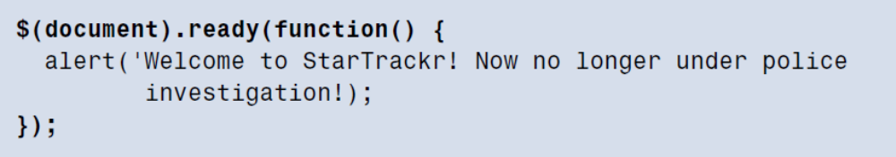
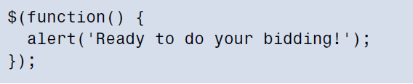
Making Sure The Page Is Ready

Slide 4


Selecting

Slide 5
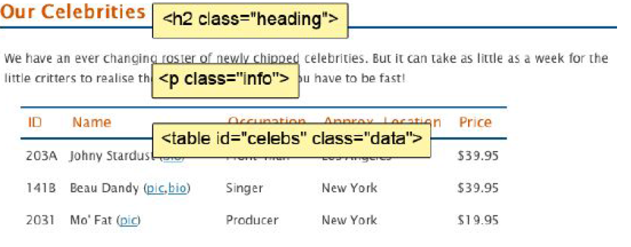
Selecting

Slide 6
Selecting
Task: To select alternate table rows on celebrity table
To select by element type:
$(‘tr’) - every table row
$(‘p’) - every paragraph
$(‘div’)- every div element
$(‘h1’)- every h1 heading
$(‘input’)- every <input> box on the page
But, we don’t want to change every table row on celebrity table, just the rows in the table that have celebrity data
Table that contains celeb info has id of celebs and class of data.

Slide 7
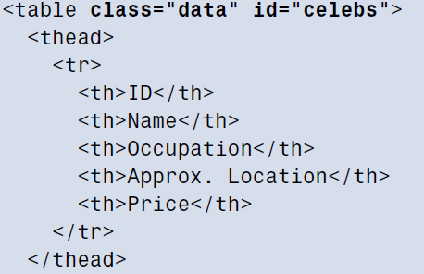
Selecting
$(‘#celebs’) – select by id
$(‘.data’) – select by class
.class can be shared by multiple elements and selector will select all elements having that .class
$(‘table.data’) – (element.class) table elements with class data
$(‘#celebs tr’) – narrowing down our selection
$(‘div.fancy p span’) – select all <span> elements inside <p> elements, which are themselves inside <div> elements, that have a class of fancy

Slide 8


Testing our selection
<table> header is also <tr> so result is 7 elements
Narrow down selector to find only table rows that lie inside the <tbody> element:
This will alert the correct length of six elements.

Slide 9
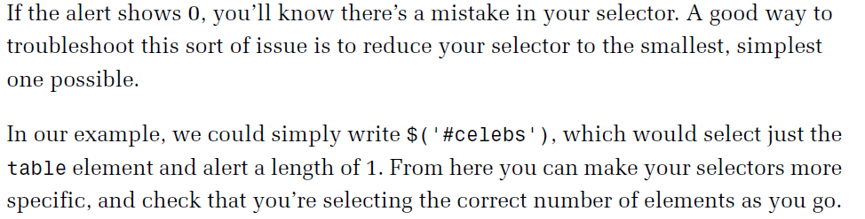
Testing our selection

Slide 10
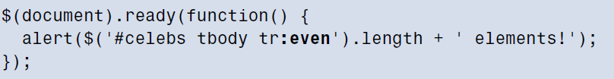
Filters
A filter removes certain items and keeps only the ones we want.
Filters are attached to the item you want to filter(in this case, the table rows) and are defined by a colon, followed by the filter name.
Other jQuery selector filters - :odd, :first, :last, :eq(3)

Slide 11

Using Multiple Selectors
We often want to apply the same action to several elements in unrelated parts of the page.
- It would select every paragraph, every <div> element, every <h1> heading and every <input> box on the page.

Slide 12
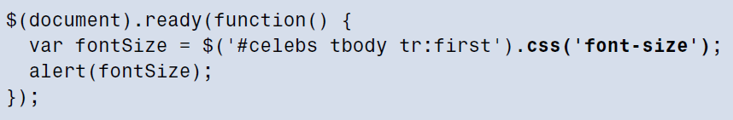
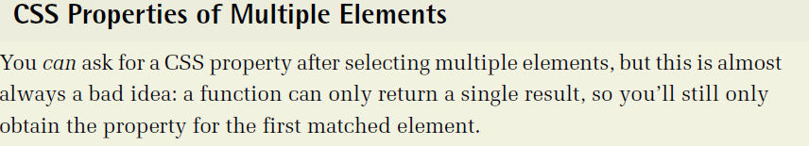
Decorating: CSS with JQuery
Reading CSS properties:
Jquery gives element’s calculated style: if you gave a div ht of 200 pixels in CSS file, but the content inside it pushed the height over 200 pixels, jQuery will provide you with actual ht of the element, rather than 200 pixels that you provide.

Slide 13
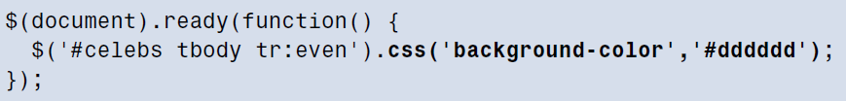
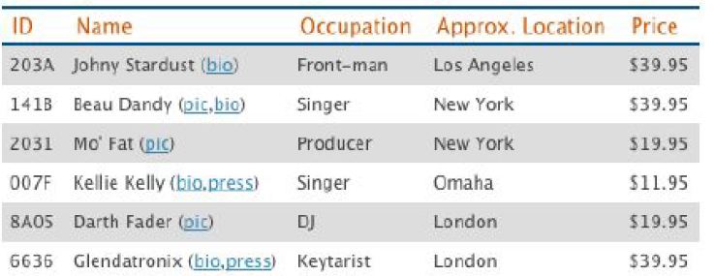
Decorating: CSS with JQuery
Setting CSS properties:
Result:

Slide 14
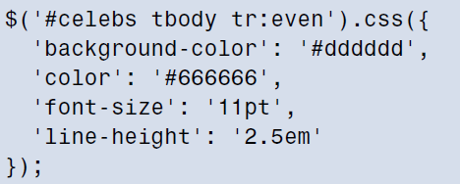
Decorating: CSS with JQuery
Jquery provides us with a nice way to set the multiple properties at the same time, using an object literal
Drawback: css properties have been added to table rows inline.

Slide 15
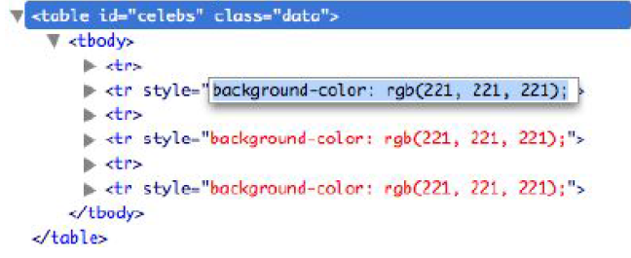
Decorating: CSS with JQuery
Inline styles are not good as per HTML/CSS best practice. It makes more sense to have all styling information in single place in CSS files. So that we can simply toggle those styles by attaching or removing class attributes to your HTML tags.

