Slide 1

I
Cs-457

Slide 2
Agenda
CS457
What is the Insta-Cart Design
Why ER/EER model?
What is ER Model?
ER diagram Notations
Components of ER model
Relationship cardinalities
Participation Constraints
Entities and their Constraints
EER diagram of Insta-Cart
Explain EER Model?
Sub and Super Class
Specialization & Generalization
Category and Union
Question?

Slide 3
Insta-Cart Design
CS457 - Signature Assignment
Insta-cart is one of the leading grocery delivery companies.
User can order online and it can get delivered to the user’s doorstep.
Insta-cart business model rotates around 3 main actors:
1.The Customers
2.The Grocery Shoppers/ Delivery Personnel
3.The Retail Partners

Slide 4
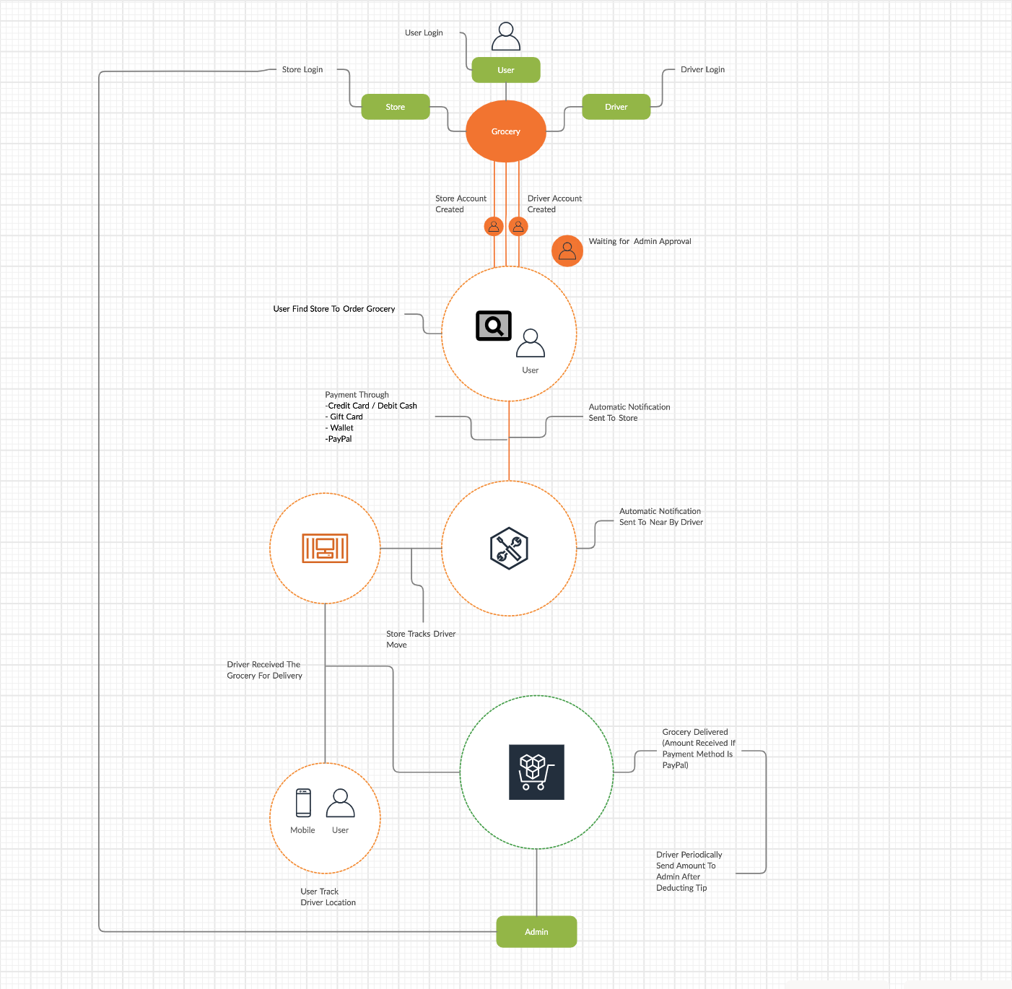
Fig; INSTA-CART WORK FLOW

Slide 5
Why We choose Er/EER Model
CS457 - Signature Assignment
EER creates a design more accurate to database schemas
It reflects the data properties and constraints more precisely.
It includes all modeling concepts of the ER model.
Diagrammatic technique helps for displaying the EER schema.
It includes the concept of specialization and generalization.
Each entity, attribute, and relationship, should have appropriate names that can be easily understood by the non-technical people as well.

Slide 6
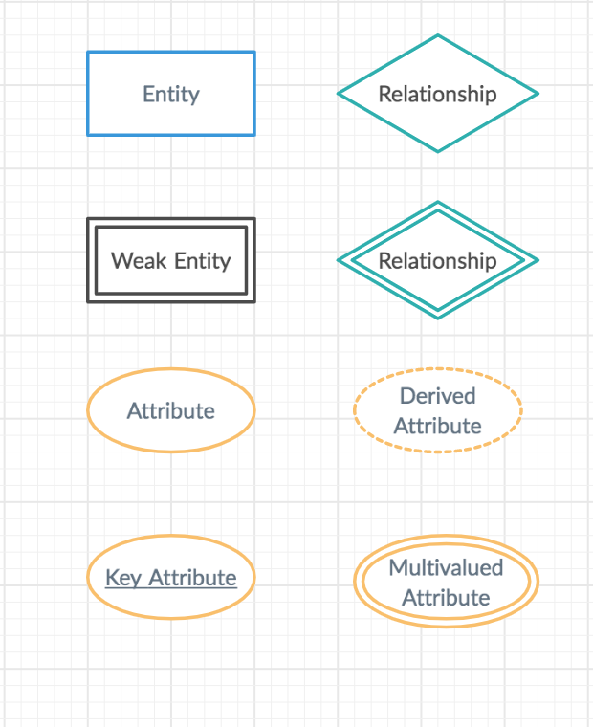
What is ER Diagram
CS457 - Signature Assignment
ER-Diagram Notations
Rectangle: represents the Entity.
Double Rectangle: represents the weak entity.
Diamond: It represents the Relationship.
Double Diamond: Weak relationship
Oval :Attribute
Double ovals : Multi valued Attribute:
Dashed oval :Derived Attribute

Slide 7
CS457 - Signature Assignment
Components of ER-Diagram
There are three main components
Entity
An entity is an object or component of data.
Strong Entity: An entity which doesn’t depend on other entity.
Weak Entity: An entity that cannot be uniquely identified by its own attributes and relies on the relationship with other entity is called weak entity.

Slide 8
Attributes
CS457 - Signature Assignment
An attribute describes the property of an entity.
Key Attribute: represents key attribute of an entity which have a unique value in a table.(Primary Key)
Derived Attribute: It represents the derived attribute which can be derived from the value of related attribute.
Multi valued Attribute:It represents multi valued attribute which can have many values for a particular entity.
Composite attribute:

Slide 9
relationship cardinality
CS457 - Signature Assignment
It shows the relationship among entities. There are four types of relationships:
One to One: When a single instance of an entity is associated with a single instance of another entity then it is called one to one relationship
1 to 1
One to Many: When a single instance of an entity is associated with more than one instances of another entity then it is called one to many relationship.
1 to N
Many to One: When more than one instances of an entity is associated with a single instance of another entity then it is called many to one relationship.
N to 1
Many to ManyWhen more than one instances of an entity is associated with more than one instances of another entity then it is called many to many relationship.
M to N

Slide 10
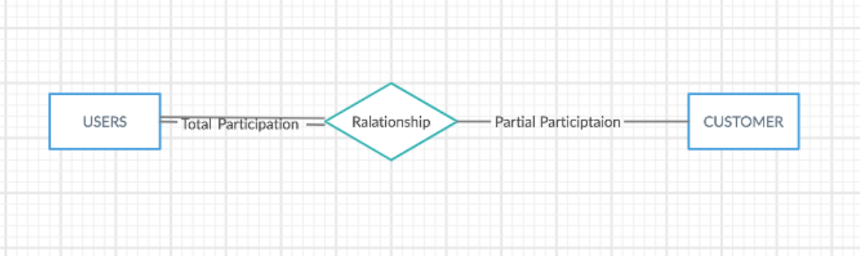
Participation constraints
CS457 - Signature AssignmentText
Total Participation − Each entity is involved in the relationship. Total participation is represented by double lines. Ex: User in Insta-Cart has total participation. A user must be a customer, driver or admin
Partial participation − Not all entities are involved in the relationship. Partial participation is represented by single lines.Ex: Payment to card type it is a partial participation.

Slide 11
USER ENTITY:
CS457 - Signature Assignment
CONSTRAINTS OF USER TABLE
Primary Key: USER_ID
NULL values are not accepted by the table for all the attributes
F_NAME AND L_NAME: VARCHAR character range 45
PASSWORD: Minimum 8 characters and at least one upper case letter and It should not contain any special characters
PHONE_NO.: VARCHAR and not should be greater than 10 digits.
ZIPCODE: VARCHAR 10 digits
USER_ID | F_NAME | L_NAME | PASSWORD | PHONE_NO | EMAIL | ADDRESS | ZIPCODE

Slide 12
DELiVERY Driver ENTITY:
CS457 - Signature Assignment
CONSTRAINTS OF DRIVER TABLE
Primary Key: DRIVER_ID
F_NAME AND L_NAME: VARCHAR character range 45
PASSWORD: Minimum 8 characters and at least one upper case letter and It should not contain any special characters
PHONE_NO.: Integer and not should be greater than 10 digits. NOT NULL
DL_NO: Unique Key and Must be 8 Character NOT NULL
SALARY: NUMERIC (15,2)
ZIPCODE: VARCHAR 10 digits
DRIVER_ID | F_NAME | L_NAME | PASSWORD | PHONE_NO | EMAIL | ADDRESS | GENDER | DL_NO. | SALARY | AVG_RATING

Slide 13
store_Admin ENTITY:
CS457 - Signature Assignment
CONSTRAINTS OF ADMIN TABLE
Primary Key: ADMIN_ID
F_NAME AND L_NAME: VARCHAR character range 45
PASSWORD: Minimum 8 characters and at least one upper case letter and It should not contain any special characters
PHONE_NO.: Integer and should not be greater than 10 digits.
ZIPCODE: Integer 10 digits
SALARY: NUMERIC (15,2)
GENDER: M , F or other
ADMIN_ID | F_NAME | L_NAME | PASSWORD | PHONE_NO | EMAIL | ADDRESS | GENDER | SALARY

Slide 14
Stores ENTITY:
CS457 - Signature Assignment
CONSTRAINTS OF STORE TABLE
Primary Key: STORE_ID
STORE_NAME : VARCHAR character range 45
PHONE_NO. : VARCHAR(13) and not should be greater than 10 digits.
ZIPCODE: VARCHAR (10)
CITY, STATE and EMAIL : VARCHAR
STORE_ID | STORE_NAME | S_PHONE | EMAIL | OWNER | ZIPCODE | CITY | STATE

Slide 15
DEPartment ENTITY:
CS457 - Signature Assignment
CONSTRAINTS OF DEPARTMENT TABLE
DEPT_ID: Primary Key
DEPT_NAME : VARCHAR range 45
DEPT_ID | DEPT_NAME

Slide 16
PRODUCT ENTITY:
CS457 - Signature Assignment
CONSTRAINTS OF PRODUCT TABLE
PRODUCT_ID: Primary Key
DEPT_ID: FOREIGN KRY References from Department table
PRODUCT_NAME : VARCHAR character range 45
AISLE_ID: INTEGER (4)
PRODUCT_ID | DEPT_ID | PRODUCT_NAME | AISLE_ID

Slide 17
ORDER ENTITY:
CS457 - Signature Assignment
CONSTRAINTS OF ORDER TABLE
ORDER_ID: Primary Key
USER_ID: FOREIGN Key References from User table
ORDER_STATUS : In process, Delivered, Canceled, Return or Dispatched in VARCHAR
STORE_ID: FOREIGN Key References from Stores table
DRIVER_ID: FOREIGN Key References from Driver table
SHIPPED_DATE and ORDER_DATE: Date Format (YYYY-MMDD)
ORDER_ID | USER_ID | ORDER_STATUS | ORDER_DATE | SHIPPED_DATE | STORE_ID | DRIVER_ID

Slide 18
ORDER Items ENTITY:
CS457 - Signature Assignment
CONSTRAINTS OF ORDER_ITEM TABLE
PRODUCT_ID:FOREIGN Key References from Product table
ORDER_ID: FOREIGN Key References from Order table
QUANTITY: Integer
PRICE: Numeric(15,2)
PRODUCT_ID | ORDER_ID | QUANTITY | PRICE

Slide 19
PAYMENT METHOD:
CS457 - Signature Assignment
CONSTRAINTS OF PAYMENT TABLE
CARD_NUM: Primary Key
EXPIRY_DATE: Date greater than current date
ADDRESS: VARCHAR not more than 45 character long
AMOUNT: Numeric
TYPE_OF_CARD: GiftCard, Wallet, Debit or Credit
CARD_NUM | EXPIRY_DATE | NAME | ADDRESS | AMOUNT | TYPE_OF_CARD

Slide 20
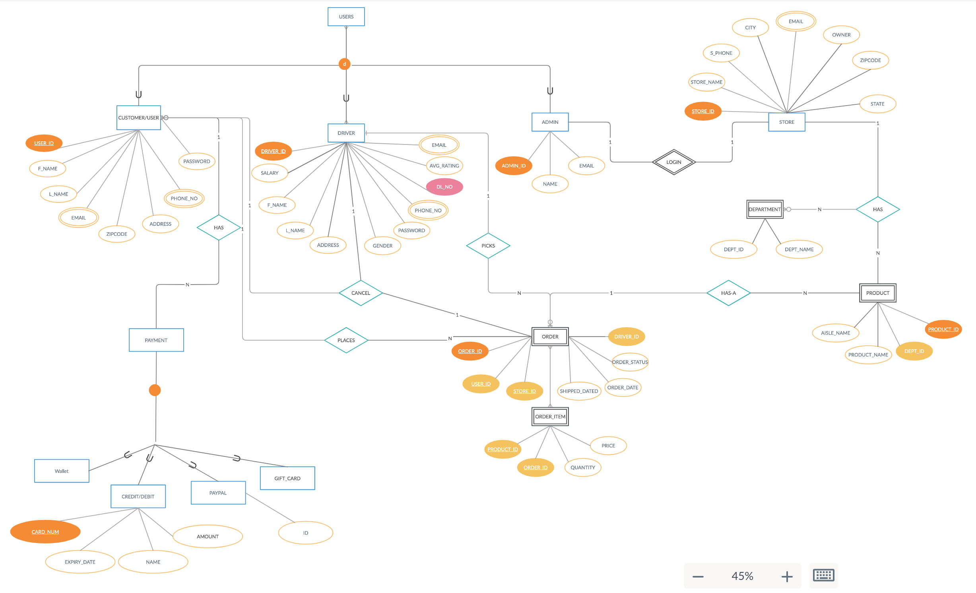
ER Diagram For Insta-Cart
CS457 - Signature Assignment

Slide 21
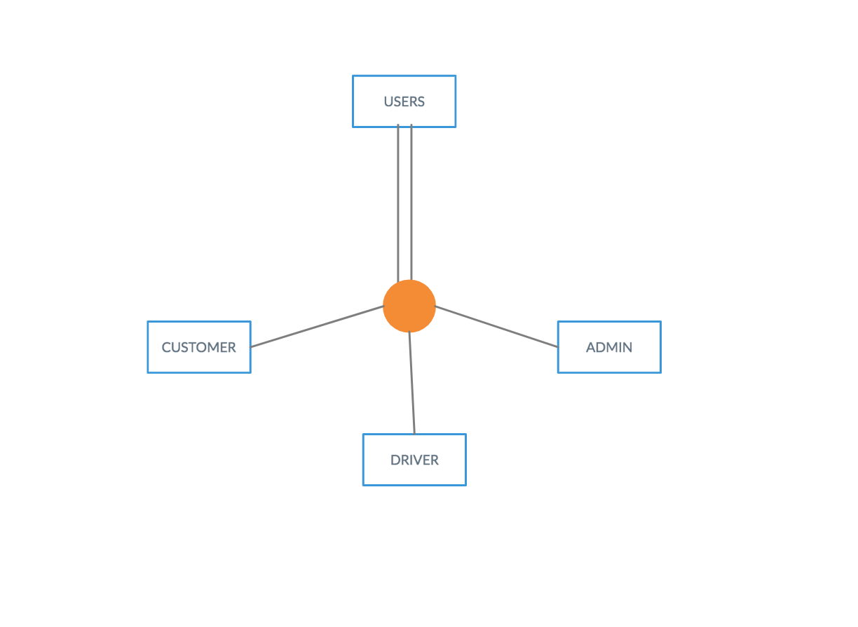
EXPLAiN EER MODEL
CS457 - Signature Assignment
Following are the main techniques to display the concept in EER model.
Sub Class and Super Class:
Sub class and Super class relationship leads the concept of Inheritance.
The relationship between sub class and super class is denoted with d symbol.
Super class is an entity type that has a relationship with one or more subtypes.
Sub class inherits properties and attributes from its super class.
Ex:In Insta Cart USER entity is a Super class and Customers, Delivery Driver, and Store Admin are the Sub Classes.

Slide 22
CS457 - Signature Assignment
Specialization and Generalization:
Generalization is the process of generalizing the entities which contain the properties of all the generalized entities means two lower level entities combine to form a higher level entity.
Ex: Customers, Drivers, and Admin can all be generalized as USERS
Specialization is a process that defines a group entities which is divided into sub groups based on their characteristic. Which means, one higher entity can be broken down into two lower level entity.
Ex: USERS can be specialized as Admin or Driver , based on what role they play in an Organization.
Category and Union:
Category represents a single super class or sub class relationship with more than one super class.
It can be a total or partial participation.
Ex. In Payment method inherits the attributes from Gift card, Debit/Credit card, Wallet, or PayPal account depending on the superclass to which Payment method user will choose to do Payments for their shopping.

Slide 23
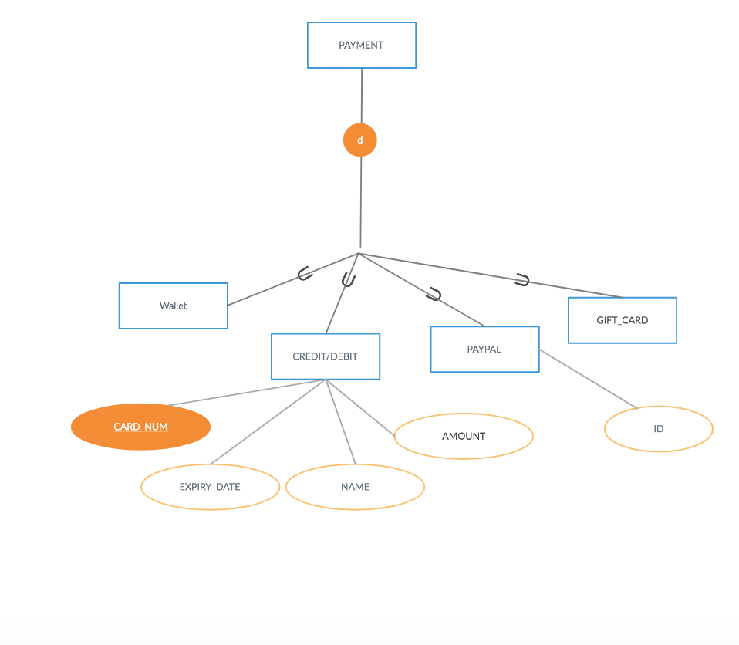
UNION SPECIALIZATION
CS457 - Signature Assignment
DIS-JOINT SPECIALIZATION
A User can be a Customer or a Delivery Driver at the same tome
Disjoint means payment can’t be more than one at a time.
User can use only one payment type at a time

Slide 24
THANK YOU!!!
QUESTIONS ?

