Slide 1
MARKETING ANALYTICS
TEAM 6:
AASHRITHA SAGAR
ALISHA PANICKER
HARSH SHAH
KARAN BHATT
NAMRATHA . C
RADHIKA SHARMA
SHAMBHAVI SINGH

Slide 2

ABOUT US
Founded in France as a perfume shop by Dominique Mandonnaud
Mandonnaud expanded this entity over several stores in 1979
LVMH (Parent company of Sephora) bought it for $262 Million in 1997
Sephora offers beauty products including cosmetics, skincare, body, fragrance, nail color, and haircare
Features nearly 300 brands, along with its own private label

Slide 3
BUSINESS OBJECTIVES
Increase Website Traffic
Increase Online Customer Engagement
Increase Online Revenue

Slide 4
TARGET AUDIENCE
TARGET AUDIENCE
Creative, Affluent Men and Women
Women (20-50yrs), Men (20-40yrs)
Desire to express personality through use of cosmetics
Skincare and Makeup lovers

Slide 5
KEY PERFORMANCE INDICATORS

Slide 6





AVERAGE ORDER VALUE
RETURNING AND
NEW VISITORS
VISITS
(SESSIONS)
CONVERSION
RATE
BOUNCE RATE

Slide 7
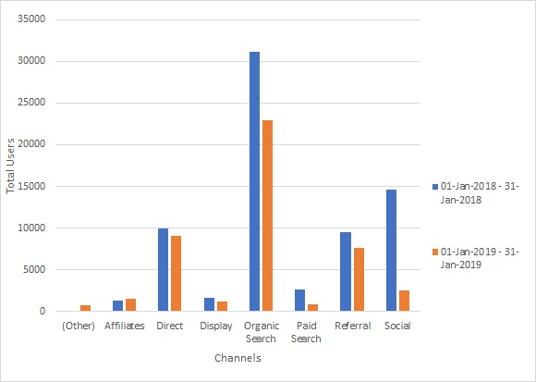
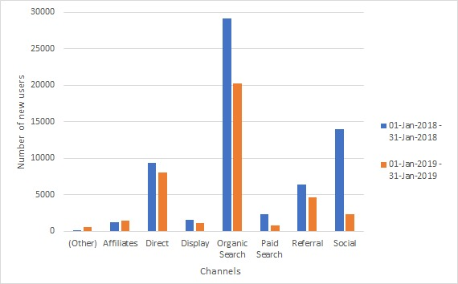
KEY METRICS
TOTAL VISITORS
Users in Jan 2018 – 69,950
Users in Jan 2019 – 44,438
NEW VISITORS
New Users in Jan 2018 – 63,971
New Users in Jan 2019 – 38,945

Slide 8
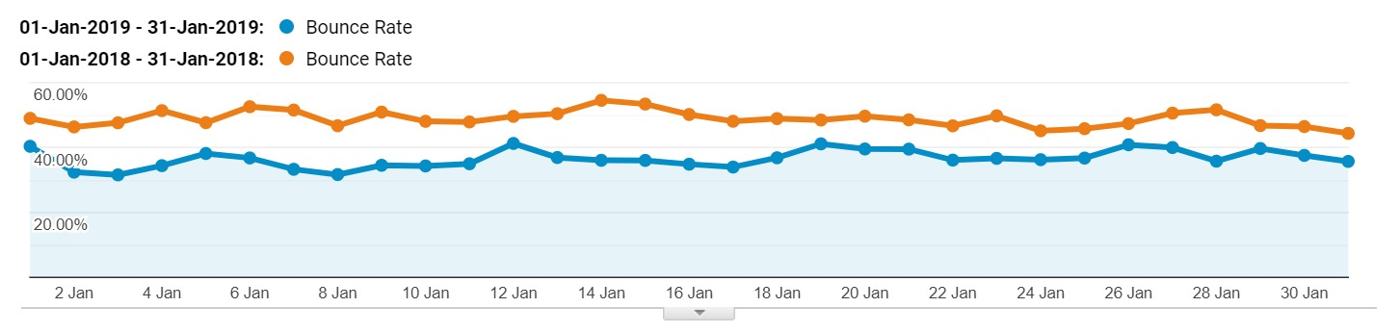
KEY METRICS
BOUNCE RATE

Slide 9
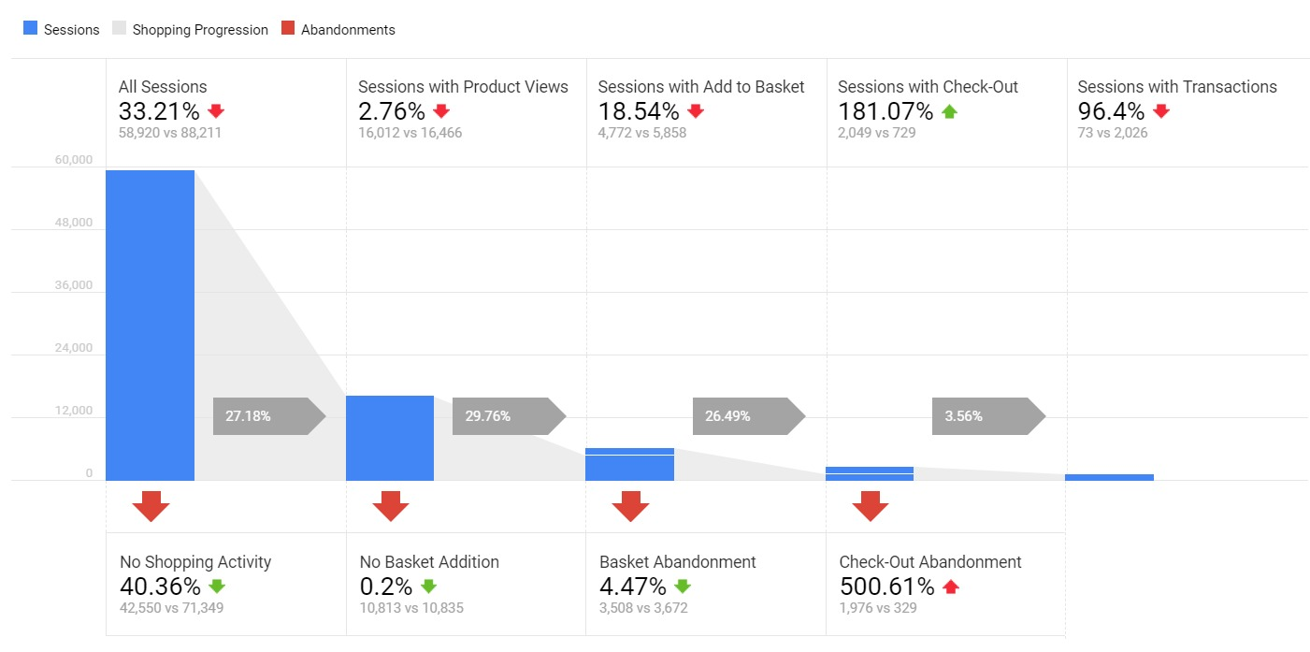
SHOPPING BEHAVIOR

Slide 10
REVENUE WATERFALL ANALYSIS
 | Visits (Sessions) | Conversion Rate | AOV | Revenue
LY | 88,211 | 2.35% | $ 195.86 | $ 404,994
TY | 58,920 | 0.12% | $ 54.08 | $ 3,948
% vs LY | - 33.21% | - 94.72% | - 72.38% | - 99.03%
# vs LY | (29,291) | - 2.22% | $ (141.78) | $ (401,045)
Metric Change Impact on Revenue | $ (134,564) | $ (383,838) | $ (293,336)

Slide 11
REVENUE WATERFALL ANALYSIS
 | Visits (Sessions) | Conversion Rate | AOV | Revenue
LY | 88,211 | 2.35% | $ 195.86 | $ 404,994
TY | 58,920 | 0.12% | $ 54.08 | $ 3,948
% vs LY | - 33.21% | - 94.72% | - 72.38% | - 99.03%
# vs LY | (29,291) | - 2.22% | $ (141.78) | $ (401,045)
Metric Change Impact on Revenue | $ (134,564) | $ (383,838) | $ (293,336)

Slide 12

KEY FINDINGS & ANALYSIS
Overall Visits and Conversion Rate has reduced in number from last year.
One key story that conversion metrics points us out to is that majority of the customers who had bought our products in the last year are not buying this year.
Customer Retention is a major pain point which has lead to the downfall in revenue this year.

Slide 13
RECOMMENDATIONS

Slide 14
RECOMMENDATIONS
Sephora needs to improve their marketing campaigns to lure the existing customers with discount offers and gift value sets with a minimum order purchase depending on the customer value to company.
Attract new users to increase website traffic and subsequent conversion by offering incentives for first-time online purchases (10% off first online order)
Invest in paid ads and display banners on social media platforms and referrals through beauty bloggers as least traffic is coming from these channels as per the data analysis
Offer reward points to customers for posting a review on social media with ‘#Sephora-Let’sBeautyTogether’ within 6 months of purchase to increase customer engagement

Slide 15
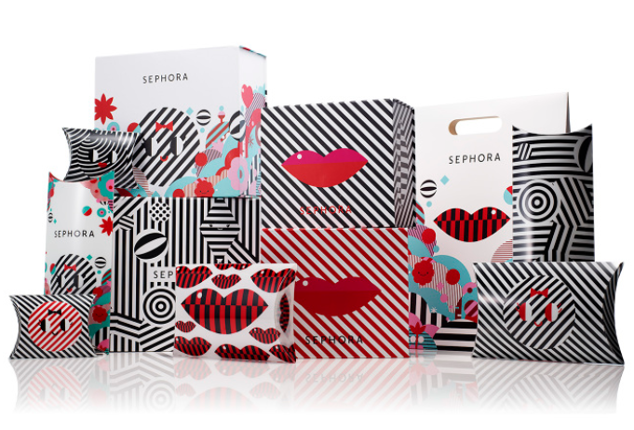
THANK YOU
Any Questions ?

