Slide 1
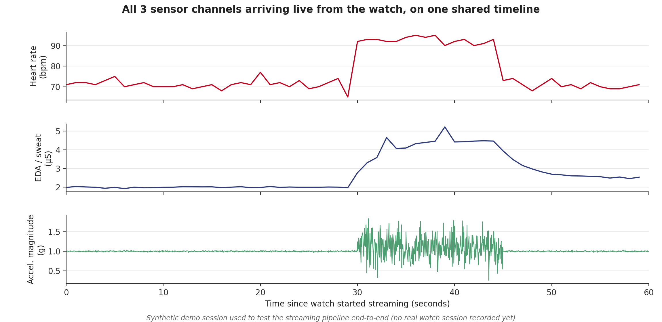
UNIVERSITY OF CINCINNATI | TASK 1.1 — BUILD LIVE DATA STREAMING
Proof: heart rate, EDA, and accelerometer all streamed from the watch to the app on one synchronized timeline, with no gaps. (Synthetic test session — no real watch session recorded yet.)

Slide 2
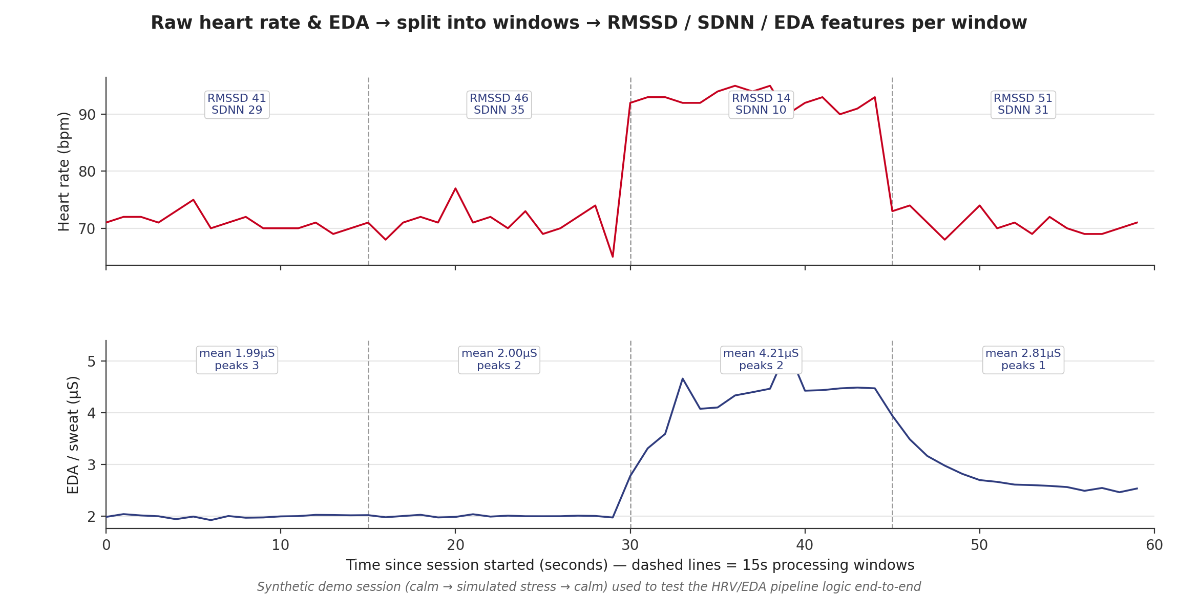
UNIVERSITY OF CINCINNATI | TASK 1.2 — BUILD HRV/EDA PROCESSING PIPELINE
Proof: raw heart rate & EDA are split into 15s windows, and RMSSD/SDNN/EDA mean are calculated per window — values clearly shift during the simulated stress segment (RMSSD drops from ~46 to ~14).

Slide 3
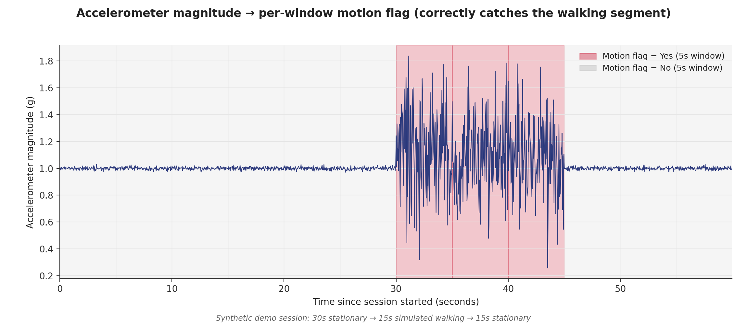
UNIVERSITY OF CINCINNATI | TASK 1.3 — BUILD ACCELEROMETER/MOTION-DETECTION PIPELINE
Proof: the motion flag correctly switches to "Yes" only during the simulated walking segment (30s–45s), keeping movement from being mistaken for a stress signal.

