Slide 1

FAKE PROFILES IDENTIFICATION IN ONLINE SOCIAL NETWORKS USING MACHINE LEARNING AND NLP
SRM INSTITUTE OF SCIENCE AND TECHNOLOGY
SCHOOL OF COMPUTING
DEPARTMENT OF COMPUTING TECHNOLOGIES
18CSP107L - MINOR PROJECT
Batch ID:4
Student 1 Reg. No:RA2111003010240
Student 1 Name : M. Namratha
Student 2 Reg. No:RA2111003010250
Student 2 Name : K. Keerthana
Guide name: Ramkumar Jayaraman
Designation : Assistant Professor Department : CTECH

Slide 2
Fake Profile Identification
Abstract:
In the present generation, the social life of everyone has become associated with online social networks. These sites have made a drastic change in the way we pursue our social life. Making friends and keeping in contact with them and their updates has become easier. But with their rapid growth, many problems like fake profiles, online impersonation have also grown. There are no feasible solutions exist to control these problems. So we came up with a framework with which the automatic identification of fake profiles is possible and is efficient. This framework uses classification techniques such as support vector machine (SVM), Random forest classifier, Gradient boost classifier, Naïve bayes, and Logistic regression algorithm and Decision Tree classify the profiles into fake or genuine classes. In final prediction we will gain the values of accuracy, classification report and confusion matrix.

Slide 3
Fake Profile Detection
Introduction:
Social networking site is a website where each user has a profile and can keep in contact with friends, share their updates, meet new people who have the same interests.These Online Social Networks (OSN) use web2.0 technology, which allows users to interact with each other. Social networking sites are growing rapidly and changing the way people keep in contact with each other. The online communities bring people with the same interests together which makes users easier to make new friends. Increasingly, machine learning (ML) offers a sophisticated solution, leveraging algorithms to discern genuine profiles from the spurious with remarkable precision. Successful identification leans heavily on feature extraction, which is the process of distilling complex data into manageable attributes. Common features include user activity metrics, text consistency, and network behavior. Sentiment analysis, which gauges the emotional tone of posts, also plays a pivotal role. Fake profiles often resort to generic or overly enthusiastic language patterns, which sentiment analysis tools can detect and quantify.

Slide 4
Fake Profile Detection
Fake profiles on social media can be created for a multitude of reasons—ranging from harmless trolling to nefarious activities like spreading misinformation, phishing, or manipulating public opinion. These profiles often exhibit traits such as abnormal posting frequencies, lack of personal information, suspicious follower-to-following ratios, and aggressive engagement tactics.Machine learning algorithms, trained on large datasets, can analyze these traits and more with incredible efficiency. Prior to implementation, rigorous frameworks ensuring data security and transparency must be established to maintain public trust and adherence to legal standards.The intersection of machine learning and social media elucidates a promising path forward in combating the proliferation of fake profiles. Through algorithms capable of feature extraction, sentiment analysis, and network scrutiny, ML models offer a robust, scalable solution to a growing digital dilemma. Continued advancements in this field could signify a substantial leap toward preserving the integrity of online interactions.

Slide 5
Problem Statement and Objectives :
In today's online social networks there have been a lot of problems like fake profiles, online impersonation, etc. To date, no one has come up with a feasible solution to these problems. In this project, I intend to give a framework with which the automatic detection of fake profiles can be done so that the social life of people become secured and by using this automatic detection technique we can make it easier for the sites to manage the huge number of profiles, which can't be done manually. The examples of these social networking sites are The Sphere, Nexopia which is used in Canada, Bebo, MySpace, Twitter, LinkedIn, Google+, Orkut, Tuenti used in Spain, Nasza-Klasa in Poland, Cyworld mostly used in Asia, etc. are some of the popular social networking sites.

Slide 6
Fake Profile Detection
Literature review:
Fake Profile Identification in Online Social Network Using Machine Learning and NLP
Social networking sites enable users to create profiles and engage with others, posing security risks. Classifying accounts helps distinguish authentic and phony profiles, detecting threats and preventing misuse .The algorithms used support vector machine ,Random forest by Deepak Kumar Sharma and Dilip Roy in the year 2023-2024.
Smruthi et al has utilized a cross-breed show and skin location calculation to identify fake accounts on social sites. The quality of the proposed work is to identify the fake account with tall precision. The result of this proposed work is utilizing 400 blended five Directed Machine Learning Algorithm datasets of fake and genuine accounts. Here there are 200 fake, and 200 genuine accounts that calculate the exactness of the Supervised Machine Learning Calculation.

Slide 7
Fake Profile Detection
The accuracy rate of the KNN calculation is 60% and other classifiers help to extend the precision rate up to 80% such as the Bayes and Choice tree classifier in 2021-2022
Srinivas approach Machine Learning and NLP methods to extend the precision rate of fake accounts detection. Through bolster vector and Naïve coves, many problems are expelled on social media, the issue is like privacy issues, cyber bullies, trolls.This paper takes the Facebook dataset for the acknowledgment of untrue accounts. Here Machine Learning Calculation besides the NLP preprocessing strategy applies for analyzing the dataset in 2020-2021.
Raturi is centered on the engineering of the system. The approach of two concepts of design in the first design will recognize the account's details by using NPL and arrange identifiers. The number of words is hurtful, the harmful words collected as the dataset. BOW with predication mode with SVM (Back Vector Machine) connects the dataset and separates the dataset for testing and preparing. It helps to calculate hurtful words from the individual accounts and recognize the wrong account based on the content shown within the accounts at that point send a warning message to give a true demonstration to proceed with the ac-count in 2018-2019.

Slide 8
Fake Profile Detection
Proposed System / Methodology:
The proposed framework in figure shows the sequence of processes that need to be followed for continues detection of fake profiles with active learning from the feedback of the result given by the classification algorithm. This framework can easily be implemented by social networking companies.
The detection process starts with the selection of the profile that needs to be tested.
After the selection of the profile, the suitable attributes (i.e. features) are selected on which the classification algorithm is implemented.
The attributes extracted is passed to the trained classifier. The classifier gets trained regularly as new training data is feed into the classifier.
The classifier determines whether the profile is fake or genuine.

Slide 9
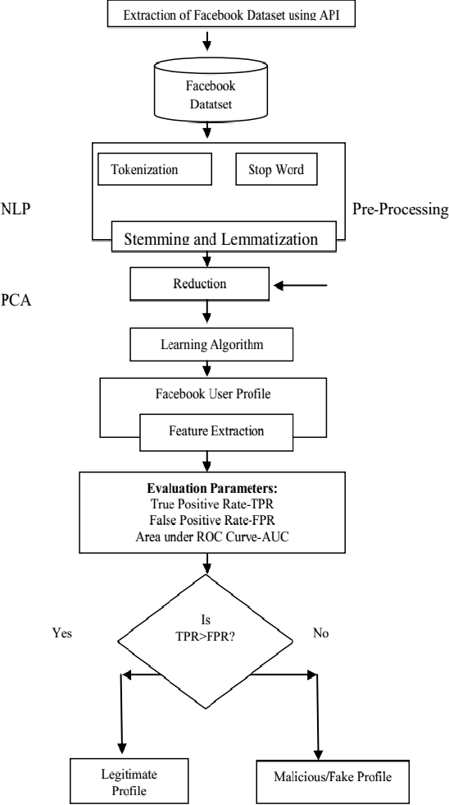
Fake Profile Detection
The classifier may not be 100% accurate in classifying the profile so; the feedback of the result is given back to the classifier.This process repeats and as the time proceeds, the no. of training data increases and the classifier becomes more and more accurate in predicting the fake profiles.

Slide 10
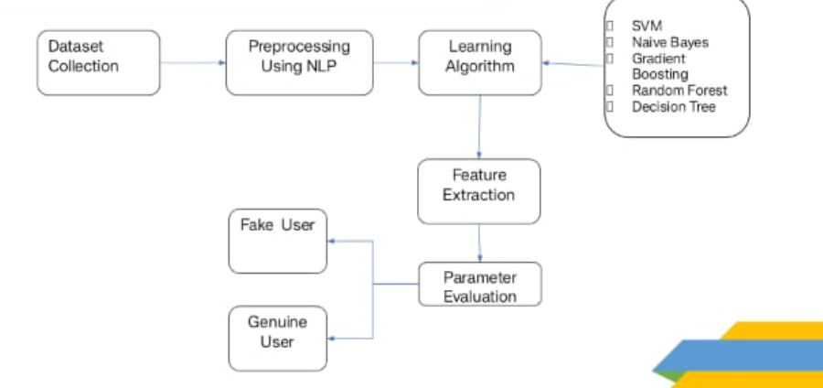
Fake Profile Detection
System Architecture:

Slide 11
References:
[1] Michael Fire et al. (2012). "Strangers intrusion detection- detecting spammers and fake profiles in social networks based on topology anomalies." Human Journal 1(1): 26-39.Günther, F. and S. Fritsch (2010). .
[2] Dr. S. Kannan, Vairaprakash Gurusamy, “Preprocessing Techniques for Text Mining”, 05 March 2015.
[3] Shalinda Adikari and Kaushik Dutta, Identifying Fake Profiles in LinkedIn, PACIS 2014 Proceedings, AISeL

