Slide 1

FAKE PROFILES IDENTIFICATION IN ONLINE SOCIAL NETWORKS USING MACHINE LEARNING
SRM INSTITUTE OF SCIENCE AND TECHNOLOGY
SCHOOL OF COMPUTING
DEPARTMENT OF COMPUTING TECHNOLOGIES
18CSP107L - MINOR PROJECT
Guide name: Ramkumar Jayaraman
Designation : Assistant Professor Department : CTECH
Batch ID:4
Student 1 Reg. No:RA2111003010240
Student 1 Name : M. Namratha
Student 2 Reg. No:RA2111003010250
Student 2 Name : K. Keerthana

Slide 2
Fake Profile Identification
Abstract:
In the present generation, the social life of everyone has become associated with online social networks. These sites have made a drastic change in the way we pursue our social life. Making friends and keeping in contact with them and their updates has become easier. But with their rapid growth, many problems like fake profiles, online impersonation have also grown. There are no feasible solutions exist to control these problems. So we came up with a framework with which the automatic identification of fake profiles is possible and is efficient. This framework uses classification techniques such as support vector machine (SVM), Random forest classifier, Gradient boost classifier, Naïve bayes, and Logistic regression algorithm and Decision Tree classify the profiles into fake or genuine classes. In final prediction we will gain the values of accuracy, classification report and confusion matrix.

Slide 3
Fake Profile Detection
Introduction:
With the rise of social media platforms, fake profiles have become a significant and persistent issue. These profiles, often created by bots, cybercriminals, or malicious actors, are designed to mimic real users or hide the true identity of the creator.
The creation and use of fake profiles can be driven by various motives, including spreading misinformation, conducting cyber attacks, scamming users, or harvesting personal data.
There are several reasons for the growing proliferation of fake profiles:-
1)Increased Online Activity
2)Ease of creation
3)Advanced Technology
Importance of Fake Profile Detection
1) Cybersecurity Threats: Fake profiles are frequently used to send malicious links or attachments, leading to phishing attacks that steal sensitive information such as passwords, banking details, or even personal identification.
2) Data Breaches: These profiles can infiltrate groups, forums, and communities to gather personal data for large-scale breaches or identity theft.

Slide 4
Fake Profile Detection
Why It’s a Critical Issue ?
1.Detecting and mitigating fake profiles is critical because of the wide-reaching implications they have for cybersecurity, social trust, and economic stability.
2. The rapid growth of fake profiles undermines the integrity of online platforms, leaving both individual users and businesses vulnerable to exploitation.
3. Addressing this issue is vital for ensuring safer, more secure social media environments that can foster genuine interaction, protect users from malicious actors, and maintain the overall credibility of digital platforms.
4. Effective detection techniques, such as the machine learning models discussed in our project, are essential tools in this fight, enabling platforms to proactively identify and remove fake accounts before they cause harm.

Slide 5
Problem Statement and Objectives :
In today's online social networks there have been a lot of problems like fake profiles, online impersonation, etc. To date, no one has come up with a feasible solution to these problems. In this project, I intend to give a framework with which the automatic detection of fake profiles can be done so that the social life of people become secured and by using this automatic detection technique we can make it easier for the sites to manage the huge number of profiles, which can't be done manually. The examples of these social networking sites are The Sphere, which is used in Canada, Bebo, My Space, Twitter, LinkedIn, Google+, Orkut, Tuenti used in Spain, Nasza- Klasa in Poland, Cy world mostly used in Asia, etc. are some of the popular social networking sites.

Slide 6
Fake Profile Detection
Literature review:
Fake Profile Identification in Online Social Network Using Machine Learning and NLP
Social networking sites enable users to create profiles and engage with others, posing security risks. Classifying accounts helps distinguish authentic and phony profiles, detecting threats and preventing misuse .The algorithms used support vector machine ,Random forest by Deepak Kumar Sharma and Dilip Roy in the year 2023-2024.
Smruthi et al has utilized a cross-breed show and skin location calculation to identify fake accounts on social sites. The quality of the proposed work is to identify the fake account with tall precision. The result of this proposed work is utilizing 400 blended five Directed Machine Learning Algorithm datasets of fake and genuine accounts. Here there are 200 fake, and 200 genuine accounts that calculate the exactness of the Supervised Machine Learning Calculation.

Slide 7
Fake Profile Detection
The accuracy rate of the KNN calculation is 60% and other classifiers help to extend the precision rate up to 80% such as the Bayes and Choice tree classifier in 2021-2022
Srinivas approach Machine Learning and NLP methods to extend the precision rate of fake accounts detection. Through bolster vector and Naïve coves, many problems are expelled on social media, the issue is like privacy issues, cyber bullies, trolls.This paper takes the Facebook dataset for the acknowledgment of untrue accounts. Here Machine Learning Calculation besides the NLP preprocessing strategy applies for analyzing the dataset in 2020-2021.
Raturi is centered on the engineering of the system. The approach of two concepts of design in the first design will recognize the account's details by using NPL and arrange identifiers. The number of words is hurtful, the harmful words collected as the dataset. BOW with predication mode with SVM (Back Vector Machine) connects the dataset and separates the dataset for testing and preparing. It helps to calculate hurtful words from the individual accounts and recognize the wrong account based on the content shown within the accounts at that point send a warning message to give a true demonstration to proceed with the ac-count in 2018-2019.

Slide 8
Fake Profile Detection
Proposed System / Methodology:
The proposed framework in figure shows the sequence of processes that need to be followed for continues detection of fake profiles with active learning from the feedback of the result given by the classification algorithm. This framework can easily be implemented by social networking companies.
The detection process starts with the selection of the profile that needs to be tested.
After the selection of the profile, the suitable attributes (i.e. features) are selected on which the classification algorithm is implemented.
The attributes extracted is passed to the trained classifier. The classifier gets trained regularly as new training data is feed into the classifier.
The classifier determines whether the profile is fake or genuine.

Slide 9
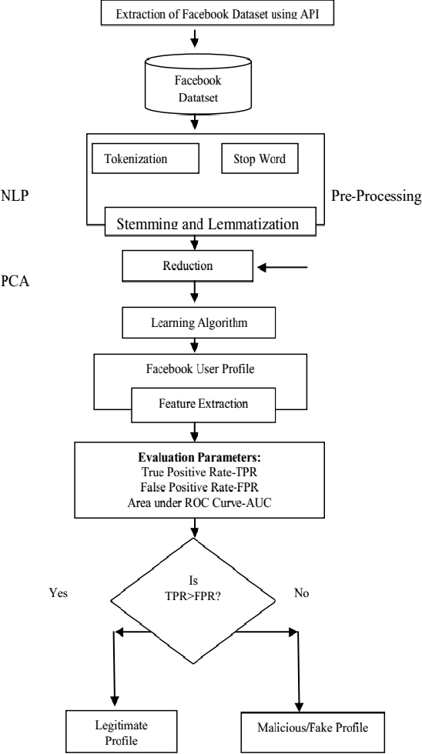
Fake Profile Detection
The classifier may not be 100% accurate in classifying the profile so; the feedback of the result is given back to the classifier. This process repeats and as the time proceeds, the no. of training data increases and the classifier becomes more and more accurate in predicting the fake profiles.

Slide 10
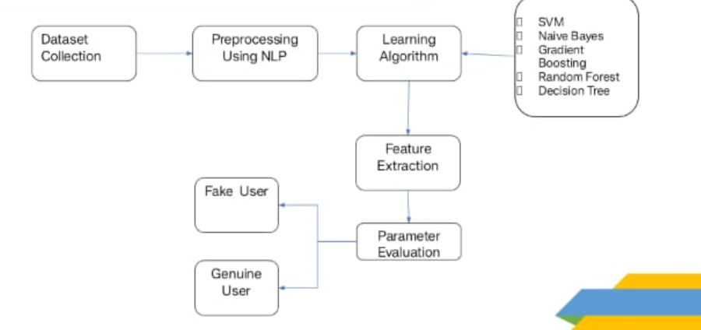
Fake Profile Detection
System Architecture:

Slide 11
Fake Profile Detection
Machine Learning Algorithms
For Fake Profile Identification using Machine Learning and NLP, several machine learning algorithms were employed to classify social media profiles as real or fake. Each algorithm was chosen based on its suitability for classification tasks, its ability to handle large datasets, and its performance in identifying patterns within both structured and unstructured data.
Algorithms Used:
1. Random Forest Classifier: Random Forest is an ensemble learning method that builds multiple decision trees during training and outputs the class that is the mode of the classes of individual trees. It reduces overfitting compared to a single decision tree and provides high accuracy by combining the predictions of multiple trees.
why it is used: Random Forest was chosen for its robustness in handling large datasets and its ability to capture complex relationships between features. It also performs well with both numerical and categorical data, making it ideal for this project where the dataset contains mixed types of features.
2. Gradient Boosting Classifier: Gradient Boosting is an ensemble technique that builds models sequentially, with each model attempting to correct the errors made by its predecessor. It uses a boosting strategy, where weak learners (often decision trees) are combined to create a strong model.
Why It is Used: Gradient Boosting was used for its ability to handle imbalanced datasets and its focus on correcting misclassified profiles. It is particularly effective in identifying difficult-to-classify cases, making it useful for detecting subtle patterns in fake profiles.

Slide 12
Fake Profile Detection
3.Support Vector Machine (SVM):SVM is a powerful classifier that works by finding the optimal hyperplane that best separates the data points into two categories. It is particularly effective in high-dimensional spaces.
Why It Was Used: SVM was chosen for its ability to handle large feature spaces and its effectiveness in situations where the dataset is highly dimensional, as seen with the various features extracted from user profiles.
4.Naïve BayesNaïve Bayes: It is a probabilistic classifier based on Bayes’ Theorem, with the assumption of independence between features. Despite this strong assumption, it works well in many real-world scenarios.
Why It Was Used: Naïve Bayes was implemented due to its simplicity and efficiency in handling text data (such as bios and comments). It’s especially useful when working with natural language processing (NLP) tasks.

Slide 13
Fake Profile Detection
5.Decision Tree: Decision Tree is a non-parametric supervised learning method used for classification. It works by recursively splitting the dataset based on certain criteria to create a tree of decisions that leads to the classification of the input data.
Why It Was Used: Decision Tree was selected for its simplicity and ease of interpretation. It provides clear rules that help explain why a profile is classified as real or fake.
The models were chosen for the following reasons:-
Diverse Approaches: Each model represents a different approach to classification—ensemble methods (Random Forest, Gradient Boosting), linear classifiers (SVM), probabilistic models (Naïve Bayes), and rule-based methods (Decision Tree). This allowed for a comprehensive evaluation of which method performs best in identifying fake profiles.
Handling Imbalanced Data: Many machine learning tasks suffer from class imbalance, where fake profiles are fewer than real ones. Models like Gradient Boosting and Random Forest are well-suited for such problems by focusing on misclassified instances or using ensemble techniques.

Slide 14
Fake Profile Detection
Conclusion:
This project has successfully demonstrated the application of various machine learning algorithms for the detection of fake profiles on social media platforms. By leveraging classification techniques such as Support Vector Machine (SVM), Random Forest, Gradient Boosting, Naïve Bayes, and Decision Tree classifiers, we were able to achieve significant results in terms of accuracy and efficiency.
The Random Forest Classifier was the most effective model, achieving 100% accuracy. This indicates its robustness and reliability in identifying fake profiles. Random Forest’s ensemble method, which aggregates the decisions from multiple decision trees, contributed to its superior performance.
Its ability to handle large datasets with high dimensionality and its resistance to overfitting are key factors in achieving such high accuracy.
On the other hand, the Gradient Boosting Classifier also showed promising results, with an accuracy of 86%. Gradient Boosting, by focusing on correcting errors from previous models, provides a solid alternative to Random Forest. However, it is slightly less effective in cases where there are missing data points or incomplete profiles, as it requires more computational resources and time to train.

Slide 15
Fake Profile Detection
The comparative analysis of these models highlights the importance of choosing the right algorithm based on the nature of the data and the specific objectives of the project.
While Random Forest is ideal for general classification tasks, Gradient Boosting can be a valuable choice when dealing with more complex datasets or when higher precision is needed in certain areas.In future work, more advanced techniques like deep learning or multi-modal learning can be explored to further improve the model's accuracy and scalability.
Additionally, implementing real-time detection systems could enhance the practical applicability of this research, especially for large social media platforms dealing with millions of profiles.This project has provided a foundational understanding of how machine learning algorithms can be employed for fake profile detection, setting the stage for future research and development in this area.

Slide 16
References:
[1] Michael Fire et al. (2012). "Strangers intrusion detection- detecting spammers and fake profiles in social networks based on topology anomalies." Human Journal 1(1): 26-39.Günther, F. and S. Fritsch (2010). .
[2] Dr. S. Kannan, Vairaprakash Gurusamy, “Preprocessing Techniques for Text Mining”, 05 March 2015.
[3] Shalinda Adikari and Kaushik Dutta, Identifying Fake Profiles in LinkedIn, PACIS 2014 Proceedings, AISeL

