Slide 1

Azure Capstone Project -Portuguese Bank data
Namratha yeluri
F09593

Slide 2
Overview
GitHub
Azure Data Lake Storage
Azure Databricks
Azure Datafactory
Logic App & Web Activity
Azure Synapse

Slide 3

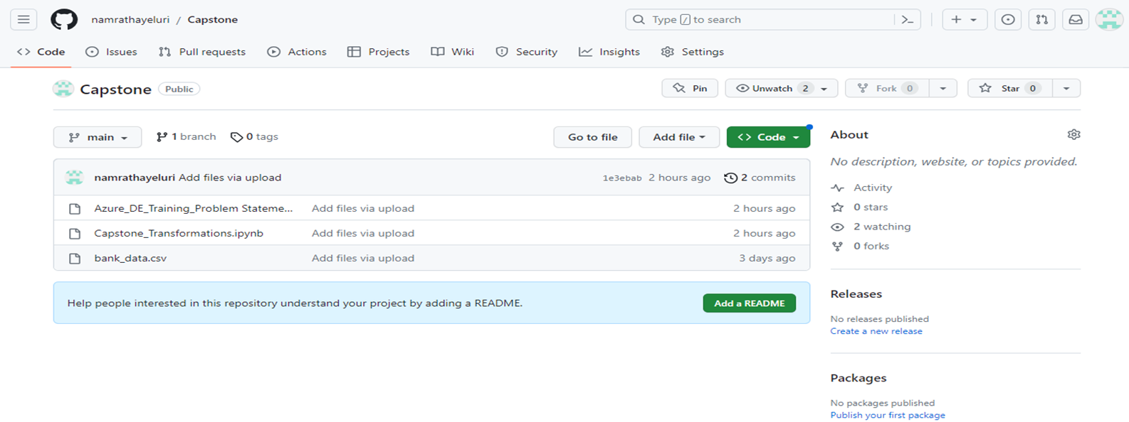
GitHub
Created a GitHub repository to store all documents related to project
In GitHub, Uploaded Problem statement, Dataset and Azure Notebook used for transformation.
GitHub Link → https://github.com/namrathayeluri/Capstone

Slide 4

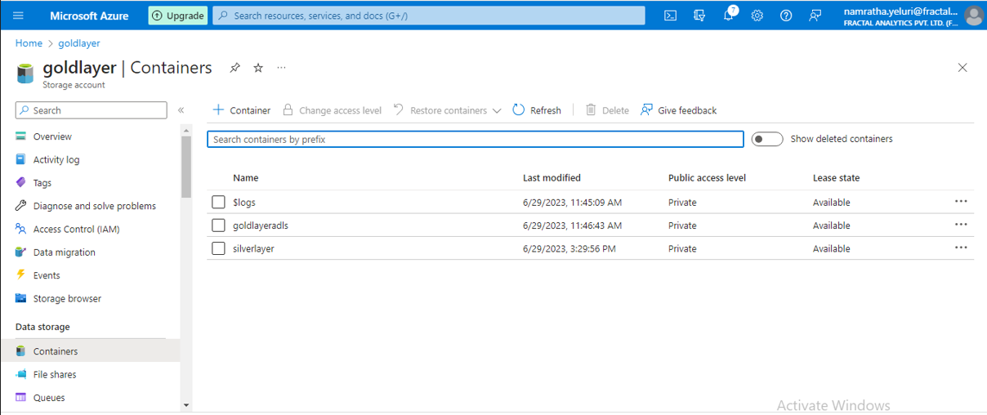
Azure Data Lake Storage
Created Two storage accounts
→One for Bronze Layer
→One for Silver & Gold Layer
Imported data directly from GitHub to Bronze layer container through DataFactory Pipeline with Copydata activity.
After making the transformations to the dataset imported from bronze layer, the updated data set in stored in Gold Layer.
Uploaded raw dataset to Silver layer

Slide 5
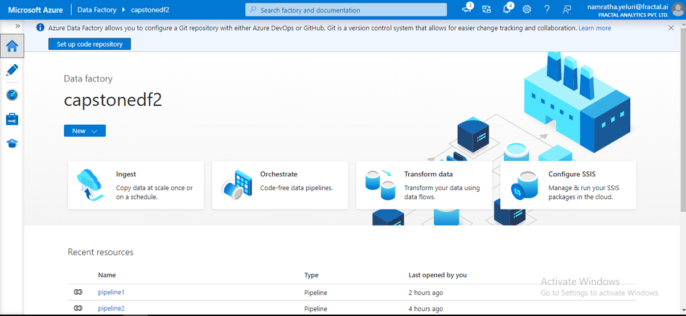

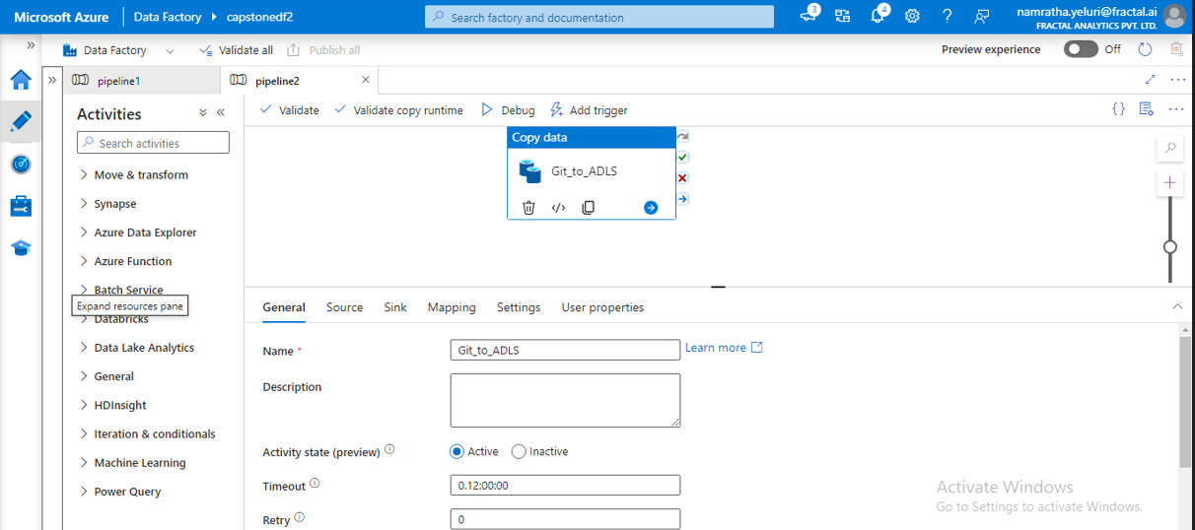
Azure Data Factory
In Azur Data Factory, created two pipelines
→Pipeline 1: Azure notebook to Web activity
→Pipeline 2: To copy data from GitHub to ADLS Bronze layer

Slide 6
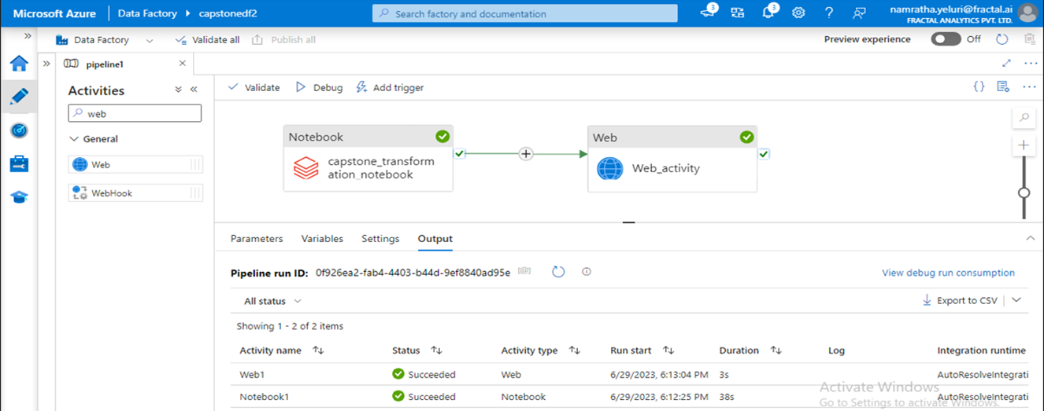
Final Pipeline in Data factory

Slide 7
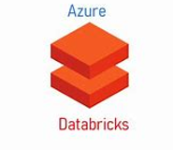
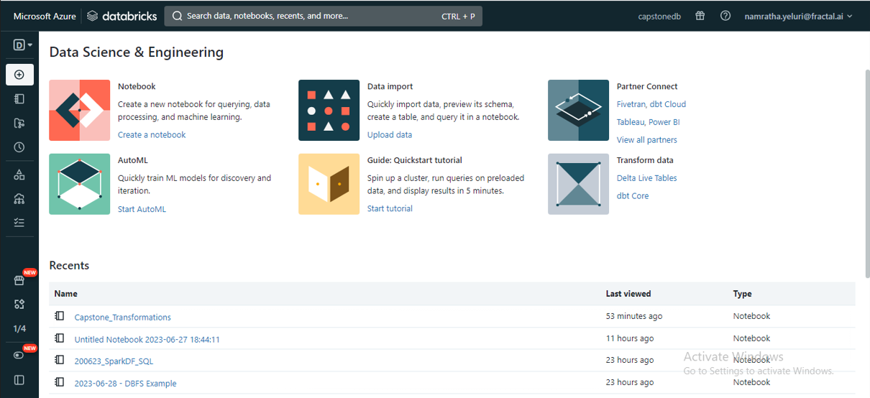
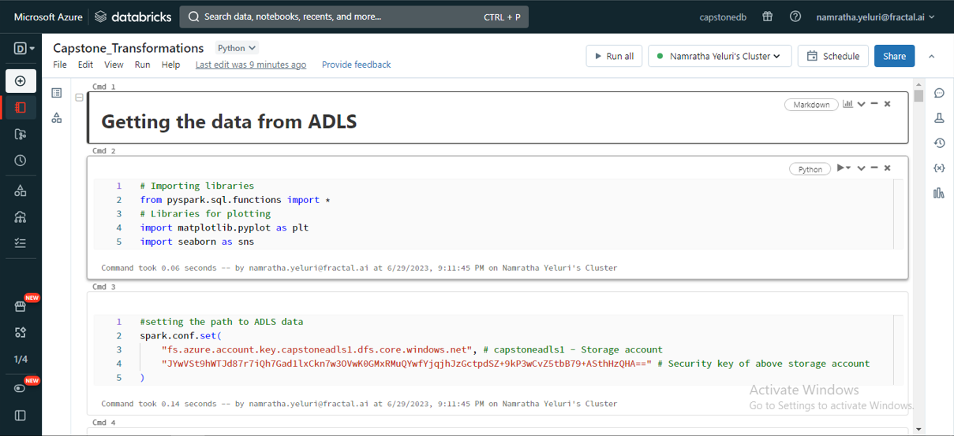
Azure DataBricks
Create Databricks workspace
Under workspace tab created new notebook.
In Notebook, Imported raw data from ADLS bronze layer.
After, performed required transformation activities.
After transformations data write back to ADLS Gold layer.

Slide 8
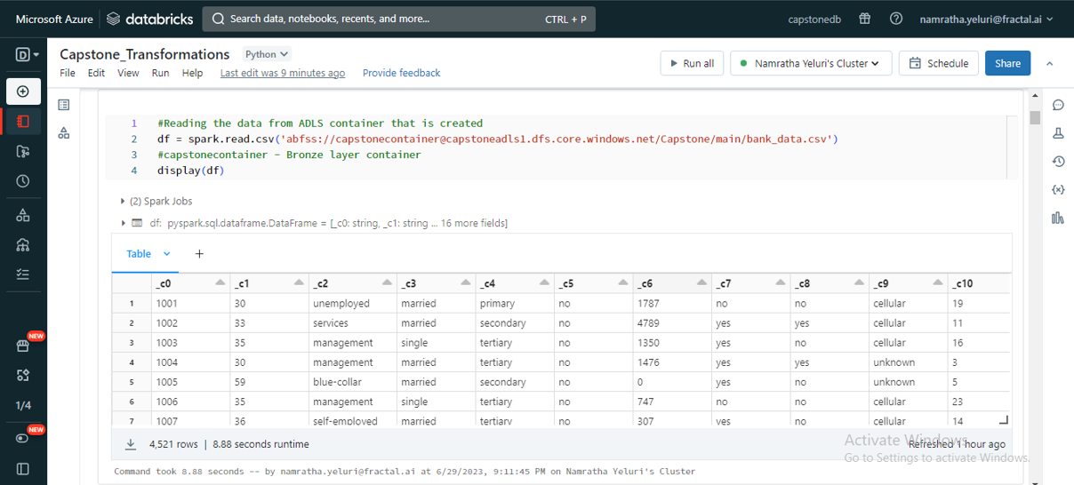
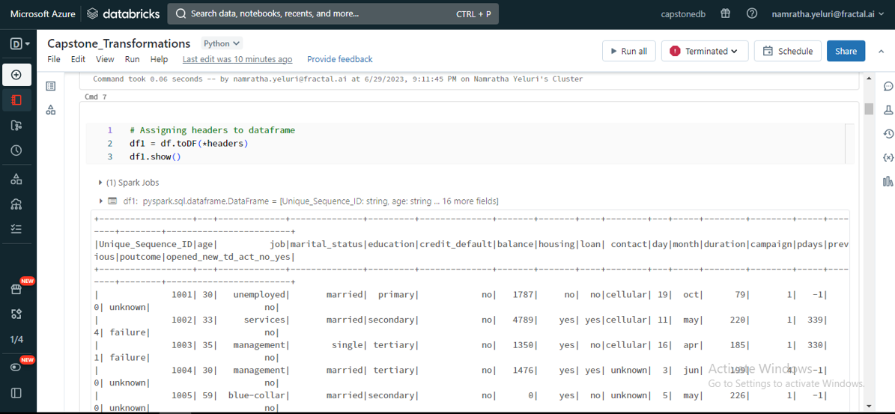
Transformations in ADB Notebook
Raw Data from Bronze layer
After assigning headers to the data

Slide 9

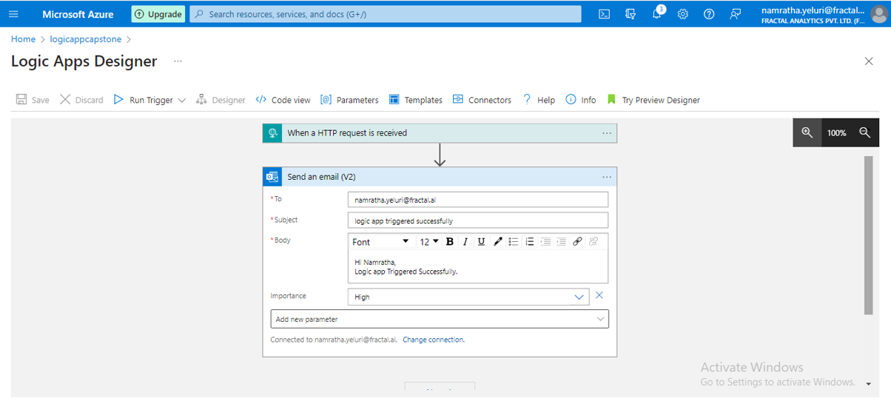
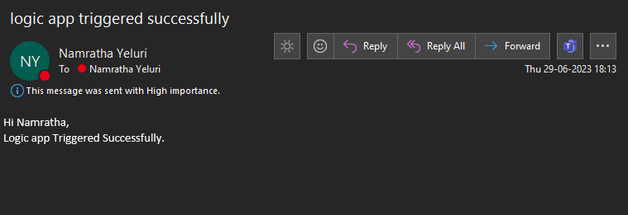
Logic App & Web Activity
Create Logic apps service
Go to Logic app designer to trigger the message once the action is done.
Select “When a HTTP request is received” trigger and select “Send an email” action to get the message.
Connect the logic app with the web activity to get the message once the web activity runs successfully.

Slide 10

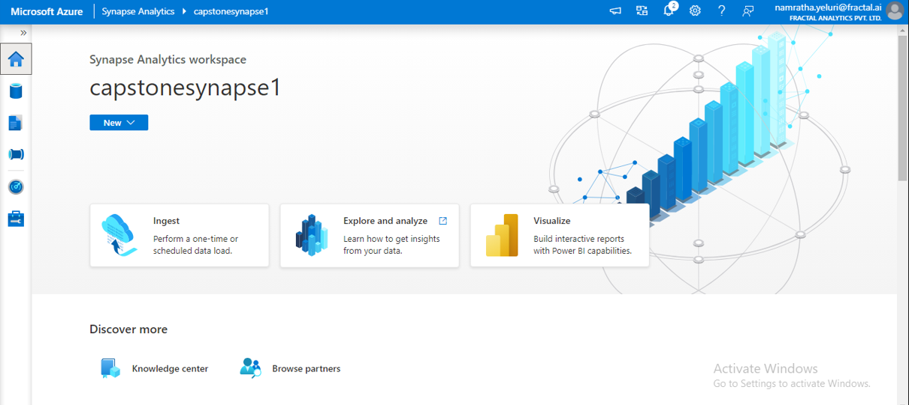
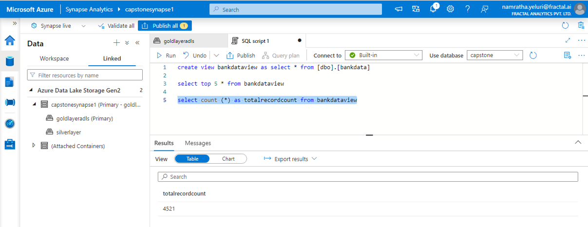
Azure Synapse
Created Azure Synapse workspace.
Created a view in Synapse using Serverless SQL and imported data into view from Gold layer.
Displayed the data from the view by SQL query.

Slide 11
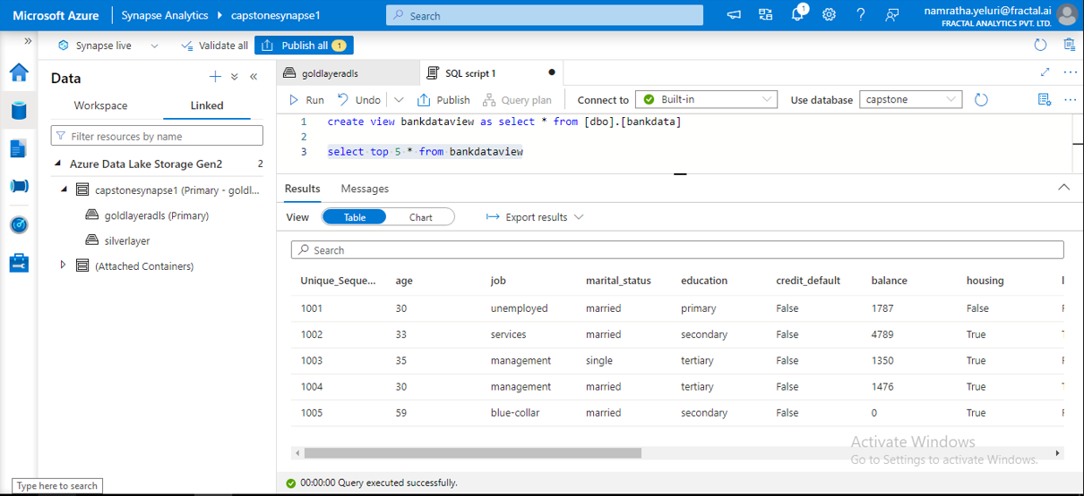
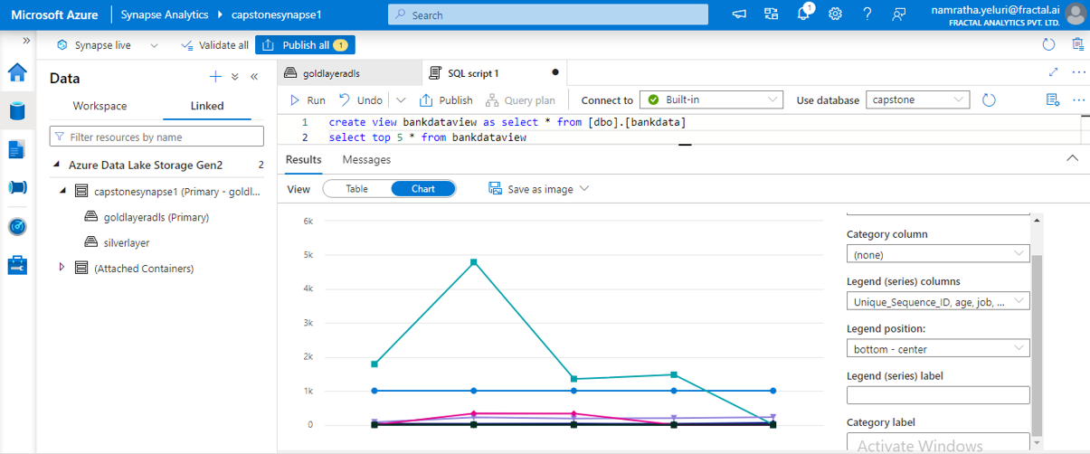
Creating View in Synapse
Top 5 rows from the dataset imported from Gold layer

Slide 12

Thank You

