Slide 1
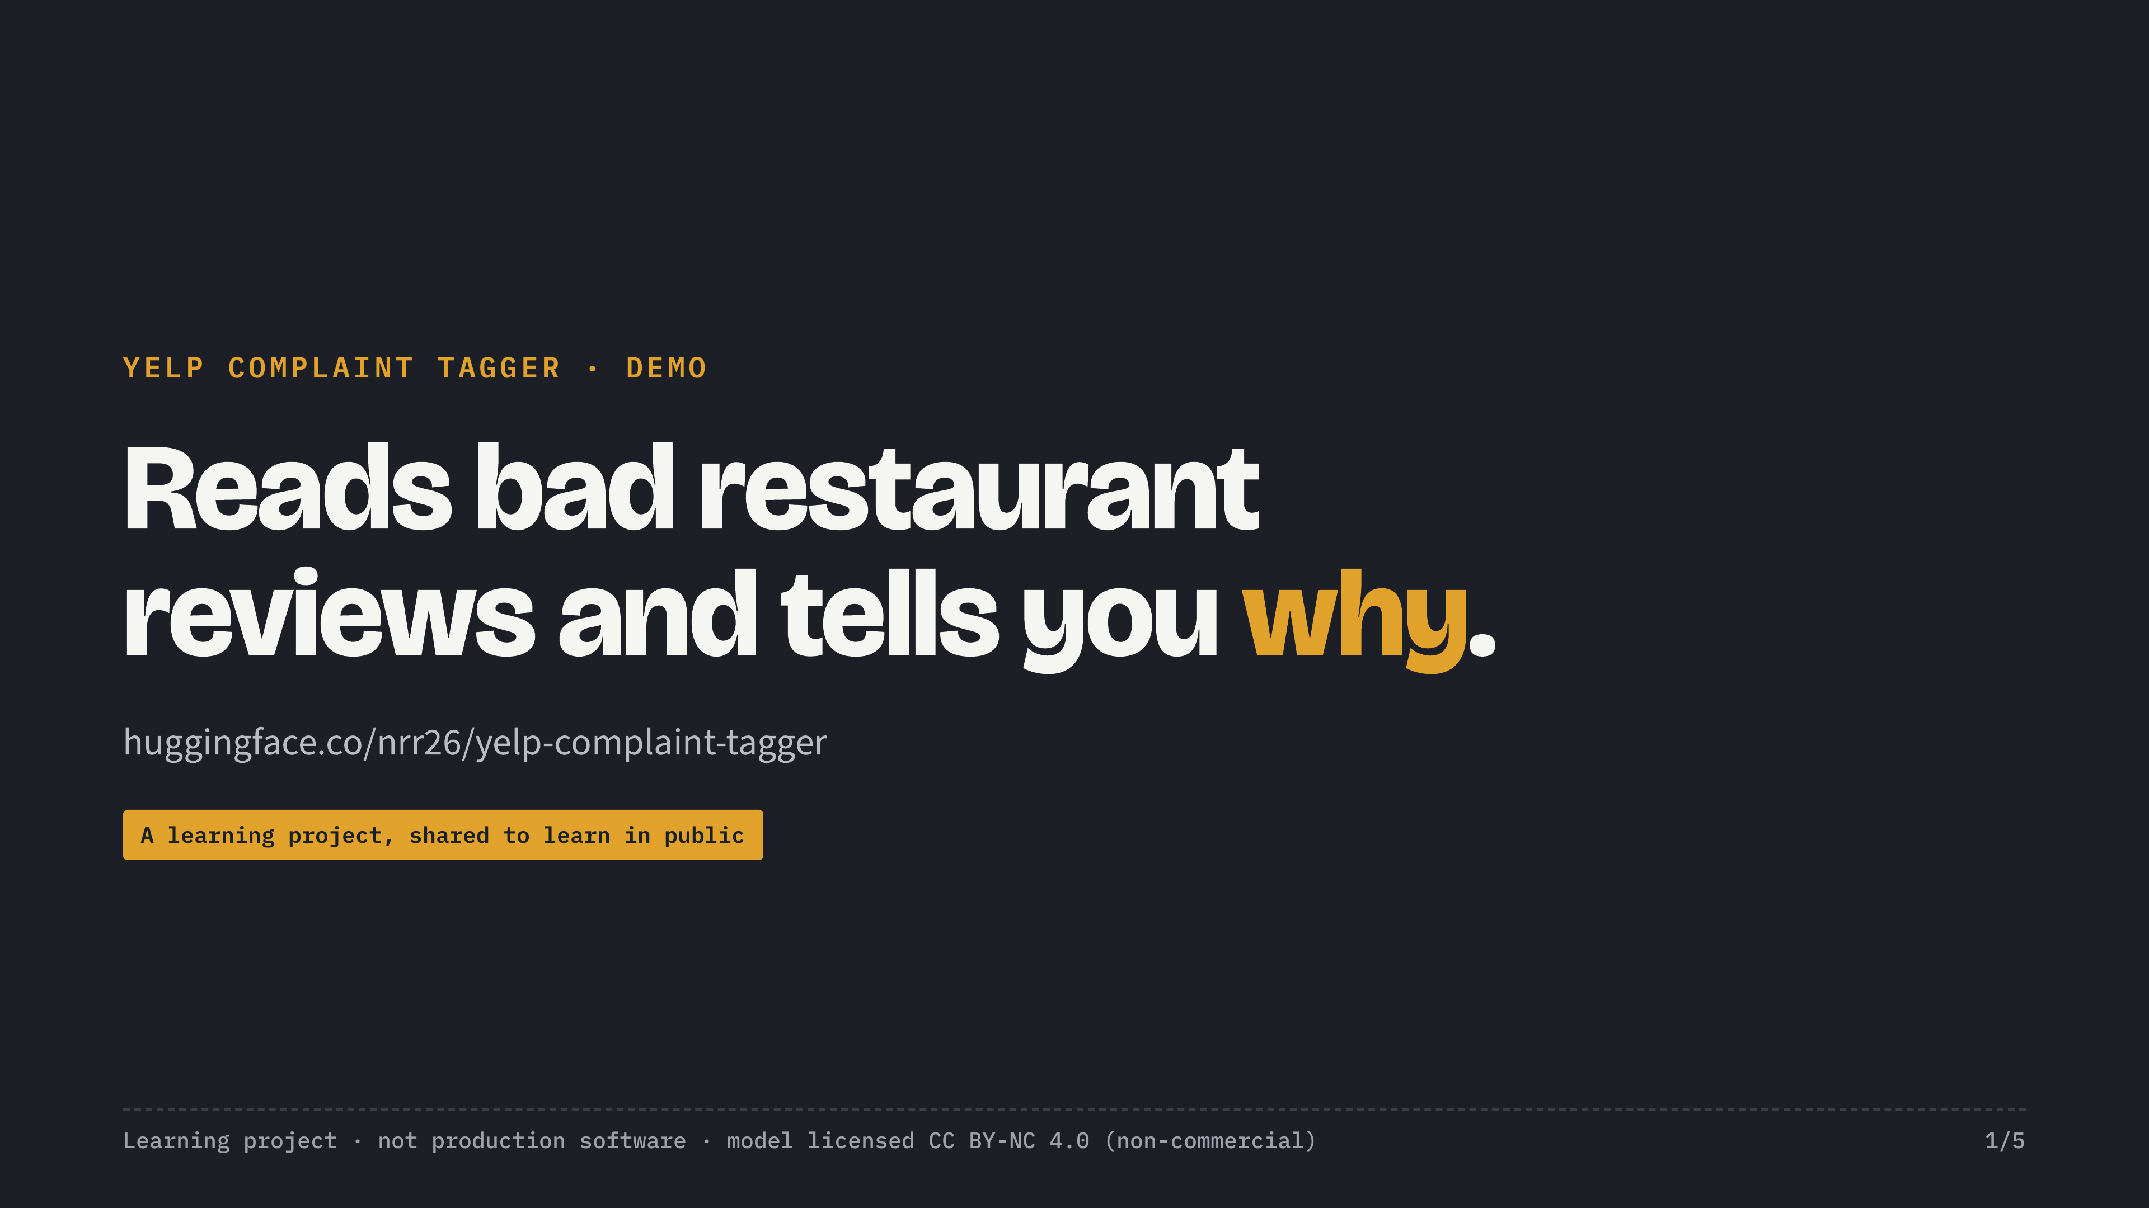
Notes:
Title card. Show for 3 seconds at the start and as the last frame.

Slide 2
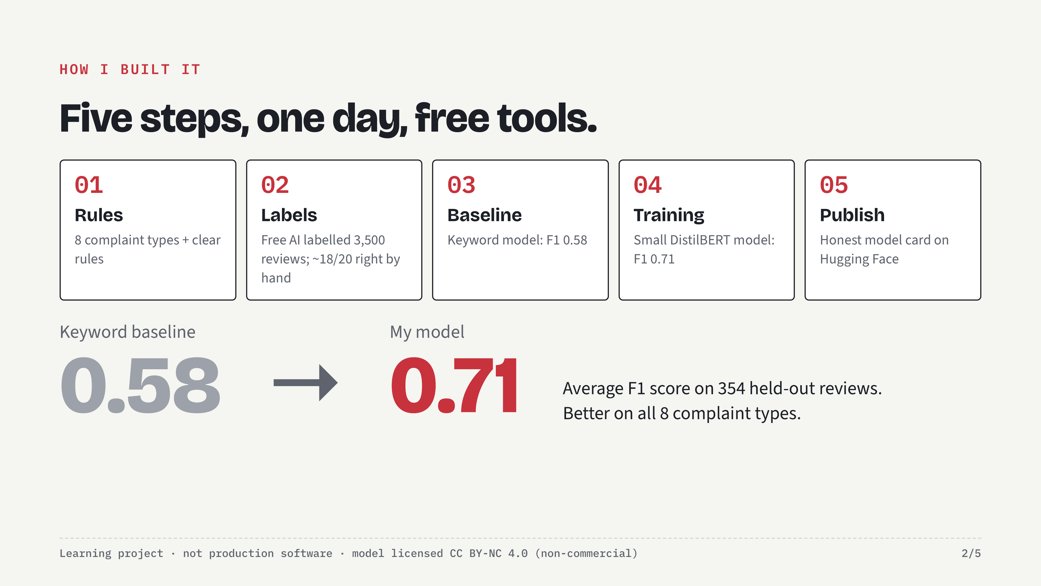
Notes:
How did I build it? In one day, with free tools. First, I wrote a short labelling guide: eight complaint types and a few clear rules. For example, praise is not a complaint, and slow service is not the same as rude service. Second, a free open-source AI model labelled 3,500 real Yelp reviews using that guide. I checked its work by hand. About 18 out of 20 were right. Third, I trained a small, fast model on those labels. Small means it's cheap to run on thousands of reviews. On a standard quality score, the F1 score, it went from 0.58 for a keyword approach to 0.71. It beats the keyword approach on all eight complaint types.

Slide 3
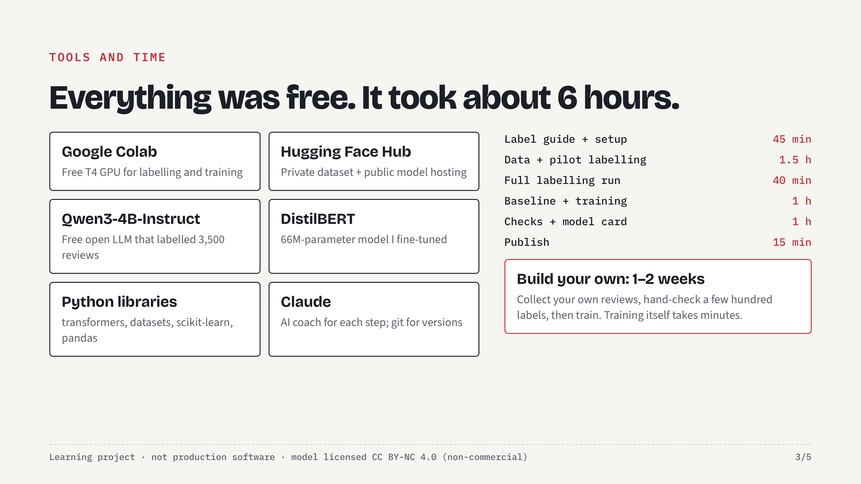
Notes:
Everything I used is free. Google Colab gave me a free GPU. Hugging Face hosts the data and the model. An open-source AI model did the first round of labelling, and DistilBERT is the small model I trained. It took me about six hours, with an AI coach walking me through each step. If you want a model for your own business, plan on about one to two weeks. Most of that time goes into collecting your own reviews and checking a few hundred labels by hand. The training itself takes minutes.

Slide 4
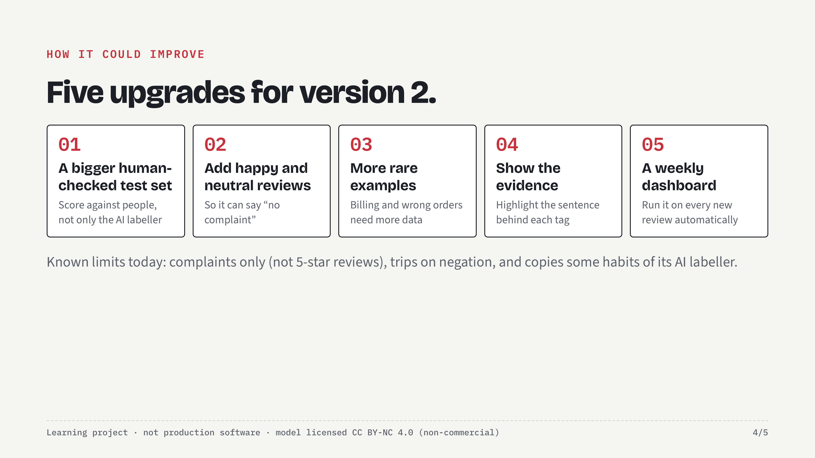
Notes:
Here is how I would make it better. First, a larger hand-checked test set, a few hundred reviews, so the score reflects people, not just the AI labeller. Second, train it on happy and neutral reviews too, so it can say 'no complaint'. Third, more examples for the rare complaints, like billing and wrong orders. Fourth, show the exact sentence behind each tag, so a manager can trust it at a glance. And finally, a simple dashboard that runs it on every new review, every week.

Slide 5
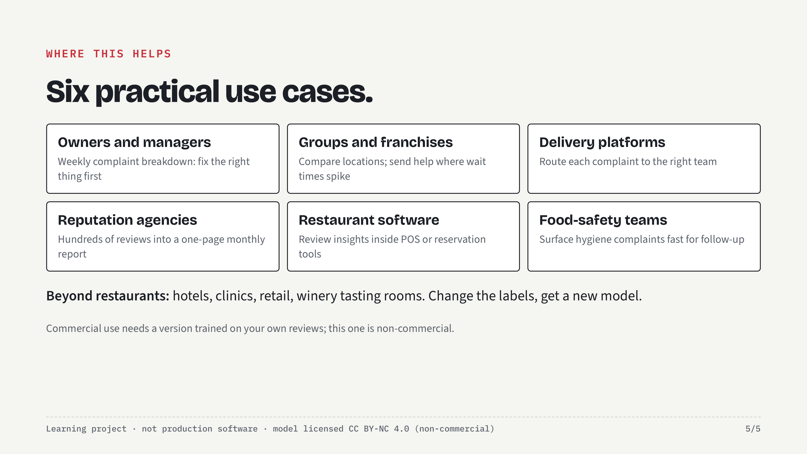
Notes:
So where could this be useful? Here are six practical use cases. One. Restaurant owners and managers: a weekly complaint breakdown, so you fix the right thing first. Two. Restaurant groups and franchises: compare locations. If one store has twice the wait-time complaints, you know where to send help. Three. Delivery and ordering platforms: send each complaint to the right team. Order mistakes go to the kitchen, billing goes to finance. Four. Reputation and marketing agencies: turn hundreds of client reviews into a one-page monthly report. Five. Restaurant software companies, like point-of-sale or reservation platforms: build review insights into the product. Six. Food-safety teams: surface hygiene complaints fast, so a person can follow up. The same approach works beyond restaurants: hotels, clinics, retail, or wineries with tasting rooms. Change the labels, and you have a new model.

