Slide 1
OpenGL Primitive Drawing
Jung Lee

Slide 2
OpenGL-related Sites
OpenGL official site
http://www.opengl.org/
Khronos group
http://www.khronos.org/
Nehe productions
http://nehe.gamedev.net/

Slide 3
OpenGL Necessary Files
Latest OpenGL version: 4.4
Required files
Header File
gl.h, glaux.h, glu.h, glut.h
To the ‘include’ directory
Static Library
opengl32.lib, glaux.lib, glu32.lib, glut32.lib
To the ‘lib’ directory
Dynamic Library
opengl32.dll, glu32.dll, glut.dll, glut32.dll
C:\WINDOWS\system32

Slide 4
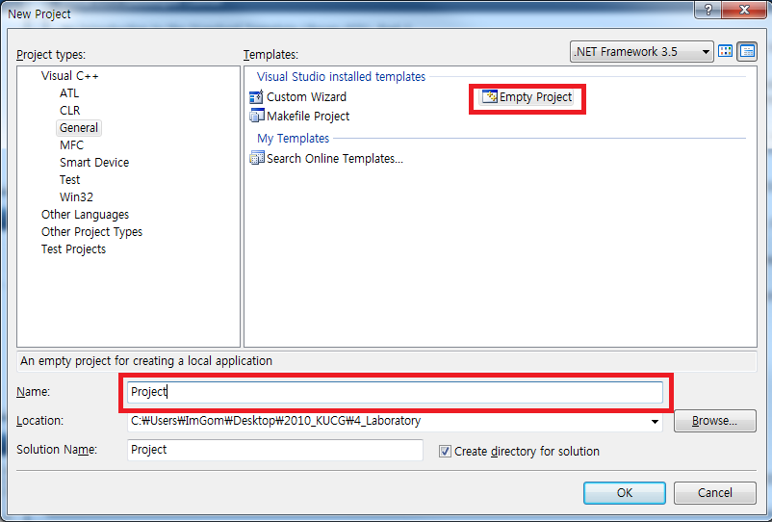
Project Creation[Visual Studio 2008] (1/2)
[File] → [New] (Ctrl+Shift+N)
[Project types] → [General]
[Templates] → [Empty Project]
Enter the project file name

Slide 5
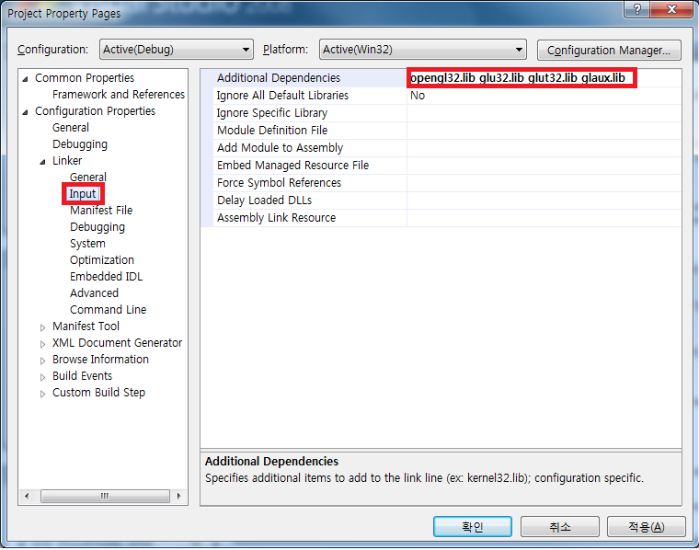
Project Creation[Visual Studio 2008] (2/2)
[Project] → [Settings…] (Alt+F7)
[Link] → [Input] → [Additional Dependencies]
Type ‘opengl32.lib glu32.lib glut32.lib glaux.lib’

Slide 6
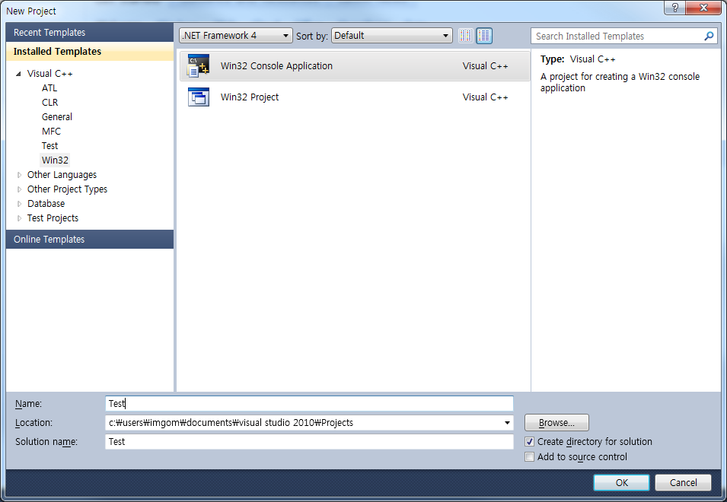
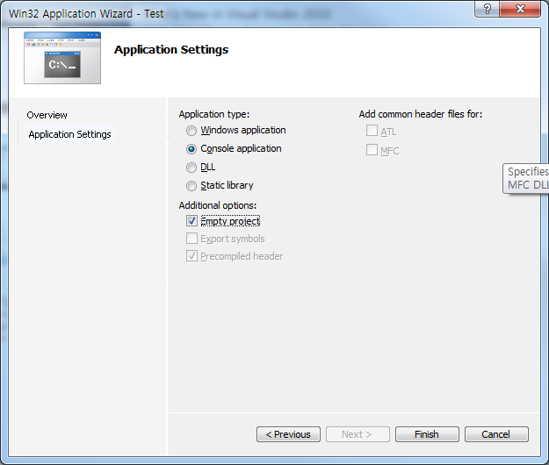
Project Creation[Visual Studio 2010] (1/2)
[File] → [New] → [Project] (Ctrl+Shift+N)
[Visual C++] → [Win32] → [Win32 Console App]
Enter the project name
[Empty project]

Slide 7
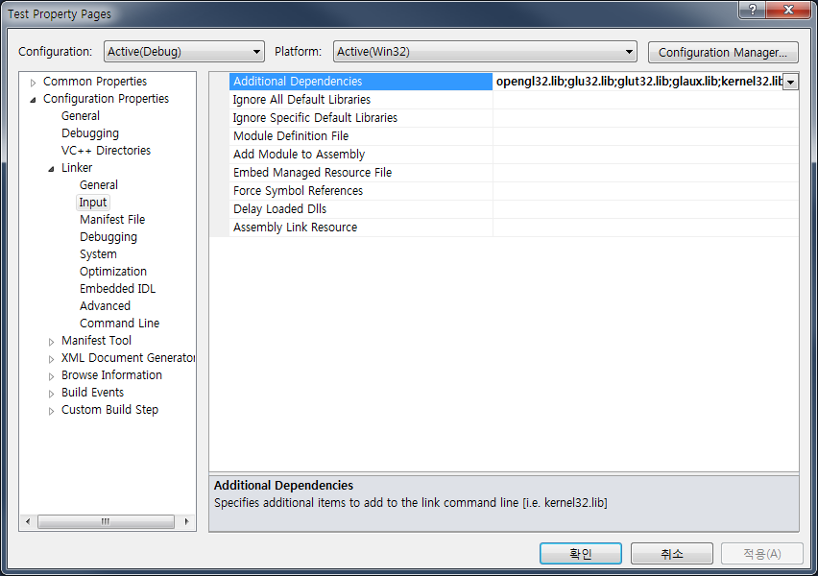
Project Creation[Visual Studio 2010] (2/2)
[Project] → [Properties] (Alt+F7)
[Configuration Properties] → [Linker] → [Input]
[Additional Dependencies]
Type ‘opengl32.lib glu32.lib glut32.lib glaux.lib’

Slide 8
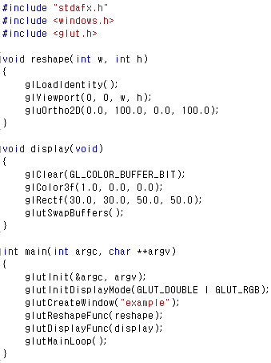
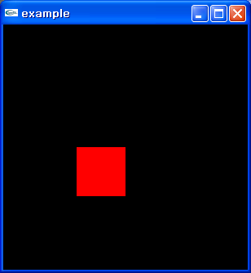
Rectangle Example

Slide 9
OpenGL Primitives
Point
GL_POINTS
Line
GL_LINES | GL_LINE_STRIP | GL_LINE_LOOP
Polygon
GL_POLYGON
GL_TRIANGLES | GL_TRIANGLE_STRIP | GL_TRIANGLE_FAN
GL_QUAD_STRIP

Slide 10
3D Point
Specifies a 3D location
Represented by three coordinates
Infinitely small
GL_POINTS
glBegin(GL_POINTS);
glVertex3f(v1x, v1y, v1z);
glVertex3f(v2x, v2y, v2z);
glVertex3f(v3x, v3y, v3z);
glVertex3f(v4x, v4y, v4z);
glEnd();
(x, y, z)
v1
v2
v4
v3

Slide 11
3D Line Segment
P₂
Linear combination of two points
Parametric representation
P=P₁+t(P₂ - P₁), (0 ≤ t ≤ 1)
GL_LINES
glBegin(GL_LINES);
glVertex3f(v1x, v1y, v1z);
glVertex3f(v2x, v2y, v2z);
glVertex3f(v3x, v3y, v3z);
glVertex3f(v4x, v4y, v4z);
glEnd();
P₁
v1
v2
v4
v3

Slide 12
3D Connected Lines
v1
v2
GL_LINE_STRIP
glBegin(GL_LINE_STRIP);
glVertex3f(v1x, v1y, v1z);
glVertex3f(v2x, v2y, v2z);
glVertex3f(v3x, v3y, v3z);
glVertex3f(v4x, v4y, v4z);
glEnd();
GL_LINE_LOOP
glBegin(GL_LINE_LOOP);
glVertex3f(v1x, v1y, v1z);
glVertex3f(v2x, v2y, v2z);
glVertex3f(v3x, v3y, v3z);
glVertex3f(v4x, v4y, v4z);
glEnd();
v4
v3
v1
v2
v4
v3

Slide 13
3D Triangle
GL_TRIANGLES
glBegin(GL_TRIANGLES);
glVertex3f(v1x, v1y, v1z);
glVertex3f(v2x, v2y, v2z);
glVertex3f(v3x, v3y, v3z);
glEnd();
v1
v3
v2

Slide 14
3D Quadrilateral
GL_QUADS
glBegin(GL_QUADS);
glVertex3f(v1x, v1y, v1z);
glVertex3f(v2x, v2y, v2z);
glVertex3f(v3x, v3y, v3z);
glVertex3f(v4x, v4y, v4z);
glEnd();
v1
v4
v2
v3

Slide 15
3D Polygon
GL_POLYGON
glBegin(GL_POLYGON);
glVertex3f(v1x, v1y, v1z);
glVertex3f(v2x, v2y, v2z);
glVertex3f(v3x, v3y, v3z);
glVertex3f(v4x, v4y, v4z);
glVertex3f(v5x, v5y, v5z);
glVertex3f(v6x, v6y, v6z);
glEnd();
v1
v6
v2
v5
v3
v4

Slide 16
Basic Functions(1/2)
glPointSize(GLfloat size)
glGetFloatv(GL_POINT_SIZE_RANGE, array_address)
Returns the range of the point size that the hardware supports
glLineWidth(GLfloat width)
glGetFloatv(GL_LINE_WIDTH_RANGE, array_address)
Returns the range of the line width that the hardware supports

Slide 17
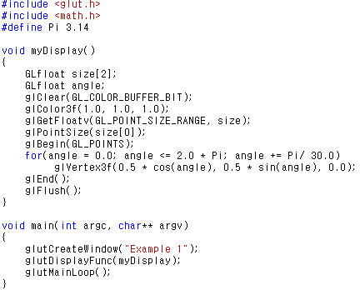
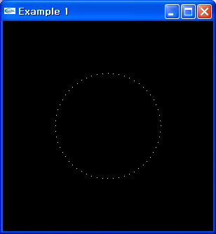
Point Example

Slide 18
Basic Functions(2/2)
glShadeModel(mode)
Sets the polygon filling method
mode
GL_FLAT
By only one color
GL_SMOOTH
By the weighted-averaging the colors of member vertices (gradation)
Default value

Slide 19
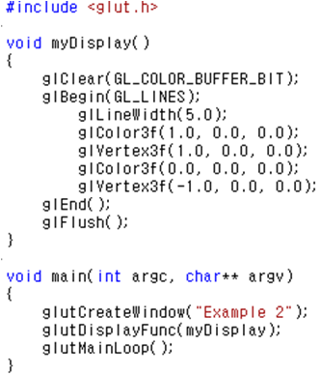
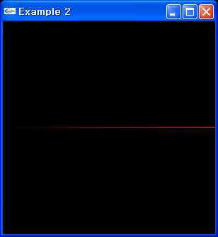
Line Example

Slide 20
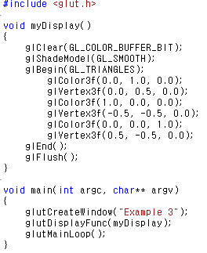
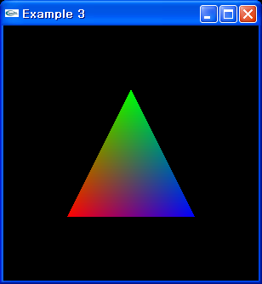
Triangle Example

Slide 21
‘Single vs. Double Buffering’ glFlush() vs. glutSwapBuffers()
Single buffering(GLUT_SINGLE, default)
Double buffering(GLUT_DOUBLE)
cf.) triple buffering
Graphic Processor
Frame Buffer
Video Controller
Display Device
Slow
Very Fast
Front Buffer
Graphic Processor
Video Controller
Display Device
Back Buffer

Slide 22
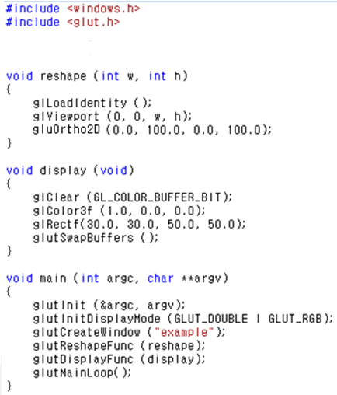
Rectangle Example : Revisited
Double
Single

Slide 23
Assignment #1
Modeling & rendering equilateral polygons
Within a (invisible) circle of 50 in diameter
A regular triangle
A regular pentagon
A regular hexagon
A regular dodecagon
Submission
Due date: 2015/03/17, 23:59
Program title: ID_1
Filename: ID_1.zip
Compressed source files only
T
P
H
D

