Slide 1
Vector and Matrix Algebra

Slide 2
Vector Algebra

Slide 3
Scalar vs. Vector
Scalar
Concept of magnitude
Size, length, …
Vector
Scalar + direction

Slide 4
Vector-valued Quantities
Force
Direction + strength
Displacement
Direction + distance of moving object …
Velocities
Direction + speed

Slide 5

Various Vectors
A user’s eye direction in a 3D environment
A facing direction of a polygon
Normal vector
Direction in which a ray of light travels

Slide 6
Drawing Vectors
Head
Tail

Slide 7
Point and Vector
Point(x, y, z)
A location in 3D space
No size or volume
Vector(x, y, z)
Direction + magnitude
Not fixed at specific location
Point can be represented as a vector

Slide 8
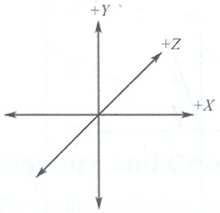
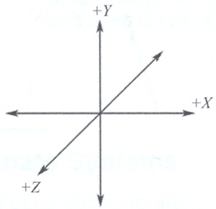
Coordinate Systems: Left-handed vs. Right-handed
Left-handed coordinate system
Direct3D
Right-handed coordinate system
OpenGL
Math textbooks
[Left-handed]
[Right-handed]

Slide 9
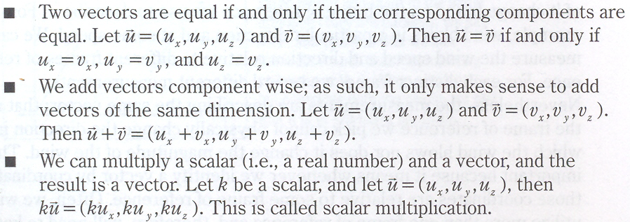

Basic Vector Operations
Equality
Addition/subtraction
Scalar multiplication

Slide 10
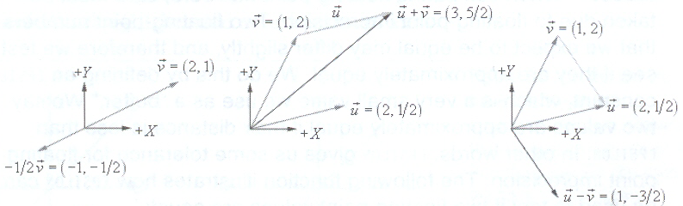
Geometric Interpretations
Scalar multiplication
Addition
Subtraction

Slide 11
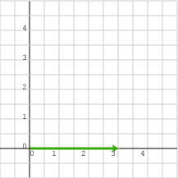
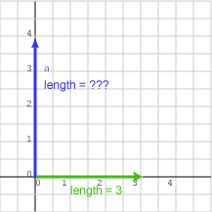
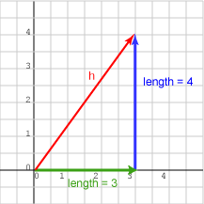
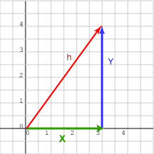
Vector Length(Norm/Magnitude)
[Pythagorean Formula]

Slide 12
Unit Vector
A vector with length 1
Normalization
Making a unit vector

Slide 13
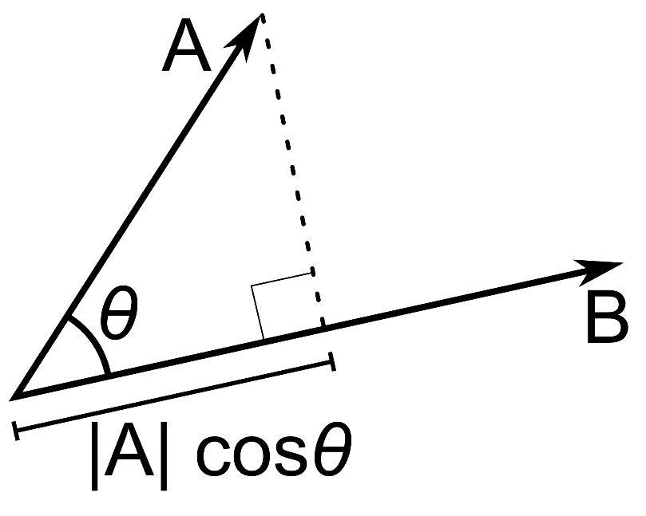
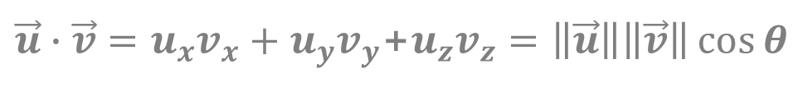



Dot (Inner/Scalar) Product
Dot product of two unit vectors
Result : scalar value
Thus, dot product is called scalar product
The value has a meaning
The sign of the product : directional relationship of two vectors
$\vec{u}∙\vec{v}=u_{x}v_{x}+u_{y}v_{y}$+$u_{z}v_{z}=\left\|\vec{u}\right\|\left\|\vec{v}\right\|\cos{θ}$
$$\vec{u}$$
$$\vec{v}$$
$$\left\|\vec{u}\right\|\cos{θ}$$

Slide 14
Meaning of Dot Product (between Unit Vectors)
0: orthogonal
1: same direction
-1: opposite direction
>0: less than 90°
<0: more than 90°
Important roles in graphics
Lighting
Reflection
Culling
etc.

Slide 15
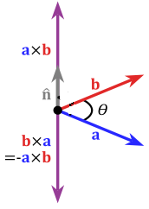



Cross (Outer/Vector) Product
Cross product of two vectors
is orthogonal to and
Result : vector
Thus, cross product is called vector product
$$\vec{w}=\vec{u}×\vec{v}=\left(\left(u_{y}v_{z}−u_{z}v_{y}\right),\left(u_{z}v_{x}−u_{x}v_{z}\right),\left(u_{x}v_{y}−u_{y}v_{x}\right)\right)$$
$$\vec{w}$$
$$\vec{u}$$
$$\vec{v}$$

Slide 16
Cross Product Example
$$\vec{w}=\vec{u}×\vec{v}=\left(\left(u_{y}v_{z}−u_{z}v_{y}\right),\left(u_{z}v_{x}−u_{x}v_{z}\right),\left(u_{x}v_{y}−u_{y}v_{x}\right)\right)$$
A (1, 0, 0), B (0, 1, 0)
C = A x B = (0x0-0x1, 0x0-1x0, 1x1-0x0)
= (0, 0, 1)
A, B, and C are the basic coordinate axes

Slide 17
Cross Product Application 3D Plane Equation
Linear combination of three points
Implicit representation
cf.) parametric representation
P·N - d = 0, or
ax + by + cz - d = 0
d
Nearest distance to the plane from the origin
Along the orthogonal direction to the plane
N=P₂P₃xP₂P₁=(a, b, c)
P₁
P₃
P₂

Slide 18
Cross Product Application 3D Plane Example
Find the plane equation for the following 3 points
P₁(1, -1, 1), P₂(2, 0, 1), P₃(-1, 1, 0)
3D plane equation : P·N - d = 0
Solution
First, find the normal vector N
N = P₂P₃ x P₂P₁
P₂P₃ = P₃ - P₂ = (-3, 1, -1)
P₂P₁ = P₁ - P₂ = (-1, -1, 0)
N = (-1, 1, 4)
Then we can get the distance d
P·N – d = P₂·N – d = (2, 0, 1)·(-1, 1, 4) – d = 2 – d = 0
d = 2
∴ P·(-1, 1, 4) - 2 = 0
N=P₂P₃xP₂P₁=(a, b, c)
P₁
P₃
P₂

Slide 19
Cross Product Application Positive (Negative) Half-space
Positive half-space
Space in front of the plane
Negative half-space
Space behind the plane
On the plane

Slide 20
Cross Product Application Point-Plane Spatial Relation
P·N - d > 0
Point in the positive half-space
P·N - d < 0
Point in the negative half-space
P·N - d = 0
Point on the plane
N
P₁
P₂
d₂ < d < d₁

Slide 21
Vector Data Structure Prototype
class VECTOR
{
public:
float Magnitude();
float InnerProduct(VECTOR v);
VECTOR CrossProduct(VECTOR v);
float x;
float y;
float z;
};
float VECTOR::Magnitude()
{
return sqrt(x * x + y * y + z * z);
}
float VECTOR::InnerProduct(VECTOR v)
{
return (x * v.x + y * v.y + z * v.z);
}
VECTOR VECTOR::CrossProduct(VECTOR v)
{
VECTOR result;
result.x = y * v.z - z * v.y;
result.y = z * v.x - x * v.z;
result.z = x * v.y - y * v.x;
return result;
}

Slide 22
Matrix Algebra

Slide 23
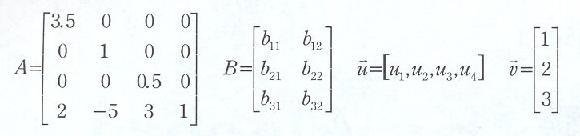
Matrix Examples
Matrix A : 4x4
Square matrix
Matrix B : 3x2
Matrix u : row vector
Matrix v : column vector

Slide 24
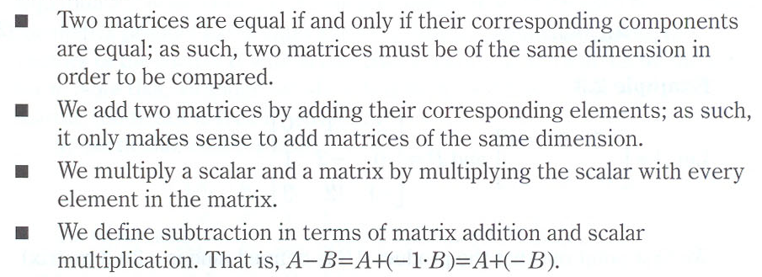
Basic Matrix Operations
Equality
Addition/subtraction
Scalar multiplication

Slide 25
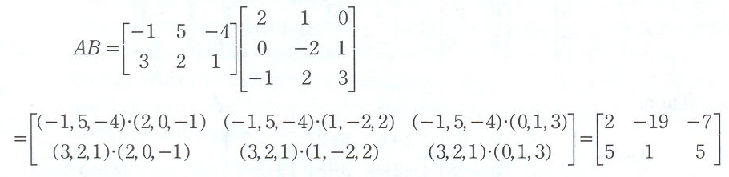


Matrix Multiplication
Associativity

Slide 26
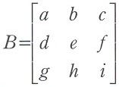


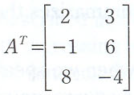
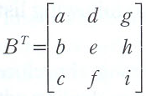

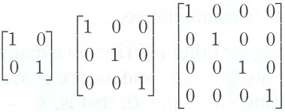

Various Matrices
Transpose of MxN matrix : NxM matrix
Identity matrix

Slide 27
Matrix Data Structure Prototype
class MATRIX
{
public:
MATRIX Add(MATRIX m);
MATRIX Subtract(MATRIX m);
MATRIX Multiply(MATRIX m);
MATRIX Transpose();
float ele[4][4];
float num_of_rows;
float num_of_columns;
};
MATRIX MATRIX::Add(MATRIX m)
{
MATRIX result;
for(int i = 0; i < num_of_rows; i++)
for(int j = 0; j < num_of_columns; j++)
result.ele[i][j] = ele[i][j] + m.ele[i][j];
return result;
}
MATRIX MATRIX::Multiply(MATRIX m)
{
int i, j, k;
MATRIX result;
for(i = 0; i < num_of_rows; i++)
for(j = 0; j < num_of_columns; j++)
result.ele[i][j] = 0.0;
if(num_of_columns == m.num_of_rows)
{
result.num_of_rows = num_of_rows;
result.num_of_columns = m. num_of_columns;
for(i = 0; i < num_of_rows; i++)
for(j = 0; j < m.num_of_columns; j++)
for(k = 0; k < num_of_columns; k++)
result.ele[i][j] += ele[i][k] * m.ele[k][j];
}
return result;
}

Slide 28
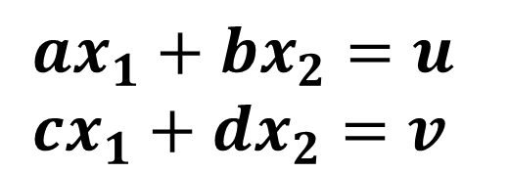
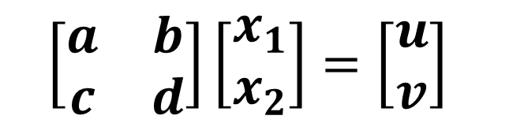
Matrix Application: Linear System
Two expressions are interchangeable
$$ax_{1}+bx_{2}=u \\ cx_{1}+dx_{2}=v$$
$$\left[\begin{matrix}a & b \\ c & d\end{matrix}\right]\left[\begin{matrix}x_{1} \\ x_{2}\end{matrix}\right]=\left[\begin{matrix}u \\ v\end{matrix}\right]$$

Slide 29
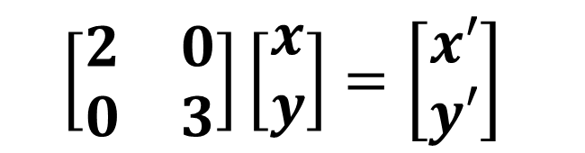
Scaling using Matrix Example
Multiplying x 2 times and y 3 times
x’ = 2x = 2x + 0y
y’ = 3y = 0x + 3y
$$\left[\begin{matrix}2 & 0 \\ 0 & 3\end{matrix}\right]\left[\begin{matrix}x \\ y\end{matrix}\right]=\left[\begin{matrix}x′ \\ y′\end{matrix}\right]$$

Slide 30
Linear System Example
Two lines
2x – y = 8
-x + 3y = 1
How can we obtain the crossing point of the two lines?

Slide 31
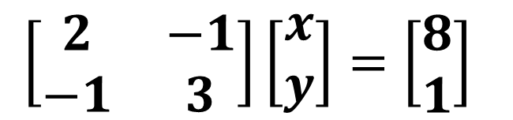
Linear Systems
$$\left[\begin{matrix}2 & −1 \\ −1 & 3\end{matrix}\right]\left[\begin{matrix}x \\ y\end{matrix}\right]=\left[\begin{matrix}8 \\ 1\end{matrix}\right]$$
A system with multiple linear equations (x = 5, y = 2)
Can be solved using various related algorithms
Gauss elimination
Gauss-Seidel relaxation
Conjugate gradient, etc.
Frequently represented as Ax = b
Special case - sparse system
Most elements of the matrix A are filled with 0
Wide rage of applications including computer graphics
Vector crossing / plane-vector crossing, etc.
Linear algebra, numerical analysis

Slide 32
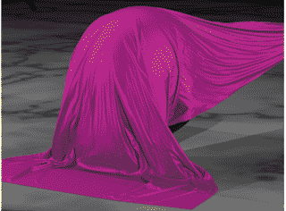
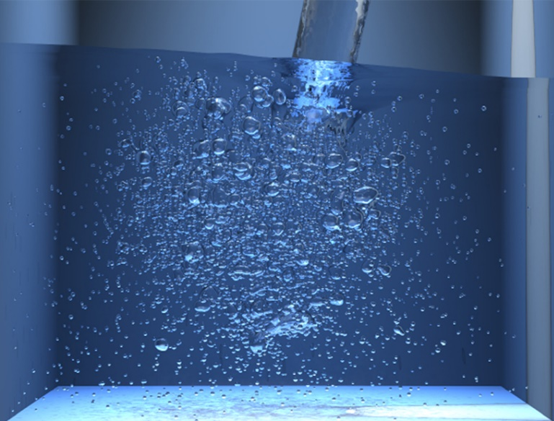
Applications in Computer Graphics
Various physical simulations
Cloth simulation
Fluid simulation
Object collision
Can’t be solved manually
The system is generally large
Numerical algorithms & PCs
Gauss-Seidel
Conjugate gradient, etc.
May not have a solution
Approximate using algorithms such as ‘Least squares’

Slide 33
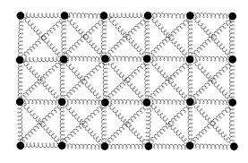
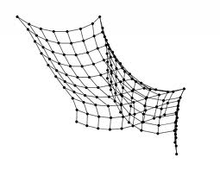
Cloth Simulation Overview
Cloth can be modeled as a group of particles
Interconnected like a grid
How can we simulate the deformation of the cloth?
When a part of the cloth is being pulled

Slide 34
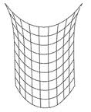
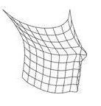
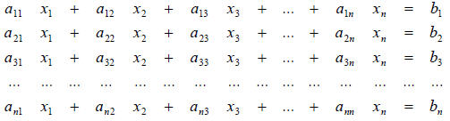
Cloth Simulation Example
Position of each particle
x_{i}
x_{i} can be modeled as a linear equation
ex) spring equation
The coefficients of the equation will be a_{ij}
The collection of the linear equations form a linear system
Which can be solved to get a solution
Force

Slide 35
Consistency of Linear System
Less equations than # of unknown variables
Under-determined
Same # of equations for # of unknown variables
More equations than # of unknown variables
Over-determined

Slide 36
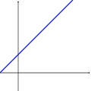
Less equations than # of unknown variables: Under-determined
No unique solution
All the points on the line are valid solution
Need more equations

Slide 37
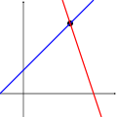
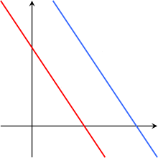
Same # of equations for # of unknown variables
Unique solution
Determinant is not 0
Linear solver
No solution
Determinant is 0

Slide 38
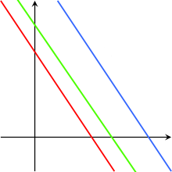
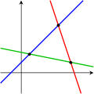
More equations than # of unknown variables: Over-determined
Unique solution
Redundant equations – Some equations are actually the same
No unique solution
Infinite set of solutions
Or no unique solution
Approximation is possible using some algorithms
ex) least squares
Approximated Solution

