Slide 1
Geometric Transformations

Slide 2
Geometric Transformations
Basic geometric transformations
Translation
Scaling
Rotation
Advanced geometric transformations
Homogeneous coordinate
Advanced 3D rotations
etc.

Slide 3
Geometric Transformations’ Roles
Positioning
Animation
Deformation
Camera control
etc.

Slide 4
3D Translation
y
T(t_{x}, t_{y}, t_{z})
x
z

Slide 5
3D Scaling
Not just for a size
Also for a position, which is a distance from the origin
y
x
z

Slide 6
Fixed-point Scaling
y
y
y
y
F
z
x
z
x
z
x
z
x
Original Position
Translation
Scaling
Inverse Translation

Slide 7
3D Rotations
Popular rotations about basic coordinate axes
x-axis rotation
y-axis rotation
z-axis rotation
General 3D rotations
Type 1
About an axis parallel to one of basic coordinate axes
Type 2
About an arbitrary axis

Slide 8
Rotations about Basic Coordinate Axes
Counter-clockwise rotation
z-axis Rotation
x-axis Rotation
y-axis Rotation
y
y
y
x
x
x
z
z
z

Slide 9
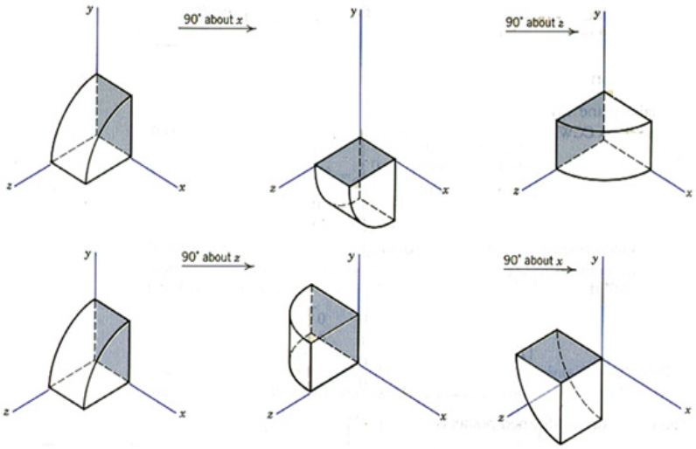
Order of rotations matters!!

Slide 10
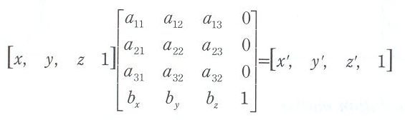
Homogeneous Coordinate in Mathematics
4th coordinate in 3D means …
The size of basic step of the coordinate system
ex) (1, 2, 3, 1) = (2, 4, 6, 2)

Slide 11


Homogeneous Coordinate in Computer Graphics
Integrates translation matrices into the multiplication scheme
Provides computational efficiency
ex) A complex object with a million vertices
To be scaled, rotated, and translated
1. Apply 3 transformation matrices to every vertex
No homogeneous coordinate
scale: 1m, rotation: 1m, translation: 1m
→ 3x3 matrix multiplication: 2m, 3x3 matrix addition: 1m
2. Apply just a pre-computed composite matrix
Careful with the order,
→ 4x4 multiplication: 2(for ), 4x4 multiplication: 1m

Slide 12
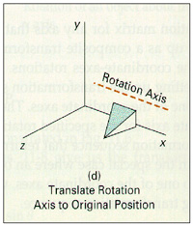
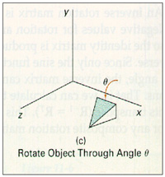
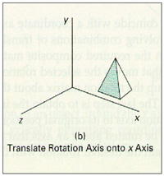
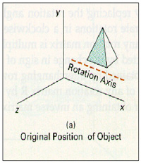
3D Rotation Type 1
About an axis parallel to a basic coordinate axis

Slide 13
3D Rotation Type 2
About an arbitrary axis
y
T
Translate (x₁, y₁, z₁) to the origin
(x₂, y₂, z₂)
R_{A}
Rotate (x₂’, y₂’, z₂’) on to the z axis
(x₁, y₁, z₁)
R
Rotate the object around the z-axis
x
R_{A}⁻¹
Rotate the axis to the original orientation
T⁻¹
Translate the rotation axis to the original position
z

Slide 14
Arbitrary Axis Rotation Process(1/5)
Step 1. Translate the tail vertex to the origin
y
(x₂, y₂, z₂)
(x₂ – x₁, y₂ – y₁, z₂ – z₁)
(x₁, y₁, z₁)
x
z

Slide 15
Arbitrary Axis Rotation Process(2/5)
Step 2. Rotate about x axis by α
y
(0, b, c)
(a, b, c)
Projected
Point
α
α
x
(a, 0, d)
z
Rotated
Point

Slide 16
Arbitrary Axis Rotation Process(3/5)
Step 3. Rotate about y axis clockwisely by β
= counterclockwisely by (-β)
y
Projected
Point
d
x
β
Rotated
Point
(a,0,d)
z

Slide 17
Arbitrary Axis Rotation Process(4/5)
Step 4. Rotate about z axis by θ
y
θ
x
z

Slide 18
Arbitrary Axis Rotation Process(5/5)
Step 5. Reverse all the transformations
To place the axis back in its initial position
y
x
z

Slide 19
Arbitrary Axis Rotation Matrix

Slide 20
To get the inverse of the rotation matrix
Just take its transpose
Every rotation matrix is a orthonormal matrix
Orthonormal matrix?
Characteristics
Each row vector is perpendicular to the other ones
Each column vector is perpendicular to the other ones
Every row & column vector is a unit vector
Inverse of orthonormal matrix
Its transpose matrix
All rotation matrices are definitely “orthonormal”

Slide 21
Orthonormality of Rotation Matrices
ex) z-axis rotation matrix
row vectors
(cosθ, -sinθ, 0, 0)
(sinθ, cosθ, 0, 0)
(0, 0, 1, 0)
(0, 0, 0, 1)
Perpendicular property
(cosθ, -sinθ, 0, 0)·(sinθ, cosθ, 0, 0) = cosθsinθ – sinθcosθ = 0
(cosθ, -sinθ, 0, 0)·(0, 0, 1, 0) = 0
(cosθ, -sinθ, 0, 0)·(0, 0, 0, 1) = 0
(sinθ, cosθ, 0, 0)·(0, 0, 1, 0) = 0
(sinθ, cosθ, 0, 0)·(0, 0, 0, 1) = 0
(0, 0, 1, 0)·(0, 0, 0, 1) = 0
Unit Vectors
z-axis rotation matrix → has perpendicular unit row/column vectors
→ orthonormal matrix

Slide 22
Reflection
Reflection to the xy plane
y
y
(a, b, c)
(a, b, -c)
x
x
z
z

Slide 23
3D Transformation Summary
General transformation matrix
4x4 square matrix
Scaling, Rotation, Reflection
Translation

Slide 24
Arbitrary Axis Rotation Example

Slide 25
Problem Description
Find the rotation matrix that rotates 90º about an axis by its endpoints A(2, 1, 0) and B(3, 3, 1)
Works to do
Translate the point A to the origin
T(-2, -1, 0)
Adjust the axis A’B’ to one of the coordinate axes
Rotate 90º
Reverse all the transformations

Slide 26
Step 1
Translate tail point A to the origin
T(-2, -1, 0)
y
B’(1, 2, 1)
A’(0, 0, 0)
x
z

Slide 27
Step 2
Rotate axis A’B’ about the x axis by α
Until it lies on the xz plane
y
(0, 2, 1)
B’(1, 2, 1)
l
α
x
B”(1, 0, )
z

Slide 28
Step 3
Rotate axis A’B’’ about the y axis by -β
Until it coincides with the z axis
y
l
x
β
(0, 0, )
B”(1, 0, )
z

Slide 29
Step 4
Rotate 90° about the z axis

Slide 30
Final Result

