Slide 1
Transformation Programming
Jung Lee

Slide 2
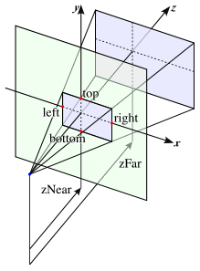
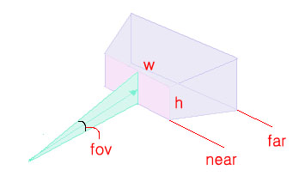
View Volume
void glOrtho(GLdouble left, GLdouble right, GLdouble bottom, GLdouble top, GLdouble zNear, GLdouble zFar)
void glFrustum(GLdouble left, GLdouble right, GLdouble bottom, GLdouble top, GLdouble zNear, GLdouble zFar)
void gluPerspective(GLdouble fov, GLdouble aspect, GLdouble near, GLdouble far)
fov: field of view (degree, 0~180)
aspect: aspect ratio (Width/Height)
near: near clipping plane
far: far clipping plane

Slide 3
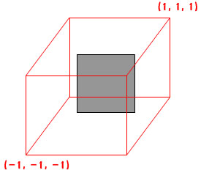
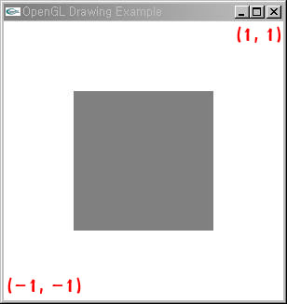
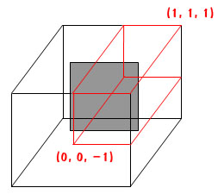
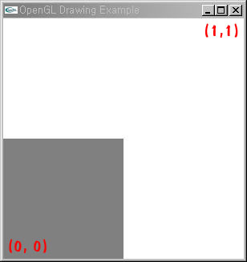
How the view volume works (1/2)
glOrtho(-1.0, 1.0, -1.0, 1.0, -1.0, 1.0);
Projection
glOrtho(0.0, 1.0, 0.0, 1.0, -1.0, 1.0);
Projection

Slide 4
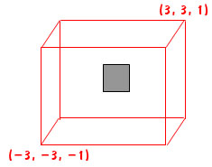
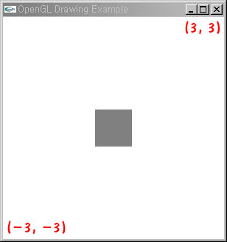
How the view volume works (2/2)
glOrtho(-1.0, 1.0, -1.0, 1.0, -1.0, 1.0);
Projection
glOrtho(-3.0, 3.0, -3.0, 3.0, -1.0, 1.0);
Projection

Slide 5
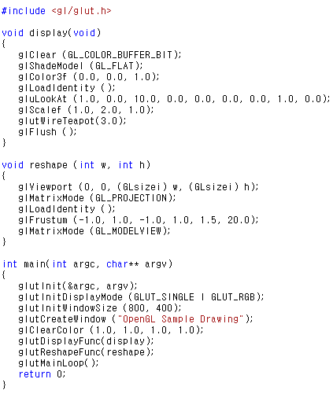
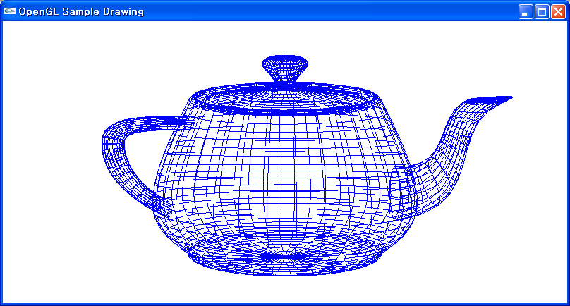
glFrustum()

Slide 6
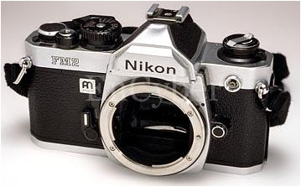
Viewing Parameters
Up Vector
Camera position (p_{x}, p_{y}, p_{z})
Eye point or view reference point
Camera direction (d_{x}, d_{y}, d_{z})
Up vector (u_{x}, u_{y}, u_{z})
Field of view (x_{fov}, y_{fov})
Viewplane
Plane onto which an object is projected
“Look-at” point
Focal length
Camera direction = viewplane normal
Camera
Position
Camera Direction
“Look-at” Point
Viewplane

Slide 7
Viewing Transformation
void gluLookAt(GLdouble eyex, GLdouble eyey, GLdouble eyez, GLdouble atx, GLdouble aty, GLdouble atz, GLdouble upx, GLdouble upy, GLdouble upz)
(eyex, eyey, eyez) : camera position
(atx, aty, atz) : “Look-at” point
(upx, upy, upz) : camera up-vector
Default
gluLookAt(0.0, 0.0, 0.0, 0.0, 0.0, -100.0, 0.0, 1.0, 0.0);

Slide 8
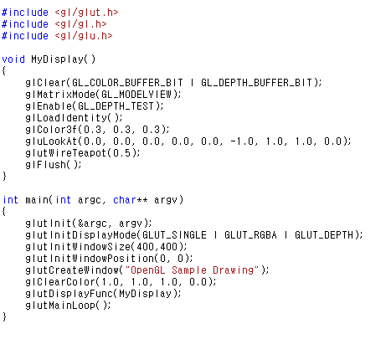
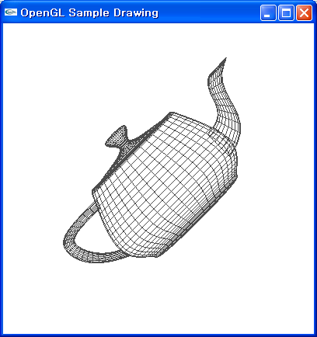
gluLookAt()

Slide 9
Viewport Transformation
void glViewport(GLint x, GLint y, GLsizei width, GLsizei height)
Left-low corner coordinate (x, y)
Viewport size (width, height)
Example
// initialize the size of a window
glutInitWindowSize(200, 200);
// sets the position and size of a viewport
glViewport(0, 0, 100, 100);
(0, 200)
(0, 100)
(0, 0)
(100, 0)
(200, 0)

Slide 10
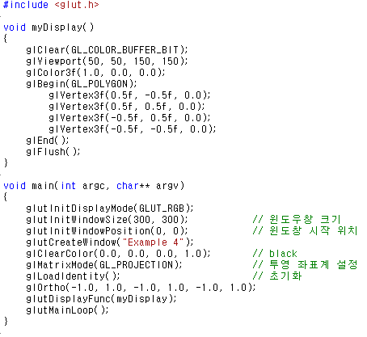
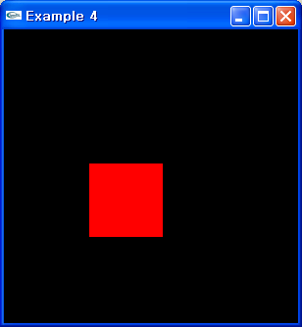
glViewport()

Slide 11
Callback Functions
Registers a specialized user-defined function
Called when a certain event occurs
Useful callback functions
glutReshapeFunc()
glutKeyboardFunc()
glutMouseFunc()
glutMotionFunc()
glutPassiveMotionFunc()
glutIdleFunc()

Slide 12
System Callback Functions
void glutReshapeFunc(void(*func)(int width, int height))
Called when the window size or shape is changed
width : new width of a window
height : new height of a window
void glutIdleFunc(void (*func)(void))
Called when there are no events to be processed
→ idle time

Slide 13
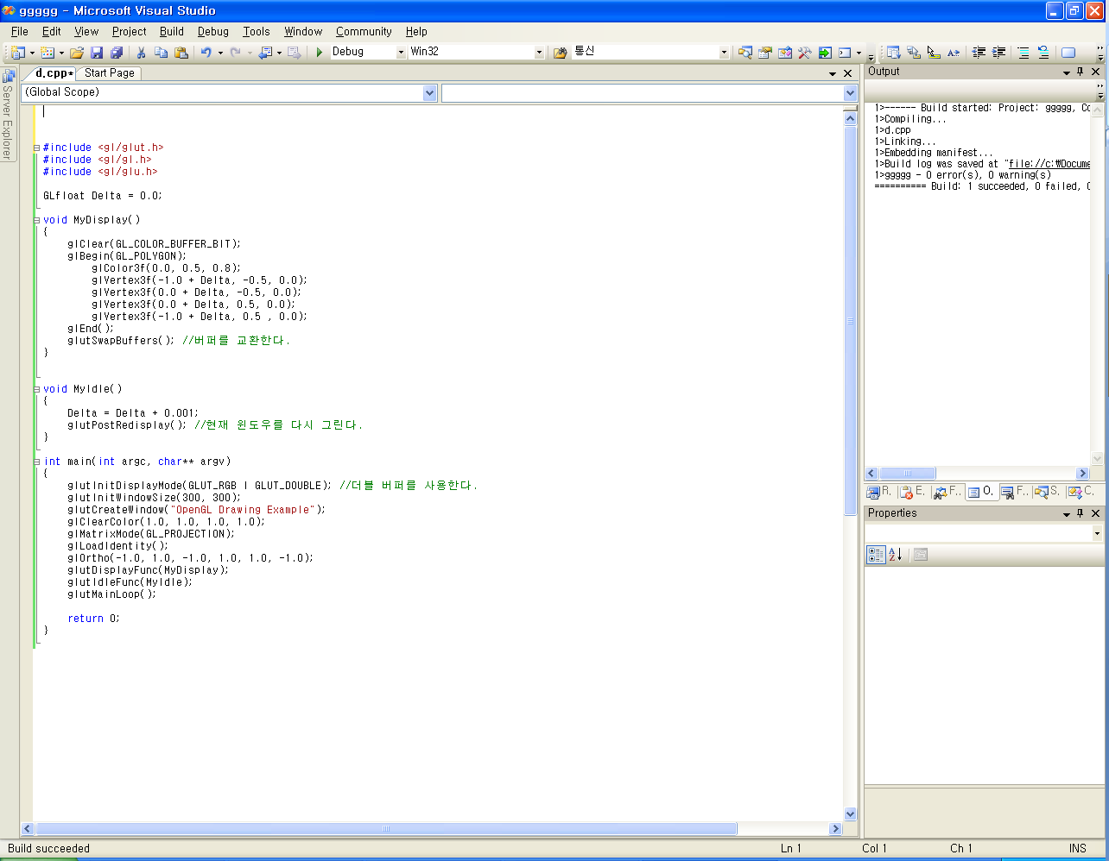
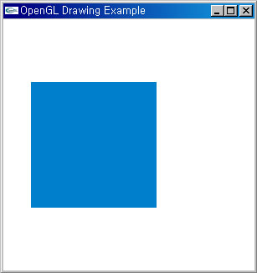
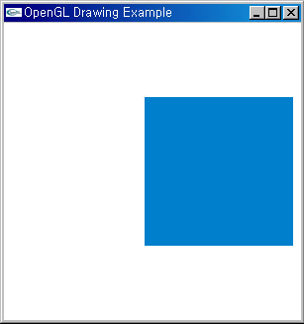
glutIdleFunc()

Slide 14
Keyboard Callback Function
void glutKeyboardFunc(void(*func)(unsigned char key, int x, int y))
Called when a key is pressed
key : ASCII code of the pressed key
(x, y) : the coordinate of a mouse

Slide 15
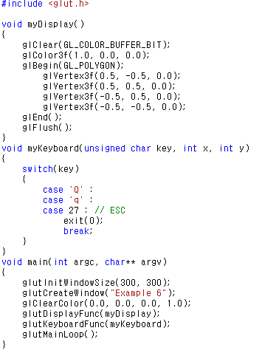
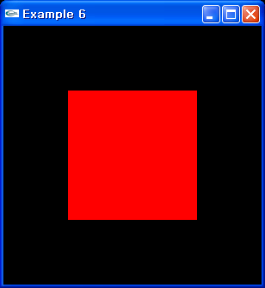
glutKeyboardFunc()

Slide 16
Mouse Callback Functions
void glutMouseFunc(void(*func)(int button, int state, int x, int y))
Called when a mouse button is pressed
button
GLUT_LEFT_BUTTON , GLUT_RIGHT_BUTTON, GLUT_MIDDLE_BUTTON
state
GLUT_DOWN, GLUT_UP
(x, y) : the coordinate of a mouse
void glutMotionFunc(void(*func)(int x, int y))
Called when a mouse is dragged
void glutPassiveMotionFunc(void(*func)(int x, int y))
Called when a mouse is moving without being pressed

Slide 17
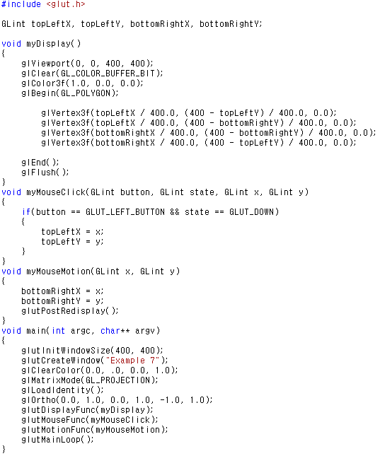
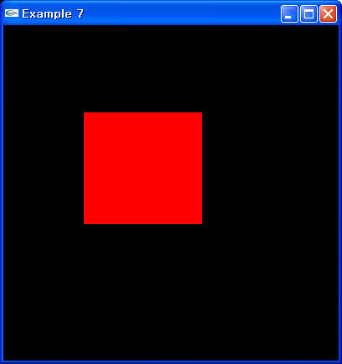
glutMouseFunc() / glutMotionFunc()

Slide 18
Front Face Detection
GLuint glFrontFace(GLenum mode)
Determine which face definition is the front face
mode
GL_CCW : counter-clockwise (default)
GL_CW : clockwise
GLuint glCullFace(GLenum mode)
Determine which face must be culled(= hidden)
mode
GL_FRONT
GL_BACK (default)

Slide 19
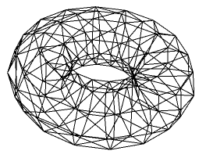
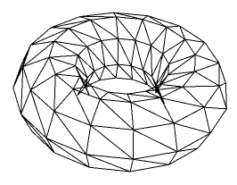
Front Face Detection (2/2)
void glEnable/glDisable(GLenum feature)
Enable or disable the operation of OpenGL
According to the macro ‘feature’
feature
GL_CULL_FACE
Default : glDisable(GL_CULL_FACE);
vs.

Slide 20
Matrix-related Functions (1/2)
void glMatrixMode(GLenum mode)
Sets the type of a matrix stack to be processed
mode
GL_MODELVIEW
When we move the object
GL_PROJECTION
When we define the clipping view volume
void glLoadIdentity()
Loads the identity matrix on the current matrix stack

Slide 21
Matrix-related Functions (2/2)
void glLoadMatrixf(const GLfloat *M)
Loads the given matrix on the current matrix stack
void glMultMatrixf(const GLfloat *M)
Multiplies the given matrix with the current matrix of the matrix stack
*M
16-length array
Means 4x4 matrix
Column-major notation

Slide 22
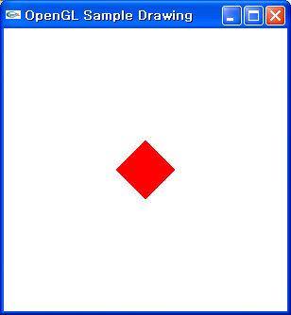
Transformations: Rotation
void glRotatef(GLfloat angle, GLfloat x, GLfloat y, GLfloat z)
Rotation axis (x, y, z)
Example
// Declare the transformation mode
glMatrixMode(GL_MODELVIEW);
glLoadIdentity();
// z-Rotate the objects by 45 degree
glRotatef(45.0, 0.0, 0.0, 1.0);
// Draw the solid cube
glutSolidCube(0.3);

Slide 23
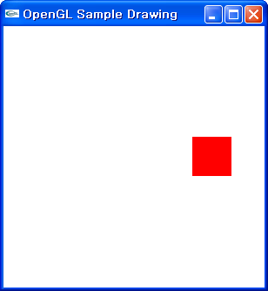
Transformations: Translation
void glTranslatef(GLfloat dx, GLfloat dy, GLfloat dz)
Example
glMatrixMode(GL_MODELVIEW);
glLoadIdentity();
// Translate the objects by (0.5, -0.5, 0.0)
glTranslatef(0.5, -0.5, 0.0);
glutSolidCube(0.3);

Slide 24
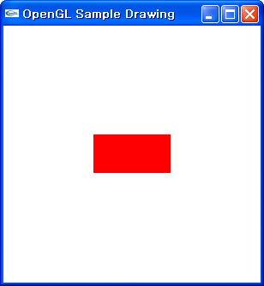
Transformations: Scaling
void glScalef(GLfloat sx, GLfloat sy, GLfloat sz)
Example
glMatrixMode(GL_MODELVIEW);
glLoadIdentity();
// Scale the objects by (2.0, 1.0, 1.0)
glScalef(2.0, 1.0, 1.0);
glutSolidCube(0.3);

Slide 25
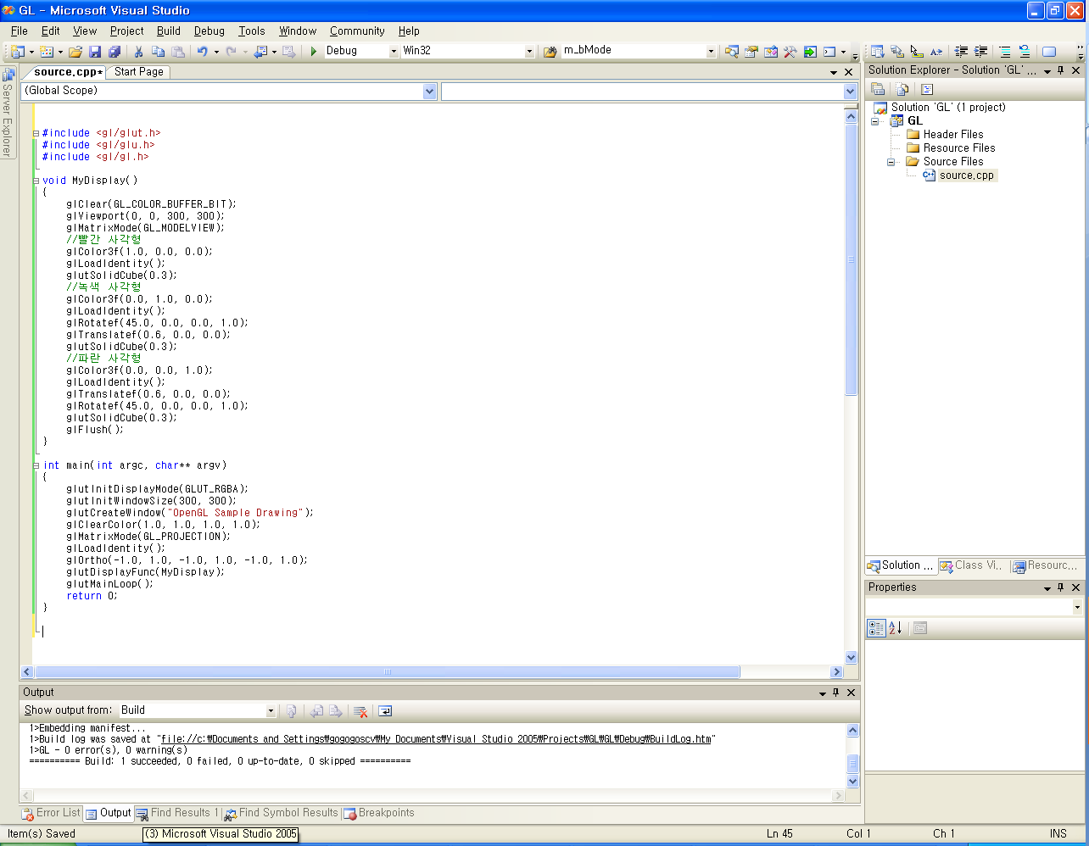
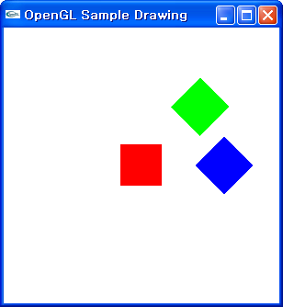
Series of Transformations

Slide 26
glPushMatrix() / glPopMatrix()
Store/retrieve the current matrix
In the stack corresponding to the current matrix mode
When popping the matrix,
The modelview matrix is replaced by the one from stack
Number of matrices storable in the stack
glGetIntegerv()
GL_MAX_MODELVIEW_STACK_DEPTH: 32
GL_MAX_PROJECTION_STACK_DEPTH: 2

Slide 27
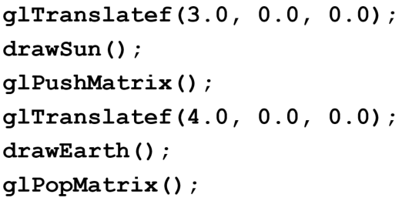
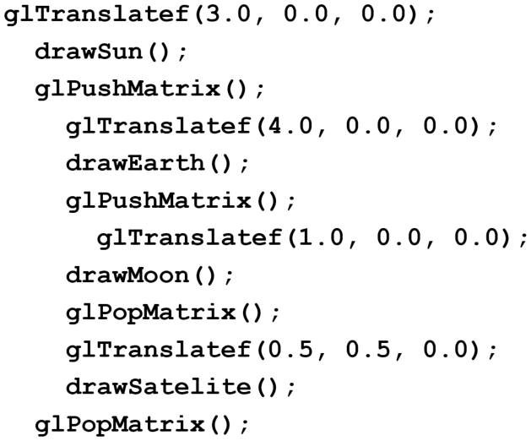
Example of glPushMatrix() & glPopMatrix()
[Sun & Earth]
(3.0, 0.0, 0.0)
Modelview
Stack
(7.0, 0.0, 0.0)
T(4.0, 0.0, 0.0)
T(3.0, 0.0, 0.0)
(3.0, 0.0, 0.0)
T(3.0, 0.0, 0.0)
T(3.0, 0.0, 0.0)
(3.0, 0.0, 0.0)
(7.0, 0.0, 0.0)
[Sun, Earth, & Moon]
Modelview
Stack
(8.0, 0.0, 0.0)
T(0.5, 0.5, 0.0)
(7.0, 0.0, 0.0)
T(1.0, 0.0, 0.0)
T(4.0, 0.0, 0.0)
T(3.0, 0.0, 0.0)
T(4.0, 0.0, 0.0)
T(3.0, 0.0, 0.0)
(7.5, 0.5, 0.0)
T(4.0, 0.0, 0.0)
T(3.0, 0.0, 0.0)
T(3.0, 0.0, 0.0)
T(3.0, 0.0, 0.0)
(3.0, 0.0, 0.0)

