Slide 1
3D Rendering Pipeline

Slide 2
3D Rendering Pipeline (1/2)
Goal
Generating a 2D image
From a 3D scene
Input
A virtual camera
3D objects
Light sources
Textures
etc.

Slide 3
3D Rendering Pipeline (2/2)
3D Primitives
Modeling Transformation
Transforms into 3D world coordinate system
Lighting
Illustrates according to lighting and reflectance
Viewing Transformation
Transforms into 3D viewing coordinate system
Projection Transformation
Transforms into 2D viewing coordinate system
Clipping
Ignores primitives outside window’s view
Viewport Transformation
Transforms a viewplane into a viewport
Scan Conversion
Draws final pixels in frame buffer
Image

Slide 4
Transformations in 3D Rendering Pipeline
3D Primitives
Modeling Transformation
Transforms into 3D world coordinate system
Lighting
Illustrates according to lighting and reflectance
Viewing Transformation
Transforms into 3D viewing coordinate system
Projection Transformation
Transforms into 2D viewing coordinate system
Clipping
Ignores primitives outside window’s view
Viewport Transformation
Transforms a viewplane into a viewport
Scan Conversion
Draws pixels in frame buffer
Image

Slide 5
Transformations & Coordinates
P(x, y, z)
3D Modeling Coordinate
Modeling Transformation
3D Viewing Coordinate
3D World Coordinate
Viewing Transformation
3D Viewing Coordinate
Projection Transformation
3D Modeling Coordinate
2D Projection Coordinate
Viewport Transformation
3D World Coordinate
2D Device Coordinate
p(x’, y’) or p(u, v)

Slide 6
Transformations & Coordinates
P(x, y, z)
3D Modeling Coordinate
Modeling Transformation
3D Viewing Coordinate
3D World Coordinate
Viewing Transformation
3D Viewing Coordinate
Projection Transformation
3D Modeling Coordinate
2D Projection Coordinate
Viewport Transformation
3D World Coordinate
2D Device Coordinate
p(x’, y’) or p(u, v)

Slide 7
Modeling Transformation (1/2)
Coordinate systems
Modeling (object / local) coordinate
Coordinate when each object is modeled or created
World coordinate
Coordinate in the target scene
<Modeling Coordinate System>

Slide 8
Modeling Transformation (2/2)
Arranging the objects in the target scene
Modeling coordinate → world coordinate
Different coordinates even for the objects with same shape
<World Coordinate System>

Slide 9
Transformations & Coordinates
P(x, y, z)
3D Modeling Coordinate
Modeling Transformation
3D Viewing Coordinate
3D World Coordinate
Viewing Transformation
3D Viewing Coordinate
Projection Transformation
3D Modeling Coordinate
2D Projection Coordinate
Viewport Transformation
3D World Coordinate
2D Device Coordinate
p(x’, y’) or p(u, v)

Slide 10
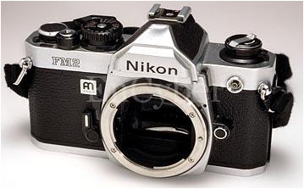
Viewing Parameters
Up Vector
Camera position (p_{x}, p_{y}, p_{z})
Eye point or view reference point
Camera direction (d_{x}, d_{y}, d_{z})
Up vector (u_{x}, u_{y}, u_{z})
Field of view (x_{fov}, y_{fov})
Viewplane
Plane onto which an object is projected
“Look-at” point
Focal length
Camera direction = viewplane normal
Camera
Position
Camera Direction
“Look-at” Point
Viewplane

Slide 11
Viewing Transformation Overview
World-to-viewing coordinates
Camera position → origin
View up vector → y axis
Camera direction → z axis
Cross product of y and z axes → x axis
y
x
z

Slide 12
Viewing Transformation Process
Translate the camera position to the origin
Apply some rotations
To align the x_{v}, y_{v}, and z_{v} axes with the world axes
UVN transformation simplifies these rotations
y_{w}
y_{v}
x_{v}
y_{w}
y_{w}
z_{v}
y_{v}
x_{v}
y_{v}
z_{v}
x_{w}
x_{w}
z_{v}
x_{v}
x_{w}
z_{w}
z_{w}
z_{w}

Slide 13
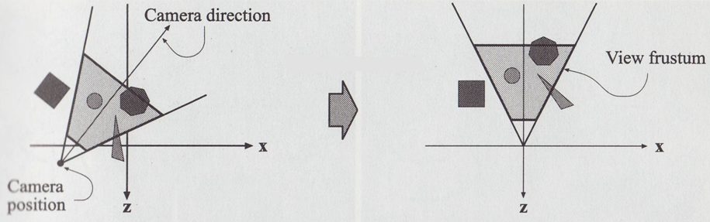
2D Illustration of Viewing Transformation

Slide 14
Viewing Transformation Process
Translation
Camera position (x₀, y₀, z₀)
Rotation
Rotate about the x_{w} to bring z_{v} into the x_{w}z_{w} plane
Rotate about the y_{w} to align the z_{w} and z_{v}
Rotate about the z_{w} to align the y_{w} and y_{v}
UVN transformation makes the series of rotation easy

Slide 15
UVN Transformation
Align the x_{v}, y_{v}, and z_{v} axes with the world axes
Calculate unit uvn vectors
V : View-up vector
N : Camera direction
U : Perpendicular to both V and N

Slide 16
Viewing Transformation Matrix

Slide 17
Viewing Transformation Example (1/3)
Find the viewing transformation matrix
Camera position C(1, 3, 2)
Camera direction D(1, 0, -2) → N
Up vector E(0, -1, 0) → V
Translation

Slide 18
Viewing Transformation Example (2/3)
UVN transformation

Slide 19
Viewing Transformation Example (3/3)

Slide 20
Transformations & Coordinates
P(x, y, z)
3D Modeling Coordinate
Modeling Transformation
3D Viewing Coordinate
3D World Coordinate
Viewing Transformation
3D Viewing Coordinate
Projection Transformation
3D Modeling Coordinate
2D Projection Coordinate
Viewport Transformation
3D World Coordinate
2D Device Coordinate
p(x’, y’) or p(u, v)

Slide 21
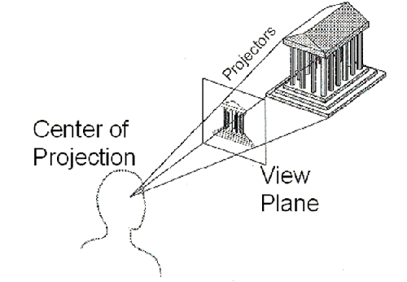
Projection
In Mathematics
Transform points in n-space to m-space (m < n)
In Computer Graphics
Map 3D coordinates to 2D coordinates
Based on the selected camera model

Slide 22
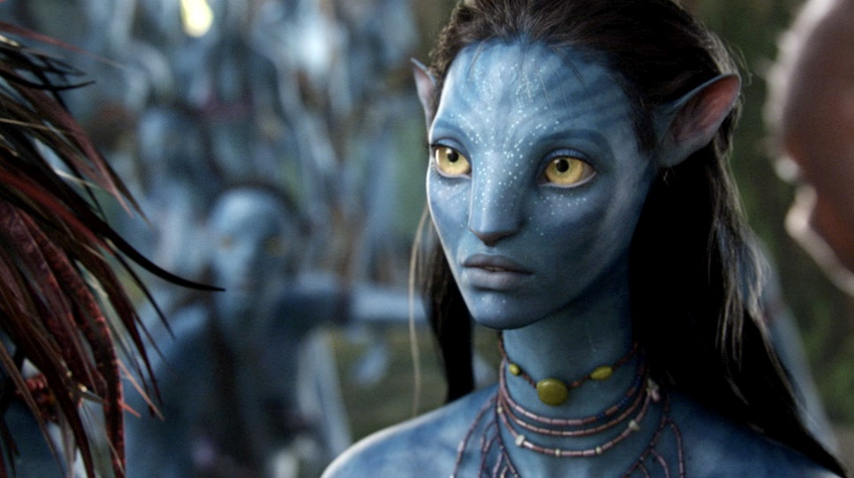
Camera Models
Real camera model
Lens distortion
Motion blur
Depth of field
Pin-hole camera model
No lens distortion
No motion blur
Ideal projection case
[Depth of Field, Avatar(2009)]

Slide 23
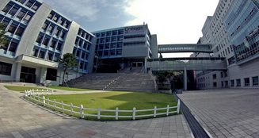
Lens Distortion Example
Varies according to the lens curvature

Slide 24


Depth of Field Example #1
Varies according to intensity of focus

Slide 25
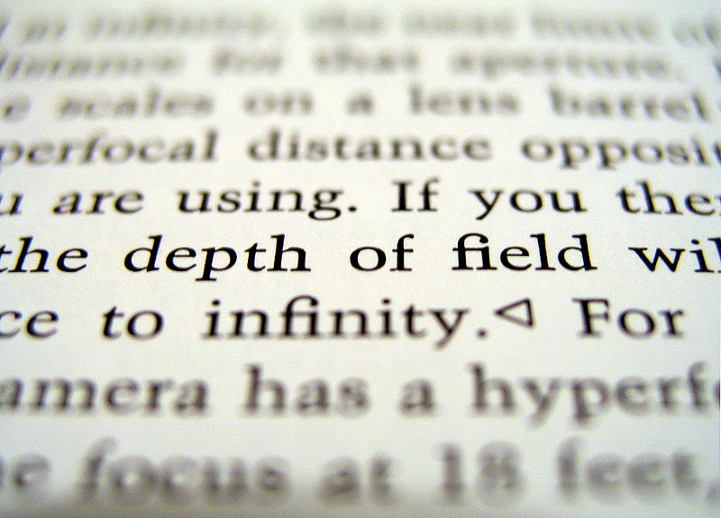
Depth of Field Example #2

Slide 26

Motion Blur Example #1
Due to rapid movement or long exposure

Slide 27
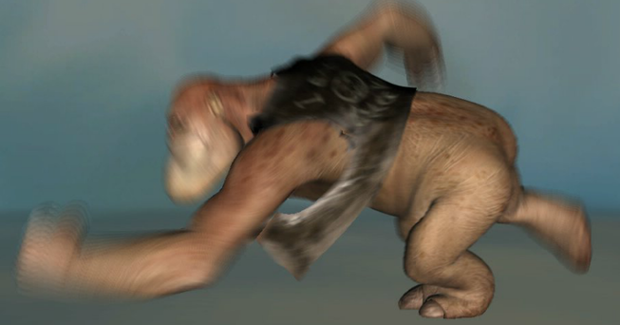
Motion Blur Example #2
Slow motion
Fast motion

Slide 28
Taxonomy of Projections
Geometric Projection
Perspective
Parallel
1-point
2-point
3-point
Orthographic
Oblique
Top
Cabinet
Other
Front
Axonometric
Cavalier
Side

Slide 29
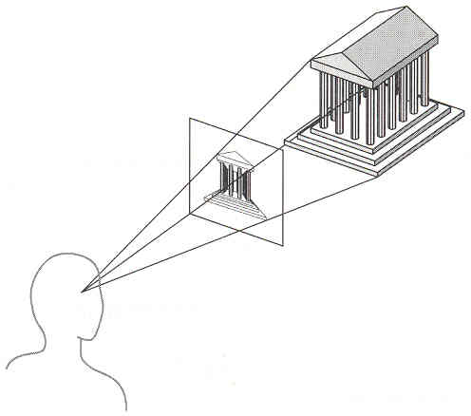
Perspective Projection
Mimics the way we perceive objects
Map points …
Onto viewplane
Along projectors
Emanating from center of projection (COP)
Projectors
Center of Projection
Viewplane

Slide 30
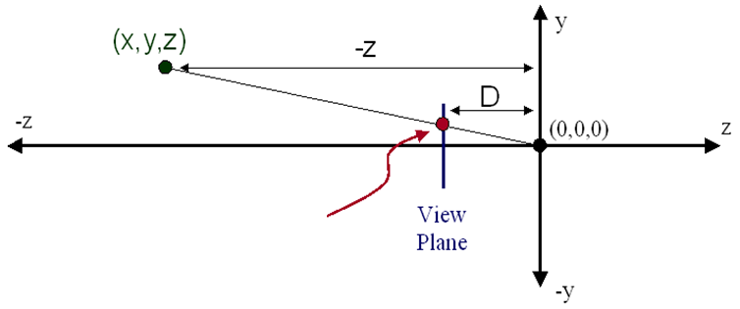

Perspective Projection Basic
Compute 2D projection coordinates
Using the observation of similar triangles
Viewplane

Slide 31
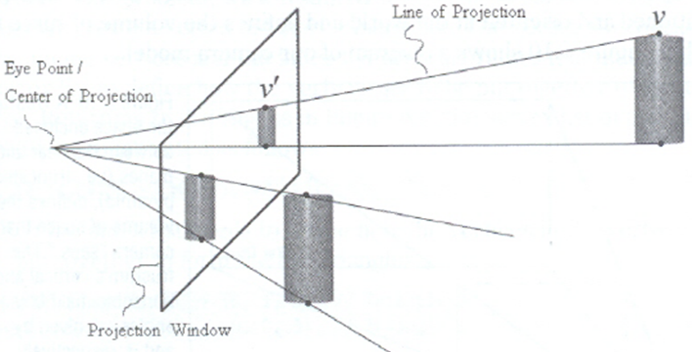
Perspective Illusion

Slide 32
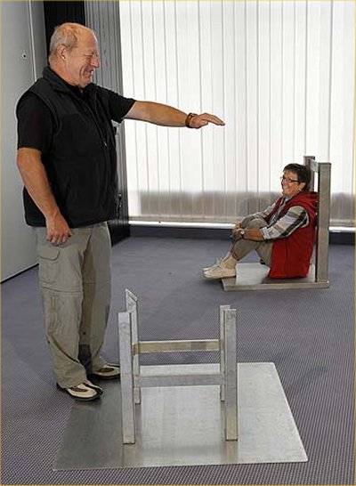
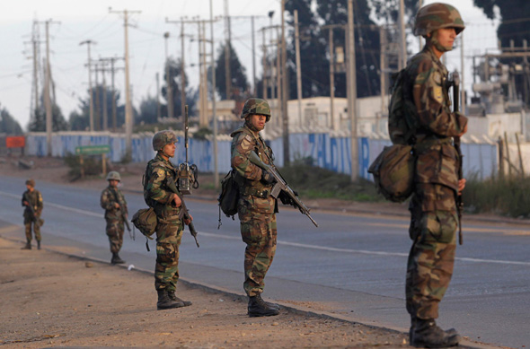
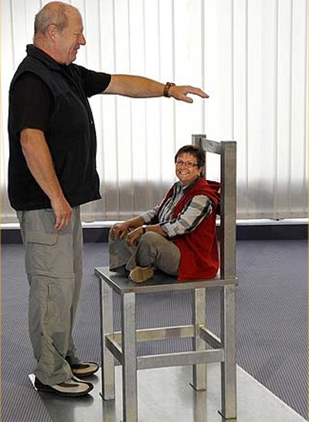
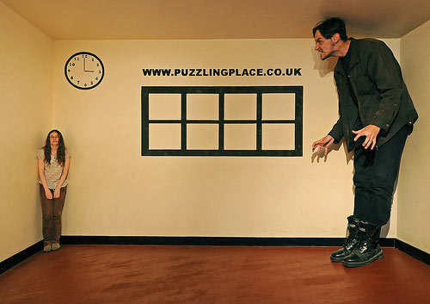
Perspective Illusion Example

Slide 33
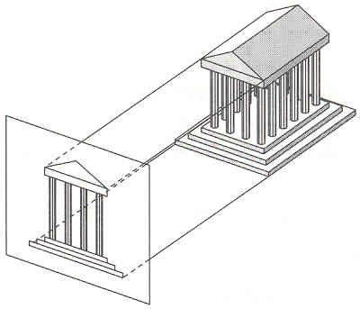
Orthographic Projection
Center of projection (COP) is at infinity
Direction of projection is orthogonal to the viewplane
Same for all points
DOP
Viewplane

Slide 34
View Volume
3D volumetric area that we can(want to) see …
Objects outside the view volume will be ignored
Clipping
Related to …
View angle
Left, right, bottom, top
Aspect ratio = width / height
Direction of projection (DOP)
Related to the projection mode
View distance
Near, far

Slide 35
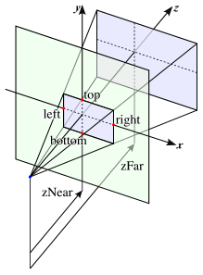
Perspective View Volume
zFar
zNear
left
right
Viewplane
Viewplane
Camera

Slide 36
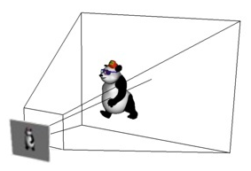
Perspective View Volume

Slide 37
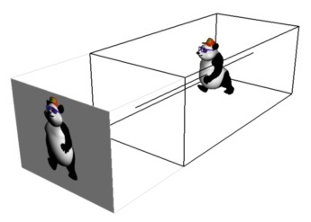
Orthographic View Volume

Slide 38
Perspective vs. Orthographic
Center of
Projection
Viewplane
Viewplane

Slide 39
Summary of Projection
Perspective projection
+ Size varies inversely with distance
+ Looks realistic
– Parallel lines do not (in general) remain parallel
Orthographic projection
+ Good for exact measurements
+ Parallel lines remain parallel
– Less realistic looking

Slide 40
Transformations & Coordinates
P(x, y, z)
3D Modeling Coordinate
Modeling Transformation
3D Viewing Coordinate
3D World Coordinate
Viewing Transformation
3D Viewing Coordinate
Projection Transformation
3D Modeling Coordinate
2D Projection Coordinate
Viewport Transformation
3D World Coordinate
2D Device Coordinate
p(x’, y’) or p(u, v)

Slide 41
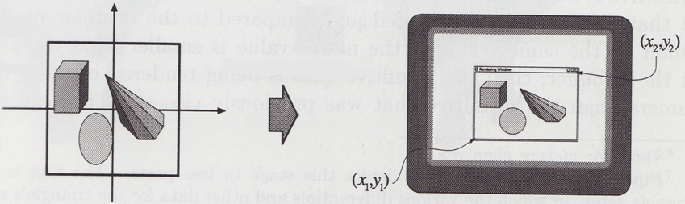
Viewport Transformation
Translates the viewing coordinates
Into the device coordinates
View volume vs. viewport
Where we want to see vs. where we want to display

Slide 42
Another Processes in the Pipeline
Clipping
Scan Conversion

Slide 43
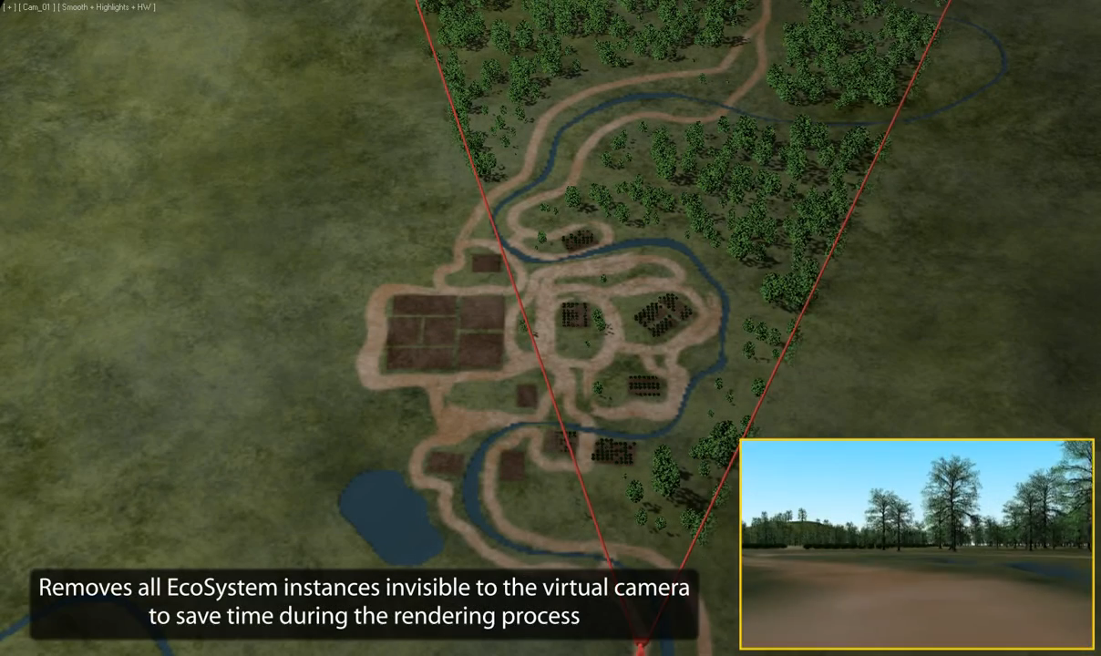
Clipping aka. Frustum Culling
Ignore all objects out of the view volume
Maximize the frame rate and visual quality
Just for rendering process
Not the interaction-related processes
ex) collision detection

Slide 44
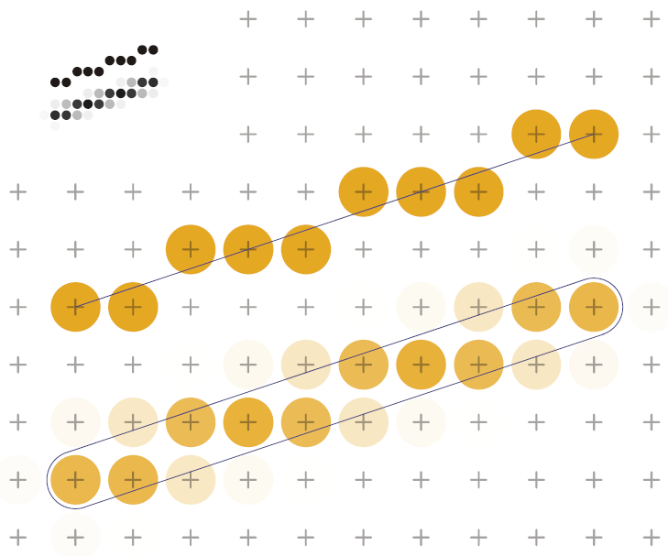
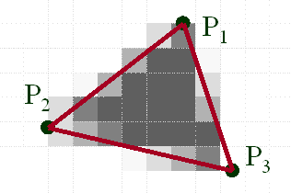
Scan Conversion
Determines the pixels that intersect the polygon
Draw/fill the pixels in the polygon
Antialiasing issues

