Slide 1
LOGO
TribeLink
“Where Global Teams Become Tribes”
Presented by Speaker A (CEO) | Speaker B (CPO) | Speaker C (CFO)
01 / 10

Slide 2
Remote Workers Are Drowning
🔧
💔
💸
Tool Overload
Disconnection
Talent Loss
Average of 8 disconnected tools per worker
87% of remote workers feel isolated
Billions lost every year to disengagement
Based on a survey of 1,200+ remote professionals across 30 countries.
02 / 10

Slide 3
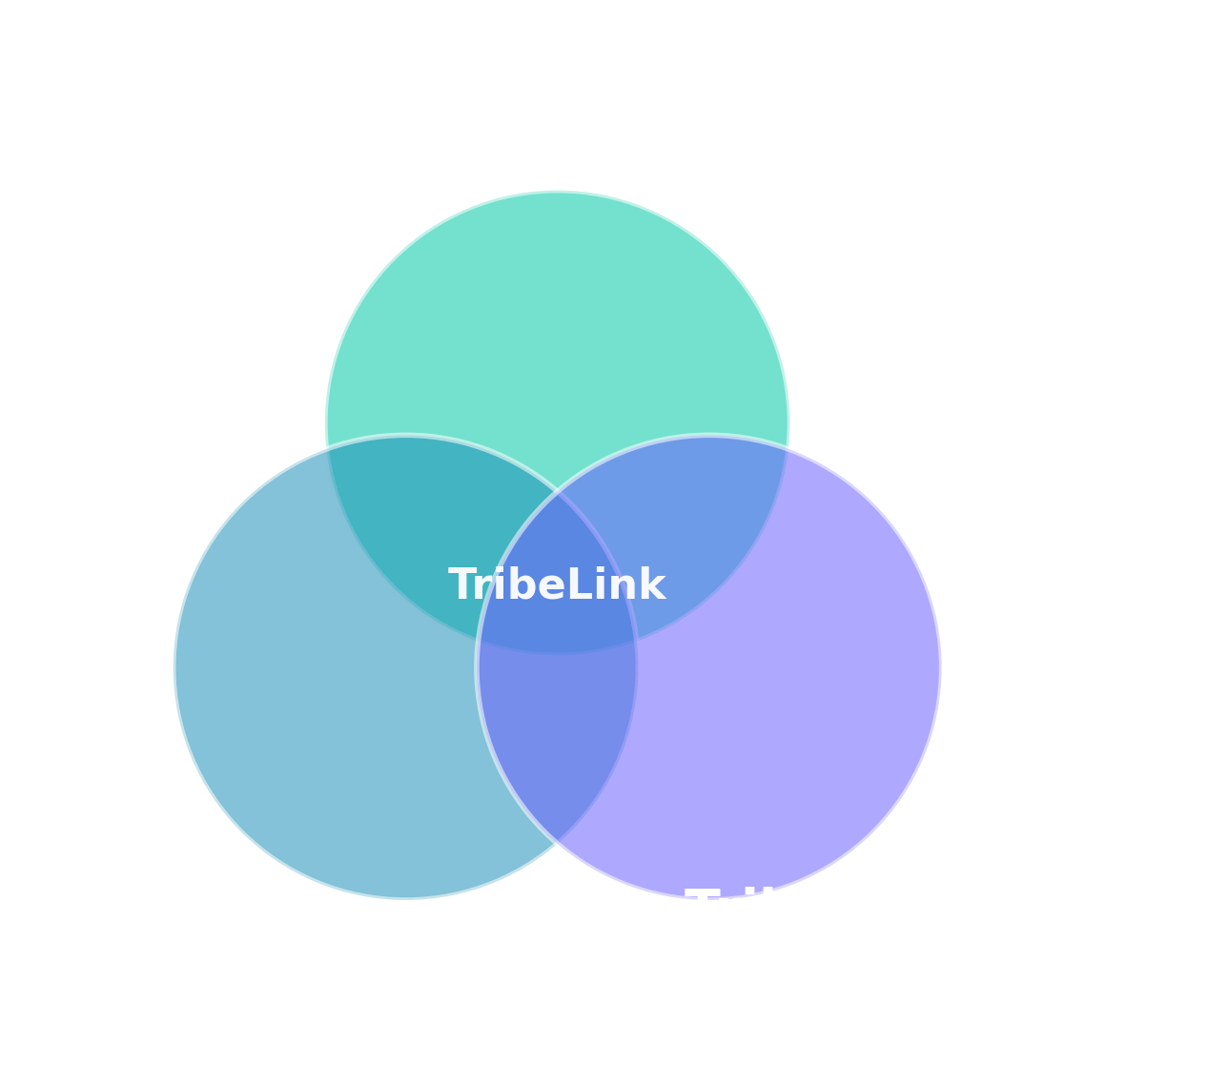
Introducing TribeLink
One platform. One tribe. Infinite potential.
03 / 10

Slide 4
4 Features That Set Us Apart
🤖
AI Tribe Matching
🗳️
Smart Voting System
Accurate, adaptive role pairing
Democratic team decisions
📊
Contribution Analytics
🌿
Green Workspace
Real-time impact tracking
Environmentally friendly carbon dashboard
04 / 10

Slide 5
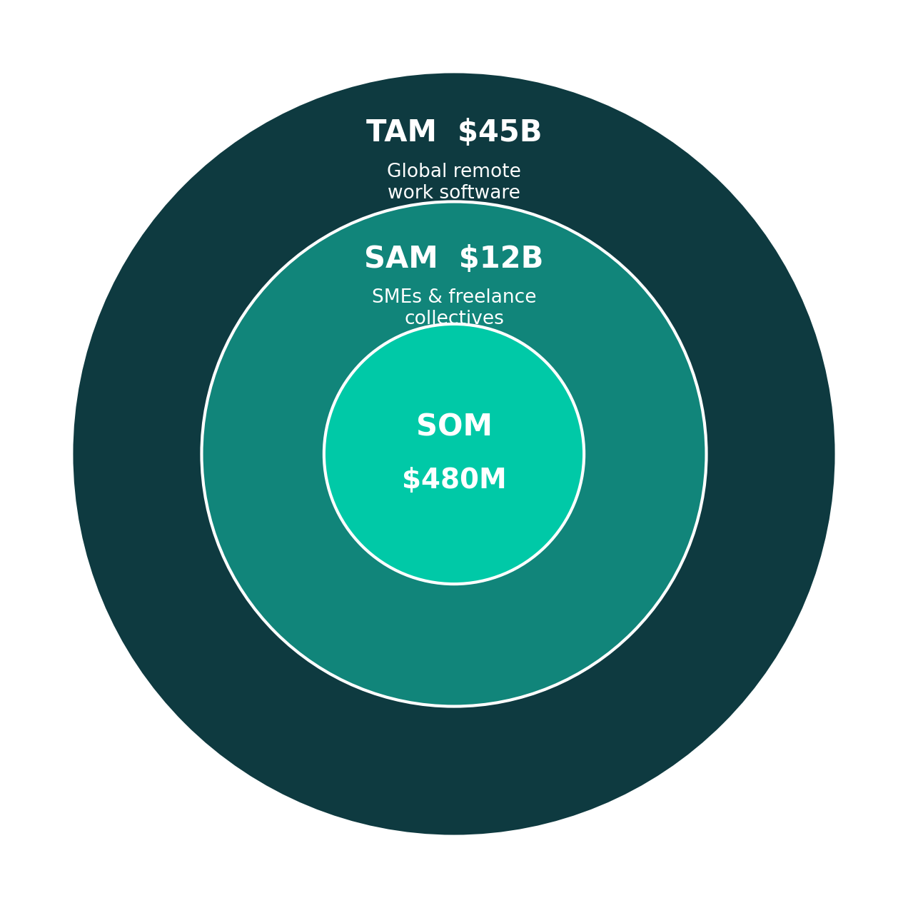
A $45B Global Opportunity
1.57B
freelancers worldwide
15%
CAGR through 2030
05 / 10

Slide 6
We Don't Just Give You a Tool. We Give You a Home.
Feature | TribeLink | Slack | Notion | Asana
AI Team Matching | ✔ | ✘ | ✘ | ✘
Voting System | ✔ | ✔ | ✘ | ✘
Contribution Tracking | ✔ | ✘ | ✔ | ✔
Carbon Dashboard | ✔ | ✘ | ✘ | ✘
Virtual HQ | ✔ | ✘ | ✘ | ✘
06 / 10

Slide 7
Three Revenue Streams. Built to Scale.
💳
⭐
🌱
SaaS Subscriptions
Premium Features
Ethical Advertising
Starter $12
Pro $29
Enterprise Custom
Advanced AI
Voting archives
Remote support
Eco-brand
partnerships via
Green Workspace
Freemium → Conversion → Upsell → Partnership
07 / 10

Slide 8
We Have Proof.
847
Beta Participants · 22 Countries
Q3 2026
Q4 2026
Q1 2027
Q2 2027
78%
Retention Rate (vs. 55% industry avg)
Global Public Beta
Slack & Notion Integration
Virtual HQ 2.0
Series A Ready
+62
NPS Score
Pilot partners
Fintech SG
EdTech Berlin
Agency São Paulo
08 / 10

Slide 9
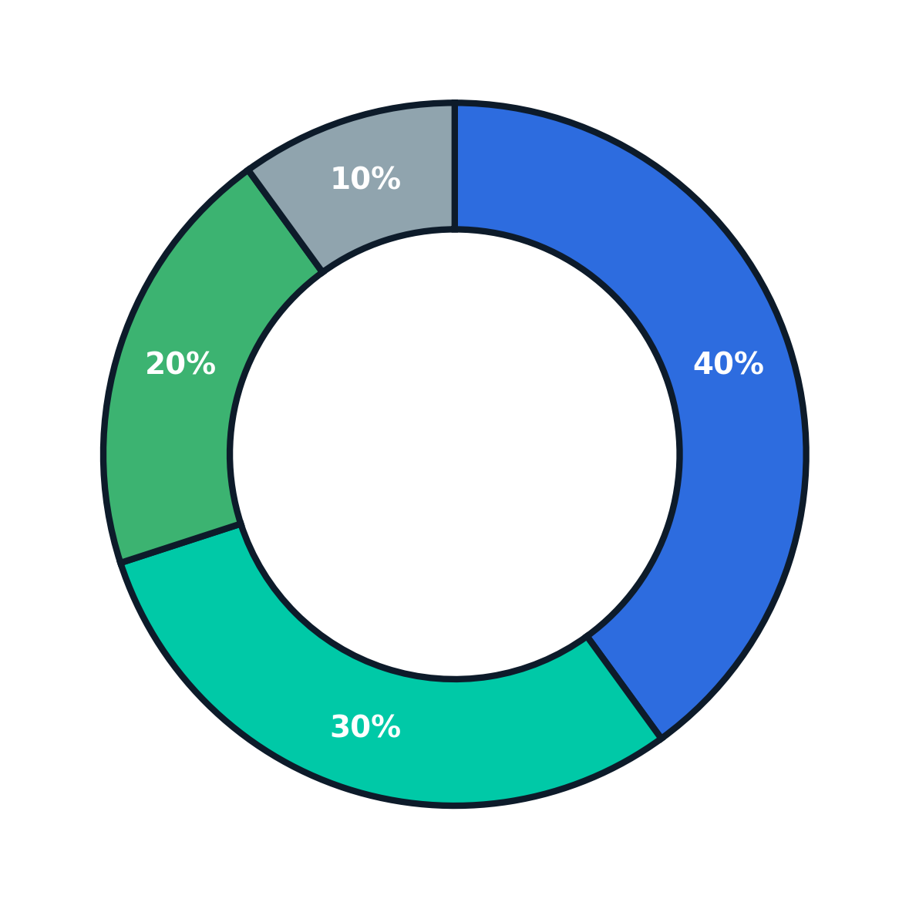
Raising $500K Seed Round
Milestone | Timeline
10,000 paying users | Month 12
$2.4M ARR | Month 18
Series A target valuation | $8–10M
18-Month Path to Series A
40% Product Development
30% Sales & Marketing
20% Operations & Talent
10% Legal & Compliance
09 / 10

Slide 10
Let's Build the Future of Work — Together.
“Distance is never a barrier to great work.”
Speaker A
Speaker B
Speaker C
CEO
CPO
CFO
ceo@tribelink.io
cpo@tribelink.io
cfo@tribelink.io
TL
TribeLink
www.tribelink.io
QR CODE
10 / 10

