Slide 1
winedApp
Wine Recommendation + Analysis R Shiny App
Alexander Sigman
NYCDSA
May 2019

Slide 2
The App:
https://lxsigman.shinyapps.io/winedup_shiny_app/

Slide 3

0. Target Users:

Slide 4
1. The Data
Ca. 36,000 wine reviews from Wine Enthusiast site
Relevant Columns: country, province, region/subregion, variety, winery, title, description [review], price [per bottle], points

Slide 5
2. Data Pre-Processing 1: Red/White Tagging
Rows not tagged as red/white/other
Method 1: parse titles for wine (partial and partially unreliable)

Slide 6
2. Data Pre-Processing 1: Red/White Tagging
Rows not tagged as red/white/other
Method 1: parse titles for wine (partial and partially unreliable)
Method 2: join with wine variety tables scraped from Wikipedia wine varieties page (using rvest) [100% success!]

Slide 7
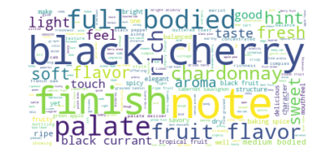
3. Data Pre-processing 2: Keyword Derivation
[Using nltk]
Step 1: Tokenize words in descriptions, filtering for stop words + custom stop words (e.g., ‘wine’, ‘drink’, ‘nose’, ‘glass’, ‘grape’)
Step 2: Bigram collection
Step 3: POS tagging
Step 4: Frequency rank-based filtering
Step 5: Manual filtering (for appropriate descriptive terms)

Slide 8
4. Data Pre-Processing 3: Missing Country Values
Filled in manually (only ca. 10 such values)

Slide 9
5. Site Structure + Content: A Taste

Slide 10
Conclusions
For most wines, the correlation between price and points awarded is not strongly positive (in some cases, it is negative)

Slide 11
Conclusions
For most wines, the correlation between price and points awarded is not strongly positive (in some cases, it is negative)
No significant difference in trends for red vs. white wines

Slide 12
Conclusions
For most wines, the correlation between price and points awarded is not strongly positive (in some cases, it is negative)
No significant difference in trends for red vs. white wines
The US, Italy, and France are most represented in the dataset (unsurprisingly)

Slide 13
Conclusions
For most wines, the correlation between price and points awarded is not strongly positive (in some cases, it is negative)
No significant difference in trends for red vs. white wines
The US, Italy, and France are most represented in the dataset (unsurprisingly)
Most wines between $4-$50/bottle…with a few outliers in the $1000-2000 range

Slide 14
Future Work
Test on larger dataset

Slide 15
Future Work
Test on larger dataset
Enable user to determine if wine distributed in local area

Slide 16
Future Work
Test on larger dataset
Enable user to determine if wine distributed in local area
Use data to predict price based upon existing features

Slide 17
Coda
Q.: Would you like to try a Petit Verdot?

Slide 18
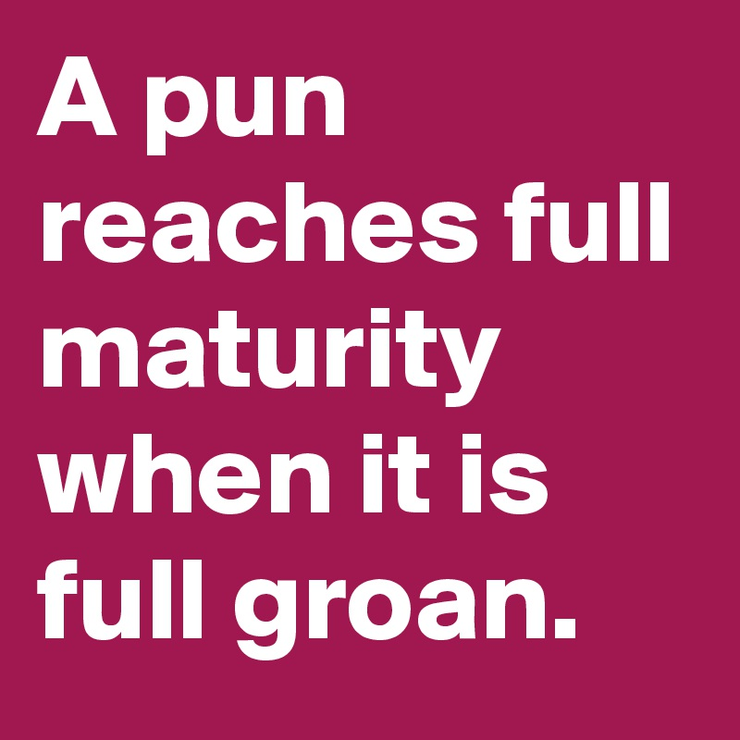
Coda
Q.: Would you like to try a Petit Verdot?
A.: I’m kind of dehydrated…how about a grand verre d’eau?

Slide 19
Cheers!
[Questions?]

