Slide 1
winedApp
Wine Recommendation + Analysis R Shiny App
Alexander Sigman
NYCDSA
08 May 2019

Slide 2
The App:
https://lxsigman.shinyapps.io/winedup_shiny_app/

Slide 3

0. Target Users:

Slide 4
1. The Data
Ca. 36,000 wine reviews from Wine Enthusiast site
Relevant Columns: country, province, region/subregion, variety, winery, title, description [review], price [per bottle], points awarded

Slide 5
2. Data Pre-Processing 1: Red/White Tagging
Rows not tagged as red/white/other
Method 1: parse titles for color (partial and partially unreliable)

Slide 6
2. Data Pre-Processing 1: Red/White Tagging
Rows not tagged as red/white/other
Method 1: parse titles for color (partial and partially unreliable)
Method 2: merge with wine variety tables scraped from Wikipedia wine varieties page (using rvest) [100% success!]

Slide 7
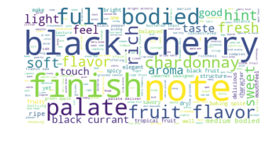
3. Data Pre-processing 2: Keyword Derivation
[Using nltk]
Step 1: Tokenize words in descriptions, filtering for stop words + custom stop words (e.g., ‘wine’, ‘drink’, ‘nose’, ‘glass’, ‘grape’, ‘taste’)
Step 2: Bigram collection
Step 3: POS tagging
Step 4: Frequency rank-based filtering
Step 5: Manual filtering (for appropriate descriptive terms)

Slide 8
4. Data Pre-Processing 3: Missing Country Values
Filled in manually (only ca. 10 such values)

Slide 9
5. Site Structure + Content: A Taste

Slide 10
General Trends
Wine prices (per bottle) and points awarded do not show a strong positive correlation (for certain countries, there is a negative correlation).
Most wines fall within the range of $4-50 per bottle, but the distribution is right-skewed. The full price range is $4-2013.
Varietals vary considerably with respect to point and price ranges, as well as country distribution.
There is a statistically significant difference between mean prices for red vs. white wines ($42.47 and $30.51, respectively, with p << 0.05).
There is also a statistically significant difference regarding mean point values for reds vs. whites (88.43 and 88.29, respectively, with p << 0.05).

Slide 11
Future Work
Test on larger dataset
Enable user to determine if wine distributed in local area
Use data to predict price based upon existing features

Slide 12
Coda
Q.: Would you like to try a Petit Verdot?

Slide 13
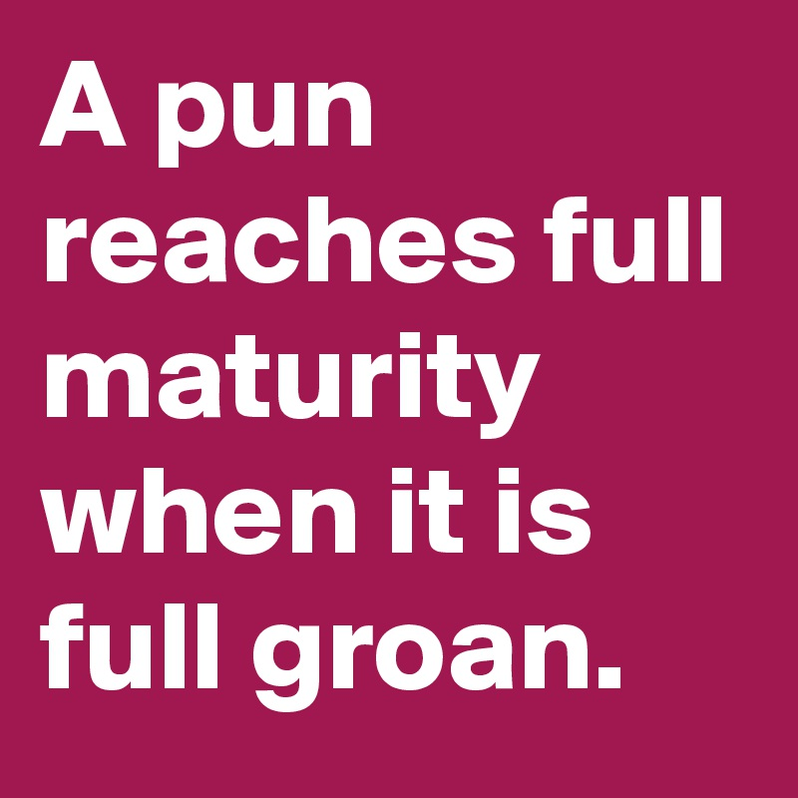
Coda
Q.: Would you like to try a Petit Verdot?
A.: I’m kind of dehydrated…how about a grand verre d’eau?

Slide 14
Cheers!
[Questions?]

