Slide 1
Namhun Kim (Bachelor’s course) System Semiconductor Engineering University of Sangmyung
Verilog HDL: Chapter 1 ~ 3
Summer Bootcamp 2022

Slide 2
Contents
Learning Object
1. Understanding Verilog
2. *.v files simulation
3. Fundamental Language Structure of Verilog

Slide 3
Verilog HDL?
About Verilog HDL
Verilog HDL = Verilog Hardware Description Language
Verilog HDL != VHDL(VHSIC HDL)
“Similarly, in the digital design field, designers felt the need for a standard
language to describe digital circuits. Thus, HDLs came into existence.”
-Verilog HDL: A Guide to Digital design and Synthesis-

Slide 4



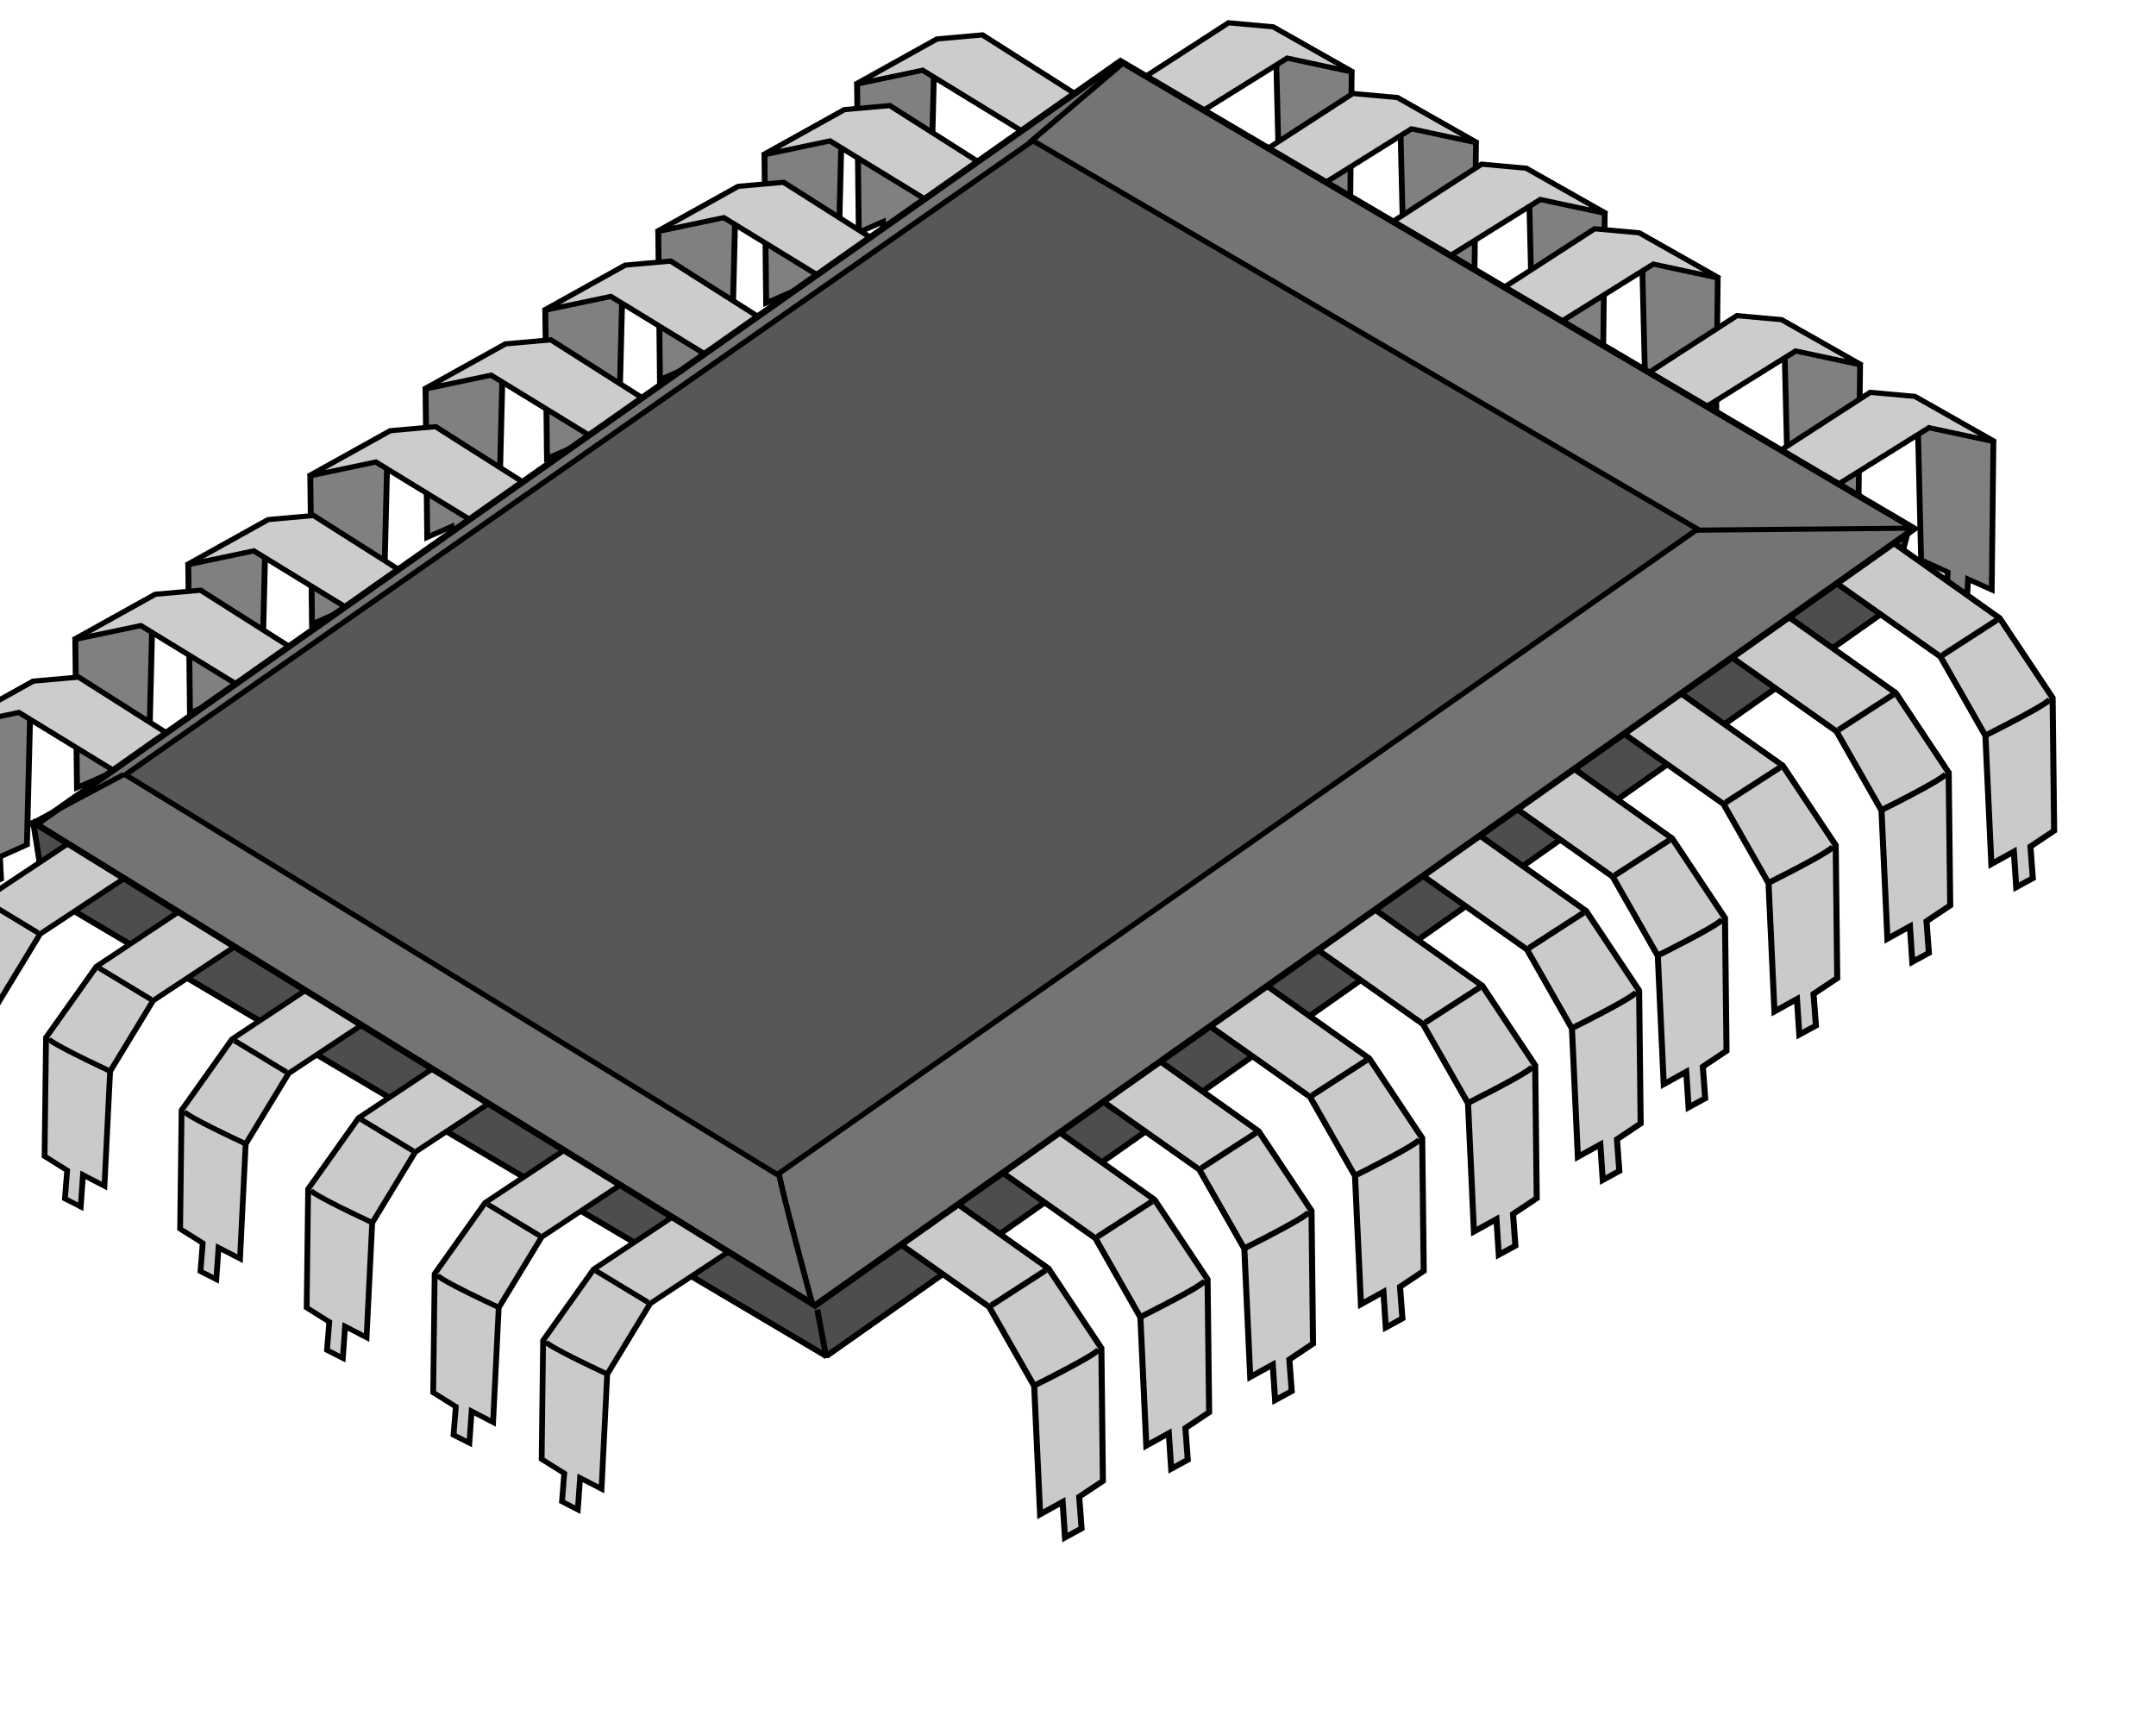
Digital Design Process
We Handle This!
Design Specification
Behavioral Description
Behavioral Description
RTL Description(HDL)
RTL Description(HDL)
Verification & Test
Verification & Test
Gate-Level Netlist
Physical Layout
Implementation

Slide 5
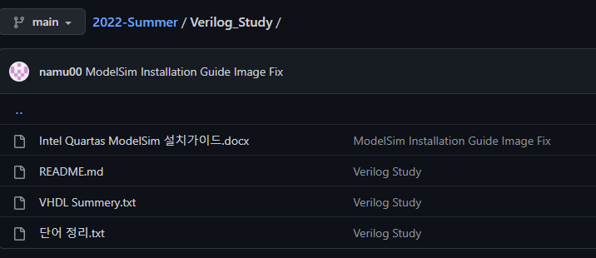
Installation ModelSim
My Github: https://github.com/namu00/2022-Summer/tree/main/Verilog_Study
Download and Flow the guide.docx

Slide 6
Configuration of Verification & Test
RTL: Registor Transfer Level
Registor: a collection of FF
Verification & Test
1. Functional Verification
Check whether hardware’s function is working perfectly
Testbench is used to Check functionality
2. Logic Synthesis/ Timing Verification
Check the RTL level Issues
Timing Diagram Check using Testbench
Resistor: 저항
Registor: 레지스터

Slide 7
Simulating .v files
Run Simulation .v files

Slide 8
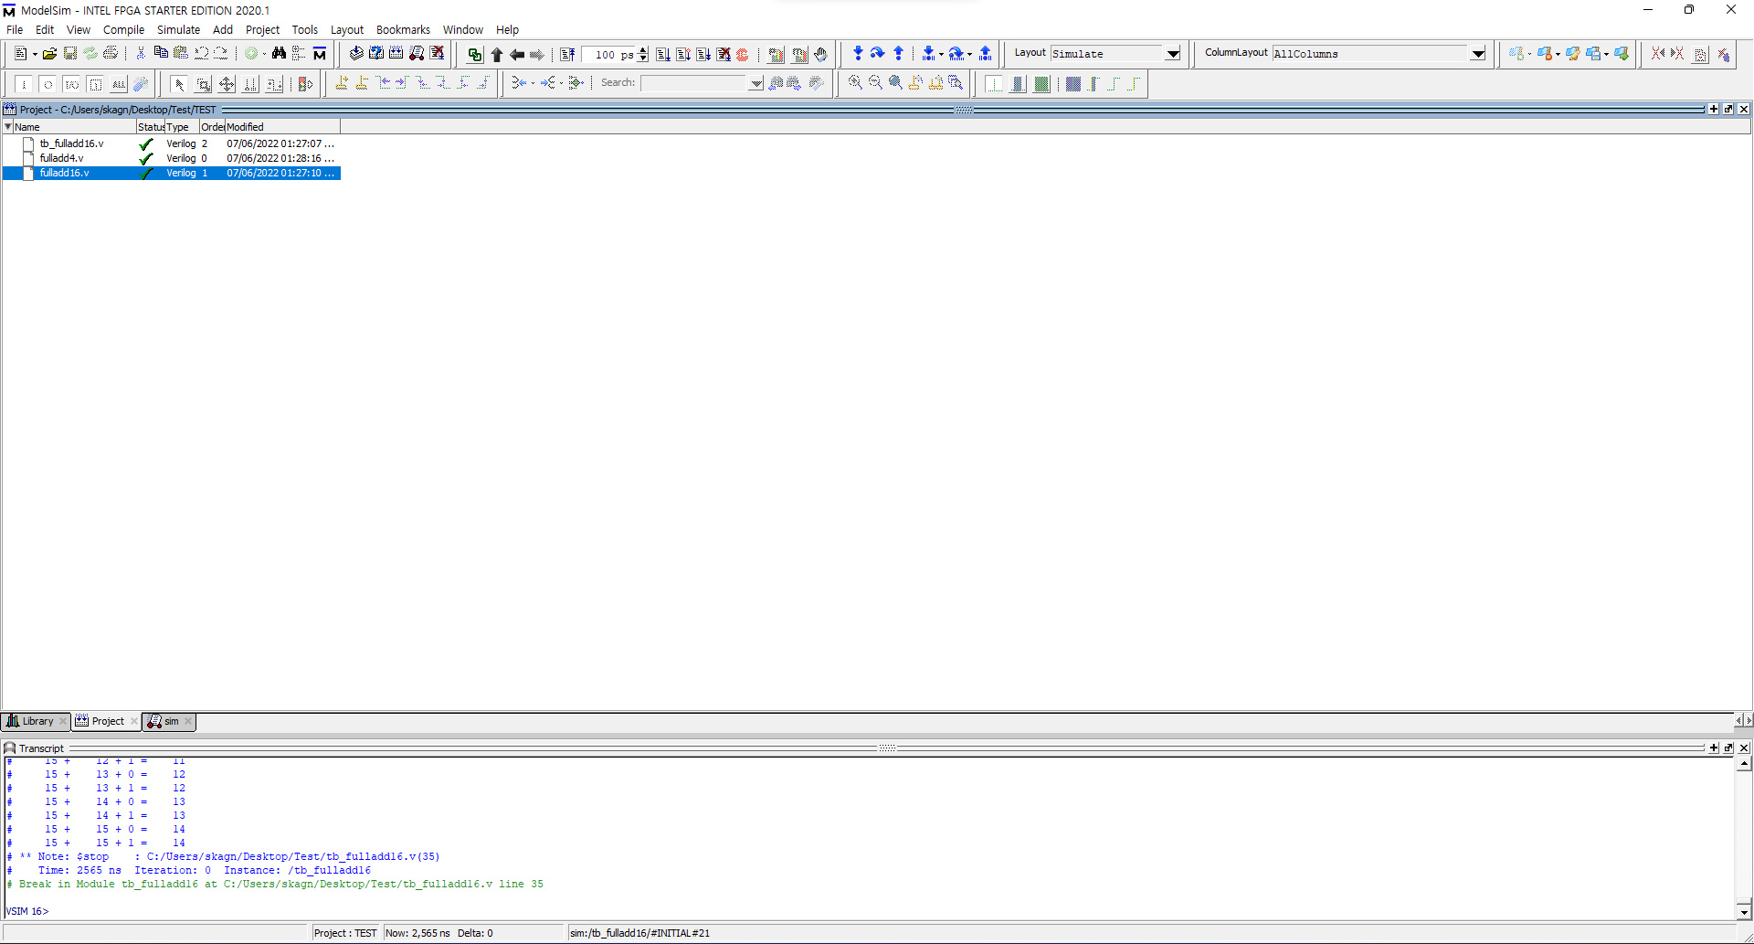
Simulating .v files
Run Simulation .v files

Slide 9
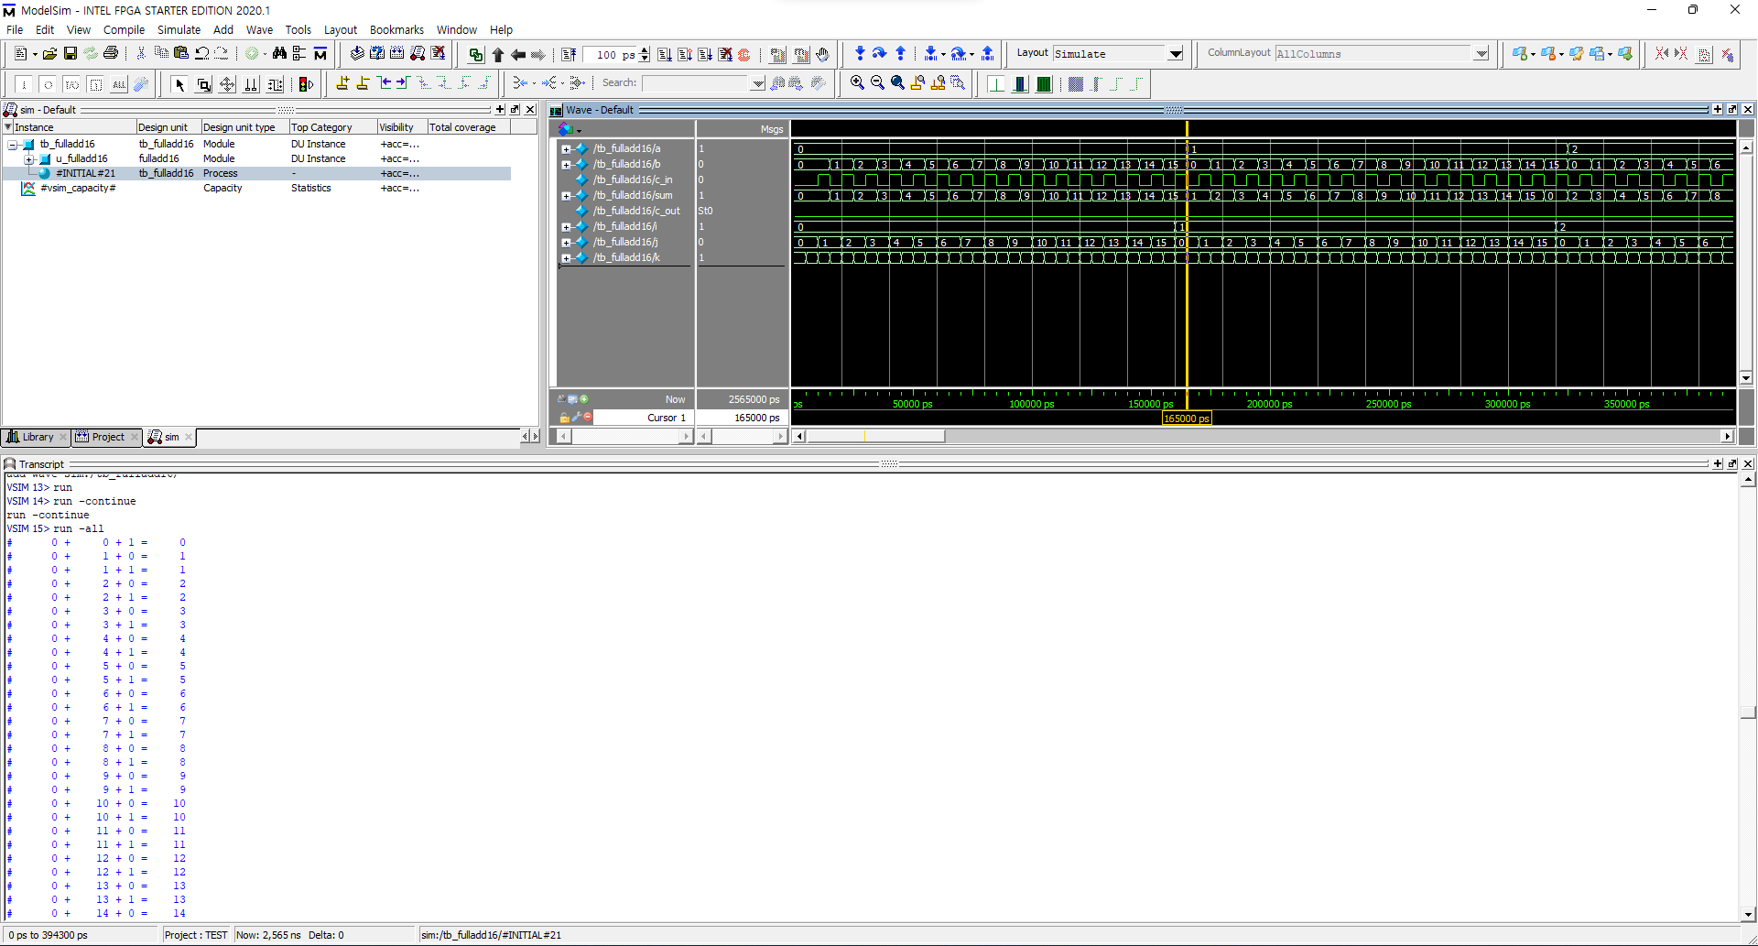
Blah~ Blah~
Blah~
Blha~

Slide 10
Blah~ Blah~
Blah~
Blha~

Slide 11
Blah~ Blah~
Blah~
Blha~

