Slide 1
Kim, Namhun System Semiconductor Engineering University of Sangmyung
Cifar10 & fashion MNIST Traning
Fall 2022

Slide 2
Contents
Network Structure
Train Method
Accuracy Comparison
Loss/Accuracy Plot
References

Slide 3
Network Structure
Custom LeNet-5 Structure
Fully-Connected Layer
Convolution Layer
ELU
AFFINE
ELU
AFFINE
ELU
AFFINE
ELU
AFFINE
ELU
AFFINE
SOFTMAX
INPUT
…
…
…
…
…
OUT
Filter Count
C1: 10 C2: 200
C3: 400
Node
400 → 400 → 300 → 200 → 100 → 10

Slide 4
Training Method
Using CNN with Data Augmentation
Strategy | Method
Network | Custom LeNet-5
Initial Learning Rate | 0.001
Activation Fuction | ELU
BatchNorm | No
Optimizer | Adam
Batch Size | 200^{[1]}
IMG Augmentation | Yes, (Flip Left-Right)
CIFAR-10 & fashion MNIST

Slide 5
Accuracy Results
Accuracy Comparison
 | Accuracy | Difference
Baseline | 88% | -
Custom LeNet-5 | 90.95% | +2.95%pp
 | Accuracy | Difference
Baseline | 62% | -
Custom LeNet-5 | 69% | +7%pp
Fashion-MNIST
CIFAR-10

Slide 6
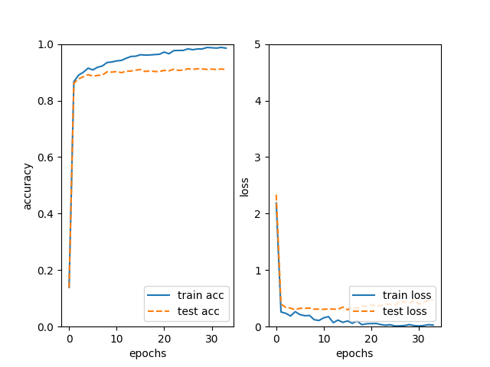
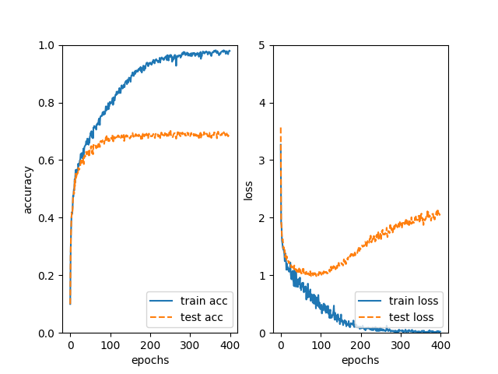
Loss/Accuracy Plot
Accuracy & Loss
Fashion-MNIST
CIFAR-10

Slide 7
Reference
[1] Kandel, I., & Castelli, M. (2020). The effect of batch size on the generalizability of the convolutional neural networks on a histopathology dataset. ICT express, 6(4), 312-315.

