Slide 1
Namhun, Kim (Bachelor’s Course) System Semiconductor Engineering University of Sangmyung
Final Product Description
Summer 2022

Slide 2
Contents
Idea
Module & Testbench format
Pseudo Code
Structure
Function Structure
Implementation

Slide 3
Idea
Module & Testbench format
module buffer_4bit (clk, in, out);
input [3:0] in;
input clk;
output reg [3:0] output;
always @(posedge clk) begin
output <= in;
end
endmodule
module testbench();
reg [3:0] in;
reg clk;
wire [3:0] output;
buffer_4bit test_unit(clk, in, out);
initial clk = 1’b0;
always #1 clk = ~clk;
initial begin
in = 4’b1010; @(negedge clk);
in = 4’b1111; @(negedge clk);
$stop;
end
endmodule

Slide 4
Idea
Module & Testbench format
module buffer_4bit (clk, in, out);
input [3:0] in;
input clk;
output reg [3:0] output;
always @(posedge clk) begin
output <= in;
end
endmodule
module testbench();
reg [3:0] in;
reg clk;
wire [3:0] output;
buffer_4bit test_unit(clk, in, out);
initial clk = 1’b0;
always #1 clk = ~clk;
initial begin
in = 4’b1010; @(negedge clk); in = 4’b1111; @(negedge clk);
$stop;
end
endmodule

Slide 5
Idea
Module & Testbench format
module buffer_4bit (clk, in, out);
input [3:0] in;
input clk;
output reg [3:0] output;
always @(posedge clk) begin
output <= in;
end
endmodule
module testbench();
reg [3:0] in;
reg clk;
wire [3:0] output;
buffer_4bit test_unit(clk, in, out);
initial clk = 1’b0;
always #1 clk = ~clk;
initial begin
in = 4’b1010; @(negedge clk);
in = 4’b1111; @(negedge clk);
$stop;
end
endmodule

Slide 6
Idea
Module & Testbench format
module buffer_4bit (clk, in, out);
input [3:0] in;
input clk;
output reg [3:0] output;
always @(posedge clk) begin
output <= in;
end
endmodule
module testbench();
reg [3:0] in;
reg clk;
wire [3:0] output;
buffer_4bit test_unit(clk, in, out);
initial clk = 1’b0;
always #1 clk = ~clk;
initial begin
in = 4’b1010; @(negedge clk);
in = 4’b1111; @(negedge clk);
$stop;
end
endmodule

Slide 7
Pseudo Code
Replace keyword input/output/output reg to reg/wire
(Example)
input in; → reg in;
output out; → wire out;
2. Create Module Instance String
(Example)
module not(in, out); → not not(in, out); → not test_unit(in, out);
3. If “Clock” Exist, Create clk/rst State
4. Create TestVector via Wavedrom JSON
5. Write “testbench.v”

Slide 8
Structure
Functions
__main__
tb_gen
get_io
module_instance
tv_gen
file_test
print_err
get_module_name
wave_interpreter

Slide 9
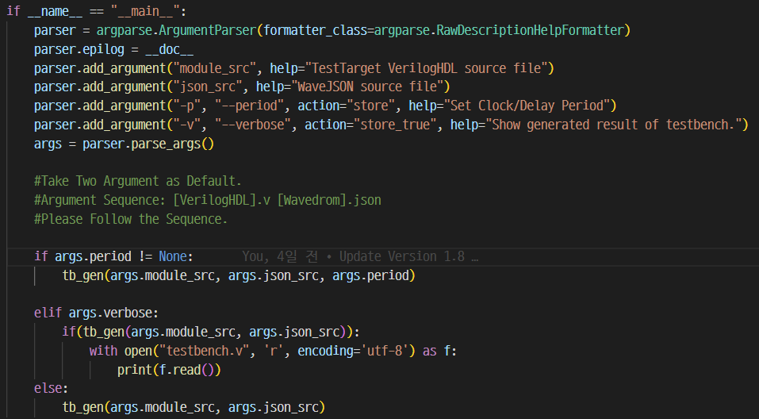
Structure
__main__

Slide 10
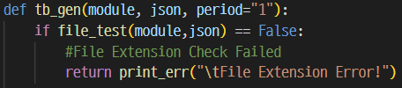
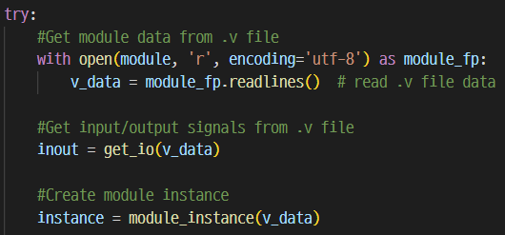
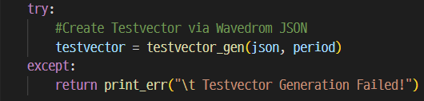
Structure
tb_gen()
“testbench.v”
`timescale 1ns/1ns
module testbench();
inout
instance
(clk/rst) ← Optional
testvector
endmodule

Slide 11
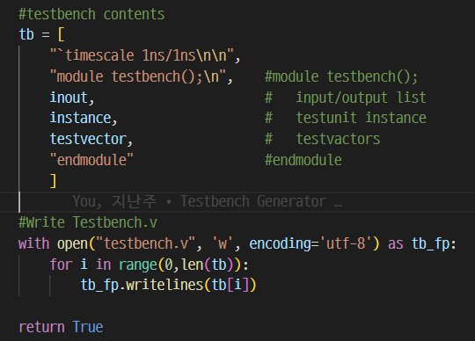

Structure
tb_gen()
Testbench Contents List
Write “testbench.v”

Slide 12
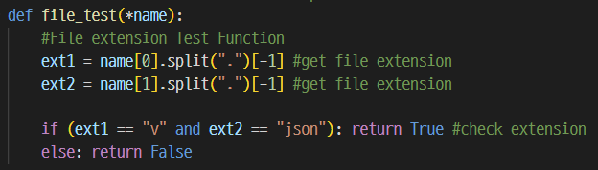

Structure
file_test() & print_err()
Check File Extension.
Example)
*name = [“test.txt”, ”test.v”]
ext1 = “test.txt” → [“test”, “txt”][-1] == “txt”
ext2 = “test.v” → [“test”, “v”][-1] == “v”
Print Error Message with Highlight.
Example)

Slide 13


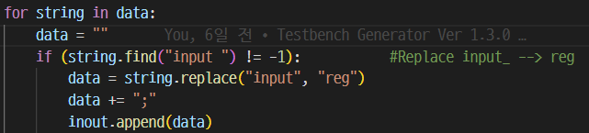
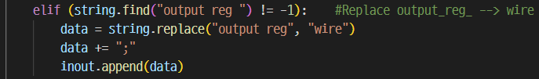


Structure
get_io()
Redefine module data,
Replace input → reg
Replace output reg → wire
Replace output → wire
Return Testbench formatted I/O State

Slide 14

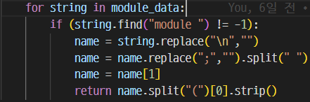
Structure
get_module_name()
Module Name Extraction
(In “module.v”)
module and_gate(in, out);\n
input in;\n
output out;\n
...
endmodule
(In Function Processing)
name = “module and_gate(in, out);”
name = [“module”, “and_gate(in,” , “out)”]
name = name[1] == “and_gate(in,”
#name.split(“(“)[0].strip() == “and_gate“

Slide 15
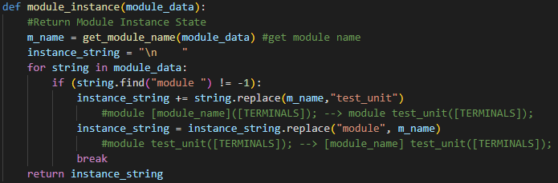
Structure
module_instance()
(Example)
module not(in, out); → not not(in, out); → not test_unit(in, out);

Slide 16
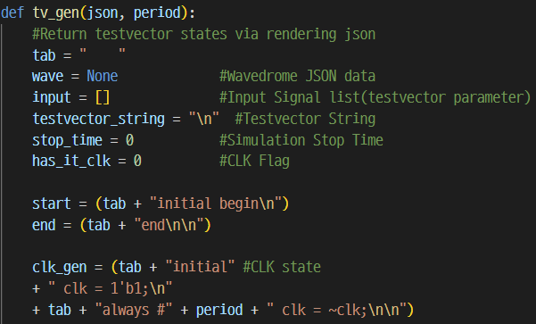
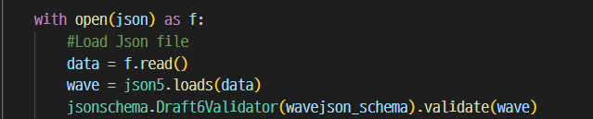
Structure
tv_gen()
Declare Variables
Open & Check Json file

Slide 17

Structure
tv_gen()
Get Input Signals from json
“example.json”
{signal:[
{name:"a", wave:"l...h..."},
{name:"b", wave:"l.h.l.h."},
{name:"c", wave:"lhlhlhlh"},
{},
{name:"out", wave:"l......h"}
]
}
input
output

Slide 18
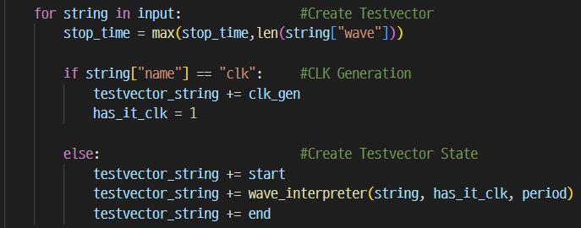
Structure
tv_gen()
Create Testvector
“example1.json”
“example2.json”
{signal:[
{name:"clk", wave:"P......."},
{name:"rst", wave:"lh......"},
{name:"d", wave:"hlhlhlhl"},
{},
{name:"out", wave:"l.hlhlhl"}
]
}
{signal:[
{name:"a", wave:"l.h."},
{name:"b", wave:"lhlh"},
{},
{name:"out", wave:"l..h"}
]
}

Slide 19
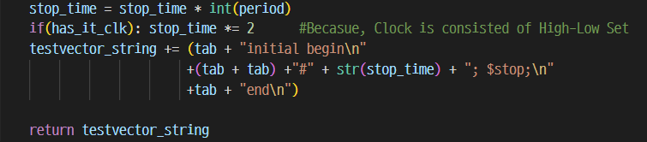
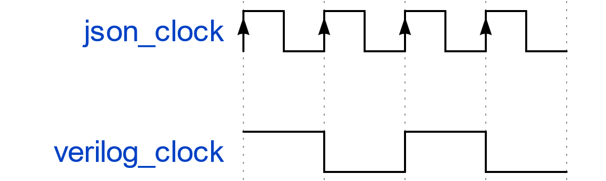
Structure
tv_gen()
Set Sim Stop time
{name:”json_clk”, wave:”P...”}
initial verilog_clk = 1’b1;
always #1 verilog_clk = ~clk;

Slide 20
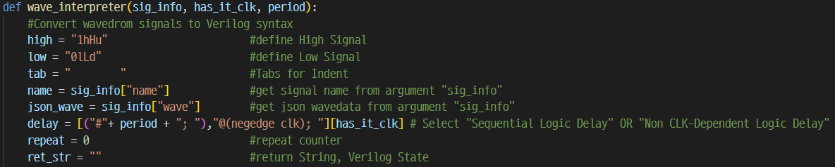
Structure
wave_interpreter()
“example1.json”
“example2.json”
{signal:[
{name:"clk", wave:"P......."},
{name:"rst", wave:"lh......"},
{name:"d", wave:"hlhlhlhl"},
{},
{name:"out", wave:"l.hlhlhl"}
]
}
{signal:[
{name:"a", wave:"l.h."},
{name:"b", wave:"lhlh"},
{},
{name:"out", wave:"l..h"}
]
}

Slide 21
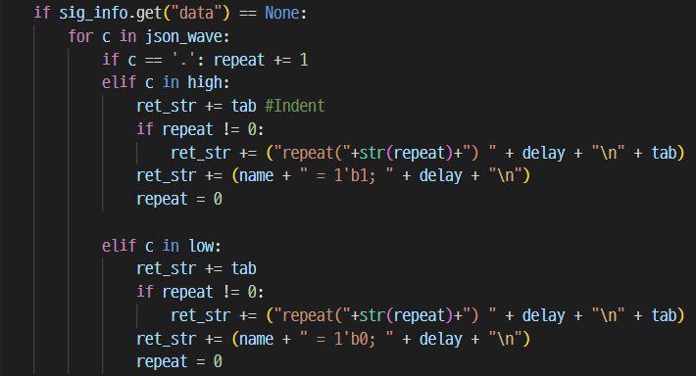
Structure
wave_interpreter()
“example.json”
{signal:[
{name:"a", wave:"hl.."},
{name:"b", wave:"lhl."},
{name:"c", wave:"l.hl"},
{name:"d", wave:"l..h"},
{},
{name:"out",wave:"====",
data:["00","01","10","11"]}
]
}

Slide 22
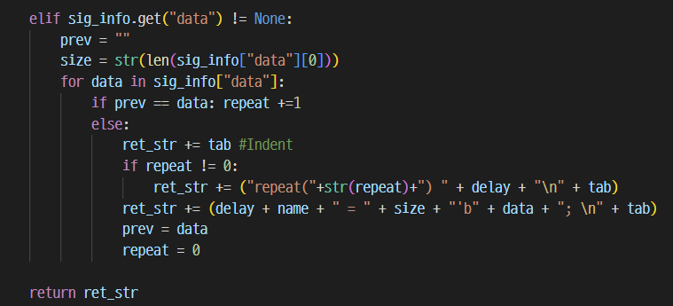
Structure
wave_interpreter()
“example.json”
{signal:[
{name:"clk", wave:"P."},
{name:"rst", wave:"h."},
{name:"in",wave:"==",
data:["0000","1111"]},
{},
{name:"out", wave:"==",
data:["0000", "1111"]}
]
}

Slide 23
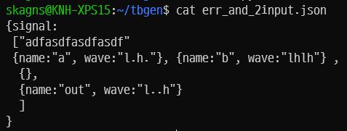
Implementation
Operating System: Ubuntu 20.04.4 LTS
Working Directory: /home/skagns/tbgen
Python Version: 3.8.10
Error Case
File Test Failed
Args Seq Error
Json File Error

Slide 24
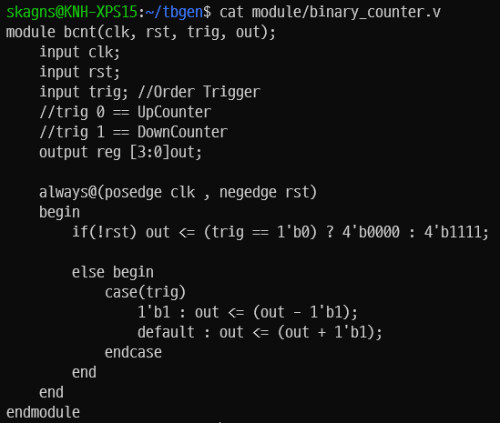
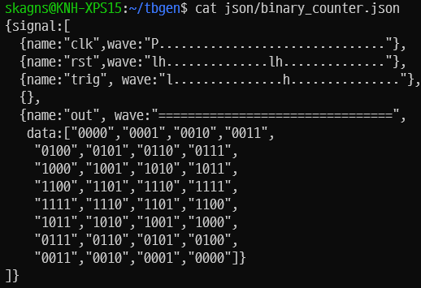
Implementation
Operating System: Ubuntu 20.04.4 LTS
Working Directory: /home/skagns/tbgen
Python Version: 3.8.10
Sequential Logic Test (Binary Counter)
binary counter module
binary counter wavedrom

Slide 25
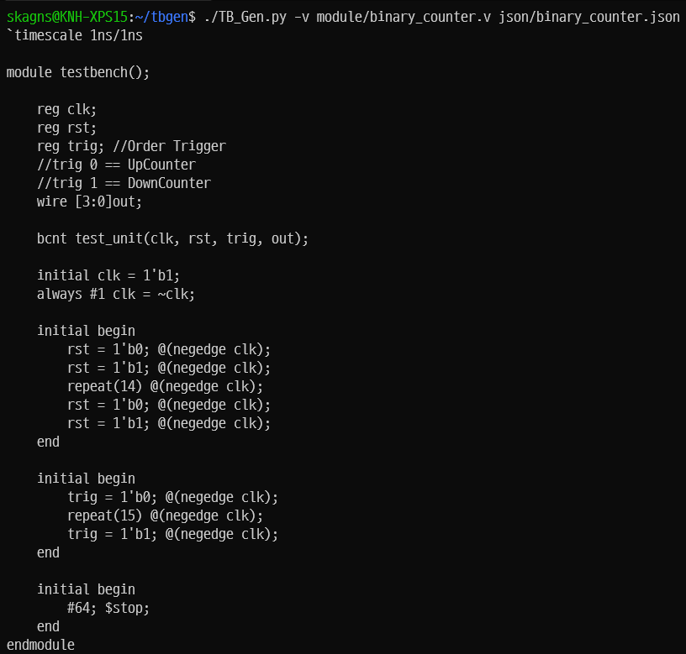
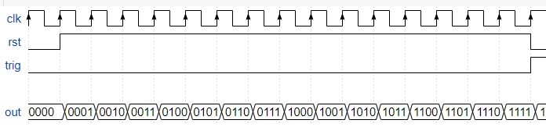
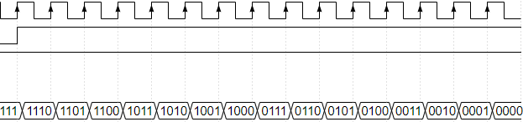
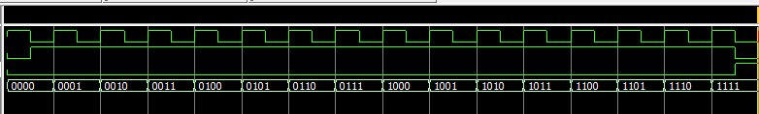

Implementation
Operating System: Ubuntu 20.04.4 LTS
Working Directory: /home/skagns/tbgen
Python Version: 3.8.10
Sequential Logic Test (Binary Counter)

Slide 26
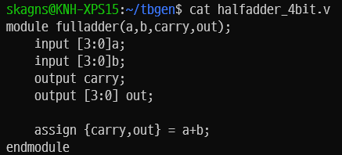
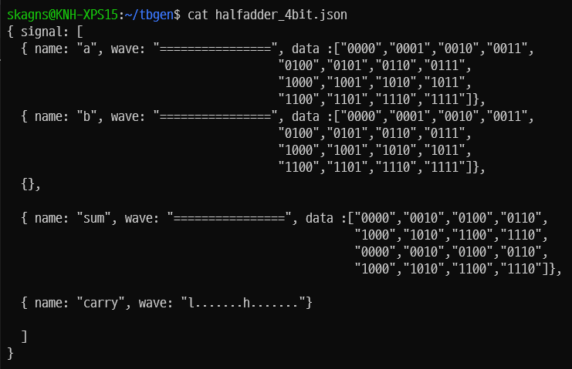
Implementation
Operating System: Ubuntu 20.04.4 LTS
Working Directory: /home/skagns/tbgen
Python Version: 3.8.10
Non-Clock-Dependent Logic Test (halfadder_4bit)
module
wavedrom json

Slide 27
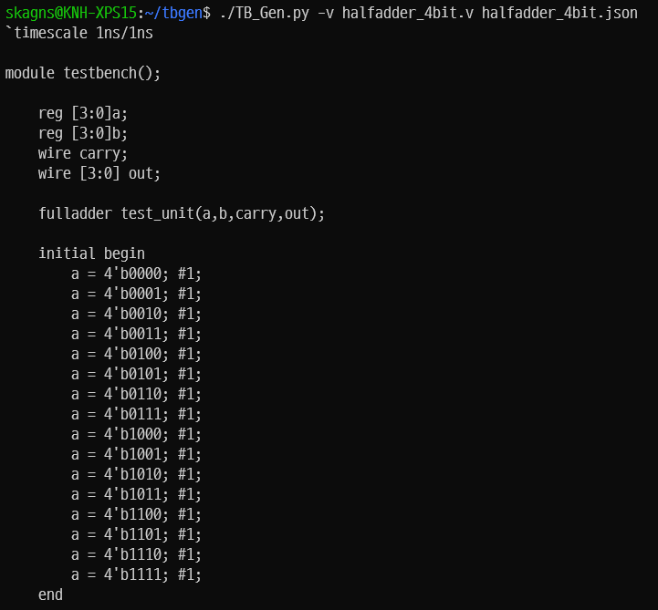
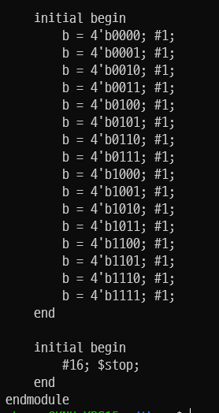
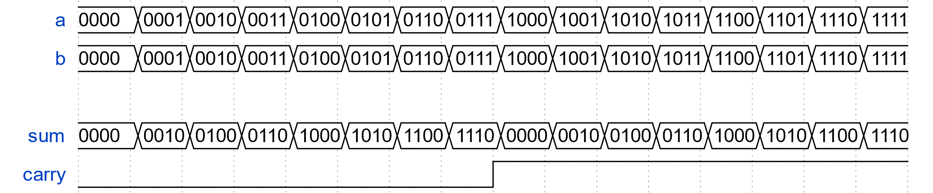

Implementation
Operating System: Ubuntu 20.04.4 LTS
Working Directory: /home/skagns/tbgen
Python Version: 3.8.10
Non-Clock-Dependent Logic Test (halfadder_4bit)

