Slide 1
Namhun Kim (Bachelor’s course) System Semiconductor Engineering University of Sangmyung
Verilog HDL: Chapter 1 ~ 3
Summer Bootcamp 2022

Slide 2
Contents
Learning Object
1. Understanding Verilog
2. *.v files simulation
3. Fundamental Language Structure of Verilog

Slide 3
Verilog HDL?
About Verilog HDL
Verilog HDL = Verilog Hardware Description Language
“Similarly, in the digital design field, designers felt the need for a standard
language to describe digital circuits. Thus, HDLs came into existence.”
-Verilog HDL: A Guide to Digital design and Synthesis-

Slide 4
Verilog HDL?
About Verilog HDL
Verilog HDL = Verilog Hardware Description Language
Verilog HDL != VHDL(VHSIC HDL)
“Similarly, in the digital design field, designers felt the need for a standard
language to describe digital circuits. Thus, HDLs came into existence.”
-Verilog HDL: A Guide to Digital design and Synthesis-

Slide 5



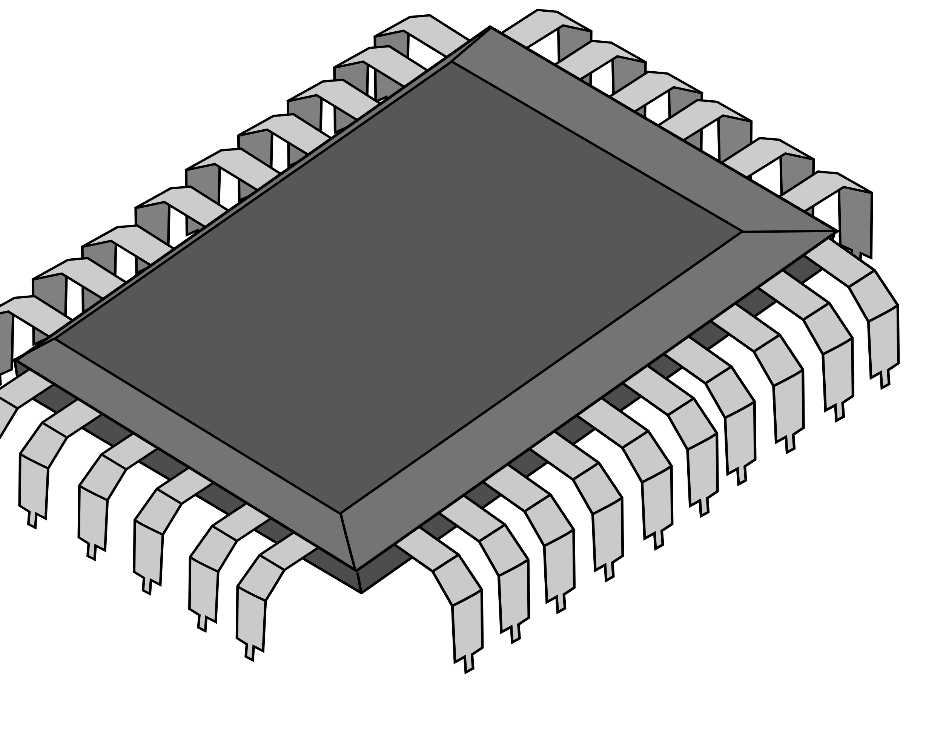
Digital Design Process
Design Specification
Behavioral Description
RTL Description(HDL)
Verification & Test
Gate-Level Netlist
Physical Layout
Implementation

Slide 6
Digital Design Process
We Handle This!
Design Specification
Behavioral Description
Behavioral Description
RTL Description(HDL)
RTL Description(HDL)
Verification & Test
Verification & Test
Gate-Level Netlist
Physical Layout
Implementation

Slide 7
Configuration of Verification & Test
RTL: Registor Transfer Level
Registor: a collection of FF
Verification & Test
1. Functional Verification
Check whether hardware’s function is working perfectly
Testbench is used to Check functionality
2. Logic Synthesis/ Timing Verification
Check the RTL level Issues
Timing Diagram Check using Testbench
Resistor: 저항
Registor: 레지스터

Slide 8
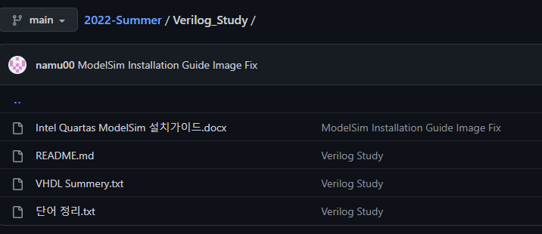
Installation ModelSim
My Github: https://github.com/namu00/2022-Summer/tree/main/Verilog_Study
Download and Flow the guide.docx

Slide 9
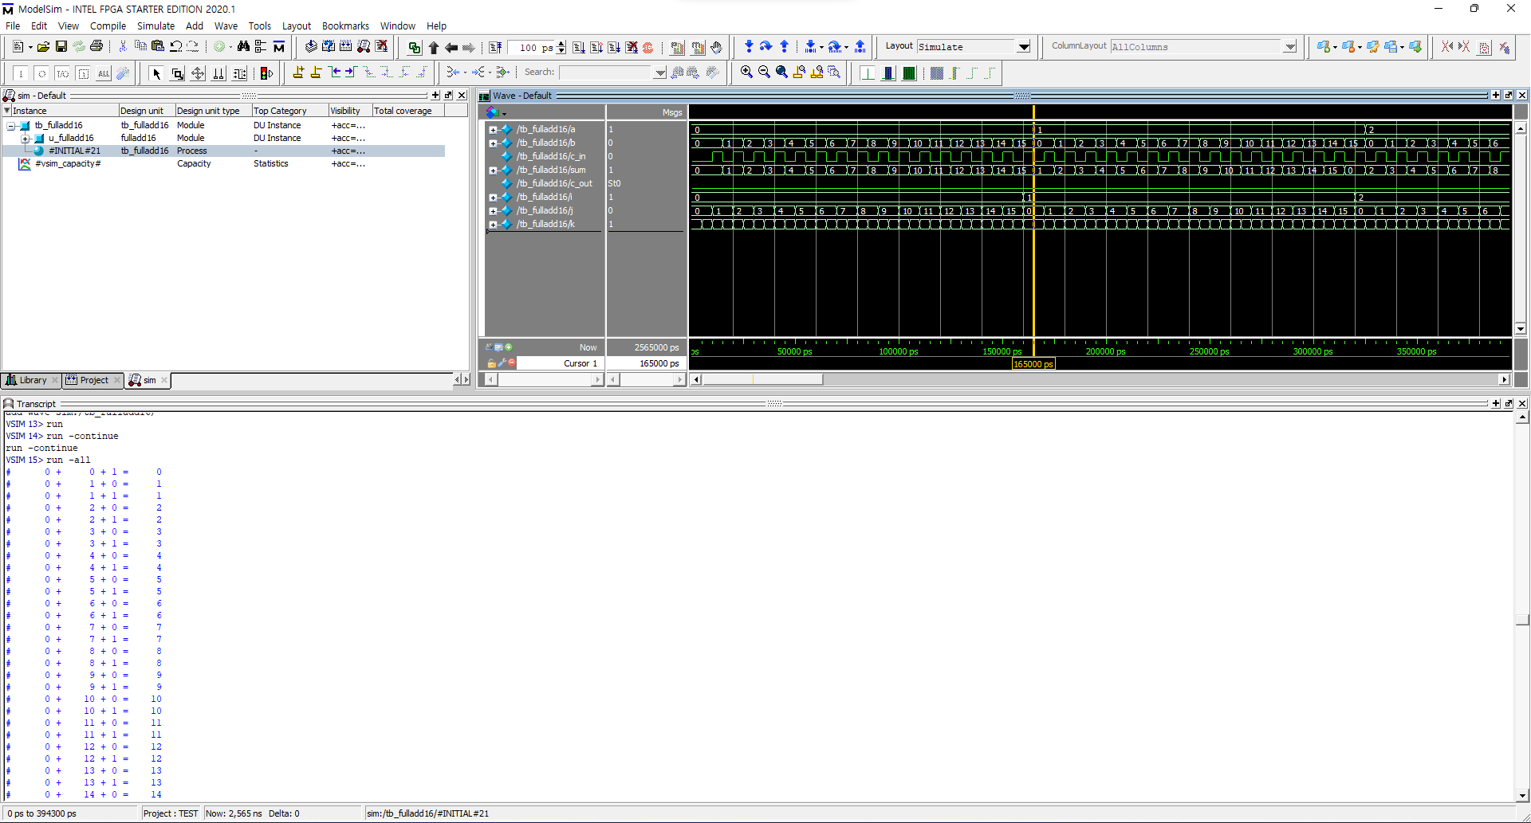
Blah~ Blah~
Blah~
Blha~

Slide 10
Blah~ Blah~
Blah~
Blha~
개발 폰트는 Naver D2Coding 또는 Consolas를 추천합니다.
00 oO iI ll //맑은고딕
00 oO iI lL //Consolas
00 oO iI lL //D2 Coding

Slide 11
Module & Module Instance
Module
4bit full adder
module fulladd4(sum, c_out, a, b, c_in);
output [3:0] sum; // 4비트 배열 선언
output c_out;
input [3:0] a; // 4비트 배열 선언
input [3:0] b; // 4비트 배열 선언
input c_in;
assign {c_out, sum} = {1’b0, a} + {1’b0, b}
endmodule
module <MODULE_NAME> (TERMINAL_LIST);
...
//Module Internals
...
endmodule

Slide 12
Module & Module Instance
Module Instance
In 16bit full adder code..
module fulladd16(sum, c_out, a, b, c_in)
...
fulladd4 unit_0( .a(a[3:0]),
.b(b[3:0]),
.sum(sum[3:0]),
.c_in(c_in),
.c_out(c_out_0));
fulladd4 unit_1(sum[7:4], c_out_1, a[7:4], b[7:4], c_out_0);
fulladd4 unit_2(...);
fulladd4 unit_3(...);
...
endmodule

Slide 13
Module & Module Instance
Module Instance
In 16bit full adder code..
module fulladd16(sum, c_out, a, b, c_in)
...
fulladd4 unit_0( .a(a[3:0]),
.b(b[3:0]),
.sum(sum[3:0]),
.c_in(c_in),
.c_out(c_out_0));
fulladd4 unit_1(sum[7:4], c_out_1, a[7:4], b[7:4], c_out_0);
fulladd4 unit_2(...);
fulladd4 unit_3(...);
...
endmodule
Module Instance Declaration!

Slide 14
Module & Module Instance
Module Instance
Module Instance Declaration Form
module <MODULE_NAME> (TERMINAL_LIST)
...
<MODULE> <INSTANCE_NAME_0> (TERMINAL_LIST);
<MODULE> <INSTANCE_NAME_1> (TERMINAL_LIST);
...
endmodule

Slide 15
Hierarchy Concept
Top-Down
16 Bit Full Adder
Unit_0
Unit_1
Unit_2
Unit_3
Logic Gates
Logic Gates
Logic Gates
Logic Gates

Slide 16
Hierarchy Concept
Bottom-Up
16 Bit Full Adder
Unit_0
Unit_1
Unit_2
Unit_3
Logic Gates
Logic Gates
Logic Gates
Logic Gates

Slide 17
StimulusBlock & Testbench
Stimulus Block Concept
(Stimulus Block)
a
b
carry_in
16Bit Full Adder
sum
carry_out

Slide 18
StimulusBlock & Testbench
Stimulus Block Concept
(Top Level Block)
Stimulus
Block
a
a
Design Block
16bit
F_add
b
b
sum
sum
c_in
c_in
c_out
c_out

Slide 19
Blah~ Blah~
Blah~
Blha~

Slide 20
Language Structure
Comments
Operators
// One line comment
/* multiple line comment */
// Similar like C language
a = a + b; // 합
a = a – b; // 차
a = ~b; // 논리 부정
a = b && c; // AND연산
a = b || c; // OR연산
a = b ? c : d; // 조건 연산
//...etc

Slide 21
Language Structure
Numbers
String
4’b1111 // 4비트 2진수 1111
12’habc // 12비트 16진수 abc
16’d255 // 16비트 10진수 255
1234 // 10진수 1234, 형식을 지정하지 않은 숫자는 기본적으로 10진수 취급
4’bx // 4비트 미지수 x
8‘dz // 8비트 하이-임피던스
“Hello, World!” // 문자열 표현

Slide 22
Language Structure
Key-words
reg == input signal
wire == output signal
Key-word | Definition
reg | 일반적으로 사용하는 레지스터
wire | 디바이스의 물리적인 연결, 값 저장 x
real | 실수 표현 레지스터
time | 시간 저장 레지스터
integer | 정수 표현 레지스터 (signed형태 사용 가능)

Slide 23
Language Structure
input / output
input == input
output == output
module not_gate(in, out);
input in;
output out;
assign s = ~in;
endmodule
module half_adder(a, b, sum);
input a;
input b;
output sum;
assign sum = a + b;
endmodule

Slide 24
Language Structure
Key-word example
testbench.v
module testbench();
reg a;
reg b;
wire sum;
half_adder ha (a, b, sum);
initial begin
#10 a = 1'b0; b = 1'b0;
#10 a = 1'b0; b = 1'b1;
#10 a = 1'b1; b = 1'b0;
#10 a = 1'b1; b = 1'b1;
#10 $stop;
end
endmodule
half_adder.v
module half_adder(a, b, sum);
input a;
input b;
output sum;
assign sum = a + b;
endmodule

Slide 25
System Task
Task | Definition
$display | Shell에 값을 출력
$time | 시간을 보여줌
$stop | 작업을 중단함
$finish | 작업을 그만 둠
module testbench();
reg a;
reg b;
wire sum;
half_adder ha (a, b, sum);
initial begin
#10 a = 1'b0; b = 1’b0;
$display("%t ns : a = %d, b = %d", $time, a, b);
#10 a = 1'b0; b = 1’b1;
$display("%t ns : a = %d, b = %d", $time, a, b);
#10 a = 1'b1; b = 1’b0;
$display("%t ns : a = %d, b = %d", $time, a, b);
#10 a = 1'b1; b = 1’b1;
$display("%t ns : a = %d, b = %d", $time, a, b);
#10 $stop;
end
endmodule

Slide 26
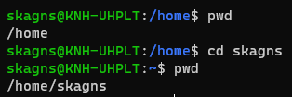
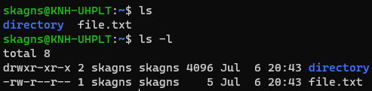
Extension
Linux Shell command
cd : Change Directory
ls : list
★ls –l★

Slide 27
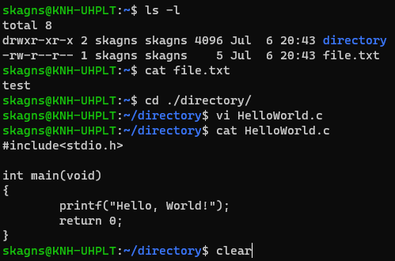
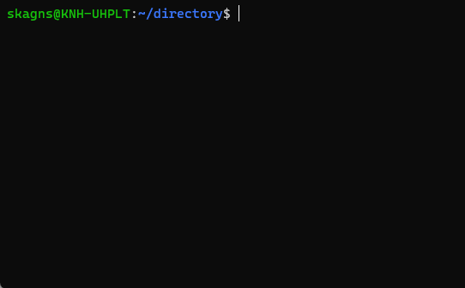
Extension
Linux Shell command
clear : Clear Screen

