Slide 1
LOGIN
<meta name="google-site-verification" content="Hxht2P4eBnSy72AGRPu7h4inenbzhJvARm7oHP7aK74">

Slide 2
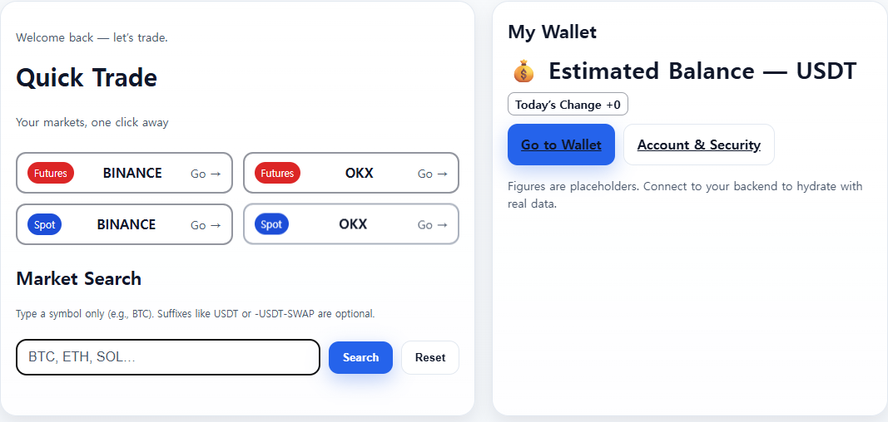
③
① Navigate to Trading Page
Action: When a user selects an exchange, they should be directed to the main trading page (the one with the charts) for that specific exchange.
①
② Symbol Search Functionality This section describes the behavior of the search bar.
Search Execution: When a user types a symbol (e.g., BTC, ETH) and clicks the "Search" button, the system will display the corresponding results.
Search Triggers: The search should be initiated in two ways:
By clicking the "Search" button.
By pressing the Enter key after typing in the search field.
Reset: A "Reset" button should be available. When clicked, it will clear the search results and reset the view to its default state.
②
③ Extended Navigation to Namubit.com
This feature expands upon the existing functionality of www.namubit.com. Two new navigation links should be added:
- Go to Wallet: Clicking the "Go to Wallet" button should navigate the user to: https://www.namubit.com/wallet
- Account & Security: Clicking the "Account & Security" button should navigate the user to: https://www.namubit.com/dashboard

Slide 3
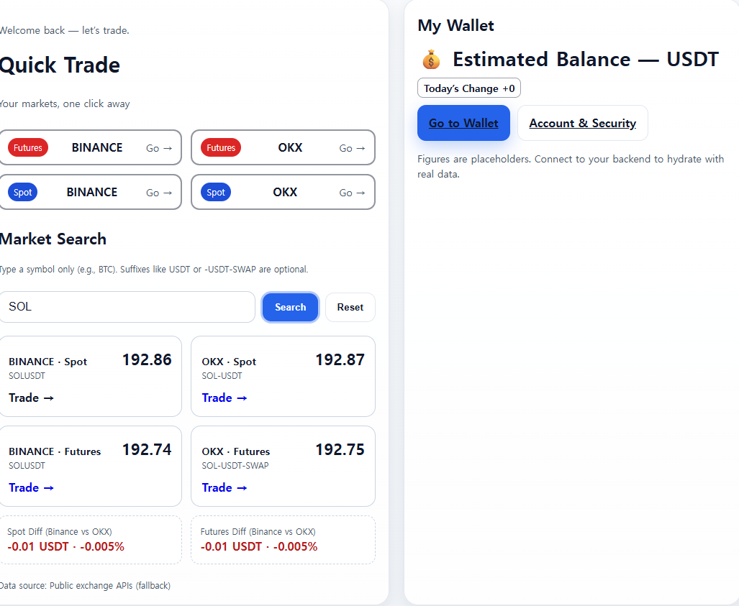
① 1. Grid Display & Navigation
- What to do: Display the trade types (e.g., SPOT, FUTURES) for each exchange in a grid layout.
- How it works: When a user clicks on a specific trade type (like "Binance SPOT"), the application should navigate directly to that trading window.
- Example: A user sees a grid with "Binance SPOT" and "OKX SPOT". Clicking "Binance SPOT" opens the trading screen for Binance Spot.
2. Reset Functionality
- What to do: Add a "Reset" button to the interface.
- How it works: When a user clicks this button, all settings, filters, and views on the screen should return to their original, default state.
3. Handling Unavailable Symbols
- What to do: If a trading symbol does not exist on a particular exchange, display "N/A" in the price field.
- How it works: This prevents showing '0' or an error message, making it clear to the user that the symbol is simply not available on that platform.
4. Price Difference Calculation
- What to do: The formula for calculating the price difference is fixed.
- How it works: Always calculate the difference as Binance Price - OKX Price. This calculation logic should not be changed.
5. UI Layout Adjustment
- What to do: Swap the positions of "OKX SPOT" and "Binance SPOT" in the grid display.
- How it works: The goal is to change the visual order in which they appear on the screen.
Important Technical Note - API Source Update Required
- Current Status: The dashboard is currently pulling data directly from the native Binance and OKX APIs.
Action Needed: Please update the implementation to fetch all data from the Connex API instead. All direct calls to the Binance and OKX APIs should be removed and replaced with the appropriate Connex API endpoints.
①

Slide 4
LOGOUT

Slide 5
