Slide 1
Business Network using Blockchain
Presented by :
NamrataKumbhar
Rujuta Koli
Nargis Patwardhan
Rutuja Jadhav
Dnyaneshwar Raut

Slide 2
Introduction
Domain Introduction
Blockchain is immutable data structure used to record participants and transactions, records added in block are time-stamped and agreed by participants which cannot be modified by anyone once added to block.
Current trends
Shared ledger, privacy, smart contract, trust, decentralization
E.g. Decentralized currency (Bitcoin ,Ethereum ,Monera), Supply chains.

Slide 3
Need for work
In business network, participants needs to share data, records of exchange, proof of ownership etc. Traditionally each participating member maintains their own records and forward it to central authority to collect, distribute and verify. Currently data of businesses is growing so fast and big. Many partners share same kind of records but still keep different records thus increasing cost,complexity and errors. There is need to keep business records safe and accessible. Distributed ledger technology aims to solve these problems by letting us create a shared ledger on business network which is immutable, distributed, permissioned. It provides ability to keep all participants on track and updated.
We need to identify type of business networks, the objects and type of transactions. Model business requirements to fit on blockchain network. There is need to design an API to make network interactable, provide and user interface which should be easy to understand and there should be no need of technical knowledge to make transactions.

Slide 4
Problem statement and Objectives
To create a blockchain business network to keep the records of the ownership of assets and provide an simple interactable user interface for end users.
Objectives
Model network into required ledger keeping form.
Give it ability to add new types of assets, participants.
Make law enforcement agency as participant with special permission in network.
Make customer to customer / business to business transactions possible eliminating any intermediary.
Provide facility to sell asset or auction it.
Provide facility to identify participant.
Provide a wallet facility.
Selective endorsement facility.

Slide 5
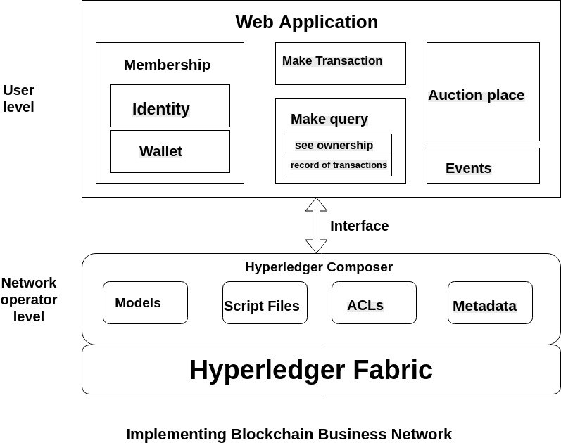
Proposed work
Diagrammatic description of topic

Slide 6
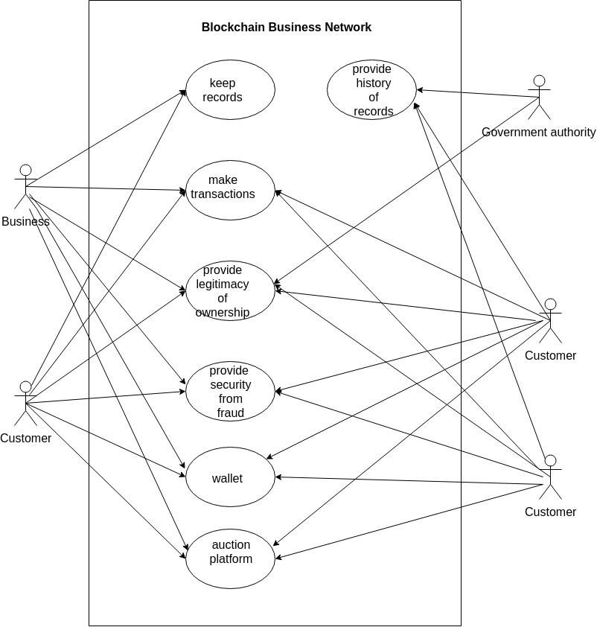

Slide 7
Modules
Web Application
Membership
Identity
Wallet
Make Transaction
Make Query
See Ownership
Record of Transaction

Slide 8
Auction Place
Events
Hyperledger Composer
Models
Script Files
ACL’s
Metadata
Hyperledger Fabric

Slide 9
Implementation Details
Technology to be used
Blockchain
Hyperledger composer
Hyperledger fabric
World Wide Web
HTML ,CSS, JavaScript
Node.js
REST API
YEOMAN
LOOPBACK
3. For Documentation
Markdown
HTML

Slide 10
Software and Hardware requirements
Hardware requirements
Processor: Intel(R) Core (TM) i5-5200U CPU@2.20Hz 2.19GHz .
System Type: 64 bit OS, x64-based processor .
Edition :Windows 10 Home Single Language .
Software requirements
Operating System : Windows xp & above or Linux.
Web Browser.

Slide 11
Progress Till Now…..

Slide 12
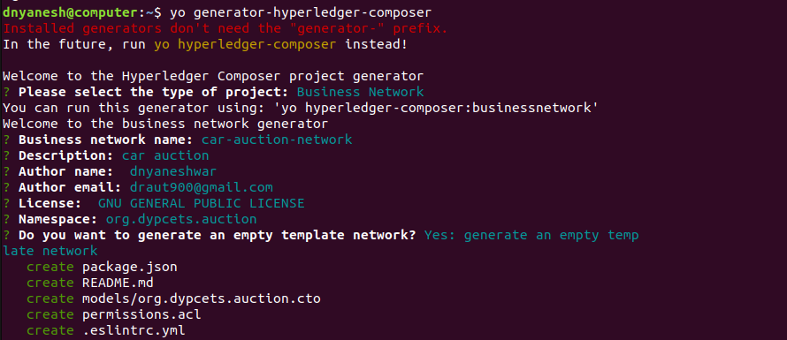
Setting up boilerplate

Slide 13
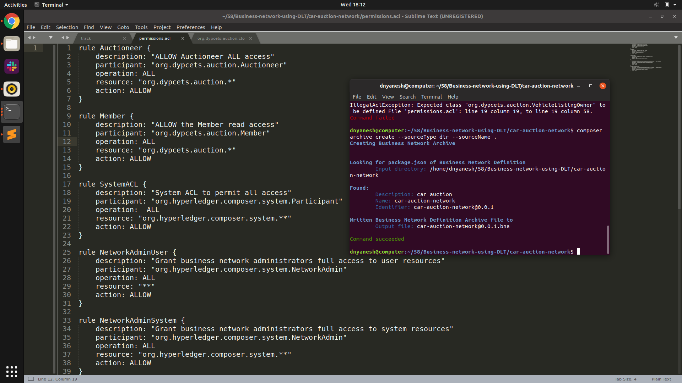
Creating bna from model file

Slide 14
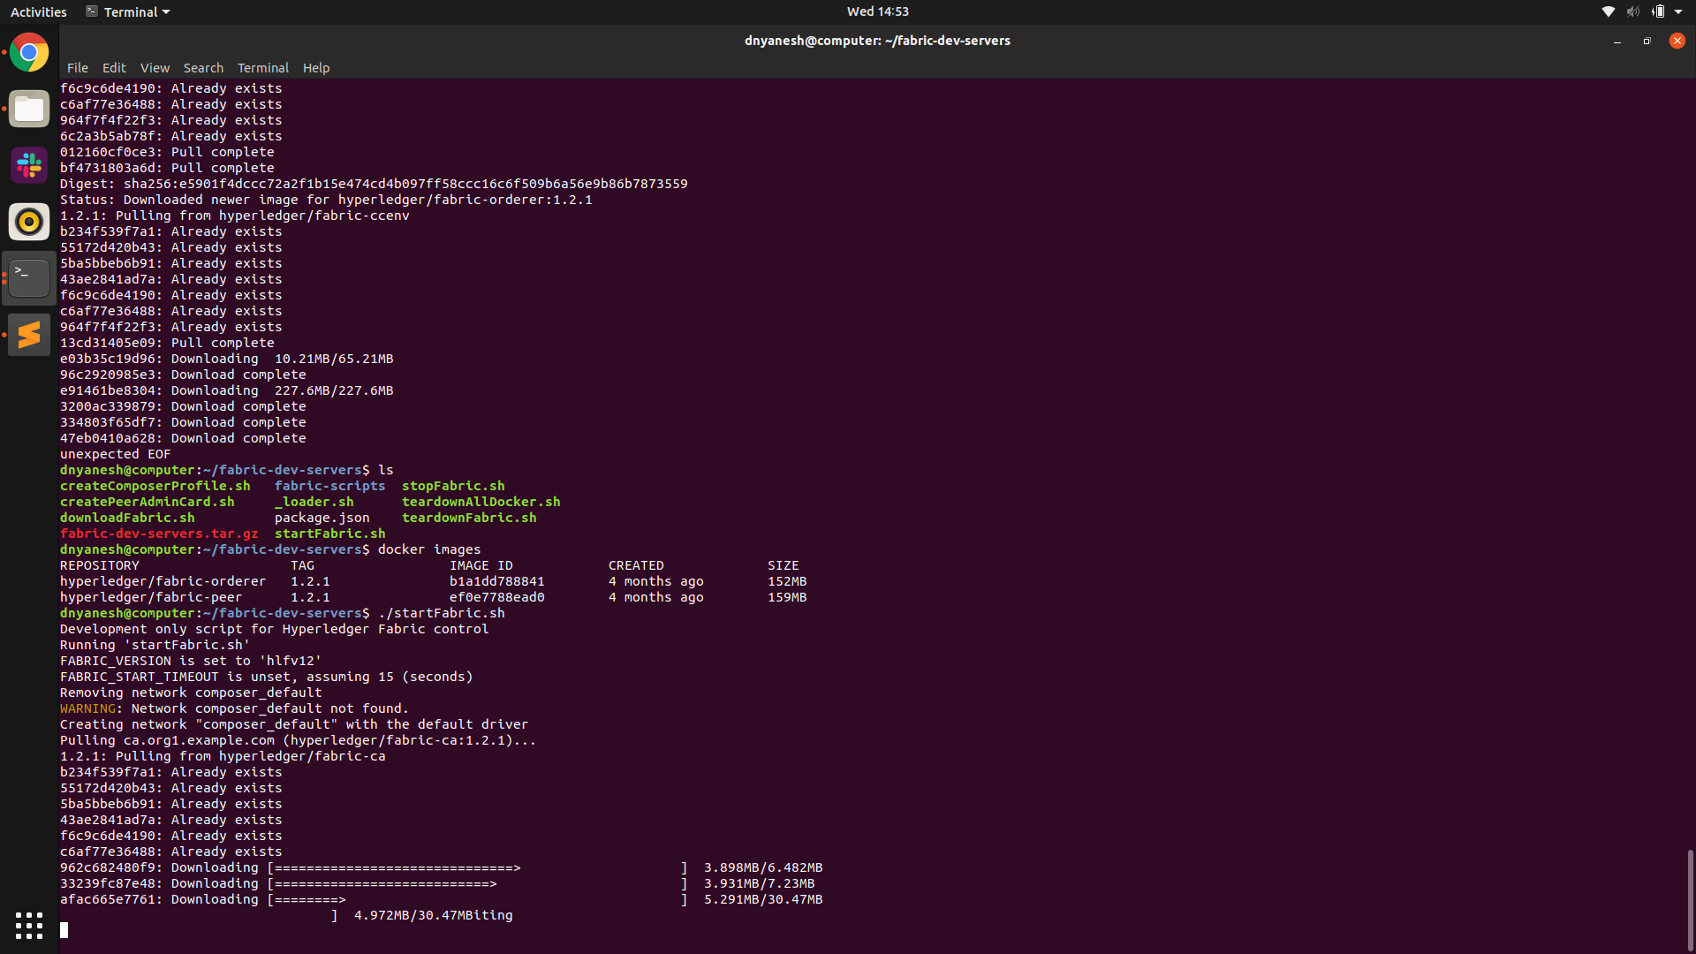
Staring fabric

Slide 15
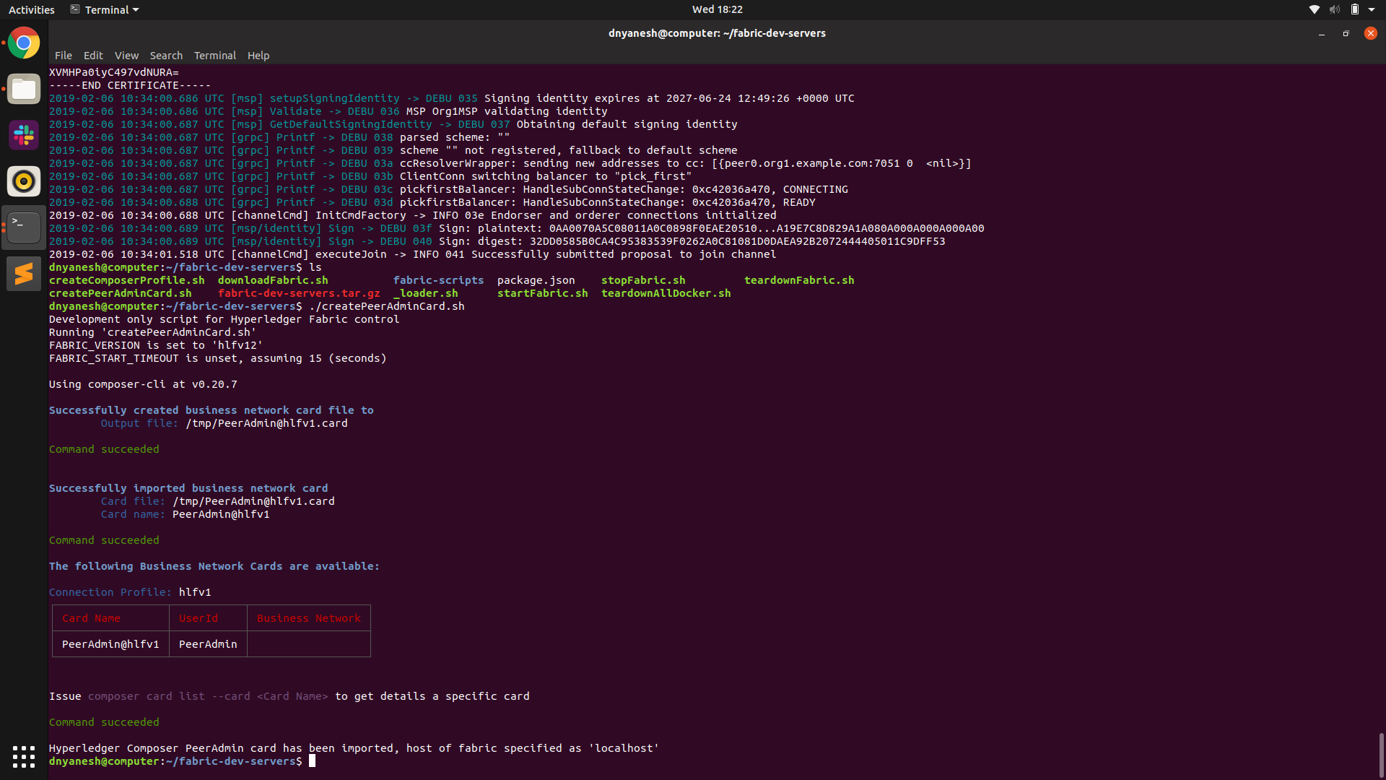
Creating peeradmincard

Slide 16
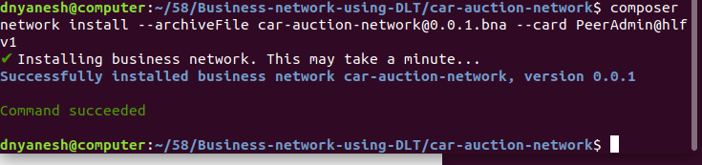
Installing bna on network

Slide 17
Deploying network (ERROR!!)

