Slide 1
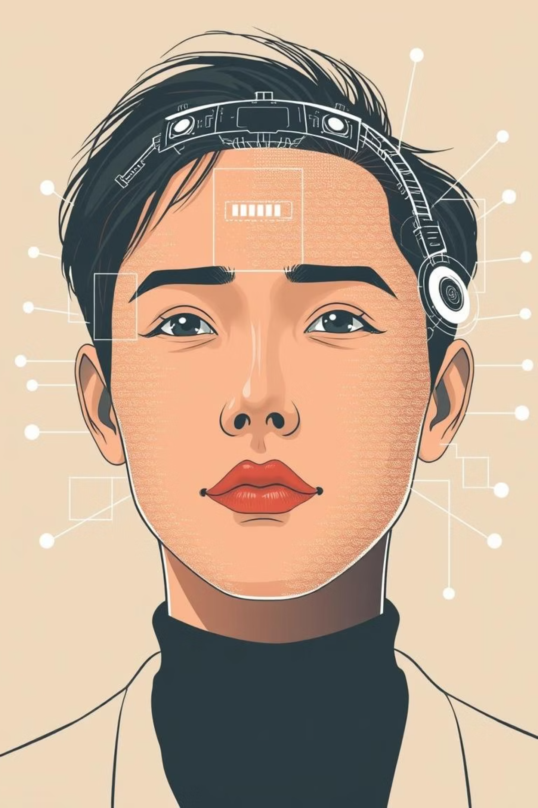

Deepfake Video Detection
Comparing 3D CNN, EfficientNet, and ConvLSTM Approaches
Presented by: Namrata, Ritish, Mansi

Slide 2
Outline
Deepfake Video Detection
The Rising Threat of Deepfakes
Research Objectives: Model Comparison
Development Environment & Dependencies
Dataset: Scale & Scope
Robust Frame Extraction Pipeline
Model 1: 3D CNN for Spatiotemporal Learning
Model 2: EfficientNet for Spatial Efficiency
Model 3: ConvLSTM for Spatiotemporal Dynamics
Performance Summary & Key Metrics
Future Directions.

Slide 3

The Rising Threat of Deepfakes
What are Deepfakes?
Artificially intelligent-generated synthetic media, particularly videos, that realistically mimic the appearance and voice of real individuals. They leverage deep learning to superimpose faces or alter speech.
Why are they a concern?
Deepfakes pose significant risks, enabling misinformation campaigns, identity fraud, and privacy violations. Their increasing sophistication makes detection crucial for maintaining digital trust and security.
Our mission: Develop deep learning models to accurately identify these deceptive creations and protect against their misuse.

Slide 4
Research Objectives: Model Comparison
This research aims to rigorously evaluate three distinct deep learning architectures for their efficacy in deepfake detection.
1
2
3
3D Convolutional Neural Network (CNN)
EfficientNet (Transfer Learning)
Convolutional Long Short-Term Memory (ConvLSTM)
Leveraging its ability to directly process spatiotemporal data from video frames, capturing motion and appearance cues simultaneously.
Utilizing a pre-trained EfficientNet backbone for highly efficient and accurate spatial feature extraction from individual frames.
Combining CNNs for spatial feature learning with LSTMs for sequential temporal modeling, designed to capture complex video dynamics.
Our evaluation will focus on accuracy and robustness, providing critical insights into the optimal approach for practical deepfake detection systems.

Slide 5




Development Environment & Dependencies
Our experimental setup ensured seamless integration and GPU acceleration for deep learning model training.
R & Reticulate
Python & TensorFlow
Primary scripting environment, with reticulate bridge for Python libraries.
Core deep learning framework, enabling efficient computation and model development.
Google Colab Pro
Dependencies
Cloud-based GPU compute for accelerated training and experimentation.
Installed essential libraries for deep learning, video processing (e.g., OpenCV, FFmpeg), and data handling.
Rigorous environment setup was crucial for reproducible and efficient experimentation.

Slide 6


Dataset: Scale & Scope
Deepfake Detection Benchmarks
We utilized a subset of well-known deepfake datasets, specifically curated to include both authentic and synthetically generated videos (.mp4 format).
Labels: Clearly defined REAL vs. FAKE classifications.
Proof-of-Concept Size: A manageable subset was extracted for initial model development and testing within Colab's runtime constraints.
A Major Challenge:
The full-scale deepfake datasets are exceptionally large, often exceeding ~470GB. This presented a significant hurdle for training comprehensive models without specialized infrastructure, leading to the use of a smaller subset.

Slide 7
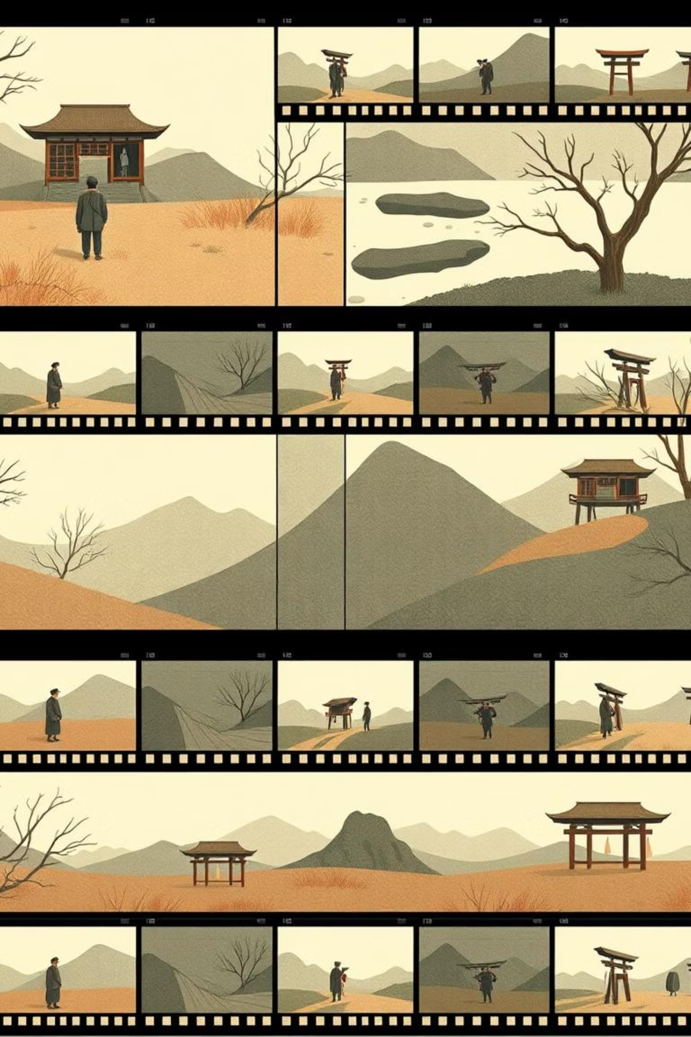



Robust Frame Extraction Pipeline
To prepare video data for model ingestion, a reliable frame extraction and preprocessing pipeline was essential.
Video Input
MP4 video files serve as the raw input for the detection pipeline.
Safe Frame Extraction
Implemented a custom Python function (extract_frames_safe_py) to reliably convert video streams into individual image frames, handling potential errors.
Preprocessing & Selection
Each extracted frame undergoes essential preprocessing, including resizing to a uniform dimension, normalization of pixel values (0-1 range), and strategic frame selection to capture representative temporal sequences.
Sequential Output
The result is a sequence of preprocessed image frames ready for deep learning model input, crucial for spatiotemporal analysis.

Slide 8
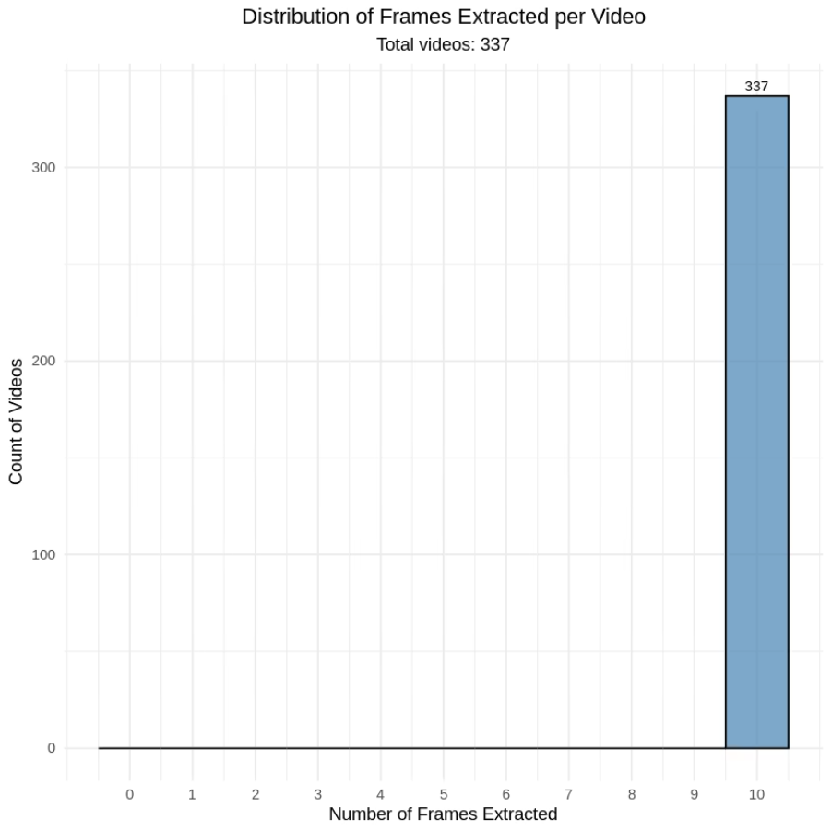
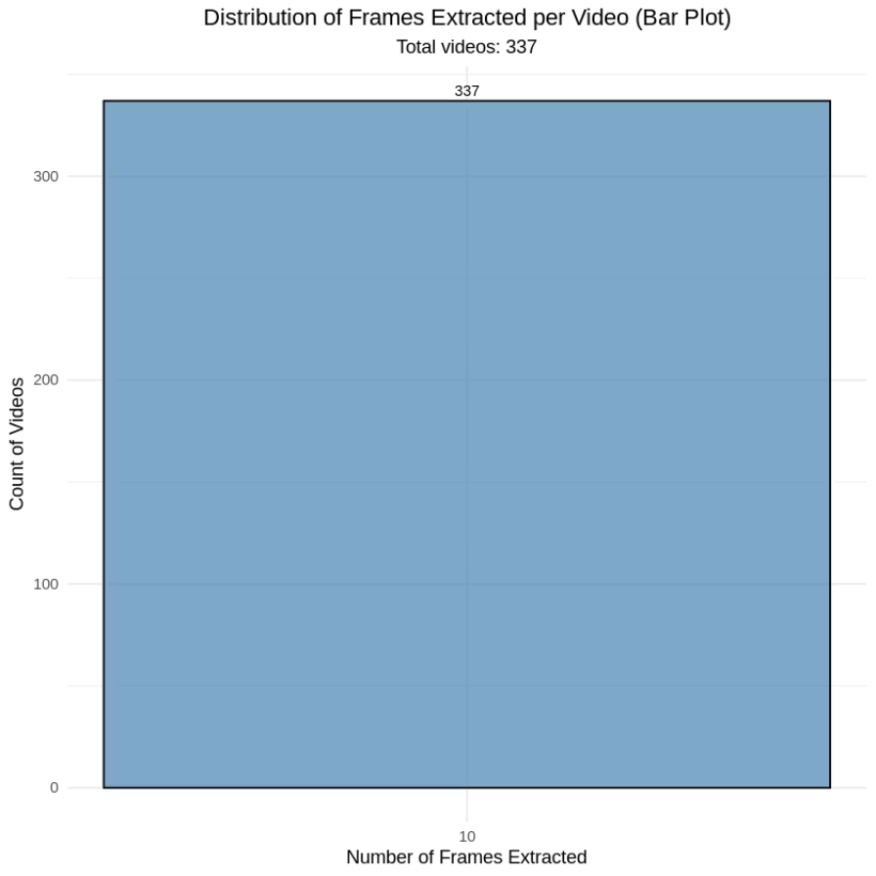
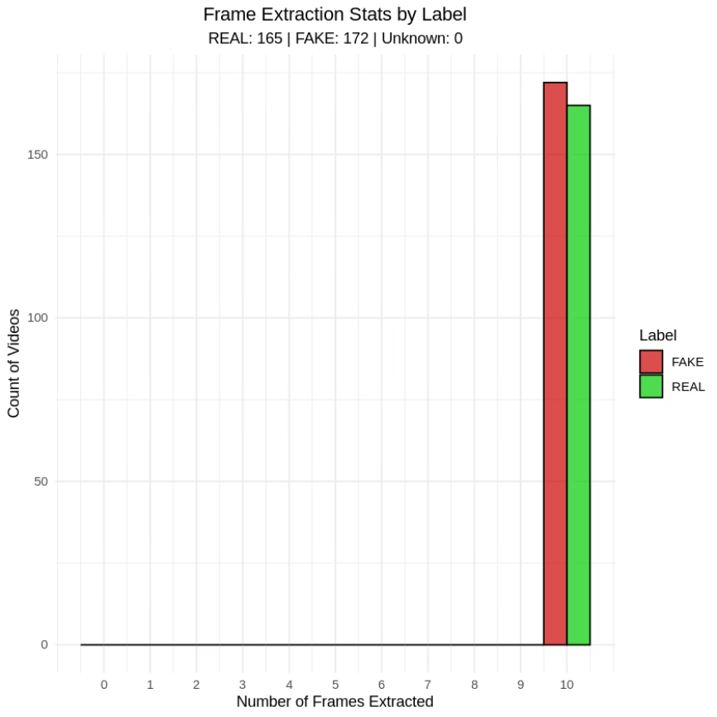

Slide 9

Model 1: 3D CNN for Spatiotemporal Learning
Direct Spatiotemporal Feature Learning
The 3D CNN is designed to process video data directly, enabling the simultaneous capture of both spatial features (within frames) and temporal features (across frames). This architecture is inherently suited for tasks where motion and sequential information are critical.
Architecture Highlights
Comprised of stacked 3D convolutional and pooling layers, which allow the network to learn hierarchical representations from volumetric input (height, width, time).
Pros:
Exceptional for capturing complex motion dynamics and inter-frame relationships. Ideal for raw video input without explicit feature engineering.
Cons:
Computationally intensive, requiring significant GPU resources and extended training times due to the high dimensionality of 3D convolutions.

Slide 10
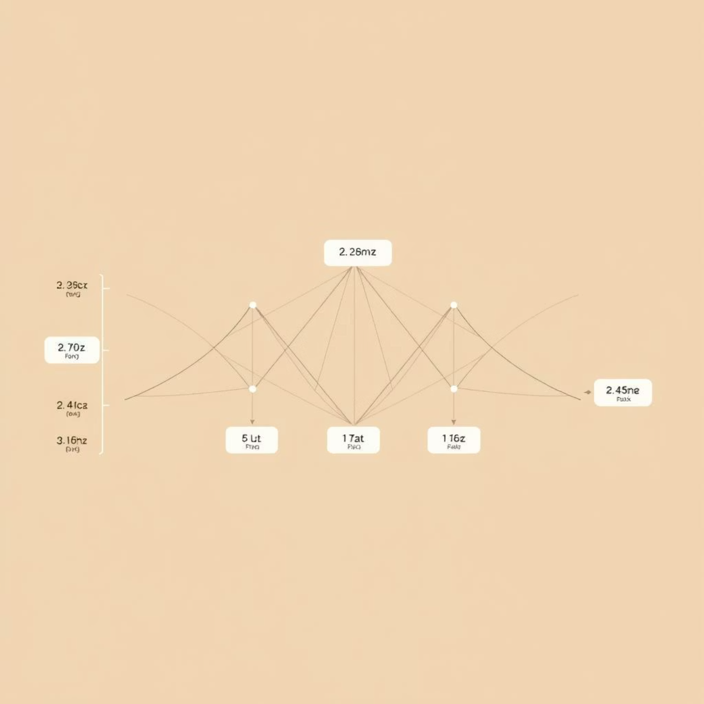
Model 2: EfficientNet for Spatial Efficiency
Leveraging the power of transfer learning, this approach utilizes EfficientNet's optimized architecture for robust spatial feature extraction.
Transfer Learning Approach
We employed a pre-trained EfficientNetB0 backbone, renowned for its balance of accuracy and computational efficiency across various image recognition tasks. This backbone effectively extracts rich spatial features from individual video frames.
Custom Classifier Head
A light-weight classifier head was trained on top of the frozen EfficientNet features to perform the final deepfake classification, adapting the pre-learned knowledge to our specific task.
Pros:
Highly efficient processing and strong accuracy on image-level features. Benefits from extensive pre-training on vast datasets, reducing training time and data requirements.
Cons:
Inherently less temporal awareness compared to models designed for sequential data. Relies on frame-by-frame processing, potentially missing subtle inter-frame inconsistencies.

Slide 11
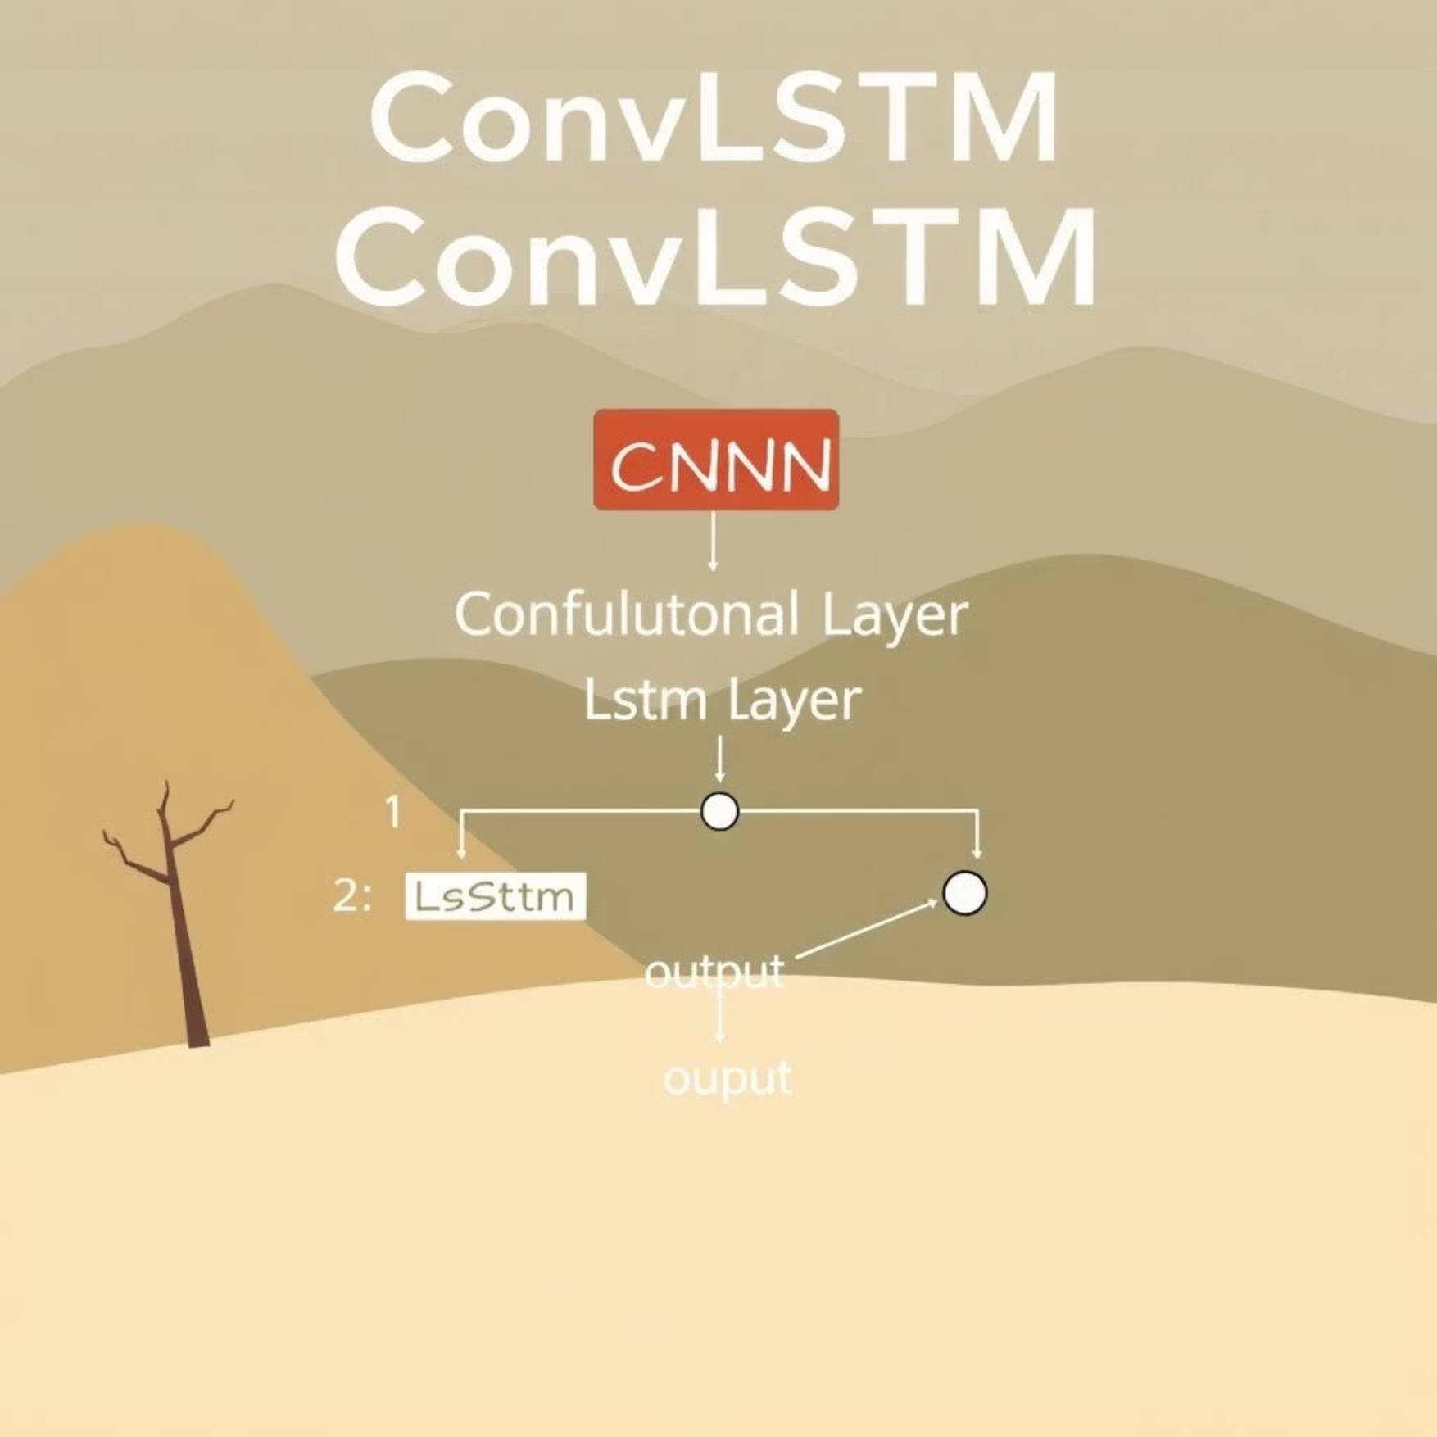
Model 3: ConvLSTM for Spatiotemporal Dynamics
Hybrid Spatiotemporal Learning
ConvLSTM (Convolutional Long Short-Term Memory) combines the spatial feature extraction capabilities of Convolutional Neural Networks (CNNs) with the temporal modeling strength of Long Short-Term Memory (LSTM) networks.
This hybrid design allows the model to both understand the content within each video frame and track how that content evolves over time, making it ideal for sequential data like video.
1
Pros:
Excellent at capturing video dynamics and long-range temporal dependencies. Handles variable-length sequences effectively.
2
Cons:
Generally slower to train than purely convolutional models due to the recurrent nature of LSTMs. Can be more complex to optimize.

Slide 12
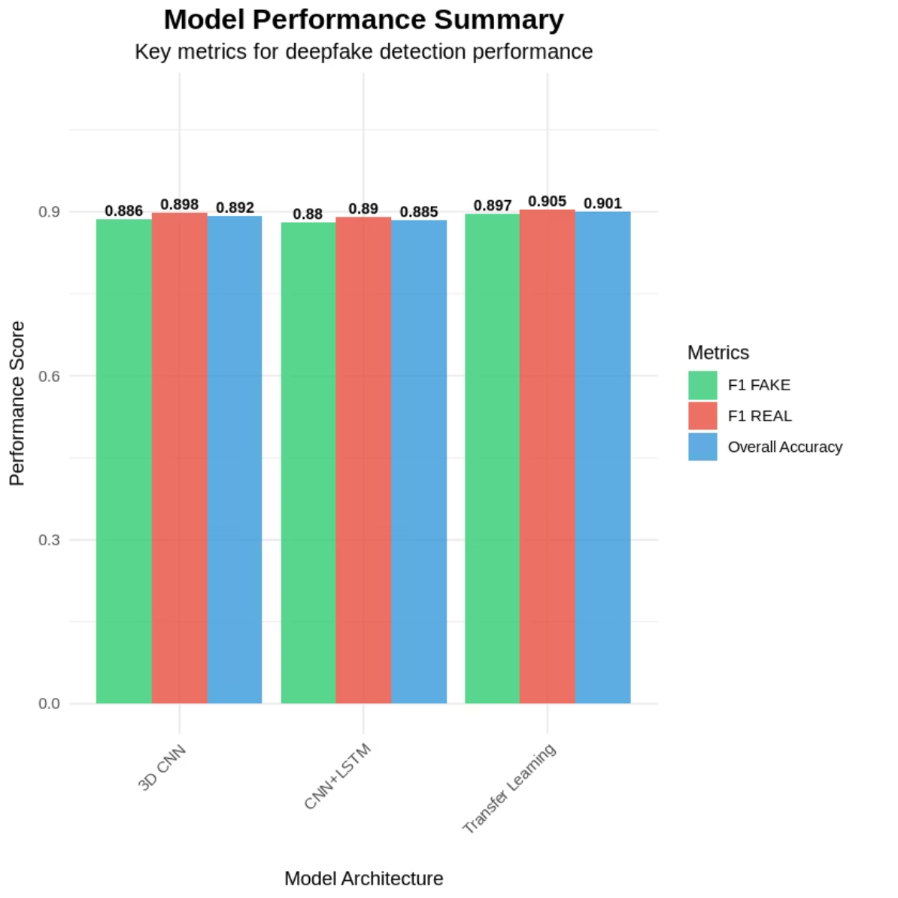
Performance Summary & Key Metrics
Our experimental results highlight the strengths of each model, with ConvLSTM demonstrating the most promising overall performance on our proof-of-concept dataset.
Model Rankings (by Composite Score):
Transfer Learning: 0.9002
3D CNN: 0.8908
CNN+LSTM: 0.8840

Slide 13

Future Directions
Scale up with full deepfake dataset.
Explore hybrid models and transformers.
Deploy real-time detection system.
Transition from proof-of-concept subsets to comprehensive, full-scale deepfake datasets for more robust model training and evaluation.
Investigate more advanced architectures, including combinations of current models (hybrid) and the application of transformer networks for enhanced spatiotemporal learning.
Develop and implement a deployable system capable of real-time deepfake detection, focusing on efficiency and practical application.

Slide 14
References
Chollet, F. (2017). Xception: Deep learning with depthwise separable convolutions. CVPR, 1251–1258. Google & Jigsaw. (2019). Deepfake Detection Challenge dataset. Kaggle. https://www.kaggle.com/c/deepfake-detection-challenge
Ji, S., Xu, W., Yang, M., & Yu, K. (2013). 3D convolutional neural networks for human action recognition. IEEE TPAMI, 35(1), 221–231. Tan, M., & Le, Q. V. (2019). EfficientNet: Rethinking model scaling for CNNs. ICML, 6105–6114.
Dosovitskiy, A., et al. (2021). An image is worth 16x16 words: Transformers for image recognition. ICLR.
Verdoliva, L. (2020). Media forensics and deepfakes: An overview. IEEE JSTSP, 14(5), 910–932.
Afchar, D., Nozick, V., Yamagishi, J., & Echizen, I. (2018). MesoNet: A compact facial video forgery detection network. IEEE International Workshop on Information Forensics and Security (WIFS), 1–7. https://doi.org/10.1109/WIFS.2018.8630761
Rossler, A., Cozzolino, D., Verdoliva, L., Riess, C., Thies, J., & Nießner, M. (2019). FaceForensics++: Learning to detect manipulated facial images. IEEE International Conference on Computer Vision (ICCV), 1–11. https://arxiv.org/abs/1901.08971
Nguyen, H. H., Yamagishi, J., & Echizen, I. (2019). Capsule-forensics: Using capsule networks to detect forged images and videos. IEEE International Conference on Acoustics, Speech and Signal Processing (ICASSP), 2307–2311. https://doi.org/10.1109/ICASSP.2019.8682602
Korshunov, P., & Marcel, S. (2018). Deepfakes: A new threat to face recognition? Assessment and detection. arXiv preprint, arXiv:1812.08685. https://arxiv.org/abs/1812.08685
Güera, D., & Delp, E. J. (2018). Deepfake video detection using recurrent neural networks. IEEE International Conference on Advanced Video and Signal Based Surveillance (AVSS), 1–6. https://doi.org/10.1109/AVSS.2018.8639163

Slide 15
THANK YOU
Q & A

