Slide 1

ScheduLearn:
Your AI-Powered Learning Scheduler
Discover. Schedule. Learn.
Presented by
Ayush, Namrata, Ben, Ritish

Slide 2

Problem Statement
Challenges in
Discovery
Scheduling Difficulties
Finding quality podcasts, videos, and articles
Fitting learning into busy, unpredictable schedules
User Need
Smart system to find and schedule learning seamlessly

Slide 3
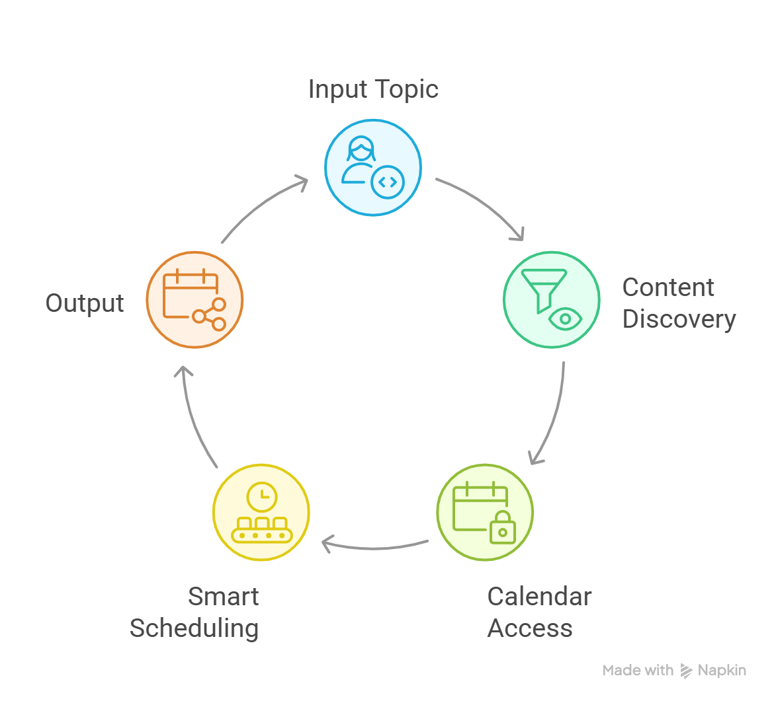





ScheduLearn
Input Topic
User submits learning topic
Content Discovery
Calls API & filters podcasts/videos
Calendar Access
Connects securely to Google Calendar
Smart Scheduling
Allocates sessions based on free slots
Output
Updated calendar with embedded content links

Slide 4




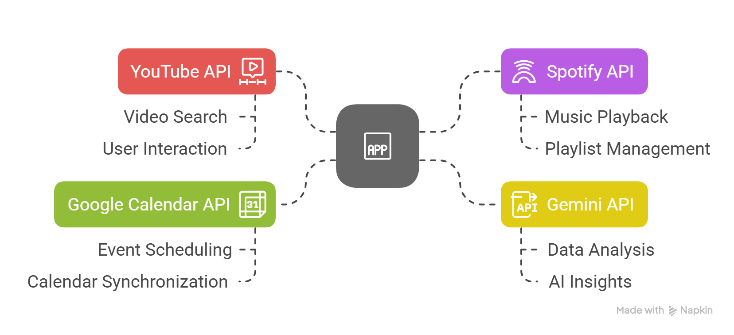
APIs Used
Gemini API
Google Calendar API
YouTube Data API
Spotify API
Content ranking & summarization
Fetches videos
Discovers podcasts
Reads/writes user calendar

Slide 5

Demo

Slide 6
Conclusion
ScheduLearn = Discover + Schedule + Learn
We bring automation, AI, and smart scheduling together
to simplify your learning journey.

Slide 7
Thank You

