Slide 1
Making Climate Change Great Again
Jessica T. , Laura H.
Nam L. , Bryan K.

Slide 2
What is the Goal?
Looking at climate data to find any anomalies that would have been influenced by the 2016 elections or other geo-political factors

Slide 3
Questions the Team will Tackle
Have any of Trump’s policies influenced the climate data sets?
By regions (potentially)
Have other major countries met their emissions goals?
How long would it take for specific countries to meet their emissions or climate goals?

Slide 4
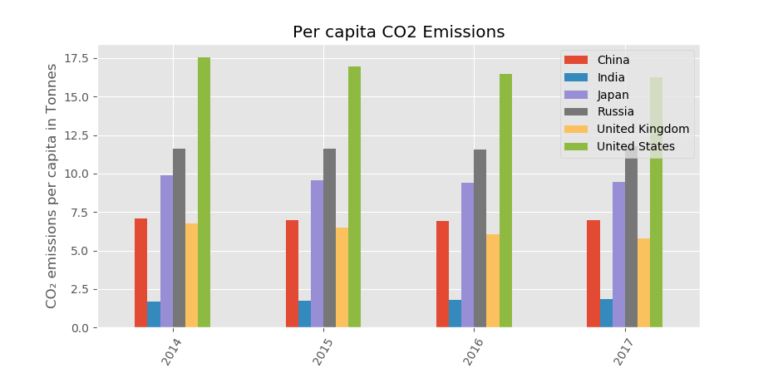
Bar Graph to show Example of Emissions

Slide 5
Have other major countries met their emissions goals?
Paris Agreement
Since the Paris Agreement of 2016, 196 countries have committed to the agreement in efforts to deal with greenhouse-gas-emissions mitigation, adaption, and finance in order to combatant climate change.
Despite Agreement
Global carbon emissions continue to increase despite the agreement and makes the recent years to be the hottest on record. Using data from Climate Action Tracker we can find which countries are making the best efforts and which countries are failing to meet their goals.

Slide 6
The good, the bad,
Top of the class
Between the 6 major countries we decided to analyze, India comes out at the top of the class for meeting its emissions goals. India has emerged as a global leader in renewable energy and continues to invest more in them than fossil fuels which greatly increases India’s plan to generate 40 percent of its power through renewables by 2030. Amazing!
Shows signs of Promise
China is somewhat of many irony. China is on course to meet its Paris targets, though it is only for the fact that the targets to meet are highly inadequate, and are not ambitious enough to limit warming to below 2 degrees C, in which the Paris Agreement requires a min of at least limiting warming to 1.5 degrees C. Furthermore, in 2018, Chinese consumers bout more electric vehicles than the rest of the world combined. China is also the largest manufacturer of solar technology in the world, but through all the positive means of these consuming and manufacturing, China is also the largest consumer of coal, and continues to finance the construction of coalfired power stations all over the world.

Slide 7
And the ugly
Barely trying..
Climate Action Tracker ranked United States Paris targets as “critically insufficient.” Trump’s Administration’s ongoing hostility toward climate action and attempts to roll back the Clean Power Plan, the administration furthers to make plans to weaken regulations to limit HFC emissions and regulations of methane leaks from gas and oil productions. Ultimately the administration has signaled its intent to withdraw form the Paris Agreement in 2020 altogether.

