Slide 1
Session 08
Collections
(http://docs.oracle.com/javase/tutorial/collections/index.html)
Session 09 - Collections
Notes:
Lists are common data in almost all of programs. In tis lesson, the framework for managing group of elements in the java.util package are introduced . If you use them, you will save noticeable efforts.

Slide 2
Objectives
Collections Framework (package java.util):
  List: ArrayList, Vector → Duplicates are agreed
  Set: HashSet, TreeSet → Duplicates are not agreed
  Map: HashMap, TreeMap
  Queue: LinkedList, PriorityQueue
  Deque: LinkedList, ArrayDeque
Session 09 - Collections

Slide 3
The Collections Framework
The Java 2 platform includes a new collections framework.
A collection is an object that represents a group of objects.
The Collections Framework is a unified architecture for representing and manipulating collections.
The collections framework as a whole is not threadsafe.
Session 09 - Collections
Notes:
Thread: unit of running code (methods) of a process ( program in running).
Nowaday, operating systems support the time-sharing mechanism which allows many process running concurrently. CPU will run instructions of each process in a duration (about 50 milsecond) the the process will pause to yield CPU to others.
Also, a computer can have a multicore-CPU with 2, 4, 8,… cores. Some processes/ threads execute really concurrently.
A common data can be accessed by some threads concurrently → It’s value is not reliable → not threadsafe.
To make a common data being reliable, a mechanism in which at a time, only one thread is granted to access this data → Synchronization → threadsafe

Slide 4
The Collections Framework…
Reduces programming effort by providing useful data structures and algorithms so you don't have to write them yourself.
Increases performance by providing high-performance implementations of useful data structures and algorithms.
Provides interoperability between unrelated APIs by establishing a common language to pass collections back and forth.
Reduces the effort required to learn APIs by eliminating the need to learn multiple ad hoc collection APIs.
Reduces the effort required to design and implement APIs by eliminating the need to produce ad hoc collections APIs.
Fosters software reuse by providing a standard interface for collections and algorithms to manipulate them.
Session 09 - Collections

Slide 5
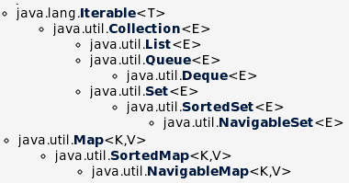
Collection Interfaces
Methods declared in these interfaces can work on a list containing elements which belong to arbitrary type. T: type, E: Element, K: Key, V: Value
Details of this will be introduced in the topic Generic
3 types of group:
List can contain duplicate elements
Set can contain distinct elements only
Map can contain pairs <key, value>. Key of element is data for fast searching
Queue, Deque contains methods of restricted list.
Common methods on group are: Add, Remove, Search, Clear,…
Session 09 - Collections

Slide 6
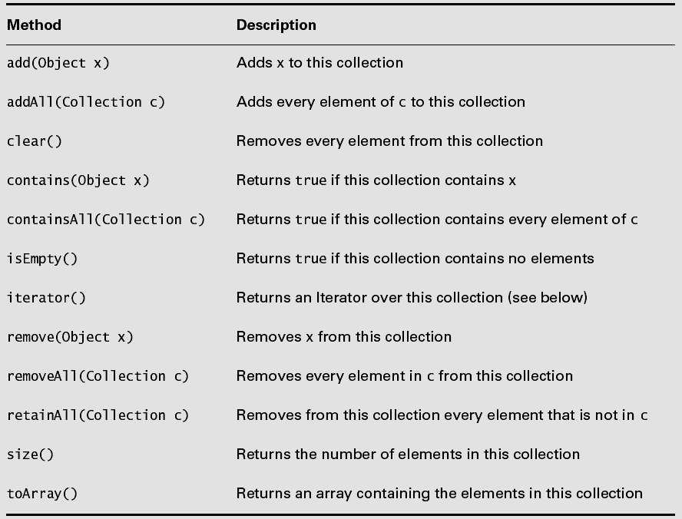
Common Methods of the interface Collection
Elements can be stored using some ways such as an array, a tree, a hash table.
Sometimes, we want to traverse elements as a list → We need a list of references → Iterator
Session 09 - Collections

Slide 7
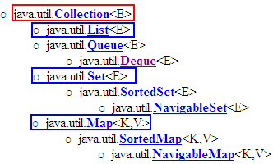



The Collection Framework…
Central Interfaces
Common Used Classes
Store: Dynamic array
Use index to access an element.
Store: Specific structute/tree
Use iterator to access elements
java.lang.Comparable interface
keySet()
values()
Use iterator
A TreeSet will stored elements using ascending order. Natural ordering is applied to numbers and lexicographic (dictionary) ordering is applied to strings.
If you want a TreeSet containing your own objects, you must implement the method compareTo(Object), declared in the Comparable interface.

Slide 8
Lists
A List keeps it elements in the order in which they were added.
Each element of a List has an index, starting from 0.
Common methods:
  void add(int index, Object x)
  Object get(int index)
  int indexOf(Object x)
  Object remove(int index)
Session 09 - Collections

Slide 9
Classes Implementing the interface List
  AbstractList
  ArrayList
  Vector (like ArrayList but it is synchronized)
  LinkedList: linked lists can be used as a stack, queue, or double-ended queue (deque)
Session 09 - Collections

Slide 10
List Implementing Classes
  Vector vec = new Vector();
  for (int i = 101; i <= 110; i++) {
  vec.add(i);
  }
  for (int i = 0; i < vec.size(); i++) {
  System.out.println(vec.get(i));
  }
  //or using Iterator
  /*
  Iterator iter = vec.iterator();
  while (iter.hasNext()) {
  System.out.println(iter.next());
  }
  */
Session 09 - Collections

Slide 11
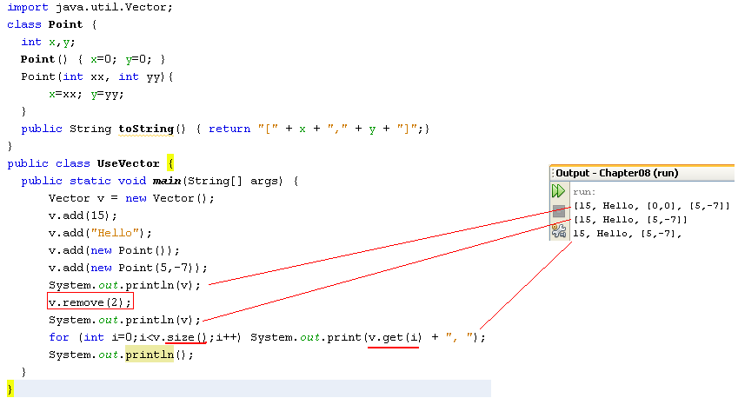
Using the Vector class
java.util.Vector<E> (implements java.lang.Cloneable,
java.util.List<E>, java.util.RandomAccess, java.io.Serializable)
The Vector class is obsolete from Java 1.6 but it is still introduced because it is a parameter in the constructor of the javax.swing.JTable class, a class will be introduced in GUI programming.

Slide 12
Lớp ArrayList (java.util)
  Manager 1 list of objects
  Can Có thể tăng/giảm kích thước theo nhu cầu
  Suporrt methods add, : add, set, Remove, xóa phần tử,…
  Is generic class (generic): ArrayList<T> : set of object have type is T
Session 09 - Collections

Slide 13
    ArrayList<nguoi> nvs =new ArrayList<nguoi>();
    nvs.add(new nguoi(1001));
    nvs.add(new nguoi(1015));
    nvs.add(new nguoit(1022));
Size of ArrayList: size()
Get 1 element of ArrayList
  Nguoi nv=nvs.get(2);// Lấy phần tử thứ 03 trong danh sách mảng
  int i = nv.size();
  nv = nvs.get(i); //Error (?)
Session 09 - Collections

Slide 14
Sets
Lists are based on an ordering of their members. Sets have no concept of order.
A Set is just a cluster of references to objects.
Sets may not contain duplicate elements.
Sets use the equals() method, not the == operator, to check for duplication of elements.
void addTwice(Set set) {
set.clear();
Point p1 = new Point(10, 20);
Point p2 = new Point(10, 20);
set.add(p1);
set.add(p2);
System.out.println(set.size());
}
will print out 1, not 2.
Session 09 - Collections

Slide 15
Sets…
Set extends Collection but does not add any additional methods.
The two most commonly used implementing classes are:
  TreeSet
    Guarantees that the sorted set will be in ascending element order.
    log(n) time cost for the basic operations (add, remove and contains).
  HashSet
    Constant time performance for the basic operations (add, remove, contains and size).
Session 09 - Collections

Slide 16
TreeSet and Iterator
Ordered Tree – Introduced in the suject Discrete Mathematics
Set: Group of different elements
TreeSet: Set + ordered tree, each element is calles as node
Iterator: An operation in which references of all node are grouped to make a linked list. Iterator is a way to access every node of a tree.
Linked list: a group of elements, each element contains a reference to the next
Session 09 - Collections

Slide 17
TreeSet = Set + Tree
The result may be:
Random r = new Random();
TreeSet myset = new TreeSet();
for (int i = 0; i < 10; i++) {
int number = r.nextInt(100);
myset.add(number);
}
//using Iterator
Iterator iter = myset.iterator();
while (iter.hasNext()) {
System.out.println(iter.next());
}
7
27
36
41
43
46
49
57
75
83
Session 09 - Collections

Slide 18
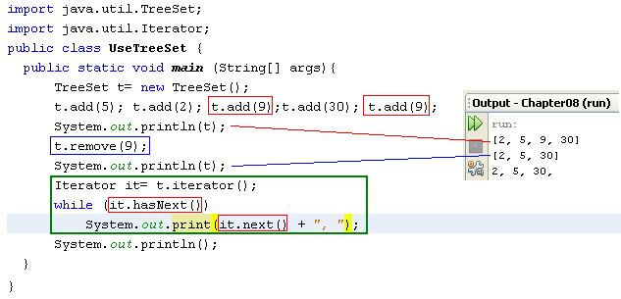
Using the TreeSet class & Iterator
A TreeSet will stored elements using ascending order. Natural ordering is applied to numbers and lexicographic (dictionary) ordering is applied to strings.
If you want a TreeSet containing your own objects, you must implement the method compareTo(Object), declared in the Comparable interface.

Slide 19
Hash Table
49
In array, elements are stored in a contiguous memory blocks → Linear search is applied → slow, binary search is an improvement.
Hash table: elements can be stored in a different memory blocks. The index of an element is determined by a function (hash funtion) → Add/Search operation is very fast (O(1)).
14
Brown
9
Hoa
5
Smith
“Smith”
f
5
The hash function f may be: ‘S’*10000+’m’*1000+’i’*100+’t’*10+’h’ % 50
0
Linel
Session 09 - Collections
Notes:
This slide is intended to introduce the most basic concept about a hash table. More details about hash table will be studied in the subject Data Structure and Algorithms.

Slide 20
HashSet = Set + Hash Table
The result may be:
Random r = new Random();
HashSet myset = new HashSet();
for (int i = 0; i < 10; i++) {
int number = r.nextInt(100);
myset.add(number);
}
//using Iterator
Iterator iter = myset.iterator();
while (iter.hasNext()) {
System.out.println(iter.next());
}
84
55
7
76
77
95
94
12
91
44
Session 09 - Collections

Slide 21
HashSet or TreeSet?
If you care about iteration order, use a Tree Set and pay the time penalty.
If iteration order doesn’t matter, use the higher-performance Hash Set.
Session 09 - Collections

Slide 22
How to TreeSet ordering elements?
Tree Sets rely on all their elements implementing the interface java.lang.Comparable.
public int compareTo(Object x)
  Returns a positive number if the current object is “greater than” x, by whatever definition of “greater than” the class itself wants to use.
Session 09 - Collections

Slide 23
How to TreeSet ordering elements?
class Student implements Comparable{
int no;
...
public int compareTo(Object o) {
Student st = (Student) o;
if(no > st.getNo())
return 1;
else if(no == st.getNo())
return 0;
else
return -1;
}
. . .
}
Comparing 2 students based on their IDs ( field no)
Session 09 - Collections

Slide 24
How to TreeSet ordering elements?
public static void main(String[] args) {
Random r = new Random();
TreeSet myset = new TreeSet();
for (int i = 0; i < 10; i++) {
int no = r.nextInt(100);
Student st = new Student(no, "abc");
myset.add(st);
}
//using Iterator
Iterator iter = myset.iterator();
while (iter.hasNext()) {
Student st = (Student)iter.next();
System.out.println("No: " + st.getNo());
}
}
No: 2
No: 8
No: 11
No: 19
No: 33
No: 52
No: 78
No: 83
No: 92
No: 96
Session 09 - Collections

Slide 25
Maps
Map doesn’t implement the java.util.Collection interface.
A Map combines two collections, called keys and values.
The Map’s job is to associate exactly one value with each key.
A Map like a dictionary.
Maps check for key uniqueness based on the equals() method, not the == operator.
IDs, Item code, roll numbers are keys.
The normal data type for keys is String.
K
V
key
value
Each element: <key,value>
Session 09 - Collections

Slide 26
Maps..
Java’s two most important Map classes:
  HashMap (mapping keys are unpredictable order – hash table is used, hash function is pre-defined in the Java Library).
  TreeMap (mapping keys are natural order)-> all keys must implement Comparable (a tree is used to store elements).
Session 09 - Collections

Slide 27
HashMap
public static void main(String[] args) {
HashMap mymap = new HashMap();
mymap.put(1, “One");
mymap.put(2, “Two");
mymap.put(3, “Three");
mymap.put(4, “Four");
//using Iterator
Iterator iter = mymap.keySet().iterator();
while (iter.hasNext()) {
Object key = iter.next();
System.out.println(key + ": " + mymap.get(key));
}
}
//output
1: One
2: Two
3: Three
4: Four
Key: integer, value: String
Session 09 - Collections

Slide 28
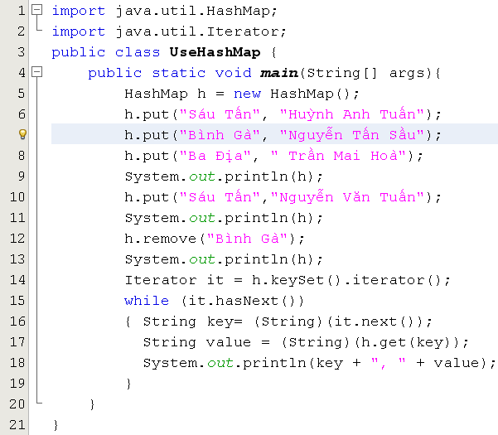
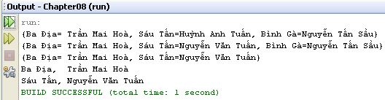
Using HashMap class & Iterator
Key: String, value: String

Slide 29
Interface Queue and Deque
Queue
Deque
Interfaces for restricted list (limited manipulatation), programmers can not access an arbitrary element but elements at the beginning or the end of the list only.
Deque: A linear collection that supports element insertion and removal at both ends. The name deque is short for "double ended queue" and is usually pronounced "deck". Most Dequeimplementations place no fixed limits on the number of elements they may contain, but this interface supports capacity-restricted deques as well as those with no fixed size limit.
Session 09 - Collections
Notes:
Restricted: hạn chế
Arbitrary: Tùy ý

Slide 30
Interface Queue
Queue
public interface Queue<E> extends Collection<E>
boolean | add(E e) Inserts the specified element into this queue if it is possible to do so immediately without violating capacity restrictions, returning true upon success and throwing an IllegalStateException if no space is currently available.
E | element() Retrieves, but does not remove, the head of this queue.
boolean | offer(E e) Inserts the specified element into this queue if it is possible to do so immediately without violating capacity restrictions.
E | peek() Retrieves, but does not remove, the head of this queue, or returns null if this queue is empty.
E | poll() Retrieves and removes the head of this queue, or returns null if this queue is empty.
E | remove() Retrieves and removes the head of this queue.
Classes:
Session 09 - Collections
Notes:
Retrieves: tìm kiếm

Slide 31
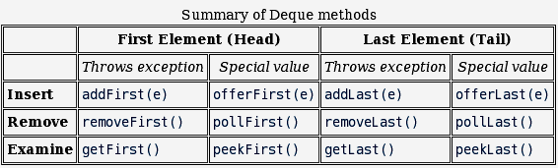
Interface Deque…
Deque
Head
Tail
public interface Deque<E> extends Queue<E>
IN addition to methods inherited from the interface Queue, some methods are declared:
Classes
java.util.LinkedList<E> (implements java.lang.Cloneable, java.util.Deque<E>,
java.util.List<E>, java.io.Serializable)
java.util.ArrayDeque<E> (implements java.lang.Cloneable,
java.util.Deque<E>, java.io.Serializable)
Session 09 - Collections

Slide 32
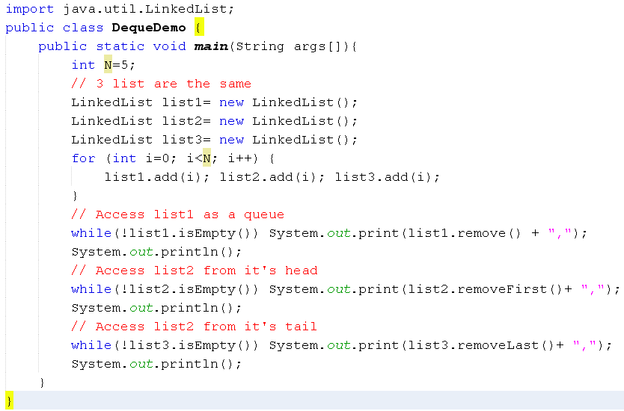

Queue/Deque Demo.
4
3
2
1
0
0
tail
head
Session 09 - Collections

Slide 33
Summary
The Collections Framework
  The Collection Super interface and Iteration
  Lists
  Sets
  Maps
  Support Classes
  Collections and Code Maintenance
Session 09 - Collections

