Slide 1
Sort
Algorithms
Session10 - Algorithms
Notes:
Operations such as adding, searching, removing, updating are common works on a list. Their algorithms are very common and in almost of cases, they do not depend on specific type.
This chapter will introduce 2 pre-defined classes, Collections and Arrays, declared in the java.utils package, which make utilities when these group operations are needed.

Slide 2
Objectives
Array
public static void main(String[] args) throws Exception
{String [] a = {"1","9","6","7","3","2","10A"};
int i;
System.out.println(" Before sorting:");
for(i=0;i<7;i++) System.out.println(a[i]);
Arrays.sort(a);
System.out.println(" After sorting:");
for(i=0;i<7;i++) System.out.println(a[i]);
System.out.println();
}
Session10 - Algorithms

Slide 3
Araylist, vector, hashset, treeset
class A implements Comparable
{String name; int sal;
A() {}
A(String name, int sal) {this.name = name; this.sal = sal;}
public boolean equals(Object x)
{A y = (A) x;
return(sal==y.sal);
}
public int compareTo(Object x)
{ A y = (A) x;
if(sal<y.sal)
return(-1);
else if(sal==y.sal)
return(0);
else
return(1);
}
public String toString() {return(name + " " + sal);}
}
Session10 - Algorithms

Slide 4
class MyList extends ArrayList//Vector or Hashet, treeset, LinkList
{public boolean isEmpty() {return(super.isEmpty());}
void add(A x)
{if(indexOf(x)==-1)
super.add(x);
else
System.out.println(" The element already exists, no addition");
}
void addMany(String [] a, int [] p, int n)
{ A x;
for(int i=0;i<n;i++) {x = new A(a[i],p[i]); add(x);}
}
void display()
{System.out.println(" The elements of the list:");
for(int i=0;i<size();i++) System.out.println(get(i));
}
void display2()
{System.out.println(" The elements of the list:");
Iterator h = iterator();
while(h.hasNext())
System.out.println(h.next());
}
}
Session10 - Algorithms

Slide 5
public class Main
{
public static void main(String[] args) throws Exception
{String [] a = {"Hung", "Lan", "Ngo", "Khoai", "San"};
int [] p = {22,18, 15, 11, 7};
int n = 5;
MyList t = new MyList();
t.addMany(a,p,n);
t.display();
A x = new A("ABC",15);
System.out.println( " Position of person with sal 15: " + t.indexOf("ABC"));
System.out.println( " The list before sorting:");
t.display2();
System.out.println( " The list after sorting:");
Collections.sort(t);
t.display2();
t.add(x);
System.out.println();
}
}
Session10 - Algorithms

Slide 6
Sort use Comparable interface by 2 attributes
class Person implements Comparable
{String name; int age;
Person() {}
Person(String xName, int xAge) {name = xName; age = xAge;}
public String toString() {return("(" + name + "," + age + ") ");}
public int compareTo(Object x)
{Person y = (Person) x;
return(name.compareTo(y.name));
}
}
Session10 - Algorithms

Slide 7
class MyList
{ArrayList<Person> t;
MyList() {t = new ArrayList<Person>();}
void clear() {t.clear();}
boolean isEmpty() {return(t.isEmpty());}
void add(Person x) {t.add(x);}
void addMany(String [] a, int [] b)
{int n, i; Person x;
n = a.length;
for(i=0;i<n;i++)
{x = new Person(a[i],b[i]);
add(x);
}
}
void display()
{for(int i=0;i<t.size(); i++) System.out.print(t.get(i));
}
void sortByName()
{Collections.sort(t);
}
Session10 - Algorithms

Slide 8
void sortByAge()
{Collections.sort(t, new Comparator<Person>()
{
@Override
public int compare(Person x, Person y)
{if(x.age<y.age)
return(-1);
else if(x.age==y.age)
return(0);
else
return(1);
}
});
}
}
Session10 - Algorithms

Slide 9
class Main
{
public static void main(String args[])
{String [] a = {"Hoa","La","Canh","Cay","Goc","Re","Hoa"};
int [] b = {21,19,25,18,23,22,11};
MyList t = new MyList();
t.addMany(a,b);
t.display();
System.out.println("\nSort by name:");
t.sortByName();
t.display();
System.out.println("\nSort by age:");
t.sortByAge();
t.display();
System.out.println();} }
Session10 - Algorithms

Slide 10
Sort use generic Comparable interface
\PRO192\PRO192-materials (for students)\02-examples\07-Lang and util packages\10-Java collections\06-sort using Collections class\2-using generic Comparable interface
Sort use Comparator
\PRO192-materials (for students)\02-examples\07-Lang and util packages\10-Java collections\06-sort using Collections class\3-using Comparator interface
Sort serial by a attribute
Session10 - Algorithms

Slide 11

Introduction
An algorithm on a list can be applied on some lists although the type of elements in each list can be different.
The polymorphic algorithms described here are pieces of reusable functionality provided by the Java platform.
All of them come from the Collections class and the Arrays class (support classes), and all take the form of static methods whose first argument is the collection on which the operation is to be performed.
Session10 - Algorithms

Slide 12
The Collections class
A support class containing static methods which accept collections as their parameters.
file:///J:/Softs/JavaSofts/JavaDocs/docs-Java8/api/java/util/Collections.html
Session10 - Algorithms

Slide 13
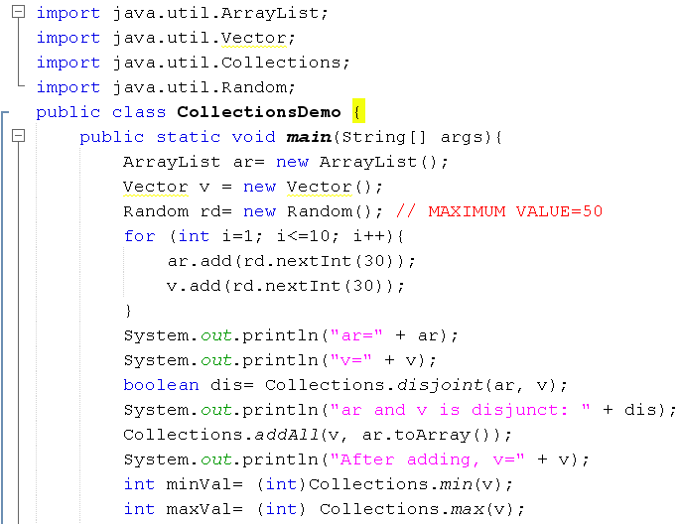
Collections Demo.
Session10 - Algorithms

Slide 14
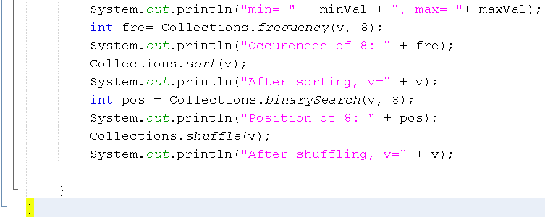
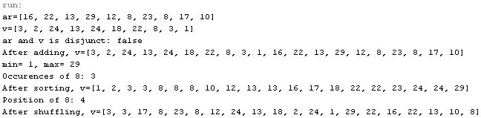
Collections Demo.
Session10 - Algorithms

Slide 15
Sorting
The sort algorithm reorders a List so that its elements are in ascending order according to an ordering relationship.
Example
  public class Sort {
  public static void main(String[] args) {
  List<String> list = Arrays.asList(args);
  Collections.sort(list);
  System.out.println(list);
  }
  }
Session10 - Algorithms

Slide 16
Comparator Interface
A comparison function, which imposes a total ordering on some collection of objects
The following demonstration will show you the way to sort a list based on your own criteria: A list of employees will be sorted based on descending salaries then ascending IDs.
Session10 - Algorithms

Slide 17
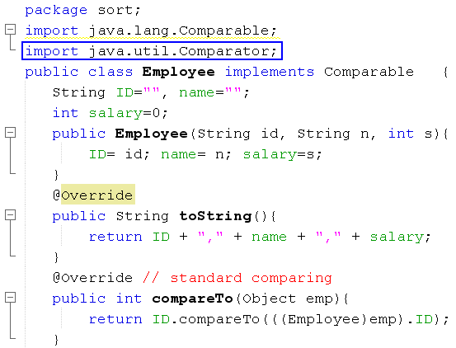
Comparator Interface – Demo.
Session10 - Algorithms

Slide 18
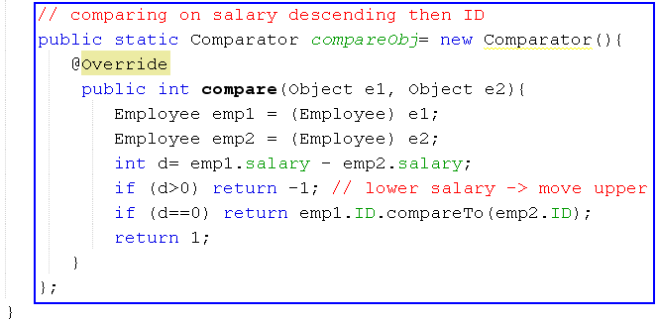
Comparator Interface- Demo.
Comparing 2 employees based on descending salaries then ascending IDs
Create an anonymous object for comparing 2 employees
Session10 - Algorithms

Slide 19
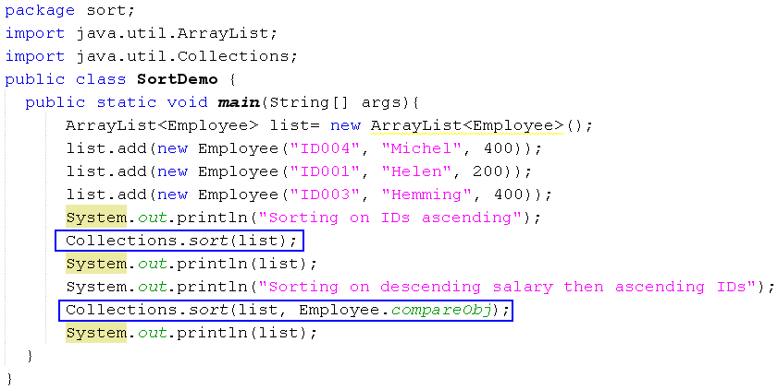

Comparator Interface- Demo.
Session10 - Algorithms

Slide 20
Routine Data Manipulation (1)
The Collections class provides five algorithms for doing routine data manipulation on List objects, including:
  reverse()
  fill()
  copy()
  swap()
  addAll()
Session10 - Algorithms

