Slide 1
Design Patterns

Slide 2
What is Design Pattern?
A Design Pattern is a proven, documented, practiced Design Solution for commonly occurring Design Problem.
There is no need to re invent the Wheel.
Advantages of Using Design Patterns:
Saves time during Software Design and Development
Common Terminology
Better Software Quality
Design patterns represent the best practices used by experienced object-oriented software developers.
These Design solutions were obtained by trial and error by numerous software developers over quite a substantial period of time.
Design Patterns in other fields like Civil, Music, etc…

Slide 3
Who benefits from the use of design patterns ?
Answer is all of the stakeholders of a project benefit from the use of design patterns. Project Sponsor
Reduced development time which translates in to shorter project timelines and greater return on investment compared to other projects that do not make use of design patterns.
Project Manager
Project managers benefit from the use of design patterns because they reduce the amount of time needed to design a system, and typically the sub components of the system already have a proven track record.
System Architect/Engineer
System architects/engineers benefit from the use of design patterns because reduce the amount of time needed to design the core a system. The additional time is used to alter the design pattern through the use of innovative design and common design principles to adhere to the project’s requirements.
Programmer
They can reuse existing code already established by the design pattern and only have to integrate or customize the changes outlined by the system architects/engineers.
User
Software is typically delivered sooner than projects that do not incorporate the use of design patterns, and they are assumed that the system will work as designed because it was based on a system that was already proven to work properly.

Slide 4
Classification of Design Patterns
Design Patterns are broadly classified into three, Creational, Structural and Behavioral Patterns.
Creational Design patterns: Creational design patterns are concerned with the way of creating objects. These design patterns are used when a decision must be made at the time of instantiation of a class (i.e. creating an object of a class).
Structural Design Patterns: Structural design patterns are concerned with how classes and objects can be composed, to form larger structures.
The structural design patterns simplifies the structure by identifying the relationships.
These patterns focus on, how the classes inherit from each other and how they are composed from other classes.
Behavioral Design Patterns: Behavioral design patterns are concerned with the interaction and responsibility of objects.
In these design patterns, the interaction between the objects should be in such a way that they can easily talk to each other and still should be loosely coupled.

Slide 5
Difference between Tight and Loose Coupling
In object oriented design, the amount of coupling refers to how much the design of one class depends on the design of another class.
In other words, how often do code changes in class A force related code changes in class B?
Tight coupling means code change in one class forces code changes in other class also. Loose coupling means classes are mostly independent.
In general, loose coupling is recommended because it's easier to maintain.

Slide 6
Tight Coupling Example
class Traveler
{
Car c=new Car();
void startJourney() { c.move(); }
}
class Car
{ void move() { // logic... } }
Loose Coupling Example
class Traveler
{ Vehicle v;
public void setV(Vehicle v) { this.v = v; }
void startJourney() { v.move(); }
} //=========================Interface==============================
interface Vehicle { void move(); }
//====================Multiple class implement vehicle interface. First class====
class Car implements Vehicle { public void move() { // logic } } //===================Second class================
class Bike implements Vehicle { public void move() { // logic } }

Slide 7
Facade Pattern(Structural pattern)
A Facade Design Pattern is providing Simple, Single Unified interface to a set of classes. Below is an example of the same.
As shown in the diagram, an Application is directly dependent on Display, FileSystem, Networking etc….we are assuming each of these services are provided by corresponding class. Without using Facade Pattern, Application is directly dependent on these classes.
But by re designing above solution by using facade Pattern, Application is not directly dependent on each of individual classes, Hence any change in the public methods exposed by the individual class or change of class, may not directly impact Application.
If any changes in the individual classes, changes need to be performed in the UnifiedAPI, and hence Application need not be changed.

Slide 8
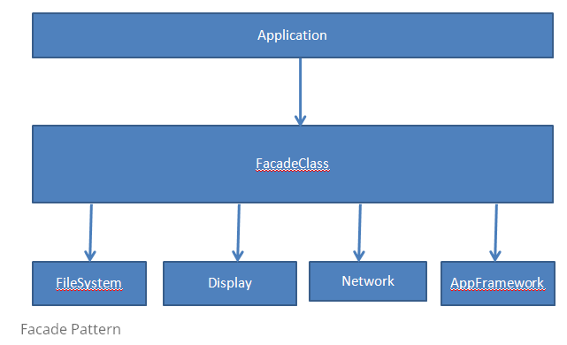

Slide 9
Mediator Pattern(Behavioral Pattern)
Mediator design pattern is very helpful in an applications where multiple objects are interacting with each other.
If the objects interact with each other directly, the system components are tightly-coupled with each other that makes higher maintainability cost and not hard to extend.
Mediator pattern focuses on provide a mediator between objects for communication and help in implementing lose-coupling between objects.

Slide 10
Mediator Pattern(Behavioral Pattern)
Mediator pattern is used to reduce communication complexity between multiple objects or classes.
This pattern provides a mediator class which normally handles all the communications between different classes and supports easy maintenance of the code by loose coupling.
Mediator pattern falls under behavioral pattern category.

Slide 11
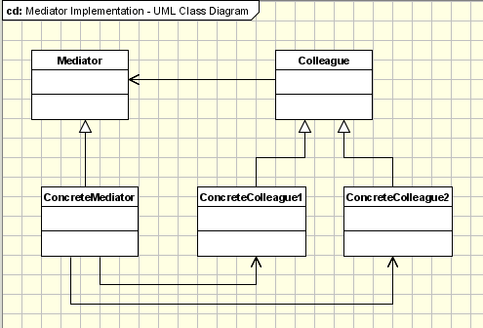
Mediator Pattern(Behavioral Pattern)
For example consider a real time example where in Flights which are about to Land or Take off, interaction with ATC(Air Traffic Controller) Tower. Imagine complexity such interaction without ATC??

Slide 12
Mediator Pattern(Behavioral Pattern)
One of the examples is represented by the Dialog classes in GUI applications frameworks.
A Dialog window is a collection of graphic and non-graphic controls.
The Dialog class provides the mechanism to facilitate the interaction between controls.
For example, when a new value is selected from a ComboBox object a Label has to display a new value.
Both the ComboBox and the Label are not aware of each other structure and all the interaction is managed by the Dialog object.
Each control is not aware of the existence of other controls.

Slide 13
Observer Pattern(Behavioral Pattern)
Observer Pattern = publisher + subscriber.
Observer pattern has been used in GUI action listener. Swing GUI example shows how action listener works like an observer.
The following is a typical example about head hunter. There are two roles in this diagram - HeadHunter andJobSeeker. Job seekers subscribe to a head hunter, and head hunter notifies job seekers when there is a new job opportunity.

Slide 14
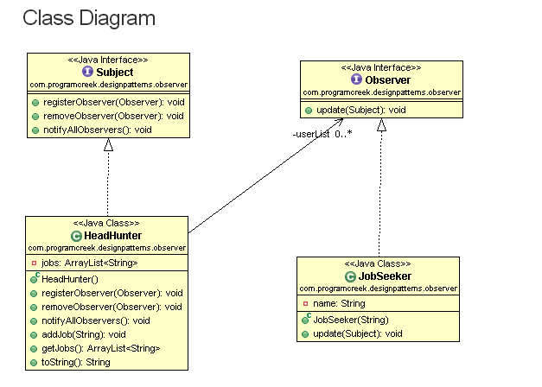

Slide 15
Subject Interface
public interface Subject
{
public void registerObserver(Observer o);
public void removeObserver(Observer o);
public void notifyAllObservers();
}
Observer Interface
public interface Observer {
public void update(Subject s);
}

Slide 16
Advantages of Observer Design Pattern
Supports the principle to strive for loosly coupled designs between objects that interact.
Allows to send data to many other objects in a very efficient manner.
No modification is need to be done to the subject to add new observers.
You can add and remove observers at anytime(i..e during runtime also)
TBD, explore on Java built in class Observable
Difference between Observer and Mediator Design Pattern
The Observer pattern works well when no coordination between the observers is necessary and theobserves relationship goes one way.
For example, let objects B and C observe object A. When object A fires event X, then object B should execute method Y() and object C should execute method Z(). If methods B.Y() and C.Z() are totally independent and require no coordination, then go ahead and use the observer pattern.
On the other hand, if B.Y() must be executed before C.Z() then you will want to use the Mediator pattern where the mediator encapsulates this coordination. In this scenario, mediator M would observe object A and would have references to objects B and C. When A fires event X, M will handle the event and call B.Y() and C.Z() in the prescribed order.
Also, if objects A, B and C need to observe each other then using a mediator as an intermediary will go a long way to decouple these objects and avoid spaghetti code.

Slide 17
DAO Pattern
The Data Access Object (DAO) pattern is now a widely accepted mechanism to abstract away the details of persistence in an application.
Using DAO Pattern, instead of domain logic communicate directly with the database, file system, web service, or whatever persistence mechanism your application uses, the domain logic speaks to a DAO layer instead. This DAO layer then communicates with the underlying persistence system or service. In Java, Hibernate Framework (ORM) is a best example for the same.
The advantage of the DAO layer is that if you need to change the underlying persistence mechanism you only have to change the DAO layer, and not all the places in the domain logic where the DAO layer is used from.
Business Logic
DAO
Data Source(Data Base or File or any other)

Slide 18
Factory Design Pattern(Creational Pattern)
As known, the most usual way to create an object in Java, is using new keyword. But always directly creating an object using new keyword may lead to few complexities.
Later, incase a design decision like singleton, etc… taken, then the code where all object is created using new keyword need to be changed.
Hence best approach to create objects of classes is by using Factory Pattern.
Factory, as name suggest, is a place to create some different products of similar type. In this case a Factory class create different objects of same Type.
Define an interface for creating an object, but let subclasses decide which class to instantiate. Factory Method lets a class defer instantiation to subclasses.
Factory pattern is most suitable where there is some complex object creation steps are involved.
We can see many examples of factory pattern in JDK itself e.g.
java.sql.DriverManager#getConnection()
Assignment:
purpose of super keyword
Difference between abstract class and interface
Base class of all classes in Java

Slide 19
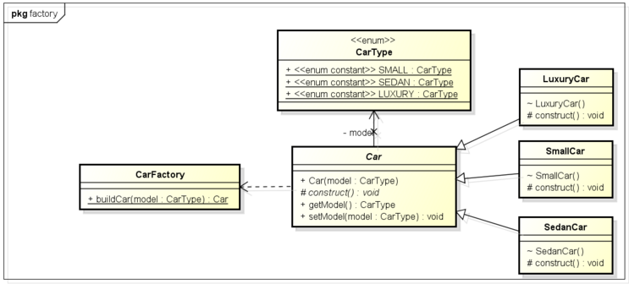
Factory Design Pattern

Slide 20
Factory Design Pattern
For example a graphical application works with shapes. In our implementation the drawing framework is the client and the shapes are the products. All the shapes are derived from an abstract shape class (or interface).
The Shape class defines the draw and move operations which must be implemented by the concrete shapes. Let's assume a command is selected from the menu to create a new Circle.
The framework receives the shape type as a string parameter, it asks the factory to create a new shape sending the parameter received from menu.
The factory creates a new circle and returns it to the framework, casted to an abstract shape. Then the framework uses the object as casted to the abstract class without being aware of the concrete object type.
The advantage is obvious: New shapes can be added without changing a single line of code in the framework(the client code that uses the shapes from the factory).
Asssignment: What is Reflection in Java?

Slide 21
Intention of the builder pattern is to find a solution to the telescoping constructor anti-pattern. The telescoping constructor anti-pattern occurs when the increase of object constructor parameter combination leads to an exponential list of constructors. Instead of using numerous constructors, the builder pattern uses another object, a builder, that receives each initialization parameter step by step and then returns the resulting constructed object at once.

Slide 22
Builder Design Pattern(Creational Pattern)
Constructors in Java are used to create object and can take parameters required to create object.
Problem starts when an Object can be created with lot of parameters, some of them may be mandatory and others may be optional.
Consider a class which is used to create Cake, now you need number of item like egg, milk, flour to create cake. many of them are mandatory and some of them are optional like cherry, fruits, etc. If we are going to have overloaded constructor for different kind of cake then there will be many constructor and even worst they will accept many parameter.
Problems:
1) too many constructors to maintain.
2) error prone because many fields has same type e.g. sugar and and butter are in cups so instead of 2 cup sugar if you pass 2 cup butter, your compiler will not complain but will get a buttery cake with almost no sugar with high cost of wasting butter.
You can partially solve this problem by creating Cake and then adding ingredients but that will impose another problem of leaving Object on inconsistent state during building, ideally cake should not be available until its created.

Slide 23
Builder Design Pattern
We will use same example of creating Cake using Builder design pattern in Java. here we have static nested builder class inside Cake which is used to create object.
Guidelines for Builder design pattern in Java
1) Make a static nested class called Builder inside the class whose object will be build by Builder. In this example its Cake.
2) Builder class will have exactly same set of fields as original class.
3) Builder class will expose method for adding ingredients e.g. sugar() in this example. each method will return same Builder object. Builder will be enriched with each method call.
4) Builder.build() method will copy all builder field values into actual class and return object of Item class.
5) Item class (class for which we are creating Builder) should have private constructor to create its object from build() method and prevent outsider to access its constructor.

Slide 24
Benefits of Builder Design Pattern
Undoubtedly, the number of lines of code increase at least to double in builder pattern, but the effort pays off in terms of design flexibility and much more readable code. The parameters to the constructor are reduced and are provided in highly readable method calls.
Builder pattern also helps minimizing the number of parameters in constructor and thus there is no need to pass in null for optional parameters to the constructor. It’s really attracts me.
Another advantage is that Object is always instantiated in a complete state rather than sitting in an incomplete state until the developer calls (if ever calls) the appropriate “setter” method to set additional fields.

Slide 25
Abstract Factory Design Pattern(Creational Pattern)
Abstract Factory Pattern is also considered as Factory of Factory Pattern.
Factory method: You have a factory that creates objects that derive from a particular base class
Abstract factory: You have a factory that creates other factories, and these factories in turn create objects derived from base classes. You do this because you often don't just want to create a single object (as with Factory method) - rather, you want to create a collection of related objects.

Slide 26
Abstract Factory Design Pattern(Creational Pattern)
The classes that participate to the Abstract Factory pattern are: AbstractFactory - declares a interface for operations that create abstract products.
ConcreteFactory - implements operations to create concrete products.
AbstractProduct - declares an interface for a type of product objects.
Product - defines a product to be created by the corresponding ConcreteFactory; it implements the AbstractProduct interface.
Client - uses the interfaces declared by the AbstractFactory and AbstractProduct classes.

Slide 27
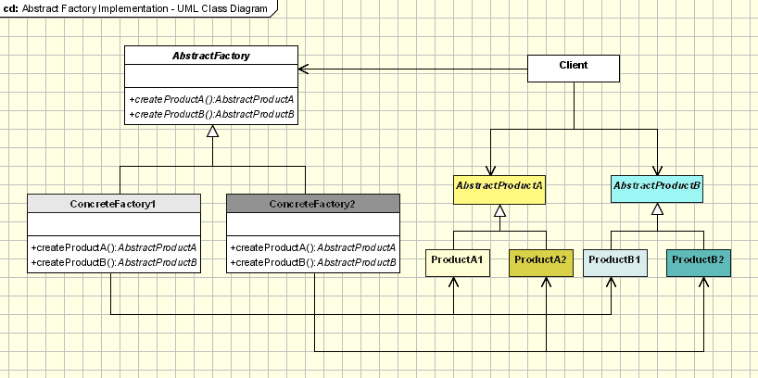
Abstract Factory Design Pattern(Creational Pattern)

Slide 28
Builder Pattern or Factory Design Pattern?
Whenever you are not clear which of the above patterns need to be applied for a specific situation, you may consider below points, which helps you
A factory is simply a wrapper function around the constructor. The principle difference is that a factory method pattern require the entire object to be built in a single call, with all the parameters pass in on a single line. Then final object will be return. A real life example can be “meal of the day” in a restaurant. The creation of the meal is a factory pattern, because you tell the kitchen get me the meal of today and the kitchen decide what object to generate based on the hidden criteria.
A builder pattern, whereas is a wrapper object around all the possible parameters you might want to pass to a constructor. This allows you to use setter method to build your own parameter list. A real life example appears if you order a custom pizza ( any drink). In this case, waiter tell the chef ( TeaBuilder, CoffeeBuilder in our example, you will see soon) I need a pizza; add extra cheese, olives, and corn to it. Therefore, the builder exposes the attributes the generated object should have, but hide how to set them.

Slide 29
Prototype Pattern – Creational Pattern
Prototype design pattern is used when the Object creation is a costly affair and requires a lot of time and resources and you have a similar object already existing.
Prototype pattern provides a mechanism to copy the original object to a new object and then modify it according to our needs. Prototype design pattern uses java cloning to copy the object.

Slide 30
Prototype Pattern – Creational Pattern
Prototype Design Pattern Example
Lets understand prototype design pattern with an example. Suppose we have an Object that loads data from database. Now we need to modify this data in our program multiple times, so it’s not a good idea to create the Object using new keyword and load all the data again from database.
The better approach would be to clone the existing object into a new object and then do the data manipulation.
Prototype design pattern mandates that the Object which you are copying should provide the copying feature. It should not be done by any other class. However whether to use shallow or deep copy of the Object properties depends on the requirements and its a design decision.

Slide 31
Visitor Pattern
Many distinct and unrelated operations need to be performed on node objects in a heterogeneous aggregate structure. You want to avoid "polluting" the node classes with these operations. And, you don't want to have to query the type of each node and cast the pointer to the correct type before performing the desired operation.
Visitor pattern is used when we have to perform an operation on a group of similar kind of Objects. With the help of visitor pattern, we can move the operational logic from the objects to another class.
For example, think of a Shopping cart where we can add different type of items (Elements). When we click on checkout button, it calculates the total amount to be paid. Now we can have the calculation logic in item classes or we can move out this logic to another class using visitor pattern. Let’s implement this in our example of visitor pattern.
Notice the implementation of accept() method in concrete classes, its calling visit() method of Visitor and passing itself as argument.
We have visit() method for different type of items in Visitor interface that will be implemented by concrete visitor class.

Slide 32
Iterator Design Pattern(Behavioral Pattern)
Iterator design pattern in one of the behavioral pattern. Iterator pattern is used to provide a standard way to traverse through a group of Objects.
Iterator pattern is widely used in Java Collection Framework. Iterator interface provides methods for traversing through a collection.
Provides a way to access the elements of an aggregate object without exposing its underlying represenation.
Iterator pattern is not only about traversing through a collection, we can provide different kind of iterators based on our requirements.
Iterator design pattern hides the actual implementation of traversal through the collection and client programs just use iterator methods.
Suppose we have a list of Radio channels and the client program want to traverse through them one by one or based on the type of channel(for eg. English Channels only).
Traditional approach is to provide a collection of channels to the client and let them write the logic to traverse through the channels and decide whether to process them. But this solution has lots of issues such as client has to come up with the logic for traversal. We can’t make sure that client logic is correct. Furthermore if the number of client grows then it becomes very hard to maintain.
Here we can use Iterator pattern and provide iteration based on type of channel. We should make sure that client program can access the list of channels only through the iterator.

Slide 33
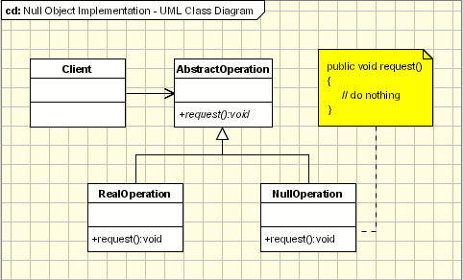
Null Object Pattern(Behavioral Pattern) Provide an object as a surrogate for the lack of an object of a given type.The Null Object Pattern provides intelligent do nothing behavior, hiding the details from its collaborators.

Slide 34
Null Object Pattern(Behavioral Pattern)
The participants classes in this pattern are: AbstractClass - defines abstract primitive operations that concrete implementations have to define.
RealClass - a real implementation of the AbstractClass performing some real actions.
NullClass - a implementation which do nothing of the abstract class, in order to provide a non-null object to the client.
Client - the client gets an implementation of the abstract class and uses it. It doesn't really care if the implementation is a null object or an real object since both of them are used in the same way. Example: Log System
Let's say we need a logging framework in order to support the logging of an application. The framework must fulfill the following requirements:The destination of the output messages should be selected from a configuration file and it can be one of the following options: Log File, Standard Console or Log Disabled.
Must be open for extension; new logging mechanism can be added without touching the existing code.

Slide 35
Memento Design Pattern(Behavioral Pattern)
General meaning of “memento” is an item kept as a reminder of a person or event”
It is sometimes required to capture the internal state of an object at some point and have the ability to restore the object to that state later in time.
For example, consider case of Calculator, where in certain calculations are performed, and when the user want to trace back which all calculations are performed.
Similarly consider case of any Text Editor, where user makes changes to content, and may need to undo changes, this is possible only when previous changes are stored somewhere in the order.
These are the situations where Memento pattern is useful. Memento Pattern , Captures and externalizes an object's internal state so that it can be restored later, all without violating encapsulation.

Slide 36
Memento Design Pattern(Behavioral Pattern)
The participants of this Pattern are
Originator: Creates a memento object capturing the originators internal state.
Use the memento object to restore its previous state.
Caretaker: Responsible for keeping the memento.
The memento is opaque to the caretaker, and the caretaker must not operate on it. Holds an ArrayList(or any other Collection) that contains all previous versions of the Memento. It can store and retrieve stored Mementos.
Memento: Stores internal state of the Originator object. The state can include any number of state variables.

Slide 37
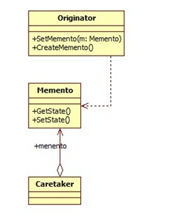
Memento Design Pattern

Slide 38
Singleton Design Pattern(Creational pattern)
In some cases, we need to maintain one and only one object at any point of time.
For example consider Notification or Status Bar on your Mobile. There is only one instance, and all Applications interact with one and only one object(of Notification Bar).
So, how to achieve this? By using Singleton Design Pattern…
Singleton Design Pattern ensures that maximum one object can exist for a class, at any point of time, during execution.

Slide 39
Singleton Design Pattern(Creational pattern)
Below are steps to develop a Singleton class.
Make all constructors private.
Add a static method, which creates and returns object of the class.
Add a static data member of its type, so that it can be returned, if object already exists.
Add a static int data member, which stores number of objects currently exists(whose value will be either 0 or 1, always)
In static method(added above in step 2), if number of objects is zero, create new object(by invoking private constructor), and return it. If number of objects is one, return existing object, without creating new object.
Assignment:
a) How Singleton can be used in Multi threaded program
b) When an instance already exists, return null
c) Difference between Inheritance and Composition

Slide 40
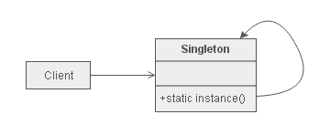
Singleton Design Pattern
UML Diagram

Slide 41
Proxy Design Pattern(Structural Pattern)
In some situations an object of one class need to be used instead of object of another class.
This Place holder object provides some advantages, few are as below.
#1. to Access Remote Object. #2. to control access of few methods of original object. #3. it may be costly(consumes more memory or time) to use original object…and original object can be loaded only when need arises(lazy loading) …and many more specific situations.
For eg: Real life examples likes Proxy Voting, Proxy Attendance, etc…
Below is an example, of using place holder object of VideoProxy instead of original Video object.
As shown in example below, object of Video class loads video file, even to display thumb nail. As known it consumes more memory to load multiple video thumb nails, in a single screen.
To keep memory consumption minimal, ProxyVideo has been implemented, which displays an Image to display thumb nail. And the video file is loaded, only when user want to play the video, that too only the specific video file which the user opted to view, will be loaded to play.
In proxy Pattern either Composition or Inheritance can be used, between participants
Assignment: Difference between Composition and Aggregation

Slide 42
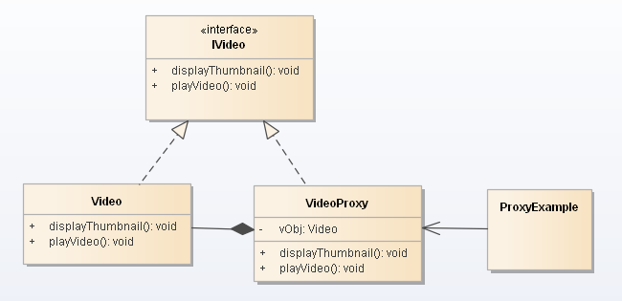
Proxy Design Pattern

Slide 43
Adapter Design Pattern(Structural Pattern)
Adapter pattern makes two incompatible interfaces to work together. These Incompatible interfaces are not designed and developed for one another, and assuming they have evolved separately.
Adapter Pattern can be implemented using any of the below.
Inheritance
Composition
Implementing Adapter pattern with Composition
Lets consider an example NewArithmetic and Arithmetic are classes, which are incompatible. And they have been designed separately, and one has not been designed for another.
Now ArithmeticAdapter is implemented to make NewArithmetic and Arithmetic classes, compatible with each other.
Here ArithmeticAdapter contains Adaptee, i..e NewArithmetic

Slide 44
Adapter Design Pattern(Structural Pattern)
Application
Adapter
3rd party component(Adaptee)

Slide 45
Difference between Proxy and Adapter Pattern
Adapter Pattern is to change the interface of class A to the expectations of another class B. The typical implementation is a wrapper class or set of classes.
Proxy Pattern is similar, but the purpose is different. The purpose of the proxy pattern is to create a stand-in for a real resource. As already briefed, this stand-in is required as the actual object is remotely located or it is expensive to create actual object or you want to give controlled access to methods of actual class, etc…

Slide 46
Composite Pattern
"Compose objects into tree structure to represent part-whole hierarchies.
Composite lets client treat individual objects and compositions of objects uniformly".
Composite design pattern treats each node in two ways-Composite or leaf.
Composite means it can have other objects below it. Leaf does not have objects below it

Slide 47
Composite Pattern
Component
declares interface for objects in composition.
implements default behavior for the interface common to all classes as appropriate.
declares an interface for accessing and managing its child components.
Leaf
represents leaf objects in the composition. A leaf has no children.
defines behavior for primitive objects in the composition.
Composite
defines behavior for components having children.
stores child components.
implements child related operations in the component interface.
Client
manipulates objects in the composition through the component interface.

Slide 48
Chain of Responsibility
Chain of Responsibility allows a number of classes to attempt to handle a request, independently of any other object along the chain. Once the request is handled, it completes it's journey through the chain.
The Handler defines the interface required to handle request, while the ConcreteHandlers handle requests that they are responsible for. If the ConcreteHandler cannot handle the request, it passes the request onto it's successor, which it maintains a link to.
The objects in the chain just need to know how to forward the request to other objects. This decoupling is a huge advantage, as you can change the chain at runtime.

Slide 49
Fly Weight Design Pattern
Use sharing to support large numbers of fine-grained objects efficiently.
Problem: Designing objects down to the lowest levels of system "granularity" provides optimal flexibility, but can be unacceptably expensive in terms of performance and memory usage.
The Flyweight pattern describes how to share objects to allow their use at fine granularity without prohibitive cost.
Each "flyweight" object is divided into two pieces:
the state-dependent (extrinsic) part, and the state-independent (intrinsic) part.
Intrinsic state is stored (shared) in the Flyweight object.
Extrinsic state is stored or computed by client objects, and passed to the Flyweight when its operations are invoked.

Slide 50
Template Design Pattern
Template method defines the steps to execute an algorithm and it can provide default implementation that might be common for all or some of the subclasses.
For example, we want to provide an algorithm to build a house. The steps need to be performed to build a house are – building foundation, building pillars, building walls and windows. The important point is that the we can’t change the order of execution because we can’t build windows before building the foundation. So in this case we can create a template method that will use different methods to build the house.
Now building the foundation for a house is same for all type of houses, whether its a wooden house or a glass house. So we can provide base implementation for this, if subclasses want to override this method, they can but mostly it’s common for all the types of houses.
To make sure that subclasses don’t override the template method, we should make it final.

Slide 51
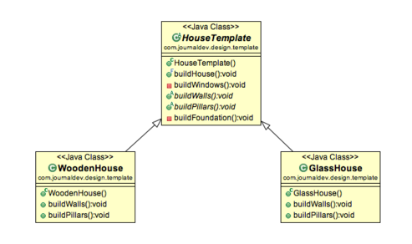
Template Design Pattern

Slide 52
State Design Pattern
State design pattern is one of the behavioral design pattern. State design pattern is used when an Object change its behavior based on its internal state.
If we have to change the behavior of an object based on its state, we can have a state variable in the Object. Then use if-else condition block to perform different actions based on the state. State design pattern is used to provide a systematic and loosely coupled way to achieve this through Context and State implementations.
State Pattern Context is the class that has a State reference to one of the concrete implementations of the State. Context forwards the request to the state object for processing. Let’s understand this with a simple example.
Suppose we want to implement a TV Remote with a simple button to perform action. If the State is ON, it will turn on the TV and if state is OFF, it will turn off the TV.

Slide 53
Fly Weight Design Pattern in Modern Browsers
Flyweight uses sharing to support large numbers of objects efficiently.
Modern web browsers use this technique to prevent loading same images twice.
When browser loads a web page, it traverse through all images on that page.
Browser loads all new images from Internet and places them the internal cache.
For already loaded images, a flyweight object is created, which has some unique data like position within the page, but everything else is referenced to the cached one.

Slide 54
Steps to use Fly Weight Design Pattern?
Ensure that object overhead is an issue needing attention, and, the client of the class is able and willing to absorb responsibility realignment.
Divide the target class's state into: shareable (intrinsic) state, and non-shareable (extrinsic) state.
Remove the non-shareable state from the class attributes, and add it the calling argument list of affected methods.
Create a Factory that can cache and reuse existing class instances.
The client must use the Factory instead of the new operator to request objects.
The client (or a third party) must look-up or compute the non-shareable state, and supply that state to class methods.

Slide 55
Object Pool Design Pattern(Creational Pattern)
Performance can be sometimes the key issue during the software development and the object creation(class instantiation) is a costly step. Object Pool Design Pattern helps in improving the Performance of Application, by avoiding to re create an object, whenever required. Instead, objects will be pre created or whenever first request is received. And after using an object, object goes back to pool, which can be reused later, whenever required again. This improves overall performance of Application, since there is no need to recreate and destroy object, every time.

Slide 56
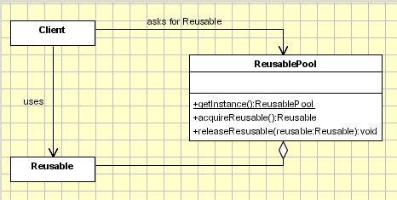
Object Pool Design pattern
Another advantage of Object pool pattern is to limit the total number of objects at a time.

Slide 57
UML(Unified Modeling Language)
Unified Modeling Language (UML) has quickly become the de-facto standard for building Object-Oriented software.
Unified Modeling Language (UML) is a graphical language for visualizing, specifying, constructing, and documenting the artifacts of a software-intensive system.
UML is a pictorial language used to make software blue prints.
So UML can be described as a general purpose visual modeling language to visualize, specify, construct and document a software system.
UML is not a programming language but tools can be used to generate code in various languages using UML diagrams.

Slide 58
UML includes the following nine diagrams and the details are described in the following chapters.
Class diagram
Object diagram
Use case diagram
Sequence diagram
Collaboration diagram
Activity diagram
Statechart diagram
Deployment diagram
Component diagram

Slide 59
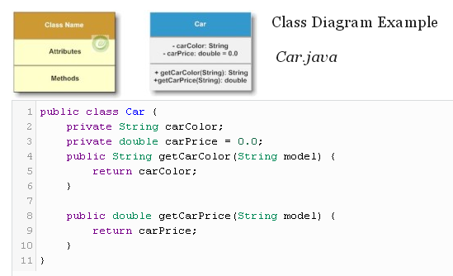
Class Diagram
diagram generally consists of interfaces, classes, associations and collaborations. Such a diagram would illustrate the object-oriented view of a system, which is static in nature. The object orientation of a system is indicated by a class diagram.

Slide 60
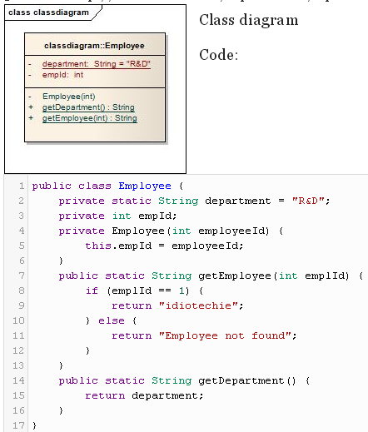
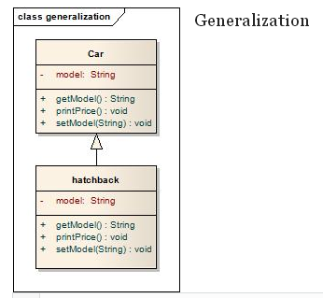
Generalization or Inheritance relationship between classes

Slide 61
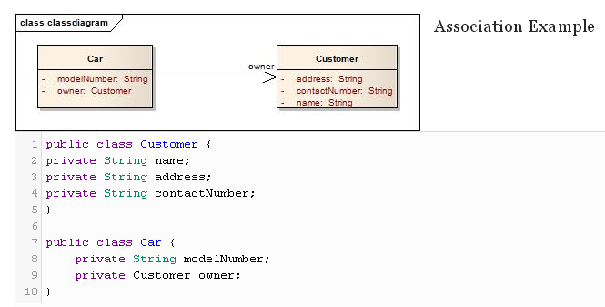
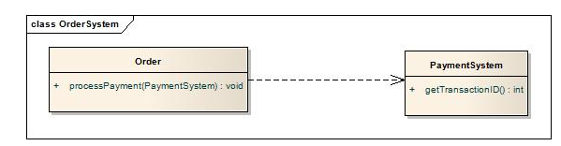
Dependency: Here Order class is dependent on PaymentSystem class

Slide 62
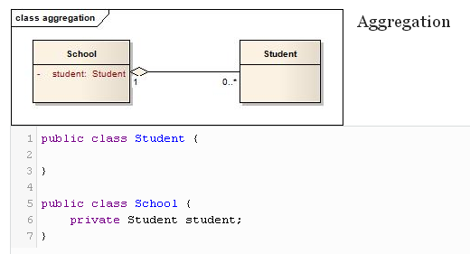
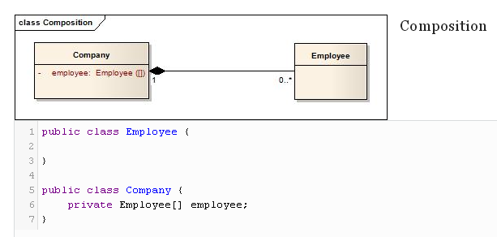
Aggregation is Weaker relationship between classes. Object of student class can exist even before or after object of School class
Composition is Stronger relationship between classes. object of Employee class cannot exist before creation of Company object.

Slide 63
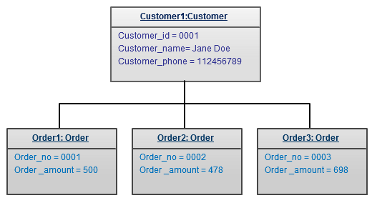
Object Diagram
Object diagrams represent an instance of a class diagram.
Basic concepts are similar for class diagrams and object diagrams.
Object diagrams also represent the static view of a system but this static view is a snapshot of the system at a particular moment.

Slide 64
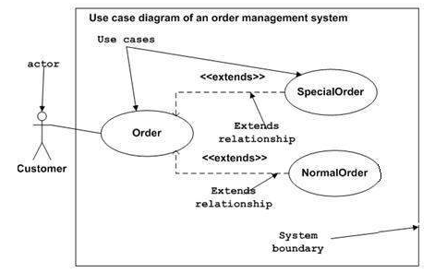
Use case diagram
It is representation of a user's interaction with the system that shows the relationship between the user and the different use cases in which the user is involved. A use case diagram can identify the different types of users of a system and the different use cases

Slide 65
UML Diagrams
Sequence diagram: Shows the order in which messages or method calls are carried out, between the objects.
Collaboration diagram: Collaboration diagram describes the organization of objects in a system taking part in the message flow.
State diagram: Shows dynamic state changes of a specific object, in response to series of events, occurring on object.

Slide 66
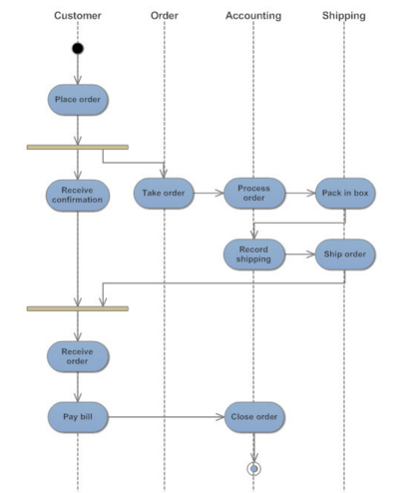
Activity Diagrams:
An activity diagram visually presents a series of actions or flow of control in a system similar to a flowchart or a data flow diagram.

Slide 67
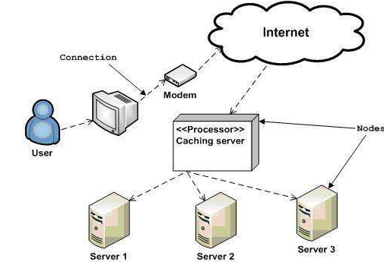
Component and Deployment diagram
Deployment diagrams are used for describing the hardware components where software components are deployed. Component diagrams and deployment diagrams are closely related.
Component diagrams are used to describe the components and deployment diagrams shows how they are deployed in hardware.

