Slide 1


WDCRBP
WOODWORK DESIGN, CRAFTING & REPAIR BOOKING PLATFORM
SP25SE026_GSP48

Slide 2
01
Introduction
02
System design & technologies
Table of content
03
Demo
04
Limitation
05
Future plans

Slide 3




Member
Võ Trọng Luân
Leader
Trần Việt Phúc
Nguyễn Đặng Phương Nam
Lê Nguyên An

Slide 4


Context and Problem
  Demand for durable, aesthetic custom wood products is skyrocketing
  Customers waste time hunting for trusted workshops across scattered channels
  Woodworkers struggle to showcase craftsmanship and gain visibility online

Slide 5
About us
WDCRBP is an online platform for woodworking services
  Easy to book and manage order
  Provides variety of skilled woodworkers
  Provides customization service (base on design idea), personalization service and guarantee/repair service

Slide 6






Technology
Back-end
Front-end
Mobile-app
Deploy

Slide 7
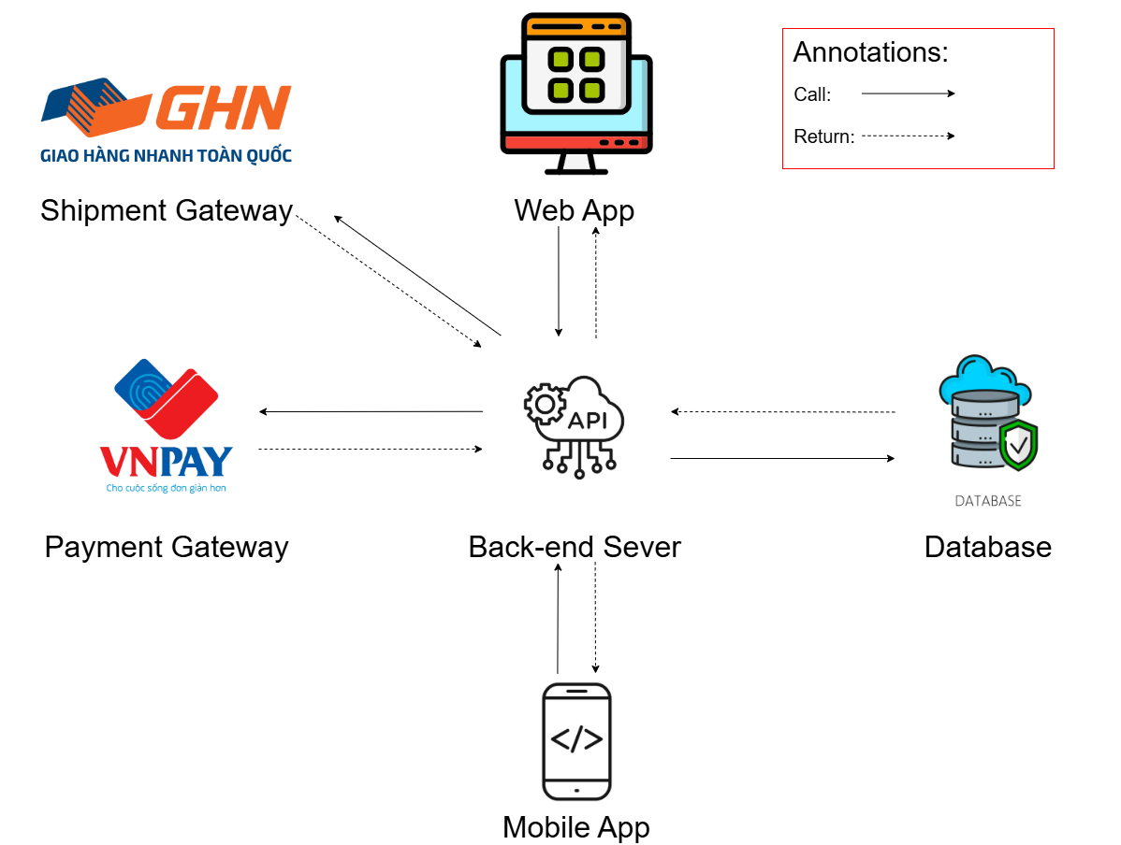
System design

Slide 8
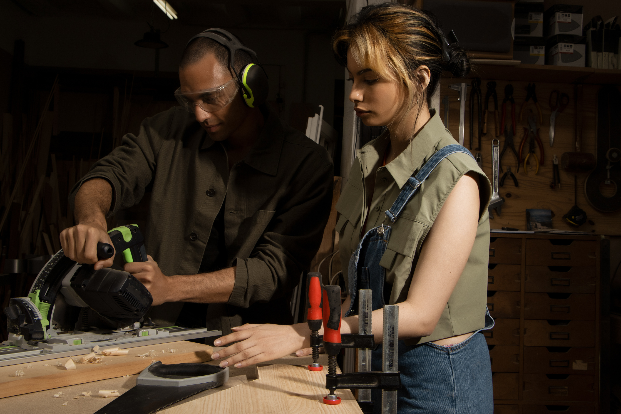
Actor
Woodworker
Who provides services and receives requests from customers

Slide 9
01
Upgrade your service pack to access additional benefits offered by the platform
02
Create and manage design idea for customization service
03
Create and manage product for sale service
04
Manage and process customers’ service orders
05
Manage and process customers’ guarantee/repair orders

Slide 10
Actor
Customer
Who uses the services provided by the woodworker

Slide 11
01
Order a customization service
02
Order a personalization service
03
Request a guarantee/repair service
04
Review and rates orders
05
File a complaint to request a refund for an order

Slide 12
Actor
Admin
Is the administrator of the system

Slide 13
01
Manage users
02
Manage woodworker applications
03
Manage transactions
04
Manage complaints
05
View statistics through charts & system config

Slide 14
01
Woodworker accesses the system, registers as a woodworker, and manages design ideas
Customer places a customization service order and completes the order process
02
Demo flow
Customer places a personalization service order and completes the order process
Exploring critical flows for project
03
04
Customer places a guarantee/repair order and completes the order process
05

Slide 15
Phase 1
01
02
03
04
05
Woodworker submits a registration request
Admin approves the registration
Woodworker deposits money and upgrades service pack and
Woodworker creates design idea
Woodworker updates the warranty policy

Slide 16
Phase 2
01
02
03
04
05
Customer places an order
Woodworker updates the consultation appointment, and the customer confirms it
Woodworker updates the contract, and the customer confirms it
Woodworker uploads images of the finished products
Customer confirms receipt of the products

Slide 17
Phase 3
01
02
03
04
05
06
Customer places an order
Woodworker updates the consultation appointment, and the customer confirms it
Woodworker updates the contract, and the customer confirms it
Woodworker uploads design files for the requested products
Woodworker uploads images of the finished products
Customer confirms receipt of the products

Slide 18
Phase 4
01
02
03
04
05
Customer places an order
Woodworker updates the consultation appointment to clarify details
Woodworker accepts the guarantee order
Woodworker confirms completion of the repair process
Customer confirms receipt of the product

Slide 19
Limitation
  Still using the sign function with a mouse and drawing signatures on mobile devices
  System architecture without load balancing. Currently using only 1 server to handle all requests

Slide 20
Future plan
  Train AI to recommend design ideas, products, woodworkers based on users’ preferences
  Allow users to edit 3D models directly in-browser and interactively preview 3D product renders for enhanced visualization
  Grant woodworkers honorary titles once the platform has built sufficient credibility
  Enable AR (Augmented Reality) preview for furniture placement in users' real-life spaces via mobile devices for better purchase confidence

Slide 21
Thank you so much for listening to our presentation

