Slide 1

Business Insights From Netflix Content Data
Nancy Gupta
Python | SQL | Power BI

Slide 2
Executive Summary
Analysis of Netflix content dataset to uncover global distribution patterns, content trends, and audience focus.
Platform is heavily movie-driven (~69%), with TV Shows contributing a smaller share.
Content is primarily targeted toward mature audiences, with TV-MA as the dominant rating.
Strong content growth observed after 2015, peaking around 2019–2020.
United States leads content production, followed by India and the United Kingdom.
Nancy Gupta
Recommendations:
Increase investment in TV Show content to improve long-term user engagement.
Expand content production in emerging and underrepresented regions to strengthen global presence.
Diversify content ratings to attract a broader audience base.

Slide 3
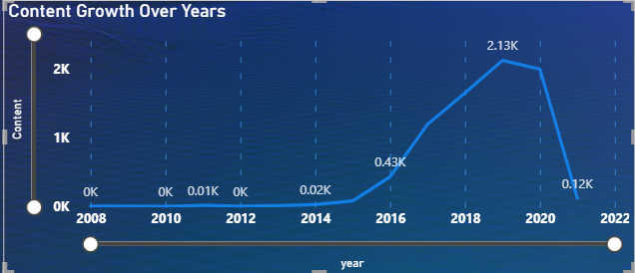
Content Growth Trends Over Time
Observation • Content additions remained negligible before 2015. • Rapid acceleration observed post-2015, peaking
around 2019–2020.
Trend • Strong expansion phase between 2016–2020. • Reflects an aggressive content scaling strategy.
Insight • Netflix rapidly increased content to attract and
retain a larger audience. • Post-2020 decline indicates a transition toward more
selective content investment.
Business Implication • Shift in growth pattern indicates transition from expansion to optimization phase.
Nancy Gupta

Slide 4

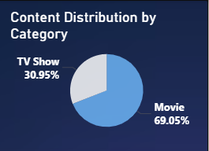
Content Distribution & Engagement Impact
• The content library is heavily skewed toward movies (~69%), indicating a film-dominant strategy.
• This imbalance suggests limited emphasis on long-format content, which is key for sustained engagement.
• TV Shows, with multi-episode structures, offer higher potential for continuous watch time and retention.
• A more balanced content mix could strengthen user engagement and platform stickiness.

Slide 5
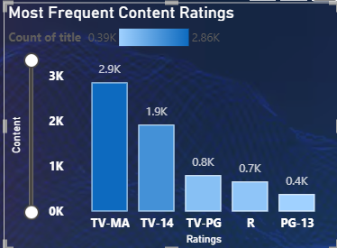
Content Ratings & Audience Focus
• The platform is heavily oriented toward mature audiences, with TV-MA dominating the content ratings.
• Lower representation of family-friendly ratings indicates a narrower audience focus.
• This suggests a strategic emphasis on adult and young-adult viewers.
• Expanding content across varied rating categories could enhance audience diversity and reach.

Slide 6
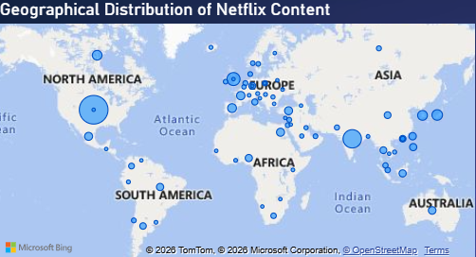
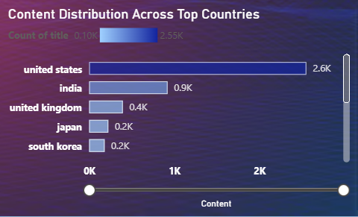
Global Content Distribution & Market Reach
Content production is strongly concentrated in a few dominant markets, led by the United States, with India and the United Kingdom as key contributors.
While global presence exists, the distribution reflects a moderate level of diversification, with emerging regions like South Korea gaining visibility.
This indicates a gradual shift toward localized and culturally diverse content, aimed at expanding international audience reach.
However, continued concentration in major markets suggests untapped potential in underrepresented regions.
Business Implication
Expanding content in emerging markets can increase global reach and reduce dependence on a few dominant regions.

Slide 7
Strategic Recommendations
• Transition from rapid content expansion to a more quality-focused strategy to sustain long-term growth
• Rebalance the content mix by increasing focus on TV Show content to improve user engagement and retention
• Expand content across diverse rating categories to attract a broader audience beyond mature viewers
• Strengthen investment in emerging and underrepresented markets to enhance global reach and reduce regional concentration

