Slide 1
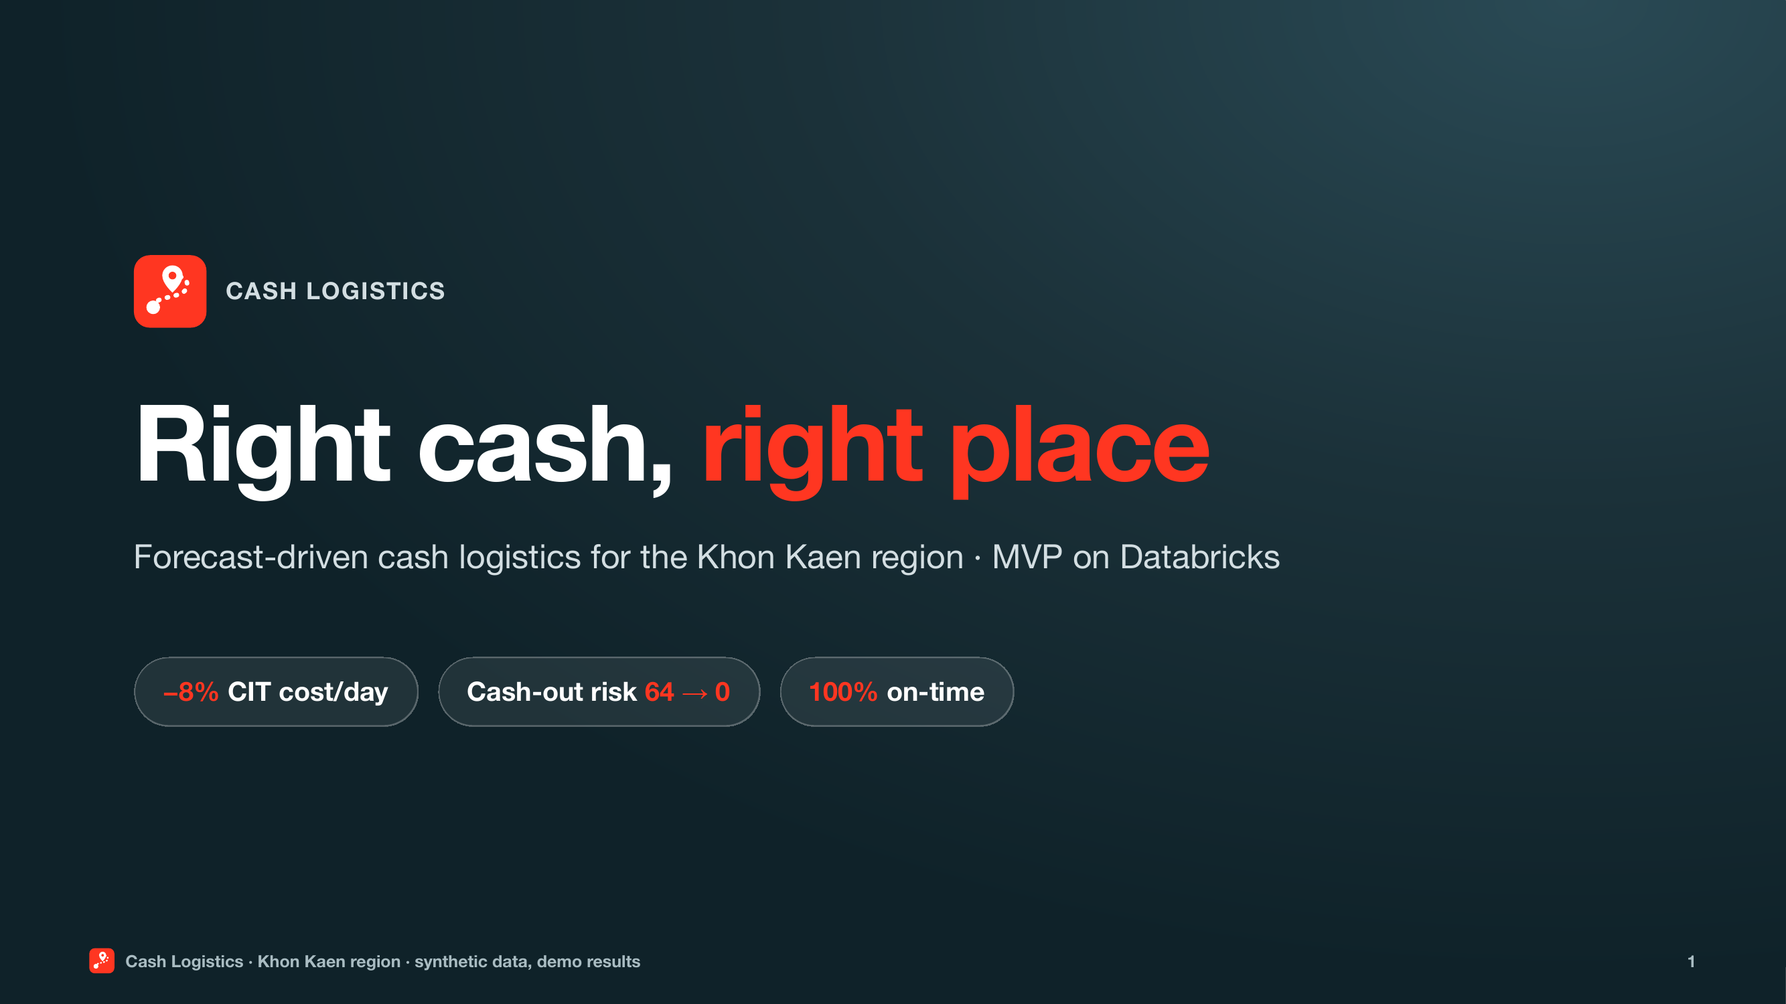
Right cash, right place
Notes:
SAY:
Good morning, Alex. Good morning, Shreya. Thanks for making the time. Here’s the plan. I’ll show the problem and the live app, then we’ll cover readiness, risks, and next steps. Does that work? (pause) From our last conversation, we agreed on one business outcome: reduce the cash sitting idle and lower the cost of moving it, without increasing cash-outs. Alex, is that still the right outcome to anchor on today? (pause) Shreya, we also agreed that any solution has to pass two tests: it must protect sensitive data, and it has to be practical for your team to operate. Are those still the right technical priorities? (pause) Great. I’ll use those two outcomes as the lens for the demo. One quick note: everything you’ll see uses synthetic data.
CLICK / CUE:
Keep the opening calm. Get one answer from each person; do not let discovery consume the demo.
At each (pause), stop and wait for their answer.
TIME: 00:00–00:45

Slide 2
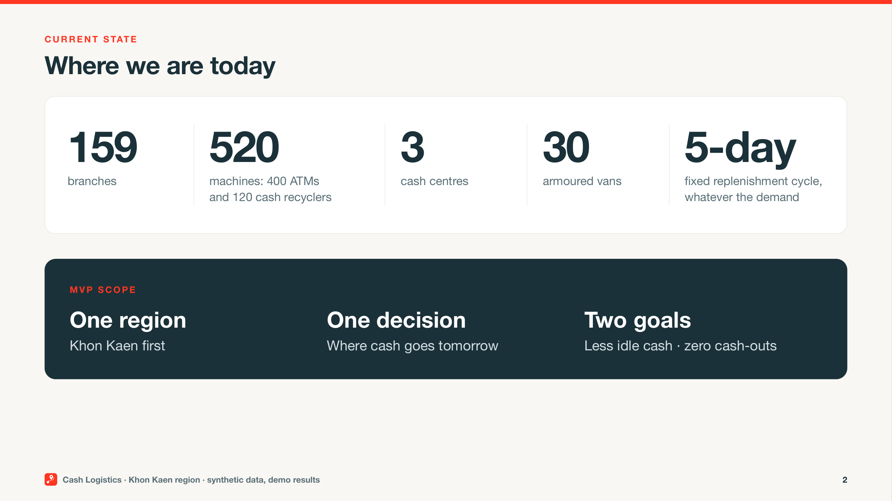
Where we are today
Notes:
SAY:
Let me start with the scope we agreed. Your cash operations cover 159 branches and 520 machines — 400 ATMs and 120 cash recyclers. They’re served by 3 cash centres and 30 armoured vans. Today, each branch and cash machine is scheduled for replenishment once every five days, whether it needs cash or not. For this first phase, we’re starting with Khon Kaen. Each morning, the team needs a clear answer to one question: which locations need cash tomorrow, and how much? The goal is less idle cash and fewer cash-outs without transforming the whole network at once.
CLICK / CUE:
No clicks. Stay on this slide.
TIME: 00:45–01:20

Slide 3
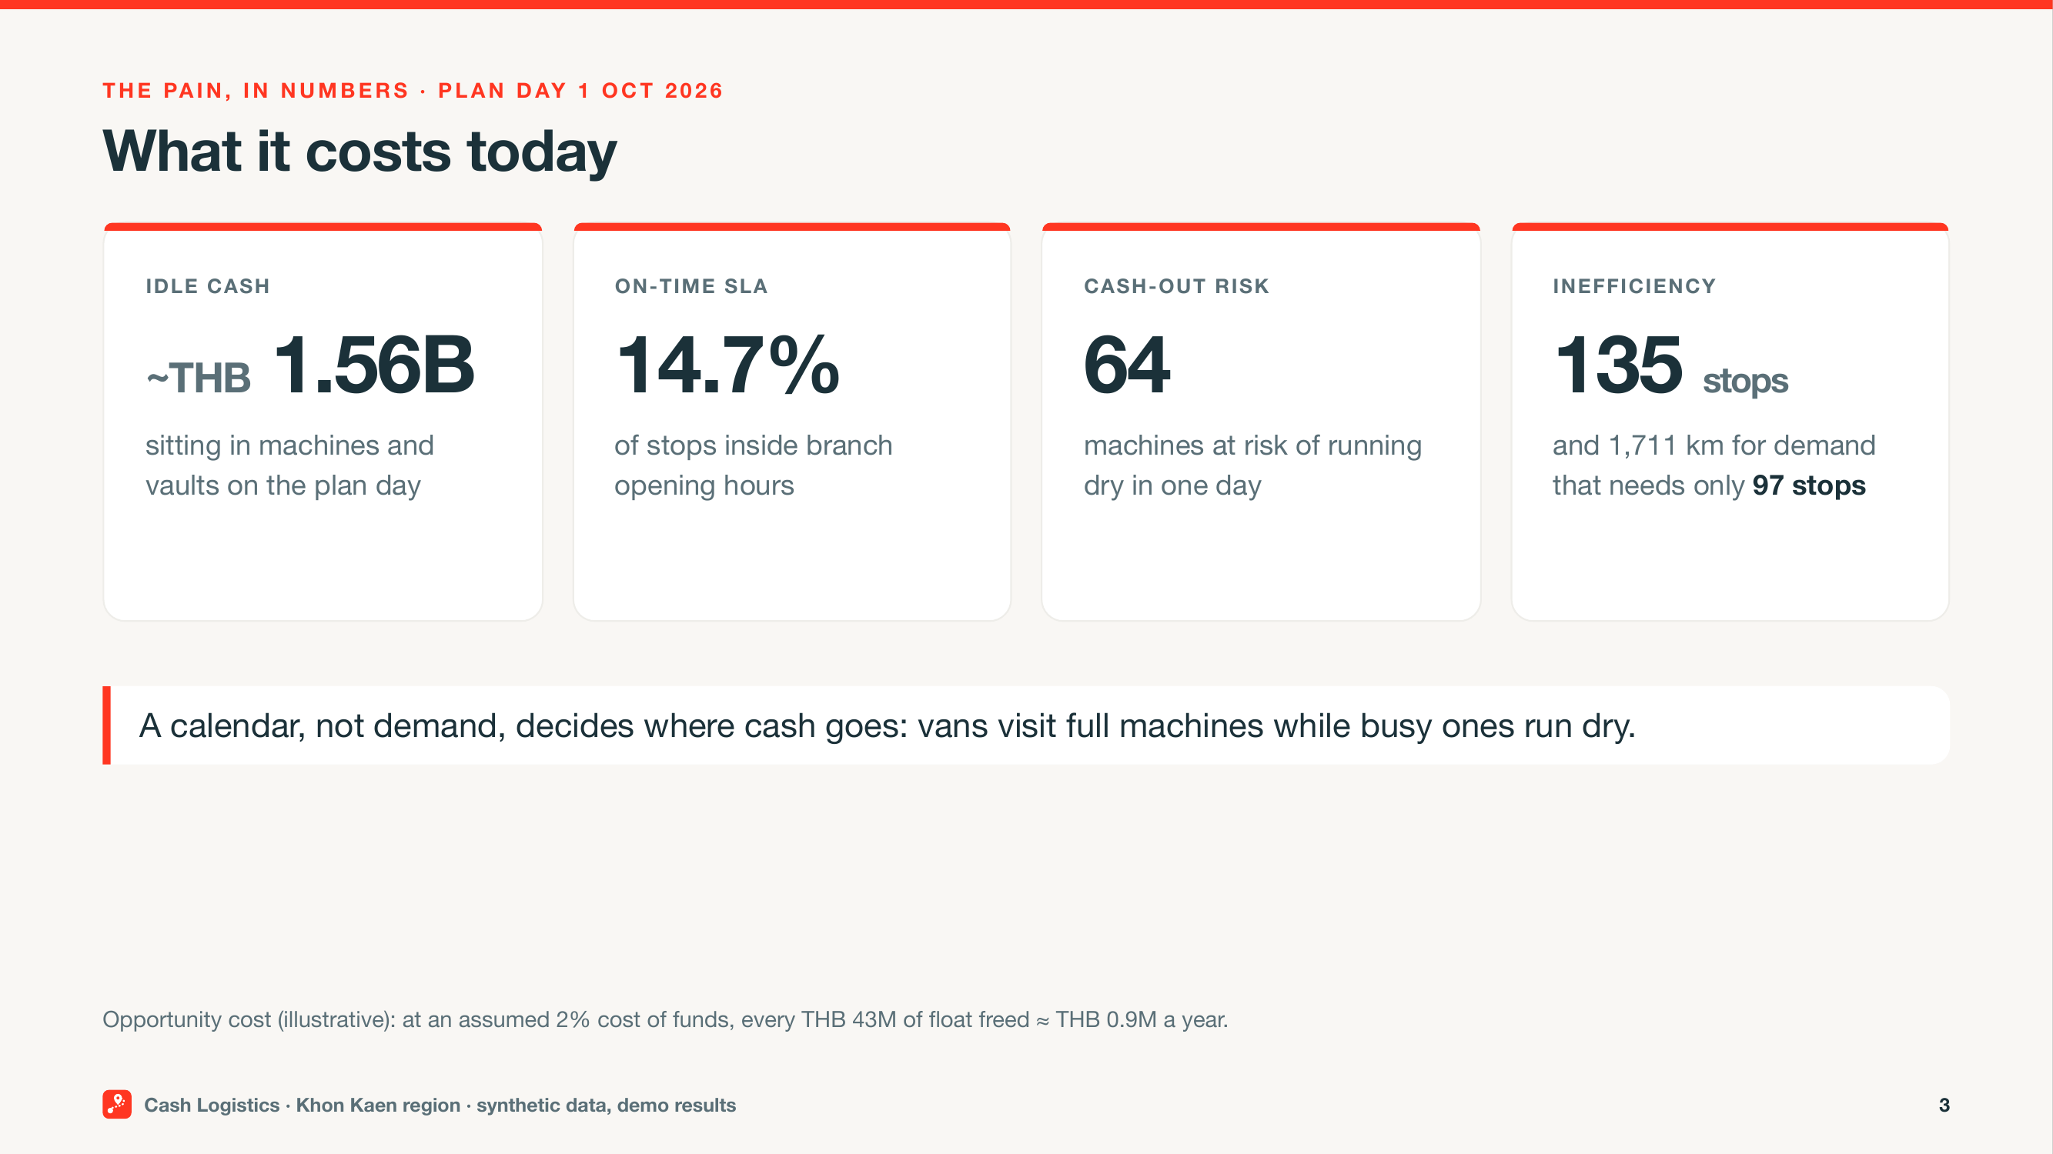
What it costs today
Notes:
SAY:
Here’s what the synthetic plan day looks like. About THB 1.6B is tied up in machines and vaults. Only about 15% of scheduled stops arrive within the required time window. And on this plan day, 64 locations are still at risk of running out of cash. The fixed cycle drives 135 stops and about 1,700 km, when demand needs 97 stops. One assumption: at a 2% cost of funds, releasing THB 43M is worth roughly THB 0.9M a year. The operating case doesn’t depend on that assumption.
CLICK / CUE:
No clicks. Stay on this slide.
TIME: 01:20–02:05

Slide 4
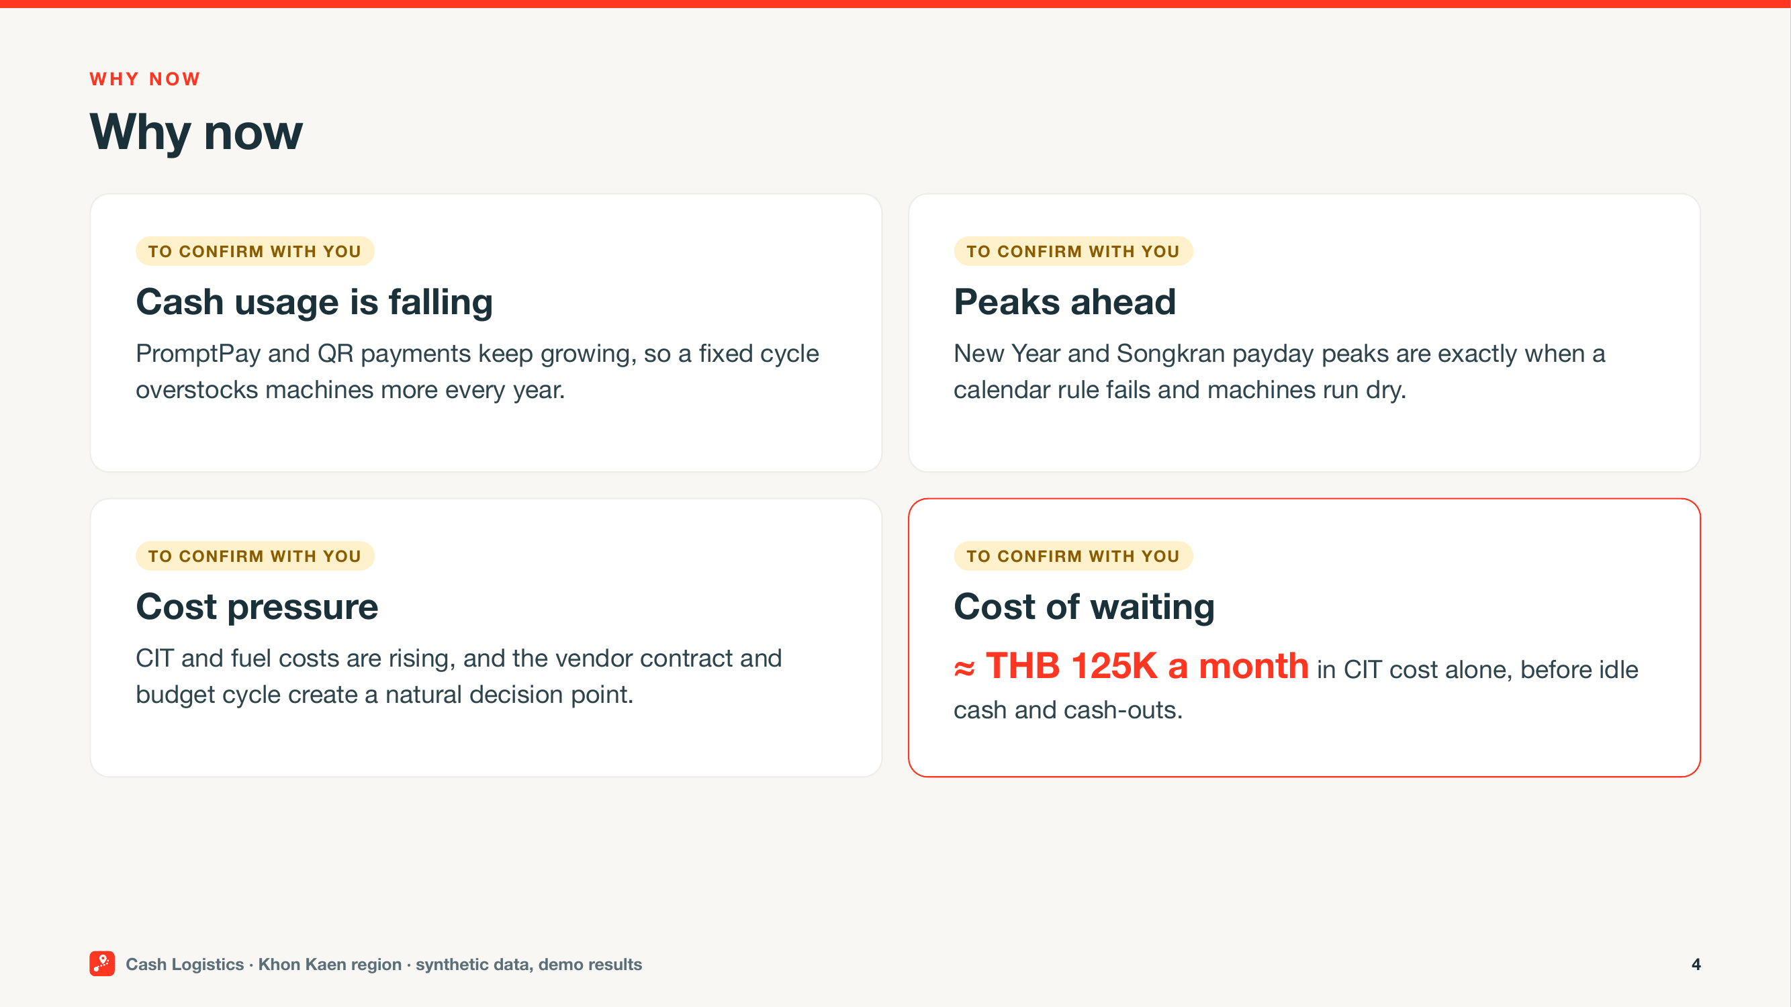
Why now
Notes:
SAY:
From what I understand, PromptPay and QR payments are changing how customers use cash. Overall cash use may be declining, but demand is becoming less predictable—especially around payday, New Year and Songkran. That makes a fixed schedule more expensive. Some locations hold too much cash, while others still run short. At the same time, fuel and cash-transport costs are increasing. Based on the assumptions in this demo, waiting another month leaves roughly THB 125K in avoidable transport cost on the table. Alex, does that match what you’re seeing? (pause) That’s helpful. I’ll keep that priority in view as we go.
CLICK / CUE:
At each (pause), stop and wait for their answer.
TIME: 02:05–03:00

Slide 5
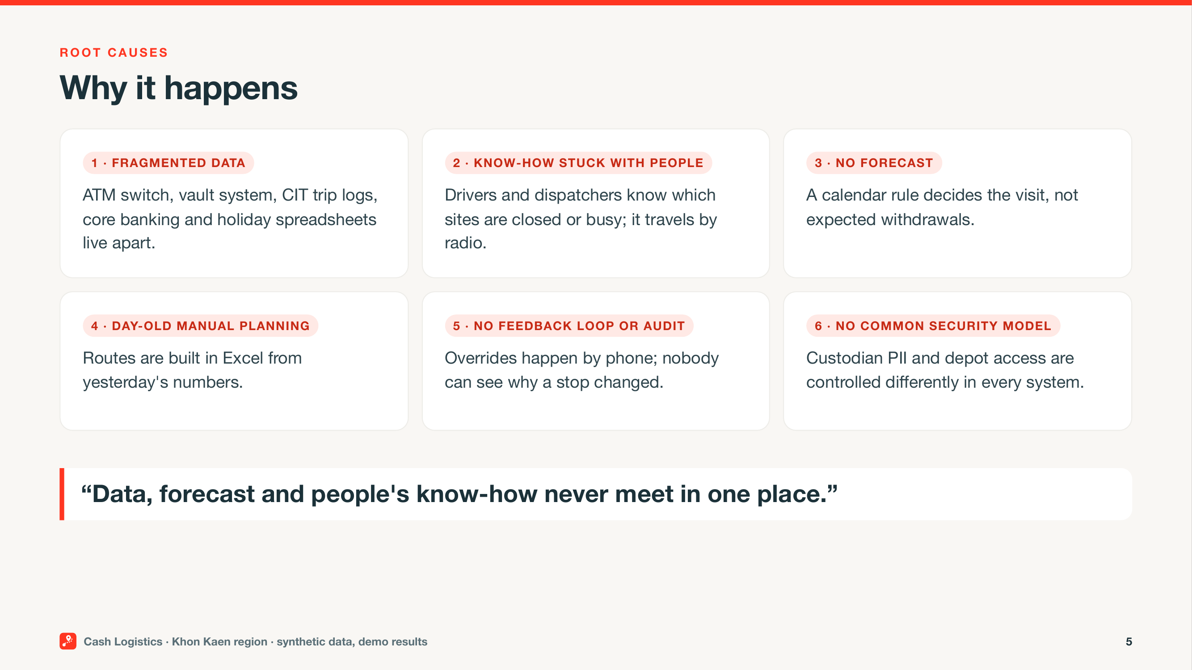
Why it happens
Notes:
SAY:
Shreya, the root cause isn’t one bad route. The ATM switch, cash-centre systems, CIT logs, core banking, and holiday spreadsheets all sit apart. Local knowledge, like a mall ATM opening late, stays in radio calls. Planning happens in Excel with day-old data and a calendar rule. There’s no forecast, feedback loop, clean override audit, or shared security model for custodian PII and depot access. The data, forecast, and people’s know-how never meet in one place.
CLICK / CUE:
No clicks. Stay on this slide.
TIME: 03:00–03:50

Slide 6
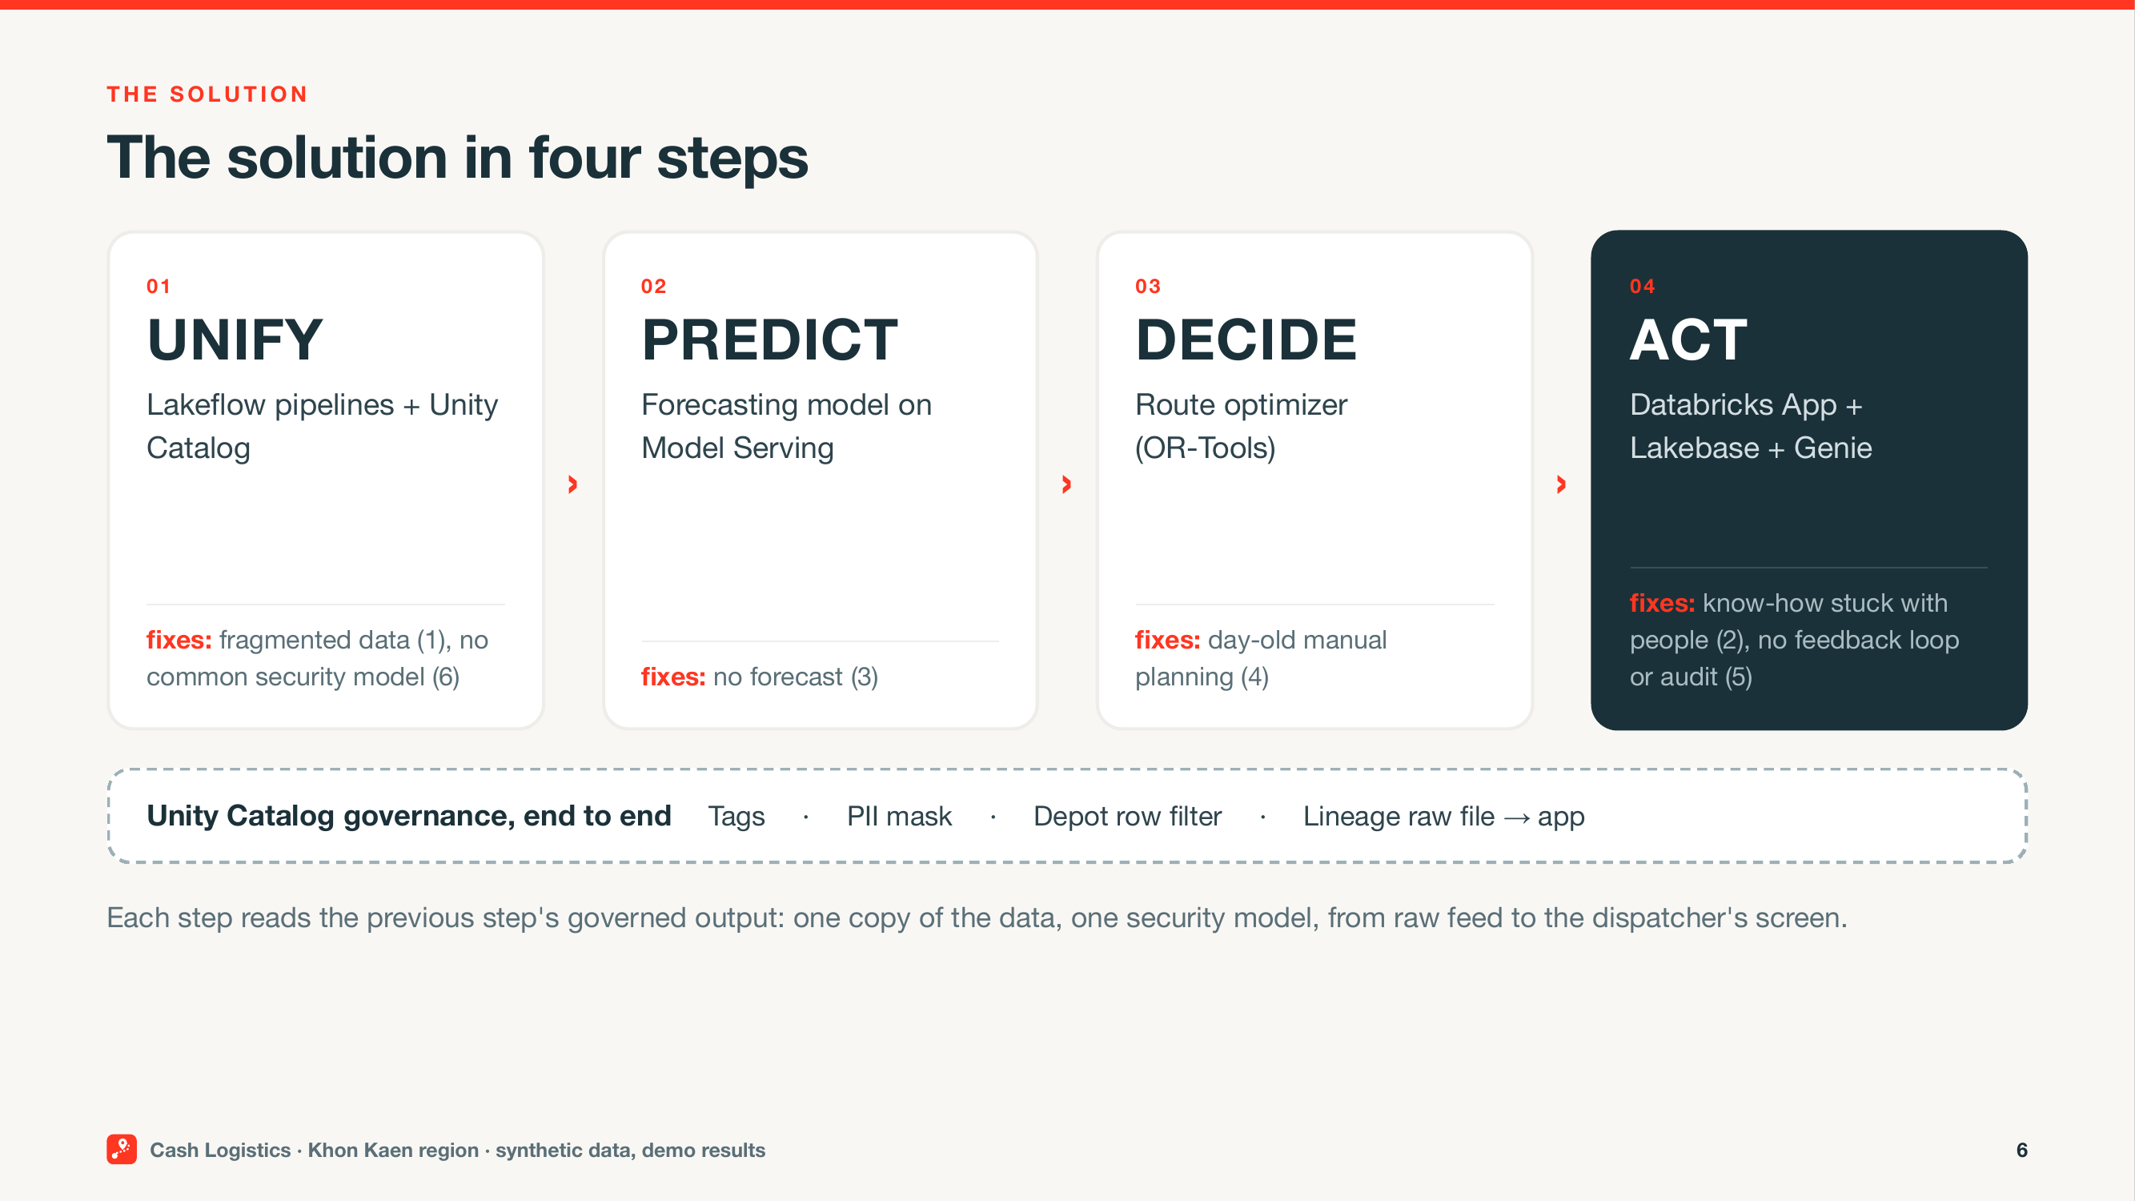
The solution in four steps
Notes:
SAY:
Shreya, let me show you what sits underneath. First, unify the feeds with Lakeflow pipelines and govern them in Unity Catalog. Next, predict machine demand through Model Serving. Then decide tomorrow’s stops and routes with the optimizer. Finally, act through a Databricks App, with Lakebase for audited writes and Genie for governed questions. The important part is the flow: fragmented feeds become trusted data, calendar rules become forecasts, manual routes become explainable plans, and radio knowledge becomes an auditable override.
CLICK / CUE:
No clicks. Stay on this slide.
TIME: 03:50–04:30

Slide 7
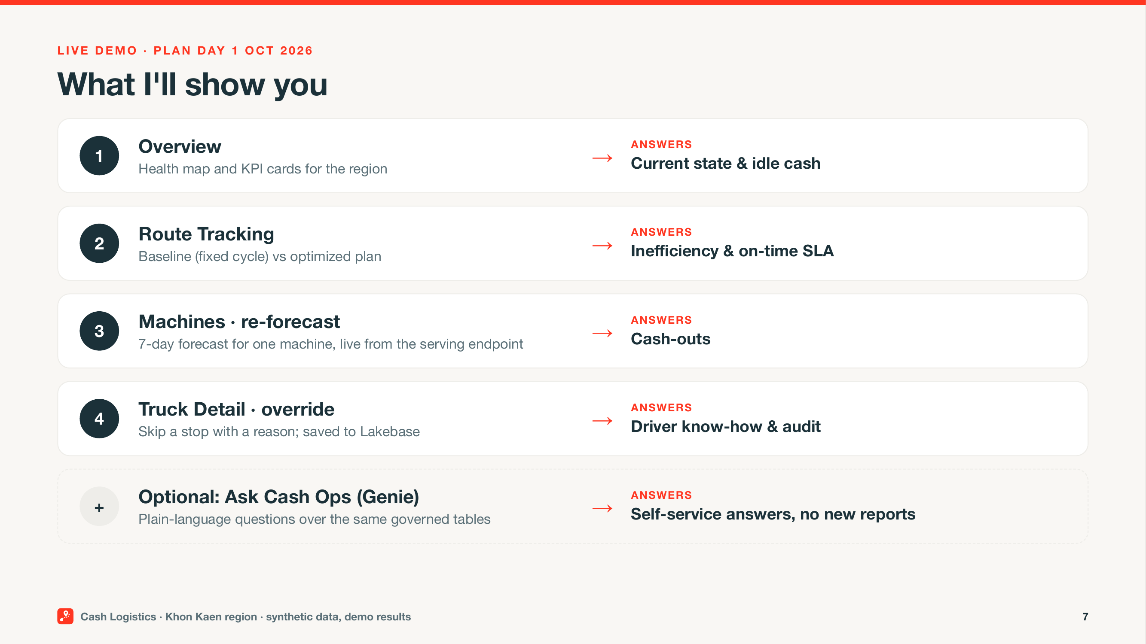
What I'll show you
Notes:
SAY:
Here’s what I’m going to show. Overview gives us current cash and risk. Route Tracking compares the fixed cycle with the optimized plan. Machines gives us a live ATM forecast. Truck Detail shows how a dispatcher changes the plan without losing the audit trail. If we have a minute, I’ll ask one plain-language question. For each step, I’ll tell you what to watch, show it, then bring it back to the decision you need to make.
CLICK / CUE:
Then leave the slides and run the live app:
Click: Open Overview and point to those KPI cards and the map.
Click: Open Route Tracking. Toggle Baseline (fixed cycle), then Optimized (CVRP-TW). Point only to the KPI cards row and map.
Do not point to the Route Summary donut or card percentage deltas.
Click: Open Machines. In Machine Summary, click row A0004. Scroll to the forecast panel. Click Re-forecast.
Click: Open Truck Detail. Switch to Optimized (CVRP-TW). Select a pending stop. Choose action SKIP. Enter reason Branch closed for renovation. Click Submit override.
Click: Open Ask Cash Ops and ask: Which nodes run out of cash in the next 3 days if we do nothing? Keep SQL collapsed.
TIME: 04:30–05:00 on this slide, then live app 05:00–13:00

Slide 8
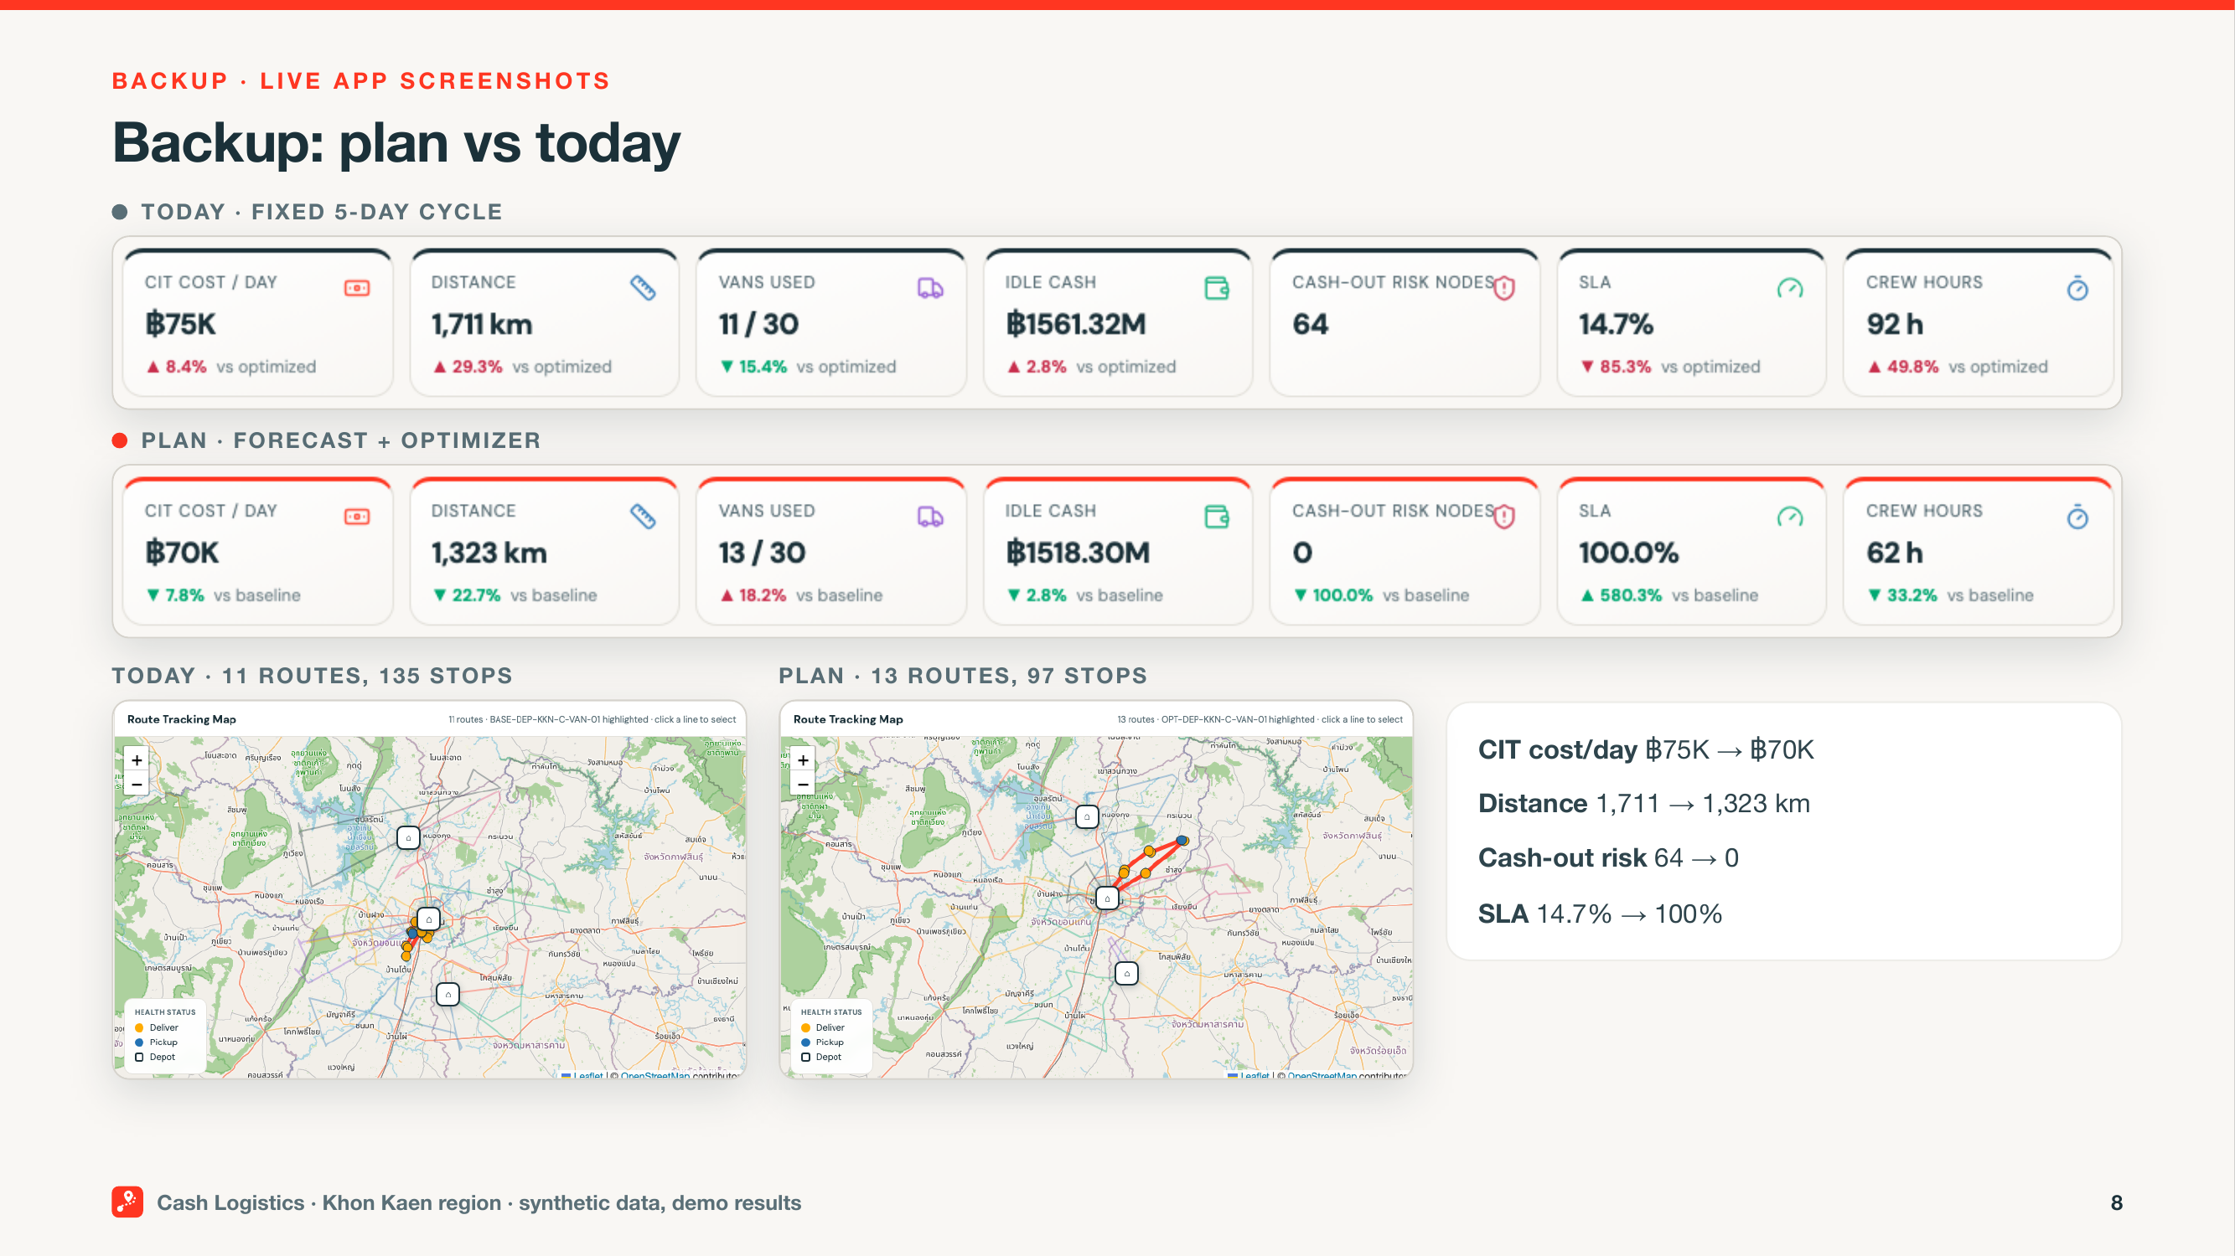
Backup: plan vs today
Notes:
SAY:
The live app isn’t responding, so I’ll switch to the captured view and keep us moving. The fixed cycle shows 135 stops, about 1,700 km, 64 machines at risk, and about 15% inside opening hours. The optimized plan shows 97 stops, about 1,300 km, 0 at risk, and 100% inside opening hours. CIT cost moves from about THB 75K to about THB 70K a day. The result is still synthetic, so the pilot tests whether it holds on your feeds.
CLICK / CUE:
Backup only if the live app fails. Otherwise skip this slide.
TIME: only if needed, during the live demo (05:00–13:00)

Slide 9
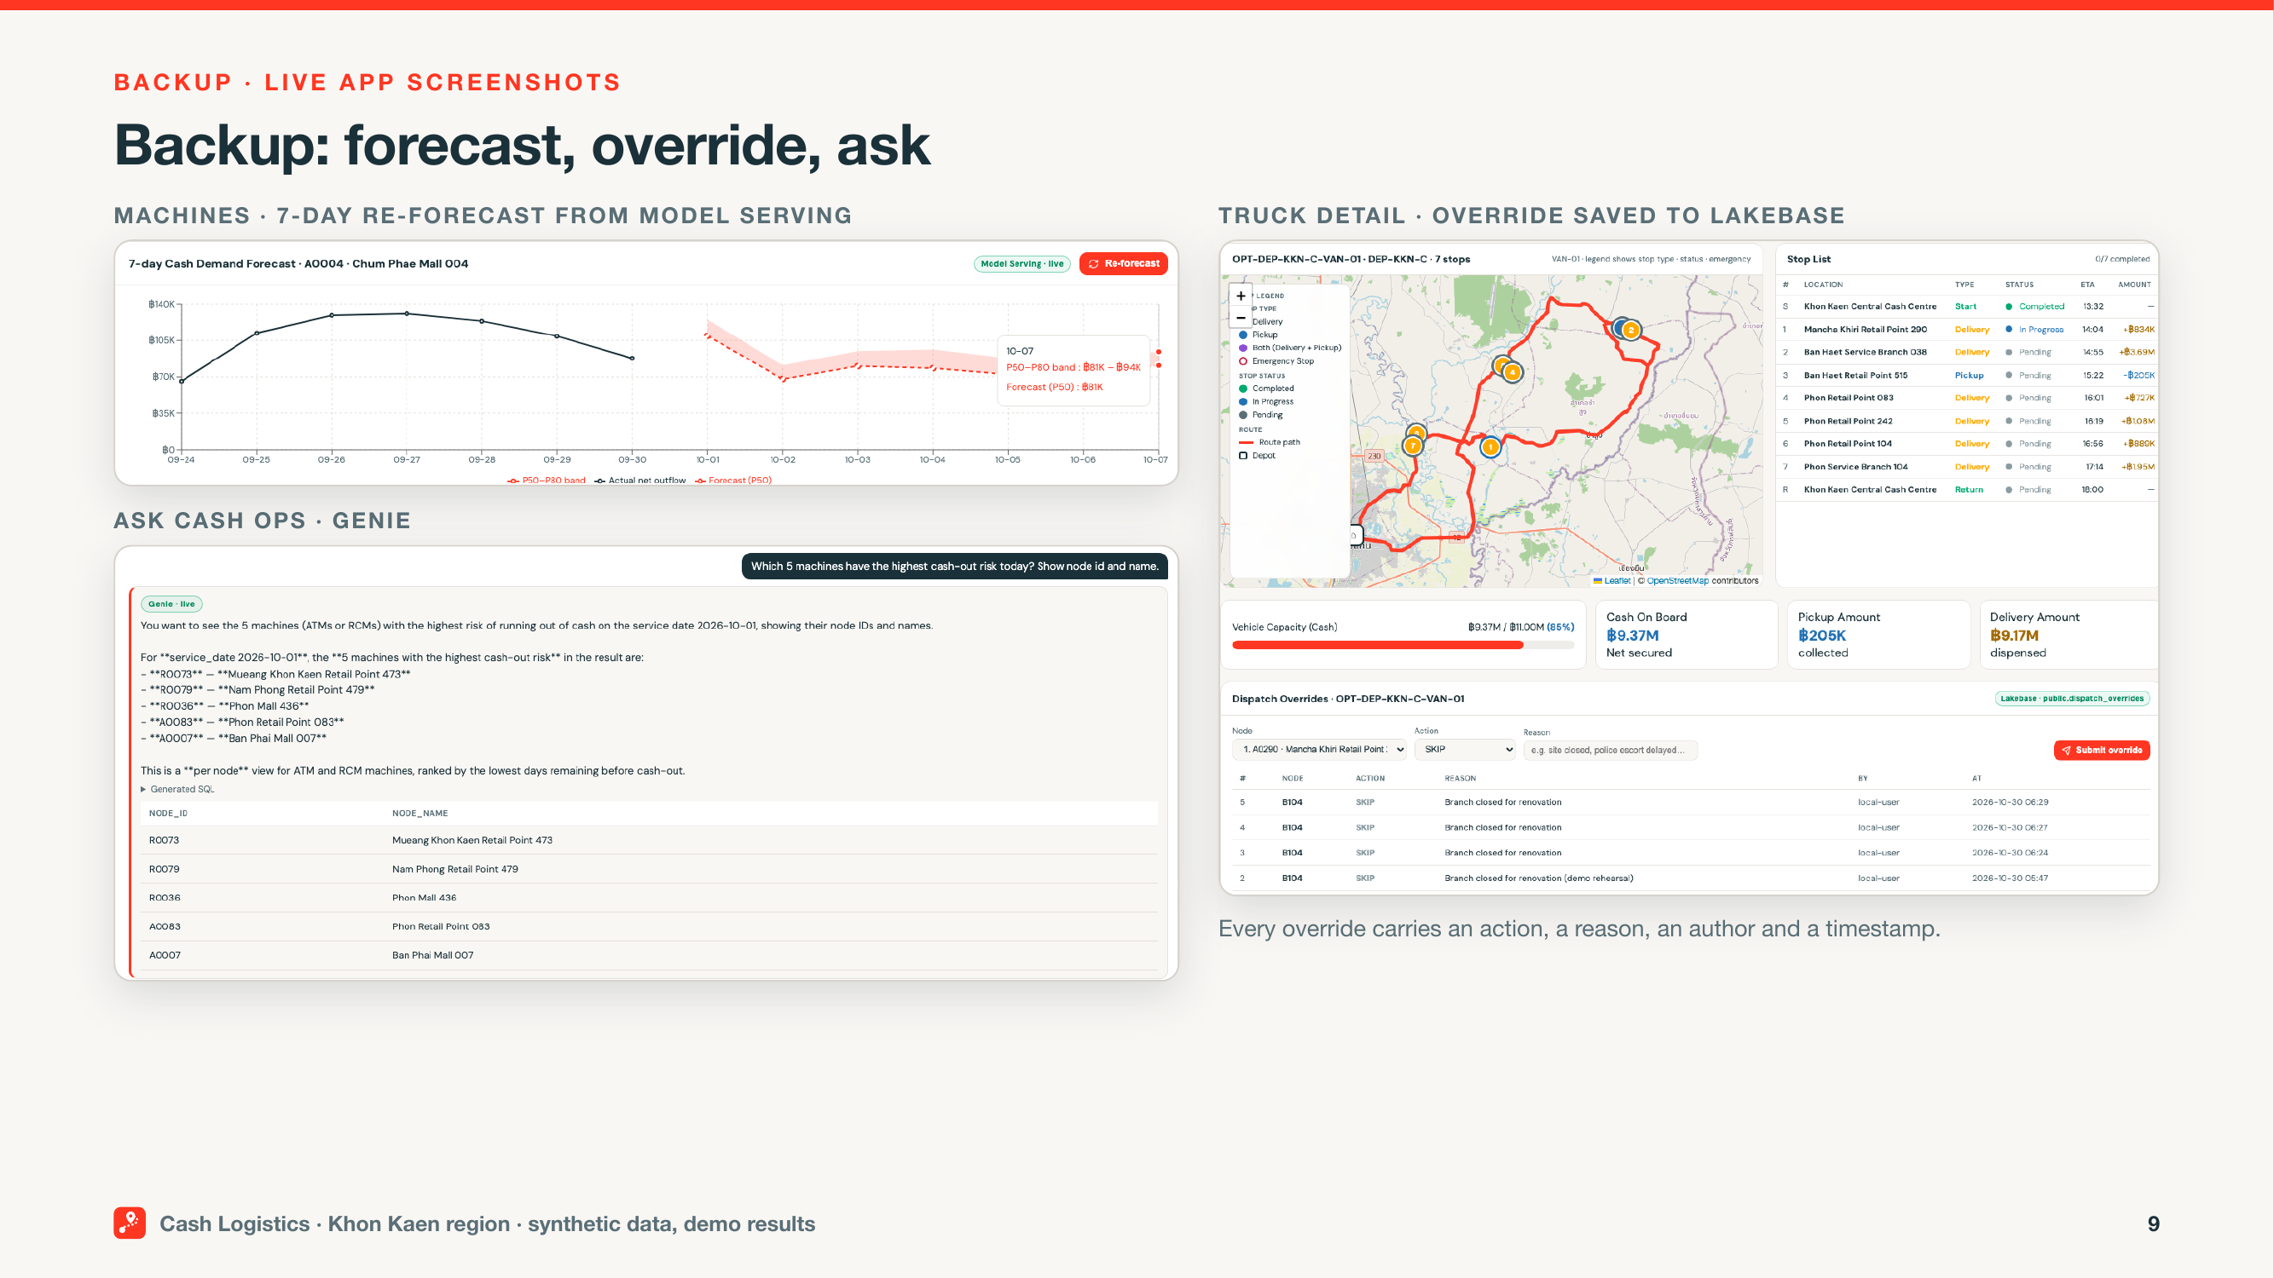
Backup: forecast, override, ask
Notes:
SAY:
This capture shows the three controls I wanted you to see. The forecast gives us a P50 to P80 range from live Model Serving, with about 81% P80 coverage. The override saves a skipped stop and its reason in Lakebase, so we know who changed what and why. Ask Cash Ops finds 79 critical nodes over the next 3 days. The app is the decision surface; the governed data and audit trail still sit underneath.
CLICK / CUE:
Backup only if the live app fails. Otherwise skip this slide.
TIME: only if needed, during the live demo (05:00–13:00)

Slide 10
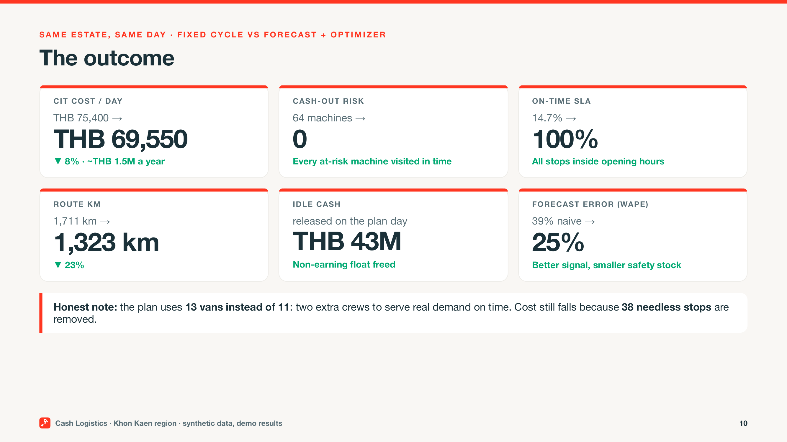
The outcome
Notes:
SAY:
Let me bring that together. On this synthetic day, CIT cost falls 8%, from about THB 75K to about THB 70K a day — about THB 1.5M a year. Distance falls 23%, from about 1,700 to about 1,300 km. Cash-out risk goes from 64 to 0. SLA moves from about 15% to 100%, and THB 43M of idle cash is released. Alex, that’s lower cost and risk. Shreya, it’s one governed path from feed to action.
CLICK / CUE:
No clicks. Stay on this slide.
TIME: 13:00–15:00

Slide 11
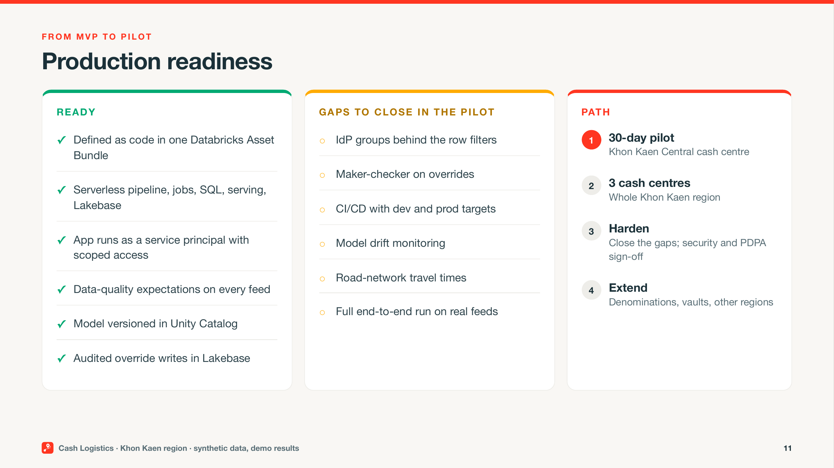
Production readiness
Notes:
SAY:
Let’s separate what’s ready from what needs work. The pipeline, job, and app are code in one Databricks Asset Bundle. It’s serverless, the app uses a scoped service principal, quality expectations are defined, the model has a champion alias in Unity Catalog, and Lakebase audits writes. Pilot gaps are IdP group mapping, maker-checker, dev and prod CI/CD, drift monitoring, and road-network travel times. The full job hasn’t run end to end on real feeds. The path is Khon Kaen Central, all 3 centres, then harden and extend.
CLICK / CUE:
No clicks. Stay on this slide.
TIME: 15:00–18:00

Slide 12
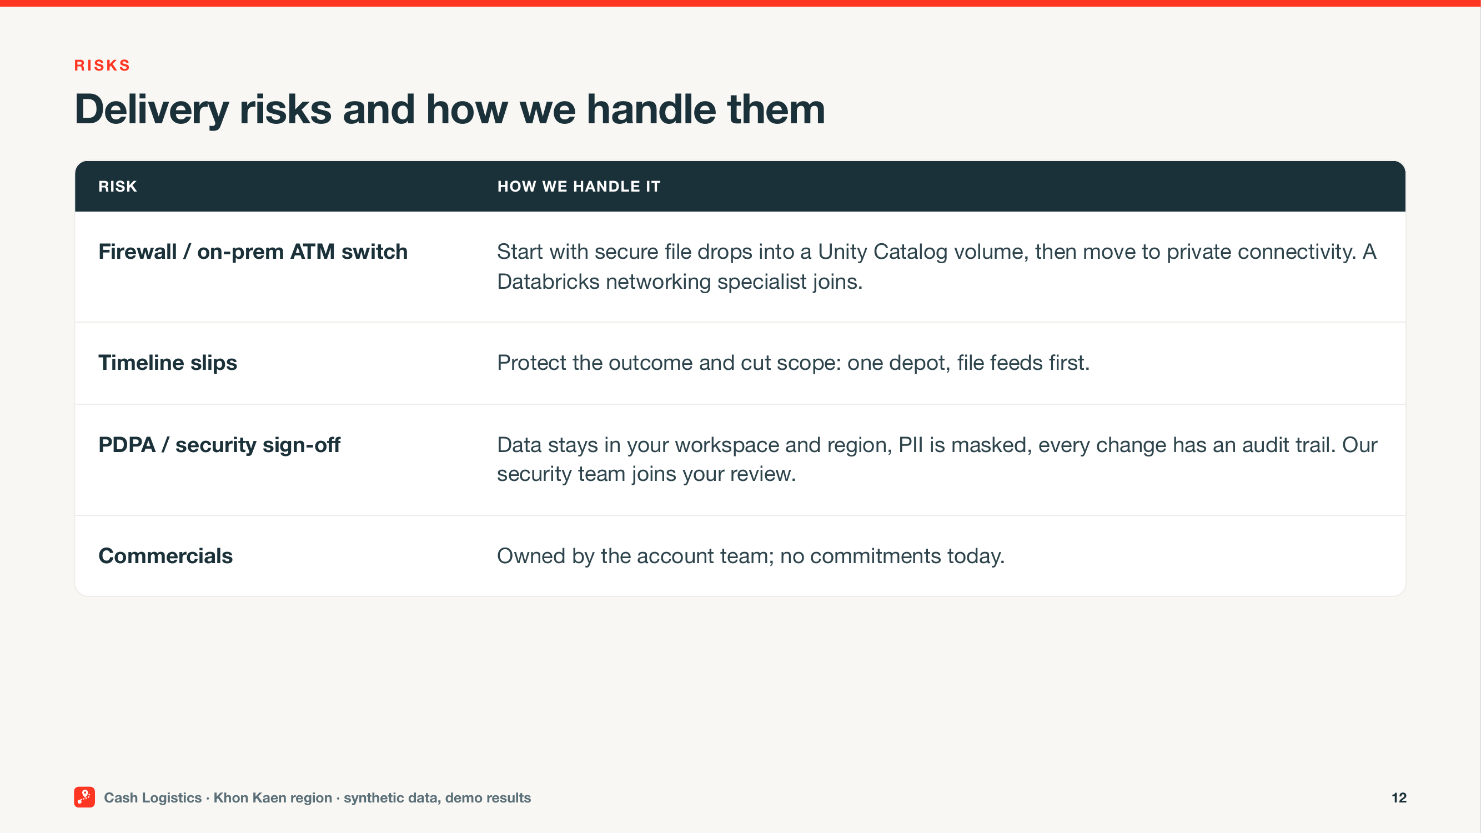
Delivery risks and how we handle them
Notes:
SAY:
Let’s talk about likely blockers. If the ATM switch sits behind a firewall, we’ll start safely with file drops into a Unity Catalog volume, then move to PrivateLink with both network teams. If timing slips, we’ll cut to one depot and file feeds, keep the success criteria, and re-plan with Alex. For PDPA, data stays in your workspace and region, PII is masked, and system tables provide audit evidence. I won’t quote commercials here; the account executive owns them. Which blocker feels most real? (pause)
CLICK / CUE:
At each (pause), stop and wait for their answer.
TIME: 18:00–26:00

Slide 13
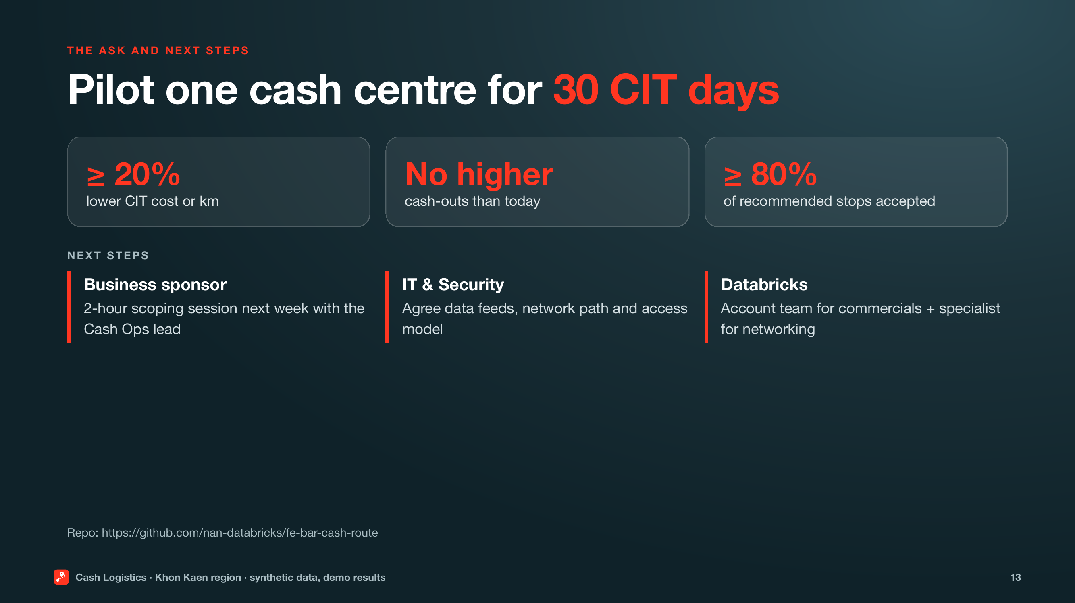
The ask and next steps
Notes:
SAY:
Let me close with a clear ask. Alex, this is a low-risk way to reduce CIT movement and idle cash without trading away customer trust. Shreya, it’s a governed design with honest gaps. I’m asking for a 30-day Khon Kaen Central pilot: at least 20% lower CIT cost or kilometres, cash-outs no higher, and at least 80% dispatcher acceptance. Alex sponsors the scoping session. Shreya brings Security and networking. I’ll bring the account team and our specialist. What would you need to see to sponsor that next step? (pause)
CLICK / CUE:
Stop talking. Let Alex or Shreya answer.
At each (pause), stop and wait for their answer.
TIME: 26:00–30:00

Slide 14
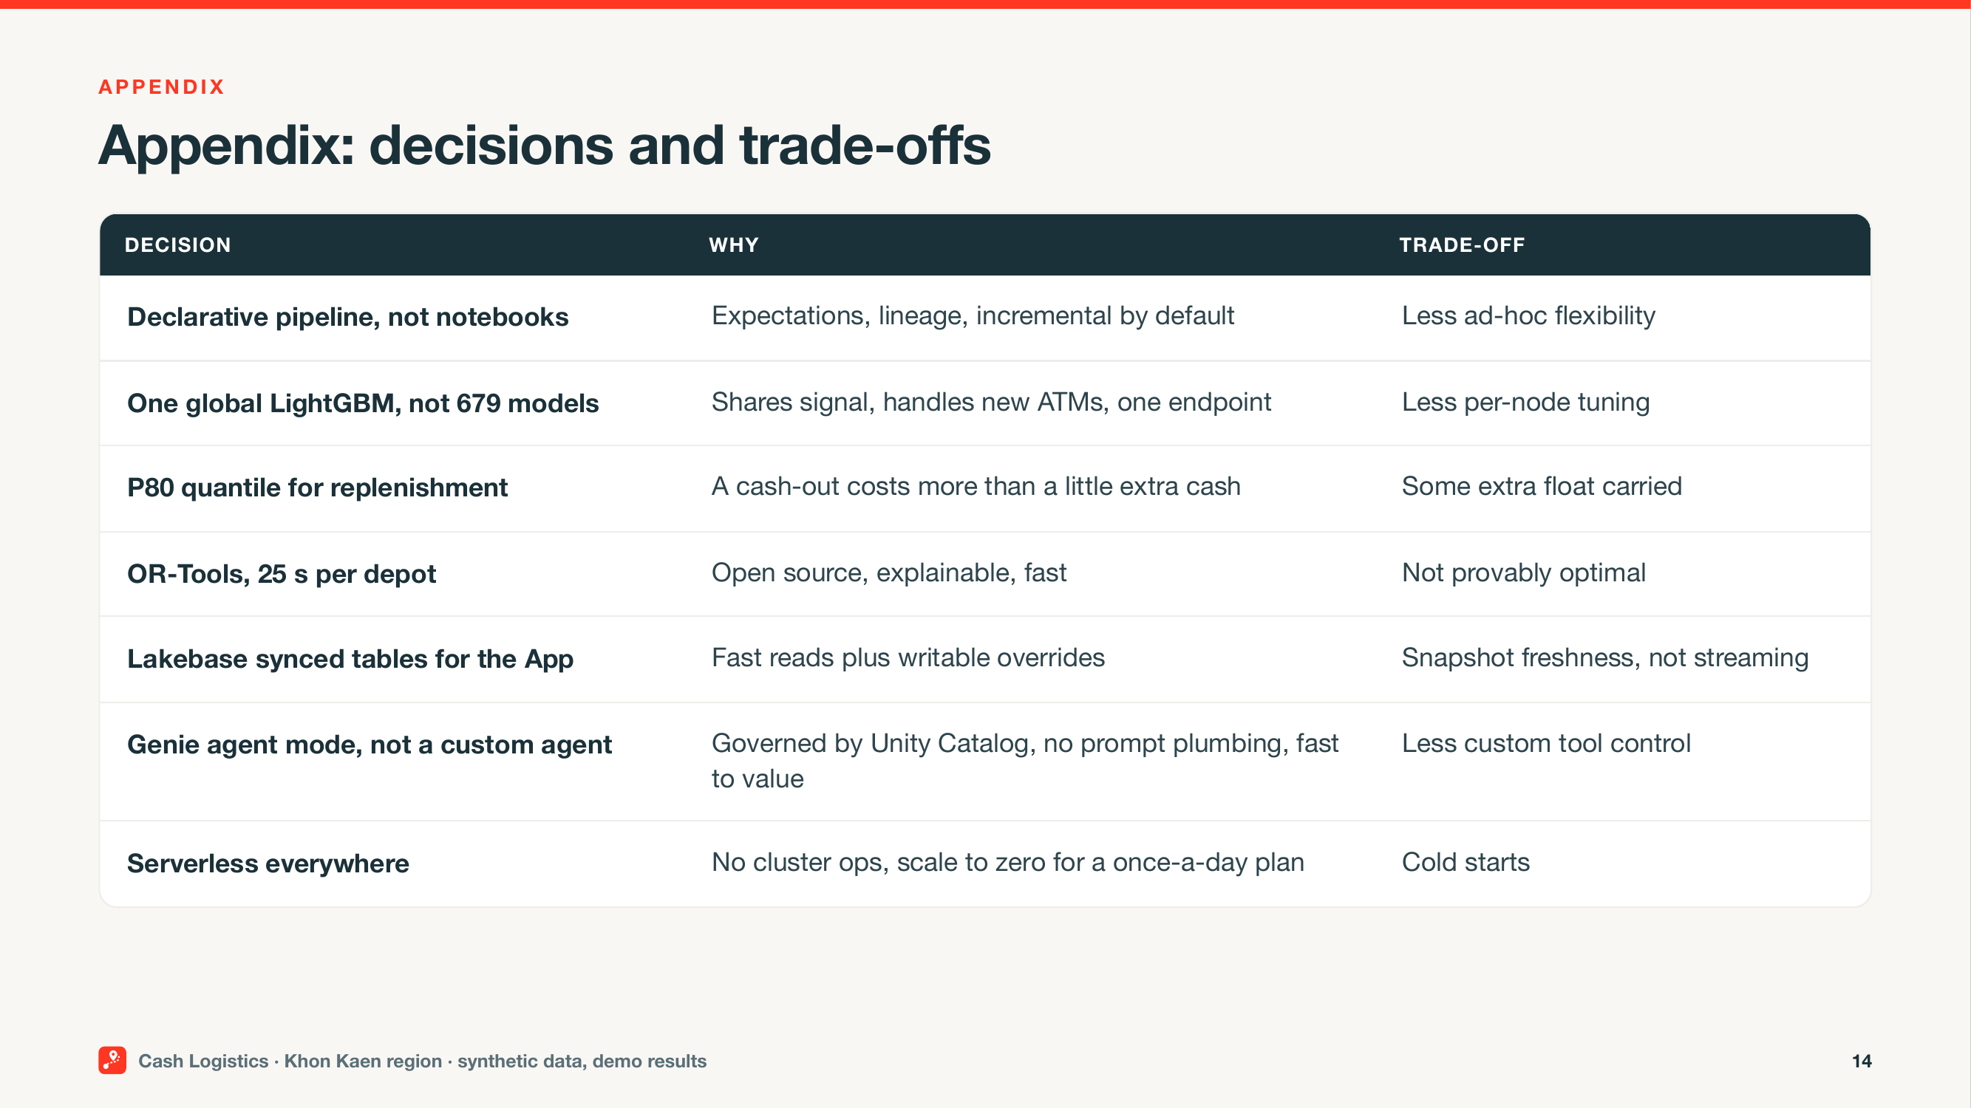
Appendix: decisions and trade-offs
Notes:
SAY:
Here are the trade-offs we made. P80 lowers cash-out risk, but it can carry more cash. 13 vans meet every opening window, while 38 unnecessary stops disappear and total cost still falls. A shared model is easier to govern, but we still need to test local payday behaviour. The optimizer is explainable and constrained, but road-network travel times must replace today’s straight-line-times-1.3 assumption. These are questions for the pilot, not hidden production claims.
CLICK / CUE:
Appendix: use in Q&A.
TIME: Q&A only, as needed (18:00–26:00 window)

Slide 15
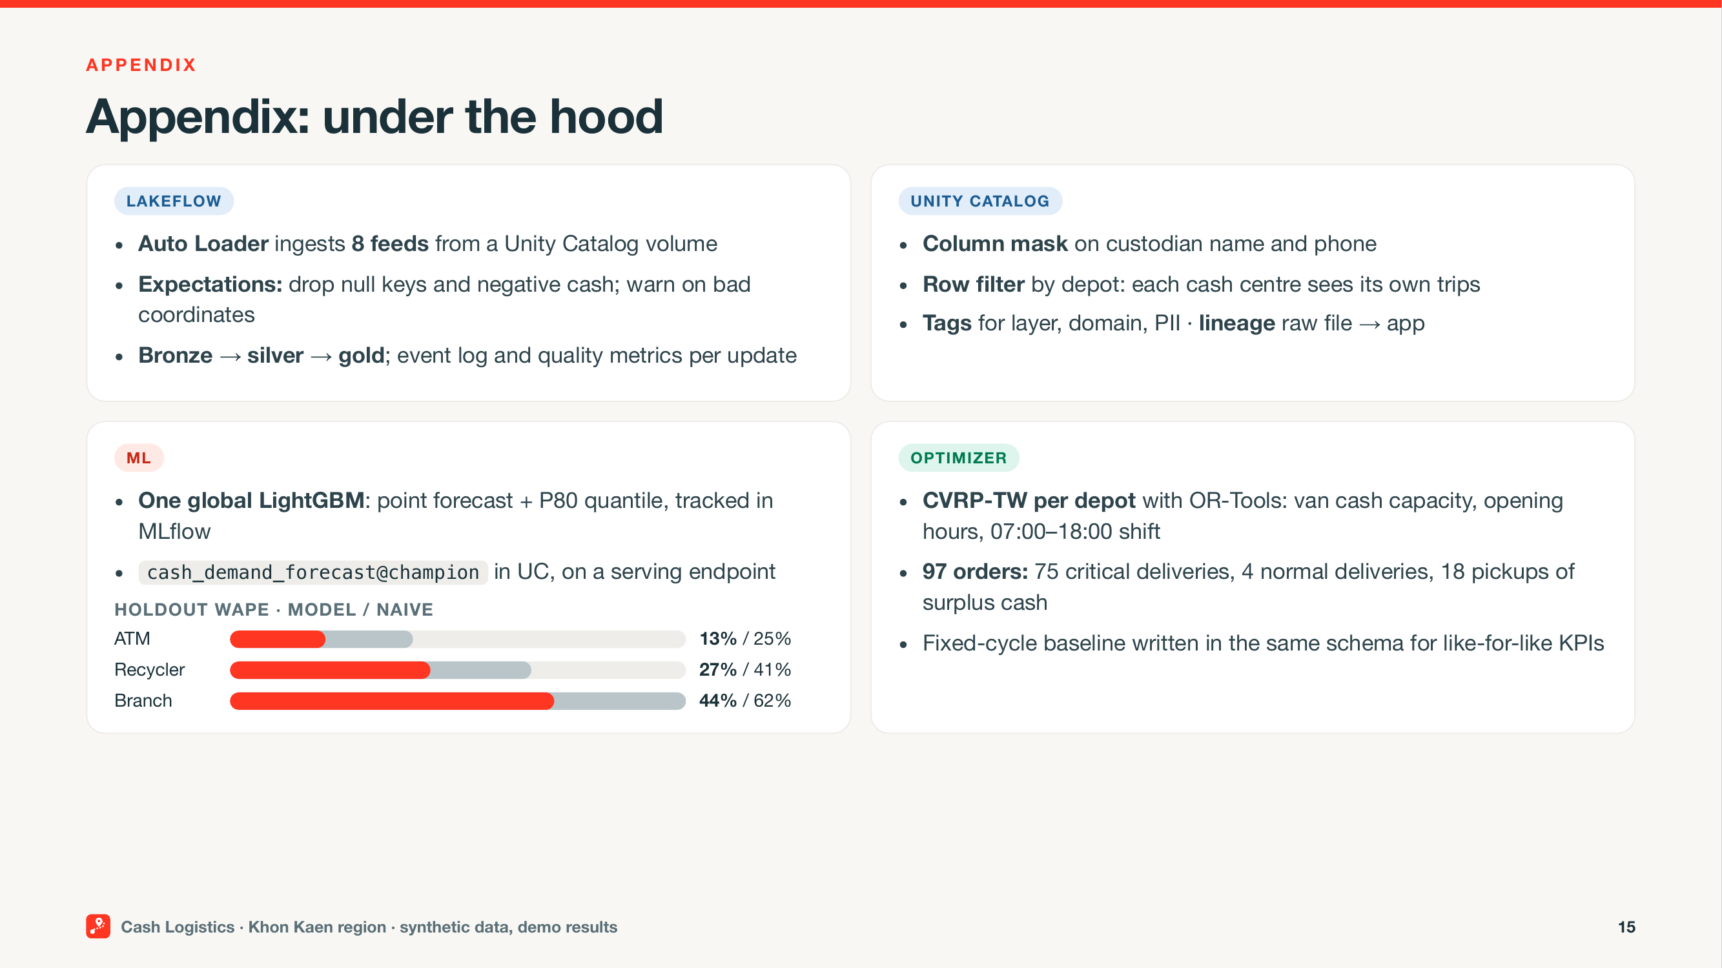
Appendix: under the hood
Notes:
SAY:
Shreya, here’s what sits underneath. Pipeline expectations reject bad records before planning. Custodian names and phone numbers are masked. Depot access is row-filtered, and lineage follows the data into the app. The forecast model is registered with a champion alias and served through a managed endpoint. The Asset Bundle keeps the pipeline, job, and app together. In the pilot, we’ll map those controls to your identity groups, add maker-checker and drift monitoring, and align deployment with your release process.
CLICK / CUE:
Appendix: use in Q&A.
TIME: Q&A only, as needed (18:00–26:00 window)

