Slide 1
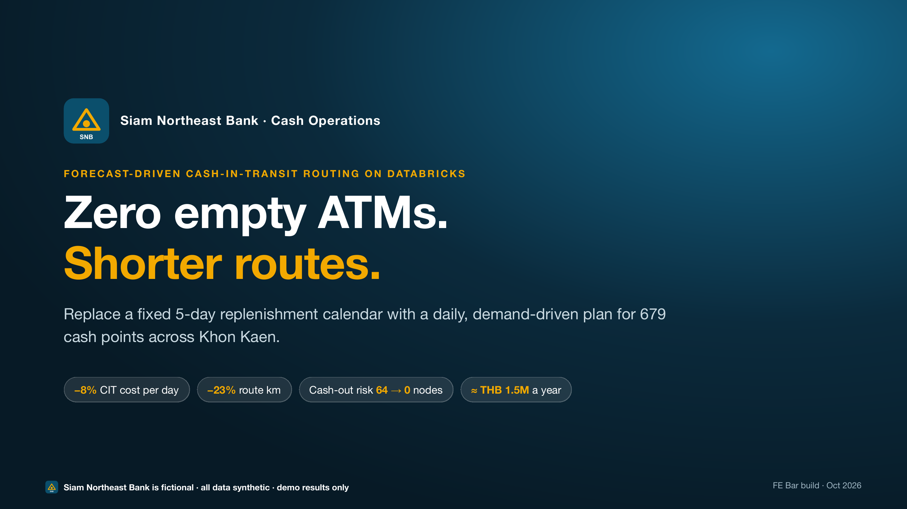
Zero empty ATMs. Shorter routes.
Notes:
SAY:
Good afternoon, Alex. Good afternoon, Shreya. Thanks for making the time. I've got about ten minutes of demo, first the business view, then how it works underneath, and then plenty of time for your questions. Does that work? The headline is simple: zero empty ATMs and shorter routes, by planning cash around demand instead of a calendar. Quick note: Siam Northeast Bank and all the data here are synthetic, so treat the numbers as indicative.
From the spoken script:
Good afternoon, Alex. Good afternoon, Shreya. Thanks for making the time.
Here's the plan. I've got about ten minutes of demo: first what it means for the business, then how it works underneath. Then I'd love to leave plenty of time for your questions, and we'll finish with next steps. Does that work for you both?
Before I show anything, two quick checks. Alex, is cash-out on payday still the biggest pain? And Shreya, anything you need to see on security that I should make sure I cover?
Great, I'll spend a bit more time on that.
CLICK / CUE:
Slide 1 on screen. Look at the people, not the slide.
Listen. Adapt
Then actually do it: more time in section 2 or 3 for Alex's pain, more in section 6 for Shreya's.
TIME: 0:00–2:00 (section 1, setup)

Slide 2
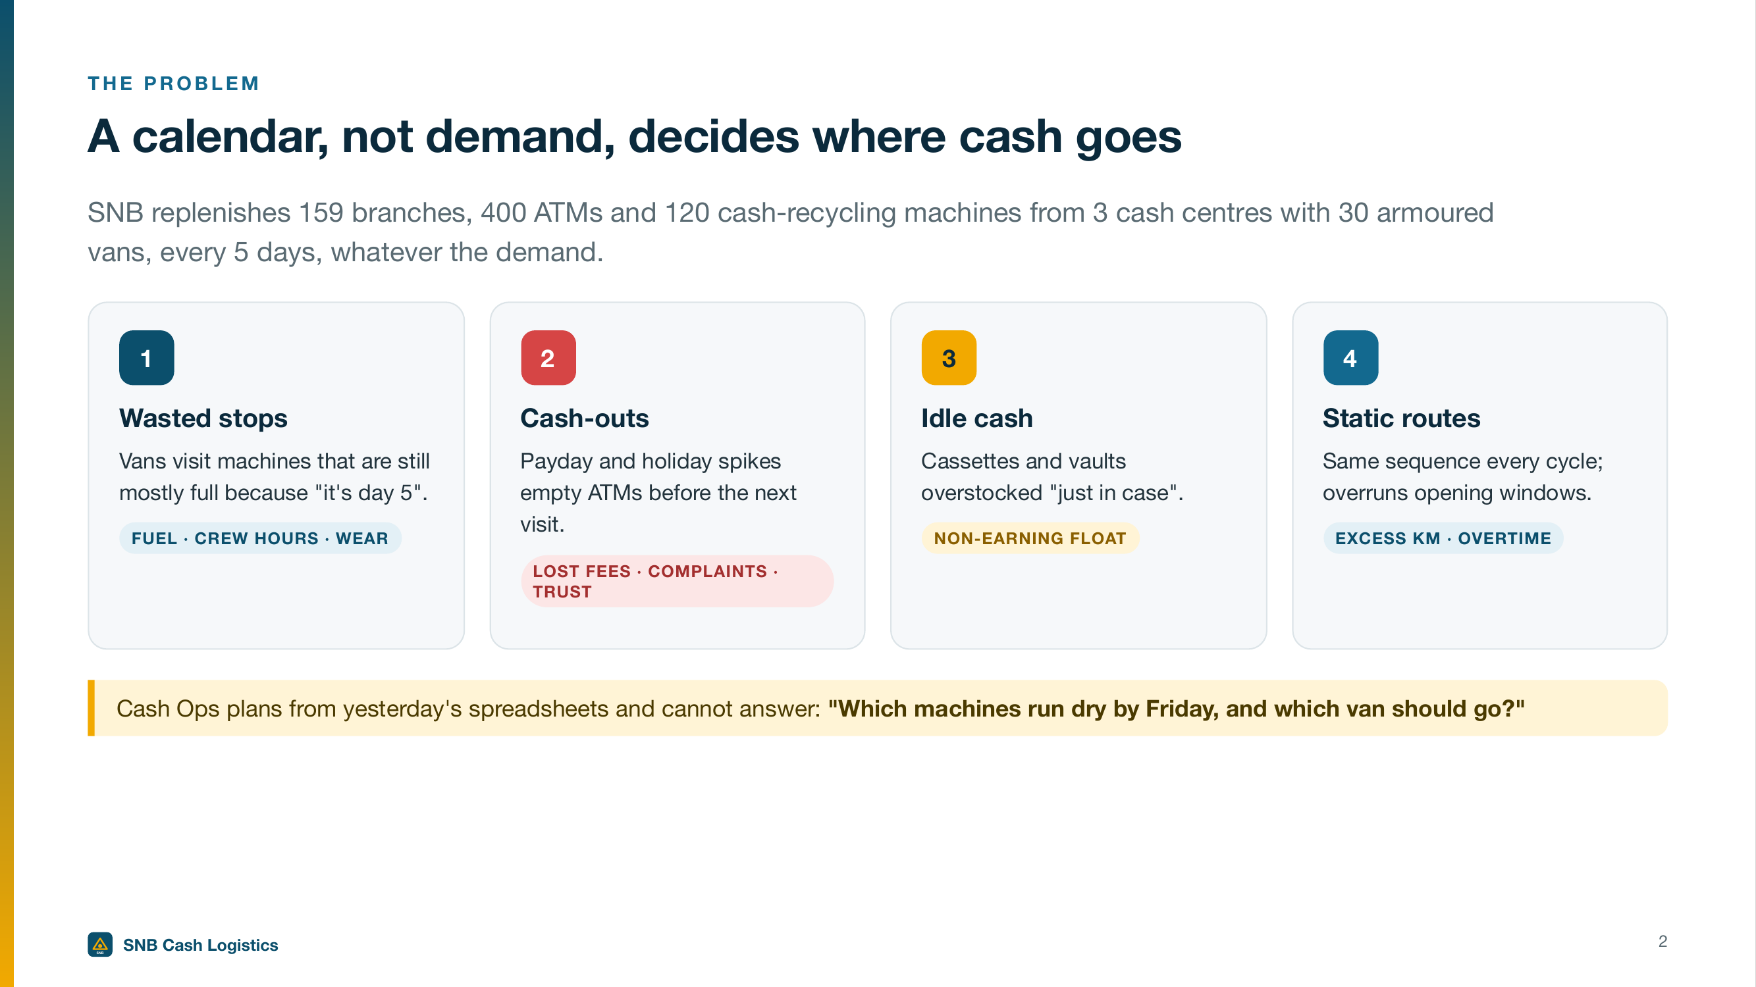
A calendar, not demand, decides where cash goes
Notes:
SAY:
Let me play back what I've heard. Siam Northeast Bank runs 159 branches, 400 ATMs and 120 cash recyclers from three cash centres with thirty armoured vans. Every one of them gets cash every five days, whatever the demand. Alex, that means vans stop at full machines, payday ATMs run dry, and cash sits idle just in case. Shreya, it means planning lives in spreadsheets you can't govern. Does that match what you're seeing?
From the spoken script:
So let me play back what I've heard. Siam Northeast Bank runs 159 branches and 520 cash machines across Khon Kaen. That's 400 ATMs and 120 cash recyclers, fed from 3 cash centres by 30 armoured vans. And every one of them gets cash every five days, whatever the demand.
CLICK / CUE:
None, stay on the slide.
TIME: 0:00–2:00 (section 1, setup)

Slide 3
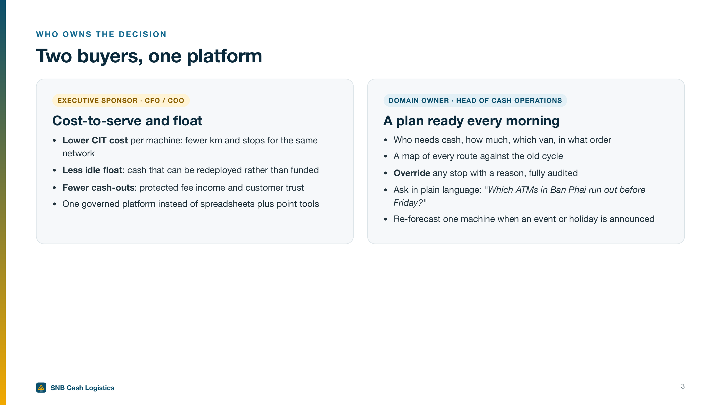
Two buyers, one platform
Notes:
SAY:
There are really two owners here. Alex, for you it's cost to serve, idle cash, cash-out incidents and customer trust, and a decision that doesn't put operations at risk. For your Cash Operations team, it's a plan ready every morning, a map against the old cycle, a way to override any stop with a reason, and plain-language answers. Shreya, the point for you is that it's one platform serving all of that, not a stack of point tools.
From the spoken script:
Alex, Shreya, you each care about different parts of this, so I'll show both. Alex, for you that calendar means three things. Vans stop at machines that are still full. Payday ATMs run dry before the next visit, and that's customer trust on the line. And cash sits idle in cassettes and vaults, just in case. Shreya, for you, it means planning lives in yesterday's spreadsheets, outside anything you can govern.
CLICK / CUE:
None, stay on the slide.
TIME: 0:00–2:00 (section 1, setup)

Slide 4
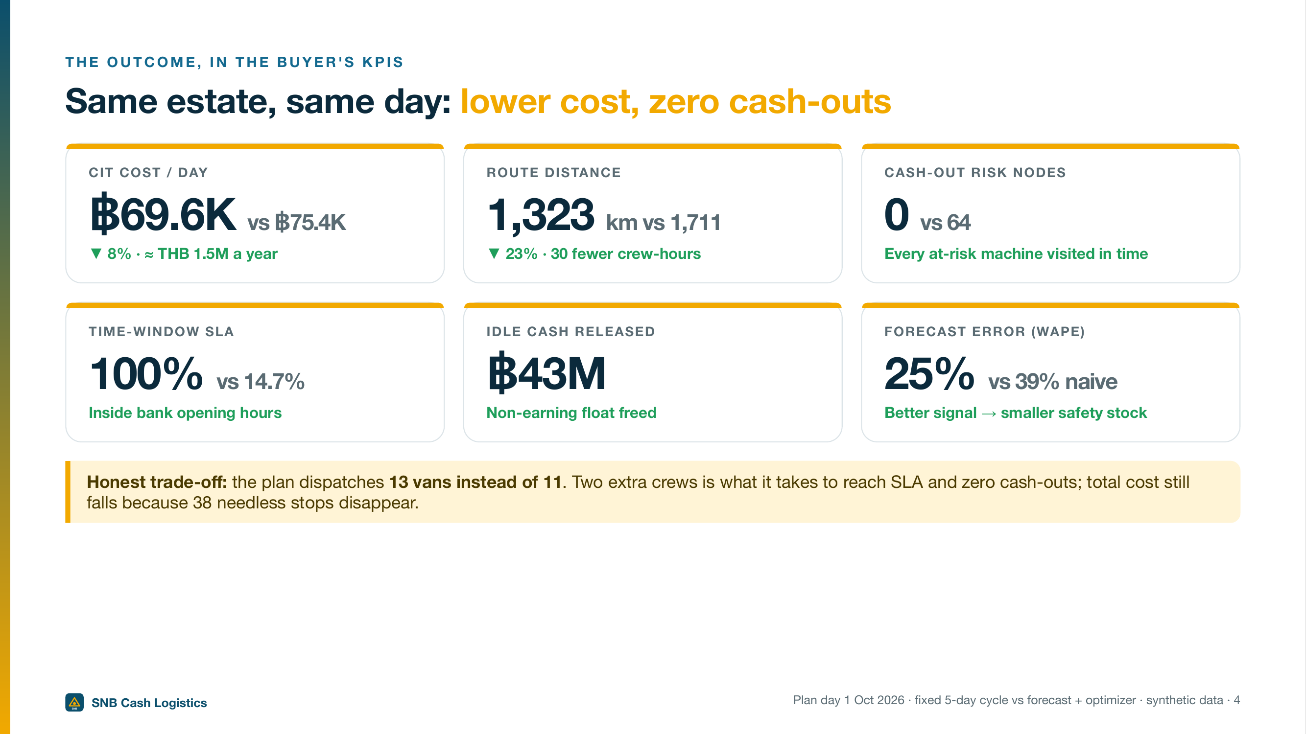
Same estate, same day: lower cost, zero cash-outs
Notes:
SAY:
Alex, here's where we'll end up. Same machines, same day. CIT cost drops from seventy-five thousand four hundred baht a day to sixty-nine thousand five hundred fifty. That's eight percent, about one and a half million baht a year. Route kilometres fall twenty-three percent. Machines at risk of running dry go from sixty-four to zero, and on-time goes from fifteen percent to a hundred. One honest point: the plan sends thirteen vans, not eleven. Two extra crews hit the time windows, and it's still cheaper because thirty-eight needless stops disappear.
From the spoken script:
Here's where we'll end up. Same machines, same day, a plan driven by demand instead of the calendar. Cash-in-transit cost drops from seventy-five thousand four hundred baht a day to sixty-nine thousand five hundred fifty. That's eight percent, or about one and a half million baht a year. Route kilometres fall twenty-three percent. And machines at risk of running empty go from sixty-four to zero.
One honest point up front: the new plan sends thirteen vans, not eleven. I'll explain why, because it's actually the good news. Quick note too: the bank and the data are synthetic, so treat the numbers as indicative.
Let me leave the slides and show you the real thing.
CLICK / CUE:
Bridge to the app
TIME: 0:00–2:00 (section 1, setup)

Slide 5
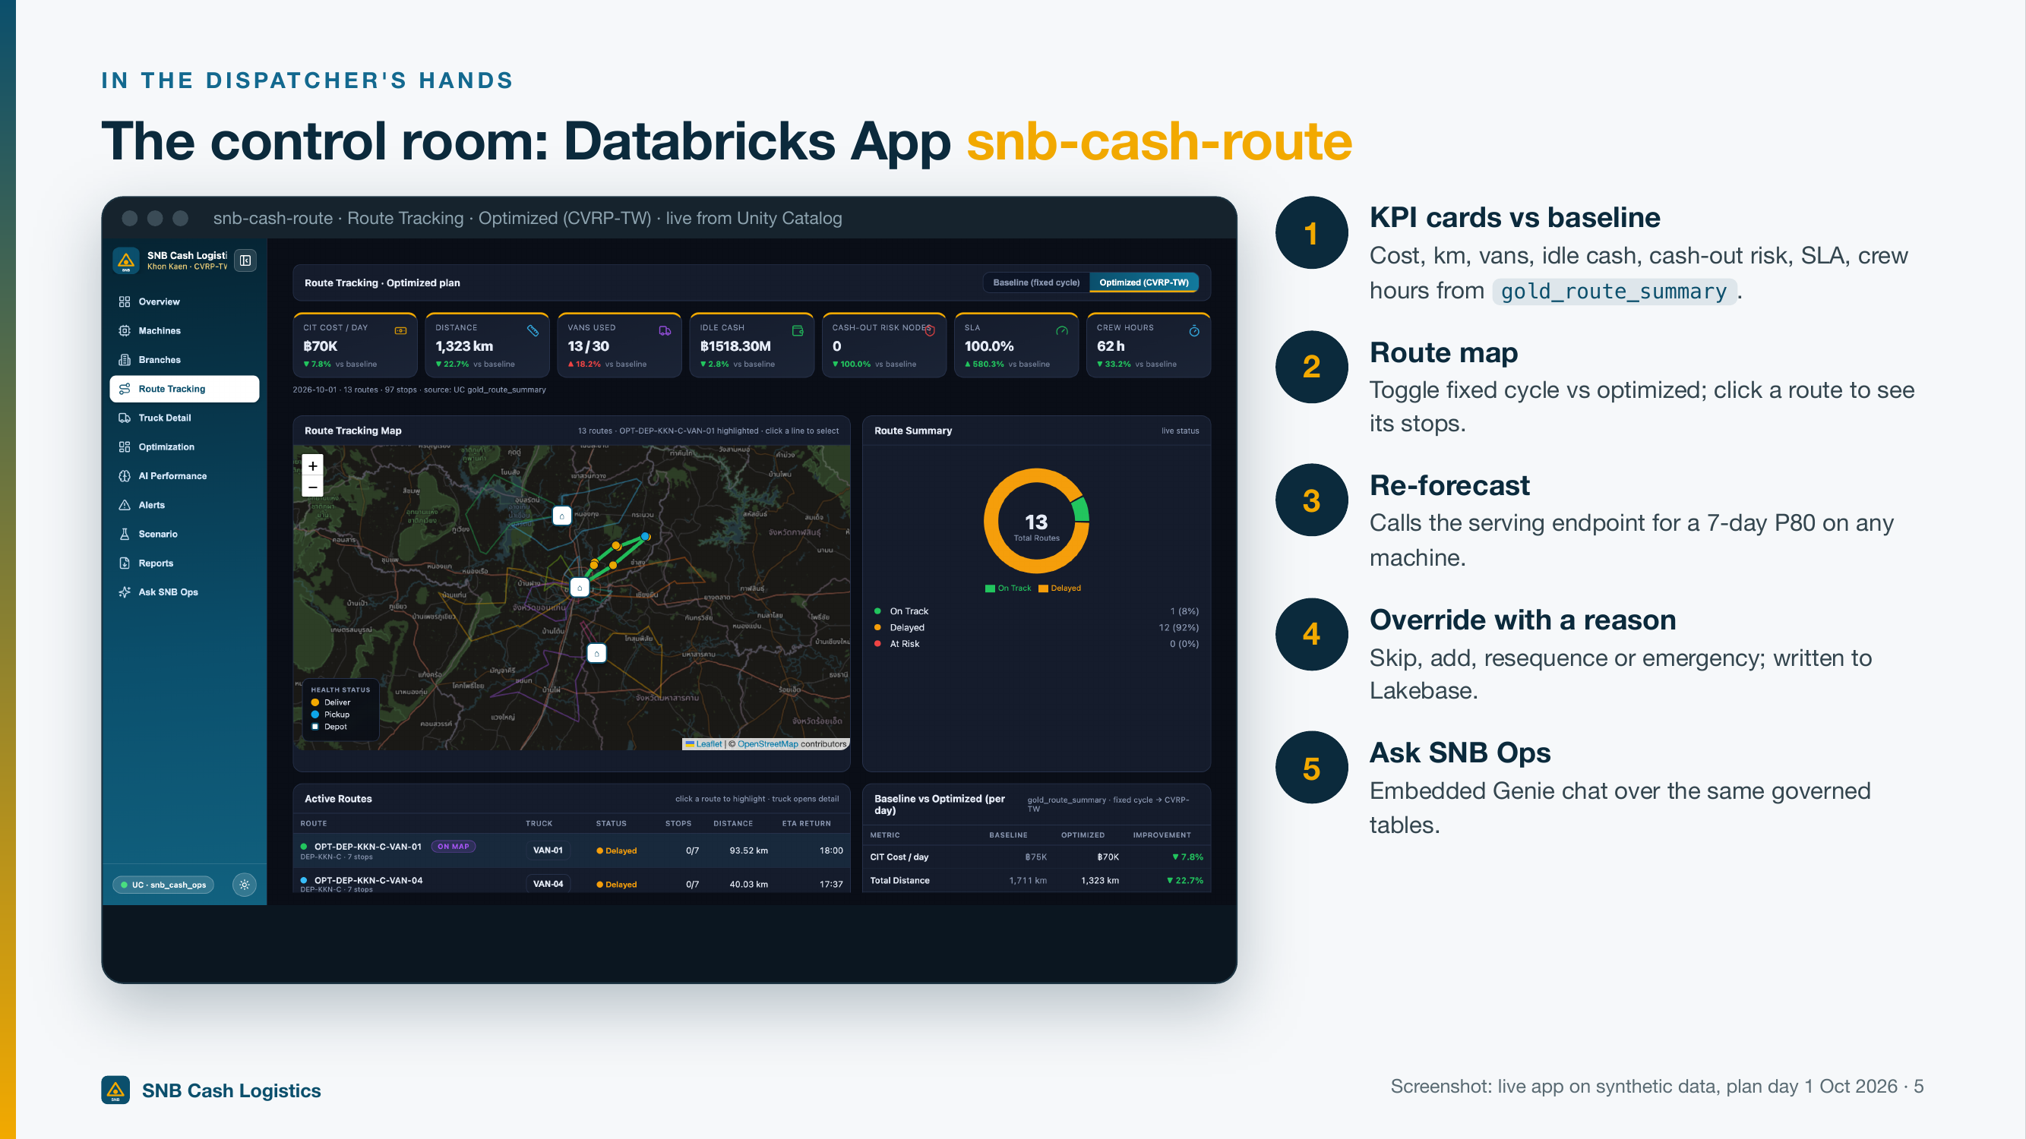
The control room: Databricks App snb-cash-route
Notes:
SAY:
This is the control room your dispatchers would use. The KPI cards up top show cost, kilometres, vans, idle cash and risk against the old cycle. The map toggles between the fixed cycle and the optimized plan. Pick any machine and re-forecast it live for the next seven days, with a busy-day band. Any stop can be skipped, added or resequenced with a reason, and that's saved for audit. And there's a built-in assistant to ask questions in plain words.
From the spoken script:
Backup if the app fails — say the section 2–4 lines while showing this.
[Section 2: Tomorrow's plan vs today's cycle (2:00–3:45) · App (backup: Slide 5)]
Alex, this one's for you. Let's look at what tomorrow costs and what it risks.
This is how the vans run today. Eleven routes, about seventeen hundred kilometres. And notice this: fewer than fifteen percent of stops land inside branch opening hours. Sixty-four machines are still at risk of running dry.
And this is the plan the platform built overnight from the forecast. Thirteen routes, about thirteen hundred kilometres. Every stop inside its time window. Zero machines at risk.
Look at the map. Instead of every van looping the whole province, each route sits tight around one cluster of machines. Each stop is there for a reason: how much cash, by when, and inside what window.
So why more vans, but lower cost? The old cycle looked cheap because it was skipping real demand. It also made thirty-eight stops nobody needed. Those disappear, from 135 stops down to 97. That pays for the two extra crews and then some. And on-time goes from fifteen percent to a hundred.
Alex, you said cost and cash-outs matter most. That's about one and a half million baht a year in CIT cost, forty-three million baht of idle cash freed up, and no machines left to run dry, with no new vans to buy.
[Section 3: Re-forecast a machine (3:45–4:45) · App (backup: Slide 5)]
Alex, you mentioned payday. That's exactly where the fixed cycle breaks. So let me show you how the plan knows a machine's about to run out.
That's the forecasting model, called live. See the "Model Serving, live" tag. The line is expected cash demand for the next seven days. The shaded P50 to P80 band runs up to a busy day. We fill to the busy day on purpose. Why? Because an empty ATM costs you far more than one extra cassette.
And that forecast is what the route optimizer turns into orders. On this plan day that's 97 orders: 75 critical deliveries, 4 normal deliveries, and 18 pickups of surplus cash.
Alex, here's why that protects customer trust. The model's error is twenty-five percent, against thirty-nine percent for the "same day last week" rule. Your team knows which machines need them before payday, instead of guessing.
[Section 4: Dispatchers stay in control (4:45–5:30) · App (backup: Slide 5)]
No plan survives the morning untouched. Your dispatchers know things the data doesn't. So let me show you how they push back.
Done. That decision's saved, with the reason and who made it.
Alex, that's what makes this a low-risk decision. Your people still make the call, and every change has an audit trail instead of a phone call or a chat message. Nothing moves cash without a human saying yes.
CLICK / CUE:
Click: Route Tracking, then the Baseline (fixed cycle) toggle.
Click: Optimized (CVRP-TW).
Point only at the KPI cards row (cost/day, distance, vans, idle cash, cash-out risk, SLA, crew hours) and the map. Don't point at the Route Summary donut or the route status labels; they're simulated live tracking. Ignore the card percentage deltas: the SLA card says "▲ 580.3%", so say "fifteen percent to a hundred" instead.
Click: Machines, then a row in the Machine Summary table, e.g. SNB-A0004 (Very High risk ATM). Scroll to the forecast panel at the bottom of the page and click Re-forecast.
Warm the endpoint before the session. Warm, the chart takes 5–8 seconds: fill it with "This is a busy ATM, and payday's coming." If it's cold (30–60 s): "The model scales to zero when nobody's using it, so the first call wakes it up. In production it stays warm before the morning run."
Click: Truck Detail. It opens on a Baseline route with every stop Completed, so switch to Optimized (CVRP-TW) first. Pick a pending stop (for example, the last stop on the route). In the overrides panel choose SKIP, type "Branch closed for renovation", then Submit override.
Point at the "Saved override #N → Lakebase" confirmation, not the BY field (it shows local-user when run locally).
TIME: 2:00–5:30 (sections 2–4, app demo)

Slide 6
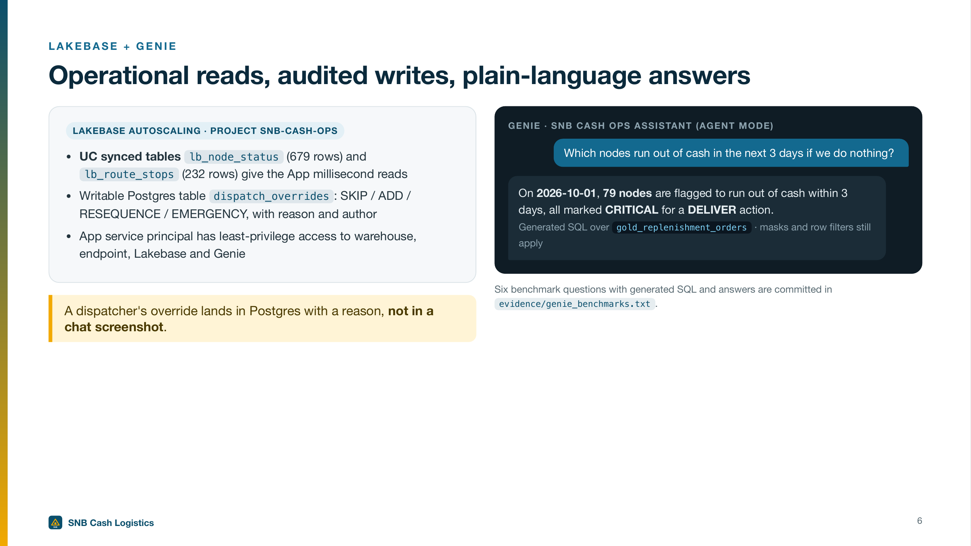
Operational reads, audited writes, plain-language answers
Notes:
SAY:
Two things make the app feel operational. The plan is served from a fast Postgres database, so the screen responds instantly, and dispatcher overrides are written back there with who made them and why. That's an audit trail, not a chat screenshot. Then the assistant. Ask it which machines run out of cash in the next three days if you do nothing, and it says seventy-nine, all flagged critical for delivery. It shows its query, and it respects the same access rules.
From the spoken script:
Backup if the app fails — say the section 5 lines while showing this.
Your team shouldn't need to raise a ticket just to ask a question. So let me ask the one that keeps Cash Ops up at night.
\
There's the answer, in plain words. Seventy-nine machines and branches will run out within three days, and every one is flagged critical for a delivery. And here's the query it ran, so it's not a black box.
Click: type
Same numbers you saw on the map. Seventy-five thousand four hundred down to sixty-nine thousand five hundred fifty. That's because it's the same data, not a separate report.
Alex, that's the early warning you'd want before a payday weekend, straight from the people who run the vans. Alex, does that answer the cost and cash-out question, or is there anything you'd want to see again?
That's the business view. Shreya, how does it actually work?
CLICK / CUE:
Click: Ask SNB Ops, then type: Which nodes run out of cash in the next 3 days if we do nothing?
It usually answers in about 12 seconds. If it goes past about 20: "While that's thinking, here's the answer from our test run," then read it from Slide 6 or evidence/genie_benchmarks.txt. Read the headline answer and open the SQL. Don't walk through the table's days-to-cashout column, and ignore any stray \
symbols in the text.
Optional, if time allows
Compare optimized versus baseline CIT cost and km for 2026-10-01.
Wait for the answer. Then the handoff
TIME: 5:30–6:45 (section 5, Ask SNB Ops)

Slide 7
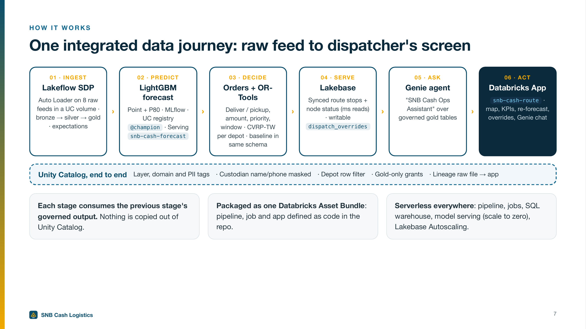
One integrated data journey: raw feed to dispatcher's screen
Notes:
SAY:
Shreya, this one's for you. Here's the journey from raw feed to the dispatcher's screen, in six steps. Ingest eight raw feeds with quality rules. Predict cash demand per machine. Turn that into delivery and pickup orders and solve the routes. Serve the plan from a fast operational database. Let people ask questions in plain language. And put it all in one app. The key point: one governance layer runs underneath every step, so you secure the data once.
From the spoken script:
Backup for the workspace tabs — say the section 6 lines while showing this.
Shreya, I know you'll want to see what's under the hood. You'd be the one running this, so let me show why it's one governed platform, not five tools taped together. Three stops: the pipeline, the governance, and the model.
CLICK / CUE:
None, stay on the slide.
TIME: 6:45–9:30 (section 6, under the hood)

Slide 8
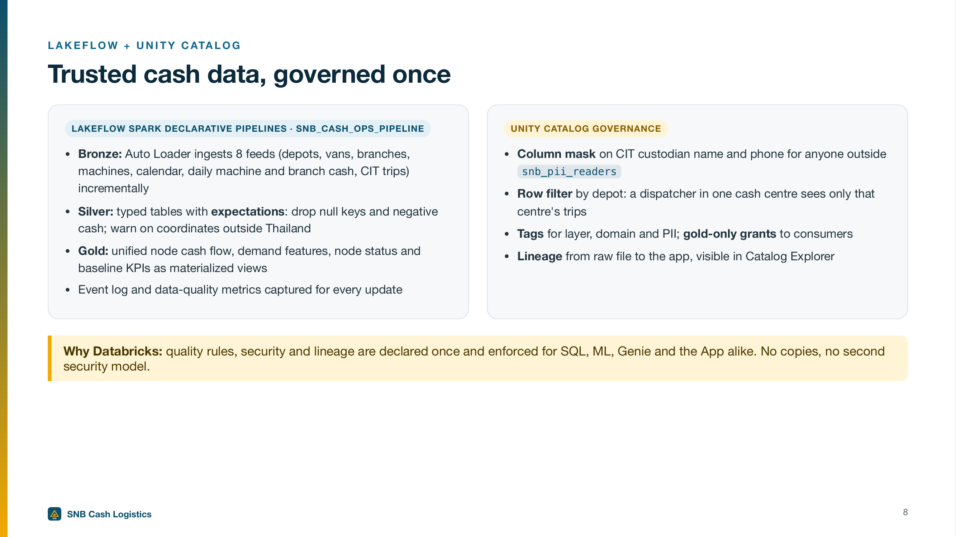
Trusted cash data, governed once
Notes:
SAY:
Shreya, this is how the data stays trustworthy. A declarative pipeline loads the eight feeds incrementally, and the quality rules drop records with missing IDs or negative cash before anything downstream sees them. Every update logs what it dropped. On the governance side, custodian names and phone numbers are masked for anyone outside the PII readers group, and a row filter means each cash centre only sees its own trips. Lineage shows the whole path to the app.
From the spoken script:
Backup for the workspace tabs — say the section 6 lines while showing this.
Eight raw feeds land in a governed volume and load incrementally. These quality rules drop bad records, like negative cash or missing IDs, before anything downstream sees them. And every update logs how many rows it dropped, so if one of your feeds is bad, you'll know on day one. That's your reliability story. And on integration: today these are files. In the pilot we'd point the same pipeline at your ATM switch, vault and van feeds, and nothing downstream has to change.
You asked about security. Custodian names and phone numbers are tagged as personal data and masked. And here, a row filter means each cash centre sees only its own trips. The assistant Alex just saw respects the same rules.
And this is the full path, from raw file to the table the app reads. When something looks wrong, you can trace it.
CLICK / CUE:
Click: Lakeflow pipeline snb_cash_ops_pipeline.
Click: Catalog Explorer, silver_vehicles, then silver_cit_trips.
Click: Lineage on gold_route_stops.
TIME: 6:45–9:30 (section 6, under the hood)

Slide 9
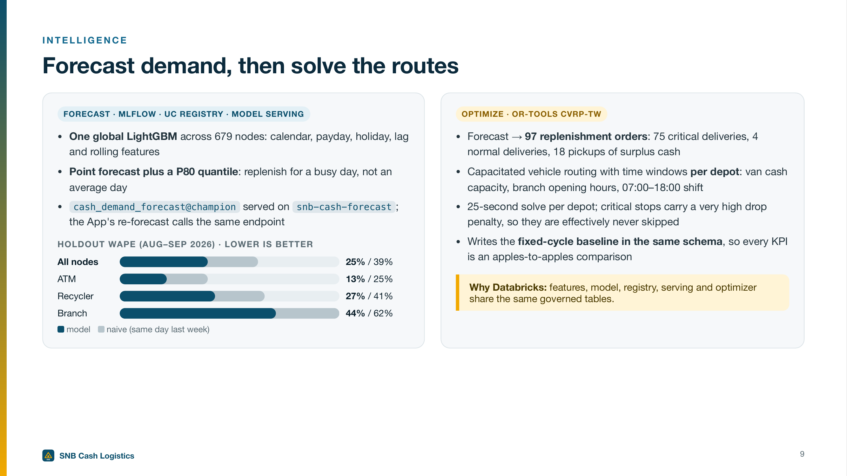
Forecast demand, then solve the routes
Notes:
SAY:
Two steps here. First, one forecasting model across every machine, using calendar, payday and holiday signals. We plan to a busy day, not an average one, because an empty ATM costs more than an extra cassette. Its error is twenty-five percent against thirty-nine for a same-day-last-week rule. Second, the forecast becomes ninety-seven orders: seventy-five critical deliveries, four normal deliveries and eighteen pickups. The route optimizer then fits them into van capacity and branch time windows.
From the spoken script:
Backup for the workspace tabs — say the section 6 lines while showing this.
The model's tracked, registered in Unity Catalog as champion, and served here. The overnight plan and that Re-forecast button use the same model.
Shreya, that's governance, security and operability in one place. One security model across SQL, machine learning, the assistant and the app. All serverless, so it scales without you managing clusters, and all defined as code in one bundle on open formats, so there's no lock-in trap and no second copy of the data to secure. Shreya, anything there you'd want to dig into?
Great question. Let me note that and come back to it in Q&A.
That's the demo. I'd love to hear what's on your minds. Alex, Shreya, what questions do you have?
CLICK / CUE:
Click: MLflow experiment, then model cash_demand_forecast@champion, then endpoint snb-cash-forecast.
Wait. If it's deep detail, park it
Bridge to Q&A
TIME: 6:45–9:30 (section 6, under the hood)

Slide 10
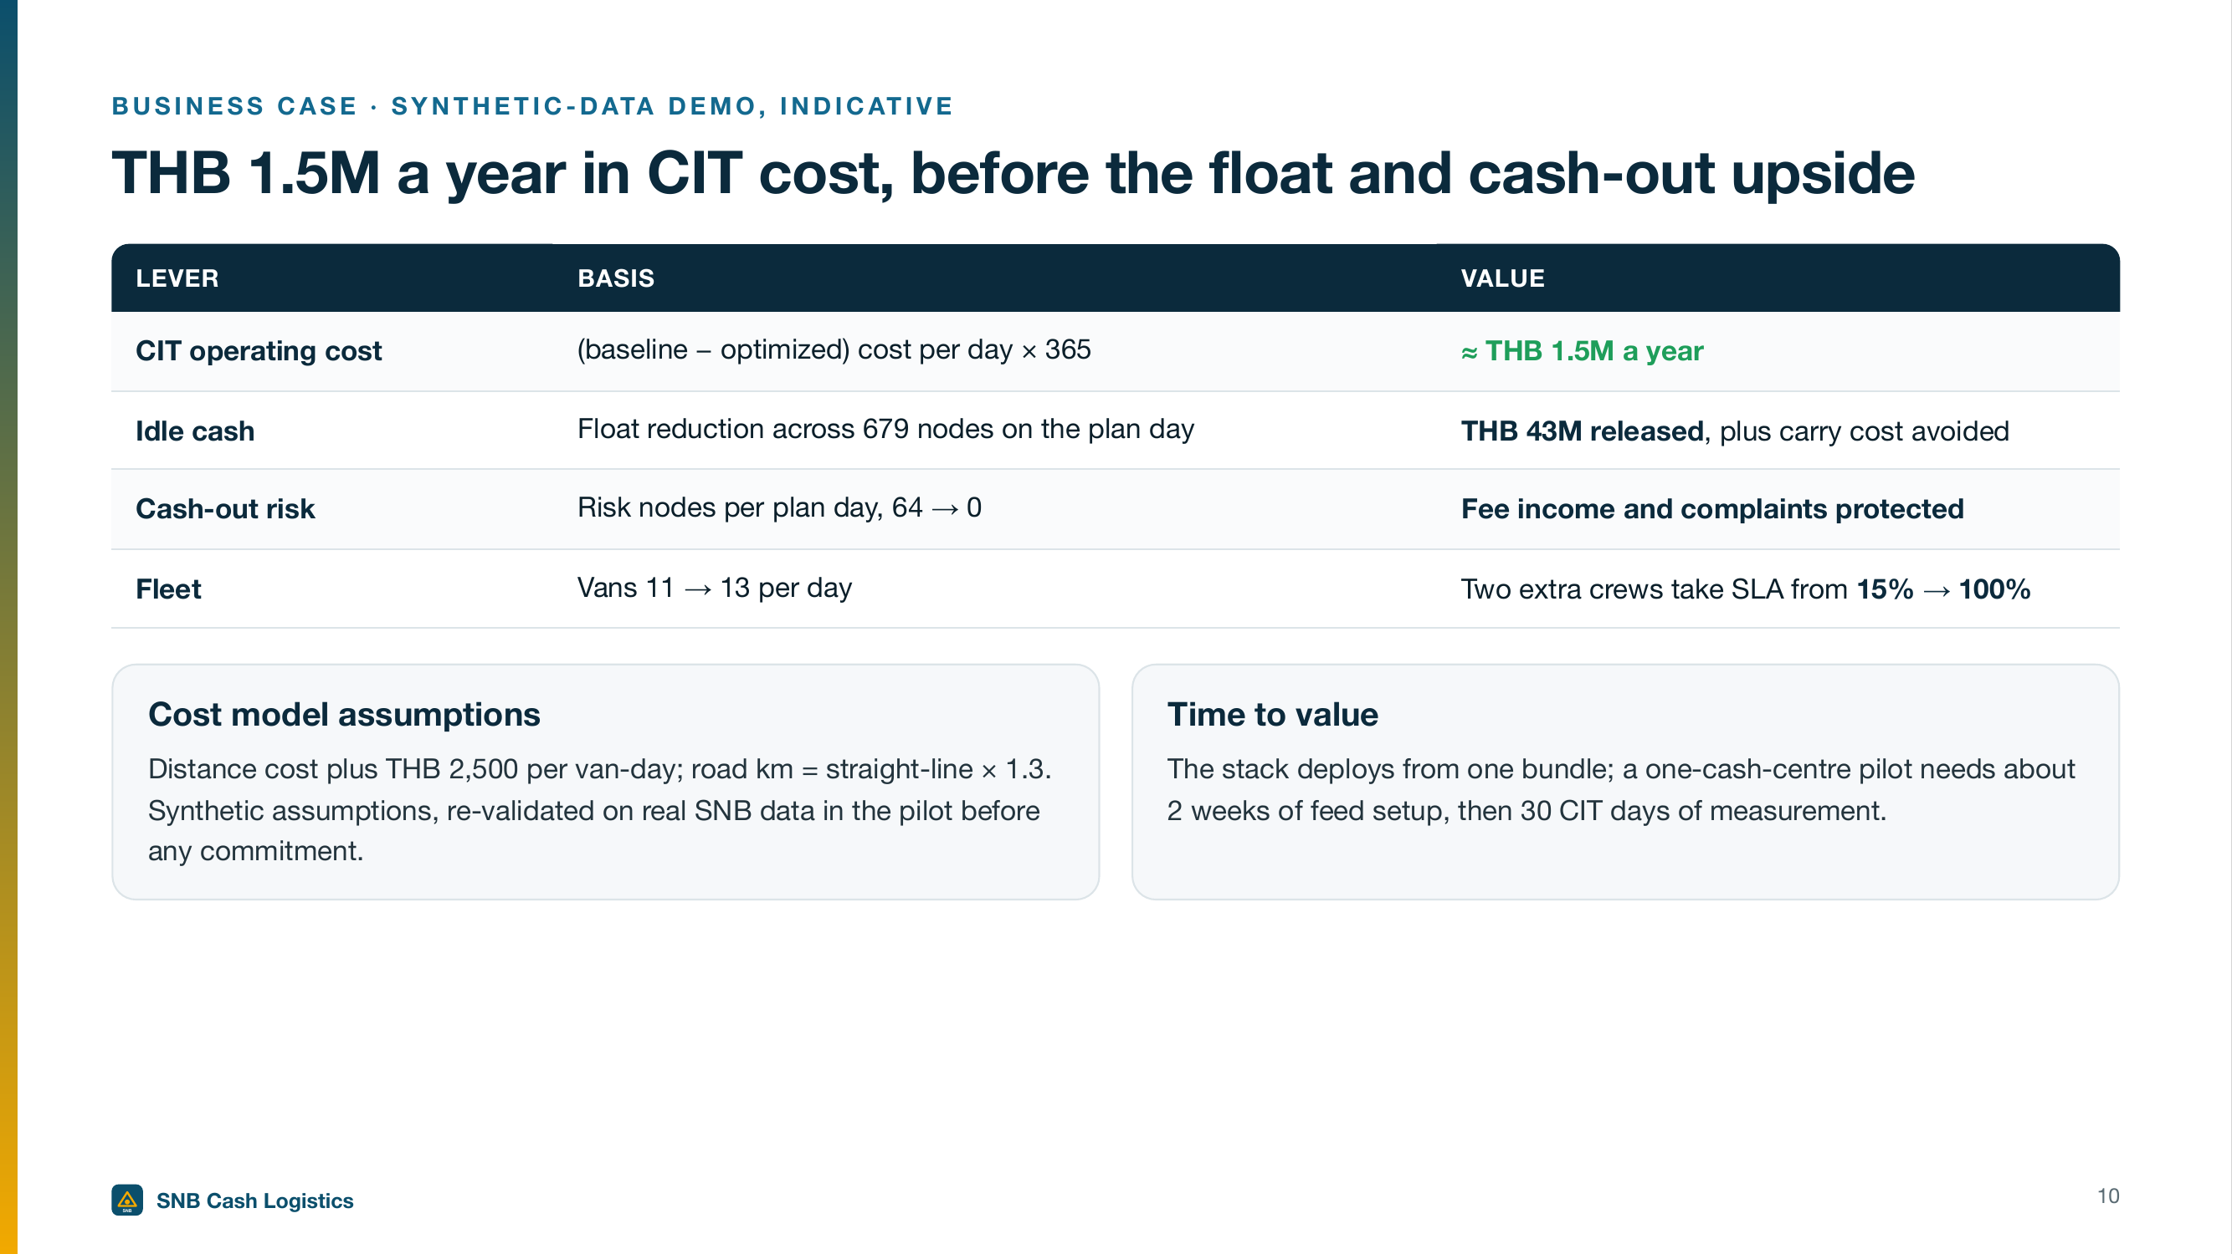
THB 1.5M a year in CIT cost, before the float and cash-out upside
Notes:
SAY:
Let me bring it back to what you both told me matters. Alex, for you: about one and a half million baht a year in CIT cost, forty-three million baht of idle cash freed, and no machines left to run dry on the plan day. Yes, it's thirteen vans instead of eleven, and that's what buys a hundred percent on-time. Shreya, for you: one governed, secure platform your team can run, on open formats and defined as code. These are synthetic assumptions, so we'd re-check them on your data first.
From the spoken script:
Let me bring it back to what you both told me matters.
Alex, for you: about one and a half million baht a year in CIT cost, forty-three million baht of idle cash freed, and no machines left to run dry on payday.
Shreya, for you: one governed, secure platform your team can run, built from open formats and defined as code.
CLICK / CUE:
None, stay on the slide.
TIME: 25:00–30:00 (section 7, close)

Slide 11
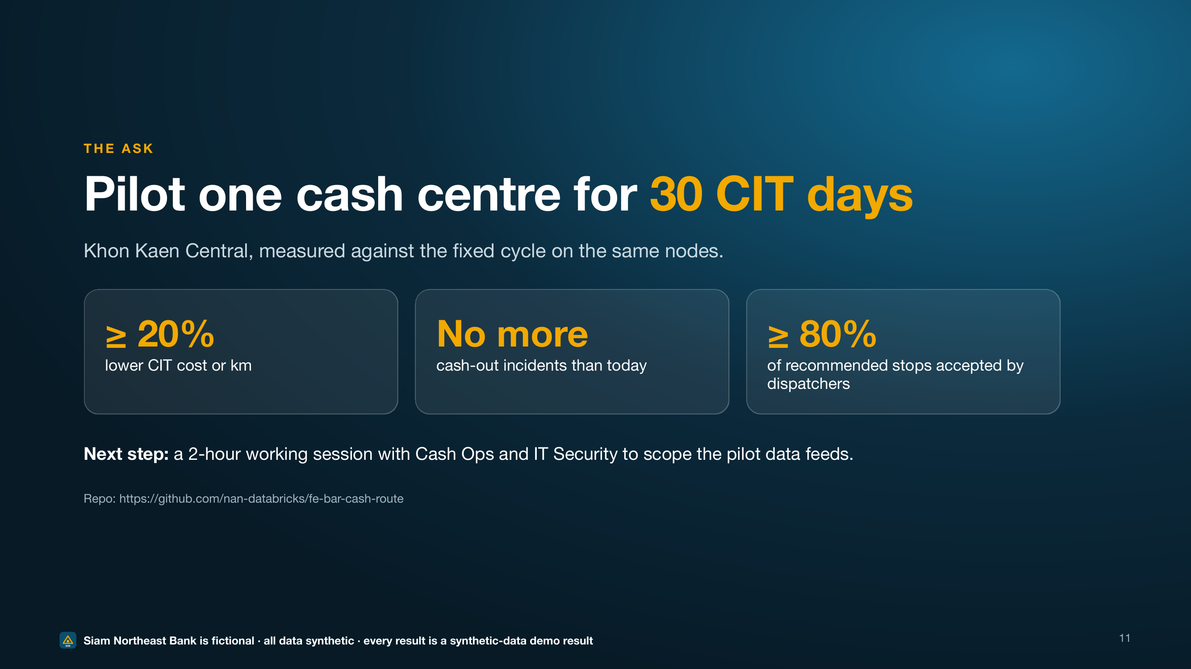
Pilot one cash centre for 30 CIT days
Notes:
SAY:
This is synthetic data, so I don't want you to take it on trust. My proposal is a thirty-day pilot in Khon Kaen Central, measured against today's cycle on the same machines. It's a win if CIT cost or kilometres fall at least twenty percent, cash-outs are no higher, and dispatchers accept at least eighty percent of recommended stops. Alex, could you sponsor a two-hour scoping session next week with your Cash Ops lead? Shreya, could you bring someone from IT Security to agree the feeds and access model? What would you need to see to say yes?
From the spoken script:
Now, this is synthetic data, so I don't want you to take it on trust. Here's what I'd propose. A thirty-day pilot in Khon Kaen Central, measured against today's cycle on the same machines. We'd call it a win if three things are true. CIT cost or kilometres fall by at least twenty percent. Cash-outs are no higher than today. And your dispatchers accept at least eighty percent of the recommended stops. It runs alongside today's process, humans confirm every plan, and the fixed cycle stays as the fallback. So the risk stays small.
So, a concrete next step. Alex, could you sponsor a two-hour scoping session next week with your Cash Ops lead? And Shreya, could you bring someone from IT Security, so we can agree the data feeds and the access model?
What would you need to see to say yes to the pilot?
CLICK / CUE:
Stop. Let them answer. Fuller objection handling is in roleplay_prep.md.
TIME: 25:00–30:00 (section 7, close)

Slide 12
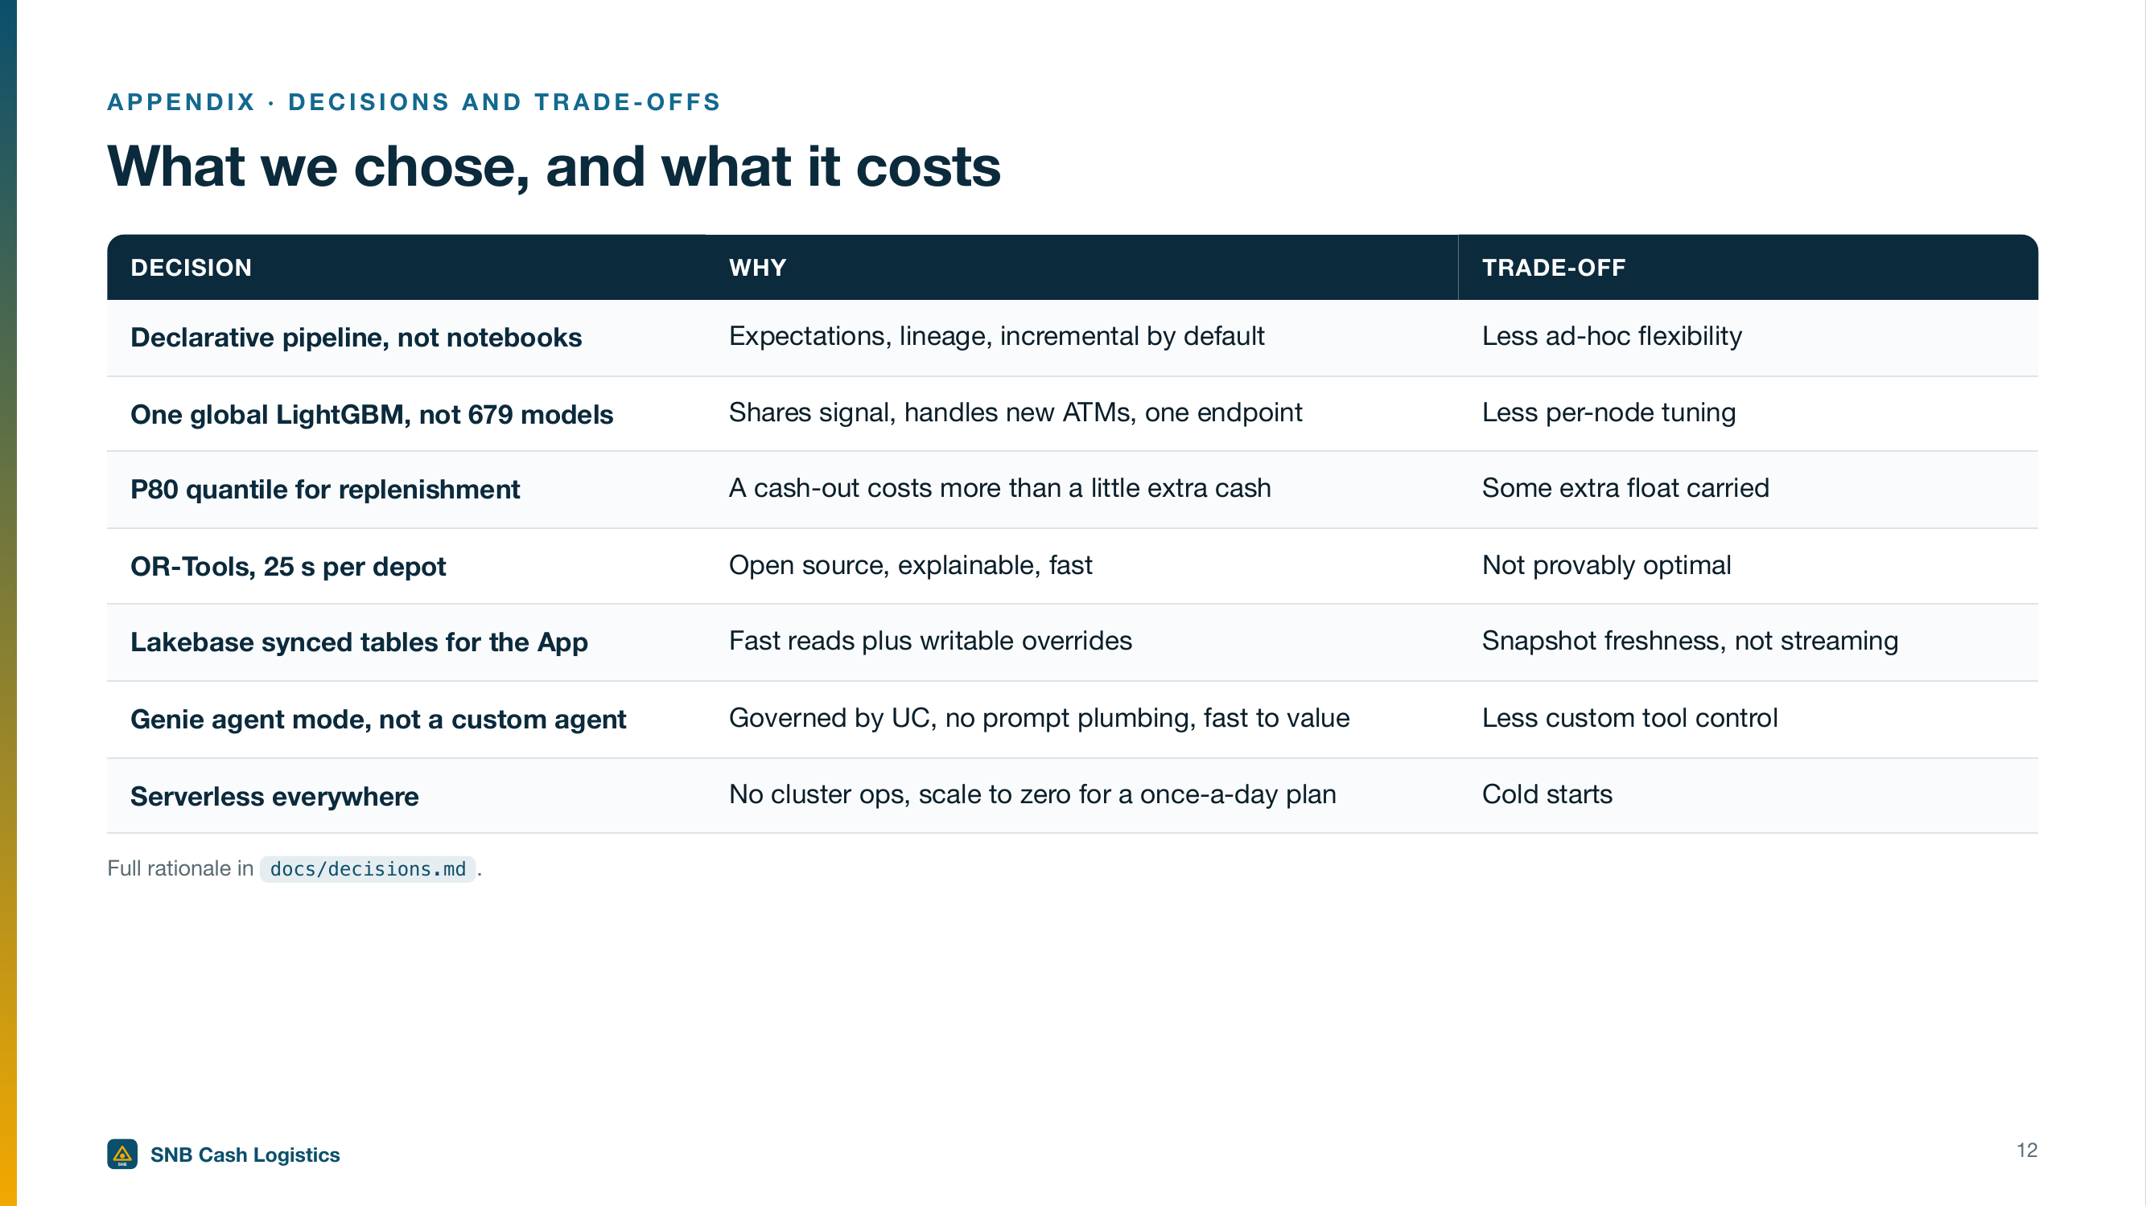
What we chose, and what it costs
Notes:
SAY:
I want to be upfront about the choices we made and what each one costs. A declarative pipeline gives us quality rules and lineage, but it's less ad hoc. One shared forecasting model handles new ATMs well, but it's less tuned per machine. Planning to a busy day carries a little extra cash. The open-source route optimizer is fast and explainable, but not provably optimal. None of these are hidden, and the pilot tests each one on your real data.
CLICK / CUE:
Appendix: use in Q&A
TIME: 12:00–25:00 (Q&A window, as needed)

Slide 13
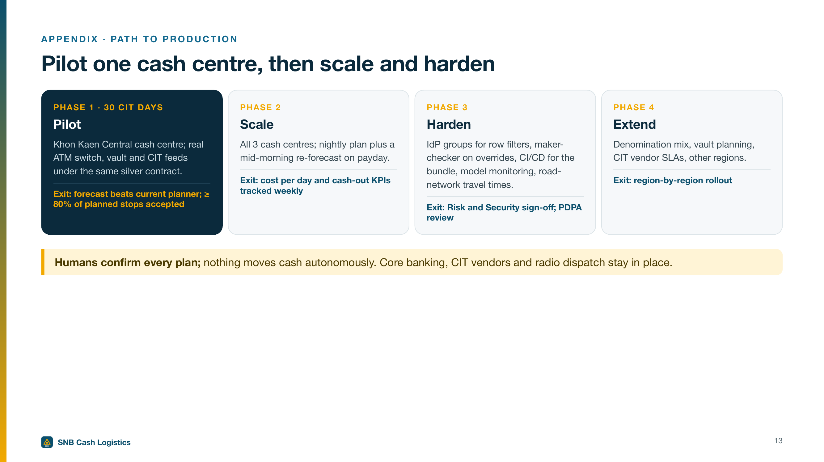
Pilot one cash centre, then scale and harden
Notes:
SAY:
Alex, Shreya, if the pilot works, here's the path. Start with thirty CIT days in one cash centre, Khon Kaen Central, on your real ATM, vault and van feeds. Then scale to all three centres, with a mid-morning re-forecast on payday. Then harden it: your identity groups for access rules, maker-checker on overrides, monitoring, real road travel times, and a Risk, Security and PDPA review. Each phase has a clear exit test before we move on.
CLICK / CUE:
Appendix: use in Q&A
TIME: 12:00–25:00 (Q&A window, as needed)

Slide 14
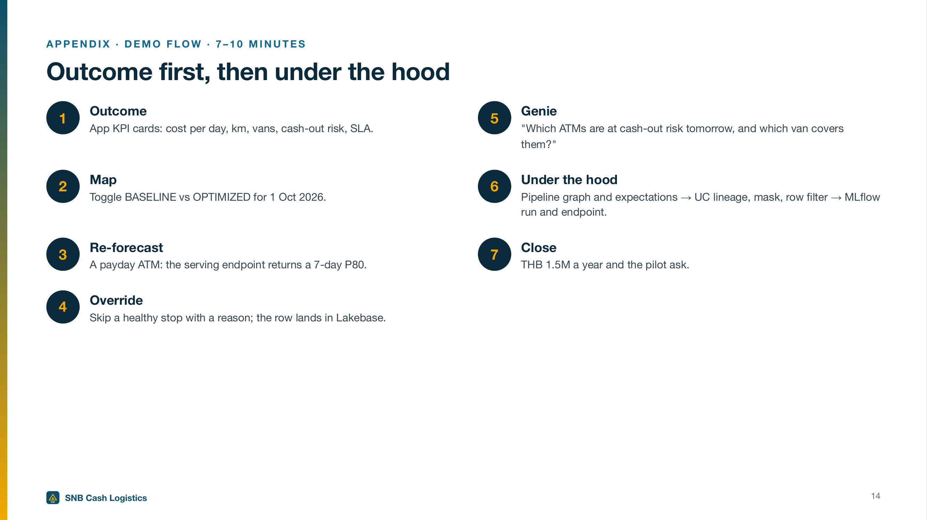
Outcome first, then under the hood
Notes:
SAY:
Here's how I'll walk you through it. Outcome first: the cost and risk numbers. Then the map, old cycle against the new plan. Then a live re-forecast on a payday machine, a dispatcher override, and a question to the assistant. After that, ninety seconds under the hood for your architect. And I'll close with the business case and a concrete pilot proposal.
CLICK / CUE:
Appendix: use in Q&A
TIME: 12:00–25:00 (Q&A window, as needed)

