Slide 1
Linux Kernel Panic Debug
Jacky Zhu 2017-11-17

Slide 2
Outline
Android device crash types
How to get kernel panic log
How to catch ramdump
How to parse ramdump
How to analyze panic log
Case sharing for kernel panic debug on CT60

Slide 3
Android device crash types
APP crash
app force close
System server crash
android reboot
Native service crash
process exit or restart
Kernel crash
device reboot
Subsystem crash
subsystem restart or device reboot

Slide 4
How to get kernel panic log
UART log
Serial tool
pstore log (last log)
cat /sys/fs/pstore/console-ramoops-0
HXLogger
/storage/IPSM/logger
Ramdump
Qualcomm QPST Tool / QCAP Tool

Slide 5
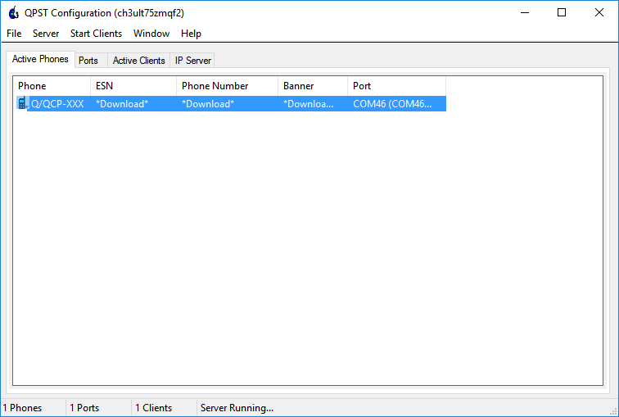
How to catch ramdump
echo 1 > /sys/module/msm_poweroff/parameters/download_mode
QPST tool
How to trigger a kernel crash:
echo c > /proc/sysrq-trigger

Slide 6
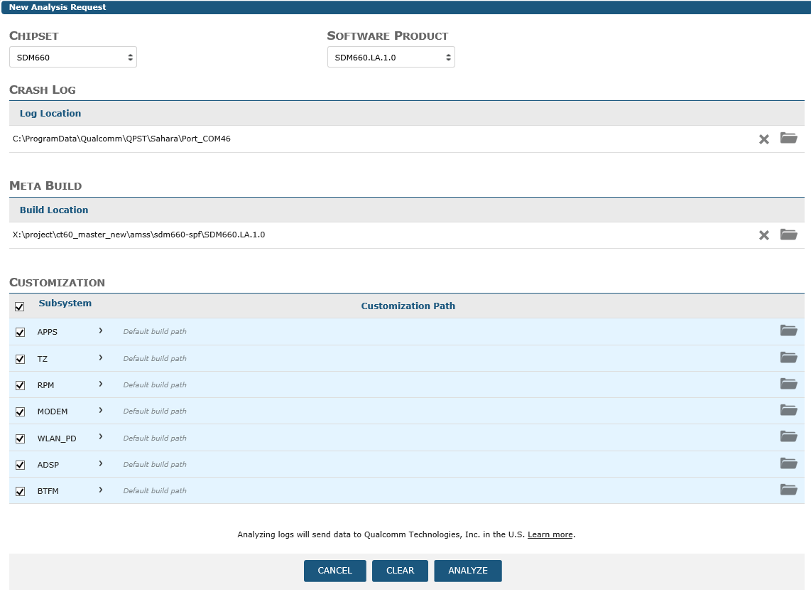
How to parse ramdump
https://cap.qti.qualcomm.com/default.aspx

Slide 7
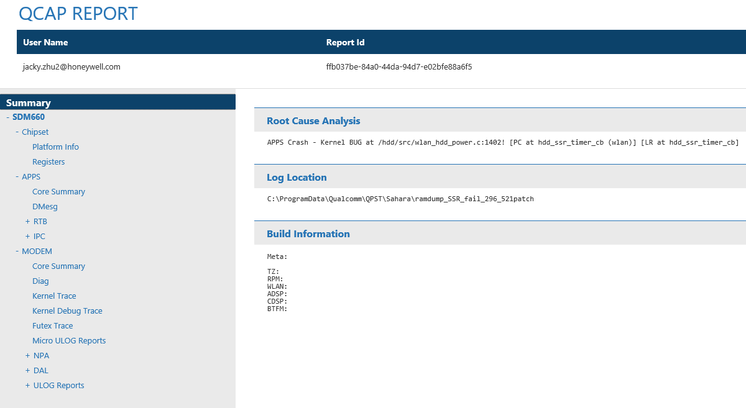
How to parse ramdump

Slide 8
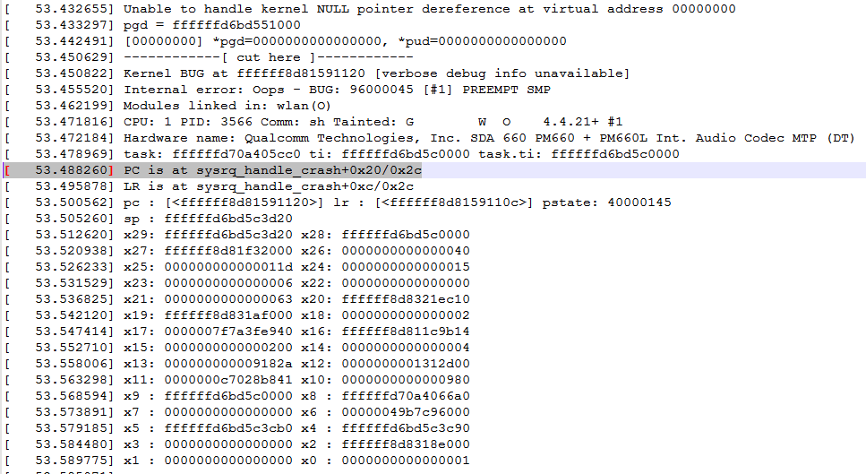
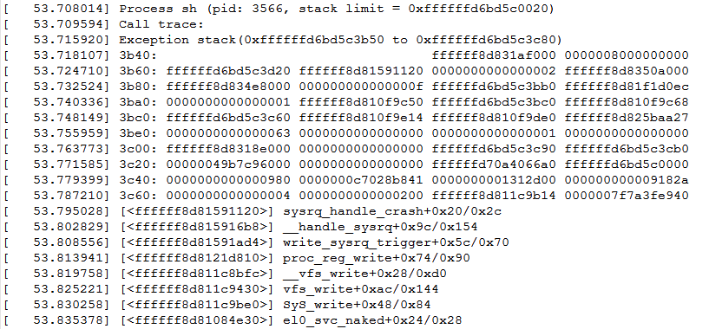
How to analyze kernel panic
Details by demo

Slide 9
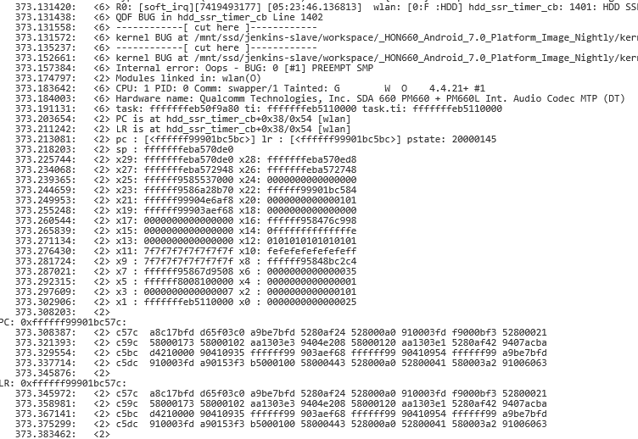
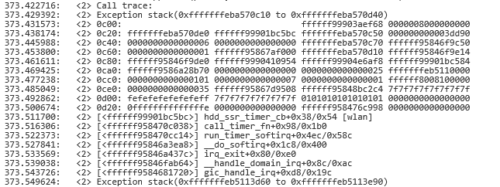
How to analyze kernel panic
Details by demo

Slide 10
Case sharing for kernel panic debug on CT60
Will demo directly …

Slide 11


