Slide 1
Linux Bash 脚本
cjzang
2017-9

Slide 2
Agenda
Why need shell script
How to write the script
Q&A

Slide 3
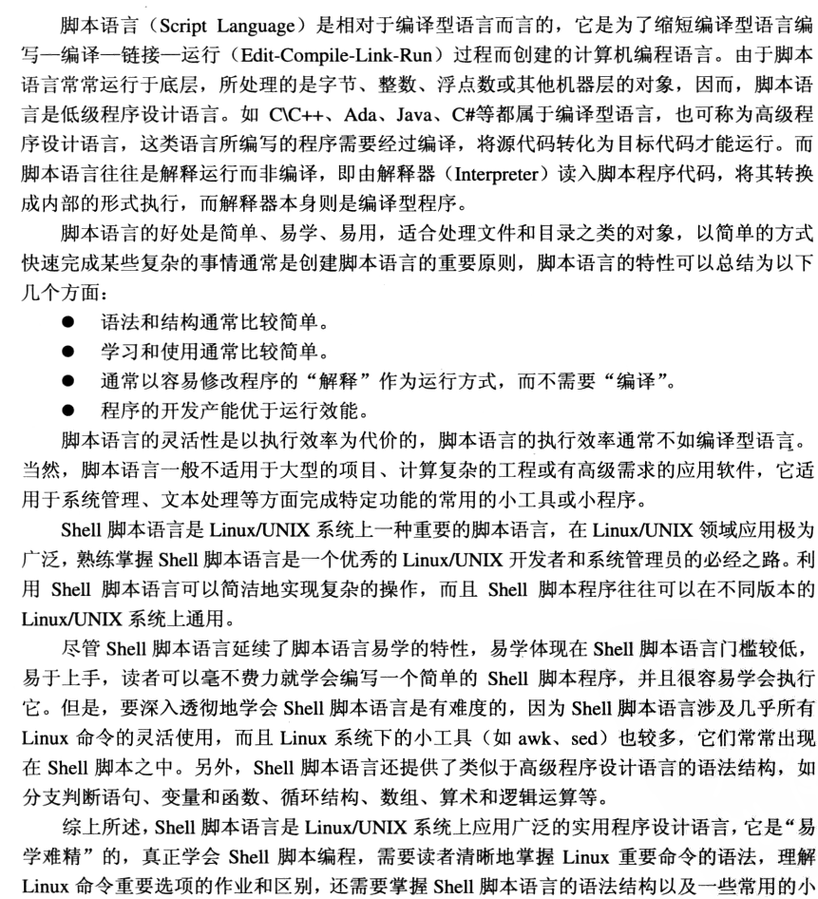
Why need shell script?

Slide 4
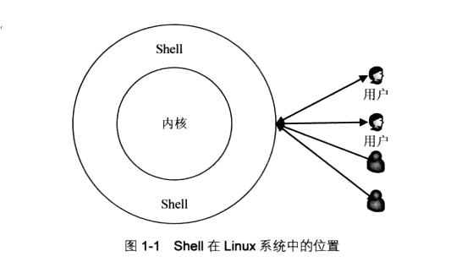

Slide 5
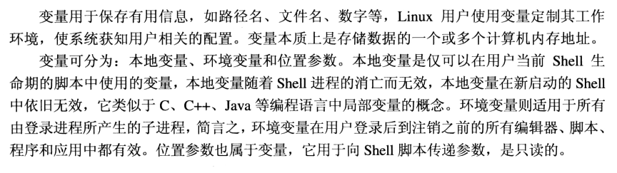
How to write shell scripte, variable define

Slide 6
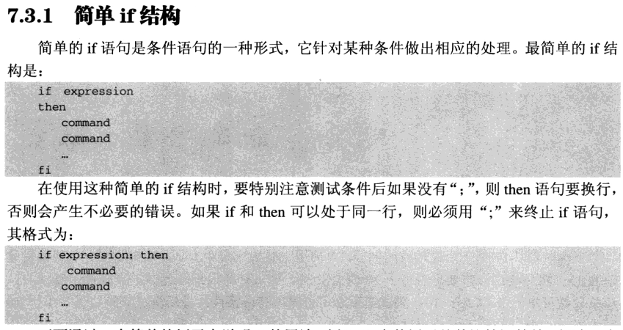
If else conditon

Slide 8
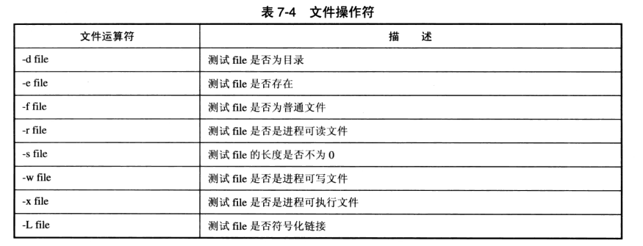
condition

Slide 9
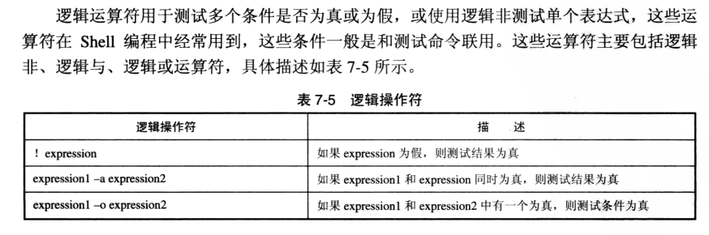

Slide 10
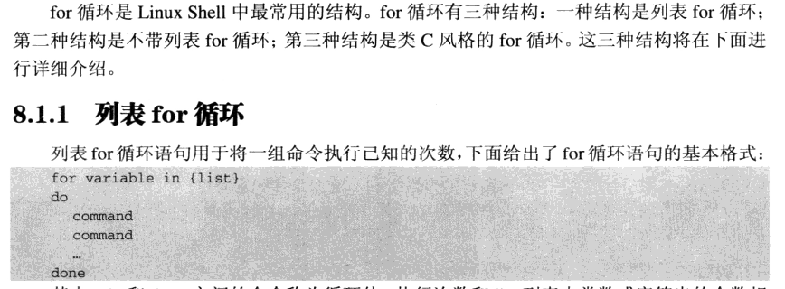

Slide 11
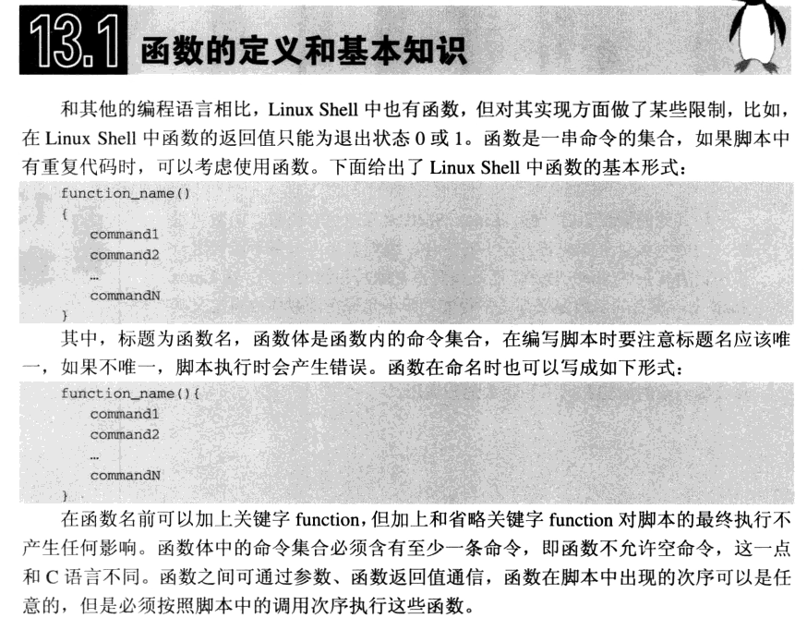
Function define

Slide 12
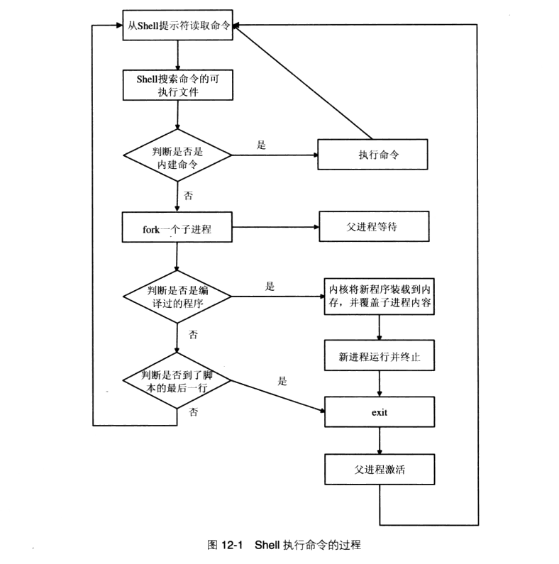
principle

Slide 13


