Slide 1
Project Report
Member:
-Đinh Vũ (Team leader)
-Hồ Lý Thái
-Ngô Văn Duy
-Đào Ngọc Long
-Trần Hùng Sơn
Team POSITIVITY

Slide 2
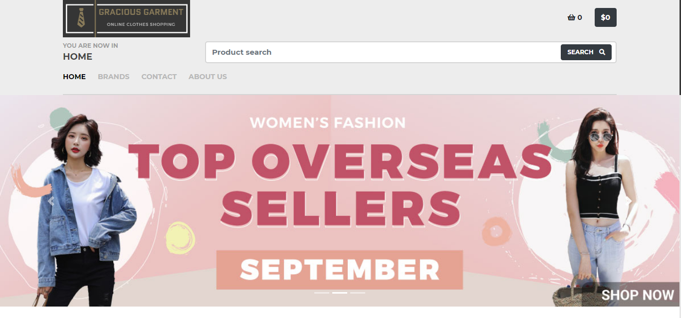
HOME PAGE

Slide 3
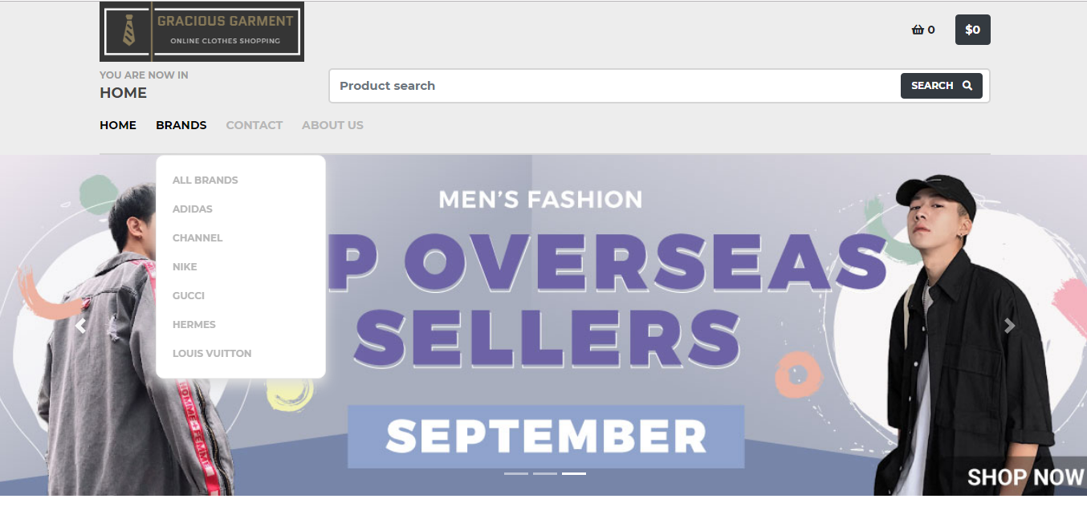
MENU BAR

Slide 4
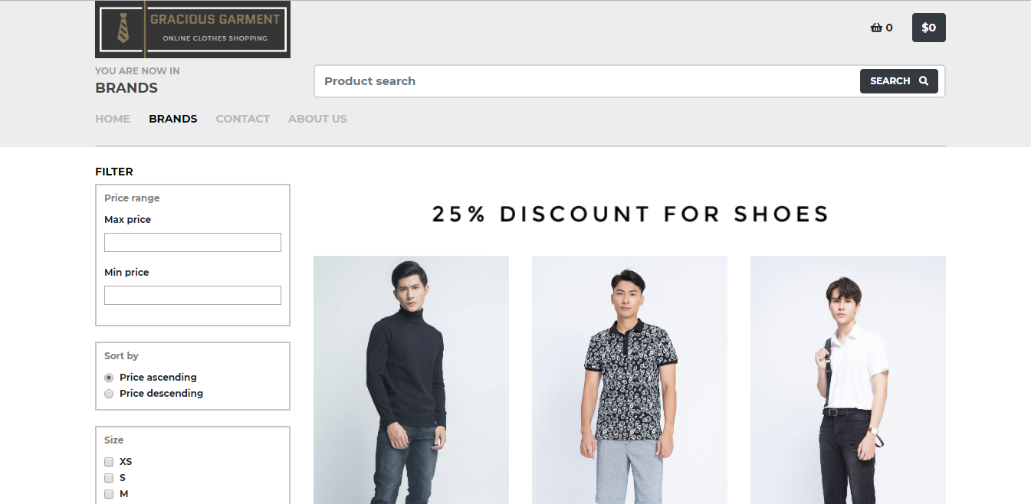
PRODUCTS

Slide 5
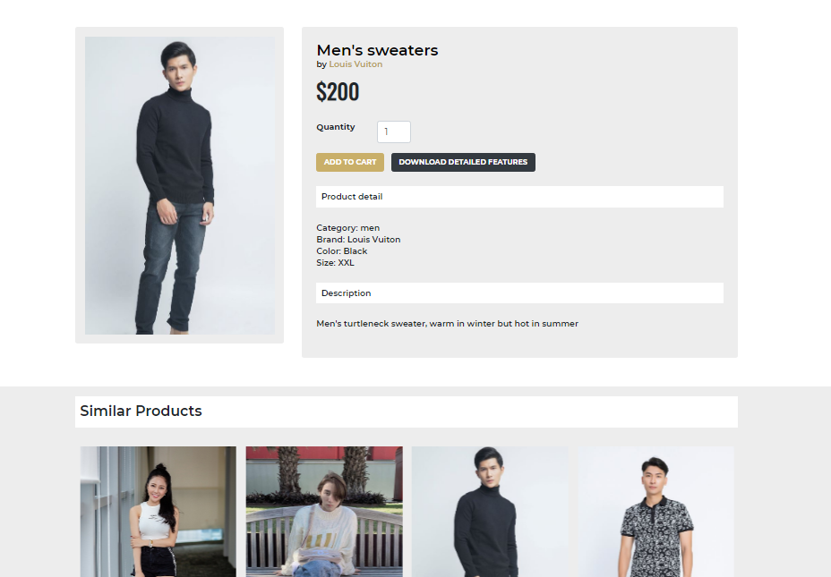
PRODUCT DETAIL

Slide 6
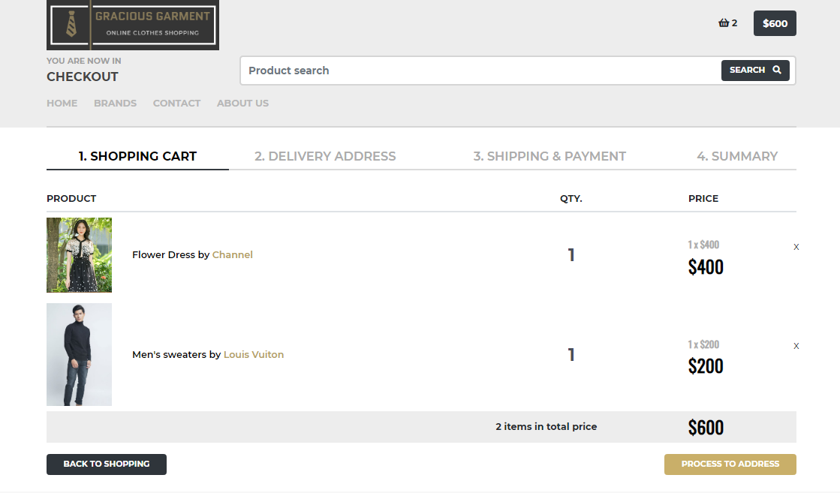
MAKE A PURCHASE

Slide 7
MAKE A PURCHASE

Slide 8
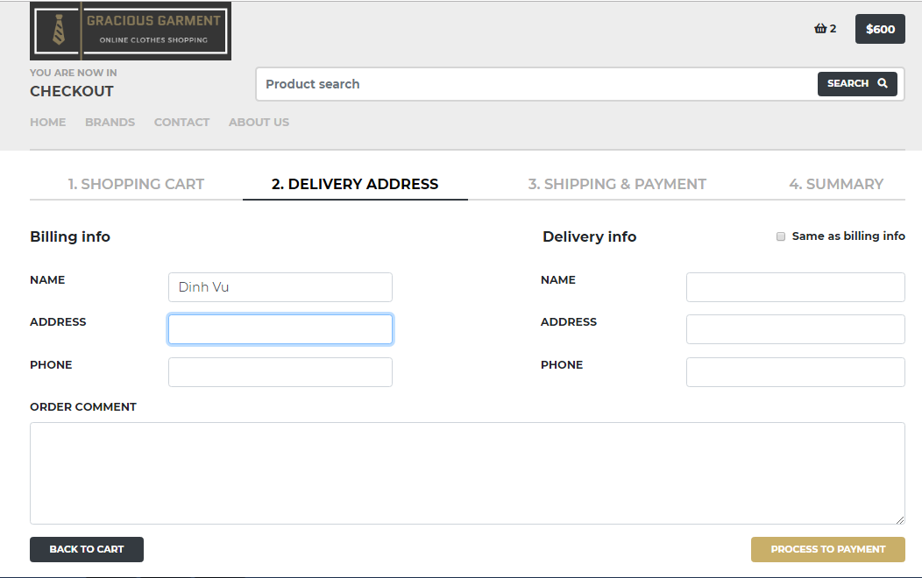
MAKE A PURCHASE

Slide 9
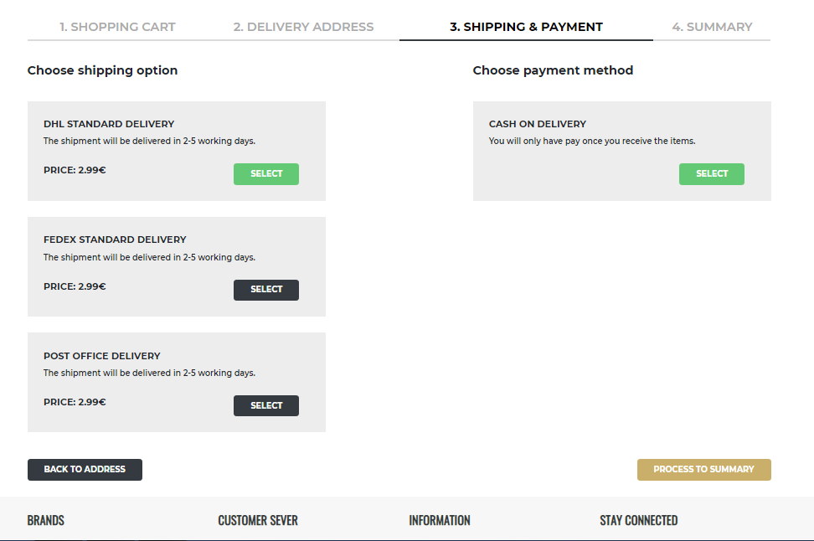
MAKE A PURCHASE

Slide 10
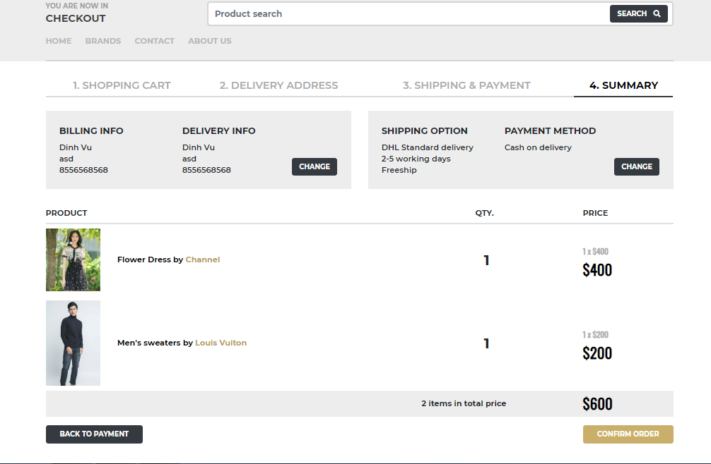
MAKE A PURCHASE

Slide 11
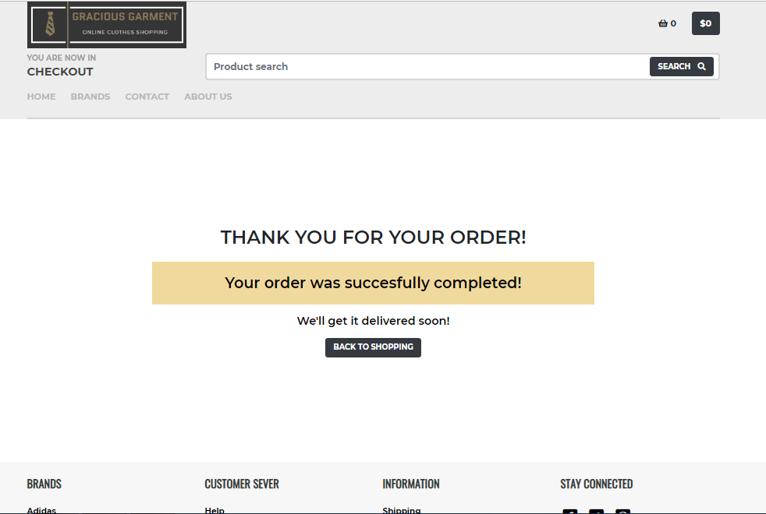
MAKE A PURCHASE

Slide 12
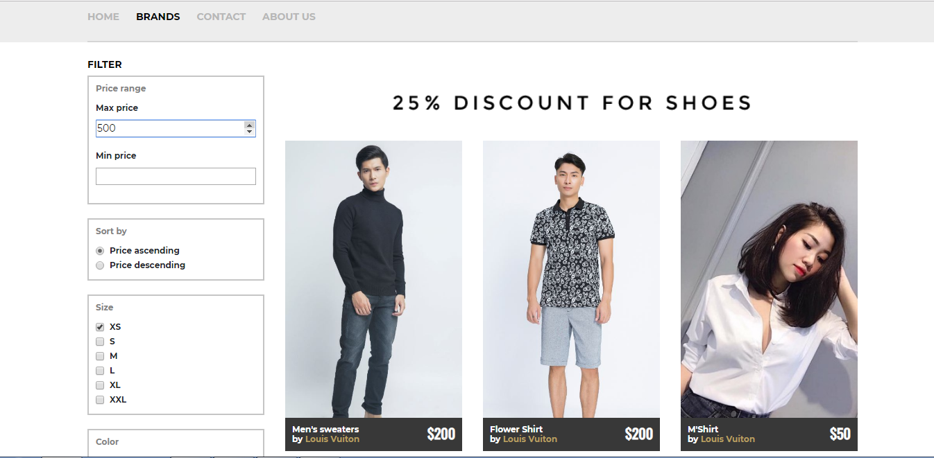
SMART FILTER

Slide 13
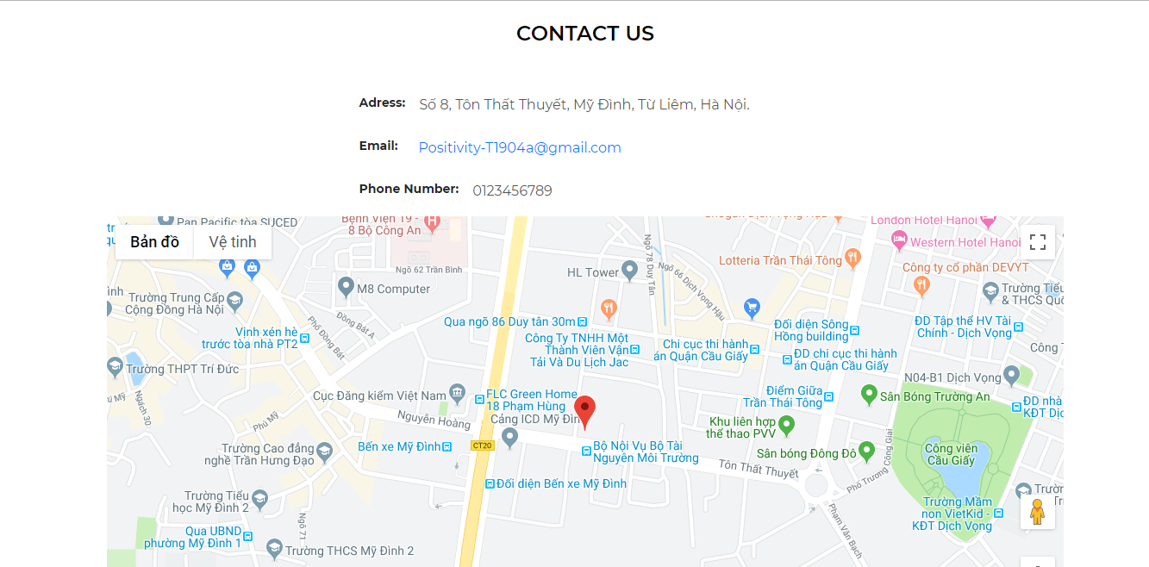
CONTACT US

Slide 14
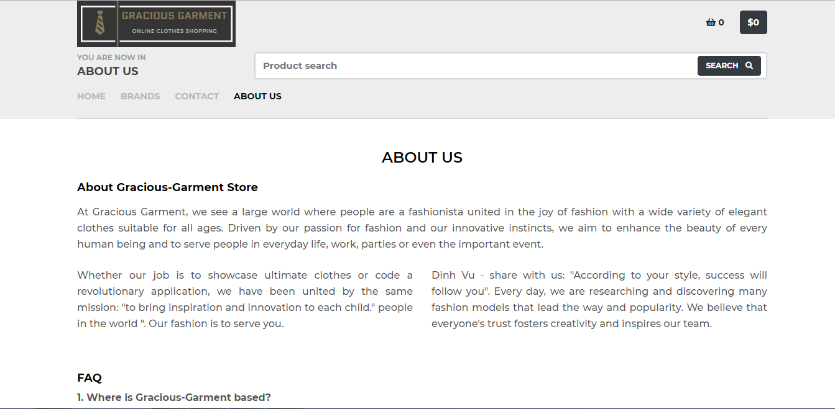
ABOUT US

Slide 15
Q&A

Slide 16
THE END
THANKS FOR WATCHING!

