Slide 1
ACVSS · MRI SUPER-RESOLUTION SAFETY
When sharper means blind.
Super-resolution makes a cheap low-field brain scan look crisp. Trained only for image quality, it can quietly erase a small tumor. We measure how often that happens, and fix it with a tumor-aware objective.
Adiza Alhassan · Nthabiseng Thema · Albert Dodoo · Victor Oyindouye Miene · Hassan Suliman

Slide 2
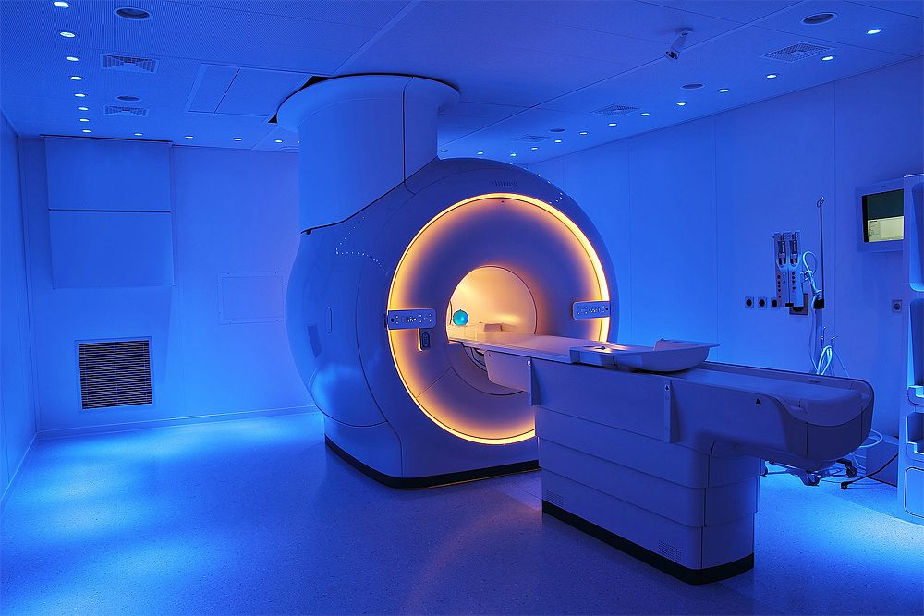
01 WHY THIS MATTERS
Tumor-aware SR · ACVSS
Cheap, low-quality scanners are the only realistic way to widen MRI access.
14
Ghana.
For more than 30 million people, and two thirds of them sit in Greater Accra.
<1
Per million, much of sub-Saharan Africa.
MRI is scarce where the disease burden is not.
37
Per million, high-income countries.
A three tesla scanner needs a shielded room, a cooling supply and power that does not fail.
Up to this many, for the same imaging need.

Slide 3
02 CONTRIBUTION
Tumor-aware SR · ACVSS
Penalise the model heavily for mistakes where the tumor is.
How we degrade
The tumor-aware loss
We take a real high-field scan and throw away the fine detail a cheap scanner cannot capture, then add noise. Every blurry input still has its true scan to be judged against.
A mistake inside the tumor costs the model far more than the same mistake in healthy tissue. It can no longer buy score by smoothing a lesion away.
Same network, same data. The only thing we changed is what it is punished for.

Slide 4
06 NEXT STEPS
Tumor-aware SR · ACVSS
Next: generative models, tested with the readout we just built.
Why generative
Why we can now try them
Then the one number
Diffusion and adversarial models make the sharpest low-field images anyone has produced. They are also the ones most likely to invent tissue.
We can measure what they lose and what they fabricate. Sharpness no longer has to be taken on trust.
A single evaluation on the 94 patients nothing has touched.
A safety metric is what makes a generative model testable rather than impressive.

Slide 5
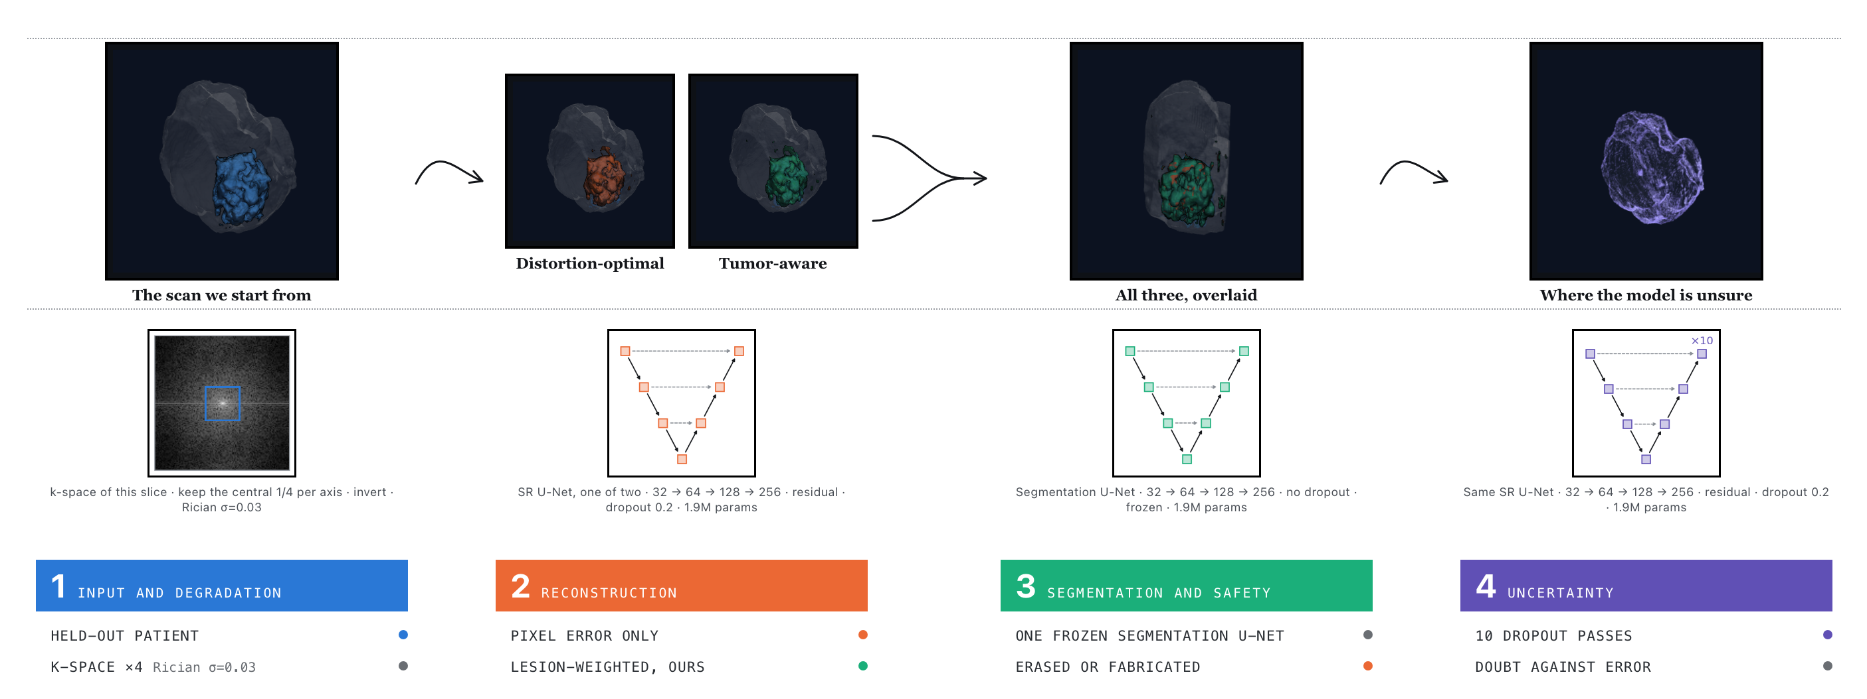
03 METHOD
Tumor-aware SR · ACVSS
Degrade a real scan, reconstruct it two ways, and ask one frozen segmentation network what it can still find.
No GAN, deliberately: an adversarial loss rewards inventing plausible tissue. 17,233 slices, 468 patients.

Slide 6
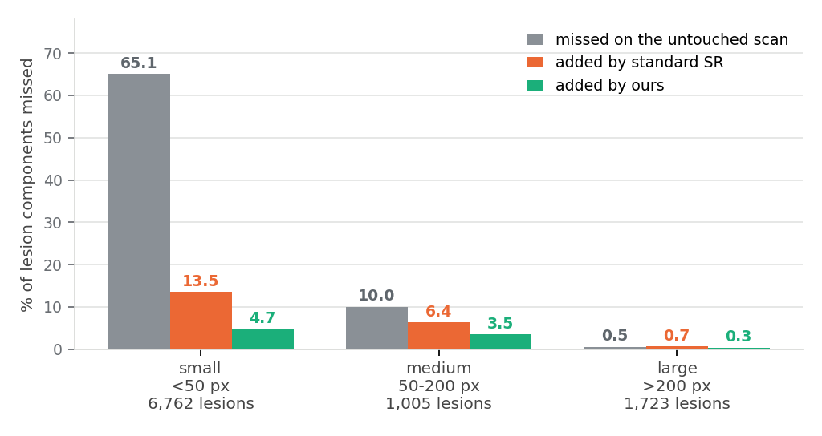
04 RESULT · REAL BRATS, 70 UNSEEN PATIENTS
Tumor-aware SR · ACVSS
Super-resolution recovers tumor the degradation destroys. Ours recovers more of it.
62.2%
58.0%
51.3%
The degraded scan
Standard SR (baseline)
Tumor-aware SR (ours)
missed before any reconstruction
recovers some of it
6.7 points better, at matched quality
Grey is what the frozen segmenter misses on the untouched scan. The block above it is what each objective adds: standard SR in orange, ours in green.

Slide 7
04 RESULT · IMAGE QUALITY
Tumor-aware SR · ACVSS
The two reconstructions are level on every quality metric we are judged by.
IMAGE
PSNR (DB), IN BRAIN
SSIM
DICE, SEGMENTER VS TRUTH
low-res input
21.84
0.498
0.588
standard SR (baseline)
24.51
0.778
0.660
tumor-aware SR (ours)
24.28
0.764
0.675
70 unseen patients. If these rows were not level, the erasure difference would be a quality difference wearing a safety costume.

Slide 8
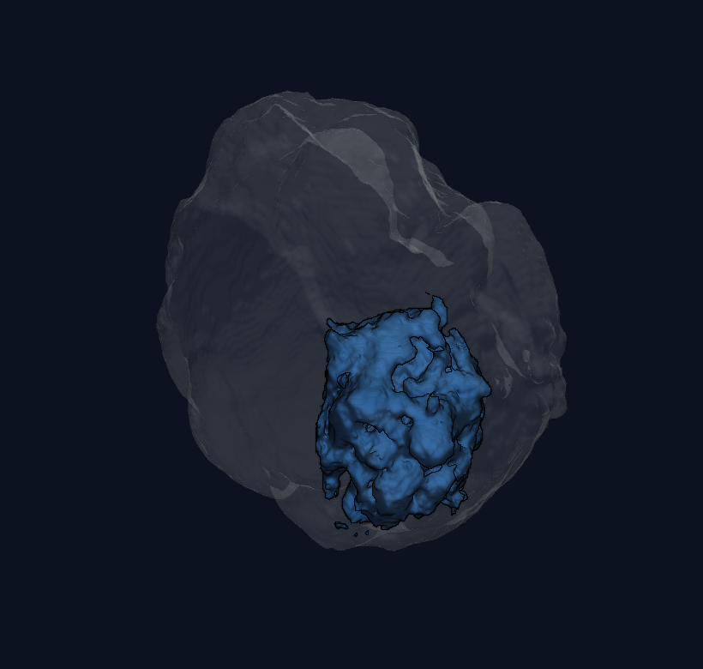
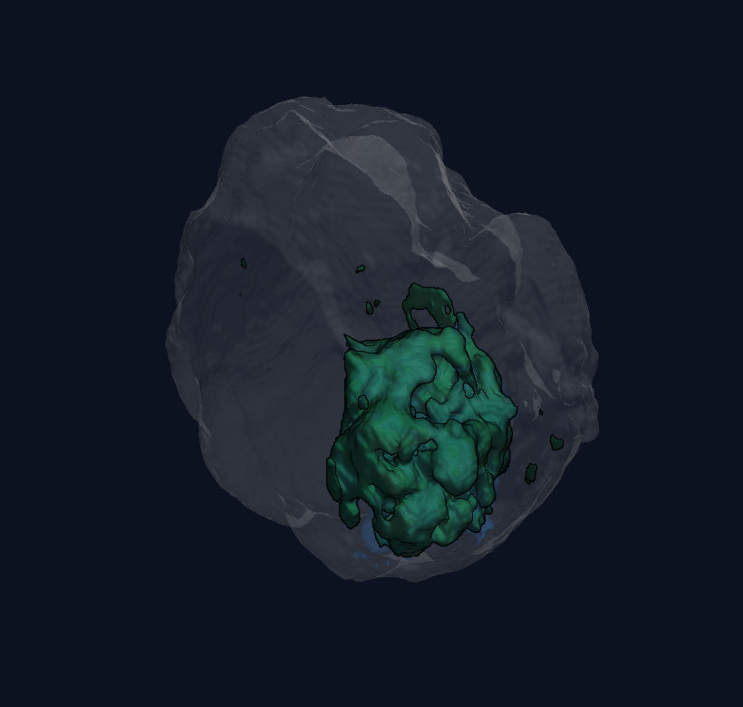
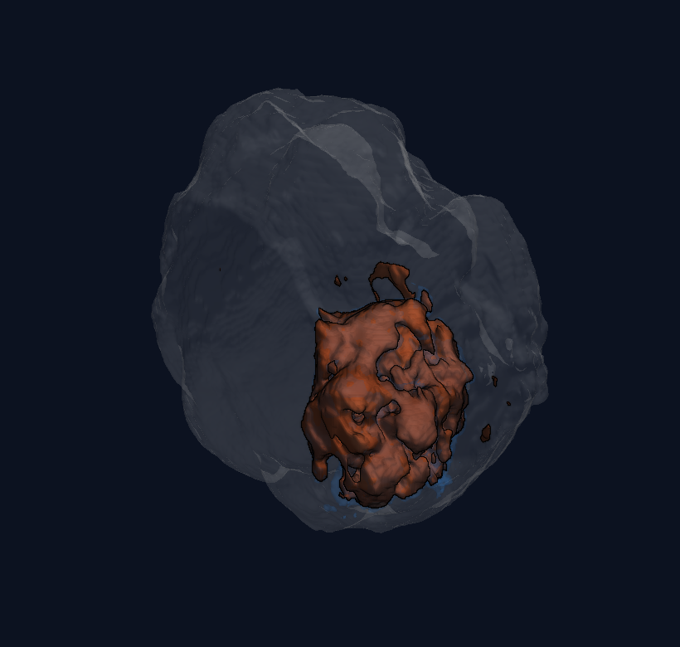
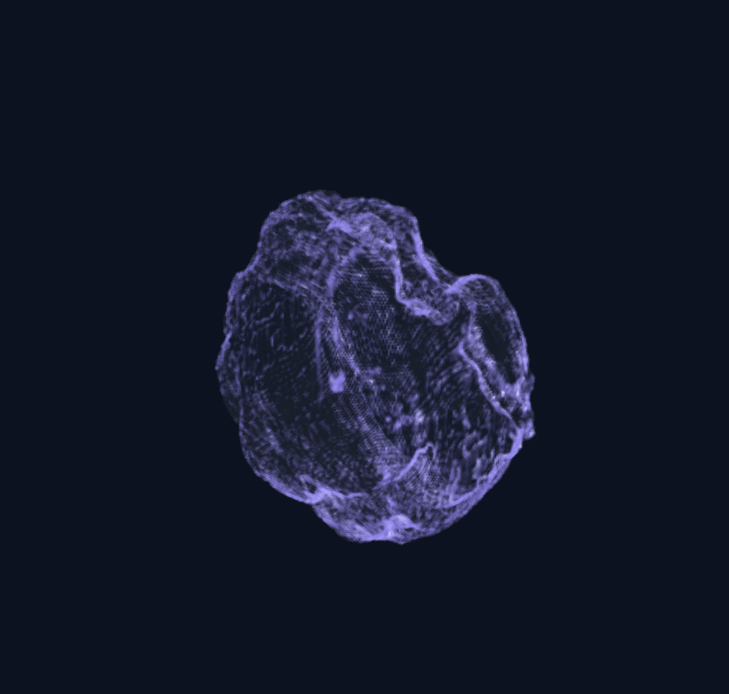
05 RESULT · FOUR VIEWPORTS
Tumor-aware SR · ACVSS
The lesions the baseline loses show up in 3D as empty blue shells.
Ground truth
Tumor-aware (ours)
Baseline
Uncertainty
the true lesions, in blue
lesions preserved
small lesions dropped
where the model is unsure
A blue shell with nothing inside it is a lesion the model lost.

