Slide 1
COVID-19
GLOBAL ANALYTICS DASHBOARD
A Data-Driven Analysis of the COVID-19 Pandemic
Using the Our World in Data (OWID) Dataset
Presented by: Nanahawah
AnalystLab Africa Internship | Tool: Power BI | Dataset: OWID COVID-19
Notes:
Welcome everyone. This presentation covers my COVID-19 dashboard project built during my AnalystLab Africa internship.

Slide 2
Dataset Overview
Our World in Data
429,000+
12
2020–2024
Data Source
Total Rows
Columns Used
Date Range
OWID COVID-19 Dataset
Daily records per country
Selected from 67 columns
Full pandemic timeline
Columns Retained After Cleaning:
iso_code
continent
location
date
total_cases
new_cases
total_deaths
new_deaths
total_vaccinations
people_vaccinated
people_fully_vaccinated
population
Notes:
The OWID dataset is one of the most comprehensive COVID datasets available. We reduced 67 columns to 12 key fields.

Slide 3
Business Problem
COVID-19 generated massive amounts of data, but decision-makers needed clear, visual answers to act fast.
🌍 Which countries were hit hardest?
📈 How did cases grow over time?
💀 What was the global death rate?
💉 Which continent vaccinated the most?
📅 When did cases peak globally?
🗺️ How did deaths compare by region?
This dashboard was built to answer all these questions in one interactive view.
Notes:
The pandemic created an information crisis. Analysts needed tools to make sense of millions of rows of daily data.

Slide 4
KPIs Defined
3T
32bn
1.12%
Total Cases
Total Deaths
Death Rate
SUM(total_cases)
SUM(total_deaths)
DIVIDE(Deaths, Cases)
Cumulative confirmed cases globally
Total deaths across all countries
% of cases that resulted in death
45T
255
Total Vaccinations
Total Countries
SUM(total_vaccinations)
DISTINCTCOUNT(location)
Total vaccine doses administered
Unique countries/regions tracked
Notes:
All KPIs were created as DAX measures in a dedicated _Measures table in Power BI.

Slide 5
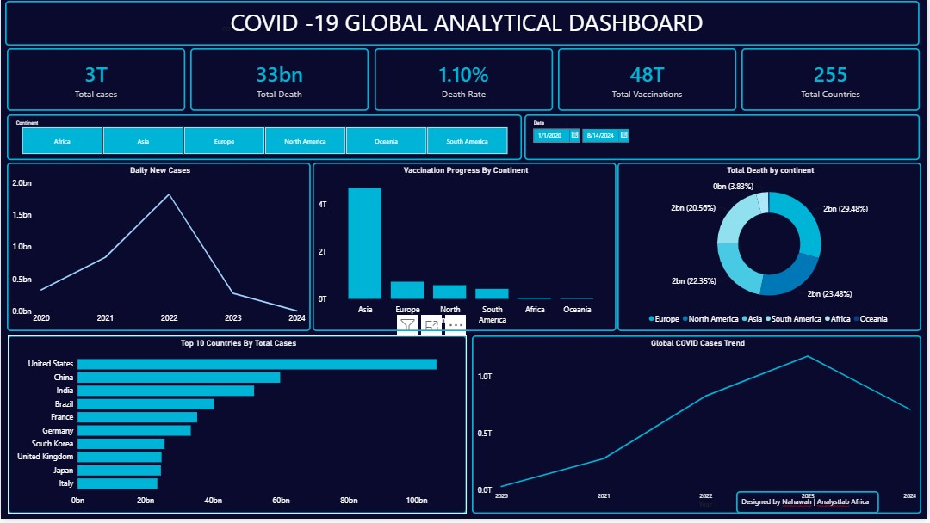
Interactive Dashboard
[Insert Dashboard Screenshot Here]
Paste your Power BI dashboard screenshot into this slide
✦ 5 KPI Cards
✦ 2 Line Charts
✦ 1 Bar Chart
✦ 1 Donut Chart
✦ 1 Column Chart
✦ 2 Slicers
Notes:
This slide should show your actual dashboard. Take a screenshot from Power BI and paste it in.

Slide 6
Key Insights
01
USA Leads in Cases
02
Omicron Peak (2022)
The United States recorded the highest total cases (~100bn cumulative), followed by China and India.
Daily new cases peaked dramatically in early 2022 at ~2bn/day, driven by the highly transmissible Omicron variant.
03
Global Death Rate: 1.12%
04
Asia Led Vaccinations
Of all confirmed COVID cases globally, approximately 1.12% resulted in death — varying significantly by country.
Asia administered the most vaccine doses globally (4T+), reflecting its large population base.
05
Europe: Highest Death Share
06
255 Countries Tracked
Europe accounted for ~29% of global deaths despite having a smaller population share than Asia.
The dataset covers 255 locations including territories, providing a truly global picture of the pandemic.
Notes:
These are the six most important insights from the dashboard. Each one tells a story about how COVID-19 impacted the world differently.

Slide 7
Recommendations
💉
Boost Africa's Vaccination Rate
Africa had the lowest vaccination coverage. Global health bodies should prioritize vaccine equity to protect vulnerable populations.
🏥
Strengthen European Health Systems
Despite strong healthcare, Europe had the highest death share. Investment in pandemic preparedness is critical for future outbreaks.
📊
Real-Time Data Infrastructure
Countries should invest in real-time health data systems to enable faster government response during future health crises.
🌐
Global Coordination
The pandemic showed that no country is safe alone. WHO coordination and data sharing between nations must be improved.
Notes:
These recommendations are grounded in the data insights from the dashboard.

Slide 8
Challenges Faced
Dataset Loading Issues
Solution:
⚠
✔ The JHU dataset had wide-format dates requiring unpivoting. Switched to OWID for a cleaner long-format structure.
Missing Vaccination Data
Solution:
⚠
✔ 93–94% of vaccination columns were empty (pre-vaccine period). Replaced nulls with 0 using Power Query.
Aggregated Location Rows
Solution:
⚠
✔ 'World', 'High-income countries' etc. inflated charts. Filtered by continent field to show only real countries.
Death Rate Percentage
Solution:
⚠
✔ Double-multiplication issue when combining DAX *100 with Power BI % format. Fixed by removing *100 from DAX.
Notes:
Every challenge we faced made us better analysts. Problem-solving is a core data analytics skill.

Slide 9
Conclusion
What This Project Demonstrated
✦ Raw data transformed into clear, actionable visual insights
✦ Power BI dashboard with 5 KPIs, 5 charts, and 2 interactive slicers
✦ Data cleaning, DAX measures, and professional dashboard design
✦ Global COVID-19 trends uncovered across 255 countries (2020–2024)
Thank You
Nanahawah | AnalystLab Africa | #AnalystLabAfrica
Notes:
Close by thanking AnalystLab Africa for the opportunity and your audience for their time.

