Slide 1
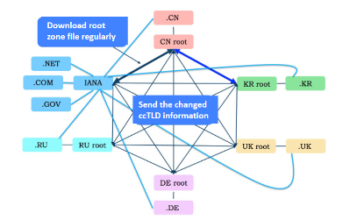
Download root
zone file regularly
.CN
CN root
.NET
.COM
IANA
KR root
.KR
.GOV
Send the changed ccTLD information
.RU
RU root
UK root
.UK
DE root
.DE
Fig. 1 has no relevant legend to explain the meaning of the connecting lines.

Slide 2
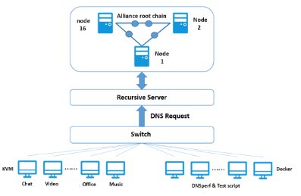
Alliance root chain
node
Node
16
2
Node
1
Recursive Server
DNS Request
Switch
KVM
……
……
Docker
Chat
Video
Office
Music
DNSperf & Test script

Slide 3
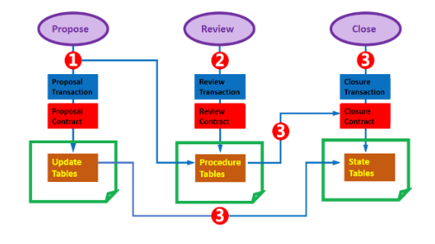
Propose
Review
Close
1
2
3
Proposal
Transaction
Review
Transaction
Closure
Transaction
Proposal
Contract
Review
Contract
Closure
Contract
3
Update
Tables
Procedure
Tables
State
Tables
3

Slide 4
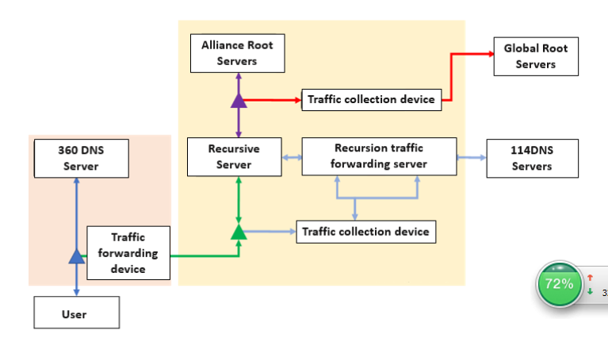
Alliance Root
Servers
Global Root
Servers
Traffic collection device
360 DNS
Server
Recursive
Server
Recursion traffic
forwarding server
114DNS
Servers
Traffic
Fowarding
device
Traffic collection device
User

