Slide 1
Music Genre Classification
Namita Anandaram, Ivan Palalia, Ronald Ho, Michael Trias

Slide 2
Outline
Data
2
3
4
Conclusion

Slide 3

Data
GTZAN dataset
The dataset consists of 1000 audio tracks each 30 seconds long.
The 10 genres are: blues, classical country, rock, disco, reggae,hip-hop, jazz, metal, pop.

Slide 4

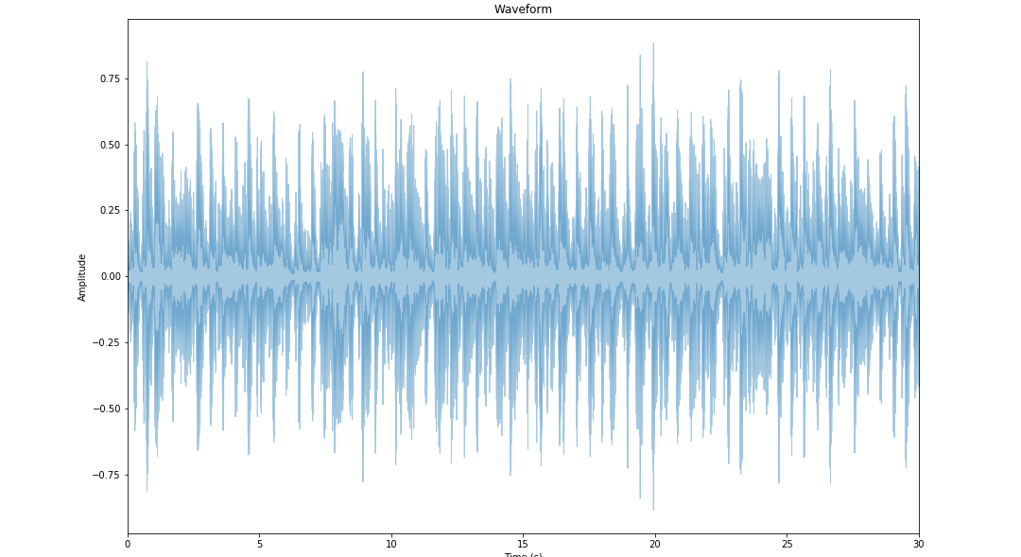
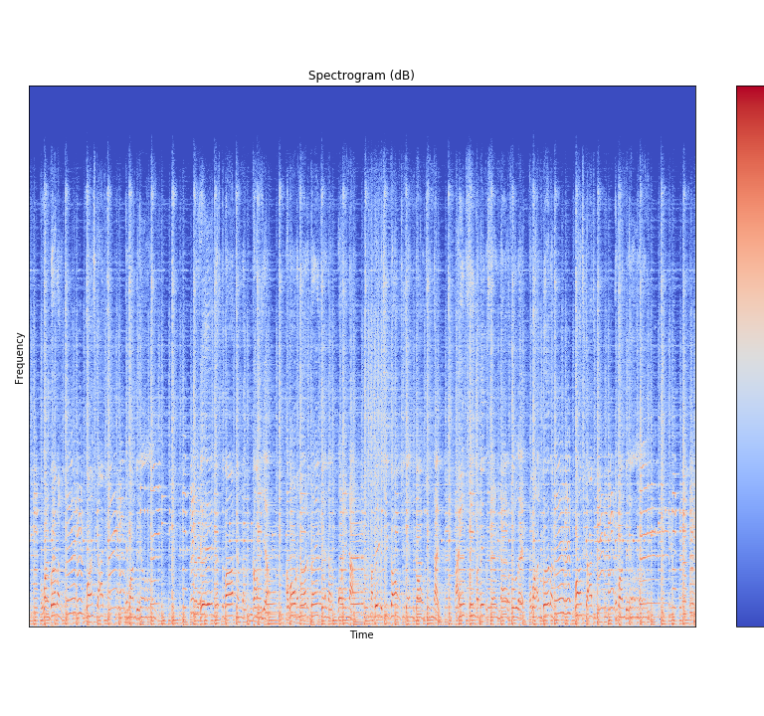
Exploring data - Waveform and spectrogram for blues

Slide 5
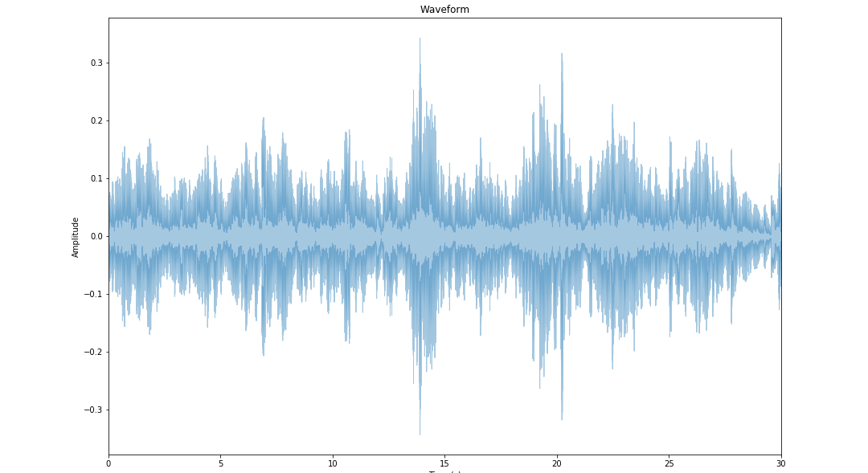
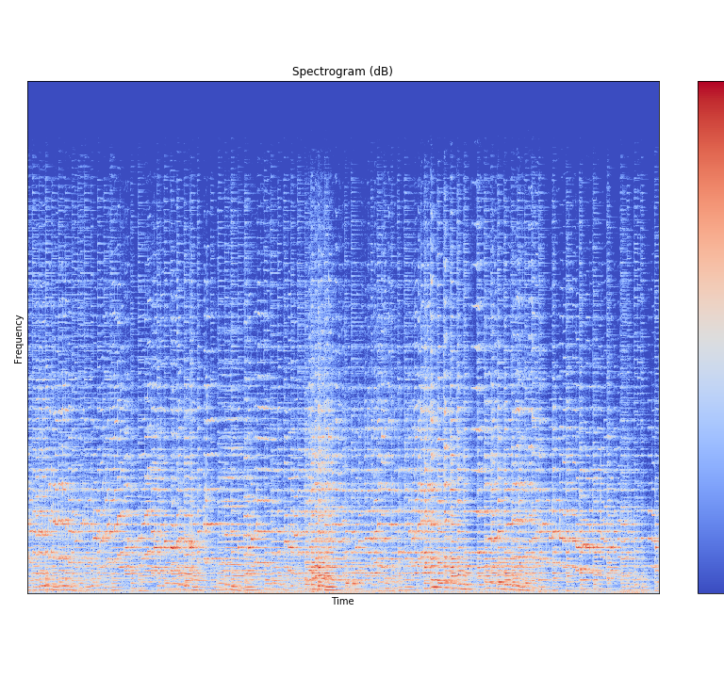
Exploring data - Waveform and spectrogram for classical

Slide 6
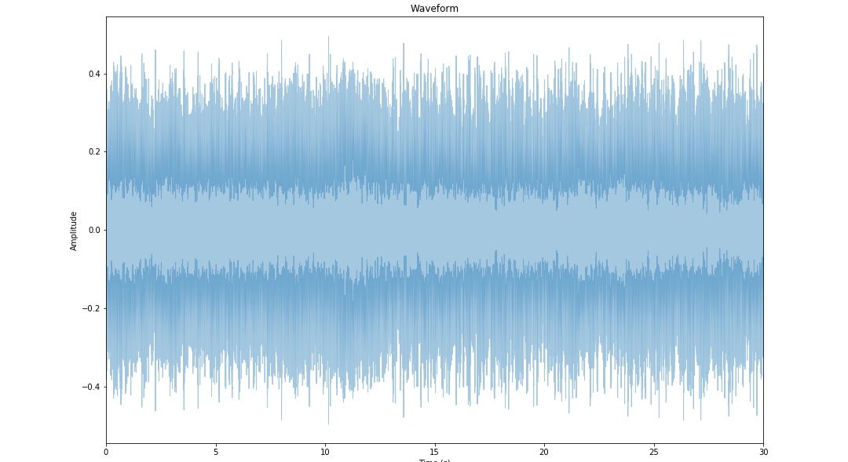
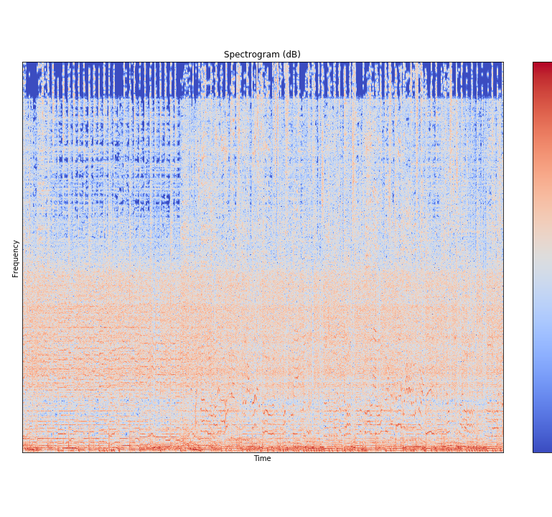
Exploring data - Waveform and spectrogram for metal

Slide 8
Conclusions & future work

Slide 9
Thank you!!! Questions??

