Slide 1

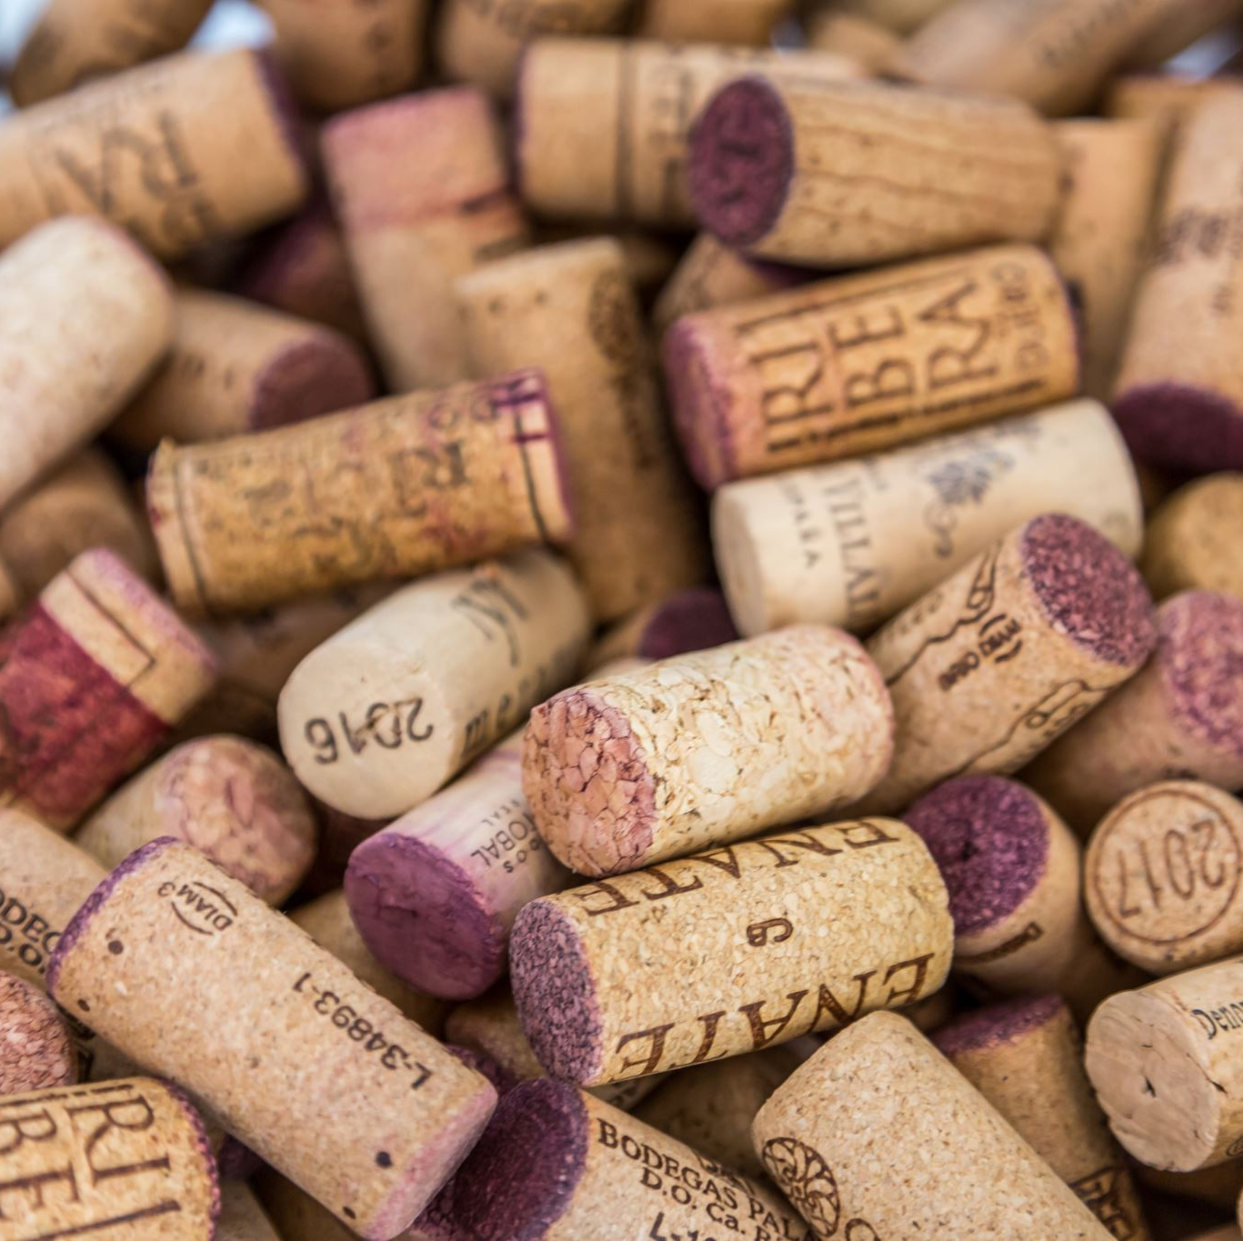
Exploring The Impact of Alcohol Content on Wine Quality
Exploratory Data Analysis using the UCI Machine Learning Repository Wine Quality Dataset
Nana Noda-Morgan
DSC530 – Fall 2024

Slide 2


Hypothesis and Objective
Hypothesis: Wines with higher alcohol content tend to have higher quality ratings.
Use exploratory data analysis (EDA) and statistical methods to assess variables that could predict quality ratings.

Slide 3
Dataset
Data Source: UCI Machine Learning Repository – Wine Quality Dataset
Dataset link: https://archive.ics.uci.edu/dataset/186/wine+quality
Two datasets, one for red wine and one for white wine samples are included. Wine quality rating (a score between 0 and 10) and 11continuous, physicochemical variables are included.

Slide 4

Variables Selected
Alcohol: The percentage of alcohol by volume (%)
Fixed Acidity: The non-volatile acids in wine that do not evaporate during the fermentation process. Affects the taste and stability of the wine (g/L)
Residual Sugar: Sugar remaining after fermentation (g/L)
pH: Acidity level of the wine (scale from 0 to 14, with 7 being neutral)
Sulphates: Sulphate concentration, which contributes to preservative properties (g/L)
Quality: Wine rating, based on sensory data (score from 0 to 10)

Slide 5
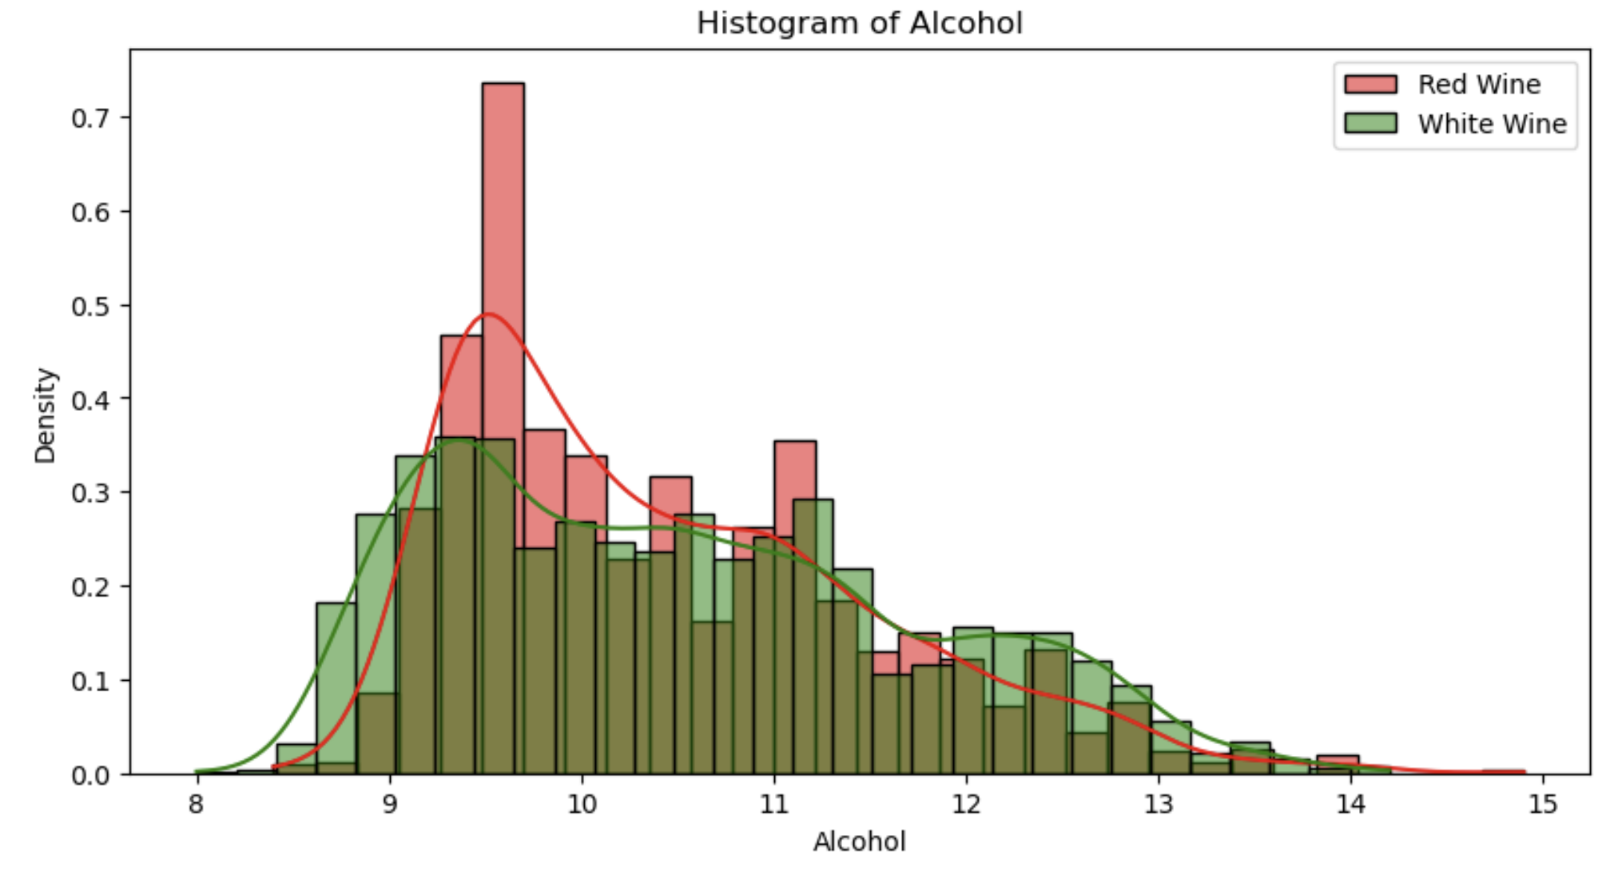
Variable 1: Alcohol

Slide 6
Variable 1: Alcohol
Red Wine - Alcohol Statistics:
Mean: 10.423
Median: 10.200
Mode(s): [9.5]
Standard Deviation: 1.066
Variance: 1.136
Range: 6.500
Skewness: 0.861
Number of Outliers: 13
Outliers: [14.14. 14. 14. 14.9 ,14.
13.6 ,13.6,13.6,14. 14.13.56666667
13.6]
White Wine - Alcohol Statistics:
Mean: 10.514
Median: 10.400
Mode(s): [9.4]
Standard Deviation: 1.231
Variance: 1.514
Range: 6.200
Skewness: 0.487
Number of Outliers: 0
Outliers: []
Cohen's d for Alcohol (Red vs. White): -0.077
A Cohen's d of -0.077 is very close to 0 and shows a very small effect size between red and white wines in terms of their alcohol content. The negative sign tells us the direction of the difference. On average, the alcohol content of red wine is slightly lower than white wine.
Outliers: Alcohol content in wines generally are between 8-15%, while some varieties could be higher. If any values are significantly over 15%, they could be indicating a potential error, or a unique type of wine. Anything below 8% are unusual but not necessarily errors. To this end, I would keep values within 8-15% but remove values over 15%.

Slide 7
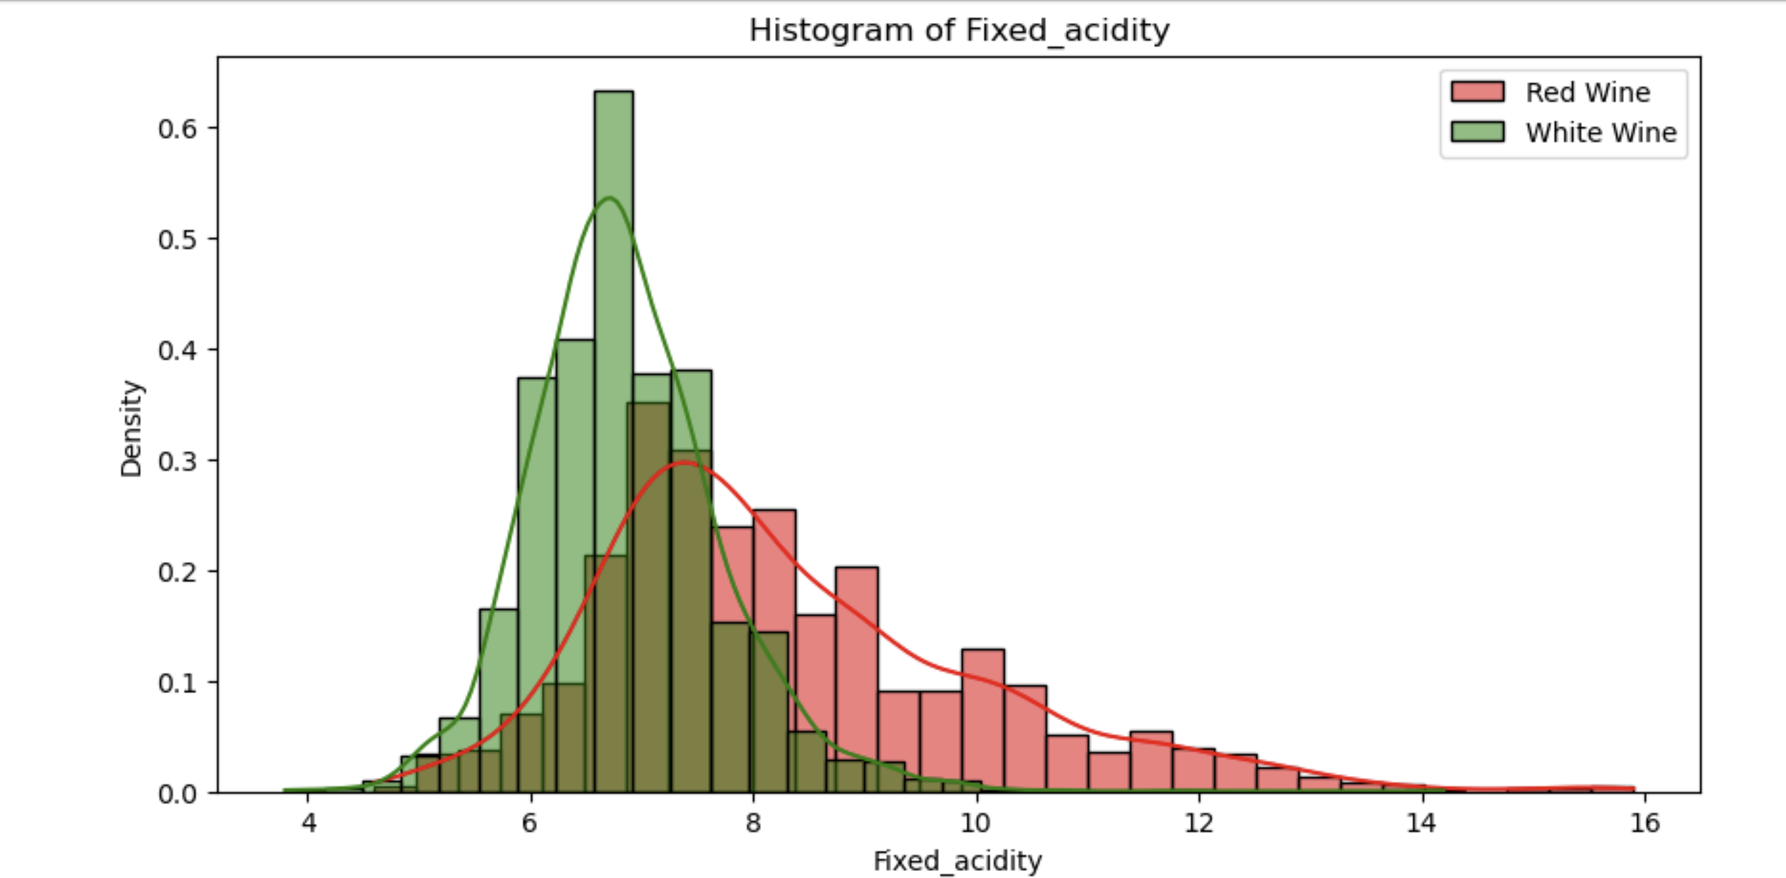
Variable 2: Fixed Acidity

Slide 8
Variable 2: Fixed Acidity
Red Wine - Fixed_acidity Statistics:
Mean: 8.320
Median: 7.900
Mode(s): [7.2]
Standard Deviation: 1.741
Variance: 3.031
Range: 11.300
Skewness: 0.983
Number of Outliers: 49
Outliers: [12.8 12.8 15. 15. 12.5 13.3 13.4 12.4 12.5 13.8 13.5 12.6 12.5 12.8…]
White Wine - Fixed_acidity Statistics:
Mean: 6.855
Median: 6.800
Mode(s): [6.8]
Standard Deviation: 0.844
Variance: 0.712
Range: 10.400
Skewness: 0.648
Number of Outliers: 119
Outliers: [ 9.8 9.8 10.2 9.1 10. 9.2 9.2 9. 9.1 9.2 10.3 9.4 9.2 9.8
9.6 9.2 9. 9.3 9.2 9.1 8.9 9.8 8.9 9.2 9.7 9.4 10.3 9.6…]
Cohen's d for Fixed_acidity (Red vs. White): 1.293
Cohen's d of 1.293 indicates a significant difference in fixed acidity between red and white wines, supporting the idea that red wines have higher acidity levels than white wines.
Outliers: High outliers of fixed acidity for both red and white wines could represent certain wine-making techniques or grape varieties that lead to unusually high acidity. However, extremely low values (like 3.8) are uncommon and may be considered data entry errors and should be examined closer.

Slide 9
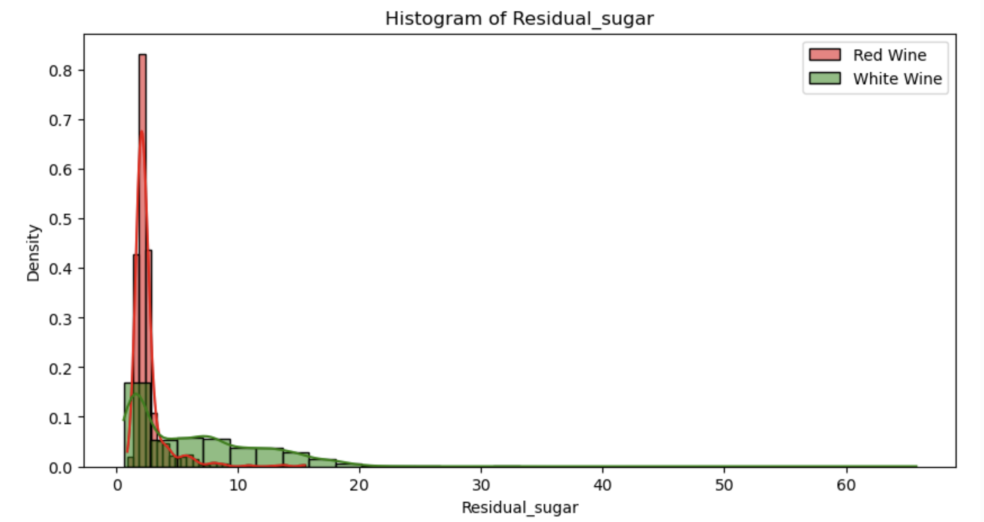
Variable 3: Residual Sugar

Slide 10
Variable 3: Residual Sugar
Red Wine - Residual_sugar Statistics:
Mean: 2.539
Median: 2.200
Mode(s): [2.0]
Standard Deviation: 1.410
Variance: 1.988
Range: 14.600
Skewness: 4.541
Number of Outliers: 155
Outliers: [ 6.1 6.1 3.8 3.9 4.4 10.7 5.5 5.9 5.9 3.8 5.1 ….]
White Wine - Residual_sugar Statistics:
Mean: 6.391
Median: 5.200
Mode(s): [1.2]
Standard Deviation: 5.072
Variance: 25.726
Range: 65.200
Skewness: 1.077
Number of Outliers: 7
Outliers: [23.5 31.6 31.6 65.8 26.05 26.05 22.6 ]
Cohen's d for Residual_sugar (Red vs. White): -0.864
Outliers: For red wines, there are 155 outliers, which is not surprising since red wines tend to have lower residual sugar. Considering this, outliers between 4 and 8 may be considered true extremes that indicate genuine variations due to fermentation methods or sugar additions during the process. However, values beyond 15 are well above the average residual sugar for red wines and could be errors.
When it comes to white wines, the outliers around 20-30 could actually be wines with added sugar or naturally sweet wines (think dessert wines), so they should be retained as meaningful data points. However, we should consider removing the 65.8 value which is more unrealistic and could be a measurement error.

Slide 11
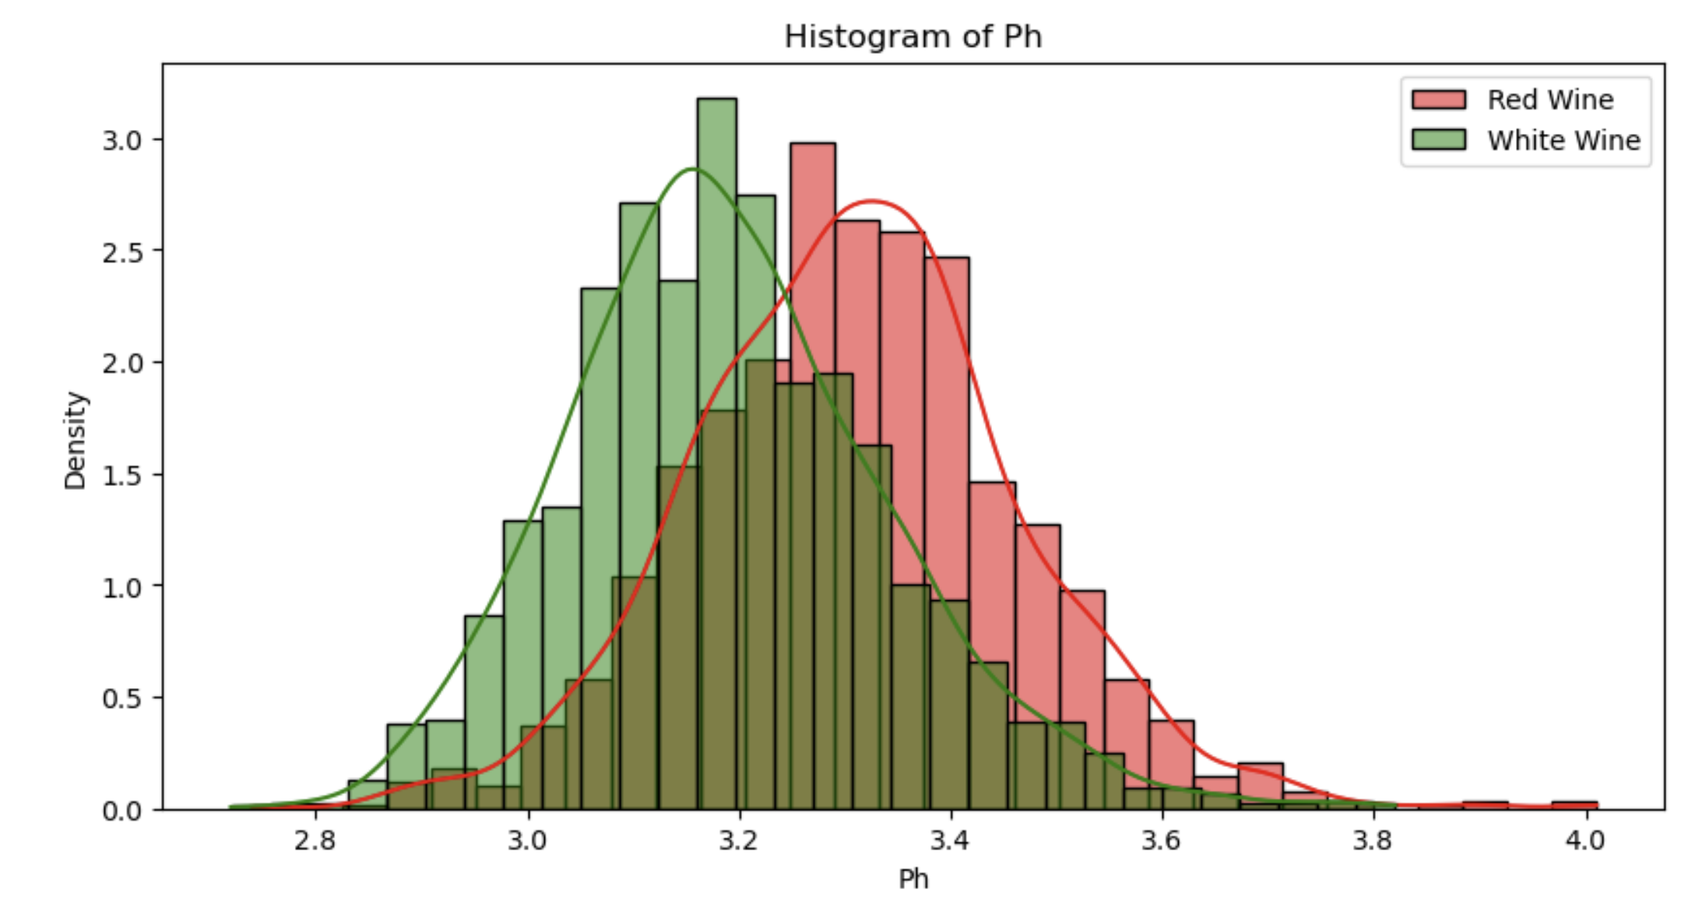
Variable 4: pH

Slide 12
Variable 4: pH
Red Wine - Ph Statistics:
Mean: 3.311
Median: 3.310
Mode(s): [3.3]
Standard Deviation: 0.154
Variance: 0.024
Range: 1.270
Skewness: 0.194
Number of Outliers: 35
Outliers: [3.9 3.75 3.85 2.74 3.69 3.69 2.88 2.86 3.74…]
White Wine - Ph Statistics:
Mean: 3.188
Median: 3.180
Mode(s): [3.14]
Standard Deviation: 0.151
Variance: 0.023
Range: 1.100
Skewness: 0.458
Number of Outliers: 75
Outliers: [3.69 3.63 3.72 3.61 3.64 3.64 3.72 3.72 3.58 3.58 3.66 3.59 2.74 3.82…]
Cohen's d for Ph (Red vs. White): 0.809
Outliers: When it comes to pH, we should consider removing extremely high and low values, such as outliers below 2.8 and outliers above 3.8. However, values that are more moderate should be retained for analysis since they could represent a natural acidity difference that impacts flavor and stability.
Based on Cohen's d, we know that red wines generally have higher pH levels.

Slide 13
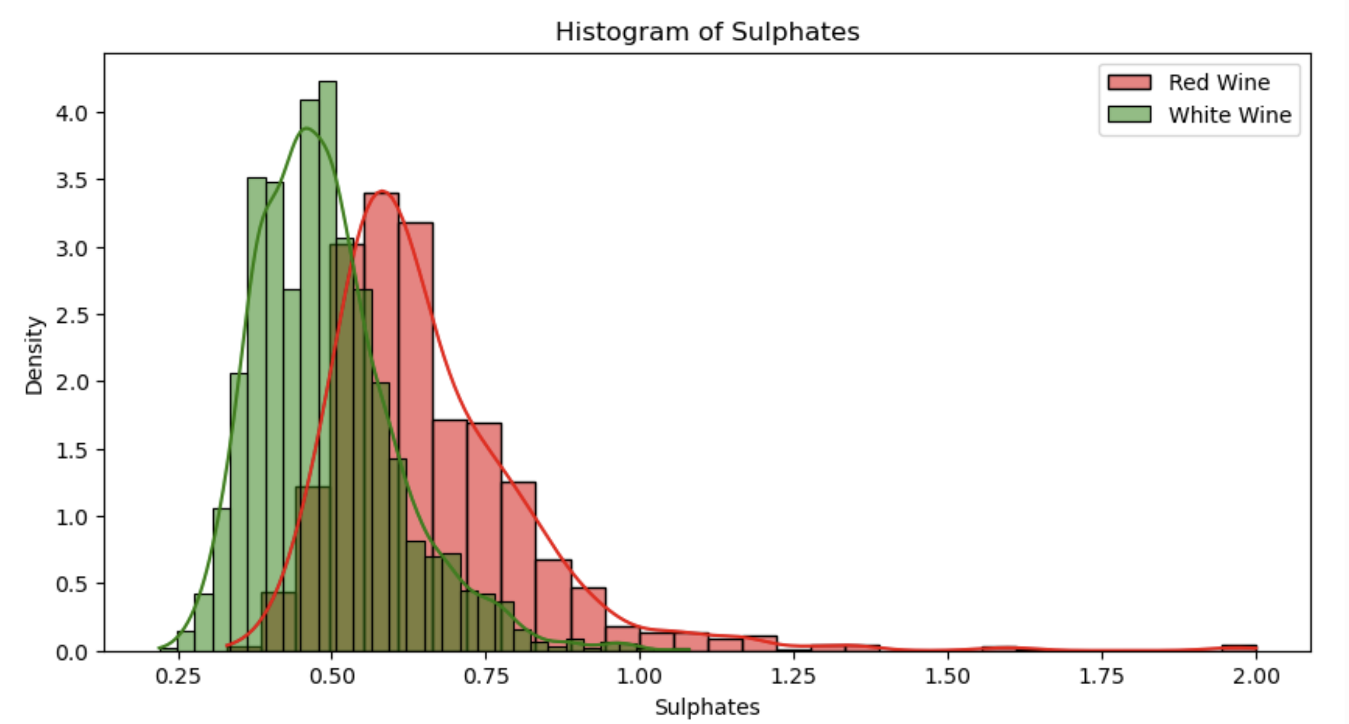
Variable 5: Sulphates

Slide 14
Variable 5: Sulphates
Red Wine - Sulphates Statistics:
Mean: 0.658
Median: 0.620
Mode(s): [0.6]
Standard Deviation: 0.170
Variance: 0.029
Range: 1.670
Skewness: 2.429
Number of Outliers: 59
Outliers: [1.56 1.28 1.08 1.2 1.12 1.28 1.14 1.95 1.22 1.95 1.98]
White Wine - Sulphates Statistics:
Mean: 0.490
Median: 0.470
Mode(s): [0.5]
Standard Deviation: 0.114
Variance: 0.013
Range: 0.860
Skewness: 0.977
Number of Outliers: 124
Outliers: [0.77 0.84 0.77 0.79 0.85 0.78 0.79 0.79 0.79 0.77 0.78 0.85…]
Cohen's d for Sulphates (Red vs. White): 1.295
Outliers: Typical range for sulphates in wines should be under 0.7 g/L. Higher values could mean needs for extended preservation but extreme values far above 1.0 g/L could suggest errors. Remove outliers above 1.0 g/L.
Sulphates are used as additives in wine and has various benefits, including preventing oxidation and bacterial growth, promoting the fermentation process and releasing desirable compounds from the grapes.
Based on the histogram and Cohen's d, we know that red wine tends to have a higher level of sulphates compared to white wine.

Slide 15
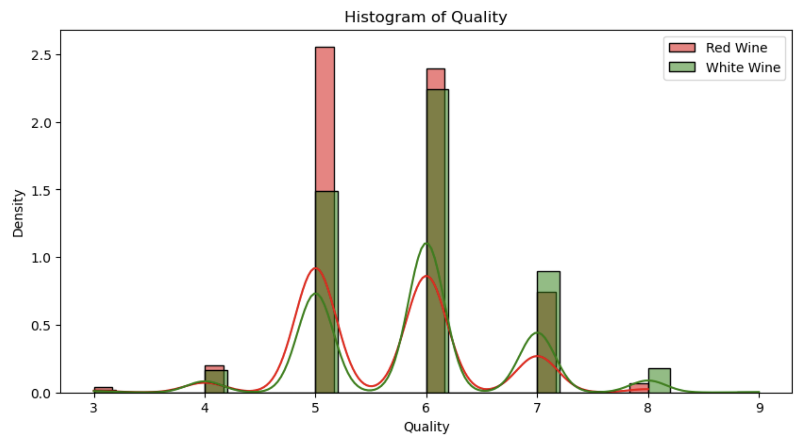
Variable 6: Quality

Slide 16
Variable 6: Quality
Red Wine - Quality Statistics:
Mean: 5.636
Median: 6.000
Mode(s): [5]
Standard Deviation: 0.808
Variance: 0.652
Range: 5.000
Skewness: 0.218
Number of Outliers: 28
Outliers: [8 8 8 8 8 3 8 8 8 3 8…]
White Wine - Quality Statistics:
Mean: 5.878
Median: 6.000
Mode(s): [6]
Standard Deviation: 0.886
Variance: 0.784
Range: 6.000
Skewness: 0.156
Number of Outliers: 200
Outliers: [8 8 8 8 8 8 8 8 3…]
Cohen's d for Quality (Red vs. White): -0.279
Outliers: Since this variable is a quality rating, and all values fall within 0 to 10, we should not be removing any values from this dataset. These would be considered true extremes and not an error, unless we see values that are outside of our expected scoring range.
A Cohen’s d value of -0.279 might indicate that white wines have a slightly higher average quality rating than red wines, but the effect size is small so the quality difference is minimal.

Slide 17
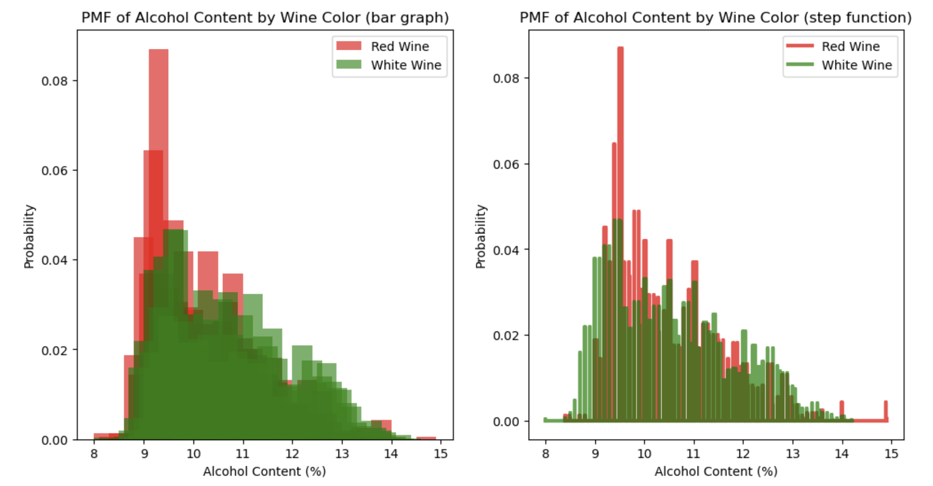
PMF of Alcohol Content (by color)
Notes:
The PMF indicates that red wines tend to have a lower alcohol content, with a peak between 9.5 to 10%. On the other hand, white wines have a broader distribution of alcohol content, with a peak around 10-11% and a more even spread up until about 13%. This suggests that winemaking practices for whites may involve more flexibility in alcohol levels. There is significant overlap in alcohol content between red and white wines, but white wines show more occurrences of higher alcohol content from this dataset. When looking at the tails of the distribution, we can see higher alcohol percentages are more common in white wines, and red wines taper off earlier.

Slide 18
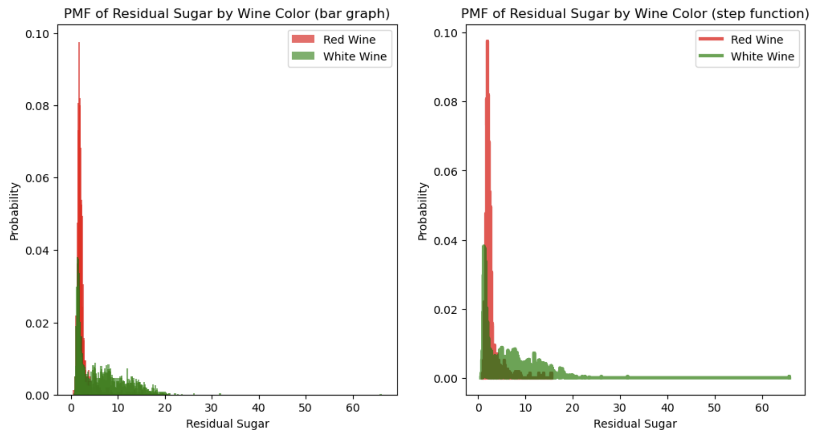
PMF of Residual Sugar (by color)
Notes:
The long tail that can be seen for the white wines tell us that white wines have much higher residual sugar levels compared to red wines. Red wines rarely exceed 2 grams per liter of residual sugar, signifying a pattern of drier red wines. This difference is consistent with common wine knowledge, where white wines are often available in both dry and sweet, while red wines are usually made in drier varieties.

Slide 19
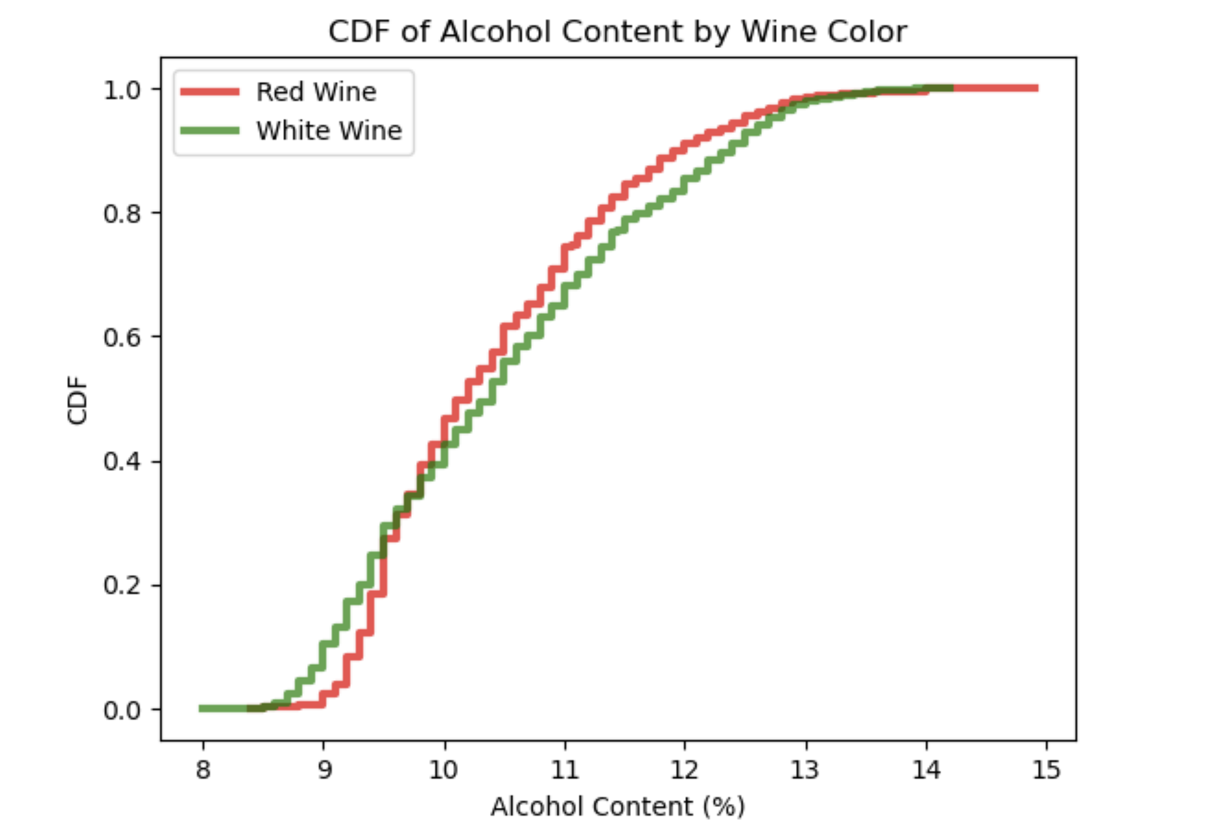
CDF of alcohol content (by color)
Notes:
The CDF for white wine is shifted to the right of the CDF for red wines, specifically around the 9.5-12% range, suggesting that in general white wines tend to have slightly higher alcohol content compared to red wines. The median for red wine is around 10% and 10.5% for white, which also reinforces the first point. The CDF for red wine rise more quickly in the lower range, showing that more red wines are clustered around lower alcohol levels. The CDF for white wines have a more gradual increase, showing a broader distribution of alcohol content.

Slide 20
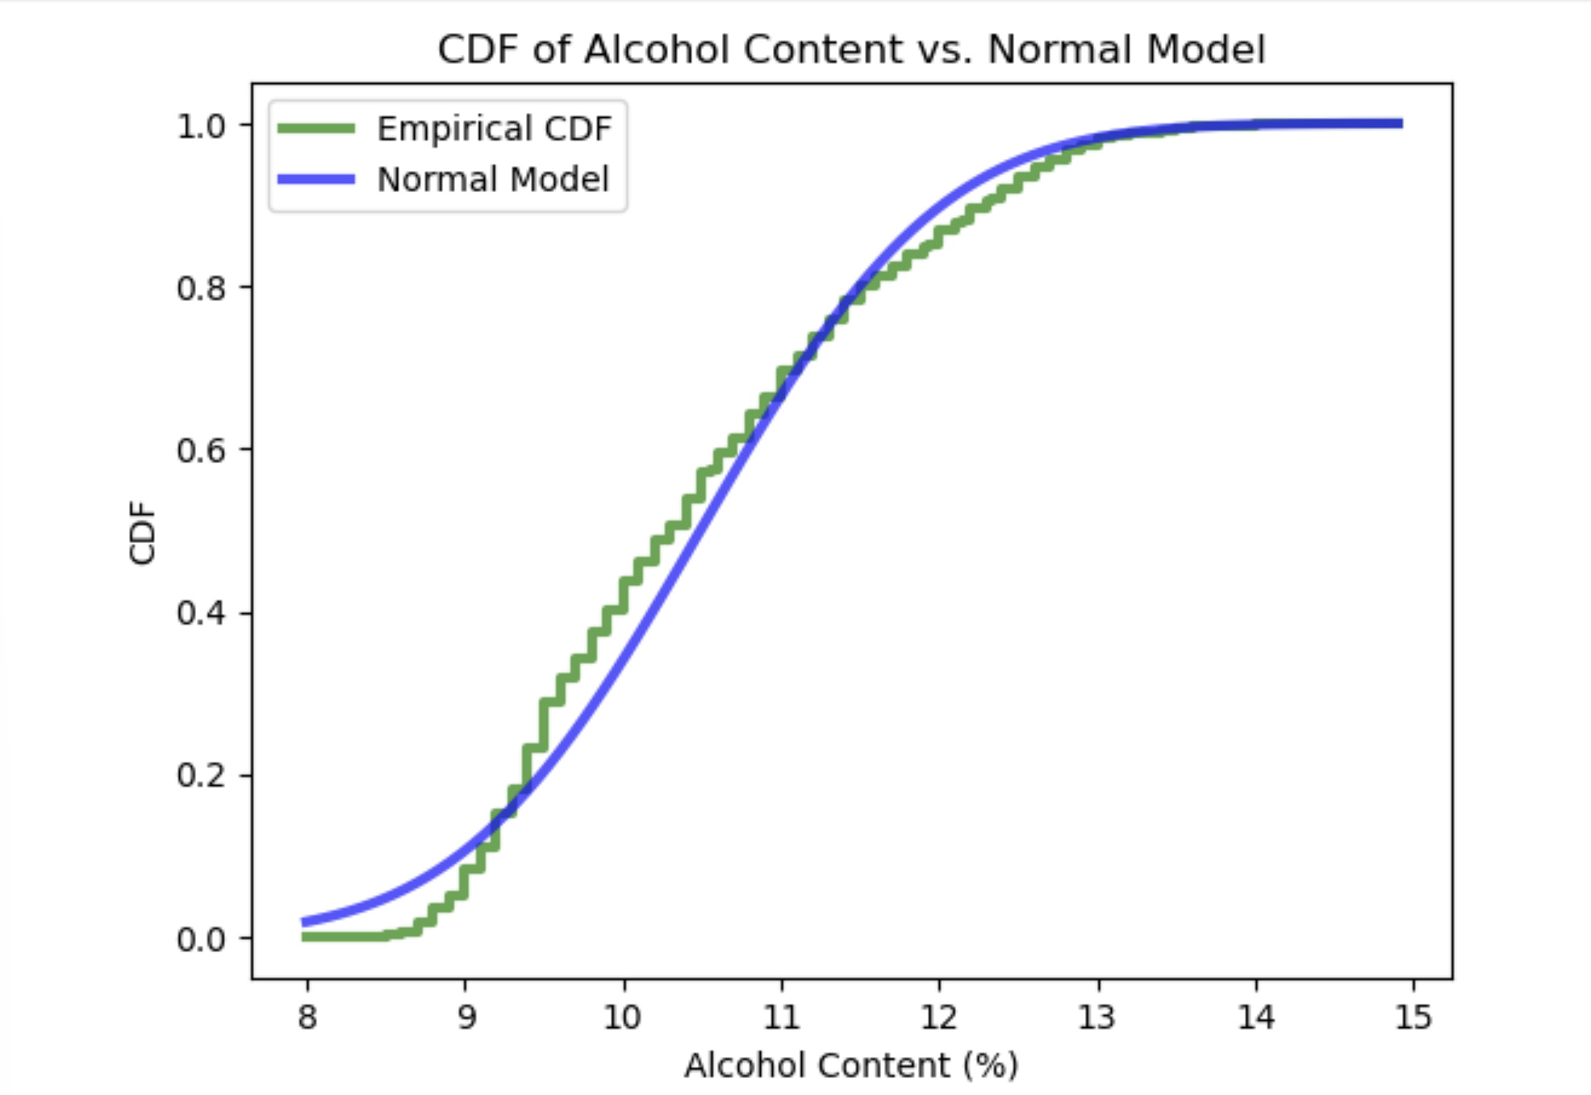
Empirical CDF vs Normal CDF
Notes:
The empirical CDF deviates from the normal model, specifically at both ends. The normal model overestimates the CDF for the lower alcohol content and underestimates it for the higher alcohol content. Overall, this normal model provides a rough approximation but doesn't capture the actual distribution perfectly.

Slide 21
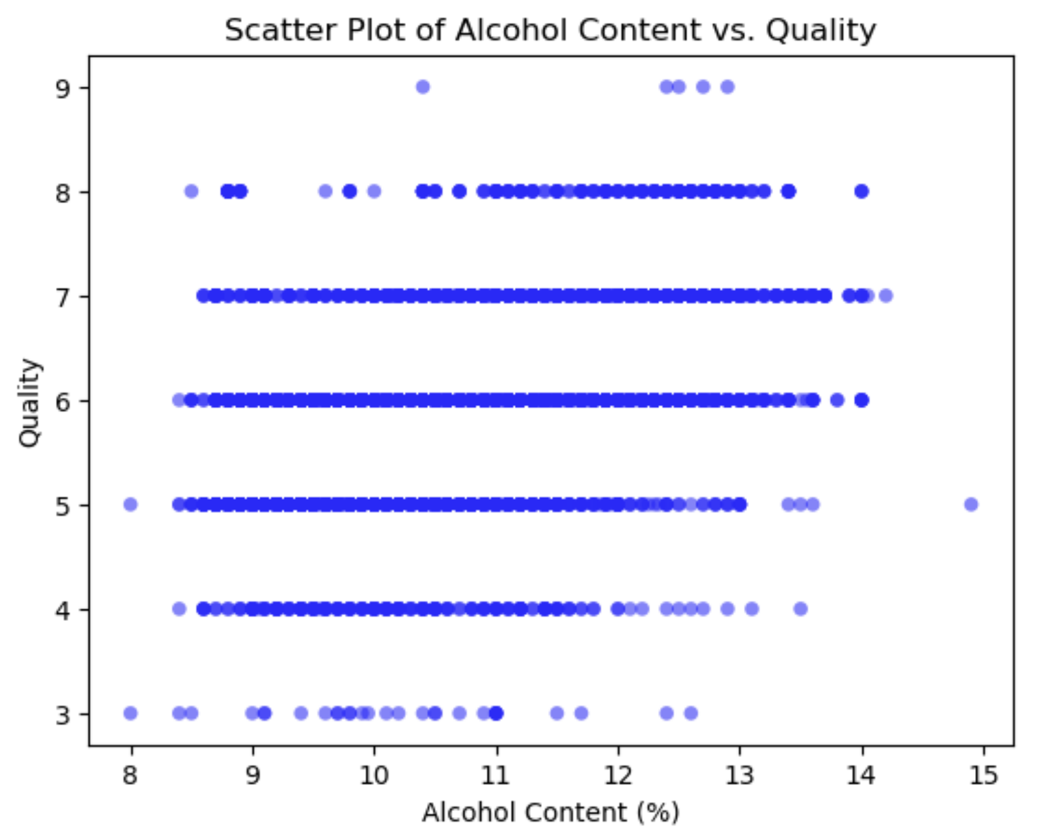
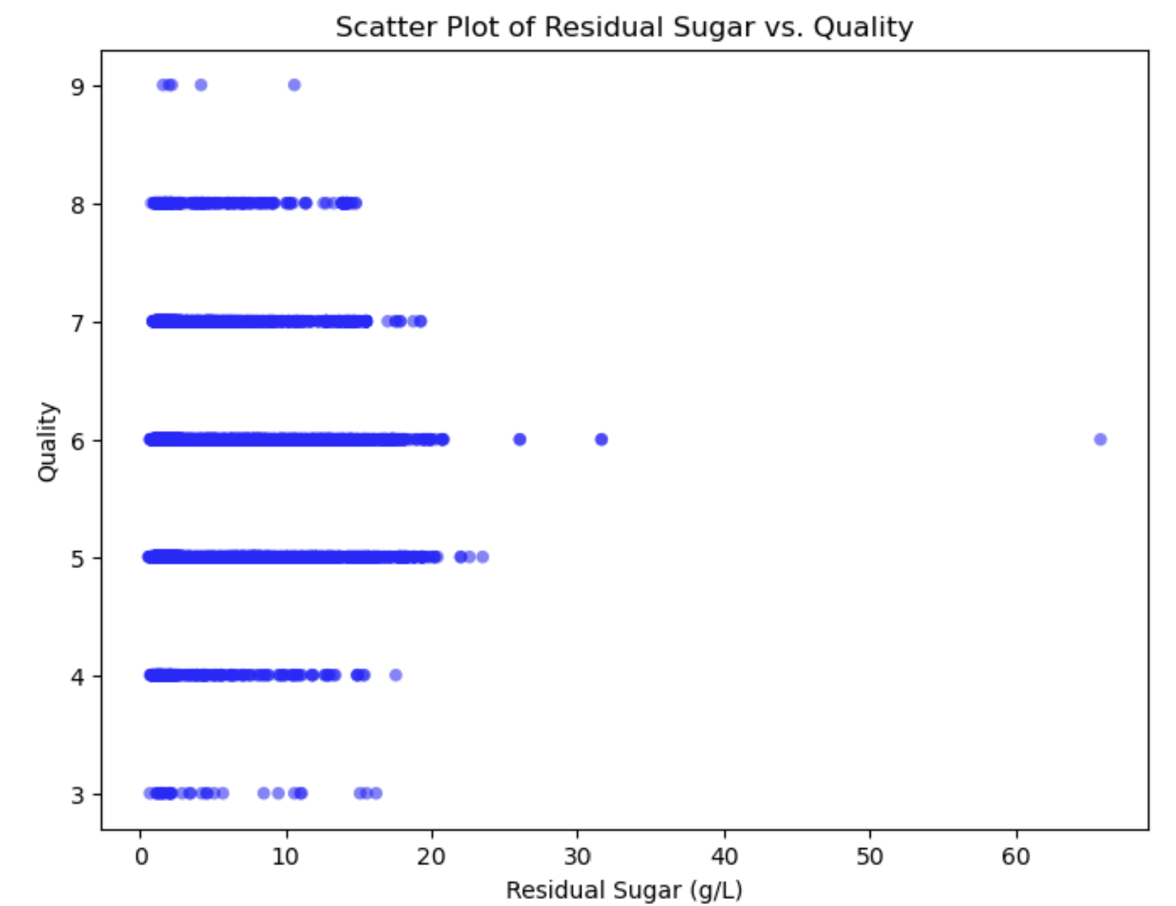
Scatter plots Alcohol content and Residual Sugar vs. Quality
Alcohol vs. Quality
Covariance: 0.46
Pearson’s Correlation: 0.44
Residual Sugar vs. Quality
Covariance: -0.15
Pearson’s Correlation: -0.04
Notes:
Alcohol vs. Quality: The scatter plot points are fairly dispersed but has a slight upward trend toward the right side, indicating that wines with higher alcohol content may be associated with higher quality scores. However, it is not a strong relationship. The positive covariance of 0.46 means that as alcohol content increases, quality does too. However, this alone doesn't tell us the strength or consistency of the relationship. Pearson's correlation of 0.44 suggests a moderate positive, linear relationship between alcohol content and quality. It is still not very strong and implies there may be other factors that influence quality.
Residual Sugar vs. Quality: The scatter plot does not show us a clear trend and the scores are spread out across residual sugar levels. The negative covariance is very low, indicating a very minimal association between residual sugar and quality. Furthermore, Pearson's Correlation of -0.04 is close to 0, suggesting no linear relationship between these variables.

Slide 22
Testing a Difference in Means
Observed Difference in Mean Quality: 0.67
p-value: 0.0000
Wines with higher alcohol content have a quality rating that is 0.67 points higher than wines with lower alcohol content.
Notes:
The p-value of 0.0000 is suggesting a very strong statistical significance. There is a very low probability that the observed difference of 0.67 is due to random chance.

Slide 23
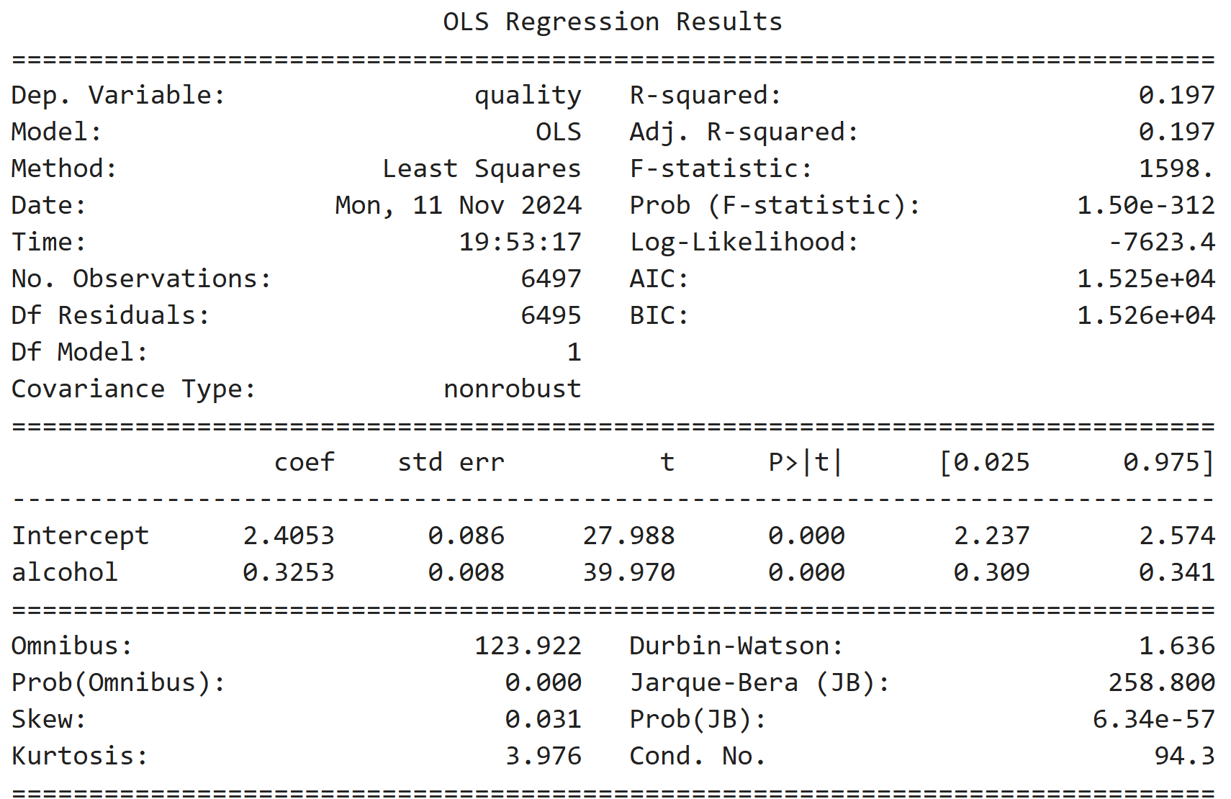
Single Variable Regression: Quality vs. Alcohol Content
Notes:
R-squared of 0.197 tells us that 19.7% of the variability in wine quality can be explained by the alcohol content. This indicates that alcohol content is a strong predictor of quality. Furthermore, the coefficient for alcohol tells us that for every 1% increase in alcohol content, we can expect the quality rating to increase by 0.33 points. This relationship is statistically significant with a p-value of less than 0.05.
Since the R-squared was less than .2, I will test out a multiple variable regression next, to see if I can improve upon the model and see if including factors other than just alcohol content will help predict wine quality more accurately.

Slide 24
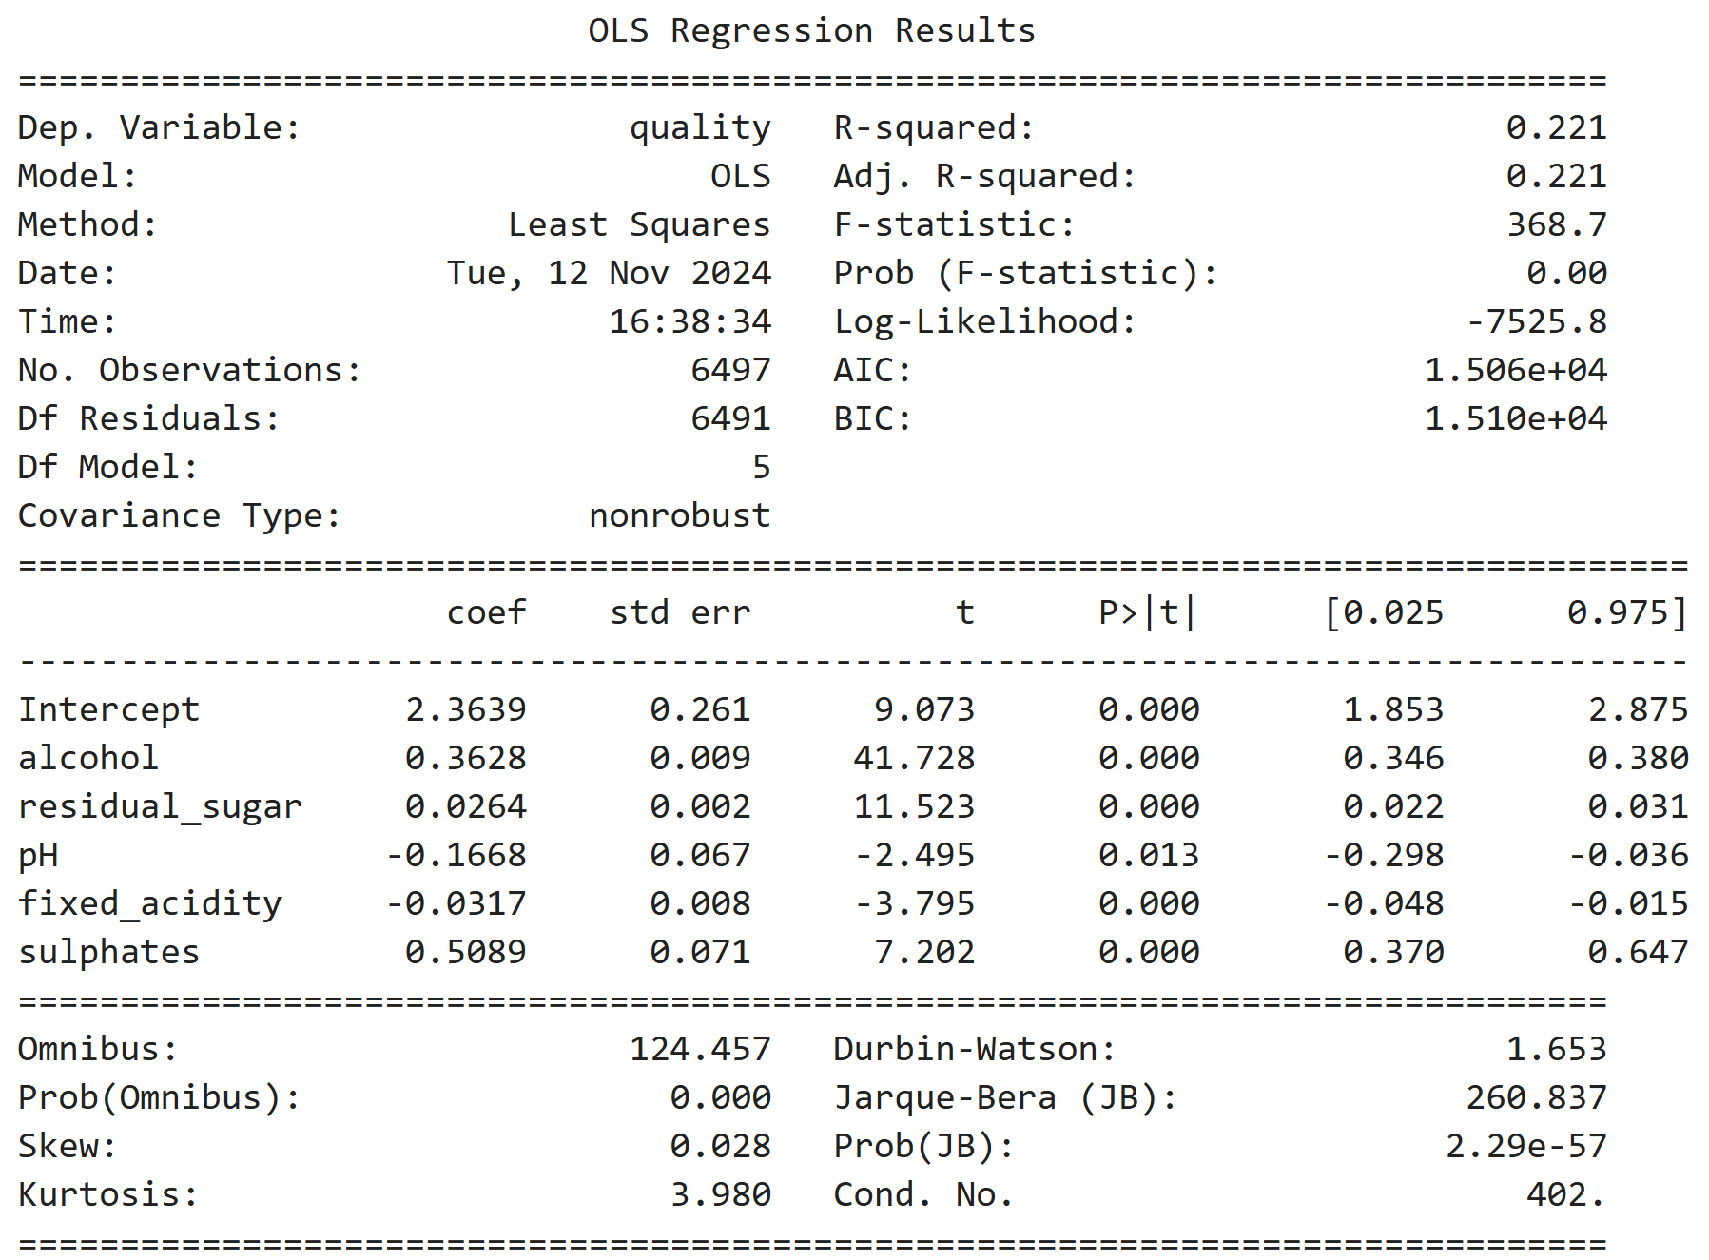
Multiple-Variable Regression: Quality vs alcohol, residual sugar, pH, fixed acidity, and sulphates
Notes:
The R-squared of 0.221 tells us that 22.1% of the variability in wine quality can by explained by the combination of alcohol content, fixed acidity, residual sugar, pH, and sulphates. This is a moderate level of explanatory power, but still suggesting that other factors could contribute to wine quality. The coefficient for alcohol is 0.3628, which tell us that for every 1% increase in alcohol content, the quality increases by about 0.36 points. The next significant variable is sulphates, with a coefficient of 0.5089, and a p-value that indicates this is statistically significant.
Alcohol and sulphates are the strongest predictors of wine quality based on our multiple regression model. Residual sugar shows a small impact, and pH does not show a statistically significant relationship.

Slide 25
Conclusion
Hypothesis: Wines with higher alcohol content tend to have higher quality ratings.
EDA Findings: Alcohol and sulphates are the most significant predictors of quality, with alcohol content showing a positive trend with quality ratings in a scatter plot.
PMF & CDF: Alcohol content distributions between high and low-quality wines indicate that higher-rated wines generally have higher alcohol levels.
Hypothesis Test: Statistically significant difference (p-value < 0.05) in mean quality between high and low alcohol wines supports the hypothesis.
Regression Analysis:
Single-variable model: Alcohol content alone explains 19.7% of quality variability.
Multiple-variable model: Including other variables like sulphates and residual sugar slightly improves model fit but alcohol remains to be a strong predictor.
The findings support our original hypothesis that higher alcohol content is associated with higher quality ratings, though quality is likely influenced by additional factors.

Slide 26
Thank you!

