Slide 1
第16讲 IP安全

Slide 2
IP安全
具有一系列应用程序特定的安全机制
例如：S / MIME，PGP，Kerberos，SSL / HTTPS
然而，存在协议层的安全问题
通过实现IP层安全，一个组织不但能保证在应用层有安全机制，而且能保证在没有应用层安全机制时，网络也是安全的。
Notes:
The Internet community has developed application-specific security mechanisms in a number of application areas, including electronic mail (S/MIME, PGP), client/server (Kerberos), Web access (Secure Sockets Layer), and others. However users have some security concerns that cut across protocol layers. By implementing security at the IP level, an organization can ensure secure networking not only for applications that have security mechanisms but also for the many security-ignorant applications.

Slide 3
网络层次结构
网络七层结构，也称为OSI模型，包括七个层次：
应用层：最靠近用户，负责应用程序间沟通和为用户提供网络服务。
表示层：用于数据转换、格式化、加密、解密、压缩、解压缩等。
会话层：负责建立、管理、终止用户会话，插入校验点来实现数据的同步。
传输层：向用户提供可靠的端到端服务，透明地传送报文。
网络层：通过路由选择算法，选择最适当的路径传输报文。
数据链路层：负责发送和接收数据，提供数据有效传输的端到端连接。
物理层：负责传送比特流，并将帧的结构和内容进行串行发送。

Slide 4
IP安全
一般IP安全机制，提供如下功能：
认证、保密
密钥管理
IP安全适用于通过LAN，公共和私有WAN以及互联网使用
1994年在一份报告（RFC1636）中确定了这样的需求
应用需要在IPv4和IPv6中进行认证和加密
Notes:
IP-level security encompasses three functional areas: authentication, confidentiality, and key management. The authentication mechanism assures that a received packet was transmitted by the party identified as the source in the packet header, and that the packet has not been altered in transit. The confidentiality facility enables communicating nodes to encrypt messages to prevent eavesdropping by third parties. The key management facility is concerned with the secure exchange of keys. IPSec provides the capability to secure communications across a LAN, across private and public WANs, and across the Internet.
In 1994, the Internet Architecture Board (IAB) issued a report titled "Security in the Internet Architecture" (RFC 1636). The report stated the general consensus that the Internet needs more and better security and identified key areas for security mechanisms. To provide security, the IAB included authentication and encryption as necessary security features in the next-generation IP, which has been issued as IPv6. Fortunately, these security capabilities were designed to be usable both with the current IPv4 and the future IPv6.

Slide 5
IP安全
IPSec用途：
通过互联网安全分支机构接入
通过互联网进行安全远程访问
与合作者建立企业间联网和企业内联网接入
加强电子商务的安全性
Notes:
IP-level security encompasses three functional areas: authentication, confidentiality, and key management. The authentication mechanism assures that a received packet was transmitted by the party identified as the source in the packet header, and that the packet has not been altered in transit. The confidentiality facility enables communicating nodes to encrypt messages to prevent eavesdropping by third parties. The key management facility is concerned with the secure exchange of keys. IPSec provides the capability to secure communications across a LAN, across private and public WANs, and across the Internet.
In 1994, the Internet Architecture Board (IAB) issued a report titled "Security in the Internet Architecture" (RFC 1636). The report stated the general consensus that the Internet needs more and better security and identified key areas for security mechanisms. To provide security, the IAB included authentication and encryption as necessary security features in the next-generation IP, which has been issued as IPv6. Fortunately, these security capabilities were designed to be usable both with the current IPv4 and the future IPv6.

Slide 6
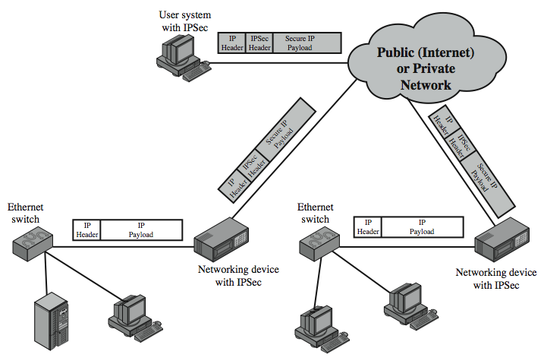
IP安全的使用
Notes:
Stallings Figure 8.1 illustrates a typical IP Security scenario. An organization maintains LANs at dispersed locations. Nonsecure IP traffic is conducted on each LAN. For traffic offsite, through some sort of private or public WAN, IPSec protocols are used. These protocols operate in networking devices, such as a router or firewall, that connect each LAN to the outside world. The IPSec networking device will typically encrypt and compress all traffic going into the WAN, and decrypt and decompress traffic coming from the WAN; these operations are transparent to workstations and servers on the LAN. Secure transmission is also possible with individual users who dial into the WAN. Such user workstations must implement the IPSec protocols to provide security.

Slide 7
IPSec 优点
在防火墙/路由器中，为跨越周边的所有流量提供强大的安全性
在防火墙/路由器中能抵抗旁路流量
在传输层以下，因此对应用程序是透明的
可以对最终用户透明
可以为个人用户提供安全保障
保证路由架构安全
Notes:
Some of the benefits of IPSec include:
• When implemented in a firewall or router, it provides strong security that can be applied to all traffic crossing the perimeter. Traffic within a company or workgroup does not incur the overhead of security-related processing.
• in a firewall is resistant to bypass if all traffic from the outside must use IP and the firewall is the only means of entrance from the Internet into the organization.
• is below the transport layer (TCP, UDP) and so is transparent to applications. There is no need to change software on a user or server system when IPsec is implemented in the firewall or router. Even if IPsec is implemented in end systems, upper-layer software, including applications, is not affected.
• can be transparent to end users. There is no need to train users on security mechanisms, issue keying material on a per-user basis, or revoke keying material when users leave the organization.
• can provide security for individual users if needed. This is useful for offsite workers and for setting up a secure virtual subnetwork within an organization for sensitive applications.
It also plays a vital role in the routing architecture required for internetworking.

Slide 8
IP 安全架构
总体描述较复杂，包含以下分组：
架构：RFC4301 Internet协议安全体系结构
认证报头（AH）：RFC4302 IP认证头
封装安全载荷（ESP）：RFC4303 IP封装安全载荷（ESP）
互联网密钥交换（IKE）：RFC4306互联网密钥交换（IKEv2）协议
加密算法：用于加密、认证、伪随机函数和密钥交换
其他：包含处理安全策略和管理信息库的内容
Notes:
The IPSec specification has become quite complex. key management. The totality of the IPsec specification is scattered across dozens of RFCs and draft IETF documents, making this the most complex and difficult to grasp of all IETF specifications. The best way to keep track of and get a handle on this body of work is to consult the latest version of the IPsec document roadmap. The documents can be categorized into the following groups:
• Architecture: Covers the general concepts, security requirements, definitions, and mechanisms defining IPsec technology, see RFC 4301, Security Architecture for the Internet Protocol.
• Authentication Header (AH): AH is an extension header for message authentication, now deprecated. See RFC 4302, IP Authentication Header.
• Encapsulating Security Payload (ESP): ESP consists of an encapsulating header and trailer used to provide encryption or combined encryption/authentication. See RFC 4303, IP Encapsulating Security Payload (ESP).
• Internet Key Exchange (IKE): a collection of documents describing the key management schemes for use with IPsec. See RFC4306, Internet Key Exchange (IKEv2) Protocol, and other related RFCs.
• Cryptographic algorithms: a large set of documents that define and describe cryptographic algorithms for encryption, message authentication, pseudorandom functions (PRFs), and cryptographic key exchange.
• Other: There are a variety of other IPsec-related RFCs, including those dealing with security policy and management information base (MIB) content.

Slide 9
IPSec 服务
IPSec选择所需的安全服务，决定密码算法和提供加密密钥，实现IP级的安全服务。
访问控制
无连接完整性
数据源认证
拒绝重播数据包
部分序列完整性的形式
保密（加密）
受限的通信流量保密性
Notes:
IPSec provides security services at the IP layer by enabling a system to select required security protocols, determine the algorithm(s) to use for the service(s), and put in place any cryptographic keys required to provide the requested services. Two protocols are used to provide security: an authentication protocol designated by the header of the protocol, Authentication Header (AH); and a combined encryption/authentication protocol designated by the format of the packet for that protocol, Encapsulating Security Payload (ESP). RFC 4301 lists the security services supported as shown above.

Slide 10
传输和隧道模式
运输模式
加密和（可选地）验证IP数据
可以做流量分析，而且效率很高
适用于ESP主机对主机流量
隧道模式
加密整个IP包
为下一跳添加新外部IP报头
沿途的路由器不可以检查内部IP头
适用于VPN，网关到网关安全
Notes:
Both AH and ESP support two modes of use: transport and tunnel mode, but will focus on ESP.
Transport mode provides protection primarily for upper-layer protocols. Transport mode ESP is used to encrypt and optionally authenticate the data carried by IP. Typically, transport mode is used for end-to-end communication between two hosts (e.g., a client and a server, or two workstations). When a host runs AH or ESP over IPv4, the payload is the data that normally follow the IP header. For IPv6, the payload is the data that normally follow both the IP header and any IPv6 extensions headers that are present. Transport mode operation provides confidentiality for any application that uses it, thus avoiding the need to implement confidentiality in every individual application.
Tunnel mode ESP is used to encrypt an entire IP packet. To achieve this, after the AH or ESP fields are added to the IP packet, the entire packet plus security fields is treated as the payload of new "outer" IP packet with a new outer IP header. The entire original, or inner, packet travels through a "tunnel" from one point of an IP network to another; no routers along the way are able to examine the inner IP header. Tunnel mode is useful in a configuration that includes a firewall or other sort of security gateway that protects a trusted network from external networks. In this latter case, encryption occurs only between an external host and the security gateway or between two security gateways. With tunnel mode, a number of hosts on networks behind firewalls may engage in secure communications without implementing IPsec.

Slide 11
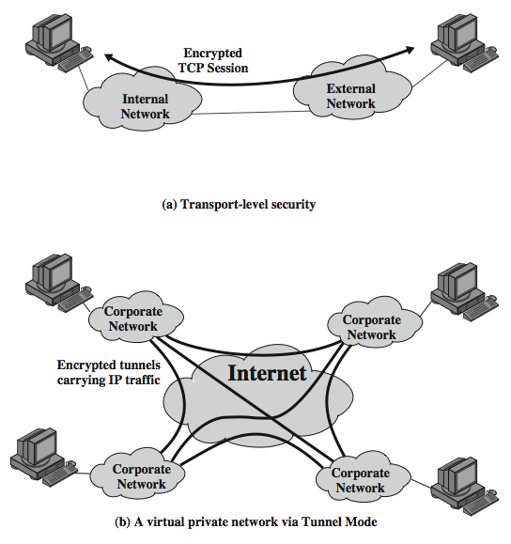
传输和隧道模式
Notes:
Stallings Figure 8.7 shows two ways in which the IPsec ESP service can be used. In the upper part of the figure, encryption (and optionally authentication) is provided directly between two hosts. Figure 19.7b shows how tunnel mode operation can be used to set up a virtual private network. In this example, an organization has four private networks interconnected across the Internet. Hosts on the internal networks use the Internet for transport of data but do not interact with other Internet- based hosts. By terminating the tunnels at the security gateway to each internal network, the configuration allows the hosts to avoid implementing the security capability. The former technique is support by a transport mode SA, while the latter technique uses a tunnel mode SA.

Slide 12
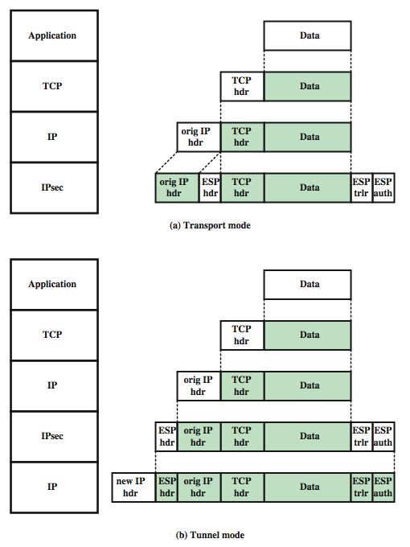
传输 和 隧道模式运行协议
Notes:
Stallings Figure 8.9 shows the protocol architecture for the two modes when ESP is used.

Slide 13
安全关联
发送方和接收方之间通信安全的单向关系
由3个参数定义：
安全参数指数（SPI）
IP目的地址
安全协议标识符
有很多其他参数
序列号，AH＆EH信息，生存周期等
拥有安全关联数据库
Notes:
Fundamental to the operation of IPsec is the concept of a security policy applied to each IP packet that transits from a source to a destination. IPsec policy is determined primarily by the interaction of two databases, the security association database (SAD) and the security policy database (SPD).
A key concept that appears in both the authentication and confidentiality mechanisms for IP is the security association (SA). An association is a one-way relationship between a sender and a receiver that affords security services to the traffic carried on it. If a peer relationship is needed, for two-way secure exchange, then two security associations are required. Security services are afforded to an SA for the use of AH or ESP, but not both.
A security association is uniquely identified by three parameters:
• Security Parameters Index (SPI): A bit string assigned to this SA and having local significance only
• IP Destination Address: the address of the destination endpoint of the SA
• Security Protocol Identifier: indicates whether the association is an AH or ESP security association.
A SA may also have a number of other parameters. In each IPSec implementation, there is a Security Association Database that defines the parameters associated with each SA. See text for details of these.

Slide 14
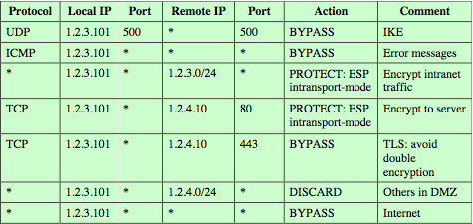
安全策略数据库
将IP流量与特定的SA相关联
将IP流量的子集匹配到相关的SA
使用选择器过滤传出流量以进行映射
使用一下信息进行关联：本地和远程IP地址，下一层协议，名称，本地和远程端口
Notes:
The means by which IP traffic is related to specific SAs (or no SA in the case of traffic allowed to bypass IPsec) is the nominal Security Policy Database. In its simplest form, an SPD contains entries, each of which defines a subset of IP traffic and points to an SA for that traffic. In more complex environments, there may be multiple entries that potentially relate to a single SA or multiple SAs associated with a single SPD entry. Each SPD entry is defined by a set of IP and upper-layer protocol field values, called selectors. These include local & remote IP addresses, next layer protocol, name, local & remote ports. In effect, these selectors are used to filter outgoing traffic in order to map it into a particular SA. Stallings Table 8.2 provides an example of an SPD on a host system (as opposed to a network system such as a firewall or router). This table reflects the following configuration: A local network configuration consists of two networks. The basic corporate has the IP network number 1.2.3.0/24. The local configuration also includes a secure LAN, often known as a DMZ, that is identified as 1.2.4.0/24. The DMZ is protected from both the outside world and the rest of the corporate LAN by firewalls. The host in this example has the IP address 1.2.3.10, and it is authorized to connect to the server 1.2.4.10 in the DMZ. The entries in the SPD should be self-explanatory. For example, UDP port 500 is the designated port for IKE. Any traffic from the local host to a remote host for purposes of an IKE exchange bypasses the IPsec processing.

Slide 15
封装安全载荷 (ESP)
提供消息内容的机密性，数据源认证，无连接完整性，反重播服务，受限的流量机密性
服务依赖于建立安全关联（SA），及网络位置
可以使用各种加密和认证算法
Notes:
ESP can be used to provide confidentiality, data origin authentication, connectionless integrity, an anti-replay service (a form of partial sequence integrity), and (limited) traffic flow confidentiality. The set of services provided depends on options selected at the time of Security Association (SA) establishment and on the location of the implementation in a network topology. ESP can work with a variety of encryption and authentication algorithms, including authenticated encryption algorithms such as GCM.

Slide 16
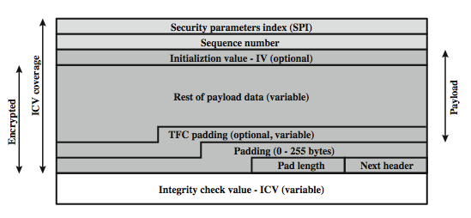
ESP
Notes:
Stallings Figure 8.5b shows the format of an ESP packet, with fields:
• Security Parameters Index (32 bits): Identifies a security association
• Sequence Number (32 bits): A monotonically increasing counter value; this provides an anti-replay function
• Payload Data (variable): This is a transport-level segment (transport mode) or IP packet (tunnel mode) that is protected by encryption
• Padding (0–255 bytes): for various reasons
• Pad Length (8 bits): the number of pad bytes immediately preceding this field
• Next Header (8 bits): identifies the type of data in the payload data field
• Integrity check value (variable): a variable-length field that contains the Integrity Check Value computed over the ESP packet
When any combined mode algorithm is employed, it is expected to return both the decrypted plaintext and a pass/fail indication for the integrity check.
Two additional fields may be present in the payload. An initialization value (IV), or nonce, is present if this is required by the encryption or authenticated encryption algorithm used for ESP. If tunnel mode is being used, then the IPsec implementation may add traffic flow confidentiality (TFC) padding after the Payload Data and before the Padding field, as explained subsequently.

Slide 17
加密、认证功能
ESP可以加密：有效负载数据，填充内容，填充长度和下一个标题字段
如果需要，有效载荷数据开始时有IV
ESP可以具有可选的ICV以实现完整性
在执行加密后计算
ESP使用填充，进而
将明文扩展到所需长度
对齐衬垫长度和下一个标题字段
提供部分流量保密
Notes:
The Payload Data, Padding, Pad Length, and Next Header fields are encrypted by the ESP service. If the algorithm used to encrypt the payload requires cryptographic synchronization data, such as an initialization vector (IV), then these data may be carried explicitly at the beginning of the Payload Data field. If included, an IV is usually not encrypted, although it is often referred to as being part of the ciphertext.
The ICV field is optional. It is present only if the integrity service is selected and is provided by either a separate integrity algorithm or a combined mode algorithm that uses an ICV. The ICV is computed after the encryption is performed.
The Padding field serves several purposes: If an encryption algorithm requires the plaintext to be a multiple of some number of bytes, the Padding field is used to expand the plaintext to the required length; to assure that the Pad Length and Next Header fields are right aligned within a 32-bit word; to provide partial traffic flow confidentiality by concealing the actual length of the payload.

Slide 18
反重播服务
重播是当攻击者重新发送已验证数据包的副本
使用序列号来挫败这个攻击
当建立新的SA时，发送者将序列号初始化为0
每个数据包的增量
不得超过2³² – 1
接收方接收序列号在（N-W + 1）窗口的数据包
Notes:
A replay attack is one in which an attacker obtains a copy of an authenticated packet and later transmits it to the intended destination. The receipt of duplicate, authenticated IP packets may disrupt service in some way or may have some other undesired consequence. The Sequence Number field is designed to thwart such attacks.
When a new SA is established, the sender initializes a sequence number counter to 0. Each time that a packet is sent on this SA, the sender increments the counter and places the value in the Sequence Number field. Thus, the first value to be used is 1. If anti-replay is enabled (the default), the sender must not allow the sequence number to cycle past 2³² – 1 back to zero. If this limit is reached, the sender should terminate this SA and negotiate a new SA with a new key.
Because IP is a connectionless, unreliable service, the protocol does not guarantee that packets will be delivered in order and does not guarantee that all packets will be delivered. Therefore, the IPsec authentication document dictates that the receiver should implement a window of size W, with a default of W = 64. The right edge of the window represents the highest sequence number, N, so far received for a valid packet. For any packet with a sequence number in the range from N – W + 1 to N that has been correctly received (i.e., properly authenticated), the corresponding slot in the window is marked .

Slide 19
安全关联的组合
单个安全关联（SA）可以实现AH，或者ESP
为了实现两者，需要将SA进行组合
形成安全关联束
可以在不同或相同的端点终止
由以下两种方式结合在一起： 运输邻接、隧道迭代
组合认证和加密
ESP具有认证，捆绑内部ESP和外部AH，捆绑内部传输AH和外部ESP
Notes:
An individual SA can implement either the AH or ESP protocol but not both. Sometimes a particular traffic flow will call for the services provided by both AH and ESP. Further, a particular traffic flow may require IPSec services between hosts and ,for that same flow, separate services between security gateways, such as firewalls. In all of these cases, multiple SAs must be employed for the same traffic flow to achieve the desired IPSec services. The term security association bundle refers to a sequence of SAs through which traffic must be processed to provide a desired set of IPSec services. The SAs in a bundle may terminate at different endpoints or at the same endpoints.
Security associations may be combined into bundles in two ways:
• Transport adjacency: more than one security protocol on same IP packet, without invoking tunneling
• Iterated tunneling: application of multiple layers of security protocols effected through IP tunneling
Encryption and authentication can be combined in order to transmit an IP packet that has both confidentiality and authentication between hosts. We look at several approaches, including: ESP with authentication option, use two bundled transport SAs, with the inner being an ESP SA and the outer being an AH SA; use a bundle consisting of an inner AH transport SA and an outer ESP tunnel SA. See text for more details.

Slide 20
IPSec 密钥管理
处理密钥生成和分发
通常需要2对密钥
AH＆ESP每方向2个
手动密钥管理
系统管理员手动配置每个系统
自动密钥管理
自动化协议，用于按需创建SA在大型系统中的密钥
Oakley＆ISAKMP协议
Notes:
The key management portion of IPSec involves the determination and distribution of secret keys. A typical requirement is four keys for communication between two applications: transmit and receive pairs for both AH and ESP. The IPSec Architecture document mandates support for two types of key management:
• Manual where a system administrator manually configures each system with its own keys and with the keys of other communicating
• Automated where an automated system enables the on-demand creation of keys for SAs and facilitates the use of keys in a large distributed system with an evolving configuration
The default automated key management protocol for IPSec is referred to as ISAKMP/Oakley.

Slide 21
Oakley 协议
是一种密钥交换协议
基于Diffie-Hellman密钥交换
增加了解决其弱点的功能
没有通信双方的信息，中间人的袭击成本高
使用cookie防止拥塞攻击
可以使用素数域或者椭圆曲线域上的运算
Notes:
Oakley is a key exchange protocol based on the Diffie-Hellman algorithm but providing added security. Oakley is generic in that it does not dictate specific formats. Oakley is designed to retain the advantages of Diffie-Hellman while countering its weaknesses. These include that it does not provide any information about the identities of the parties, is subject to a man-in-the-middle attack, and is computationally intensive
The Oakley algorithm is characterized by five important features:
1. It employs a mechanism known as cookies to thwart clogging attacks
2. It enables the two parties to negotiate a group; this, in essence, specifies the global parameters of the Diffie-Hellman key exchange
3. It uses nonces to ensure against replay attacks
4. It enables the exchange of Diffie-Hellman public key values
5. It authenticates the Diffie-Hellman exchange to thwart man-in-the-middle attacks
Oakley supports the use of different groups for the Diffie-Hellman key exchange, being 768, 1024 or 1536 bit primes, or 155 or 185 bit elliptic curves. See text for more details.

Slide 22
ISAKMP 协议
全称：Internet Security Association and Key Management Protocol
提供密钥管理框架
定义程序和数据包格式，来建立、协商、修改和删除SA
独立于密钥交换协议，加密算法和认证方式
IKEv2不再使用Oakley＆ISAKMP术语，但基本功能是一样的
Notes:
The Internet Security Association and Key Management Protocol (ISAKMP) provides a framework for Internet key management and provides the specific protocol support, defining procedures and packet formats to establish, negotiate, modify, and delete security associations. ISAKMP by itself does not dictate a specific key exchange algorithm; rather, ISAKMP consists of a set of message types that enable the use of a variety of key exchange algorithms. Oakley is the specific key exchange algorithm mandated for use with the initial version of ISAKMP. In IKEv2, the terms Oakley and ISAKMP are no longer used, and there are significant differences from the use of Oakley and ISAKMP in IKEv1. Nevertheless, the basic functionality is the same.

Slide 23
密码套件
包含多种密码算法
为了促进互操作性，使用以下方法
RFC4308定义了VPN密码组件
VPN-A使用3DES和HMAC，适合于常见的企业VPN安全性
VPN-B具有更强的安全性，使用了AES实现IPsecv3和IKEv2
RFC4869定义了与美国NSA规范兼容的四个加密套件
为ESP和IKE提供多种选择
AES-GCM，AES-CBC，HMAC-SHA，ECP，ECDSA
Notes:
The IPsecv3 and IKEv3 protocols rely on a variety of types of cryptographic algorithms. To promote interoperability, two RFCs define recommended suites of cryptographic algorithms and parameters for various applications. RFC 4308 defines two cryptographic suites for establishing virtual private networks. Suite VPN-A matches the commonly used corporate VPN security used in older IKEv1 implementations. Suite VPN-B provides stronger security and is recommended for new VPNs that implement IPsecv3 and IKEv2. Stallings Table 19.4a lists the algorithms and parameters for the two suites. For symmetric cryptography, VPN-A relies on 3DES and HMAC, while VPN-B relies exclusively on AES.
RFC 4869 defines four optional cryptographic suites compatible with the US National Security Agency's Suite B specifications. The four suites defined in RFC 4869 provide choices for ESP and IKE. They are differentiated by the choice of cryptographic algorithm strengths and a choice of whether ESP is to provide both confidentiality and integrity or integrity only. All of the suites offer greater protection than the two VPN suites defined in RFC 4308. Stallings Table 19.4b lists the algorithms and parameters for these suites. For ESP, authenticated encryption is provided using the GCM mode with either 128-bit or 256-bit AES keys. For IKE encryption, CBC is used, as it was for the VPN suites. For ESP, if only authentication is required, then GMAC is used. For IKE, message authentication is provided using HMAC with one of the SHA-3 hash functions. As with the VPN suites, IKEv2 in these suites generates pseudorandom bits by repeated use of the MAC used for message authentication. For the Diffie-Hellman algorithm, the use of elliptic curve groups modulo a prime is specified. Finally, for authentication, elliptic curve digital signatures are listed.

Slide 24
总结
本章讨论了IPSec的多个方面：
IPSec安全框架
IPSec安全策略
AH、ESP
组合安全关联
互联网密钥交换
使用的密码套件
Notes:
Chapter 8 summary.

